Slide 1
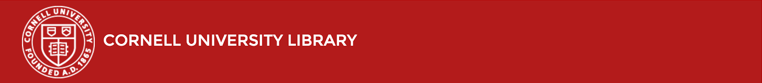
Library Catalog Update
SLAC Update
Fall 2016
Ken Bolton
Mary Beth Martini-Lyons

Slide 2
Discovery & Access: Library Catalog
How do I learn more about what is going on with Discovery & Access work at CUL?
  http://blogs.cornell.edu/discoveryandaccess/
How do I contact the Library with feedback?
  LibGateway-L@cornell.edu
  CUL-DAFeedback-L@cornell.edu
Notes:
The Discovery & Access Implementation Team has been going strong since 2012. Creating a public facing library catalog using open source software such as Solr and Blacklight. In the beginning, the team had monthly sprints to develop the catalog. In the summer of 2015 the project transitioned to a maintenance phase in which quarterly sprints are conducted, with various infrastructure work happening between sprints. Because the catalog is now so integrated with the main Library website, with most of the same people who work on the site also working on the catalog the D&A Advisory Group serves the function of both the D&A User Reps and the website advisory group that existed in the past. Feedback gets to D&A through both LibGateway-L and CUL-DAFeedback-L, and we always love to hear from you.

Slide 3
What we’ll cover today
Subject & Author Browse
Title/Format Linking
Retirement of Classic Catalog
Question & Answer
Notes:
We’ve been able to incorporate data from the authority records into the catalog and that information helps inform the subject and author browses in the catalog.
We’ve also been able to implement a feature we call Title/Format linking that allows users to link to another record for the same item.
And, time permitting, we will cover a few miscellaneous features.

Slide 4
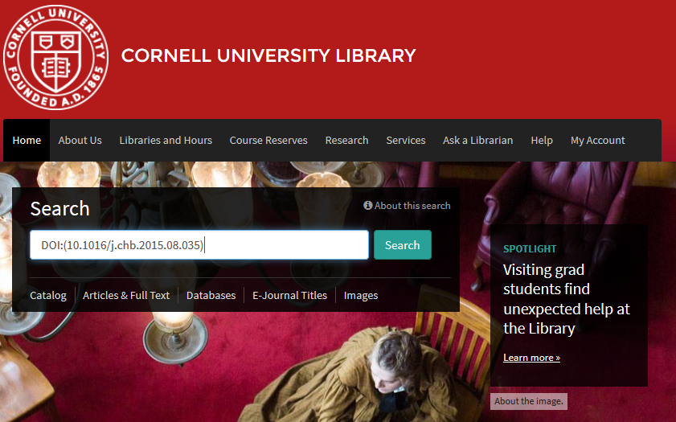
Hot Tip: DOI Searching
Notes:
There was no other really good place to put this in the presentation today, so let’s just start out with it.
We have received some feedback that users wanted to be able to search for DOIs from the main search box. It is possible, but the DOI has to be formatted like this.

Slide 5
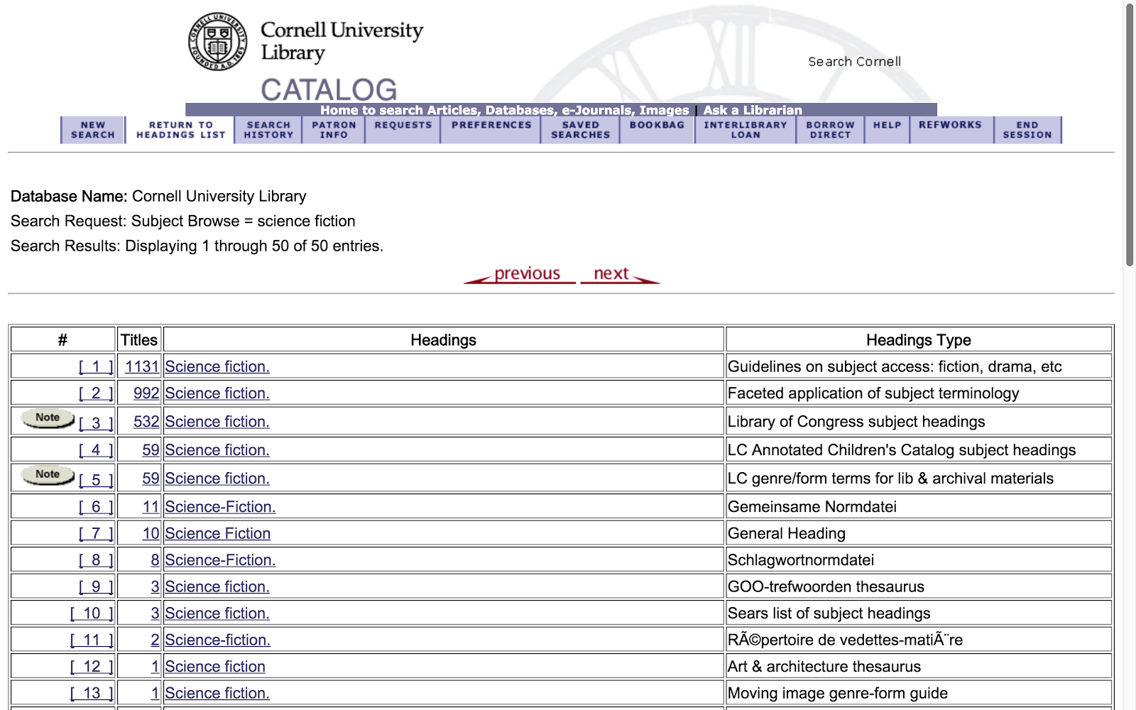
Notes:
Most of you are probably already familiar with the authorities browse in the Classic Catalog. When we launched the new catalog, we heard from a lot of staff that the new interface was lacking the browse feature for subjects and authors that people relied on, and had to return to the Classic Catalog for.

Slide 6
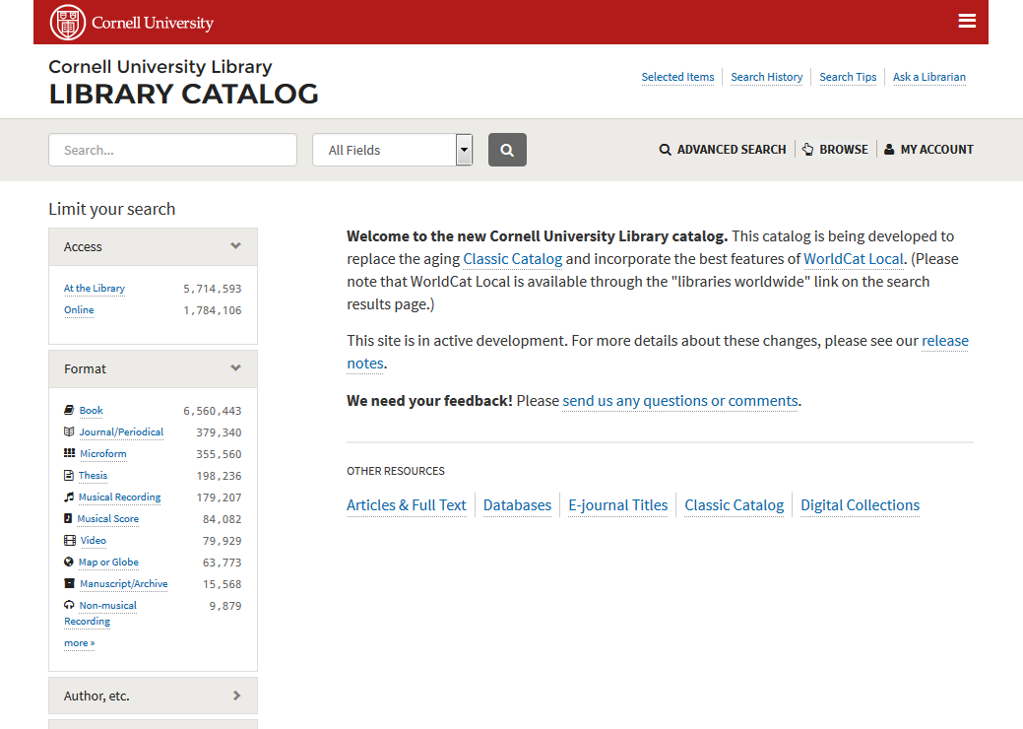
Click here to
browse by
subject or author
Notes:
To get to an author or subject browse, you click on the browse button from the catalog. This slide is showing the main catalog page, but this menu bar with the browse button is available throughout the catalog interface, including from individual item record pages.

Slide 7
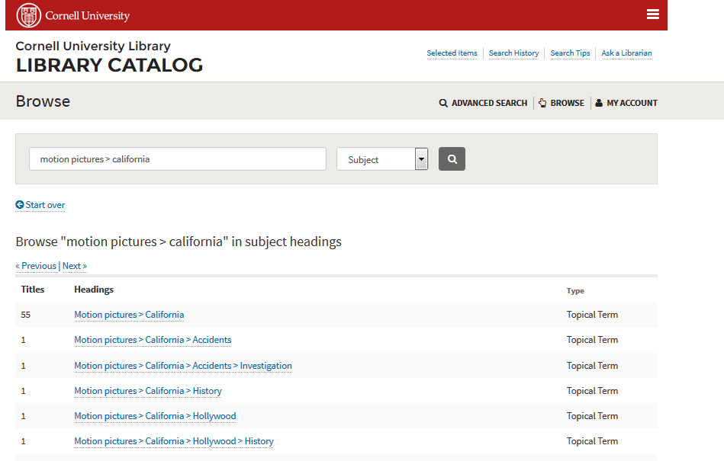
Notes:
If we want to search for items about motion pictures in the subject subdivision of California we can enter the subject and subdivision in the search box, separated by the greater than sign and choose subject as our search type

Slide 8
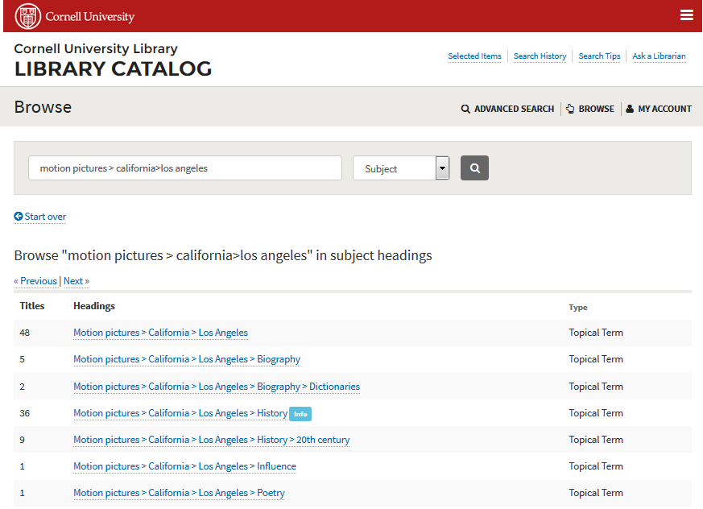
Notes:
We could further narrow our search by adding a second subdivision of Los Angeles, and so on

Slide 9
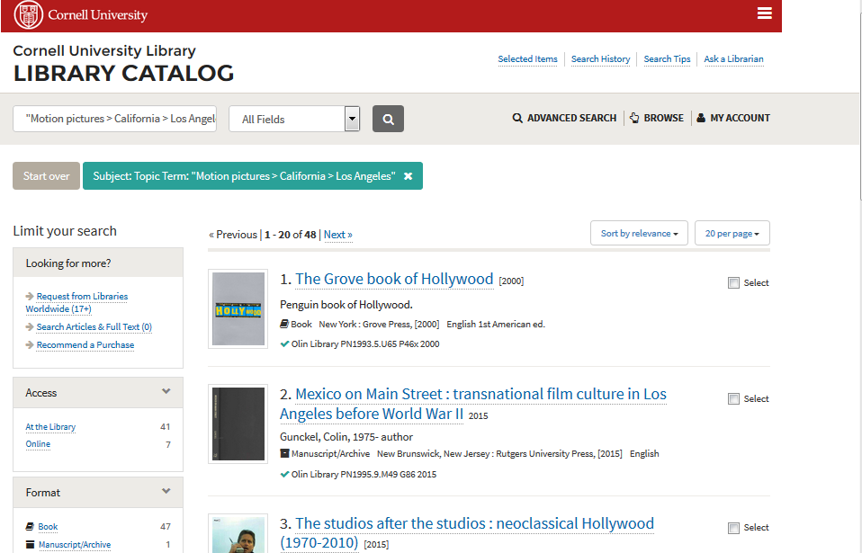
Notes:
And by clicking through we can see the results for this relatively narrow subject search

Slide 10
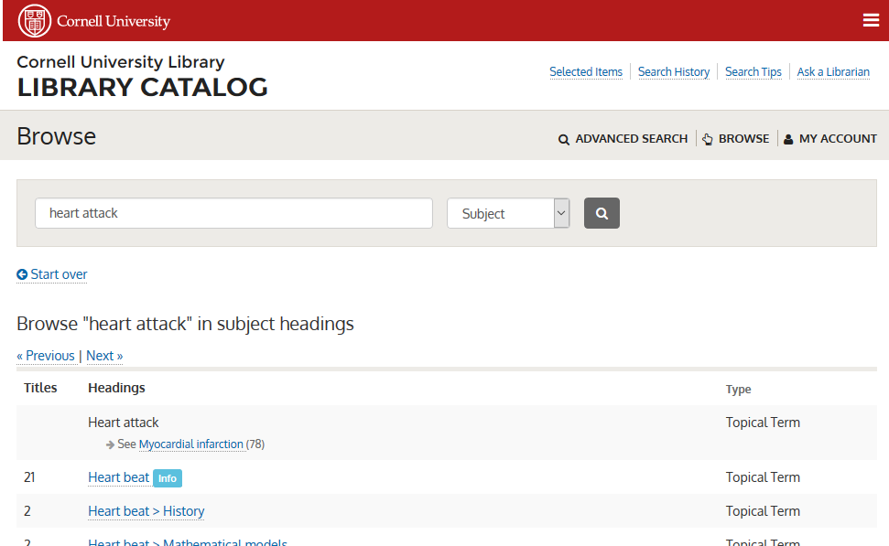

Notes:
See references have been incorporated into the new catalog, they are included explicitly in the browse interface, and incorporated in a more subtle way in the general search.

Slide 11
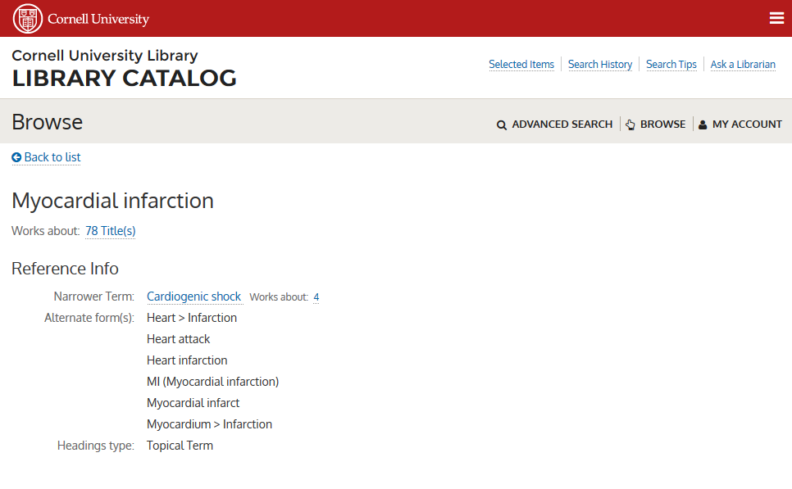
Notes:
This information comes from the alternative forms in the authority records.
Before this convention was implemented, patrons conducting a subject search for “heart attack” would have gotten zero results returned, they might have dug deeper, or they may have given up thinking we didn’t have anything suitable.
Now a “heart attack” subject search returns 81 results.

Slide 12
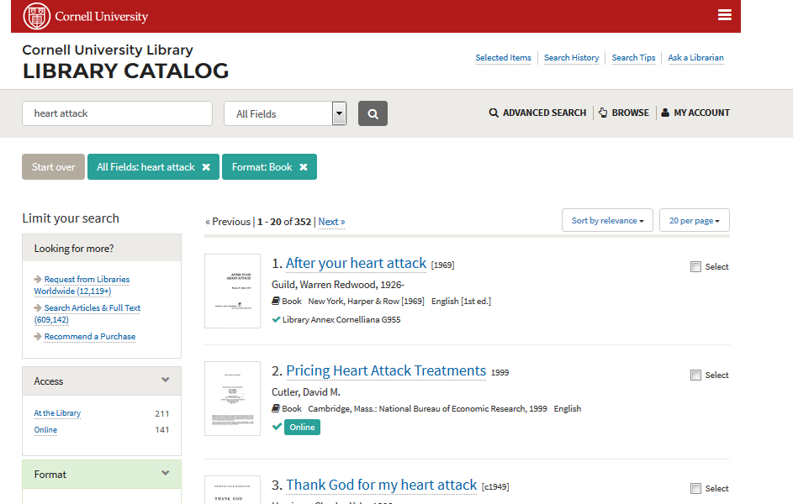
Notes:
The alternate forms have also been incorporated into the general search, so when users search for heart attack in the general catalog search, so in addition to items that explicitly have heart attack in the title,

Slide 13
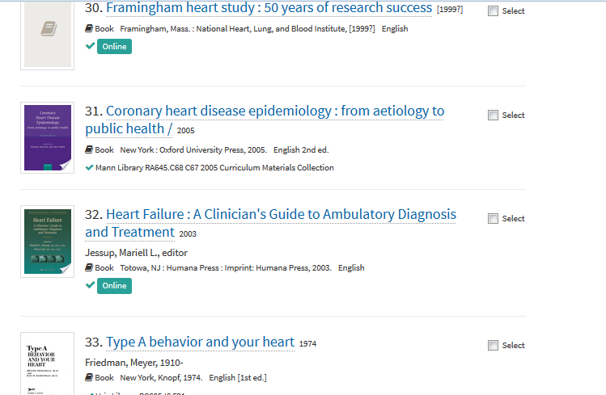
Notes:
By including alternate forms in the index, users searching for “heart attack” will also get other relevant items that don’t have “heart attack” in the title, such as these items.

Slide 14

Other form of this work…
Notes:
You may recall that WorldCat had a link on item records that let you see all editions and formats of a work
That link would lead to a list of other editions

Slide 15
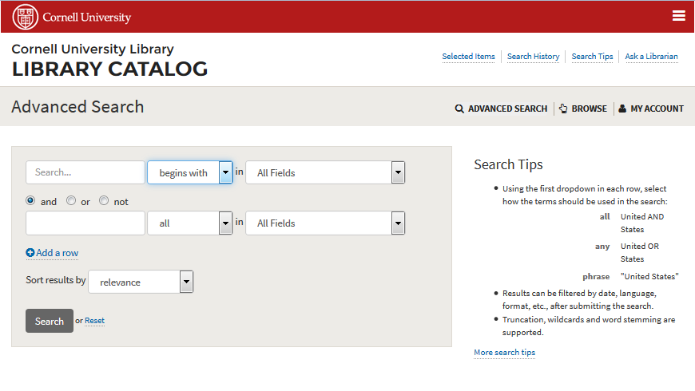
“Begins with” Searching

Slide 16
Other things in the works
Call number browse
Review use of stemming in searches
Increase frequency of cataloging updates
Look into indexing 300 field (form/genre)
Preparing for retirement of public access to the Classic Catalog
  Scheduled for Summer 2017

Slide 17

Questions?

