Slide 1
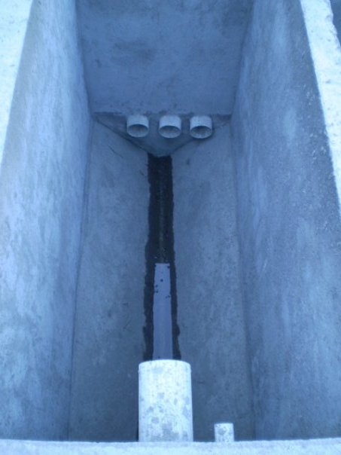
Background
What is sedimentation, and where does it occur in the water treatment process?

Slide 2
Goals
To reduce plate spacing in order to reduce plate length.
To improve previous experimental apparatus.
To optimize sedimentation with reduced plate spacing.
h_{c}
L
h
b
α
α
V_{up}
V_{α}

Slide 3
Current Research
Parameters
  Tube width
    12.5mm, 9.4mm, 4mm
  Flow rates (constant)
    Influent : 545 mL/min
    Through tube settlers: 257 mL/min
  Depth of floc blanket (constant)
Dependent Variable: Effluent Turbidity
  Goal: under 1 NTU
12 in
60°
Experimental Setup

