Slide 1

Linear Chemical Dose Controller
Ruju Mehta
Julia Mertz
Frank Owusu-Adarkwa
Spring 2012
Final Presentation
Notes:
We are a research team examining the linear chemical dose control system

Slide 2

Outline
Chemical dosing overview
New LCDC (Triple Doser)
Experiments
Calibration
Error Analysis
Conclusions & Future Work
Notes:
The LCDC is the key technology for AguaClara. The LCDC makes it possible for the plant operator to directly set the chemical dose for the coagulant. However the LCDC performance has not been as good as expected due to unexpectedly high minor losses that are not proportional to the flow . (minor losses causes a departure from non-linearity due to the square dependency on flow)

Slide 3
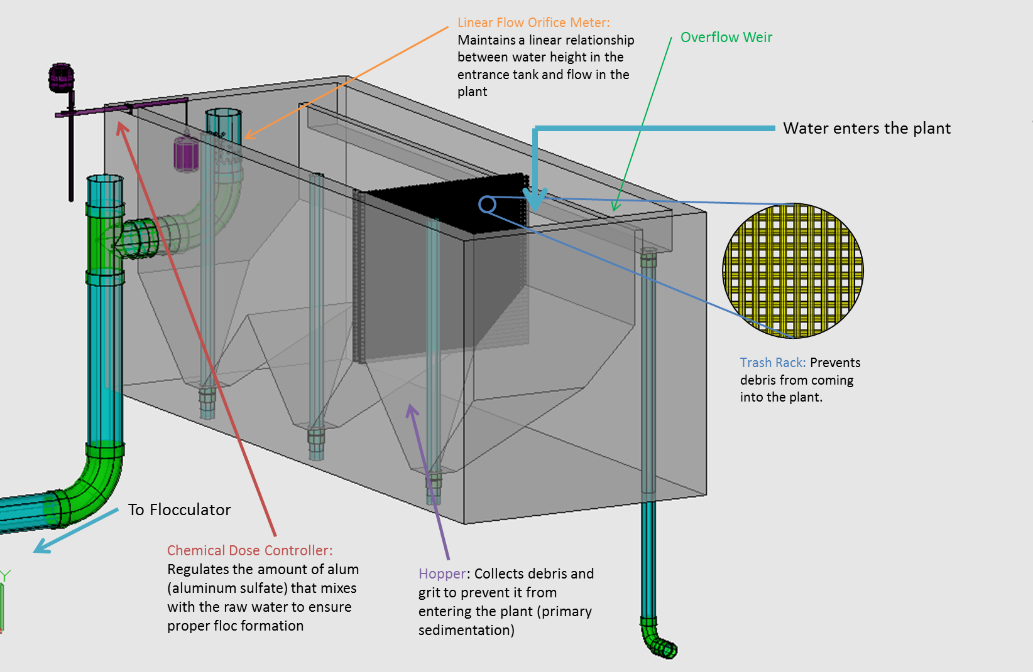
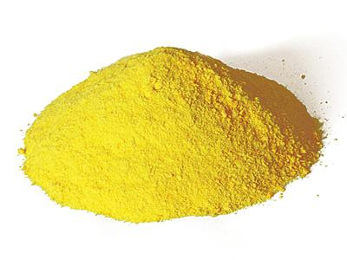
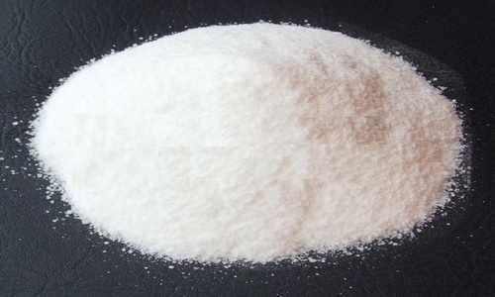
Chemical Application: Coagulation
Notes:
The first application of chemicals occurs in the entrance tank, which is labeled with the red arrow Here, a coagulant, either aluminum sulfate or polyaluminum chloride, is added at a constant dose to alter the influent water’s chemistry to make the particles in the water sticky so they will attach to each other more easily during flocculation and settle out during sedimentation.

Slide 4
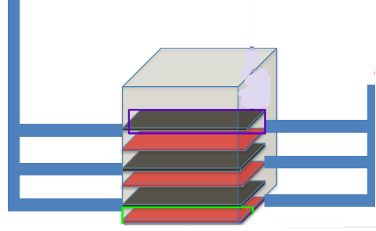
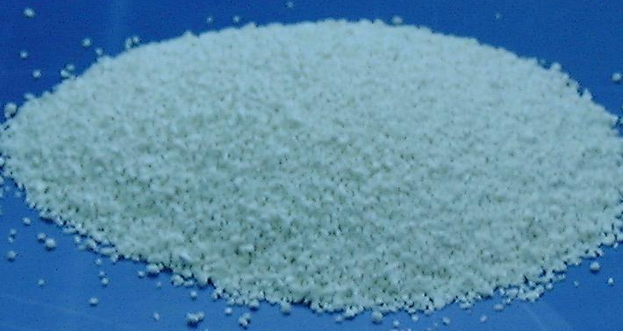
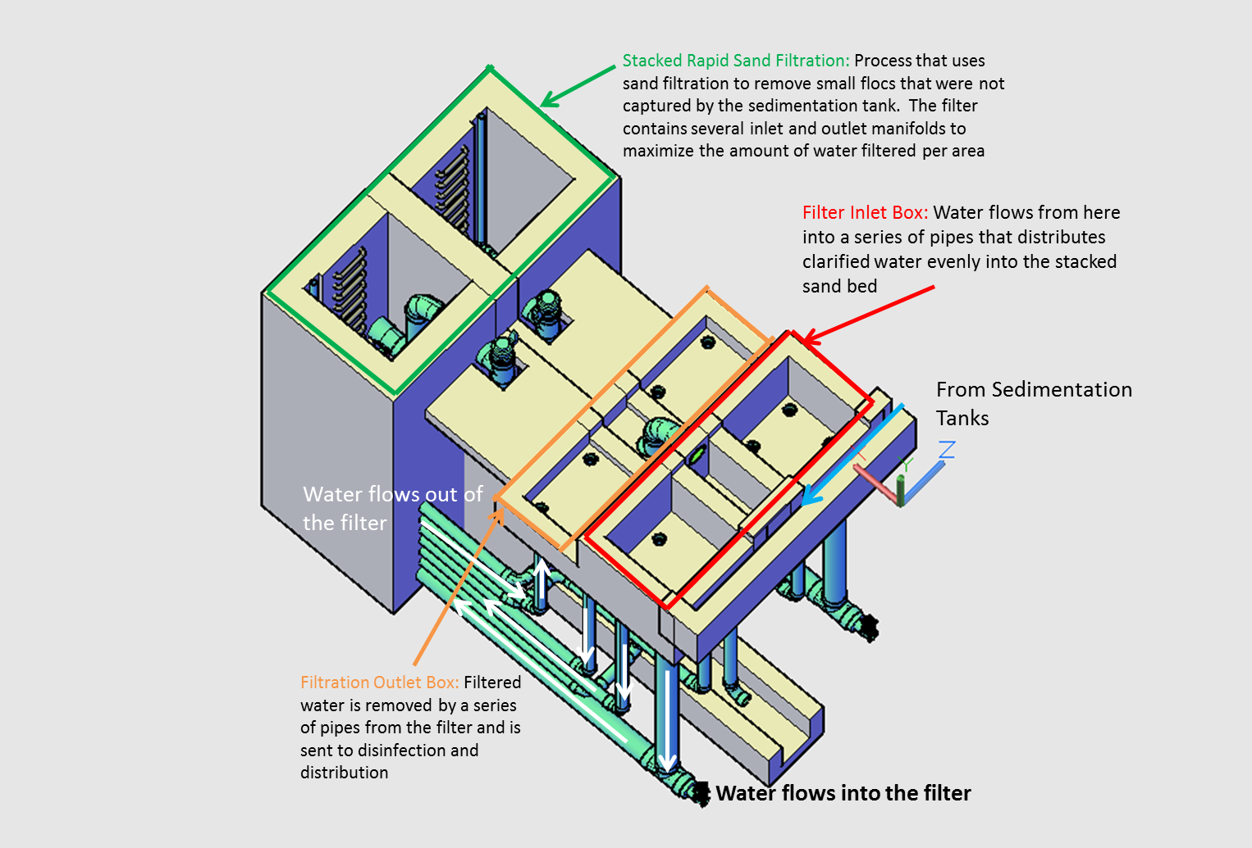
Chemical application: Disinfection
Chlorine application
Notes:
The second chemical application occurs during disinfection. At the end of the treatment process, calcium hypochlorite is added to kill any pathogens that survived through the rest of the treatment process. In existing plants, this takes place after the sedimentation tank, but in new plants with filters, it will take place after filtration.

Slide 5
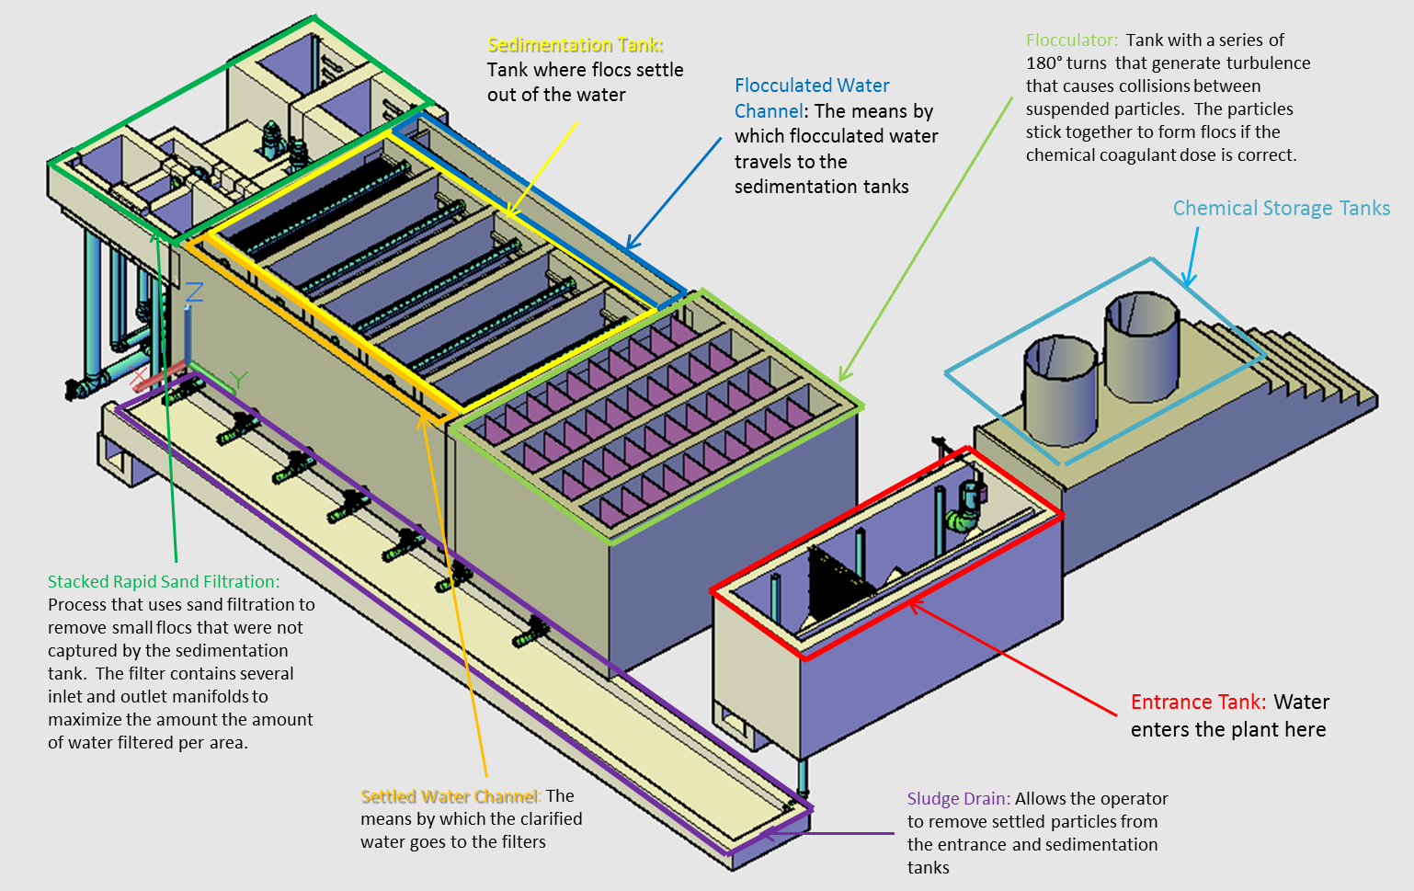
AguaClara Plant
Notes:
We need to locate the doser so that one end of the lever arms overhangs the side of the entrance tank. The float will be attached to this end. The other end of the doser needs to be accessible to the plant operator since the operator will need to set the dose of each chemical depending on the turbidity of the water coming into the plant. Aside from these two requirements, design teams over the years have tried to maximize flexibility about the doser and its components placement.

Slide 6
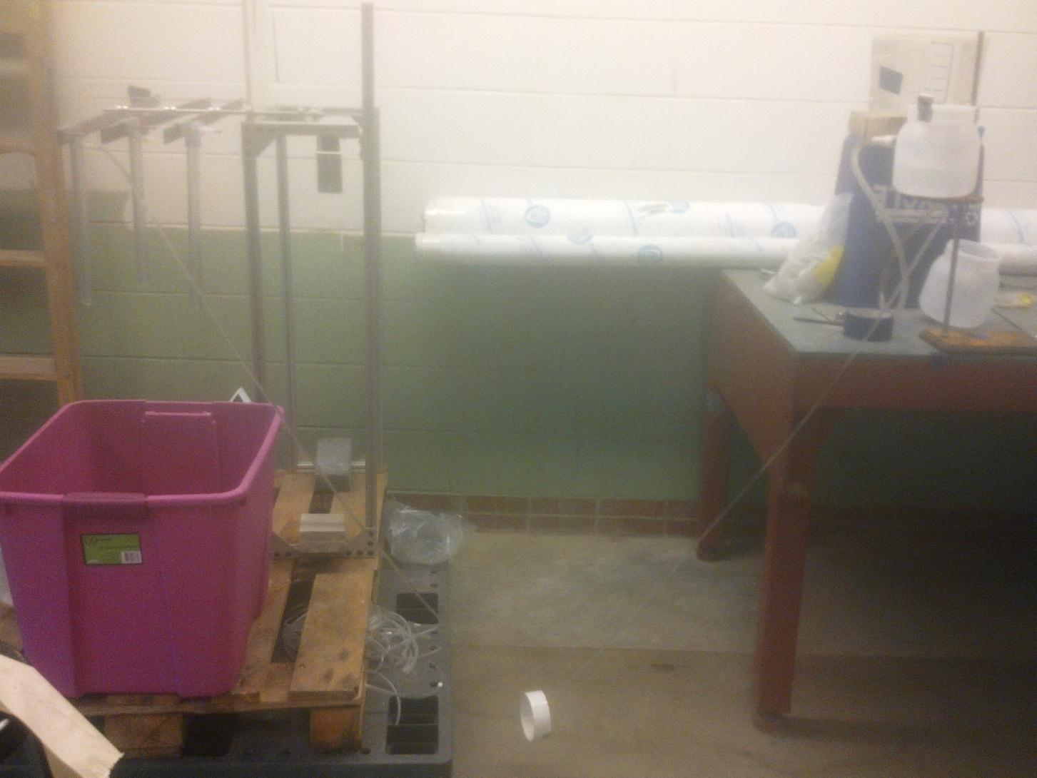
Current Design
Lever
Arm
CHT
Dosing Tube
Weight
Notes:
Talk about Assembly.
Weight to keep lever arms level. (therefore talk about the torque caused by the mass of slider/droptube etc
3 axles to keep all 3 moving at the same angle
Location of float

Slide 7
Experiments for Different Tube Lengths
Preliminary Set Up
Calibrate to Zero!
Run Full System Test, at 4,8,12,16 and 20 cm of head.
Find Percent Error and Maximum percent error through system
Calibrate again, at either the Maximum percent error through system or 20cm head to minimize Error
Run a full System Test at the calibrated set up
Find Percent Error
Notes:
Talk about how started the experiment: connecting tubing etc.
-Cut Small Diameter tube to the appropriate length
Connect to the CHT and a reducing barbed fitting
On the other side of the reducing barbed fitting is the variable length of Large Diameter Tubing
The other end of the Large Diameter tubing is connected to the drop tubed barbed fitting
What does 2nd Calibration Entail? CuttingTube length and re-running tests.

Slide 8
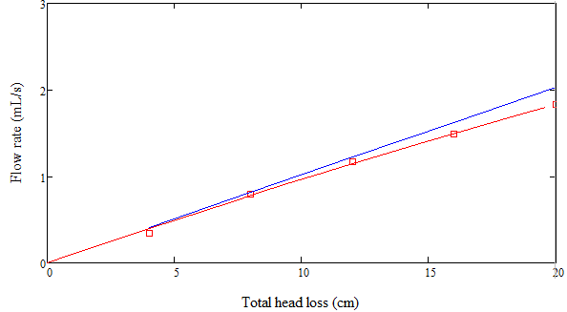
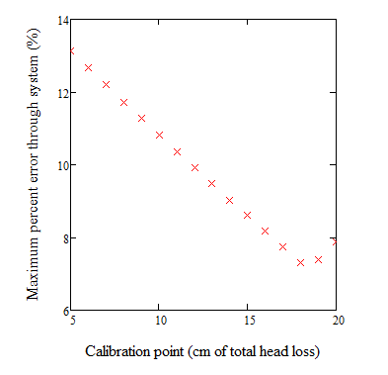
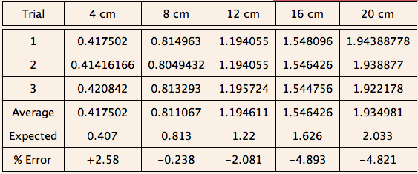
2.57m

Slide 9
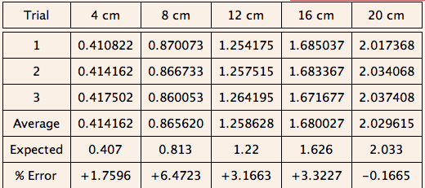
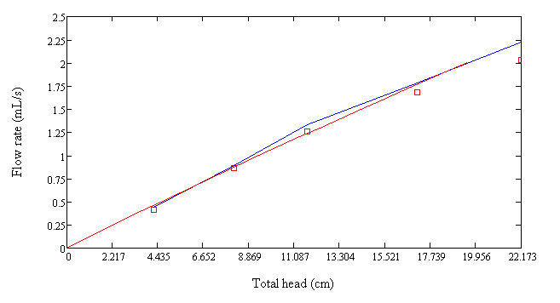
Calibrated Tube Length: 2.56

Slide 10
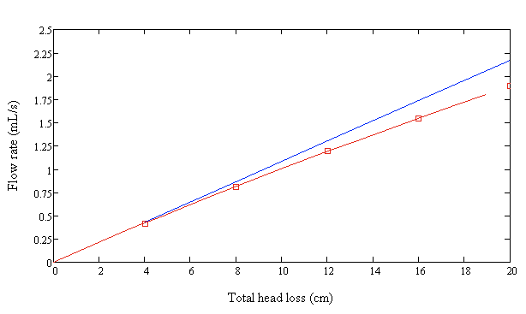
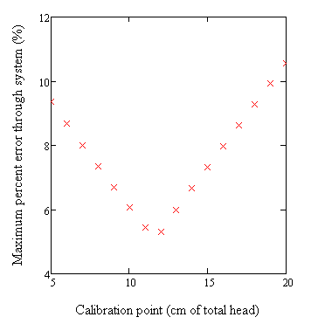
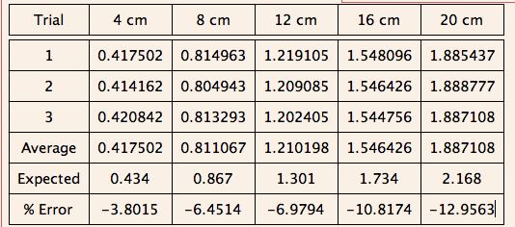
2.285m
Notes:
Discuss what MPES means
Blue line vs Red Line

Slide 11
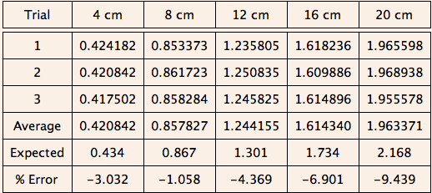
Calibrated Length: 2.26
Notes:
Did Calibration at 12cm head as MPES suggested.
The values becomes closer to the expected values, and error decreases.

Slide 12
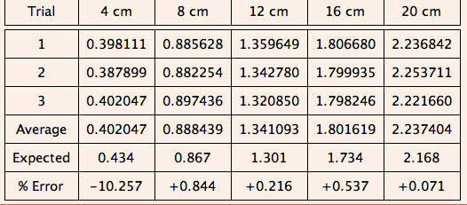
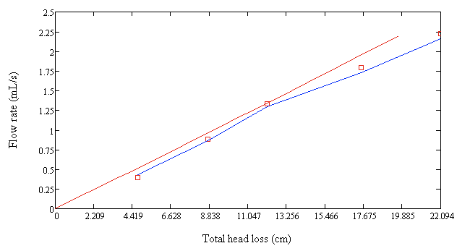
Expected Flow Rate 1.82m
Notes:
Talk about H.adders
Due to the error analysis which we’ll talk about later in the presentation,
The expected values are changed due to the calculated errors and the float error. The calculated errors are seen in the table on the previous slide. Errors from the float depend on the design used. For us, we used an LCDC with one Tee, which caused a different moment due to the different weight. For this LCDC, it is a 2.14cm change. These two errors added together, and scaled the axis in terms of this error.

Slide 13
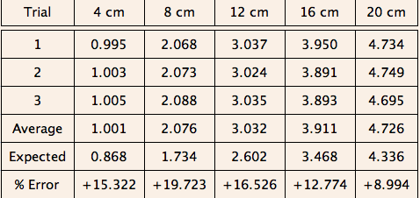
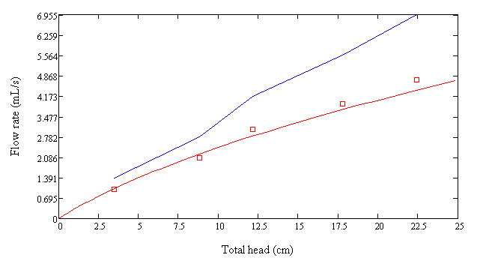
Tee Analysis with
Two 1.82 dosing tubes
Notes:
Describe how the cht needed to be changed,
Huge errors due to float design, the way the t is connected, the connection between the cht could be the error. Further calibration cz of weight?

Slide 14
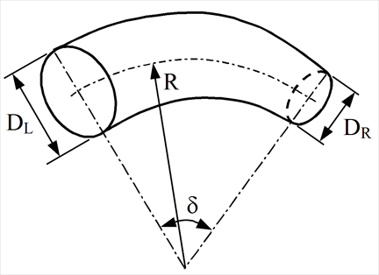

Analysis of Results
2 main sources of error
1) float
2) minor losses
Last semester- eliminating minor losses
The way that the LCDC is calibrated in Honduras is
similar to how we calibrated – we pinned the end of
the lever arms to this white board to
simulate the flow rate of water into the plant.
In real life, when the float is attached after this manner of
calibration, additional error was apparent. The weights of
the sliders and drop tubes push the float up, increasing the
head and causing higher than expected flow rates.
  We recommend that for calibration at new plants, there be a real water level and float attached.
  Even with the largest float geometrically possible, the error contributed by this lifting of the float is a significant consideration, and so it really doesn’t make sense to calibrate before it is added.

Slide 15
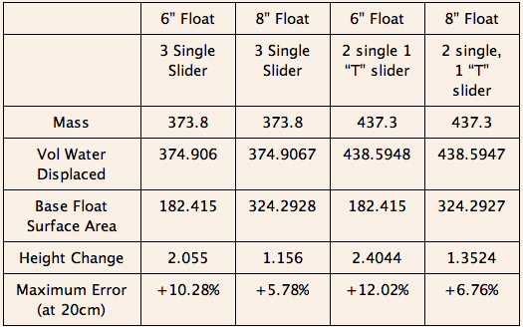
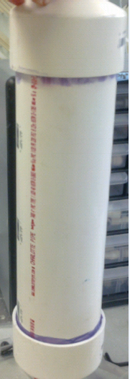
Float Design Constraints/Error
Calibrate with float already in place and with a real water level in the entrance tank to more closely simulate actual plant operation
Not negligible!
The 6” float costs $32.53 whereas the larger 8” float components comes to a sum of $104.88
Larger plants, such as those that require a “T” will be more able to pay for price hike because they are serving a larger community
Notes:
With the LFOM in the entrance tank as well, the float needs to be the proper size to fit in the entrance tank. If the float is too large, the entrance tank will need to be altered, which will lead to higher construction costs. The weight of the LCDC is something we need to consider while building the float because the mass of the LCDC will equal the water displaced by the float. We want to minimize the amount of water displaced by the mass.
It will also depend on how much money the plant has. If the plant has more money, it can afford a larger float which will minimize error.
We’ve been talking a lot about float error. Here’s some calculations that we

Slide 16
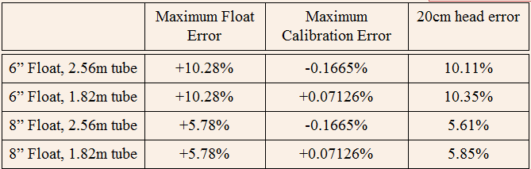
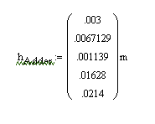
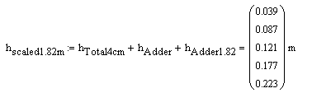
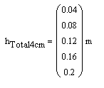
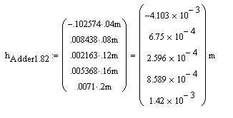
Total Error
The majority of the error in all cases is coming from the float
Calibration error * board flow rate
Quadratic increase of errors due to torques

Slide 17
MathCad Calculated Observed
Even greater error at 20cm than anticipated before accounting for float error
Pull the curve back up/left to match at 20 cm head

Slide 18
Deliverables
Experimental Data from Flow Tests
Float analysis for shorter sliders and different float sizes for cost consideration
Manual to send to operators
  Step-by-step instructions
  Images
  Youtube construction videos links
  List of parts with McMaster #s AND properties (eg transparency, chlorine resistance) so that locally available substitutes can be made

Slide 19
Conclusions
Reliable Calibration/Fabrication Techniques
Consistent process
Pay attention to radius of curvature of dosing tube!
Calibrate at 20cm head for simplicity
Larger Float + smaller sliders
“Taller” lever arms
Send extra tubing!
If we begin account for additional head because of torques/ float lift, to get the flow rates down, additional small diameter tubing needs to be sent
Notes:
Also talk about the sticker/width of lever arm to minimize abrasion to the arm itself.

Slide 20
Future Work
Test the Tee Further. Investigate why the error was not as anticipated
Cleaning procedures for the drop tubes when calcium precipitate forms
Videos detailing Calibration processes in addition to construction videos
Adopting new lever arm piece which is “taller” so screws will not interfere with stickers

Slide 21

Thank you
Questions?

