Slide 1

Low Flow Chemical
Dose Controller
Kaylyn Bacha
Danielle Feng Kwabena Nimo

Slide 2

Purpose
The LCDC doses PACl to water for flocculation as it enters the plant and chlorine to water in the exit tank

Slide 3
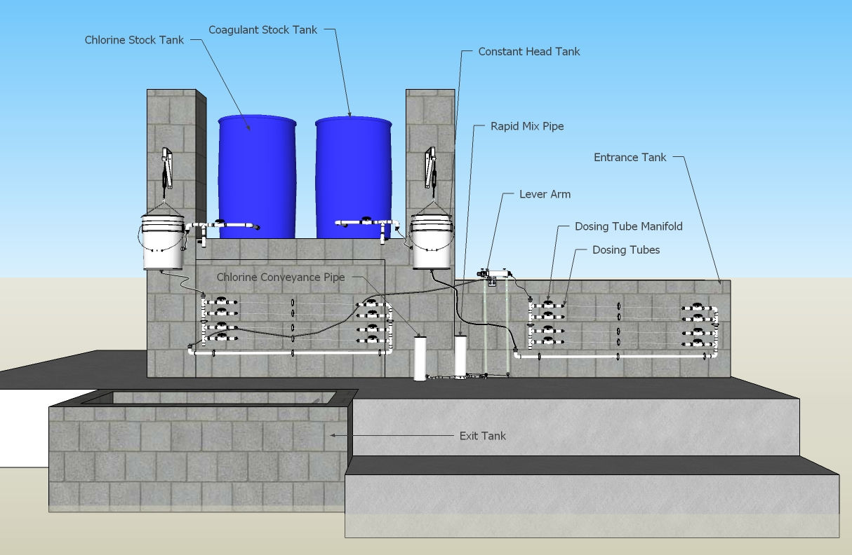
Plant Setup
Picture/Graph/Table

Slide 4


Design Theory
The Hagen-Poiseuille Equation assumes flow is laminar, viscous, and incompressible
The LCDC is designed so that major losses outweigh minor losses, maintaining a linear relationship between flow rate and total head loss.

Slide 5
Summer 2013 Challenges
Design low flow doser using half size 20” dosing arm
Test 1/16’’ dosing tubes with PACl
Design adjustable system for constant head tanks
Ensure system is chlorine resistant

Slide 6
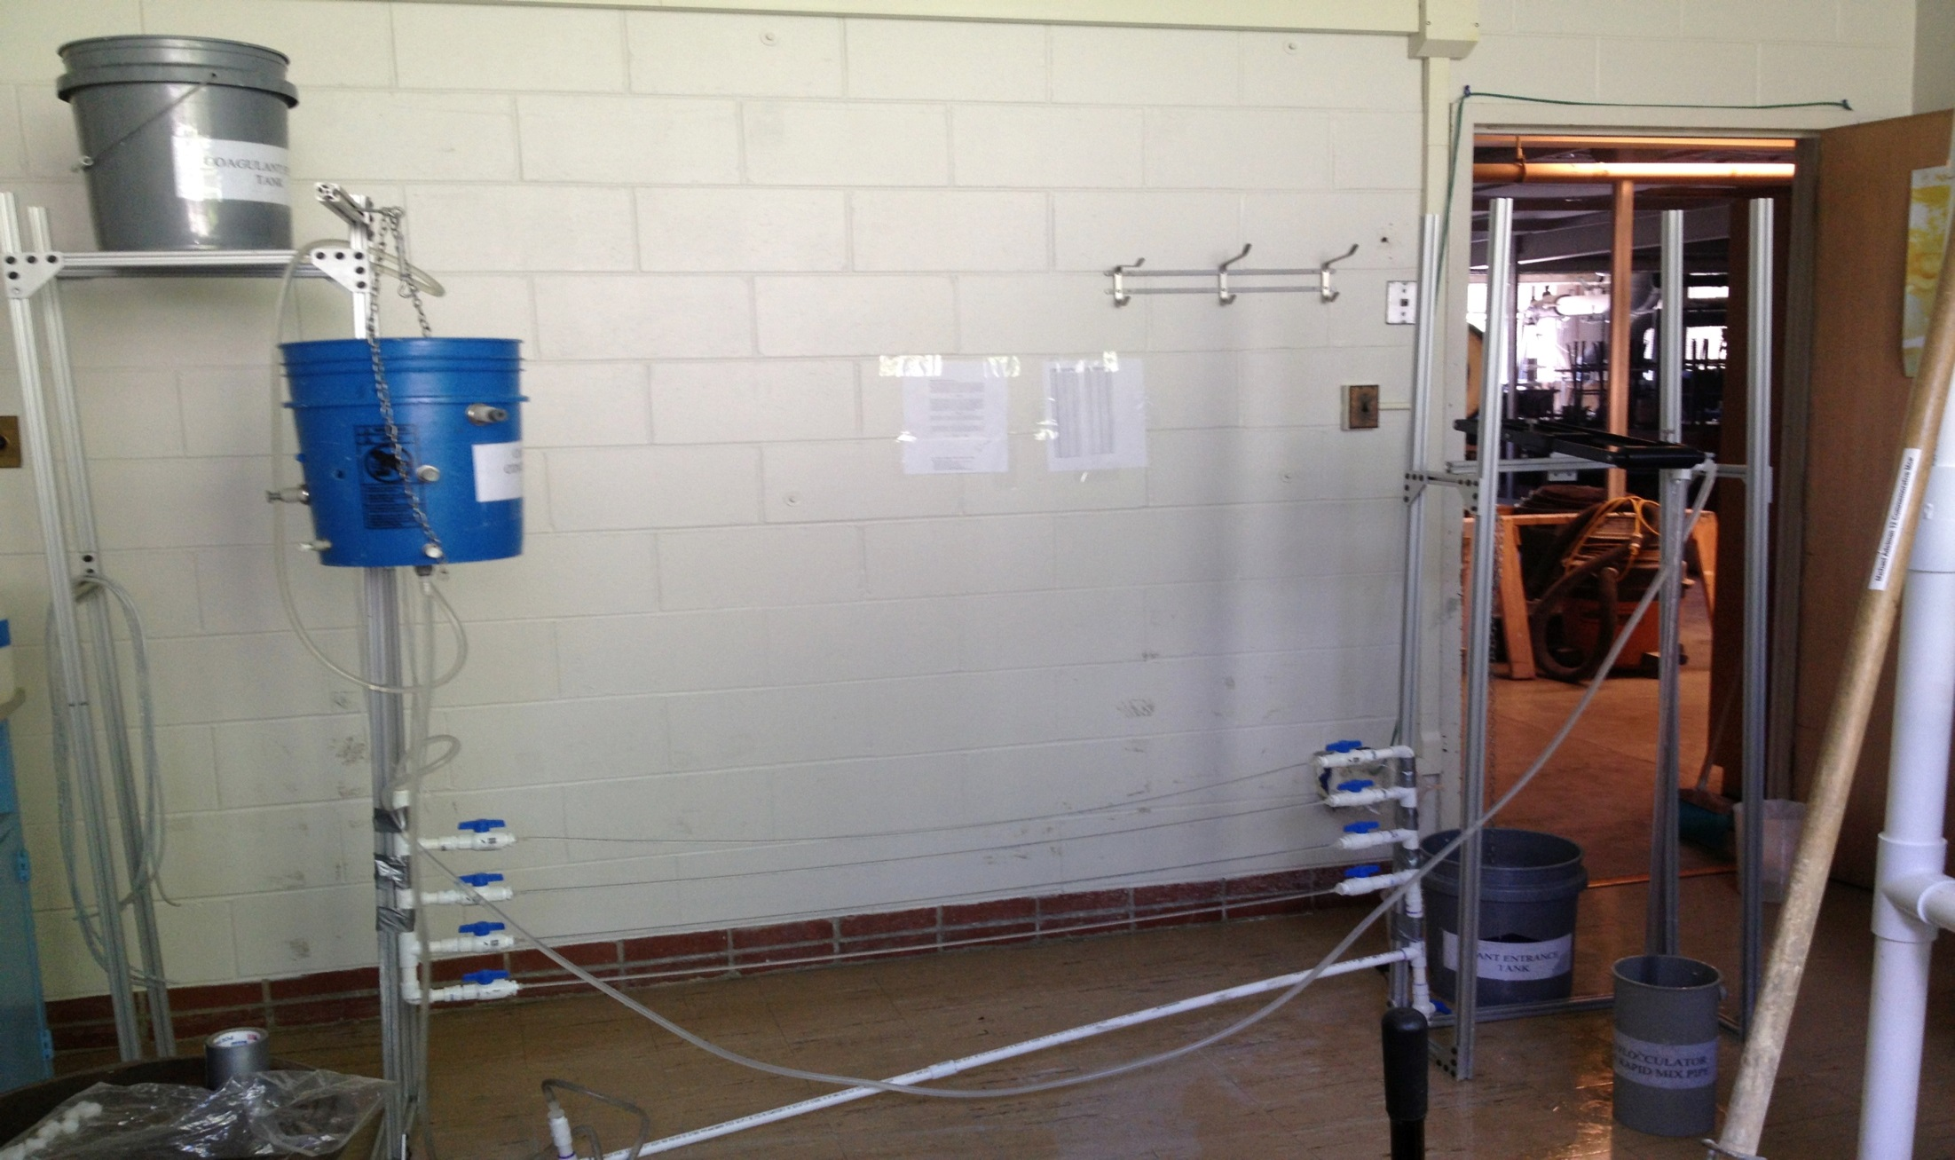
Experimental Setup
Text
Picture/Graph/Table
PACl stock tank
Constant Head Tank
Lever Arm
Dosing Tubes
Drop Tube

Slide 7
Procedures
Calibrate the lever arm
Measure the flow rate of water from drop tube
Check 1/16” tubing for clogging periodically

Slide 8
Troubleshooting
Calibrate system before every use
Make sure the water level in the CHT is constant over time
No kinks in tubes
No air bubbles

Slide 9
Water Trials
Difference in flow rate with wider tubes when comparing performance of lever arms

Slide 10
Water Trial Data
 | Large Lever Arm |  | Small Lever Arm
Average flow rate | 1/8” tubing 1.3 m | 1/16” tubing 1 m | 1/8” tubing 1.3 m | 1/16” tubing 1 m
20cm | 8.01 | 0.94 | 9.49 | 0.75
15cm | 6.81 | 0.65 | 7.52 | 0.57
10cm | 4.81 | 0.43 | 5.39 | 0.35
5cm | 2.23 |  | 2.49
In general, half size small lever arm decreases flow rate
Dosing tube diameter most dramatic reduction of flow rate

Slide 11
PACl Trials
Difficult to get steady flow rates
Flow rate changes when flow is stopped, then started again
No clogging issues
Air bubbles in tubes become bigger issue

Slide 12

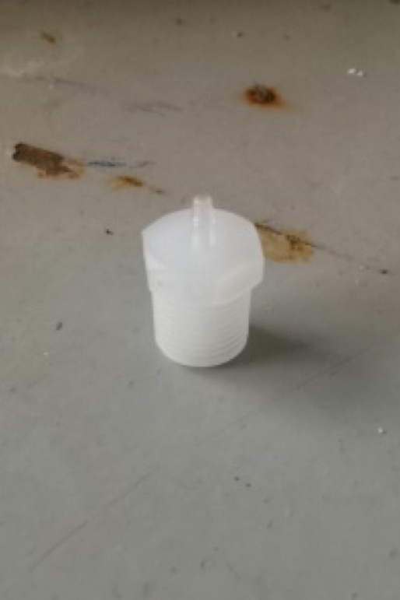
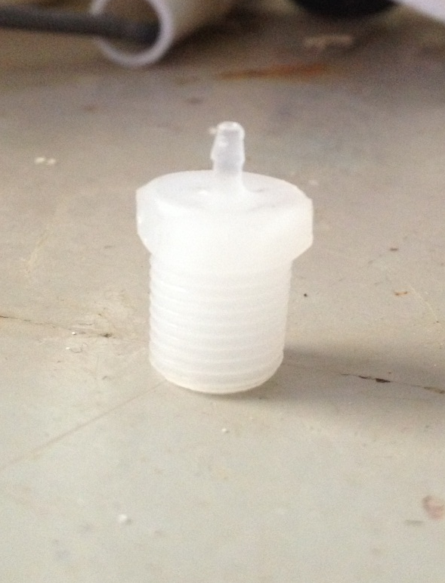
Tube Connectors Chlorine Test
Before
After
Connector between manifold and dosing tubes
No visible degradation of plastic in 30% chlorine solution after 48 hours

Slide 13
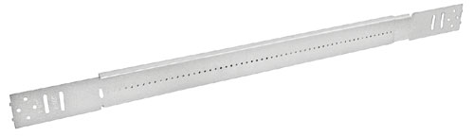
New Adjustable Head Tank
Looking into a sliding bar device, found a couple of options
Turn buckle requires disconnecting tubes from CHT
New device would allow for linear adjustment of head tank height, instead of step-wise adjustment with chain
More precision, and allows for easy measurement of head tank height

Slide 14
Future Work
Run more trials for PACl, adjusting for consistency
Test out adjustable head tank slider
Automated flow rate measurement system (flow meter device?)
Design more permanently built setup to reduce variability between teams of different semesters
Standardize all tube lengths

Slide 15
Questions?

