Slide 1
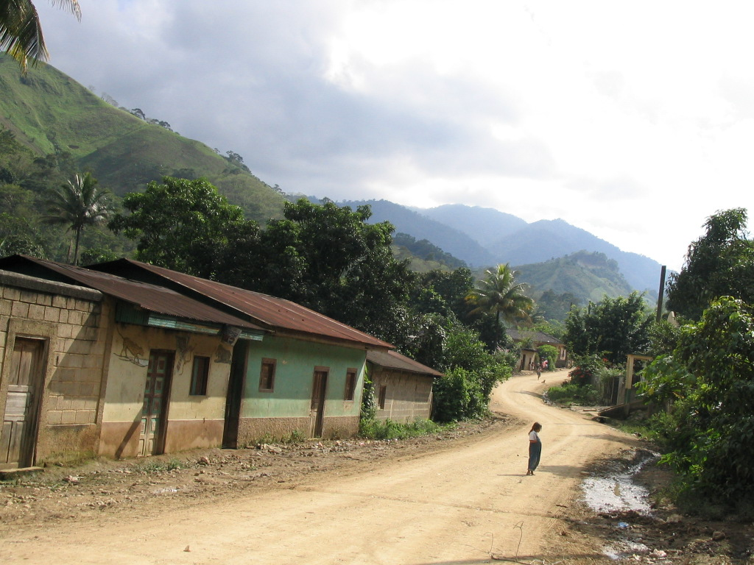







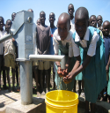


AguaClara
Prepared for Viamericas Corporation
March 2010

Slide 2

WHY AGUACLARA? ― CLEAN WATER, A GLOBAL CONCERN
The need for surface water treatment is great in Latin America and throughout the developing world. UNICEF and the World Health Organization report that globally, 884 million people lack access to safe water supplies, approximately 1 in 8 people (1).
Impact on Health
3.58 million people die each year from water related disease (2).
84% of these deaths are children from ages 0-14 (2).
Impact on Women and Children
Millions of women and children spend several hours a day collecting water from distant, often polluted sources (3).
Impact on Productivity
Every $1 USD invested in clean water and sanitation provides an economic return of $8 USD (3).
1.) UNICEF/WHO 2008. “Progress on Drinking Water and Sanitation: Special Focus on Sanitation”.
2.) World Health Organization 2008. “Safer Water, Better Health: Costs, benefits, and sustainability of interventions to protect and promote health.”
3.) 2006 United Nations Human Development Report.

Slide 3
WHY AGUACLARA? ― WE ARE PART OF THE SOLUTION
AguaClara’s designs represent an improvement over conventional technologies.
Conventional technology
Economically prohibitive ?
Poor technical design ?
High residual costs ?
Encourage dependency ?
AguaClara technology
Highly economical
Flocculation allows for a “robust” design
Low residual cost
Empowers community
Not dependent on advanced infrastructure, technology is open source
Robust design but simple to understand, maintenance is easier
Generic hardware, obtaining spare parts for repair is easy and cheap
No electricity needed for operation, sustainable

Slide 4
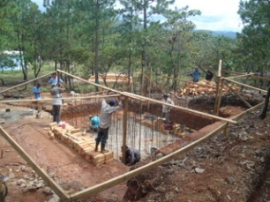
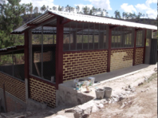
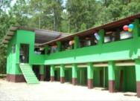
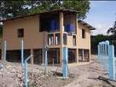

WHY AGUACLARA? ― ECONOMICS & POPULATION SERVED UNTIL TODAY
$20 per user for the design-build-train-operate-transfer costs.
$2 per user for annual maintenance.
AguaClara plants are ¼ the cost of conventional water treatment technologies.
Engineering design and technical support are provided for free by the AguaClara team.
Marcala
Agalteca plant
Oct 2009 under construction
Cuatro Comunidades
Tamara
Ojojona

Slide 5
WHY VIAMERICAS? ― BENEFIT OF PARTNERSHIP FOR VIAMERICAS
Able to accomplish the Viamericas mission to serve the customers’ communities and families
Feasible strategy for improving Viamericas’ sustainability mission
Positive public relations image
Strategy for Partnership
Initial Investment in one of the small plants
Establishment of a fund
Methodology
Viamericas role

Slide 6
STRATEGY ― INITIAL INVESTMENT
Viamericas will collaborate with APP (Agua Para el Pueblo: Honduran based NGO, partner of AguaClara and the construction general contractor) to invest in a complete construction of a small-scale water treatment plant at a desirable location.
The lead time from the start of collaboration to actual beginning of construction will be at most 2 month.
Current candidate towns
Population
Villa San Francisco, Francisco Morazan
9000
Jalaca, Francisco Morazan
1572
La Ermita, Francisco Morazan
4200
San Juan Pueblo, Atlántida
7200
Arizona, Atlántida
7200
Cantarranas(San Juan de Flores), Francisco Morazan
5154
Atima, Santa Barbara
3300
**$20 per user for the design-build-train-operate-transfer costs.

Slide 7
STRATEGY ― CONSEQUENCE OF INITIAL INVESTMENT
Viamericas will be able to promote based on the fact that the corporation already contributed to the improvement of water condition in Honduras, rather than the prospective contribution.
The customers truly believes the fact that Viamericas will strive to improve water condition in Honduras

Slide 8

STRATEGY ― ESTABLISHMENT OF A FUND
After the initial investment, Viamericas will establish a fund that would be donated periodically(every quarter or every 6-month) and directly to the Resource Foundation, a leading US nonprofit organization that facilitates philanthropic giving exclusively to Latin America and the Caribbean.
The Resource Foundation
Corporate Donor Perspective (1):
Benefits – Tax-deductible for giving to Latin America and the Caribbean
– Philanthropic investment and advisory services
– Grants management and administration
– Employee engagement and volunteer activities
– Public relations and visibility opportunities
– Proven track-record at helping donors meet charitable and financial goals, while having a lasting impact
Current Corporate Partners: Alcatel-Lucent, Citi, Chevron, Deutsche Bank, Dow Chemical Company Foundation, Johnson & Johnson, Kellogg Company, L’Oreal USA, Pfizer Inc, Starbucks, The Rohatyn Group and more
1.) The Resource Foundation: Corporations
www.resourcefnd.org

Slide 9

STRATEGY ―METHODOLOGY
Viamericas will create unique “coupons” with barcode generator (or random number generator) and distribute nationwide.
Customers will present a “coupon” to the Viamericas clerk at the time of a transaction.
“Coupons” are the index for measurability: Viamericas can donate to the fund a fixed amount per coupon presented or a fixed percentage of each transaction for which a coupon is presented. This empowers customers to generate revenue
for AguaClara by simply using Viamericas’ service.
Viamericas can establish donation collections at kiosks and
match out-of-pocket donations offered by residents.
AguaClara
Potential design of the coupon

Slide 10
STRATEGY ― VIAMERICAS’ ROLE
Kiosk managers should track the coupons returned and/or the sales associated with each.
Publicize the general concern Viamericas have towards improving water condition in Honduras and emphasize the partnership with AguaClara
Use the pictures and facts about the water treatment plant that Viamericas invested in to give concrete image of what Viamericas intends to do.

Slide 11



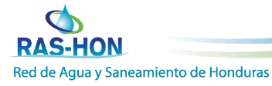

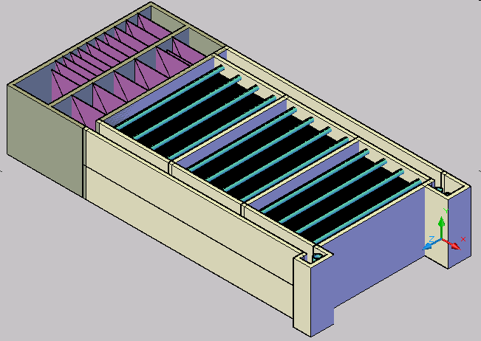
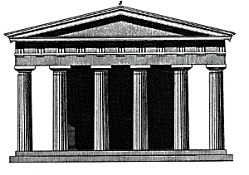
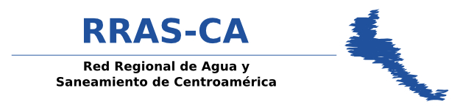
AGUACLARA CURRENT PARTNERSHIPS
Funding
Sanjuan Fund
Cornell University
Friends of AguaClara
R&D
Design
Team trip to visit project sites
Water Treatment Plant
Municipal Government
Notes:
Partnerships are crucial for the sustainability of AguaClara.
Our success is measured partly by knowledge transfer. We need to have good relationships with our partners for this to happen. If knowledge transfer doesn’t happen, then AguaClara is a drip in a bucket rather than a river of life.

Slide 12
APPENDIX
Please address further inquiries to
The following link will direct you to the FAQs page of the AguaClara website
https://confluence.cornell.edu/display/AGUACLARA/Frequently+Asked+Questions
Dr. Monroe Weber-Shirk
Director AguaClara Project
College of Engineering
Cornell University
607-255-8445
mw24@cornell.edu
Eun Gi Chung
Operations Research Engineering ‘11
College of Engineering
Cornell University
917-664-1483
ec396@cornell.edu
William Maher
Civil Engineering Class of 2012
College of Engineering
Cornell University
856-979-5433
wjm96@cornell.edu

