Slide 1

FBO Daily REPORTS
Tableau Workbook instructions
Cornell University Library
Finance and Budget Office
Last updated: 03/30/2022

Slide 2
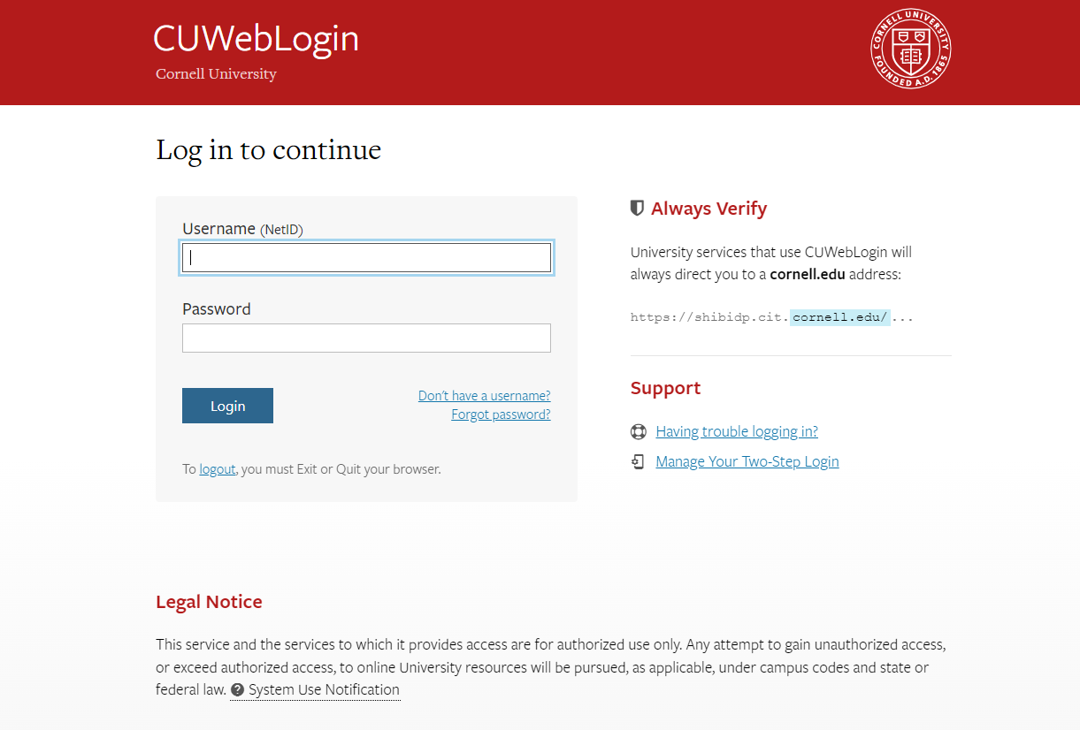
Steps to access the Workbook
Copy the link in your browser and hit “Enter”. It should bring you directly to the FBO Daily Reports Workbook.
Link: https://tableau.cornell.edu/#/views/FBODailyReports/FBOReconciliation?:iid=2
You should then be taken to the Tableau Server log-in page. You should be able to log in using your CU credentials. Enter your Net ID and your Password.
Bookmark this page for quick access.

Slide 3
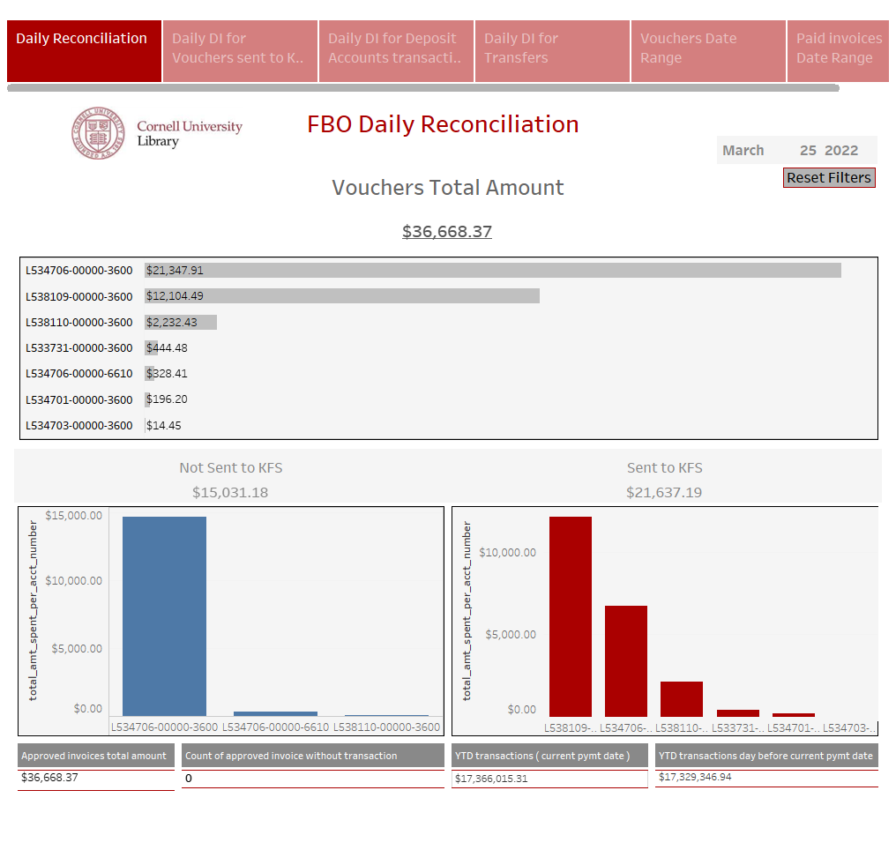
The Workbook should look like this:

Slide 4
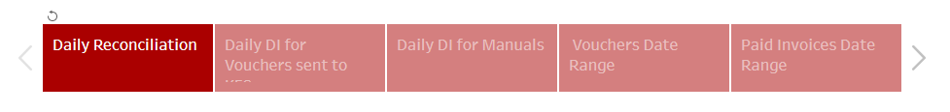
This Workbook contains 6 different option views.
You can see them at the top of the page, in red or light red.
Click on the tab to move from one page to the other.
As you select a page, the data will change.

Slide 5
Navigation bar (top left):
Undo: Will bring you to the previous page without changing anything
Revert: Will bring you back to the original view of the dashboard
Refresh: Will refresh the data. If your views have been opened for a while and a change was submitted by the owner of the dashboard, it will update if you click Refresh.

Slide 6
Navigation bar (top right):
View Original: Click to go back to the original view.
Subscribe: Click to subscribe to the Dashboard and get updates delivered directly to your inbox on a set schedule.
Edit: Let you edit the Dashboard. Should not be available to all users
Share: Click the share icon in the toolbar, copy the URL in the Link field, and past it into your email.(If permitted)
Download: Click Download to download data in PDF, image, Excel, CSV etc.
Comments: Click to add a comment
Full screen: Click for a full screen view
Note: depending on permissions, not all options may be available to you.

Slide 7
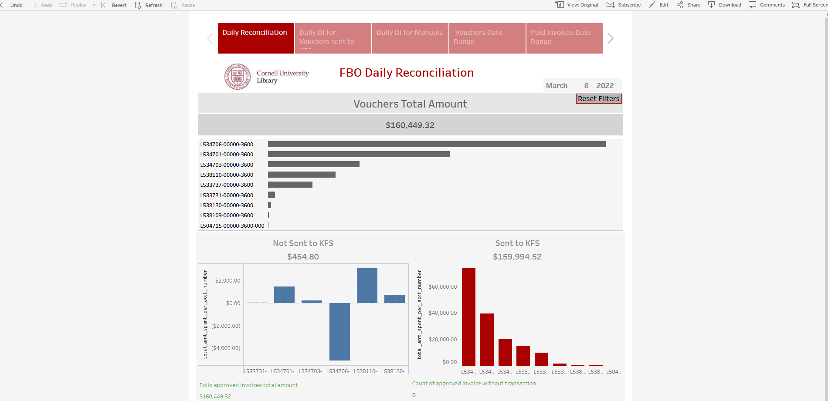
First Tab: FBO Daily Reconciliation
Payment date
Total amount of Vouchers for the date mentioned on the Dashboard. Except Monday, it is defaulting to the previous day.
Click to Reset filters
Click a specific bar to filter the data. You will then see that the data below will change and only shows data for that specific account.
Total amount of Vouchers sent to KFS. It should match the feed amount.
Total amount of Vouchers not sent to KFS (Manuals)
Notes:
Let's go from top to bottom.

Slide 8
These numbers should match. If it doesn’t, then some approved invoices did not move to PAID status.
A
B
The subtraction of to should equal the total amount of vouchers and the total amount of approved invoices.
Total amount of approved invoices for the date specified.
A
B

Slide 9
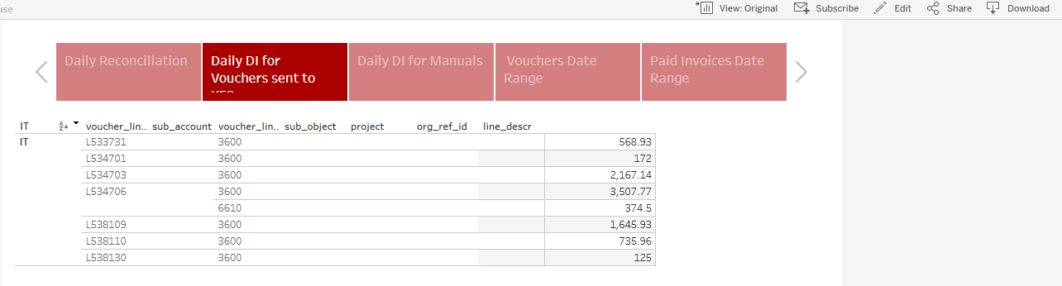
Click ‘Download’ to save a copy
Second tab: Daily DI for Vouchers sent to KFS
This page is showing the total amount of vouchers sent to KFS by account number. The results can be downloaded and imported to the daily Distribution of Income and Expense (DI) that is done to move expenses from L533000 to individual accounts.

Slide 10
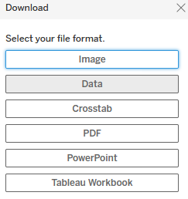
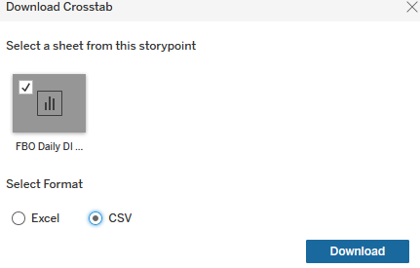
Steps to bring data from the Daily DI for Vouchers sent to KFS Dashboard to a Distribution of Income and Expense (DI) in KFS
Click Download (top right corner)
Select Crosstab as file format
3. Save as CSV. Hoovering over the sheet will provide the full name of the sheet. Select the sheet and click ‘Download’

Slide 11
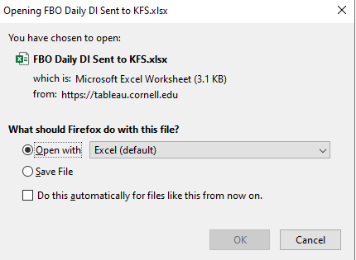
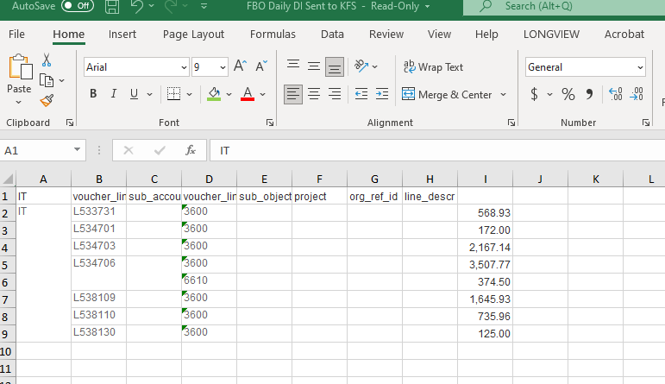
4. Select Open File and click OK
5. Delete the first row and save your document. It will be ready to import to your DI
Delete this row
You can add in the line description column the APLBXXXXX. Type once and fill down or add it in the DI document.
Save the document
You can also copy and paste on the DI Standard Import form. Fill out description in the document or later in the DI. Save and import to the DI. DI Standard Import template.

Slide 12
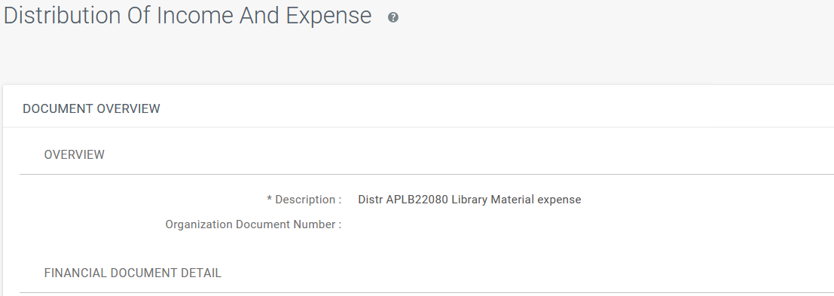
6. Create a new DI in KFS
Description:
    Distr APLBXXXXX Library Material expense.
Note: The APLB # is based on the Julian date. See below document for 2022. For example, the APLB# for March 24 would be APLB 22083.
Link: X:\LibAcct\Library Accounting shared documents\_FOLIO_Tableau

Slide 13
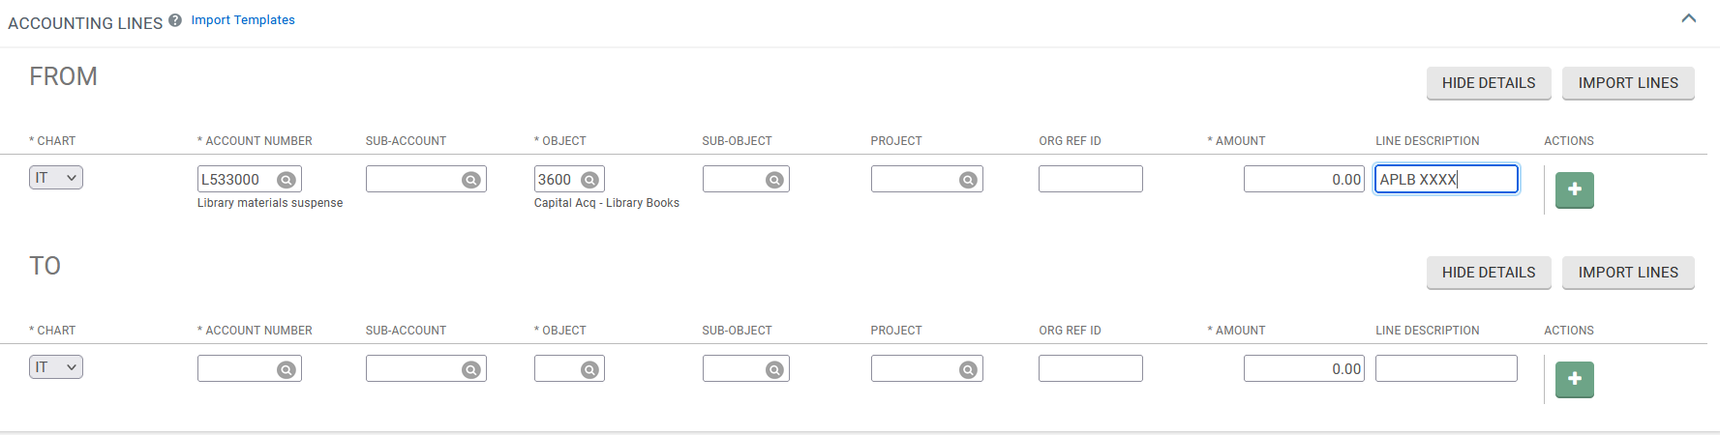
Accounting Lines – FROM section:
    The account from the FROM section is L533000, object code 3600.
    The APLB amount should be entered in the FROM section and should match the total amount of the TO section, after the data is imported
    Line description from the FROM section: APLB XXXXX to various
Note : If an account shows a credit in the import below, it will need to be moved to the FROM section.
In the TO section, click Import Lines. Browse to locate the document you saved earlier from the DI for Vouchers Sent to KFS Dashboard (DI Import 1). Click open and then click ADD .

Slide 14
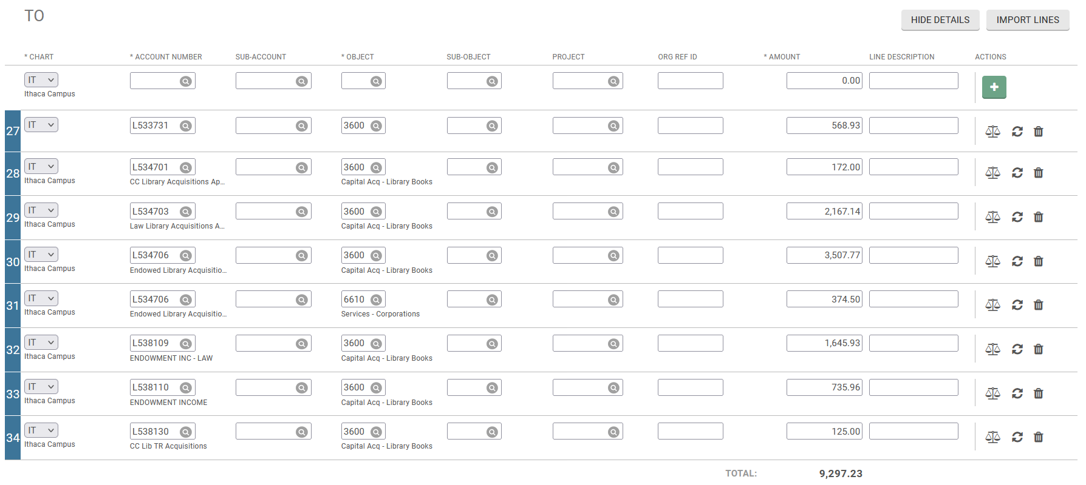
The DI document should show the imported lines.
Line Description:
    Add APLBXXXXX FR L533000 for all lines
    This step can also be completed on the Excel sheet, saves time, type it once and fill down.

Slide 15
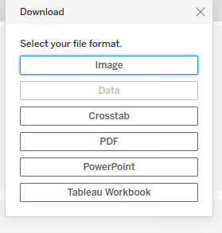
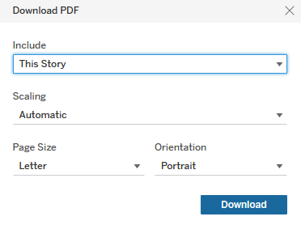
Documents to attach to the DI:
Daily Reconciliation Dashboard (Tab 1)
Vouchers Date Dashboard (Tab 5)
  Both should be saved in a PDF format in one document. You can download in a PDF format from the Dashboard by clicking ‘Download’ in the top right corner. It will save all dashboards from the Story. You can delete the pages you don’t need.
  (You can also subscribe to the Dashboard/Story and select the dashboard you want to receive.)

Slide 16
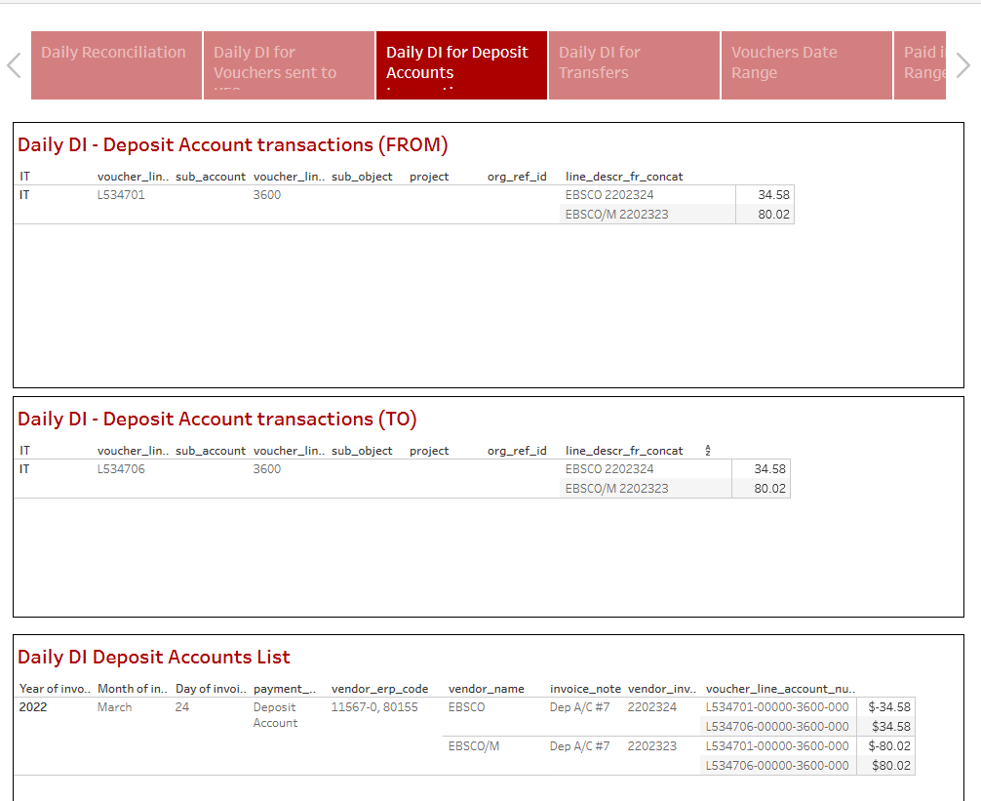
Third tab: Daily DI for Deposit Accounts
Download steps:
A
Follow the same steps as the Daily DI for vouchers sent to KFS.
You can import multiple times on the same DI, so the moves for Deposit Accounts can be added to the “APLB to various” document.
Download results and save.
Download results and save.
Import results into your DI in the FROM section.
Import results into your DI in the TO section.
Download results and attach to the document.
A
B
B
A
B
C
C

Slide 17
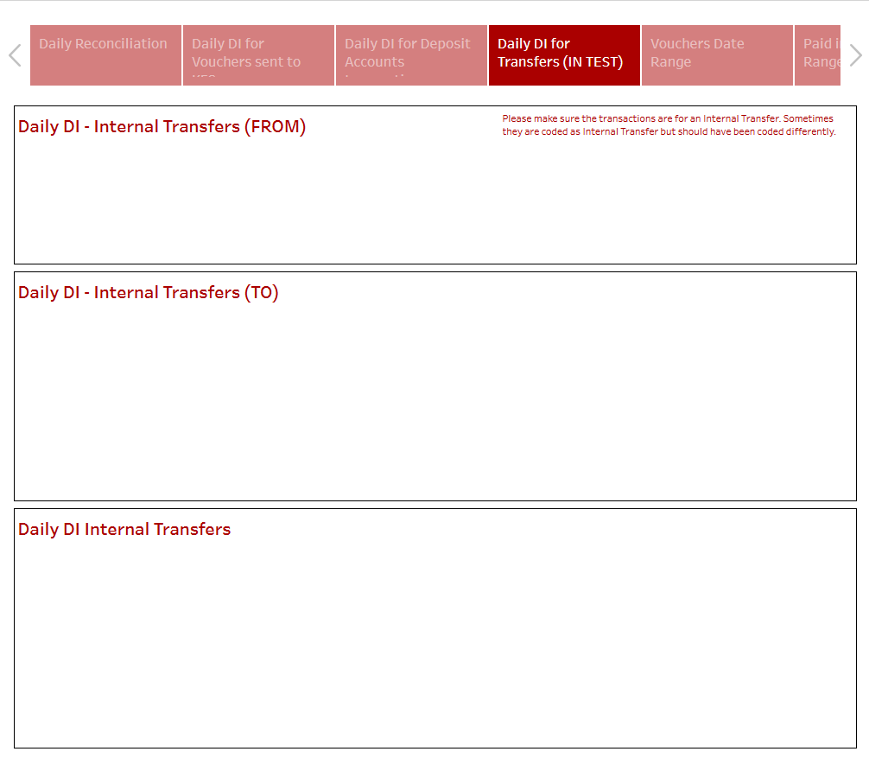
Fourth tab: Daily DI for Transfers
Download steps:
Follow the same steps as the Daily DI for Deposit Account.
You can import multiple times on the same DI, so the moves for Internal Transfer can be added to the “APLB to various” document.
Download results and save.
Download results and save.
Import results into your DI in the FROM section.
Import results into your DI in the TO section.
Download results and attach to the document.
A
A
B
B
A
B
C
C

Slide 18
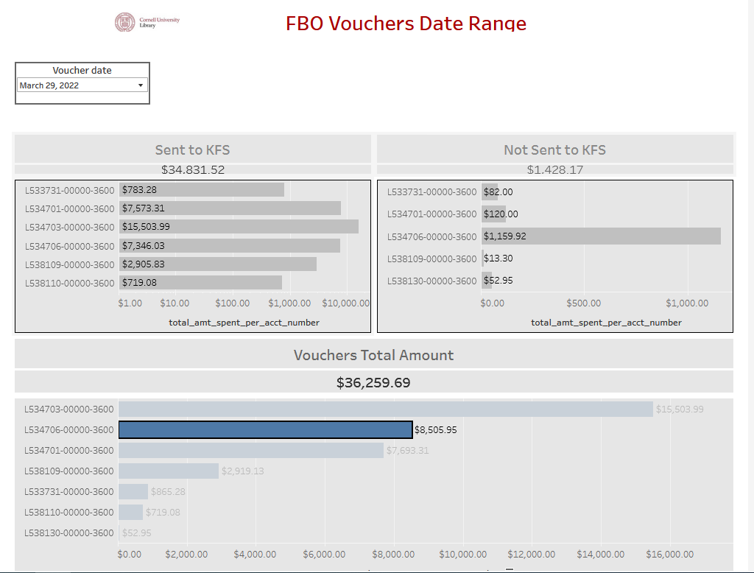
Fifth tab: Vouchers Date Range
This page allows a search of vouchers by voucher date. The filter is defaulting to the most recent date. To search for another date, click the dropdown arrow and scroll to the desired date.

Slide 19
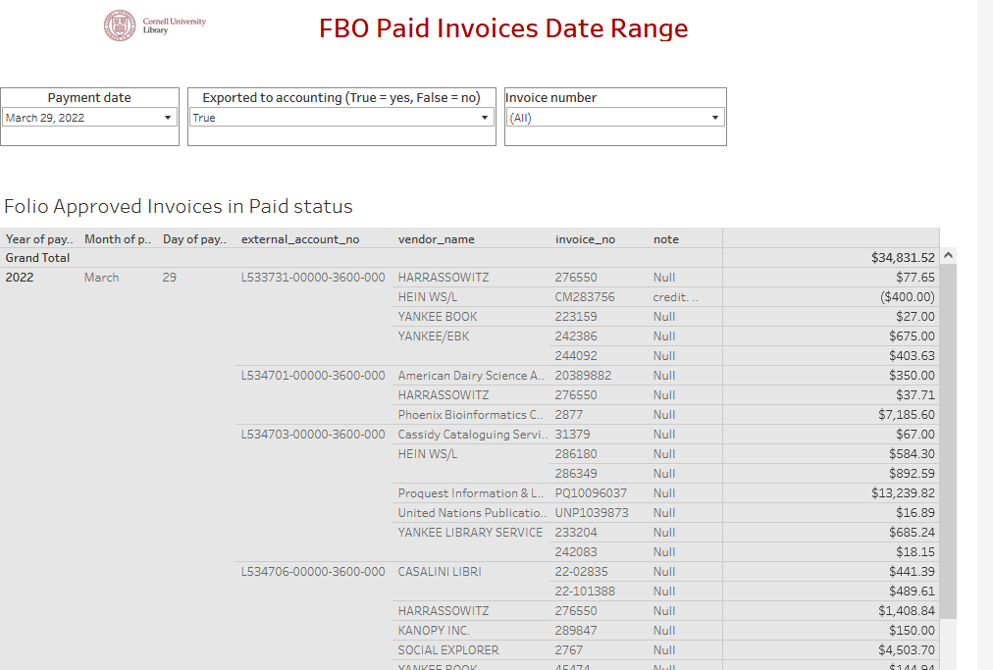
Sixth tab: Paid invoices date Range
This page allows a search of paid invoices by payment date, by invoice number or by “exported to accounting.”
The filter date can be selected by clicking the date dropdown menu.
Two choices are offered for the Export to Accounting filter. It is either True (Sent to FKS) or False (not sent to KFS/Manuals)

Slide 20

I hope you will enjoy using this dashboard!
Nancy Bolduc
nb299@cornell.edu
607-255-5102

