Slide 1

An SQL Case Study
Presented by
Jean M. Pajerek
September 2021

Slide 2
The goal: a query that lists the barcode number, enumeration, and chronology of items associated with a specific holdings record
Questions to consider:
What are the data points we need?
Which table or tables contain(s) these data points?
Will looking at this information in the FOLIO user interface give us any clues to figure this out?

Slide 3
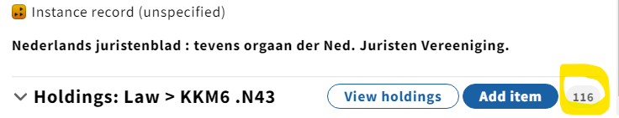
Let’s look at a test case in Inventory: a serial with 116 item records attached (instance HRID 368384).
This little number tells us how many items records are associated with this holdings record.

Slide 4
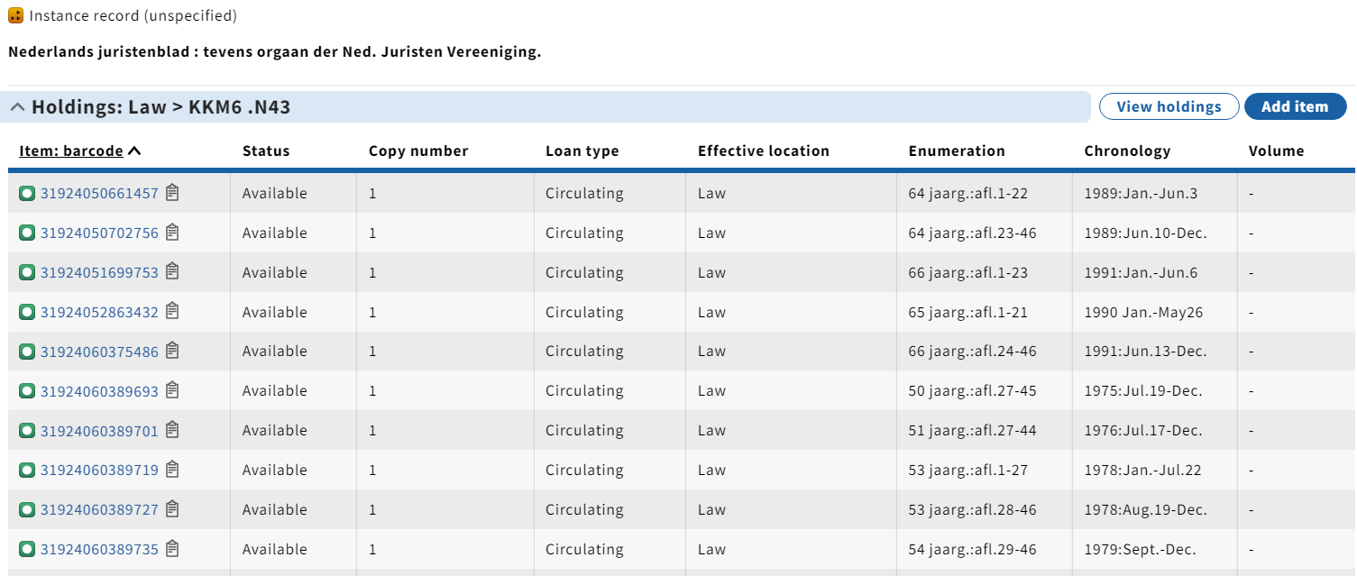
When we expand the holdings accordion, we see a list of the associated item records, which includes the barcode number and enumeration and chronology information, as well as other data points.

Slide 5
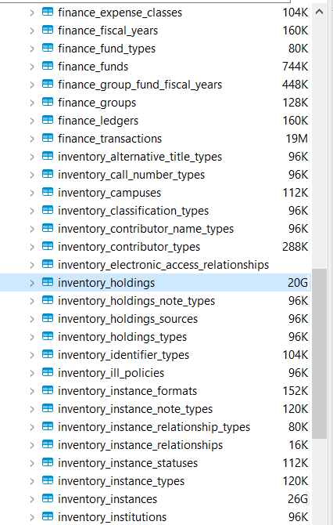
Our initial analysis suggests that the first table we need to look at in the LDP has something to do with holdings.
There is a table in the LDP called “inventory_holdings.” Could this table contain the data points we need?

Slide 6
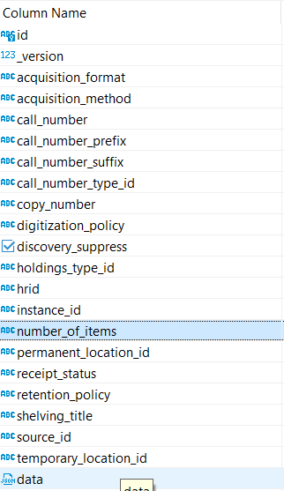
In looking at the properties associated with the inventory_holdings table, we see that only one data point has anything to do with items: “number_of_items.” This is not one of the data points we need right now.

Slide 7
We now need to ask the question: “What other table or tables might contain the data points we need?”

Slide 8
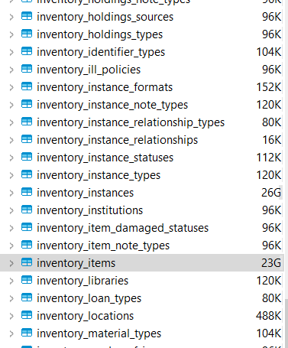
Returning to the LDP, we see that there is a table called “inventory _items.”
Could this table contain the data points we need?

Slide 9
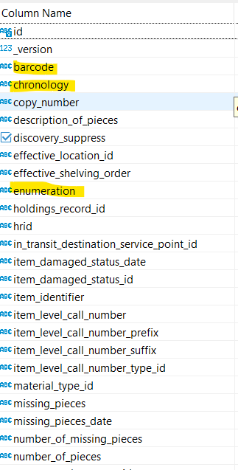
An examination of the properties of the inventory_items table shows that this is the table with most of the data points we want! That’s because the data points we want reside within item records.

Slide 10
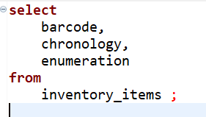
Let’s open the SQL Editor in DBeaver and write a very simple query to retrieve our 3 data points from the inventory_items table, and run it.

Slide 11
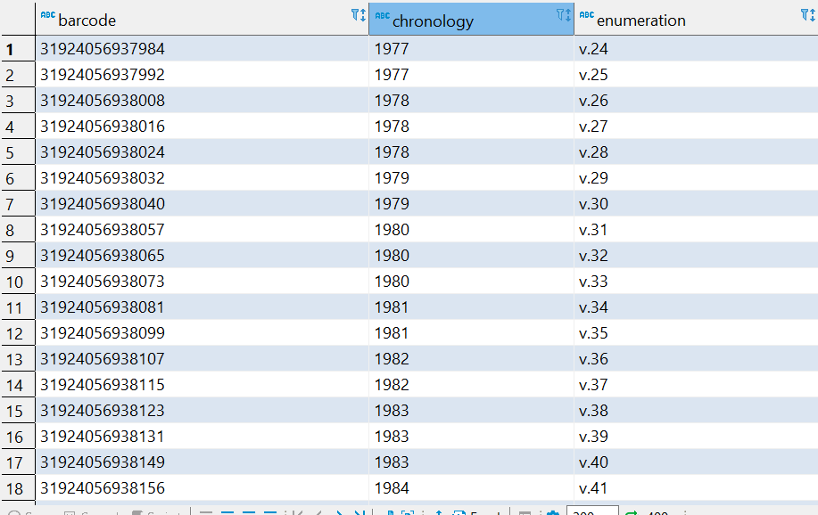
Do your results look something like this? What’s missing?

Slide 12
Recall our goal: a query that lists the barcode number, enumeration, and chronology of items associated with a specific holdings record.
Problem:
Our results make no reference to any specific holdings record. How do we bring in that data point?

Slide 13
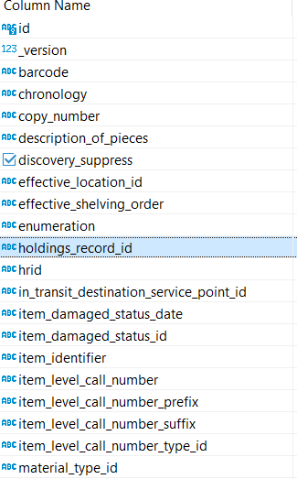
Let’s take another look at the properties associated with the inventory_items table.
This looks like a data point we might be able to use!

Slide 14
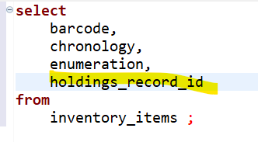
Let’s add “holdings_record_id” to the data points in our “select” statement, and run the query.

Slide 15
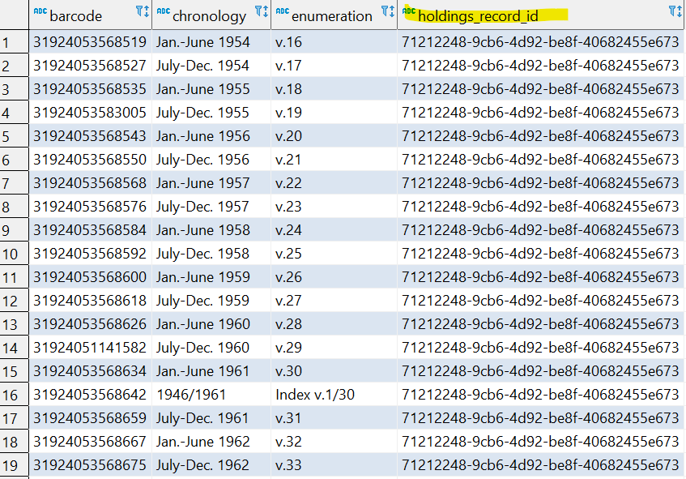
Notice that the long, alpha-numeric holdings id string now appears in our results.

Slide 16
Suppose we want the more accessible and human-friendly holdings HRID in our results? How do we get that?

Slide 17
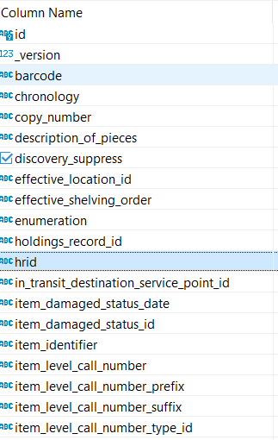
Let’s re-examine the properties associated with the inventory_items table.
Could this data point called “hrid” be what we are looking for?

Slide 18

We know that in FOLIO, there are instance HRIDs, holdings HRIDs, and item HRIDs.
We also know that within the LDP tables, the names of IDs are context-dependent. This means that within the table we’ve been looking at, inventory_items, the “hrid” data element refers to the item HRID, not the holdings HRID. This is not the HRID we need for our query.

Slide 19
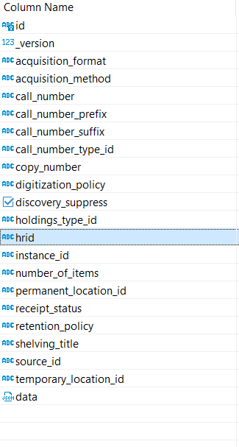
In which table are we most likely to find the holdings HRID? Hint: it’s a table we have already looked at.
Revisiting the properties associated with the inventory_holdings table, we see the data element called ”hrid.” This is the HRID for the holdings record.

Slide 20
As it turns out, the inventory_holdings table has a role to play in our query after all.
Pop quiz!
We need to connect the inventory_items table to the inventory_holdings table. To do that, we need to find a data point that the two tables have in common. In the inventory_holdings table, the point of connection we need is called “id;” i.e., the holdings record ID. What is the same data point called in the inventory_items table?
In the inventory_items table, the holdings record id is helpfully called “holdings_record_id.”

Slide 21
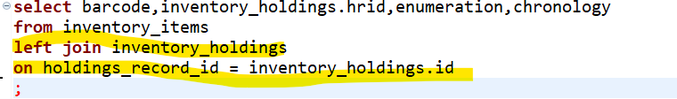
To connect the two tables, we need to add a “join” statement to our query, connecting them on the common data point.
Please DO NOT run the query below right now!! It can take a bit of time to run.
We’ve added a “join” statement to connect the two tables, using the holdings record id as a match point.

Slide 22
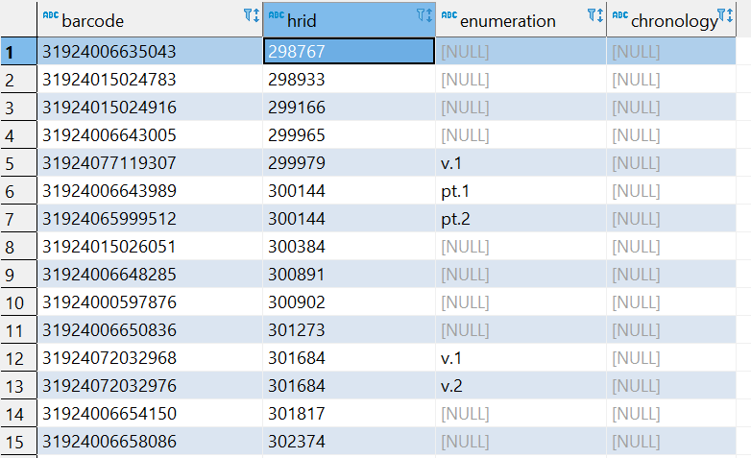
The results look like this. There are a couple of problems with this result.
Notice that one of our columns is called simply “hrid.” Which HRID is it referring to? In our query, we selected the HRID associated with the holdings record, but this is completely unclear from the results display.

Slide 23
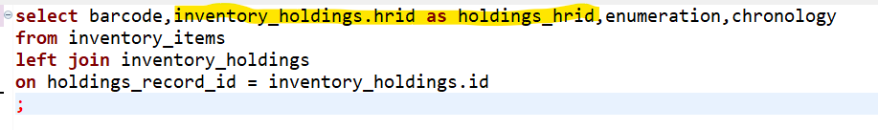
We need to add an “alias” to the query to disambiguate the label for the column called “hrid.”
Note also that the name of the source table for the HRID is prepended to the name of the data element.

Slide 24
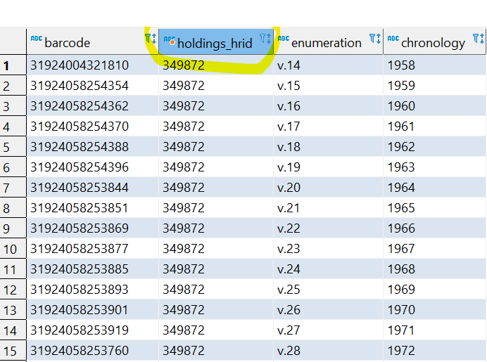
Now the column label is more intelligible, but there’s still a problem with our results.
This search result is actually unmanageably large. We want to limit our results to the item records associated with a single holdings record.

Slide 25
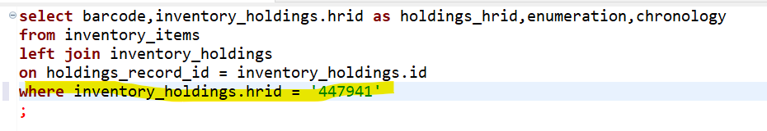
To do this, we need to add a criterion to our query by adding a “where” statement.
By adding the holdings HRID as a criterion in a “where” statement, we are able to limit the results to just the items linked to this specific holdings.

Slide 26
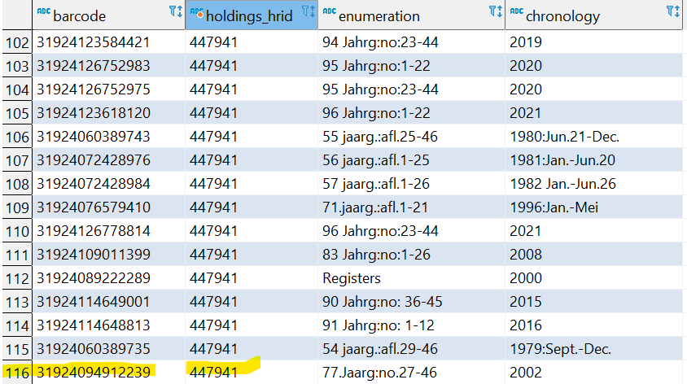
Check the accuracy of your result!
Recall that our test title, Nederlands juristenblad, has 116 item records attached to it. We can feel confident in our query result because it also has 116 results lines. Even so, wouldn’t it be nice to put the results into some kind of sensible order?

Slide 27
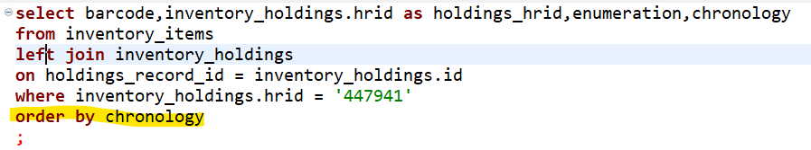
Considering the data we are working with, the best way to order the query results would be by either the enumeration or the chronology data. To do this, we use an “order by” statement.
IMPORTANT! The “order by” statement must come AFTER the “where” statement.

Slide 28
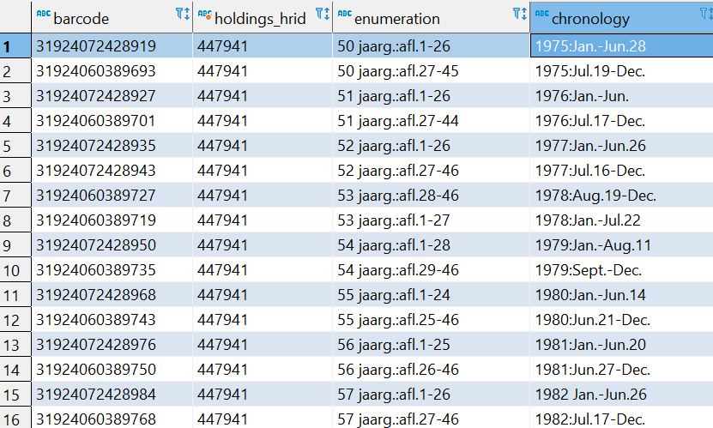
The search result is now nicely ordered by year, in ascending order.

Slide 29
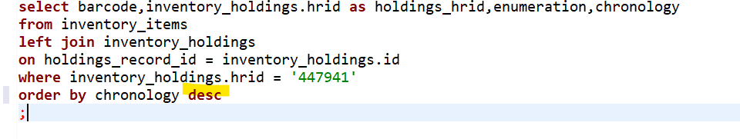
We can reverse the sort order by adding “desc” (for descending order) to the end of the “order by” statement.

Slide 30
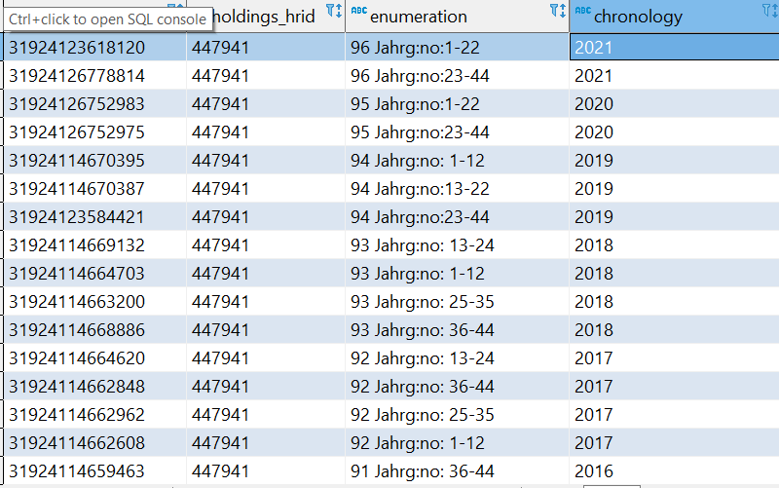
This creates a search result where the newest items appear at the top of the list.

Slide 31
Things to keep in mind
Query-writing is an iterative process of trial-and-error, testing, verifying accuracy, and refining parameters.
Before starting to write a query, identify the data elements you want to include in the results.
Once the data elements are identified, look for the tables where those data elements reside.
Having a known test case to work with is a good way to verify your results.

