Slide 1

CUL FOLIO
Reporting
Training
Sharon Beltaine
Reporting Lead, FOLIO Implementation
Cornell University Library
July 15, 2021
Notes:
Thanks for joining us. Please hold your questions until the end.

Slide 2
What is covered in this training
Getting Started with FOLIO Reporting
Connecting to the FOLIO Reporting Database
Using Canned Reports
Running Reports with Virtual DBeaver
Requesting Reporting Help

Slide 3

Getting Started with FOLIO Reporting

Slide 4
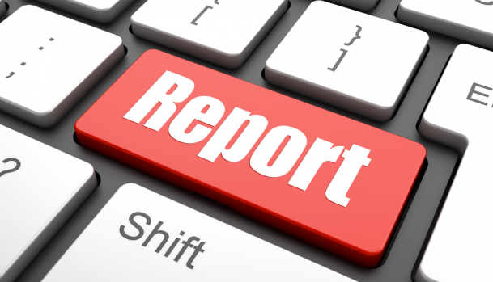
Basic Steps
Set up your connection to the FOLIO LDP Reporting Database
Choose the report query you want to run
Filter your results
Run the report query
Save the report query with your settings
Export your report results to CSV

Slide 5

Step-by-Step Documentation
Don’t Panic!
We have step-by-step guides for
everything covered in
today’s training session
See Reporting Technical Documentation
https://confluence.cornell.edu/display/folio/FOLIO+Reporting+Documentation

Slide 6
What is the Library Data Platform?
The Library Data Platform is a project that develops an open-source analytics platform (https://github.com/library-data-platform) which can be utilized by FOLIO reporting (https://github.com/folio-org/folio-analytics) for statistical and operational analytics. The term "LDP" is sometimes also used as a shorthand for a specific component of the platform, such as the LDP database or the LDP query builder app which runs in FOLIO.

Slide 7

Why Join CUL-REPORT-USERS-L?
stay informed about server outages and maintenance times impacting reporting
learn about new reporting features

Slide 8
How to Join CUL-REPORT-USERS-L
Subscribe to CUL-REPORT-USERS-L
send an email message to
CUL-REPORT-USERS-L-request@cornell.edu
For the Subject of your message, type the single word
join
Leave the body of the message blank
Send this message from the email address where you want to receive the e-list's messages
The message must be sent in plain text

Slide 9
Connecting to the FOLIO LDP Reporting Database

Slide 10
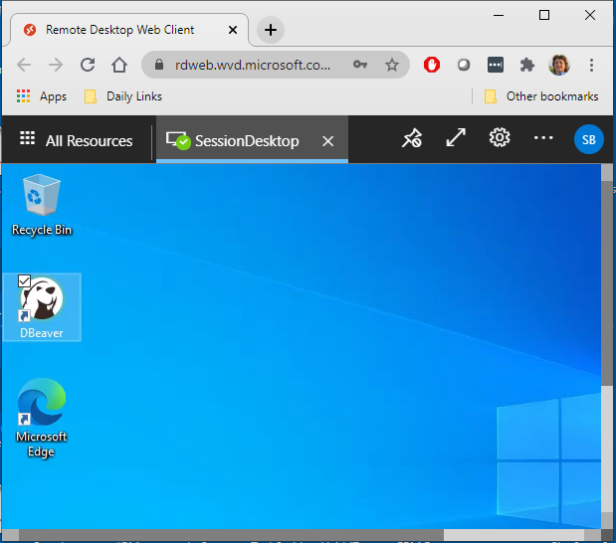
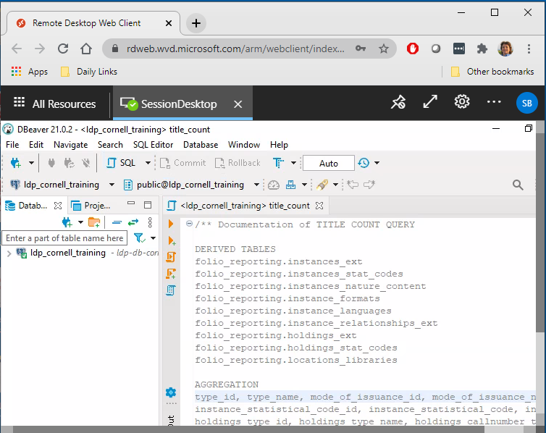

Virtualized DBeaver Reporting Application
Notes:
DBeaver is the recommended reporting application for those who need to run and/or build FOLIO reports
To provide reporting users with secure access to the Cornell LDP reporting database, CIT set up a virtualized environment, which is similar to using a Remote Desktop connection
Library Desktop Services and the Reporting Team are currently testing the virtualized environment for reporting
Report users will open a web browser link, log in with netid and password, click the DBeaver icon on the virtual desktop, and run their queries just as they would from the DBeaver desktop application

Slide 11
Logging into Your Virtual DBeaver account
Open a web browser and go to the Virtual DBeaver URL
https://rdweb.wvd.microsoft.com/arm/webclient/index.html
Choose Virtual DBeaver
At "Access local resources," click Allow
At "Enter your credentials," enter your full Cornell email address in the Username field and your email password in the Password field, then click Submit
Click the DBeaver shortcut on the desktop

Slide 12
Configure Your Connection to the Reporting Database
Choose New Database Connection
Enter Connection Settings
  Main Tab
    host: ldp-db-cornell.folio.ebsco.com
    port: 5432
    database: ldp_cornell
    user: ldpuser_cornell
    password: (see password sent to you in access authorization email)
    check the "Save password locally" checkbox
  SSL Tab
    check the SSL check box
    Under Advanced SSL mode, choose prefer
Click Test Connection then click OK

Slide 13

Demo: Connect to the Reporting Database
Virtual DBeaver URL
https://rdweb.wvd.microsoft.com/arm/webclient/index.html

Slide 14
Using Canned Reports

Slide 15
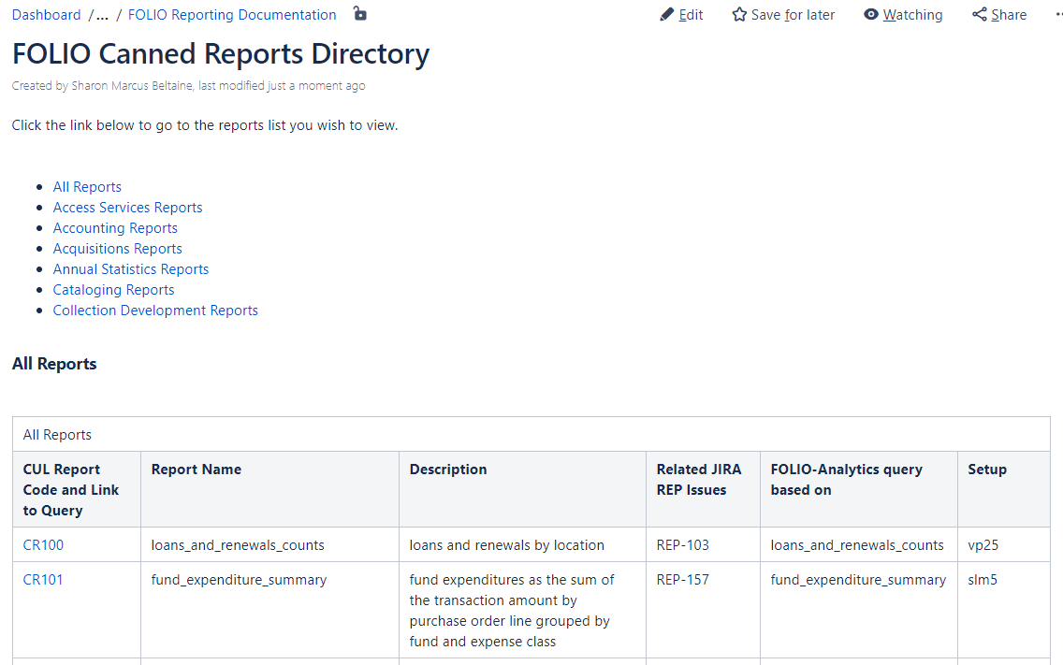
CUL FOLIO Canned Reports Directory
What is a “canned” report?
a pre-written query you can run to generate a FOLIO report
Go to https://confluence.cornell.edu/display/folio/FOLIO+Canned+Reports+Directory

Slide 16
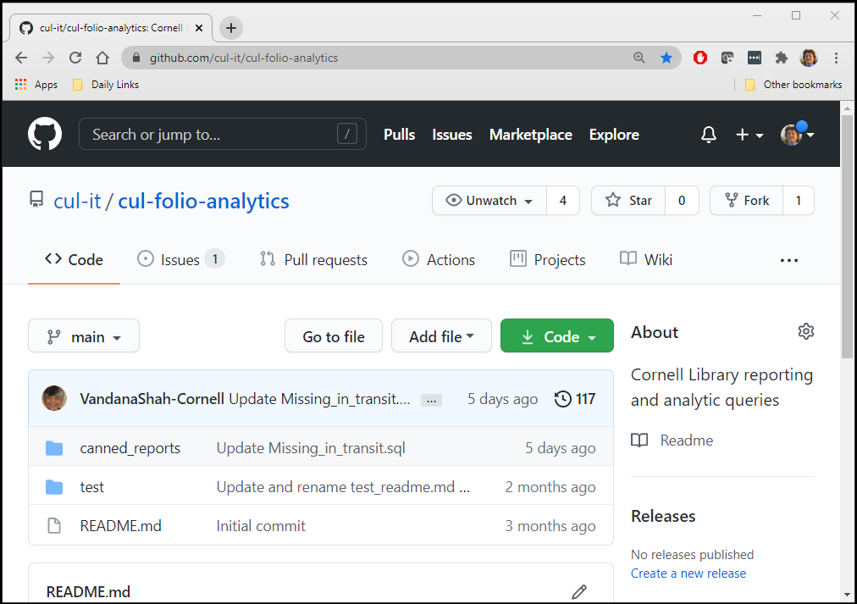

CUL FOLIO Analytics Report Repository on GitHub
Go to https://github.com/cul-it/cul-folio-analytics
Notes:
It’s just a place to store the code
The FOLIO reporting community is collaboratively developing a repository of report query templates in SQL called FOLIO Analytics
The queries in this repository are designed to be used and adapted by institutions implementing FOLIO with the LDP reporting database
SQL stands for Structured Query Language, a programming language designed for managing data in a reporting database
one of the best things you can do to get comfortable with our new reporting system is to familiarize yourself with the queries that are being developed in this repository
The FOLIO Analytics Report Repository is stored on GitHub, but you do not require a GitHub account to obtain and use the queries

Slide 17
Demo: Using Canned Reports
https://confluence.cornell.edu/display/folio/FOLIO+Canned+Reports+Directory

Slide 18
Running Reports with Virtual DBeaver

Slide 19
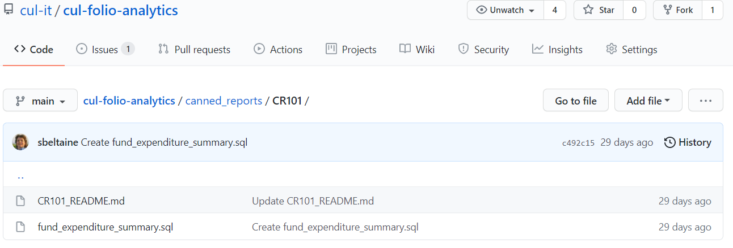
Repository File Formats: .md and .sql
Notes:
README.md documentation files are available for each query in the report repository
The .md extension means the file is in Markdown format
Markdown is a markup language for creating formatted text that is used on GitHub
The .sql extension means the file is an SQL script
SQL stands for structured query language
SQL scripts are run against the reporting database to generate reports
The README file for the query explains the query’s purpose

Slide 20
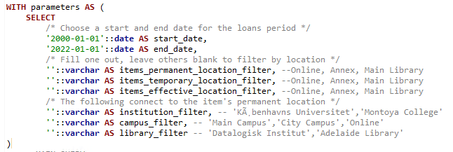
Changing Filters
Edit
parameters
Notes:
in addition to running reports, most users will change filters to get the results set needed
before you run your FOLIO report query, check the filter settings
filters are documented in the README and Comments documentation for each query

Slide 21
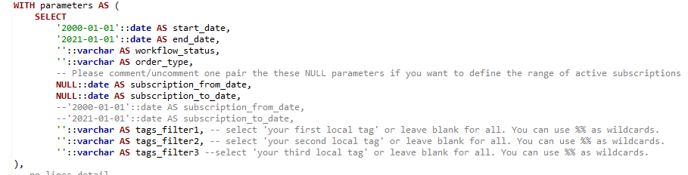
Filters are documented with Comments
comments
Notes:
about query commenting
putting 2 dashes in front of a line in a query makes it a comment, so it’s no longer part of the code that the query uses to run
report developers use comments to help document the query to make it easier to understand and use

Slide 22
Demo: Running Reports
Notes:
Requests - filter for current dates and RMC Annex
Loans and Renewals - filter by date and location

Slide 23
Requesting Reporting Help

Slide 24
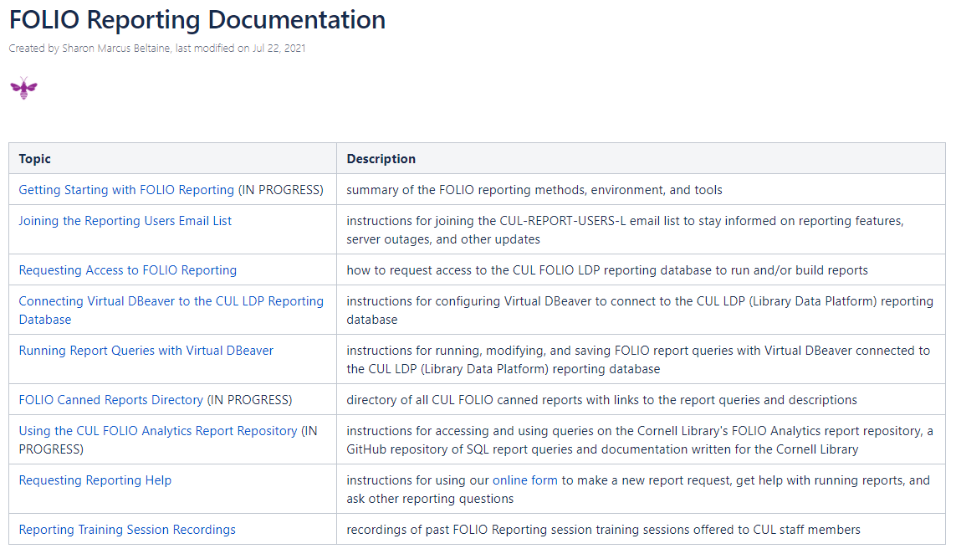
FOLIO Reporting Documentation: START HERE
https://confluence.cornell.edu/display/folio/FOLIO+Reporting+Documentation

Slide 25
Demo: Using Reporting Documentation
https://confluence.cornell.edu/display/folio/FOLIO+Reporting+Documentation

Slide 26
Demo: Requesting Reporting Help
Link to FOLIO Reporting Help Request Form

Slide 27
Reporting Support is available
the reporting team is ready to provide support
there will be more reporting training sessions
some reports available within FOLIO applications
reporting technical documentation is available
requesting reporting help is available in online form

Slide 28

FOLIO Reporting Team
Many thanks to the members of the CUL FOLIO Reporting Team for their hard work and dedication as we build FOLIO reporting services together
Vandana Shah
Natalya Pikulik
Jean Pajerek
Linda Miller
Kim Laine
Shayla Harrington
Nancy Bolduc
Sharon Beltaine
Notes:
I want to acknowledge the hard work and dedication of the reporting team as they work hard to support you as you learn how to navigate a new world of library data - thank you!

Slide 29

Questions?

Slide 30
NOTES
In app reporting
-more available in FOLIO than was in Voyager
Presentation Approach
-ask people to hold their questions until the end
-happy, positive, fluffy
Access Services
-mention that the circ log can do reports (will be training later)
Terms
-define terms in the context in which they are presented
Voyager ≠ FOLIO
-the new FOLIO reports approximate the Voyager reports; it is not possible for them to be identical given the fact that there is in-app reporting functionality and the 2 systems have different data structures, different functionality, and different data elements
Keep it Simple
-do not get too technical
-use pictures to explain technical concepts when possible

