Slide 1
Primary Hemostasis
Board Review 2021

Slide 2
Hemostasis
The arrest of bleeding or interruption of blood flow through a vessel
Depends on complex interaction of major components:
  Platelets, coagulation factors, fibrinolytic factors and blood vessels
Abnormal hemostasis: thrombosis or hemorrhage
Primary hemostasis: platelet plug formation
Secondary hemostasis: formation of the fibrin clot via the coagulation cascade
Fibrinolysis: clot breakdown

Slide 3
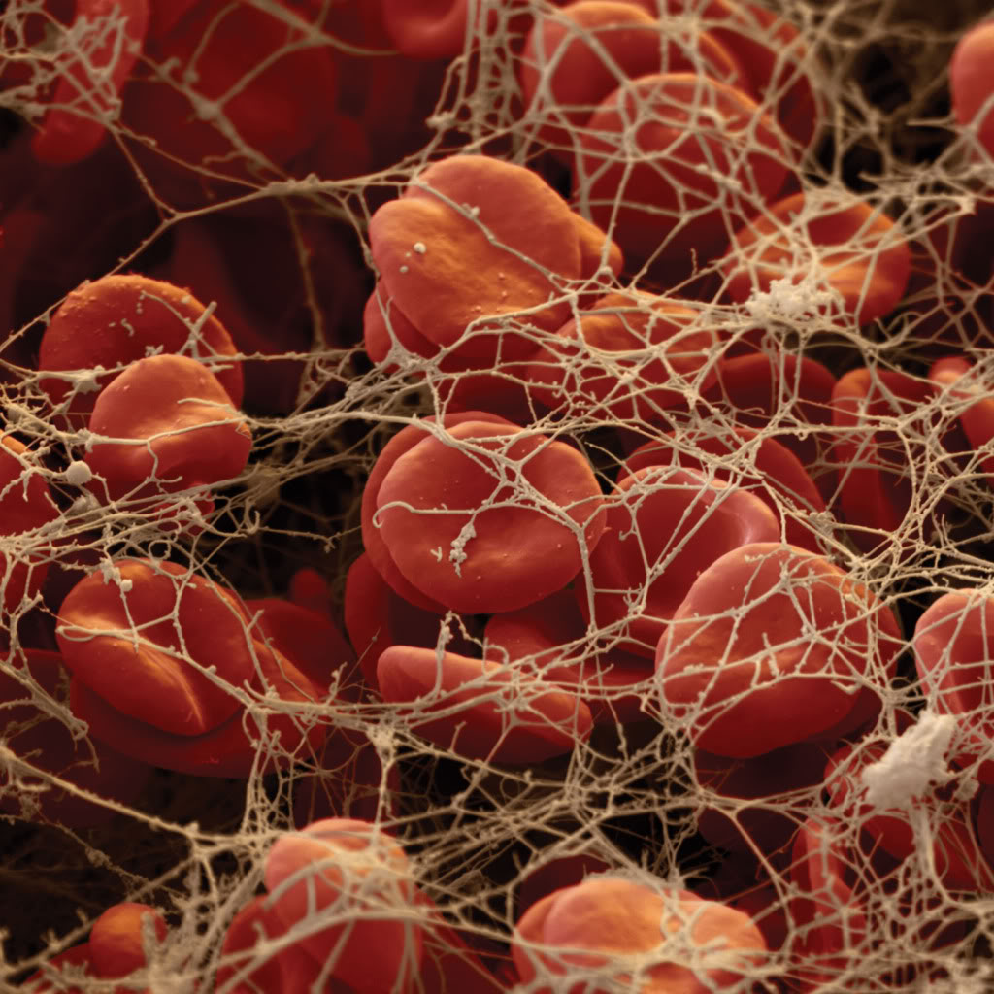
Primary Hemostasis
Platelet plug seals off small injuries esp. in microvessels (<100 μm) in mucosal surfaces
Platelet plug is only stable for a few hours if the secondary hemostatic forces do not solidify and reinforce the plug with a crosslinked fibrin meshwork
Platelets provide a phosphatidylserine (PS)-based membrane surface needed for fibrin formation (secondary hemostasis)
Constituents:
  Platelets
  Von Willebrand factor (vWf)
  Vessel wall

Slide 4
Platelets
Anucleate cytoplasmic fragments of megakaryocytes
Composed of:
  Phospholipid membrane with adhesion proteins
  An open canalicular system of membrane invaginations that serves as a conduit for substances to move between platelets and plasma and that contributes to a marked increase in external platelet surface area after activation
  A cytoskeleton that maintains a discoid shape and allows for shape change and pseudopod formation with activation due to abundant contractile proteins (actin and myosin)
  Endoplasmic reticulum that stores calcium for platelet activation and that is important in thromboxane synthesis
  Glycogen stores and mitochondria for energy
  Growth factors which facilitate growth of vascular endothelial cells, vascular smooth muscle cells, and fibroblasts

Slide 5
Platelets continued
  Composed of:
  Alpha-granules:
    vWf, fibrinogen, Factor V, factor VIII, P-selectin, platelet derived growth factor, fibronectin
  Dense/delta granules:
    ADP, serotonin, calcium, epinephrine, histamine, ATP

Slide 6
Platelet production
Megakaryopoiesis: occurs mostly in the bone marrow
  Resident myeloid progenitor cells respond to cytokines, primarily thrombopoietin by undergoing proliferation and maturation
Thrombopoiesis
  Primarily mediated by thrombopoietin
  Occurs in bone marrow, spleen, lungs
Thrombopoietin produced primarily by hepatocytes, renal tubular epithelium, and stromal cells in the bone marrow
Elimination of thrombopoietin occurs via adsorption onto platelets – negative feedback mechanism
Platelet mass established by the relative states of production, consumption, and destruction
Average canine platelet life span 6 days
Time taken from megakaryocyte maturation and release of platelets is approximately 3 to 5 days

Slide 7
Normal platelet variation
Macrothrombocytopenia in cavalier King Charles Spaniels and Akitas
  Inherited autosomal recessive platelet defect in CKCS
  A mutation in B1-tubulin likely leads to altered proplatelet formation in megakaryocytes
  Also reported in Norfolk Terriers
Relative thrombocytopenia in Greyhounds
Total effective platelet mass is maintained so no associated bleeding abnormalities or abnormalities on platelet aggregation testing

Slide 8
Sequence of events
Intact endothelium = physical barrier separating circulating platelets from thrombogenic substances (extracellular matrix proteins) in the extravascular space
The procoagulant subendothelial matrix (collagen, vWf, laminin, and fibronectin) is exposed and initiates primary hemostasis:
  Platelet adhesion
  Platelet activation
  Platelet plug formation/aggregation
All stages occur concurrently
The various mediators and ligands responsible are activated under either high shear, low shear, or all shear conditions

Slide 9
Platelet adhesion
Platelets bind to subendothelial matrix proteins with the aid of adhesion molecules or receptors on their surfaces
  Receptors are transmembrane glycoproteins and are integrin or non-integrin receptors
  Platelets can adhere to exposed collagen in two ways:
    Attaching directly to collagen via platelet glycoprotein VI receptor
    Attaching indirectly to collagen via vWf via the glycoprotein 1b-IX-V receptor
      The interaction of vWF and platelets occurs only under high shear conditions
Notes:
High shear conditions – small and medium sized arteries
Low shear conditions – large arteries and all veins

Slide 10
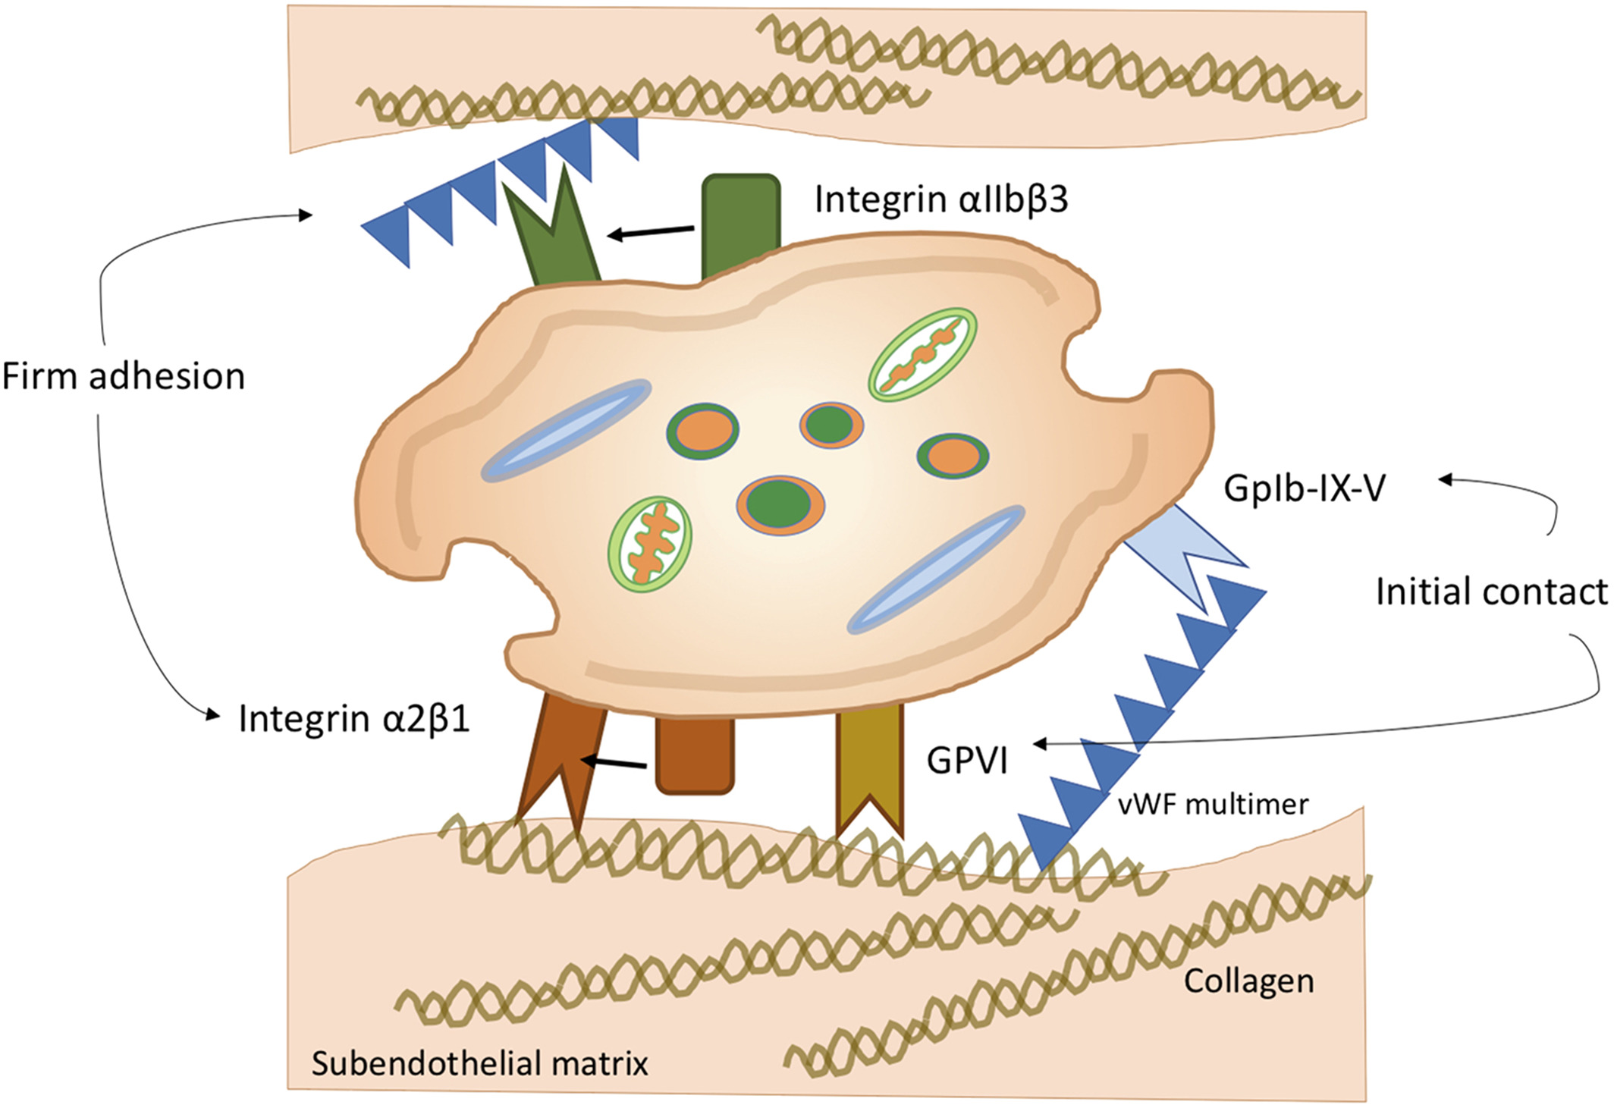
Abnormal platelet activity in dogs and cats – impact and measurement
Journal of Small Animal Practice, Volume: 61, Issue: 1, Pages: 3-18, First published: 09 January 2020, DOI: (10.1111/jsap.13092)
Notes:
Illustration of key receptors mediating platelet adhesion
IF THIS IMAGE HAS BEEN PROVIDED BY OR IS OWNED BY A THIRD PARTY, AS INDICATED IN THE CAPTION LINE, THEN FURTHER PERMISSION MAY BE NEEDED BEFORE ANY FURTHER USE. PLEASE CONTACT WILEY'S PERMISSIONS DEPARTMENT ON PERMISSIONS@WILEY.COM OR USE THE RIGHTSLINK SERVICE BY CLICKING ON THE 'REQUEST PERMISSIONS' LINK ACCOMPANYING THIS ARTICLE. WILEY OR AUTHOR OWNED IMAGES MAY BE USED FOR NON-COMMERCIAL PURPOSES, SUBJECT TO PROPER CITATION OF THE ARTICLE, AUTHOR, AND PUBLISHER.

Slide 11
Platelet adhesion continued
Von Willebrand factor (large glycoprotein) is produced by endothelial cells or megakaryocytes
  Forms polymers called multimers
  Larger multimers have greater affinity for platelets
  Stored in endothelial Weibel-palade bodies, alpha granules of megakaryocytes and platelets, and circulating in plasma
  Performs 2 major hemostatic roles:
    1. Carrier protein for FVIII, protecting it from proteolysis by protein C
    2. Adhesion of platelets to damaged endothelium

Slide 12
Platelet adhesion continued
  VWF Small multimers constitutively secreted into the subendothelial matrix and large multimers into the plasma
    Large multimers rapidly cleaved into small multimers
  Multimer size is regulated by metalloproteases – ADAMTS-13 predominantly produced by endothelial cells
    Cleaves larger multimers into smaller multimers
    vWF multimers becomes more susceptible to cleavage when bound to platelets – allows negative feedback inhibition
Binding to collagen results in a conformation change exposing the binding site for GP 1b platelet receptor on vWF
Notes:
Desmopressin acetate (DDAVP), epinephrine, thrombin, and histamine stimulate release of VWF from Weibel-Palade bodies
Desmopressin acetate – synthetic analog of vasopressin with minimal vasopressor activity causes release of vWF from endothelial cells and release of FVIII from storage sites
Release of vWF and FVIII decreases over a 24-hour period with subsequent doses of DDAVP
There is an approximately 30% decrease seen with the second injection in humans
Repeated doses are more likely to cause tachyphylaxis
Peak onset of vWF release is expected to be within 10 minutes of IV injection and reported to last approximately 2 hours

Slide 13
Platelet activation
Adhesion of platelets to subendothelial matrix proteins activates them
  Shape change: change from normal discoid shape to elongated cells with cytoplasmic extensions
  Release reaction: release contents of preformed cytoplasmic granules
    Alpha and dense granules
  Phospholipid metabolism
    Activation of phospholipase A₂ hydrolyzes membrane phospholipids (phosphatidylcholine) to arachidonic acid the substrate of COX-1 producing thromboxane A₂
Notes:
TXA2 half life 30 seconds so potent effects are short lived and remain local

Slide 14
Platelet activation continued
Phosphatidylserine exposure:
  Negatively charged phospholipid that is actively maintained on the inner membrane leaflet
  PS is flipped on the outer leaflet of the membrane allowing coagulation factors to bind
Release of procoagulant microparticles:
  Shed tiny microparticles from their membrane that are rich in PS – provide a larger surface area for fibrin formation
Activation of the fibrinogen receptor:
  Integrin α_{IIb}β₃ or GPIIb/IIIa
  Activation of platelets causes a conformation change in the receptor allowing fibrinogen to bind – high affinity state

Slide 15
Platelet activation
Platelet agonists (TXA₂, ADP, thrombin) recruit and activate additional platelets
Under high shear conditions, ADP promotes platelet activation
Under low shear conditions, TXA₂ causes activation
Thrombin – most potent platelet activator, works under all conditions
  Activation of GP Ib-IX-V complex
  Response to thrombin is independent of cyclooxygenase inhibition

Slide 16
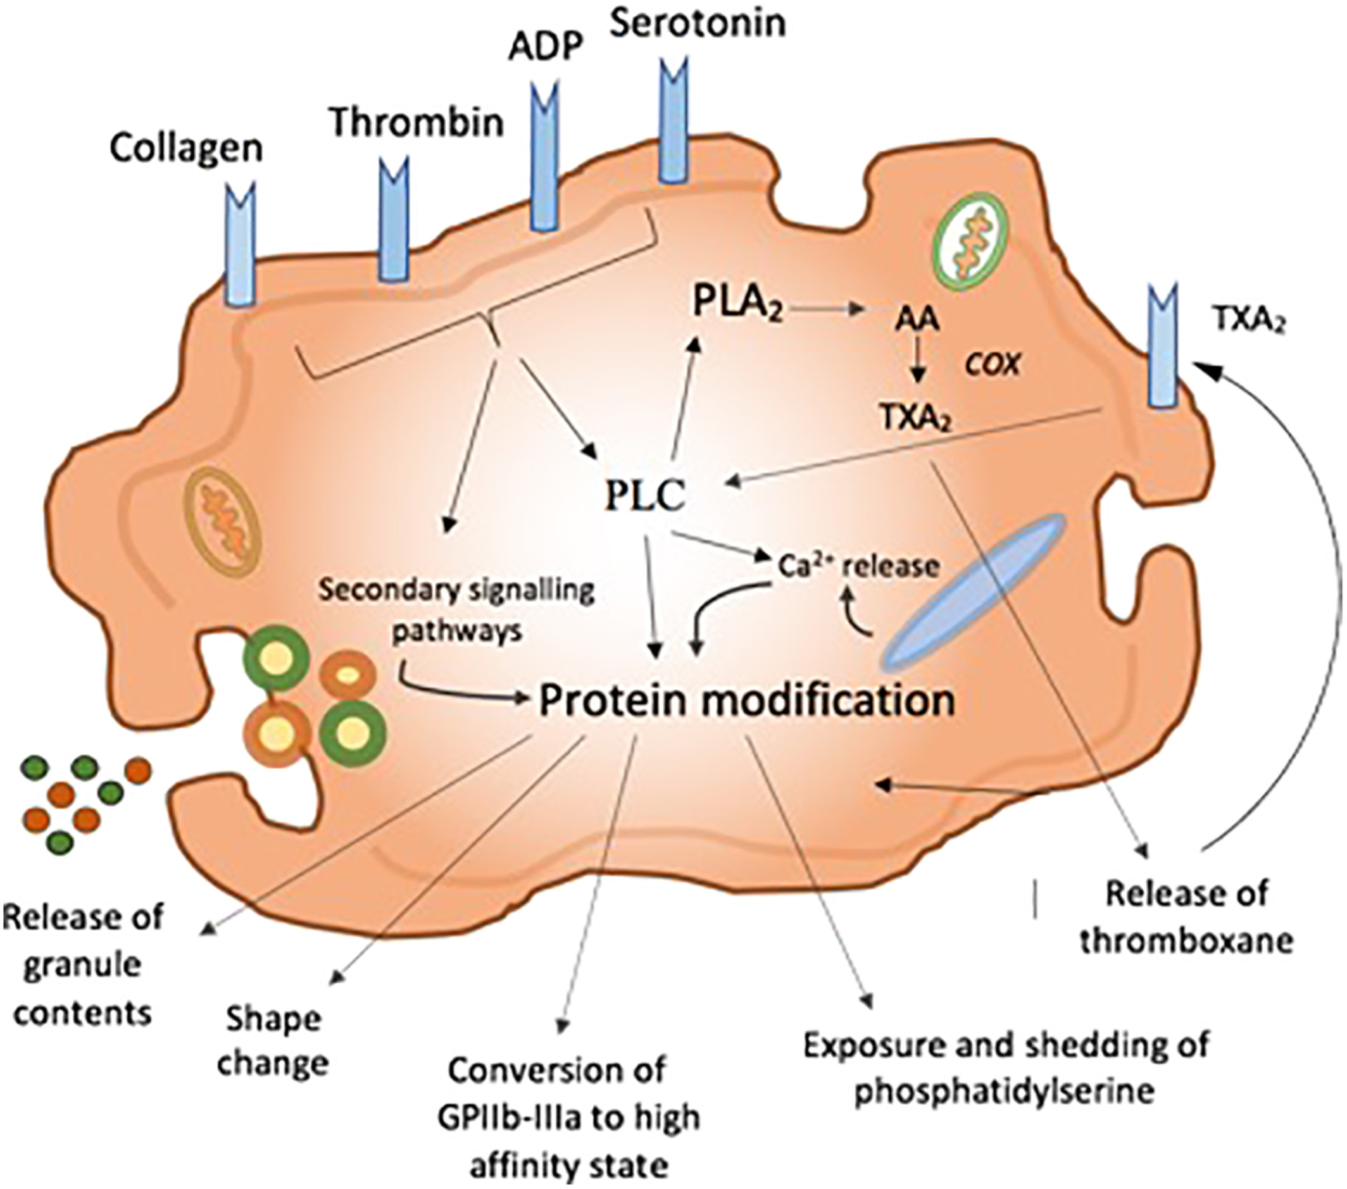
Abnormal platelet activity in dogs and cats – impact and measurement
Journal of Small Animal Practice, Volume: 61, Issue: 1, Pages: 3-18, First published: 09 January 2020, DOI: (10.1111/jsap.13092)
Notes:
Illustration of intracellular signalling pathways
IF THIS IMAGE HAS BEEN PROVIDED BY OR IS OWNED BY A THIRD PARTY, AS INDICATED IN THE CAPTION LINE, THEN FURTHER PERMISSION MAY BE NEEDED BEFORE ANY FURTHER USE. PLEASE CONTACT WILEY'S PERMISSIONS DEPARTMENT ON PERMISSIONS@WILEY.COM OR USE THE RIGHTSLINK SERVICE BY CLICKING ON THE 'REQUEST PERMISSIONS' LINK ACCOMPANYING THIS ARTICLE. WILEY OR AUTHOR OWNED IMAGES MAY BE USED FOR NON-COMMERCIAL PURPOSES, SUBJECT TO PROPER CITATION OF THE ARTICLE, AUTHOR, AND PUBLISHER.

Slide 17
Platelet aggregation
Aggregation refers to adhesion of activated platelets to each other using receptor bound fibrinogen as a bridge
Mediated primarily by fibrinogen through α_{IIb}β₃ receptor (low shear) and GP Ib-IX-V receptor (high shear)
High shear flow rate, vWF mediates platelet aggregation
Low shear flow rates, fibrinogen is the primary ligand of thrombus growth
Bridges platelets together forming the primary plug
After the platelet plug has bridged the gap, adjacent endothelial cells release prostacyclin causing vasodilation and decreased platelet aggregation
Notes:
How the endothelium is repaired under the platelet plug still a mystery
Endothelial progenitor cells that are mobilized from the bone marrow and travel to sites of vascular injury may be responsible for maintenance and repair of endothelial function in blood vessels

Slide 18
Receptor | Main ligand | Function | Comments
Α₂β_{1 integrin} | collagen | Platelet adhesion | Firm adhesion after activation
GP VI | collagen | Platelet adhesion | Initial tethering
GPIb-IX-V | vWF | Platelet adhesion | Important in arterial circulation
α_{IIb}β_{3 integrin} | Fibrinogen and vWF | Platelet aggregation | Allows fibrinogen binding and aggregation after activation
P2Y1 and P2Y12 | ADP | Platelet agonist | Site of clopidogrel action
Prostaglandin receptors | Thromboxane Prostacyclin | Platelet agonist Platelet antagonist | Site of aspirin action
Protease-activated receptors (PAR) | thrombin | Platelet agonist | Thrombin = strong agonist

Slide 19
Inhibition of primary hemostasis
ADPases, heparin sulfate, and thrombomodulin expressed on the endothelial surface to degrade or inhibit platelet agonists
Glycocalyx lines intact vessels and inhibits thrombin formation
Nitric oxide and prostacyclin are released constitutively from the endothelium and act locally to prevent platelet adhesion to normal endothelium
  NO and prostacyclin are inhibitors of platelet activation
Notes:
Layer of negatively charged glycosaminoglycans and proteoglycans

Slide 20
Syndromes affecting primary hemostasis
Thrombocytopenia, thrombocytopathia, and vasculitis or endothelial disruption
Platelet-type bleeding: ecchymoses, petechiae, intraoperative bleeding
Secondary hemostasis: intracavitary bleeding, hematomas, hemarthrosis
Mucosal bleeding (urinary, gastrointestinal) can be seen with both

Slide 21
Platelet disorders
Inherited disorders
  Extrinsic
    Lack of functional protein needed for platelet adhesion and aggregation
    Platelets are normal in structure and function
    Most common thrombocytopathy is vWD in dogs and humans
  Intrinsic
    Disorders inherent to the platelet

Slide 22
Von Willebrand disease (vWD)
Most recognized congenital bleeding disorder in dogs
Classified into 3 separate types:
  Type I – low concentration/normal structure, all multimers present
  Type II – variable concentration, absent large multimers
  Type III – absolute lack of vWF
Inherited, autosomal recessive trait
Mucosal bleeding or excessive bleeding following surgery or trauma are more common clinical signs
Petechiae/ecchymoses are uncommonly seen

Slide 23
Von Willebrand disease (vWD)
Type I – variable bleeding tendencies depending on expression of the abnormal gene
Type III – expected to have more severe bleeding, but reports of mild mucosal bleeding only
2 reported cases of VWD in cats – both of which considered type III

Slide 24
Von Willebrand disease (vWD)
Type | Breeds affected | Multimer concentration | Multimer size | Clinical importance
1 | Doberman, Corgi, Airdale terrier, and others | Low | Full spectrum of sizes | Mild to moderate bleeding tendency
2 | German short haired pointer | Variable | Absence of large multimers | Moderate to severe bleeding tendency
3 | Dutch kookier, Scottish terrier, Shetland sheepdog | Marked reduction or absence or all multimers | N/A | Mild to severe bleeding

Slide 25
Von Willebrand disease (vWD)
Acquired vWD occurs when normal vWF is produced but concurrent disease results in increased clearance or its inhibition
  immune mediated clearance or inhibition (e.g. myeloproliferative disease, neoplasia, immune-mediated disease)
  reported in conjunction with hypothyroidism
  after intravenous colloid administration
  secondary to uremia with acute kidney injury
  possibly in association with Angiostrongylus vasorum infection

Slide 26
Von Willebrand disease (vWD)
Inheritance and expression pattern differ between breeds
All males and females have two vWF genes – one inherited from the dam and one from the sire
Dogs having two abnormal genes express the most severe form

Slide 27
Von Willebrand disease (vWD)
Laboratory diagnosis often based on results of vWF antigen assay (vWF:Ag)
  Measures the amount or concentration of vWF in a blood sample
  Reports %vWF: Ag compared to a 100% standard
  Dogs having low plasma vWF:Ag (<50%) are at risk for transmitting the disease or expressing the trait
  In general, most severely affected have values less than <15%
  Plasma vWF:Ag ratios fluctuate throughout the day in normal, healthy dogs
    Fluctuation exaggerated during systemic illness (especially liver disease or inflammatory states), heat or pregnancy

Slide 28
Von Willebrand disease (vWD)
vWF:Ag are used to identify affected dogs and aid for predicting status of the vWD trait in asymptomatic dogs
Normal range – considered clear of trait, low risk for expressing or transmitting vWD
Borderline – cannot be accurately classified as carrier or clear, can be tested again, not expected to have a bleeding abnormality
Abnormal – carriers of the trait, some will express a bleeding tendency
Diagnostic range | vWF:Ag %
Normal | 70 to 180
Borderline | 50 to 69
Abnormal | 0 to 49

Slide 29
Von Willebrand disease (vWD)
Diagnosis usually begins when there is suspicious bleeding after a vascular injury
Thrombocytopenia must be ruled out first
BMBT is the best in vivo assessment of primary hemostasis
  Prolonged result is consistent with intrinsic thrombocytopathia or vWD, or rarely a vessel wall disorder

Slide 30
BMBT
Indicated in a patient with evidence of bleeding with a normal platelet count and PT/aPTT
A specific BMBT lancet device must be used
  Reference intervals are device specific
    Dogs generally considered to be less tan 4 minutes and less than 2 minutes in cats
BMBT incision is superficial so that it only stimulates platelet plug formation, and therefore not recommended as a predictor of surgical bleeding

Slide 31
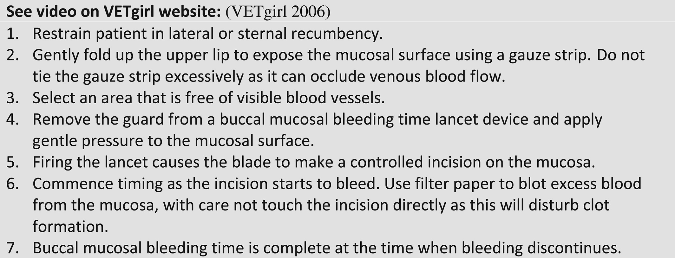
Abnormal platelet activity in dogs and cats – impact and measurement
Journal of Small Animal Practice, Volume: 61, Issue: 1, Pages: 3-18, First published: 09 January 2020, DOI: (10.1111/jsap.13092)
Notes:
Performing a buccal mucosal bleeding time
IF THIS IMAGE HAS BEEN PROVIDED BY OR IS OWNED BY A THIRD PARTY, AS INDICATED IN THE CAPTION LINE, THEN FURTHER PERMISSION MAY BE NEEDED BEFORE ANY FURTHER USE. PLEASE CONTACT WILEY'S PERMISSIONS DEPARTMENT ON PERMISSIONS@WILEY.COM OR USE THE RIGHTSLINK SERVICE BY CLICKING ON THE 'REQUEST PERMISSIONS' LINK ACCOMPANYING THIS ARTICLE. WILEY OR AUTHOR OWNED IMAGES MAY BE USED FOR NON-COMMERCIAL PURPOSES, SUBJECT TO PROPER CITATION OF THE ARTICLE, AUTHOR, AND PUBLISHER.

Slide 32
Treatment for vWD
Plasma products rich in vWF
Cryoprecipitate – concentrates fibrinogen, FVIII, vWF into a small volume
FFP
Fresh whole blood if the vWD is also profoundly anemic to provide RBCs and vWF
Avoidance of injury and drugs that can affect platelet function
Desmopressin acetate (DDAVP) – used to stimulate endothelial V2 receptors to release intracellular stores of vWF
  Type I vWD patients have some response
  Types II and III have little to no response
Notes:
Desmopressin acetate – synthetic analog of vasopressin with minimal vasopressor activity causes release of vWF from endothelial cells and release of FVIII from storage sites
Release of vWF and FVIII decreases over a 24-hour period with subsequent doses of DDAVP
There is an approximately 30% decrease seen with the second injection in humans
Repeated doses are more likely to cause tachyphylaxis
Peak onset of vWF release is expected to be within 10 minutes of IV injection and reported to last approximately 2 hours

Slide 33
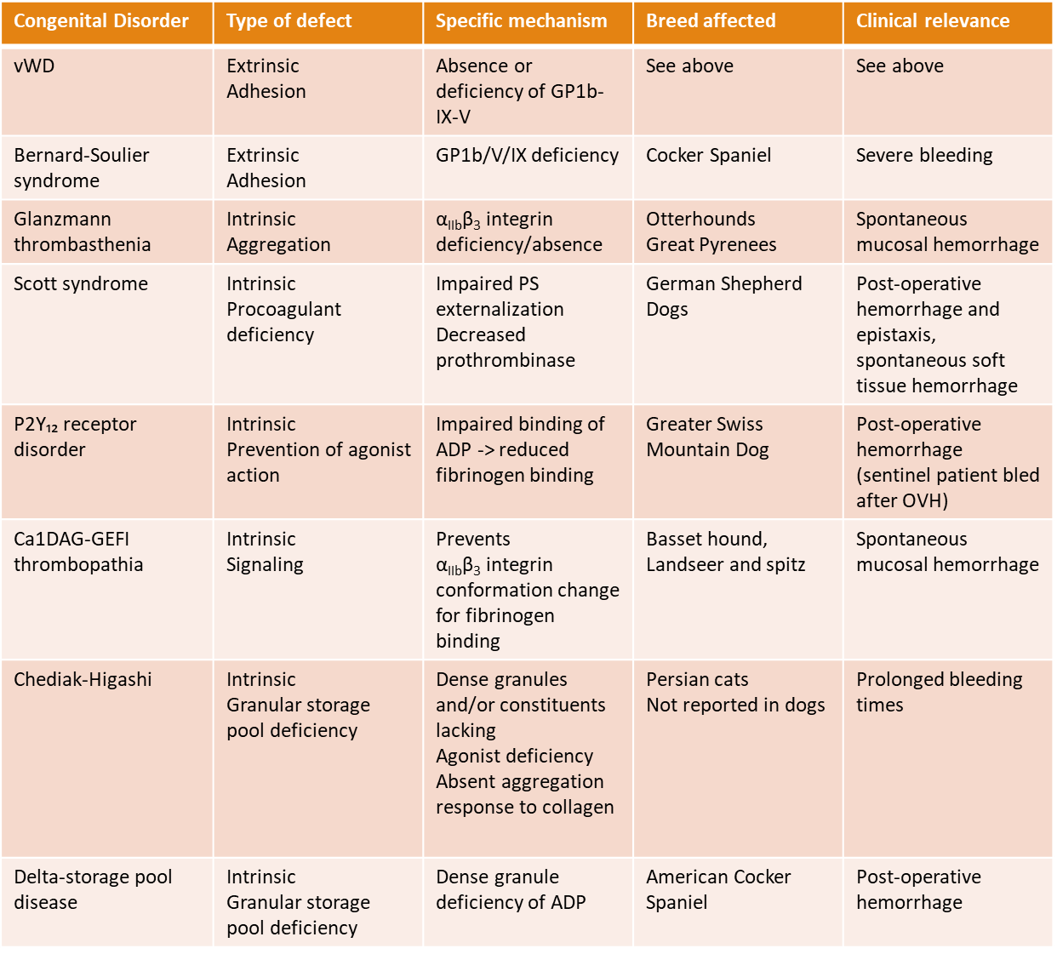
Platelet disorders

Slide 34
Congenital Disorder | Type of defect | Specific mechanism | Breed affected | Clinical relevance
vWD | Extrinsic Adhesion | Absence or deficiency of GP1b-IX-V | See above | See above
Bernard-Soulier syndrome | Extrinsic Adhesion | GP1b/V/IX deficiency | Cocker Spaniel | Severe bleeding
Glanzmann thrombasthenia | Intrinsic Aggregation | α_{IIb}β₃ integrin deficiency/absence | Otterhounds Great Pyrenees | Spontaneous mucosal hemorrhage
Scott syndrome | Intrinsic Procoagulant deficiency | Impaired PS externalization Decreased prothrombinase | German Shepherd Dogs | Post-operative hemorrhage and epistaxis, spontaneous soft tissue hemorrhage
P2Y₁₂ receptor disorder | Intrinsic Prevention of agonist action | Impaired binding of ADP -> reduced fibrinogen binding | Greater Swiss Mountain Dog | Post-operative hemorrhage (sentinel patient bled after OVH)
Ca1DAG-GEFI thrombopathia | Intrinsic Signaling | Prevents α_{IIb}β₃ integrin conformation change for fibrinogen binding | Basset hound, Landseer and spitz | Spontaneous mucosal hemorrhage
Chediak-Higashi | Intrinsic Granular storage pool deficiency | Dense granules and/or constituents lacking Agonist deficiency Absent aggregation response to collagen | Persian cats Not reported in dogs | Prolonged bleeding times
Delta-storage pool disease | Intrinsic Granular storage pool deficiency | Dense granule deficiency of ADP | American Cocker Spaniel | Post-operative hemorrhage

Slide 35
Acquired disorders
Uremia
  Prolonged mucosal bleeding times and delayed formation of the primary hemostatic plug
    Abnormalities due to defects in platelet adhesion, secretion, and aggregation
    Defects in vWF function (probably receptor binding) are thought to play a major role
    Uremic patients have been found to have normal or increased vWF levels but platelet function can be improved by transfusion of cryoprecipitate or administration of DDAVP
    Increased levels of NO and prostacyclin can alter vascular tone and platelet function
    Reduced ability to produce TXA₂
    Uremic toxins believed to act as direct platelet inhibitors by competing for receptor binding
    Many of platelet function defects can be reversed by dialysis

Slide 36
Acquired disorders
Anemia
Hepatopathy
Leptospirosis
Ehrlichiosis
IMT
Envenomation
Drugs

Slide 37
Inhibitors of Primary Hemostasis
Thromboxane inhibitors
  Aspirin – prototypical thromboxane inhibitor
  Platelets don’t contain nuclei – inhibit cyclooxygenase activity for the life of the platelet
  Irreversible acetylation of a serine residue of importance for COX system
  Normal function restored 5-10 days after a single dose of aspirin – new platelets produced daily so there is a gradual increase in function
  Aspirin also inhibits cyclooxygenase activity in endothelial cells
    Prostacyclin is the most potent endogenous platelet inhibitor and inhibits aggregation in response to all known agonists including thromboxane
    Endothelial cell COX recovers function after exposure to aspirin within hours
    Giving low dose aspirin thought to inhibit platelets but allow endothelial cells to continue to release prostacyclin due to their ability to create more cyclooxygenase

Slide 38
Antiplatelet drugs
ADP receptor antagonists
  ADP released from alpha-granules of activated platelets
  There are two ADP receptors on platelets
    P2Y₁ receptor – platelet shape change, mild, reversible aggregation
    P2Y₁₂ receptor – integrin activation, platelet granule secretion, ADP-induced thromboxane A₂ production
Thienopyridines
  Designed to interfere platelet aggregation through irreversible binding to the P2Y₁₂ receptor
  Prodrugs requiring hepatic biotransformation via hepatic P-450 enzymes
  Clopidogrel most commonly used in US

Slide 39
Questions?

