Slide 1
Pancreatitis, Vomiting, Ileus, and Drugs of the GI Tract
Trevor Chan, DVM

Slide 2
Pancreatitis

Slide 3
Categories
Acute - completely reversible inflammation after removal of inciting cause, can be recurrent
Chronic - fibrosis and other histopathological changes remain
Mild, moderate, severe
  Moderately severe acute pancreatitis (MSAP)
  Severe acute pancreatitis (SAP)
Notes:
Categories - acute, recurrent, chronic
Acute, recurrent - episodes of acute inflammation of the pancreas that can range in both severity and progression
mild/self-limiting
severe/fulminant with necrosis, SIRS/sepsis, multiorgan failure/death
Moderately severe acute pancreatitis (MSAP) and severe acute pancreatitis (SAP) comes with local complications of peripancreatic fluid collection, acute necrotic collection, pancreatic pseudocyst, or walled-off necrosis both sterile/infected
No current universally accepted classification scheme - revised human Atlanta 1992 scheme

Slide 4
Risk Factors
Dogs
Predispositions for fatal SAP
  Middle aged to older (5 years +)
  Mini Schnauzers, Yorkshire Terriers, Cocker Spaniels, Cavalier King Charles Spaniels, Collies, Boxers
  Overweight
  Concurrent endocrinopathies, other GI disturbances
  Drugs
  Hypertriglyceridemia in Mini Schnauzers
    >850mg/dL
  Dietary indiscretion, surgery
Cats
No BCS, dietary indiscretion, drug history predispositions identified yet
Hypotension during surgery
Surgical manipulation
Blunt trauma
Immune mediated
Concurrent processes
Notes:
Dogs - Any age, breed, sex, studies have been inconsistent for predisposition identifiers
Predispositions for fatal severe acute pancreatitis
Middle aged to older ( usually over 5 yo) Mini Schnauzers, Yorkies, Cockers, CKCS, Collies, Boxers
Overweight, other endocrinopathies (hyperadrenocorticism, hypothyroidism, diabetes mellitus), other GI disturbances
Drugs - KBr, phenobarbitol, azathioprine, L-asparaginase
Hypertriglyceridemia when over 850mg/dL is a risk factor for Mini Schnauzers
Dietary indiscretion/people food and surgery are risk factors
Cats - No age, sex or breed dispositions
No BCS, dietary indiscretion, drug history predispositions established in cats
Hypotension during surgery + surgical manipulation + biopsy are risk factors
FNA studies failed to show a relation
Blunt trauma + ischemia have been associated with AP
Some chronic pancreatitis cases respond to immunosuppressive therapy
Autoimmune pancreatitis in humans has two types
Type 1 = IgG-4 associated
Type 2 = chronic enteropathy
Concurrent processes - hepatic lipidosis, IBD, interstitial nephritis, diabetes mellitus, cholangitis/colangiohepatitis, IMHA
Unclear if they’re causal or risk factors. Just been found together

Slide 5
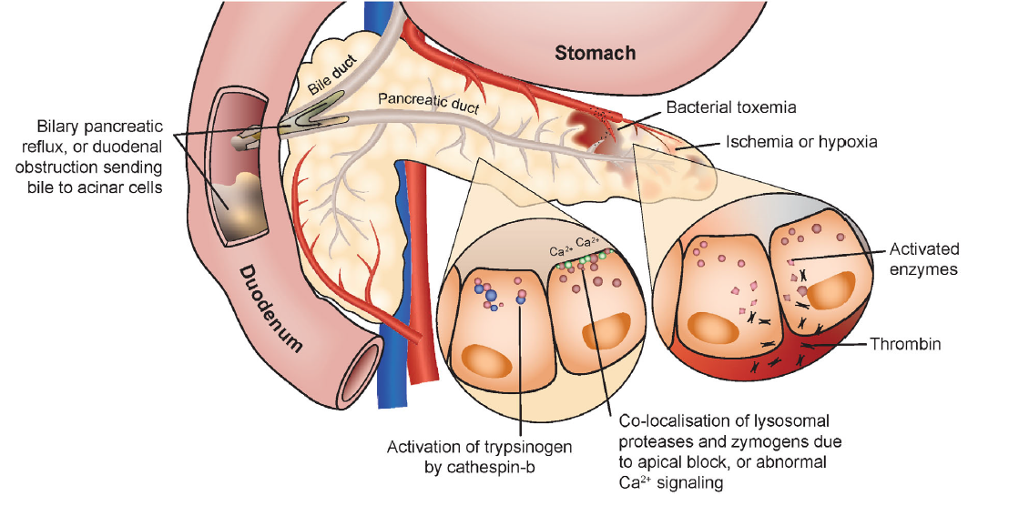
Pathophysiology
Forman MA, Steiner JM, Armstrong PJ, et al. ACVIM consensus statement on pancreatitis in cats. J Vet Intern Med. 2021;35:703–723. https://doi.org/10.1111/jvim.16053
Notes:
Dogs/cats - idiopathic with direct causal relationship difficult to demonstrate
Intrapancreatic activation of digestive enzymes which results in autodigestion
Within acinar cells, abnormal fusion of segregated lysosomes with zymogen granules can prematurely activate trypsinogen to trypsin which can activate other proenzymes
ACVIM - suspected abnormalities in calcium signaling causes these fusions/colocalizations which leads to acinar cell death and nuclear factor kappa B pathway.
Local ischemia, phospholipase A2, and reactive oxygen species disrupt cell membranes which can lead to pancreatic hemorrhage and necrosis, increased vascular permeability, and initiation of the arachidonic acid cascade
Hypoperfusion, thromboses, and bile can cause necrosis
Elastase - increased vascular permeability secondary to vessel wall elastin degradation
PLA2 can degrade surfactant, leading to pulmonary edema, ALI, and ARDS
Trypsin can activate the complement cascade -> increase in inflammatory cytokines, cells, and ROS
Kallikrein-kinin system activation -> vasodilation, hypotension, possible acute renal failure, coagulation and fibrinolytic pathways -> microvascular thromboses and DIC
Local inflammation increases pancreatic/peripancreatic microvascular permeability can causes fluid losses and stimulate further inflammatory cells and mediators (SIRS/MODS)
Extent of systemic inflammation depends on compensatory anti-inflammatory mechanism responses
Feline chronic panc - choleccystokinin and oxidative stress can damage acinar cells and lead to necrosis independent of trypsin activation
Calcium ion signaling and collapse of mitochondrial membrane potential
Pancreatic stellate cell stimulation can induce fibrosis
Liver/intestinal inflammation can upregulate inflammatory mediators, receptors, or both

Slide 6
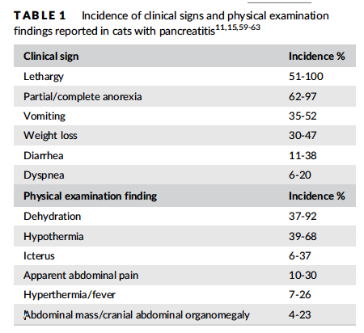
Clinical signs
Dogs
Hyporexia, anorexia
Lethargy, weakness
Vomiting, diarrhea
Dehydration
Abdominal pain and or distention
Icterus
Fever or hypothermia
Concurrent disease PE findings
Forman MA, Steiner JM, Armstrong PJ, et al. ACVIM consensus statement on pancreatitis in cats. J Vet Intern Med. 2021;35:703–723. https://doi.org/10.1111/jvim.16053
Notes:
Dogs - hyporexia/anorexia, lethargy/weakness/depressed, vomiting, diarrrhea
Dehydration, abdominal pain, icterus, fever/hypothermia, bleeding diathesis, ascites
Abdominal distention, decreased borborygmi due to peritonitis/ileus
PE with concurrent diseases (PU/PD with DM)
Cats - lethargy 51-100% hyporexia/anorexia 62-97%
Vomiting, weight loss, diarrhea less commonly
Abdominal pain 10-30%, but potentially underreported due to lack of detection, dehydration, pallor, icterus
Tachypnea, dyspnea, hypothermia/fever, tachycardia

Slide 7
Diagnostics
Hemogram
Hemoconcentration or anemia
Neutrophilic leukocytosis with left shift
Neutropenia
Thrombocytopenia
Coagulation panel
Prolonged PT/PTT
Elevated FDP/D-dimers
Chemistry
Elevated LE
Azotemia
Hyperglycemia, hypoglycemia
Hypocalcemia, hypomagnesemia
Hypokalemia, hypercholesterolemia, hypertriglyceridemia
Hypoalbuminemia
Notes:
CBC, Chem, UA can be nonspecific, but rule in/out concurrent diseases
CBC - neutrophilic leukocytosis with left shift, neutropenia, thrombocytopenia, maybe anemia/hemoconcentration (humans = more severe disease with hemoconcentration)
Potentially elevated LE/bilirubin - ischemic/toxic injury or concurrent disease
Azotemia due to prerenal - vomiting/diarrhea/hyporexia, renal disease
Hyperglycemia - stress, DM, hypoglycemia - hepatic dysfunction, SIRS/sepsis
Hypoglycemia associated with a poor outcome in cats due to acute necrotizing/suppurative pancreatitis
Hypocalcemia, hypomagnesemia (fat saponification) cats>dogs
Poorer outcome in cats
Hypokalemia, hypercholesterolemia, hypertriglyceridemia, hypoalbuminemia - GI losses, negative acute phase
Cats do not have hypertriglyceridemia
Hyperlipidemia can interfere with serum chemistry values
PT/PTT prolongations, elevated FDP

Slide 8
Clinical enzymology
Canine
Serum amylase activity 18.2-73.3%
Serum lipase activity 13.6-69%
Canine trypsin-like immunoreactivity (cTLI) 36.4-46.7% sensitivity
Canine pancreatic lipase immunoreactivity (cPLI) Spec cPL - 64-93% sensitivity depending on disease severity, 78% specificity
AUS by a board certified radiologist - 68%
Pancreatic Elastase-1
Feline
fTLI 28-64% - Associated with chronic enteropathy + GI lymphoma as well as decreased GFR
fPLI - 67-78-100% sensitivity for moderate to severe pancreatitis
SNAP fPLI - normal vs. elevated
AUS 11-67-80% sensitive
Notes:
Many circulating lipases (pancreatic, hepatic, gastric) all trying to hydrolyze triglycerides
Serum lipase/amylase can be elevated in azotemia, glucocorticoid administration - they can also be normal in pancreatitis cases, especially in cats
TLI - also increases with azotemia and feline GI disease
While it can be normal in pancreatitis cases it can be helpful in feline panc diagnosis with ultrasound
Not considered helpful in dogs
Pancreatic lipase leaks from acinar cells and enters circulation in larger than normal quantities during pancreatitis
Canine pancreatic lipase immunoreactivity (cPLI)
64-93% sensitivity depending on disease severit
78% specificity
cTLI (canine trypsin-like immunoreactivity) 36.4-46.7% sensitivity
Serum amylase activity 18.2-73.3%
Serum lipase activity 13.6-69%
AUS by a board certified radiologist - 68%
Feline
fPLI - 67-78-100% sensitivity for moderate to severe pancreatitis
fTLI 28-64%, AUS 11-67-80% sensitive
Associated with chronic enteropathy + GI lymphoma as well as decreased GFR
SNAP fPLI - normal vs. elevated
Normal - rule out pancreatitis
Elevated - equivocal, should be followed up with spec fPLI
Future markers - canine pancreatic elastase-1 for severe pancreatitis, not mild

Slide 9
Imaging
Radiographs
Ultrasound
Contrast-enhanced CT
MRI
Endoscopic retrograde cholangiopancreatography
Notes:
AXR - neither sensitive nor specific but can help build clinical suspicion
loss of cranial abdominal serosal detail in the right upper quadrant
Displacement of the descending duodenum to the right
Widened angle between proximal duodenum and pylorus with a caudal displacement of the transverse colon
Gastric distention, static gas patterns support ileus in descending duodenum and transverse colon
Also helps rule out other causes of acute abdominal pain
Mechanical obstruction/perforation
Feline - loss of serosal detail cranially, hepatomegaly, mass effect in cranial abdomen, small intestinal dilation
AUS - pancreas can appear enlarged, hypoechoic - edema/necrosis, with peripancreatic hyperechoic fat (inflammation/peritonitis)
Pancreatic duct dilation, thromboses, organ infarcts
Can identify focal peritoneal effusions, US guided FNAs
Duodenum can be dilated/corrugated (11-67% detection based on ultrasonographer skill and severity)
Can identify comorbidities involving intestines, liver, gallbladder
Contrast-enhanced CT - gold standard in human patients to identify necrosis and other localized complications
Can help guide US-FNA attempts
Feline CT - not especially sensitive for AP
MRI - T1 hyperintense, T2 iso to hypointense
10 cats - T1 hypointense, T2 hyperintense parenchyma
Dilated pancreatic ducts in 5
Enlarged pancreas 9
Peripancreatic hyperintensity 2
Endoscopic retrograde cholangiopancreatography - technically challenging, requires contrast fluoroscopy, not well established yet to assess biliary/exocrine pancreas

Slide 10
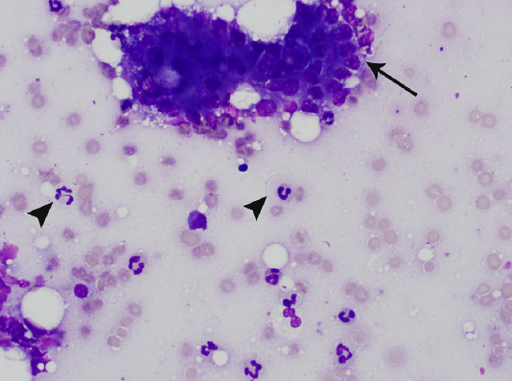
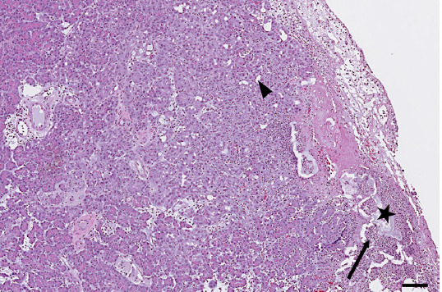
Cytology and Histopathology
Ultrasound-guided Fine Needle Aspirates
Abdominocentesis
Biopsy
Forman MA, Steiner JM, Armstrong PJ, et al. ACVIM consensus statement on pancreatitis in cats. J Vet Intern Med. 2021;35:703–723. https://doi.org/10.1111/jvim.16053
Notes:
Safe using 20-22G needle even in cats with pancreatitis
24/73 samples were nondiagnostic - need gentle pressure and quick smearing - digestive enzyme release will degrade acinar cells quickly
FNA - can be helpful to identify local complications including infections, necrosis, and disease progression monitoring
Acinar cells can be dysplastic - cytomegaly, karyomegaly, prominent nucleoli, increased cytoplasmic basophilia (pancreatic neoplasia rare in cats)
Inflammatory cells possible but can be highly localized and missed on FNA
Biopsy - can be clinically unnecessary, logistically dangerous for critically ill patients, and difficult to correlate with clinical severity and can miss focal complications
Abdominocentesis + cPLI + lipase in the effusion can help AP diagnosis
Modified transudate/exudate with blood, mineral, free lipid
Degenerate neutrophils and activated macrophages with vacuoles/hemosiderin
Cytology - cluster of acinar cells with erythrocytes and nondegenerate neutrophils - suppurative pancreatic inflammation
Histopath - fat necrosis @ star, focal suppurative inflammation at the arrow with early focal acinar to ductal metaplastia at arrowhead

Slide 11
Treatment
Resuscitation, Fluid Therapy, Monitoring
Judicious Calcium Supplementation
Vasopressors
Oxygen supplementation
Transfusions
Notes:
Resuscitation, Fluid Therapy, Monitoring
Early rehydration can improve pancreatic perfusion and oxygen delivery which would limit tissue damage
Duration of clinical signs before hospital presentation is directly proportional to the odds of death
Severe disease can present as hemodynamically unstable
Human AP - LRS decreases systemic inflammation vs. normal saline at 24h
Fluid needs can be substantial with potential dehydration from vomiting, third spacing into peritoneal cavity, GI tract, interstitium
Serial reassessment of electrolytes/acid base status necessary in the beginning
KCl supplementation
Calcium supplementation can exacerbate free radical production and cellular injury - only supplement with muscle fasciculations seen
Colloids can help reduce crystalloid volume needed, can help improve microvascular perfusion and maintain overall intravascular volume
Serial monitoring for overhydration
Vitals, BP, CVP, urine output, PCV/TS, VBG/electrolytes, BG, albumin, lactate
PE, mentation, ECG
Pressors - experimental feline AP used low dose dopamine (5mcg/kg/min) which reduced microvascular permeability and pancreatic inflammation
Transient improvement on pancreatic perfusion (study showed improvement within 12 hours of experimentally induced pancreatitis in cats)
Dopamine may induce vomiting
Norepinephrine, vasopressin, epinephrine
Oxygen supplementation
Hypovolemic shock, respiratory abnormalities
Evaluate for ALI/ARDS, aspiration pneumonia, pleural effusion, PTE, overhydration, pre-existing cardiopulmonary disease
Metabolic acidosis, pain, hyperthermia - tachypnea
Significant anemia - pRBC transfusion - disease process vs. serial sampling from cats/small dogs
FFP - severe acute pancreatitis cases can potentially benefit from alpha 2 macroglobulins which contain protease inhibitors (canine)
Depletion lead to rapid decompensation/death
Human studies and canine retrospectives haven’t found clinical improvement of survival rates
Coagulopathies -> DIC

Slide 12
Treatment
Pain Management
Opioids
Ketamine
Lidocaine
Avoid NSAIDs
Tramadol
Gabapentin
Cerenia
Nutrition
Within 24 hours
Jejunostomy tube
Nasogastric tube
Esophagostomy tube
Low volume/trickle feeding
Parenteral nutrition
Appetite stimulants
Notes:
Pain Management
Helps decrease stress hormones, improve ventilation, may even help with GI ileus due to pain
Full mu opioid, low dose ketamine/lidocaine
Lidocaine may help with severe ileus due to promotility effects
Avoid NSAIDs, maybe epidurals/intraperitoneal analgesia
Cats - buprenorphine may suffice or escalate to full mu
Tramadol, gabapentin can be additional when combined with bup/cerenia PO as an outpatient therapy
Nutrition
Start enteral nutrition early - within 24 hours
Improves gut mucosal structure and function
Decreased bacterial translocation
Improves gastrointestinal bloodflow
Shorter duration in hospital
Mild panc cats may eat on their own with supportive care - avoid long term diet due to feline hospitalization food aversion
Theoretically a jejunostomy tube will circumvent exocrine pancreatic stimulation
Logistically difficult due to the need for GA and special equipment
Humans naso-jejunal feedings had no improved outcome
Nasogastric/Etubes
Low volume enteral nutrition (trickle feeding, microenteral nutrition) for patients with severe ileus/intractable vomiting
Consider partial or total parenteral nutrition when enteral nutrition not possible
Glutamine and B12 supplementation seem to be helpful as well, though more elemental/partial elemental diets still need to be studied for the ideal composition
Appetite stimulants
Mirtazipine - adverse effects of agitation but can be an antiemetic
Capromorelin PO has been studied in healthy cats and cats with CKD

Slide 13
Treatments
Gastrointestinal protectants
Anti-emetics
Promotility agents
Primary disease or comorbidity treatments
Antibiotics
Corticosteroids
Notes:
Other Supportive Care
GI protectants, thermal support, physical therapy
Anti-emetics, promotility agents
Maropitant - neurokinin 1 (NK1R) antagonist
Blocks substance P from binding in the vomiting center, CRTZ, and GI tract
Visceral analgesic, anti-inflammatory activity
Ondansestron - 5HT3 receptor antagonist to block serotonin induced stimulation of vagal afferent activity
Metoclopramide CRI may be contraindicated due to dopamine antagonism
Compounded cisapride PO recommended
Erythromycin
Primary disease process treatments
ABX therapy
Prophylactic therapy not recommended
Humans with SAP - increased risk of infection with over 30% necrosis, infection usually happens later in the disease progression and is associated with MODS/death
Usually a sterile process - save for suspected/documented infection/sepsis
Corticosteroids
May have beneficial anti-inflammatory properties including pancreatitis-associated protein production which can limit inflammation
Critical illness related corticosteroid insufficiency
Concurrent diseases - chronic enteropathy, sterile cholangitis
Not enough data - DM, heart disease in cats, and no studies in cats yet so routine use not recommended

Slide 14
Treatments and Outcome
Respiratory complications
Surgery
Outcome
Potentially more flare-ups, complications
Mortality 9-41% over 4 studies
Low iCa, hypoglycemia, azotemia - negative prognostic indicators
Notes:
Respiratory complications
tachypnea/dyspnea can be due to pleural effusion or pulmonary edema to ALI/ARDS, volume overload, CHF, asp pneu, PTE, pain
Thoracocentesis for fluid analysis, CXR, echo
Sx
Infected pancreatic necrosis
Extrahepatic biliary obstruction
Failed medical management
Human medicine is starting to pull back on early surgical intervention
Helps fully declare healthy vs. necrotic tissue
US guided draining of pancreatic pseudocysts, cholecystocentesis
Outcome
Potentially more flare ups in the next weeks/months
Investigate for pancreatic pseudocysts, walled off necrosis, EHBDO
DM, chronic pancreatitis, EPI
Mortality 9-41% over 4 studies
mild/moderate - good prognosis
Severe acutte panc with complications/comorbidities are guarded/grave
Low plasma ionized calcium, hypoglycemia, azotemia - negative prognostic indicators

Slide 15
Vomiting

Slide 16
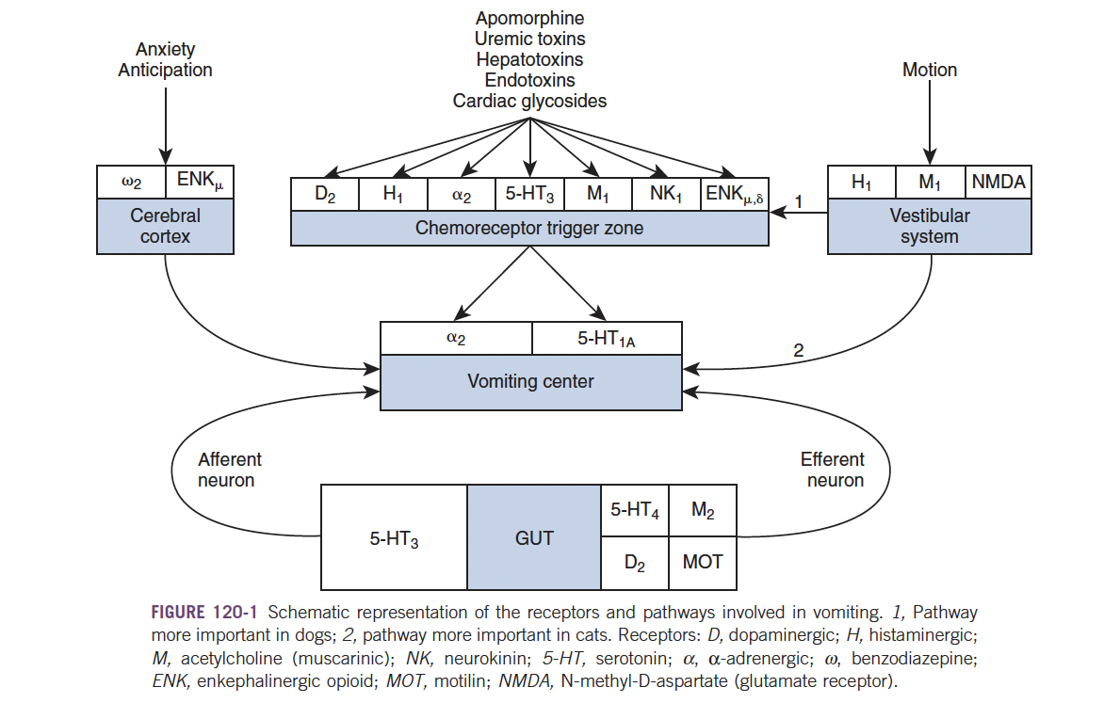
Physiology
Silverstein, D., 2015. Small animal critical care medicine. St. Louis, Mo.: Elsevier, Saunders, p.637.
Notes:
Physiology
Vomiting center in the medulla
Vagal and sympathetic afferent nerves from GI tract transmit impulses to MVC due to overdistention or stimulation
Vestibular system, cerebrum, chemoreceptor trigger zone in the area postrema on the floor of the fourth ventricle - incomplete blood brain barrieer
CRTZ sensitive to drugs, toxins in the blood
Intestinal anti-peristalsis
Deep inspiration, strong diaphragmatic contraction with abdominal wall muscles and relaxation of the lower esophageal sphincter

Slide 17
Consequences of Vomiting
Dehydration
Acid-base disturbances
Aspiration pneumonia
Notes:
Dehydration (reduction of intake, excessive losses)
Acid base disturbances - hypochloremic metabolic alkalosis
Stomach contents have hydrogen and chloride ions
Most common acid-base for dogs with GI FB’s regardless of location
Chronic vomiting - metabolic acidosis from dehydration/mixed disturbances
Hypokalemia
Aspiration pneumonia - hopefully reflex glottis closure minimizes this risk during emesis
Brachycephalics, dogs with impaired laryngeal function, impaired neurologic status

Slide 18
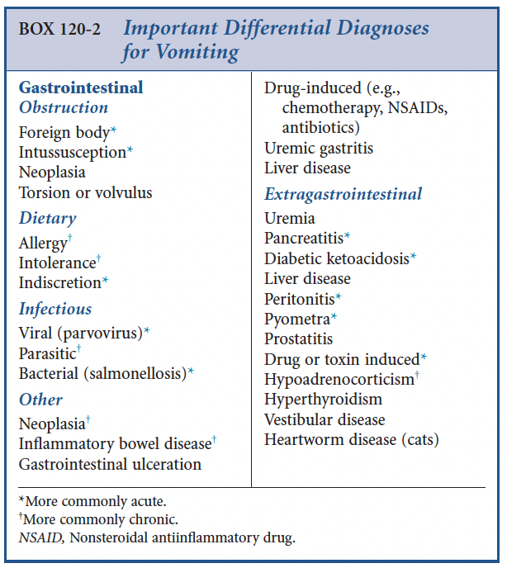
Building to a Diagnosis
History
Physical Exam
Silverstein, D., 2015. Small animal critical care medicine. St. Louis, Mo.: Elsevier, Saunders, p.637.
Notes:
History
Vomiting vs. regurgitation vs. cough/hacking with terminal retch
Onset, duration, frequency, content, diet, exposure, blood, coffee grounds, bile, hx
PE
Abdominal palpation - localize pain, organomegaly, fluid wave, FB
Mouth - ketosis, uremia, FB anchoring
Neck - thyroid slip
Rectal - hematochezia, prostatomegaly/pain, worms
Thoracic auscultation - inspiratory crackles (aspiration pneumonia)

Slide 19
Clinical Pathology
QATs
Venous Bloodgas
CBC
Chemistry
Urinalysis
Fecal
Notes:
CBC, Chem - screening for extra GI causes; normal can localize to primary GI
VBG, PCV/TS - electrolyte imbalances, dehydration
UA, USG - prerenal vs. renal
Fecal - giardia, hookworm, coccidia screen with Zinc sulfate floatation, potentially for selective bacteria culture

Slide 20
Imaging
Abdominal Radiographs
Ultrasound
Chest Radiographs
Notes:
AXR - acute vomiting rule out FB obstruction
AUS - more accurate with an experienced ultrasonographer
Equivocal AXR, serial monitoring
Identify neoplastic obstructions, extra GI evaluation
Better for chronic vomiting dogs - evaluating intestinal wall thickness and other abdominal structures
CXR - aspiration pneumonia, esophageal disease, metastatic screening, heart and vessel assessment

Slide 21
Treatment
Primary disease
Correct electrolyte derangements and acid/base disturbances
Supportive care
Anti-emetics
Gastrointestinal protectants
Fasting
Nutrition
Notes:
Treat primary disease
Correct electrolyte/acid-base disturbances
Keep vomiting under control when appropriate
Anti-emetics, GI protectants when appropriate
Fast for 24 hours - allow GI tract to rest/avoid stimulation and reduce aspiration pneumonia risk
Consider feeding tubes or parenteral nutrition

Slide 22
Ileus

Slide 23
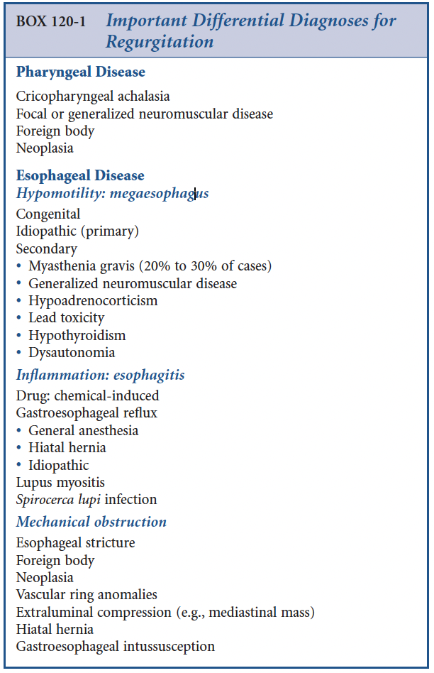
Regurgitation
Clinical consequences - aspiration pneumonia
Differential Diagnoses
- idiopathic is the most common in adult dogs
- Focal myasthenia gravis, hypothryoidism
Silverstein, D., 2015. Small animal critical care medicine. St. Louis, Mo.: Elsevier, Saunders, p.635.
Notes:
Aspiration pneumonia is proven to be a significant negative prognostic indicator for megaesophagus dogs
Every step should be taken to minimize aspiration chances
Change in feeding protocols, anesthetic protocols, and persistent head elevation attempts.
Congenital - Wire-haired Fox Terriers, Miniature Schnauzers, German Shepherd Dogs, Great Danes, Irish Setters, Labrador Retrievers, Newfoundlands, and Shar Peis
Siamese cats, but feline congenital megaesophagus is rare
Distention sensitive vagal afferent system that innervates the esophagus is defective
Acquired - German Shepherd Dogs, Golden Retrievers, Irish Setters, Abyssinians, Somali cats
Delayed esophageal maturation - esophageal dysmotility without megaesophagus in young terriers
Peripheral neuropathy dogs are at increased risk of developing megaesophagus
Laryngeal paralysis, myasthenia gravis, esophagitis, chronic/recurrent GD +/-Volvulus

Slide 24
History and Physical Exam
Hunt for esophagitis etiologies
Systemic signs can lead to primary etiologies that induce esophageal disease
Cough, dyspnea, fever
Thorough neck palpation
Thoracic auscultation
Notes:
History
Access to drugs, caustic substances, recent anesthesia, doxycycline
Hard swallowing, lip smacking
Attempts to eat regurgitant
Systemic signs
Primary disease
Aspiration pneumonia
PE
Search for masses, pain, potentially esophageal dilation?
Crackles vs. sloshing fluid in esophagus

Slide 25
Diagnostics
Clinical pathology - CBC, Chem
Thoracic radiographs, Contrast study, Endoscopy
Abdominal ultrasound usually unhelpful
Acetylcholine receptor antibody assay, ACTH stim, antinuclear antibody
Serum creatinine phosphokinase activity, lead levels, thyroid panel
Electromyography, nerve conduction velocity
Muscle and nerve biopsy
Notes:
Bloodwork can either catch systemic disease or be unremarkable with uncomplicated idiopathic megaesophagus
CXR - diagnostic for FB obstruction, aspiration pneumonia, mediastinal masses, vascular ring abnormalities
If these radiographs are negative, a contrast study or endoscopic investigation would be the next steps for regurgitating animals
Abdominal ultrasound rarely provides useful information
Addisonian dogs with megaesophagus usually have electrolyte derangements and other systemic signs
Thyroid testing can also be done though hard evidence linking hypothyroidism and megaesophagus

Slide 26
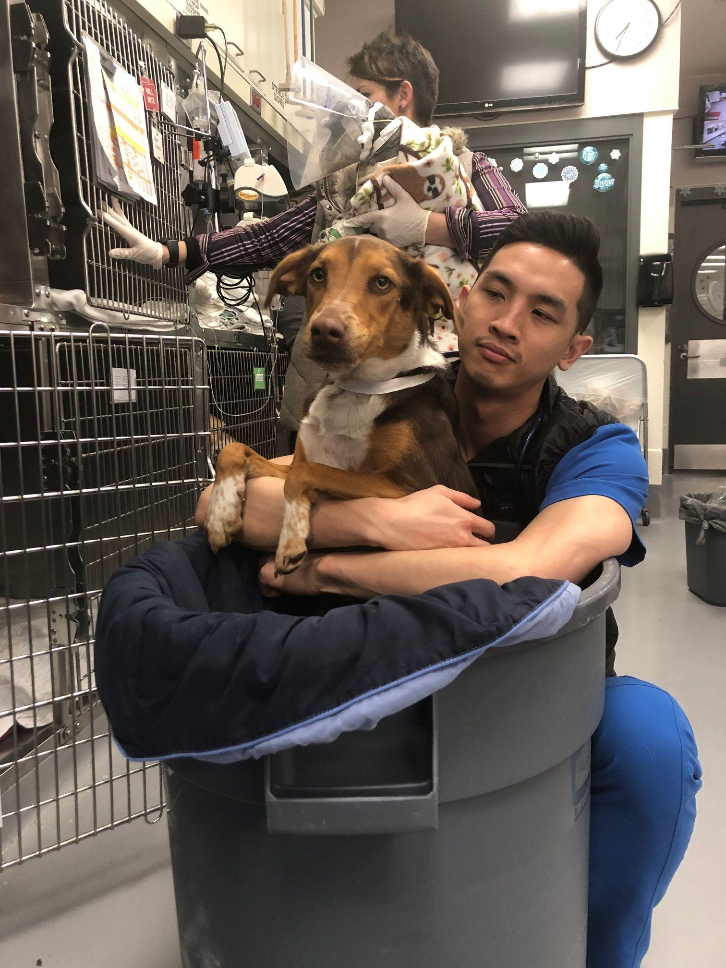
Treatment
Without concurrent disease, usually can be outpatients
Reduce esophagitis with PPI, H2R antagonist
Treat esophagitis with sucralfate
Prokinetics not shown to be beneficial, even potentially harmful
Bethanecol
Myasthenia gravis - pyridostigmine, prednisone, azathioprine
  Bailey chair, nutritional support
  G tube
Aspiration pneumonia
Antibiotics, oxygen support
Nutrition
Notes:
Empiric treatment with histamine 2 receptor antagonist, proton pump inhibitor to reduce secondary esophagitis
Canine esophagus is 100% striated muscle so metoclopramide/cisapride are not beneficial. Can tighten lower esophageal sphincter which would prevent food from reaching the stomach
Bethanechol - parasympathomimetic anecdotally may help
Nutrition - high calorie diet in small frequent meals in an upright position
Though a hard diet is usually chosen, a more liquid ration may help some patients regurgitate less
May need to consider a gastrostomy tube temporarily or permanently as needed

Slide 27
Prognosis
Congenital idiopathic megaesophagus - fair prognosis
Potentially can improve esophageal motility with supportive care and time
Acquired idiopathic megaesophagus - poor prognosis
Megaesophagus/regurgitation with a specific underlying disease may fare better with committed owners

Slide 28
Gastric Emptying Disorders
Rule out mechanical obstruction
Defective propulsion
Pump failure theory
Excessive feedback theory
Differential Diagnoses
Infectious, inflammatory, ulcers, post-surgical, electrolyte abnormalities, metabolic derangements, drugs, peritonitis, trichobezoars
Notes:
Etiology/CS
Rule out mechanical obstruction
Defective propulsion - abnormalities in myenteric neuronal or gastric smooth muscle function of antropyloroduodenal coordination
Theories (JVECC)
Primary motor dysfunction (pump failure theory)
Decreased antral motility and display of the fasting motility pattern during feeding
Disproportionate activation of an inhibitory feedback pathway from the proximal small intestine (excessive feedback)
Nutrient release of neuroendocrine peptides like cholecystokinin and serotonin which inhibit vagal and spinal afferent neurons
This theory is recently supported by the study of increased fasting and nutrient stimulated plasma CCK concentrations in critically ill human patients with delayed gastric emptying
Cats - hairballs can be caused by, and cause gastric obstruction/disturbed motility
infectious/inflammatory diseases, ulcers, post-surgical gastroparesis
Electrolyte abnormalities, metabolic derangements, drugs (cholinergic antagonists, adrenergic and opioid agonists), peritonitis

Slide 29
Consequences and Clinical Signs
Limited enteral nutrition
Depleted caloric reserves
Impaired wound healing
Decreased immune function
Increased morbidity and mortality
Weight loss
Chronic intermittent vomiting more than 8 hours post-prandial
Notes:
Consequences - limited enteral nutrition, deplete caloric reserves, impair wound healing, decrease immune function, and increase morbidity/mortality
CS - chronic, intermittent vomiting that occurs more than 8 hours after eating
Weight loss

Slide 30
Diagnosis and Treatment
Imaging Studies
Radiographs
Barium contrast
Fluoroscopy
BIPS
Endoscopy
Dietary management
Gastric prokinetics
Notes:
Imaging studies - survey films, barium contrast studies, fluoroscopy can document delayed gastric emptying
Barium impregnated polyspheres (BIPS) can be administered to observe passage of different sized beads
Endoscopy can rule out gastritis/obstructive disease
Functional disorder presumptive if endoscopy negative
Tx - dietary management of frequent small meals low in fat/protein, high carbs (cottage cheese, rice, pasta), gastric prokinetic agents

Slide 31
Small intestinal transit disorders
Old theory vs. new theory
Differential Diagnosis
Enteritis
Post-surgical ileus
Nematode impaction
Intestinal sclerosis
Radiation enteritis
functional/pseudo-obstruction due to hypomotility (idiopathic)
Notes:
Old theory for functional ileus involved paralysis and decreased motor activity of the muscularis layer
New theory for functional ileus involves a loss of synchronized coordination and dysfunctional peristalsis
Failure to transition from digestive to interdigestive migrating motor complex movements
Results in lack of borborygmi, accumulation of gas and fluid in the bowel with consequently abdominal distention
Inflammatory mediators are also suspected to play a role in ileus
Neutrophils can damage the muscularis layer by releasing proteolytic enzymes and cytokines -> releases nitric oxide which paralyzes the muscularis cells and induces stasis
DDX- enteritis, post-surgical ileus, nematode impaction, intestinal sclerosis, radiation enteritis, functional/pseudo-obstructions due to hypomotility/ileus (idiopathic)

Slide 32
Clinical Signs, Complications, Diagnosis, Treatment
Clinical signs - vomiting, diarrhea, weight loss, abdominal pain/distention
Complications - bacterial overgrowth, endotoxemia/septicemia
Diagnostics
Radiographs, contrast study, BIPS, CBC, Chem
Treatment
Steroids, antibiotics as indicated
Notes:
Complications - bacterial overgrowth, endotoxemia/septicemia
CS - vomiting, diarrhea, weight loss, abdominal pain/distention
Diagnosis/treatment
Radiographs - dilated intestinal loops without obstruction
Contrast study/BIPS
CBC - usually normal, Chem - protracted vomiting/diarrhea changes
Rule out mechanical obstructions before prokinetics
Steroids/antibiotics as indicated

Slide 33
Megacolon
Differential Diagnoses - idiopathic, pelvic canal stenosis, dysautonomia, nerve injury, Manx sacral spinal cord deformities, generalized dysfunction of colonic smooth muscle
Clinical signs
Diagnosis - PE, rectal exam, CBC/Chem, Radiographs
Treatment - diet, enemas, laxatives, colonic prokinetics, surgery
Notes:
Etiology/CS
Idiopathic megacolon +/- constipation/obstipation is common for middle aged cats
Pelvic canal stenosis, dysautonomia, nerve injury, Manx sacral spinal cord deformities
Generalized dysfunction of colonic smooth muscle
CS - reduced/absent/painful defecation
Frequent, painful unproductive attempts to posture, potentially passing dry/hard feces +/- hematochezia
Anorexia, vomiting, weight loss
Diagnosis/Treatment
PE - abdominal palpation, weight loss, abdominal pain, dehydration, mesenteric lymphadenopathy
Rectal - pelvic fractures, rectal diverticula, neoplasia
CBC/Chem - normal, dehydration, hypokalemia, hypocalcemia
AXR - document fecal impaction and exacerbating factors like bone/foreign material
Tx - mild/moderate - dietary modification, enemas, laxatives, colonic prokinetics
Subtotal colectomy with preservation of ileocolic junction for refractory medical management cases
Good recovery, mild/moderate diarrhea for weeks to months

Slide 34
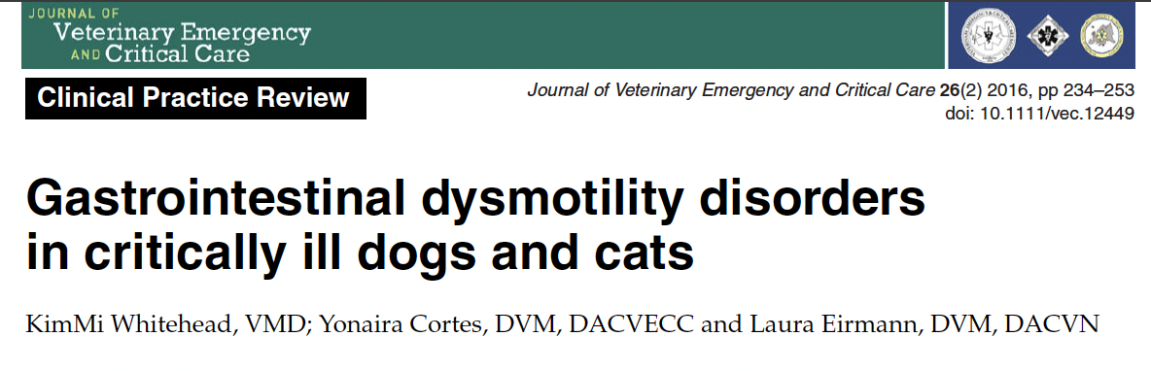
Gastric Residual Volumes
Treatment strategies
Notes:
Gastric Residual Volumes
Association between pulmonary aspiration and gastric residual volumes is inconsistent
Intermittent vs. CRI enteral nutrition in critically ill dogs showed no association between gastric residual volumes, occurence of vomiting/regurgitation, or incidence of aspiration pneumonia
Difficult to use GRV as a guidance for enteric nutrition treatment strategy until further studies
Therapeutic strategies
Treat the underlying illness
Early nutritional intervention
Judicious fluid therapy
Too much can induce mucosal edema which impairs gut function, increased permeability, increased residual intestinal stress
Potentially increased nuclear factor kappa B and increased expression of inducible NO production leads to decreased contractility/rigidity in the smooth muscle
Hypertonic saline has been shown to alter hydraulic conductivity, decrease intestinal edema, and improve overall GI transit
Early ambulation
No studies in human medicine show strong correlation, but it’s associated with decreased post-op respiratory and thrombotic complications
Correction of metabolic derangements, normothermia maintenance
Pain management and other pharmacological interventions
Pure mu’s have variable levels of ileus and analgesia
Morphine under analgesic plasma levels will induce ileus but fentanyl is more even
Consider indwelling epidurals and NSAIDs sparingly

Slide 35
Drugs of the GI tract

Slide 36
Prokinetic Drugs
Enteric nervous system
Can function independently from the CNS - no nerve fibers directly innervate intestinal epithelium
Enterochromaffin cells (enteroendocrine cells act as sensory transducers)
Serotonin
  95% in GI tract, 90% of which is in enterochromaffin cells
5-HT1P
5-HT3
5-HT4
Notes:
Enteric nervous system of the GI tract can function independently from the central nervous system
No nerve fibers directly innervate intestinal epithelium - relies on enteroendocrine cells - enterochromaffin cells as sensory transducers
95% of body’s serotonin in GI tract, 90% of which is in enterochromaffin cells
Remainder in ENS as a neurotransmitter
Enterochromaffin cells secrete serotonin into intestinal activity based on 5-HT subtypes
5-HT-1P initiates peristaltic and secretory reflexes - no medications target this receptor
5-HT3 - extrinsic sensory nerves, responsible for nausea and vomiting from visceral hypersensitivity
ondansetron/granisetron antagonize these receptors
5-HT4 receptor stimulation increase presynaptic release of acetylcholine and calcitonin gene-related peptide to enhance neurotransmission to promote propulsive peristalsis and secretory reflexes

Slide 37
Cisapride
5-HT4 Receptor agonist
Doesn’t cross the blood-brain barrier
Broader prokinetic activity than metoclopramide
Elimination via cytochrome P450 enzymes
Adverse effects in humans
Compounded now - variable efficacy
Notes:
Cisapride stimulates these receptors in conjunction with a need for natural stimulus for peristaltic/secretory reflexes
Not possible to induce perpetual/excessive motility
Not effective if enteric nerves are damaged/degenerate/nonfunctional
Cisapride
Similar to metoclopramide but does not cross the BBB or have anti-dopaminergic effects
No anti-emetic effects, no extrapyramidal signs
More potent, broader prokinetic activity
Uses - gastric stasis, idiopathic constipation, gastroesophageal reflux, postoperative ileus, megacolon
Adverse effects - humans experienced increased defecation, headache, abdominal pain, cramping, flatulence, heart rhythm disorders/death
Elimination - cytochrome P450 enzymes - concurrent drugs that utilize the same elimination raised the cisapride levels
Erythromycin, fluconazole, itraconazole
Compounded - lack standardized products so efficacy can vary
2.5-5mg/cat PO BID-TID
New formulations - mosapride - prokinetic/anti-ulcerogenic properties - not currently available in the US

Slide 38
Metoclopramide
Central dopaminergic antagonist
Peripheral 5-HT3 receptor antagonist
Peripheral 5-HT4 receptor agonist
Extrapyramidal signs
Notes:
Central dopaminergic antagonist, peripheral 5-HT3 receptor antagonist, 5-HT4 receptor agonist
Readily crosses the BBB - dopaminergic antagonist on CRTZ as anti-emetic
Striatum (caudate/lentiform nuclei) - extrapyramidal signs
Involuntary muscle spasms, motor restlessness, aggression
Restore proper dopamine/Ach balance with anti-cholinergic diphenhydramine
Increases lower esophageal tone, stimulates gastric contractions, relaxes pylorus and duodenum

Slide 39
Motilin Receptor Agonists
Macrolide antibiotics
Erythromycin, Clarithromycin, Azithromycin
Dogs - 5-HT3 pathway
Cats - direct motilin receptor stimulation
Mitemcinal - erythromycin derived motilin agonist
Notes:
Macrolide antibiotics - erythromycin/clarithromycin/azithromycin - motilin receptor agonists
Microbially ineffective doses - stimulate motility
Stimulate migrating motility complexes and antegrade peristalsis in proximal GI tract
Cholinergic and non cholinergic neuronal pathways to increase motility
Dogs 5HT3 cholinergic pathways
Cats direct stimulation on smooth muscle motilin receptors
Erythromycin - increases gastroesophageal sphincter pressure in dogs and cats
Increases gastric emptying rates in normal dogs but can let undigested food proceed to duodenum prematurely
Dog colonic transit acceleration
0.5-1mg/kg PO/IV BID-TID
Some concern for a tolerance with sustained use of the drug
Mitemcinal - motilin agonist derived from erythromycin
Still in development for human diabetic gastroparesis

Slide 40
Acetylcholinesterase inhibitors/H2R Antagonists
Ranitidine (Zantac)
Nizatidine
Cimetidine
Famotidine
Notes:
Ranitidine (Zantac), Nizatidine are histamine H2R antagonists that are prokinetics in addition to gastric acid secretion inhibitors
Acetylcholinesterase inhibition in the proximal GI tract, increasing Ach that can bind to smooth muscle muscarinic cholinergic receptors
Ranitidine has less cytochrome P450 interferences than cimetidine and nizatidine has none, so there is a wide therapeutic index
Histamine-2 receptor antagonists
Cimetidine, ranitidine, famotidine
MOA - Block gastric parietal cell H2R, competitive inhibitors of gastric acid secretion
Maximal effect is immediate on therapy
Nizatidine, ranitidine may have gastric prokinetic activity (anti-Ach activity)
Ranitidine is ineffective in preventing GA gastroesophageal reflux
Oral cimetidine absorption impaired by food
First pass hepatic metabolism - fam, ranit, cimet
Cimet/ranitid - liver metabolized
Famot/nizat excreted unchanged by the kidneys
Cimet markedly inhibits hepatic p450 enzymes, can lessen acetaminophen intoxication severity, lowers hepatic blood flow by 20%
Theophylline, lidocaine, metronidazole
famotidine/nizatidine no effect, ranitidine small effect
Side effects - CNS aberrations, thrombocytopenia in humans

Slide 41
Proton Pump Inhibitors
Omeprazole, pantoprazole, lansoprazole, esomeprazole, dexlansoprazole
Irreversibly inhibits hydrogen-potassium adenosine triphosphatase on the luminal side of the parietal cell
2-5 days for peak effects
Side effects - diarrhea, p450 inhibition, decreased drug clearance/absorption
Notes:
Omeprazole, pantoprazole, lansoprazole, esomeprazole, dexlansoprazole
Pant, lans, esom can be given IV
Dexlansoprazole can be given with food and dual delayed-release system
MOA - irreversibly inhibits hydrogen-potassium adenosine triphosphatase on the luminal slide of the parietal cell, stopping secretions of hydrogen ions into the gastric lumen
Omeprazole - prodrug, susceptible to gastric acid, needs to be coated and passed to duodenum on an empty stomach and suffers first pass through the hepatic system. Then it makes its way to the acidic parietal cells and transformed into the active drug (1 hour before feeding)
2-5 days before maximal acid secretion suppression
Still better than H2RAs in the initial phase with lingering effects when ceased
Side effects - diarrhea, omeprazole/esomeprazole inhibit P450
Decreased antiplatelet activity by clopidogrel, decreased diazepam clearance, increased LE, hypomagnesemia in humans
Oral gastric pH increase can affect other drug absorption (ketoconazole, digoxin)
pantoprazole/rabeprazole have in vitro giardia, trichomonas efficacy, unclear if its in vivo

Slide 42
Sucralfate
Octasulfate of sucrose with aluminum hydroxide
Binds to epithelial cells in acidic environment of the stomach
Stimulates local prostaglandin and epidermal growth factor
Side effects - medication absorption inhibition, constipation
Notes:
Octasulfate of sucrose with aluminum hydroxide
Binds to epithelial cells in an acidic environment of the stomach - base of ulcers/erosions for up to 6 hours
Protective against pepsin/bile acids
Stimulates local production of prostaglandins and epidermal growth factor to help with mucosal repair
Side effects - lack of medication absorption, constipation

Slide 43
Prostaglandin Analogues
Prostaglandin E1 analog
Acts directly on parietal cells to block acid secretion
Fast absorption without food, first pass, short half life
Adverse effects - stomach cramps, diarrhea, uterine contractions, abortions
Notes:
Misoprostol - prostaglandin E1 analog
Antacid, mucosal protective properties (stimulates bicarbonate, mucus, increases gastric mucosal blood flow)
Acts directly on parietal cells to block both nocturnal acid secretion and secretions in response to food, pentagastrin, histamine
Without food, its fast absorption is subjected to first pass hepatic
Short half life, needs q8-12h administration
Adverse effects - stomach cramps, diarrhea(colonic promotility), uterine contractions/abortions

Slide 44
Lafutidine
Nitric oxide mediated and histamine independent mechanism of action
Mucosal protection
Potential intestinal protective activity
Superior to lansoprazole in one study
Notes:
via capsaicin sensitive sensory nerves

Slide 45
Complications
Increasing gastric acid pH
Innate defense against bacteria
Aspiration pneumonia
C.dificile

Slide 46
Antiemetics - Maropitant
Neurokinin 1 receptor antagonist
Bone marrow hypoplasia in puppies under 11 weeks
Extensive first pass - double the oral dose, bioavailability 90% SQ vs 23-37% PO
Secondary effects
Notes:
Maropitant - NK1 receptor antagonist
Blocks substance P in the central nervous system and GI tract
Stings during injection
Bone marrow hypoplasia in puppies under 11 weeks old
Extensive first pass, bioavailability is 90% SQ, 23-37% PO
Secondary effects
Potential anti-inflammatory, neuroprotectant, hepatoprotectant
Anti-diarrheal in chemo patients, maybe anti-tumor activity
Reduced visceral pain in dogs/cats, reduced MAC of sevoflurane GA

Slide 47
5-HT3 Receptor Antagonists
Ondansetron, granisetron, dolasetron
Peripheral - intestinal vagal afferent input
Central - CRTZ, medullary vomiting center
Lingering anti-emetic effects even after liver metabolism
Adverse effects in humans
Notes:
Ondansetron, granisetron, dolasetron - chemotherapy-associated nausea in humans
Competitive blockers of serotonin receptors
Peripheral - intestinal vagal afferent input
Central - CRTZ, medullary vomiting center
Off label for over a decade
MOA - metabolized by the liver with anti-emetic effects lingering
Adverse effects in humans - constipation, diarrhea, drowsiness,
QT prolongation with dolasetron
Decreased efficacy of tramadol when given concurrently

Slide 48
Metoclopramide
Central anti-dopaminergic activity against 5-HT3 CRTZ receptors
Gastric prokinetic
Kidney excretion
Extrapyramidal signs
Notes:
Anti-dopaminergic activity to block 5-HT3 receptors in the CRTZ
Cats might have only a small amount of dopamine receptors in the CRTZ, so it may not be effective in cats
Gastric prokinetic activity, decreased gastroesophageal reflux, tightening the LES
0.4mg/kg IV then 0.3mg/kg/h for ileus/gastroesophageal reflux
Kidney excretion
Extrapyramidal signs - behavioral changes, possible hallucinations, hyperactivity

Slide 49
Promazine Derivatives
Chlorpromazine, prochlorperazine, acepromazine
Antidopaminergic and antihistaminic effects on CRTZ and at higher doses MVC
Low doses anti-emetic, higher doses hypotension/sedaation
Notes:
Broad spectrum, inexpensive, centrally acting anti-emetics effective against nausea except for inner ear disease
Antidopaminergic and antihistaminic effects that block CRTZ and at higher doses the MVC
Anticholinergic, antispasmodic, alpha-adrenergic blocking effects
Chlorpromazine, prochlorperazine, and acepromazine
At low doses, anti-emetic but at higher doses hypotension/sedation
Increase central venous pressure with either brady/tachycardia noted with possible anti-arrhythmic qualities in dogs
Metabolized by the liver, central nervous signs in hepatic insufficiency/shunt dogs
Anecdotally, avoid with metoclopramide

Slide 50
Anticholinergic agents
Aminopentamide
Cholinergic receptors located in the MVC and upper GI tract (muscarinic)
Not as effective as maropitant, ondansetron, metoclopramide
Contraindications
Notes:
Aminopentamide (0.01-0.03mg/kg IM/SC/PO BID-TID)
Cholinergic receptors in the brain at the vomiting center and in the upper GI tract via the vagus nerve (muscarinic)
Unsure which collection of receptors this medication acts on, but there’s fewer side effects than other medications in this class
No GI paralysis/distention noted
Clinically inferior to maropitant, ondansetron, metoclopramide
Contraindications - glaucoma, cardiomyopathy, tachyarrhythmias, hypertension, myasthenia gravis, or gastroesophageal reflux

Slide 51
Other anti-emetics
Trimethobenzamide - antidopaminergic, weak action clinically
Steroids - dexamethasone, methylprednisolone
Megasterol acetate, gabapentin - used in human chemotherapy protocols
Propofol
Phenobarbital, acupuncture
Bismuth subsalicylate, barium sulfate - coats mucosal lining
Notes:
Human medicine uses steroids for chemotherapy/general anesthesia nausea
Cats seem to benefit in IBD situations

Slide 52
References
Forman MA, Steiner JM, Armstrong PJ, et al. ACVIM consensus statement on pancreatitis in cats. J Vet Intern Med. 2021;35:703–723. https://doi.org/10.1111/jvim.16053
Silverstein, D., 2015. Small animal critical care medicine. St. Louis, Mo.: Elsevier, Saunders, Chp 113, 118, 120, 161, 162
Whitehead K, Cortes Y, Eirmann L. Gastrointestinal dysmotility disorders in critically ill dogs and cats. J Vet Emerg Crit Care (San Antonio). 2016 Mar-Apr;26(2):234-53. doi: 10.1111/vec.12449. Epub 2016 Jan 28. PMID: 26822390.

