Slide 1
Receiving and Claiming Monographs in FOLIO
Presented by
Jean M. Pajerek
May 2021

Slide 2



Receiving monographs in FOLIO is accomplished through the interactions of three separate FOLIO apps.

Slide 3

When a new purchase order is created and opened, FOLIO is already setting the stage for the eventual receipt of the material that was ordered.

Slide 4
For this reason, it’s important for those who create orders to keep certain things in mind.
Right now, we are talking about receiving monographs. Things to keep in mind when creating a monograph order are:
Is this a print monograph or an electronic monograph? If we’re ordering a print monograph, we’ll want to create an item record in Inventory for it.
Is this a single-volume monograph or a multi-volume monograph?
If it is a multi-volume monograph, will the volumes arrive one-by-one over some undetermined period of time, or all at once?

Slide 5
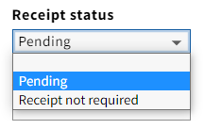
There are choices to make when creating a purchase order that correspond to these different situations.
When ordering a single-volume printed monograph, in the “PO line details” accordion, we’d want to select “Pending” in the “Receipt status” field of the purchase order line.
This will ensure that an “expected piece” will be created within the Receiving app to enable the material to be received when it arrives.
The same thing applies to an electronic monograph for which you want to record “receipt,” or activation, in the Receiving app.

Slide 6
What if we’re ordering an electronic monograph?
If we’re ordering an electronic monograph, we won’t want to create an item record at any point, but we still want to document somewhere that the resource is activated and available for users. This can be done in the Receiving app.

Slide 7

When “Pending” is designated as the receipt status at the point of ordering, the receipt status will display in the saved POL as “Awaiting Receipt.”
Notes:
Once the material has been received, the Receipt status will change to Fully received or Partially received.

Slide 8
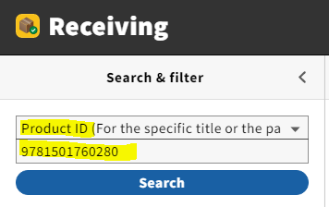
When the material arrives and is ready to be received, launch the Receiving app and search for the book in the search pane on the left side of the screen. Below we see a search by ISBN, but other searches are possible, including keyword, PO number, and POL number searches.

Slide 9
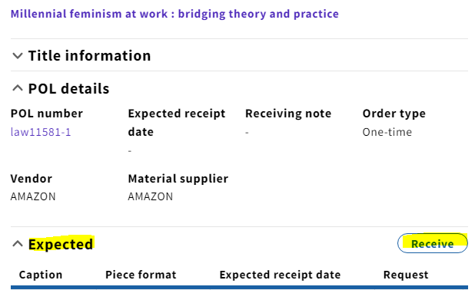
The Receiving app indicates that the material is “Expected” and can be received.

Slide 10
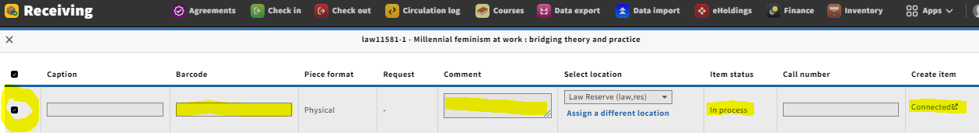
Clicking on the “Receive” button should take you to a screen that looks like this:
Notes:
On this screen, you can add a barcode number, type in a comment, or assign a different location for the newly arrived material. Note that the “Item status” is now “In process” and the item record is “Connected.”

Slide 11

Assigning a different location at the point of receipt: not as simple as it seems!
Should you have reason to assign a different location (from the location assigned when the order was created) to a monograph at the point of receiving it, be aware that doing so does NOT cause the existing holdings record in Inventory to change to that new location!
Instead, FOLIO creates a NEW holdings record in Inventory, corresponding to the new holdings location you have selected in the Receiving app. If there’s an item record already associated with the original holdings location, FOLIO will move it to the new holdings record. It’s necessary to go into the Inventory app and MANUALLY DELETE the unwanted holdings record once you’ve received your material.

Slide 12
The ability to add a barcode at the point of receipt is dependent on whether an item record was created at the point of ordering.
If an item record was not created when the purchase order line was created, you will not be able to create an item record from within the Receiving app. It’s fine to create the item record for a print monograph from within the Inventory app if necessary; however, the item status will probably be inaccurate.
In the case of an e-monograph, an item record should not have been created at the time of ordering, because e-resources do not have item records. You can still receive it without creating an item record.
Notes:
In general, it is preferable to have to create an item record within the Inventory app than to have an unwanted item record in the Inventory app that you cannot delete.

Slide 13
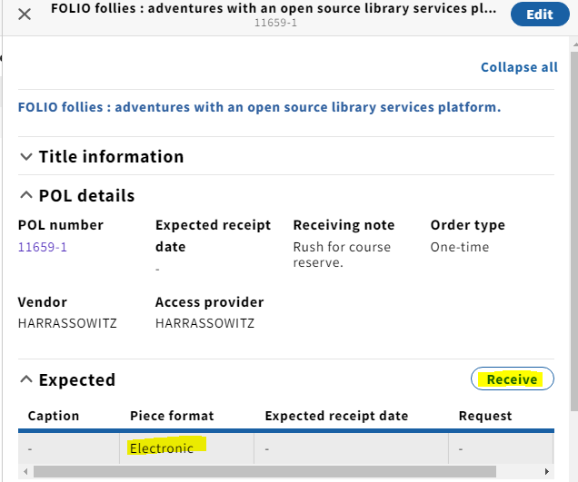
Here’s a screenshot for an electronic monograph as viewed from within the Receiving app.

Slide 14

When receiving material that has no item record, such as an e-monograph, there is no indication in the Inventory app that material is on order or in process. This is because in FOLIO, processing status information resides in item records, not holdings records.
You can type the words “In process” into the call number field of the associated holdings record in Inventory to indicate the processing status of the material, if this is permitted in your unit. This is similar to what we do in Voyager.

Slide 15

Creating a pop-up Receiving note
Creating a pop-up Receiving note in FOLIO is a two-step process.
First, a “Receiving note” must be entered into the purchase order line. A Receiving note can be typed in even after the purchase order has been opened.

Slide 16
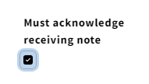
Creating a pop-up Receiving note, continued
Next, launch the Receiving app and find the purchase order line information for the ordered material. Click on the “Edit” button in the upper-right corner of the screen.
Near the bottom of the editing screen, check the checkbox that says “Must acknowledge receiving note” and save your change.

Slide 17
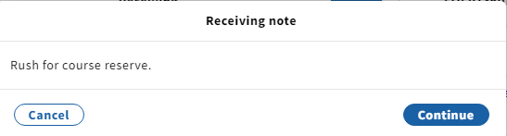
Taking this action will cause the Receiving note to pop up during the receiving process and require acknowledgement before proceeding.

Slide 18
Claiming monographs in FOLIO
Claiming involves identifying overdue material in need of claiming, communicating with the supplier about it, and documenting the supplier’s response. Following up on a claim at a later date is also frequently necessary.
FOLIO does not currently support claiming of either monographs or serial issues in the way that Voyager does.
A possible workaround involves leveraging the “Receipt status” and the “Expected receipt date” (or “Expected activation date” for an e-resource) fields in the purchase order line to create the data points needed to identify titles that may need to be claimed. This relies on the person placing the order to provide the necessary information in the purchase order line.

Slide 19
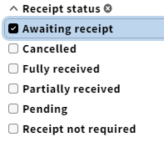
Identifying material to be claimed
Within both the Orders app and the Receiving app, you can perform searches to identify material that needs to be claimed.
For example, in the Orders app, select the “Order lines” segment in the search pane and click on the “Awaiting receipt” checkbox under “Receipt status.”

Slide 20
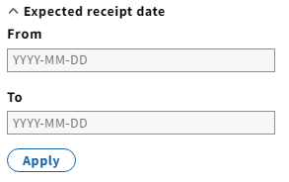
Refine your search
Refine the search further by scrolling down to the bottom of the search pane and filling out a range of dates in the “Expected receipt date” filter; further refinements are also possible, such as vendor, location and rush status:
Notes:
Many other search filters are available in the Orders app, including vendor, location, and rush status.

Slide 21
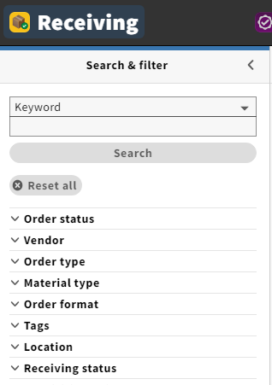
The Receiving app has some of the same search filters as the Orders app, but there are far fewer of them.

Slide 22

Once you are satisfied with your search result, you can create a list.*
*In the Iris version of FOLIO (the version we are implementing), it will be possible to generate a spreadsheet of your search results in the Orders app by clicking on the blue “Actions” button and selecting “Export results (CSV).”
This functionality is not available in our training instance of FOLIO, however.

Slide 23
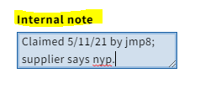
Documenting a claim
Once you have identified material in need of claiming and communicated with the supplier about it, it’s important to document the supplier’s response to the claim.
Documenting the supplier’s response to a claim is best done in the purchase order line within the Orders app, for example, in the “Internal note” field. The “Internal note” field remains editable even after a purchase order has been opened; however, notes are not searchable in Orders.
Notes:
Note: the contents of note fields are not searchable. We might want to use a tag for this.

