Slide 1
Viral infectious diseases of dogs and cats
Samantha Davis, DVM

Slide 2

Feline viruses
Feline- feline leukemia, feline immunodeficiency virus, feline infectious peritonitis, panleukopenia, feline upper respiratory disease

Slide 3
Feline leukemia: the basics
Enveloped RNA virus, gammaretrovirus
Affects 2-3% cats- US
Viremia occurs 2-4 wks after inoculation
Shed in saliva, nasal secretions, urine, feces and milk of infected cats- grooming and sharing dishes
Queens can infect kittens in utero or while nursing
Young cats, males and cats with outdoor access are most susceptible
Notes:
First described in the 1960’s, prevalence has decreased since effective vaccine was created and understanding of risk factors, vaccine may prevent against progressive infection only
Acute stage is rarely detected, fever/lethargy

Slide 4
Feline leukemia: pathogenesis
The virus replicates in oral lymphoid tissues then circulates in monocytes and lymphocytes in the peripheral blood. Infected cells can travel to sites like spleen, LN, BM and replicate.
Activates proto onco genes or disrupt tumor suppressor gene
Endogenous (enFeLV)- naturally occurring FeLV infection, invaded the genome prior to domestic cats, uncommon
Exogenous (exFeLV)- subgroups A,B,C,T – different disease progression and prognosis
Notes:
Point 4- RNA is reverse transcribed to DNA which integrates into the host genome, can make the host more or less susceptible to ex FeLV
Point 5- A- mutations B – neoplasia, C- severe anemia T- depletes T lymphocytes

Slide 5
FeLV: types of infection
Abortive infections= sufficient immune response clears the virus
Regressive infection= immune system can suppress the viral replication prior to infection of the bone marrow. Provirus positive, carrier. No shedding or disease occurs, but can become progressive with immunosuppression.
Progressive infection= host defense cannot suppress viral replication, persistent viremia occurs. Immunosuppression occurs, opportunistic infections and lymphoma are common. 80% will develop fatal disease within 3 years.
Notes:
Disease progression in progressive infection is variable, host and viral factors, worse disease states if infected young
Focal infections can occur where the virus replicates in specific tissues but are

Slide 6
Feline leukemia: signs
Anorexia
Weight loss
Fever
Lymphadenopathy
URI signs
Stomatitis
Anterior uveitis
Seizure and other neurologic changes
Notes:
Fading kitten syndrome in neonates

Slide 7
FeLV: diagnostics
CBC: NR anemia, pancytopenia
Chemistry: azotemia, variable
ELISA: detects FeLV p27 antigen in blood (Sn: 98.6% and Sp: 98.2%)
IFA: detects the presence of p27 in infected cells (often neutrophils) once BM is affected
PCR: detect viral RNA or provirus in blood or tissues
Notes:
Discordant results between tests, often a positive initial ELISA followed by negative results on either repeat ELISA or IFA, may reflect the inconsistent antigen circulation during various stages of FeLV infection, technical error, or possibly regressive infection status. These cats are generally considered presumptively infected and potential sources of infection until further clarification is possible. Standard recommendations to resolve discordant testing dictate repeating both tests in 30–60 days using serum instead of whole blood. It is not uncommon for cats, especially kittens, to test negative on a subsequent test. This could indicate a false-positive on the first test, a false-negative on the second test, or development of a regressive or abortive infection status. Once a single positive test result has been obtained, it can be difficult to ever know the true status of the cat, even if subsequent tests are negative.

Slide 8
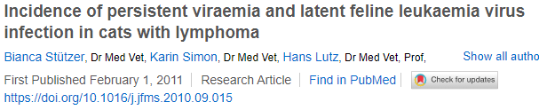
FeLV: neoplasia
Mediastinal and multicentric lymphoma, leukemia, fibrosarcoma
None of the antigen-negative cats had latent infection with FeLV
The prevalence of FeLV viremia in cats with lymphoma was 20.8%
Latent FeLV infection is unlikely to be responsible for most feline lymphomas
Notes:
Antigen neg and pos cats with lymphoma, PCR and IHC to see if any of the antigen neg cats were latently infected
Progressive infection have a 60 fold increased risk of developing lymphoma

Slide 9
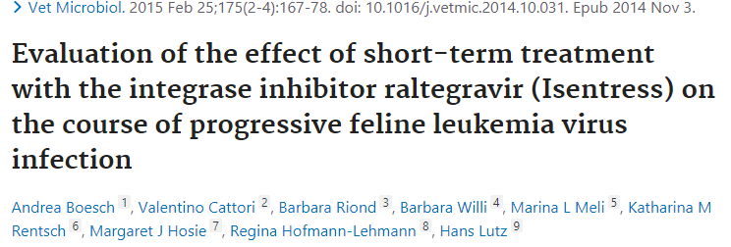
FeLV: Therapy
ZDV- reverse transciptase inhibitor, no significant improvement, but may help in cats with neurologic disease
Raltegravir- human anti HIV compound
Notes:
Reduced plasma viral RNA loads, but rebounded after cessation of tx, well tolerated no side effects
Improved survival vs placebo

Slide 10
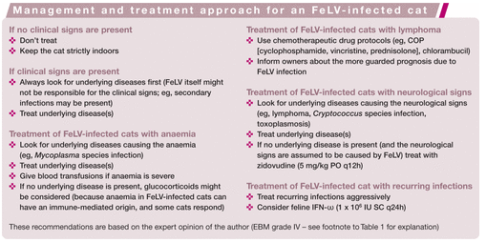
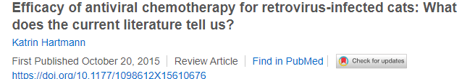
FeLV: therapy

Slide 11
FeLV: prevention
Vaccination
Disinfectants
Limit outdoor access
Testing

Slide 12
FIV: the basics
Enveloped RNA lentivirus, retrovirus
Affects 1.5-3% healthy cats, higher rates in sick/high risk cats
Shed primarily in saliva, so bites wounds are the most common mode of transmission
More common in older male cats with outdoor access
Notes:
Sexual contact and queen to kitten are though to be unlikely routes of infection

Slide 13
FIV: pathogenesis
Virus detectable 2 wks post infection
Virus infects lymph nodes and invades cells via the primary receptor CD-134 which is expressed on CD4 and CD8 T lymphocytes, B cells and activated macrophages.
Disseminates to CNS and lymphoid tissue
Inversion of the CD4: CD8 ratio
Rebound of the CD8 T lymphocytes occurs, over time both CD4 and CD8 decline

Slide 14
FIV: stages of infection
Three phases:
Acute- virus replicates in the lymphoid tissues, transient illness often with a fever, lasts for days to weeks
Subclinical- CD8 cells rebound and plasma viral load decreases, not considered latent since viral production continues, can occur for years
Terminal- severe compromise of the immune system, opportunistic infections, inflammatory and neoplastic conditions seen
Notes:
Signs are very variable and depend on phase

Slide 15
FIV: diagnostics
CBC: mild anemia, lymphopenia, neutropenia
Chemistry: hyperproteinemia
ELISA: detects antibodies to p24 antigen (Sn:93.5%, Sp: 100%), positive test in kittens <6 months could be due to persistent maternal antibodies
Western blot or IFA for confirmatory testing
PCR
Notes:
Cannot test for antigen b/c low viral loads after acute stage

Slide 16
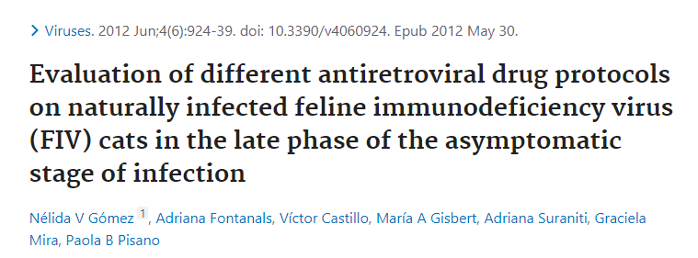
FIV: therapy
Notes:
ZDV- reverse transcriptase inhibitor, ZDV, ZDV with interferon, ZDV with 3TC, ZDV with valproic acid on cats in asymptomatic stage
ZDV alone and with 3TC improved the CD4:CD8 ratio, ZDV with 3TC greater decrease in viral load

Slide 17
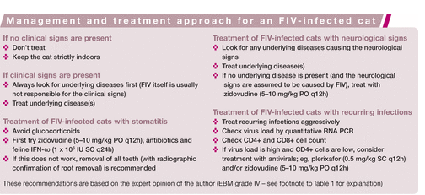
FIV: therapy
Notes:
ZDV showed a marked improvement of neuro signs in FIV

Slide 18
FIV: prevention
Vaccine- not available in US
Neuter
Limit outdoor access
Disinfectants
Testing

Slide 19
FIP: the basics
Coronavirus- enveloped SS RNA virus
Fecal oral route of transmission
Viral disease caused by mutated strains of FeCV ----→ FIPV
FIPV occurs in about 10% of cats infected with FeCV
Mostly seen in kittens (70% less than 1.5 yrs old), geriatric cats, males and pure bred cats
Notes:
Feline enteric coronavirus which is a common and causes transient GI dz

Slide 20
FIP: pathogenesis
Two serotypes- type I (most common) type II (recombinant)
S protein binds to receptor on host cell mediating cell entry
Type I- unknown receptor
Type II- aminopeptidase N receptor
Viral factors, host factors and environmental factors
Notes:
Immune response breed and genetics
Stress and overcrowding

Slide 21
FIP: signs
General signs: lethargy, anorexia, fever (often fluctuates), weight loss, icterus, lymphadenopathy
Wet form(more common): abdominal, pleural and pericardial effusion
Dry form: neurologic changes (seizures, ataxia, vestibular signs, behavior change), ocular changes (commonly anterior uveitis), dermatologic (papules, nodules)

Slide 22
FIP: diagnostics
CBC: non specific- lymphopenia, neutrophilia with LS, NR anemia
Chemistry: hyperglobulinemia in 89%, often with low or normal albumin (low A:G ratio), hyperbilirubinemia without ELE
Polyclonal elevations in gamma and alpha-2 globulins reported most commonly
Antibody titers: titers > 1:3200 are highly suggestive, can be used to rule out
Effusion analysis: straw yellow, proteinaceous, low A:G ratio, poorly cellular
RT-PCR, spike gene RT-PCR

Slide 23

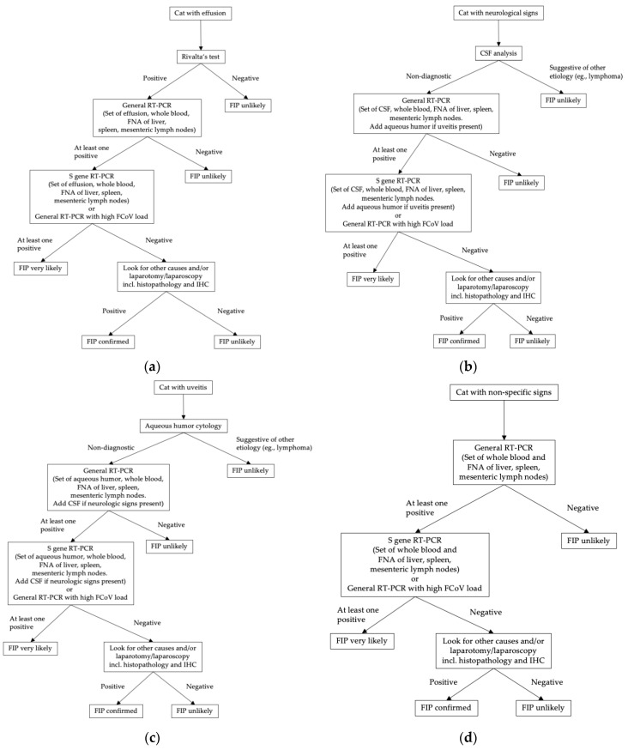
FIP:

Slide 24
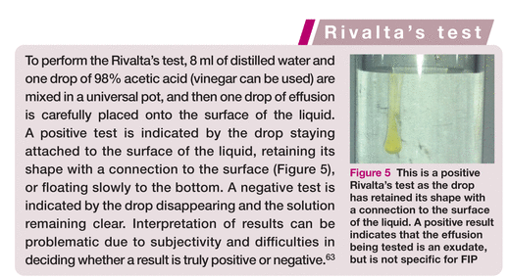
Rivalta’s test
Notes:
Not specific, positive in other diseases bacterial/septic peritonitis and lymphoma

Slide 25
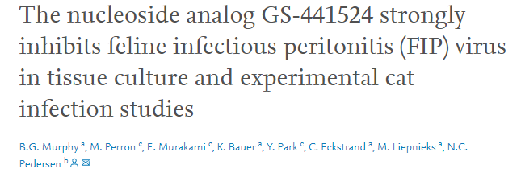
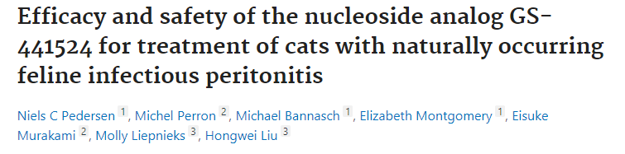
FIP: therapy
Notes:
Anti viral activity against RNA viruses – tissue- not cytotoxic and decreased RNA expression, then12 exp infected cats- treated with 2 or 5 mg/kg X 2 wks, 10 developed severe signs, 10/10 signs better in 24-48 hrs recovered after 2 wks tx, 2 cats relapsed but were treated successfully, all doing well 8 months later
Study 2- 26 cats mostly with wet form-12 wks of tx, 18 cats healthy 2 yrs out?, 8 relapsed tx with same dose or higher dose, 5 did well, 2 relapsed had third tx
NOT available

Slide 26

FIP
MST 9 days with 95% morality

Slide 27
Panleukopenia: the basics
SS non-enveloped DNA virus, parvo virus, genetically related to CPV (certain strains can also infect cats)
Very stable in the environment, can survive up to 1 yr!
Fecal oral route, infection in utero
Shed in saliva, nasal secretions, vomit, feces and urine
Usually cats <1 yr old

Slide 28
Panleukopenia: pathogenesis
First replicates in oropharyngeal lymphoid tissue
Enters cells using transferrin receptors (TfR) and viral DNA gains access to the nucleus, then replicates in cells that are in S phase of mitosis since it does not have its own DNA polymerase
Leads to lymphoid tissue necrosis, replication in the intestinal crypt cells, infection of the BM causing leukopenia and sequestration of neutrophils into the damaged gut
Predilection for rapidly dividing cells- crypt cells, myeloid progenitor cells, intestinal crypt epithelium and Purkinje cells in the external granular layer of the cerebellum in neonates
Transplacental infection can occur

Slide 29
Panleukopenia: signs
Clinicals signs are usually seen 2-10 days post incubation period
Clinical signs: fever, lethargy, vocalization, dehydration, vomiting, diarrhea, weight loss, sometimes sudden death in kittens <2 months old
Can progress to sepsis and DIC, co-infections common
In utero infections can cause abortions or kittens can be born with CNS and ocular defects- hydrocephalus, hydranencephaly, optic nerve hypoplasia, retinal dysplasia and cerebellar hypoplasia. Queens may or may not show signs

Slide 30
Panleukopenia: diagnostics
CBC: severe leukopenia, characterized by a neutropenia and lymphopenia, thrombocytopenia and mild anemia (unless severe GI loss)
Chemistry: hypoalbuminemia, hyponatremia and hypochloridemia and elevated AST, sometimes azotemia and hypoglycemia
Parvo ELISA test: should not rule out disease if negative
PCR for confirmatory testing
Notes:
2009 Study- 97 cats with suspect FPV based on clinical signs, 55 snap positive, 54/55 confirmed with PCR

Slide 31
Panleukopenia: therapy
Mainly consists of supportive care, IV fluids, anti-emetics, dextrose, active warming, antibiotics and anti parasitics
Interferon omega antiviral- inhibits replication of FPV in cell culture, was administered at the beginning of a shelter outbreak- no significant difference in survival between groups
Cats that survive 5 days usually recover
Notes:
23 kittens X3 day SQ, 17 control, those kittens were not confirmed FPV positive

Slide 32
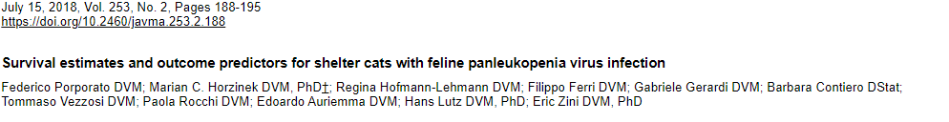
Panleukopenia
Retrospective with 177 shelter cats
20% survived discharge
Poor prognostic indicators were lethargy, low body weight, hypothermia (<100.2 F), lower WBC count at day 3,4 and 7
Glucose supplementation (when <60 mg/dL) was associated with non survivors
Clavamox, cerenia and anti-parasitics were associated with survival
Notes:
Shelter had a large outbreak for many years- admitted if from the shelter, ELISA positive, clinical or lab findings compatible
Majority of cats were 3 months but ranged to 3 yrs
Only 2 had been vaccinated
Earlier study showed a 50% survival rate and poor prognosis with leukopenia at admission, however it makes sense as evidenced here that prolonged leukopenia would be a ppi, that study also showed low plts, low K and low alb were ppi

Slide 33
Panleukopenia: prevention
Vaccination – often MLV vaccine starting at 6-8 wks then every 2-4 wks until 16 wks of age
Shelter management strategies – vaccination and quarantine

Slide 34
Feline respiratory disease complex: the basics
Most commonly secondary to herpes virus (FHV-1), calici virus (FCV), Mycoplasma, Chlamydophila or Bordetella
Co-infections common
Most commonly found in shelter populations, outdoor cat colonies
High morbidity, low mortality

Slide 35
FRDC: calici virus (FCV)
SS non enveloped RNA virus
Stable in the environment, contaminated surfaces are the most common mode of transmission
Viral replication primarily in the oropharynx
Shed in respiratory, ocular and oral secretions, less likely aerosol
Chronic infection possible, associated with stomatitis
Virulent/systemic form is worse in adults and can cause vasculitis, hepatocellular necrosis

Slide 36
FRDC: herpes virus (FHV-1)
Double stranded enveloped DNA virus
Replicates in upper respiratory epithelium, ocular epithelieum and neurons (trigeminal ganglia)- shed in nasal, oral ocular secretions
Most cats recover from acute infection in 2-3 weeks, typically infected for life, stress can cause recrudescence
Chronic ocular pathology- corneal ulcers and stromal keratitis

Slide 37
FRDC: Chlamydophila felis
Obligate intracellular gram negative bacterium
Mostly causes conjunctivitis and is shed in ocular secretions
+/- Mild respiratory signs

Slide 38
FRDC: Mycoplasma spp
Gram negative bacterium that lack a cell wall
Some species are commensal in the respiratory tract, may play a primary or secondary role in FRDC

Slide 39
FRDC: Bordetella brochiseptica
Gram negative coccobacillus
Shed in oral and nasal secretions
Can cause primary disease in cats but is usually a co- infection
May see coughing

Slide 40
FRDC: signs
Mucoid nasal discharge
Sneezing
Decreased appetite
Conjunctivitis
Fever
Lethargy
Oral ulceration
Pneumonia

Slide 41
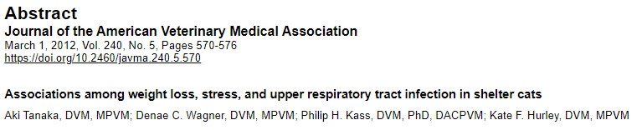
FRDC: shelter cats
60 cats admitted to the animal shelter
Measured body weight, food intake and stress scores, clinical signs
82% lost weight during the first week
Cats with high stress scores were 5X more likely to develop URI
Food intake and stress were negatively correlated

Slide 42
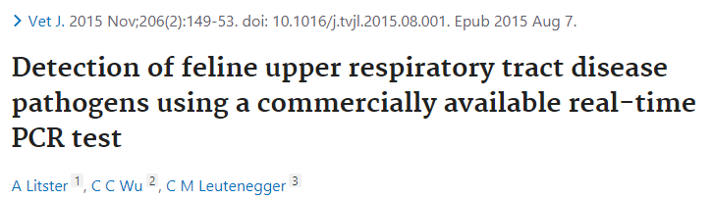
FRDC: Diagnostics
PCR vs VI and bacterial culture in 18 clinically affected shelter cats
Best anatomic site to sample
FHV-1 was the most common pathogen detected
FHV, Mf, Bb were detected by PCR more than VI/C
Best site was oropharyngeal +/- nasal or conjunctival
Notes:
PCR is faster and more sensitive so better option for practitioners
Some pcr positive but VI/BC neg most likely due to sample procressing

Slide 43
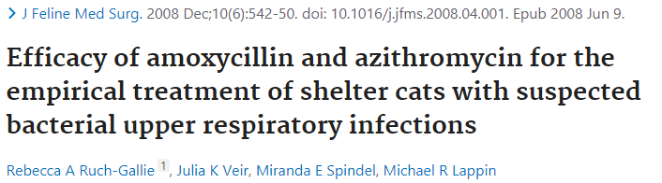
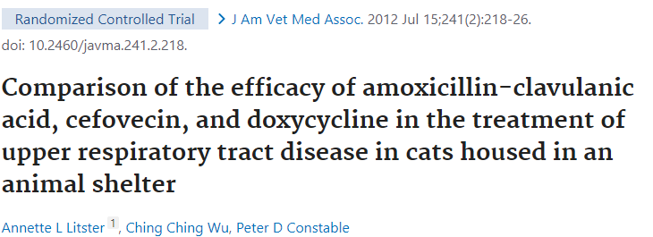
FRDC: abx therapy
31 cats with URI- clinical score
No difference in response for either antibiotic
48 shelter cats with clinical signs, randomly assigned to treatment group
Clavamox and doxycycline groups more effective than cefovecin
Notes:
Study 2: Oculonasal discharge, sneezing, coughing, dyspnea, demeanor, and food intake were scored twice daily for 14 days (0-3), Mm and Bb most common isolates, doxy and clav had increased weight by day 14 and lower sneezing, doxy lower overall oculonasal discharge, clav better food intake and demeanor earlier

Slide 44
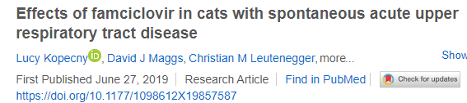
FRDC: anti-viral therapy
24 kittens with clinical signs of URI, PCR testing
Randomly assigned to receive doxy +/- famciclovir
Clinical severity scores
Duration of and clinical signs were similar between groups
However only 29% were FHV positive

Slide 45
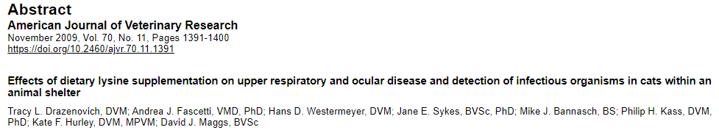
FRDC: antiviral therapy
261 adult shelter cats, fed lysine for 4 weeks vs control
3X week clinical scoe
1X week PCR for FHV and FCV
During week 2 FHV was found more in treated group
Cats in treated group were more likely to develop moderate –severe disease week 4

Slide 46
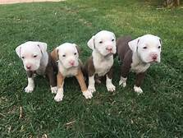
Canine viruses
Canine viruses to cover: CIRDC, influenza and parvo

Slide 47
Canine infectious respiratory disease complex: the basics
Single pathogen most likely alters host defense mechanisms and allows for opportunistic infections
Co-infections common
Often shed via droplets from the respiratory tract
Morbidity is high, mortality is low
Often self- limiting disease
Commonly found in dog parks, shelters, grooming, boarding facilities

Slide 48
CIRDC: the bugs
B. bronchiseptica: gram negative aerobic coccobaciilus, filamentous hameagglutinin – virulence factor, infection in ciliated mucosa--→ ciliary stasis and poor mucociliary clearance
CHV: enveloped DNA virus, epithelial cells of the URT, latent in sensory ganglia
CDV: enveloped SS RNA virus, replicated in lymphoid cells in the RT, lymphopenia on CBC
CAV-2: non enveloped DNA virus, replicates in non ciliated epithelial cells of URT, rarely results in clinical disease alone
CIV: (2004 racing greyhounds, Fl/2015 Chicago, US), enveloped SS RNA, H3N8, H3N2=predominant strains, inflammation and necrosis of the ciliated epithelium, shedding decreased after 1 week can be found up to 3 weeks after infection
CPiV: enveloped RNA (1967, lab dogs), usually mild infection
Notes:
CAV-1: canine infectious hepatitis, coinfection with CDV or coronavirus can increase mortality, corneal edema and interstitial nephritis can also be seen

Slide 49
CIRDC: the bugs
**Canine respiratory coronavirus (CRCoV): (2003 rehoming center UK), ciliated epithelial cells in the trachea and tonsils
**CnPnV: (2010, shelter, US), related to human resp syncytial virus, glycoprotein mediated attachment to host cells
S. zooepidemicus: beta-hemolytic, Lancefield group C bacteria, acute hemorrhagic pneumonia, fever, exotoxins that exacerbate immune response
M. cynos: normal commensal bacteria, shed in nasal and ocular secretions and saliva, sialidase activity and enzyme that assists in microbial colonization- virulence factor, may be a primary pathogen

Slide 50
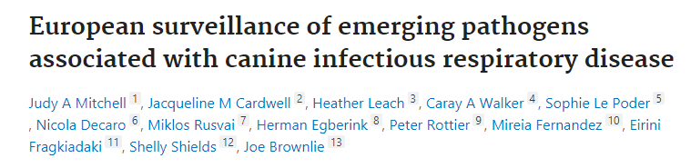
CIRDC
In a large multi-centre European study the prevalences of four key emerging CIRD pathogens; canine respiratory coronavirus (CRCoV), canine pneumovirus (CnPnV), influenza A, and Mycoplasma cynos (M. cynos)
Notes:
525 serum samples, shelter dogs and pet dogs
CRCoV and CnPnV were highly prevalent across the different dog populations studied and their presence was positively associated with an increased occurrence and severity of clinical disease
Dogs were significantly more likely to be CnPnV seropositive if they were also seropositive for CRCoV
Few positive for M cynos and flu A overall

Slide 51
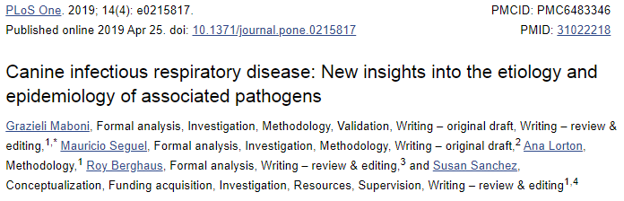
CIRDC
Disease surveillance from 2011-2017 at a diagnostic lab for symptomatic and asymptomatic dogs
Pathogens were found more commonly in symptomatic dogs
Co- infections and young age were associated with increased severity of disease
Low detection rate of classic pathogens
CPiV and M cynos most common
Notes:
Symptomatic- requested PCR panel, non- necropsy swabs
PCR panel-Mycoplasma spp., B. bronchiseptica, CAV, CDV, coronavirus (CoV) and influenza A Matrix (H3N2 and H3N8).
Added M canis and M cynos, S equi

Slide 52
CIRDC: signs
Coughing, “honking”, variably productive
Sneezing
Nasal discharge
Decreased appetite
Lethargy
Increased respiratory rate and effort
Notes:
All pathogens show similar signs and are hard to distinguish from one another
Usually mild to moderate illness

Slide 53
CIRDC: diagnostics
CBC/chemistry/urinalysis: non -specific, +/- neutrophilia, bands, lymphopenia
CXR: normal, mild unstructured interstitial pattern or show evidence of pneumonia
TTW/BAL, nasal or oropharyngeal swab
Viral pathogens: RT PCR, VI
Bacterial pathogens: culture
Notes:
Hard to interpret results since can be seen in healthy in sick and dogs

Slide 54
CIRDC: therapy
Often self limiting
If clinical signs > 7-10 days, severe signs or known outbreak then therapy is indicated
If severe supportive care with IVF, oxygen and nebulization
Outpatient – doxycycline effective against Bb or Mc

Slide 55
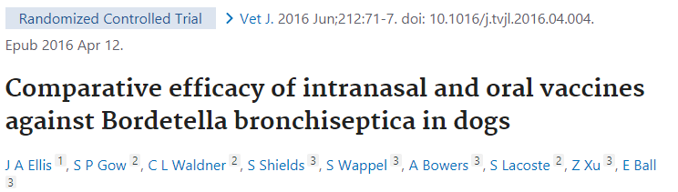
CIRDC: prevention
Vaccines against CDV, CPiV, CAV, Bb and H3N8 and H3N2
100% protective against CDV, all other decrease morbidity and shedding
Shed attenuated vaccine strains which can help confer immunity to naïve dogs
Bb: intranasal vaccine confers better immunity than oral
Notes:
#48 8 week old beagle lab puppies- IN vs oral vs IN placebo, 21 days later inoculated with Bb, oral more clinically ill than IN

Slide 56
Parvo: the basics
Small non enveloped SS DNA virus
May be a variant of feline panleukopenia virus, CPV-2 strains a,b,c
Highly contagious, can persist in the environment for up to 1 yr, resistant to common disinfectants
North American- Rottweilers, ESS, GSD, Pitbulls and Doberman are over-represented
Fecal oral route of transmission or infection in utero (can cause myocarditis)

Slide 57
Parvo: pathogenesis
Transferrin receptors are used to gain entry into host cells
Requires mitotically active cells to replicate
Replicates in the oropharyngeal lymphoid tissue and mesenteric lymph nodes, then viremia occurs with significant damage to GIT, bone marrow, thymus and lymphoid tissue
Denuded epithelial cells with blunting of villi→ GI signs, malabsorption, bacterial translocation
Peak shedding 4-7 days after infection

Slide 58
Parvo: signs
Vomiting
Diarrhea
Lethargy
Anorexia
Abdominal discofort
Intussusception
Can progress to hypovolemic shock, bacteremia, seizures

Slide 59
Parvo: diagnostics
CBC: neutropenia, lymphopenia, toxic change
Chemistry: hypoproteinemia, hypoglycemia, azotemia, ELE +/- hyperbilirubinemia, electrolyte changes
ELISA snap test: Sn (94-100%) Sp (89-100%), FN- seen more likely in dogs with lower fecal virus load and higher serum antibody concentrations
PCR- almost 100% sp/sn
Imaging: usually non –specific, ileus
Serum cortisol and thyroxine concentrations: high cortisol and low T4 at 24 and 48 hrs were associated with mortality

Slide 60
Parvo: therapy
IVF, nutrition, antibiotics, pain medications
Maropitant vs ondansetron- no difference in duration of hospitalization, duration of vomiting, requirement of rescue doses or voluntary food intake.
Metoclopramide, ondansetron and maropitant- assessed frequency and severity of vomting, vomiting day 3-5 was decreased vs the control group, no difference between the tx groups
Fecal transplant- faster resolution of diarrhea and shorter hospitalization among survivors
Hyperimmune plasma: single infusion during first 6 hrs, lower shock index and lactate concentration at 24 hrs, no difference in duration of hospitalization or mortality

Slide 61
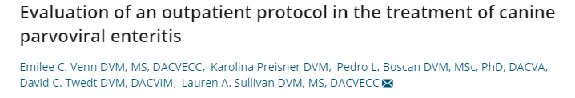
Parvo: outpatient
All puppies had at least one IVF bolus and dextrose boluses until normoglycemia then split into inpatient vs outpatient
OP: 120 ml/kg/day SQ fluids split over q 6 hrs + heat support, convenia, cerenia, offered food q 6 hrs, buprenex prn, ondansetron prn, oral karo syrup and K supplementation
PE,CBC/Chem/PT/PTT daily and monitoring daily
D/C – cessation of V, rebound from N nadir, eating/drinking and euhydrated
90% success rate IP vs 80% success rate OP
Notes:
Transition to IP group of clinical disease was severe enough
2020- PA-SPCA : 95 dogs, 83% survival rate with OP

Slide 62
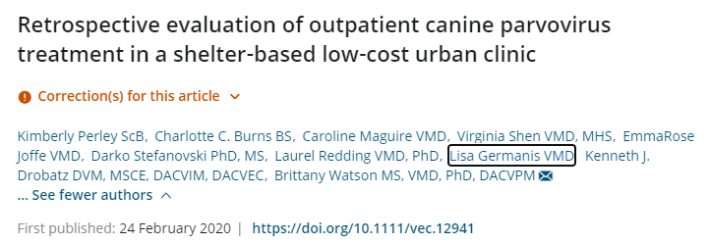
Parvo outpatient
95 dogs client owned dogs
Only if dogs were evaluated as clinically stable
Protocol:
Increase in % BW and days ill prior to presentation were associated with survival
Hypothermia was negatively associated with survival
83% survival

Slide 63
Parvo: prognostic factors
Colorado study- non survivors were less than or equal to 4 mos, 4 kgs
Parvo as model for sepsis, evaluated SIRS criteria (1991,2001) using a PIRO scoring system to help determine patient risk/adverse outcome
Predisposition(sig), Infection, Response (SIRS criteria -T,HR,RR,WBC counts, mm color/CRT), Organ dysfunction (biochemical markers)
No sig diff between PIRO score and outcome
Dogs that met SIRS 2001 criteria were 4X more likely to die

Slide 64
Rabies
Enveloped RNA virus, lyssavirus
Inactivated easily, bite wound transmission
Patho: virus replicates in muscle cells then attaches to peripheral nerve endings, nicotinic receptor is the main one, then travels up nerve axons at 3 mm/hr, massive replication occurs in the CNS, out to cardiac, skeletal, eye, kidney, pancreas, salivary glands, nerves around hair follicles
Excitatory and paralytic vs furious manifestations, coma and death occur in 1 week after onset of signs
Direct FA testing of the obex of the brain

Slide 65
Rabies: bonus
Smaller dogs elicited higher antibody levels
Answer: BMD
Dogs vaccinated before 16 weeks had a lower titers, dogs 0-1 yrs most often had inadequate titers

Slide 66
CDV
Enveloped pleomorphic RNA morbillivirus, paramyxoviridae, readily inactivated
Aerosolized and droplet transmission
Primarily effects GI, respiratory and neurologic systems
Infects monocytes within lymphoid tissues in URT and tonsils, then goes through lymphatics and blood. Hemagglutinin binds to molecule on surface of host cells- signaling lymphocytic activation molecule (SLAM) which is a membrane glycoprotein of IG,direct destruction of lymphocytes especially CD4 T cells.
Common secondary infections
Recovery provides lifelong immunity

