Slide 1
Neuromuscular Blockade
ECC Board Review
October 2019
Michelle Coady

Slide 2
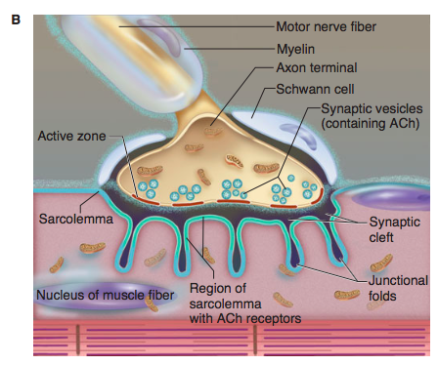
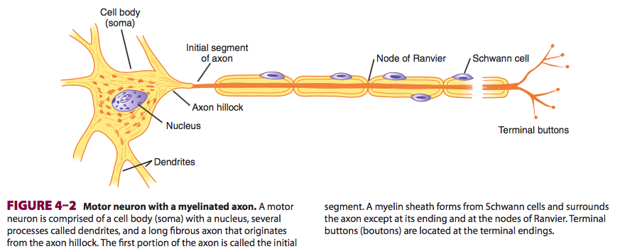
Neuromuscular Transmission
Skeletal muscle fibers are innervated by large, myelinated nerves
Nerve fibers branch out to stimulate several hundred skeletal muscle fibers
Each nerve ending makes a junction with a muscle fiber = neuromuscular junction

Slide 3
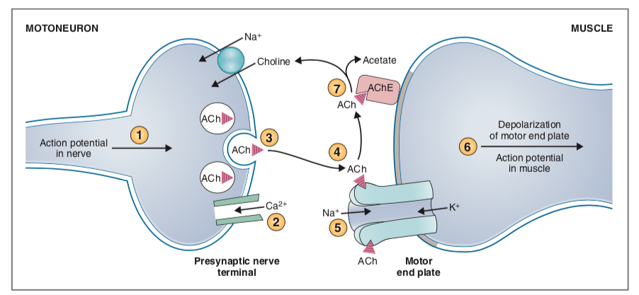
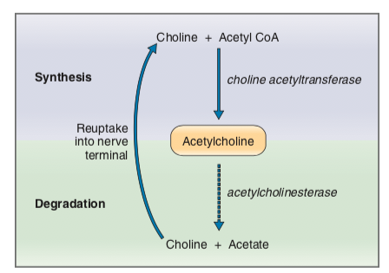
Neuromuscular Transmission
  Action potential travels down motor neuron and reaches pre-synaptic nerve terminal
  Depolarization of presynpaptic terminal opens Ca++ channels
  ACh vesicles fuse to pre-junctional membrane and release contents by exocytosis
  ACh diffuses across the cleft and binds to post-junctional nicotinic receptors
  Na+ and K+ channels open and result in depolarization of the motor end plate
  Action potential transverses T-tubule system of the sarcomlemma, resulting in calcium release from the sarcoplasmic reticulum and subsequent excitation-contraction coupling
  ACH is degraded to choline and acetate by acetylcholinesterase (AChE)

Slide 4
Neuromuscular Transmission
Neuromuscular transmission begins to fail after a minimum of 75% of post-synaptic ACh receptors have been blocked. Complete failure of transmission occurs with >90% receptor blockade
Why is this clinically relevant?
During recovery, a patient may have up to 75% of ACh receptors blocked with no detectable clinical signs, but a reduced margin of safety.

Slide 5
Neuromuscular blocking AGENTS
NMBAs paralyze all skeletal muscle in the body
Mechanical ventilation must ALWAYS be available when these agents are being used
Some muscles are more sensitive to blockade than others
  diaphragm and intercostals most resistant to blockade, usually the first to recover
  pharyngeal muscles may take much longer to recover putting patients at risk for upper airway obstruction

Slide 6
NMBAs - indications
What are indications for use of NMBAs?
Deep surgical dissection - relaxation of the abdominal musculature facilitating deep abdominal surgeries (eg. nephrectomy and adrenalectomy) or during spinal surgery
Thoracic surgery - PPV is necessary, so NMB may be helpful
Dislocations and fractures - may be helpful in fracture reduction?
Ophthalmic surgery - centrally positioned eye through relaxation of the extra ocular muscles
Endotracheal intubation - may be helpful for rapid intubation in cats to prevent; allows allows for passage of a larger endotracheal tube as the rim glottis will be more widely open.
Positive pressure ventilation

Slide 7
NeuromusCular blocking Agents
What are the 2 main classes of neuromuscular blockers?
1. Depolarizing (eg. succinylcholine)
2. Non-depolarizing
  Benzylisoquinoline dervatives (eg. atracurium, cisatracurium, mivacurium)
  Aminosteroids (vercuronium, pancuronium, rocuronium)
Is neuromuscular blockade with each group competitive or non-competitive?
1. Depolarizing -> non-competitive blockade
2. Non-depolarizing -> competitive blockade

Slide 8
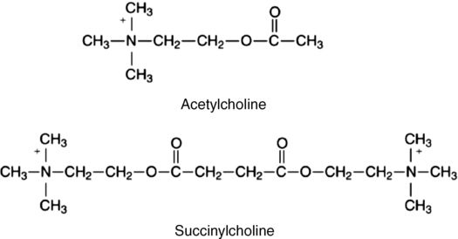
Depolarizing Agents (Succinylcholine)
Consists of two molecules of ACh joined together
Binds post-synaptic Ach receptors, generating an AP
NOT metabolized by acetylcholine, so instead remains bound to receptors until the blood concentration allowing the drug to diffuse down its concentration gradient into the plasma, where it is degraded by pseudocholinesterase
Phase 1 block: initial muscle stimulation (seen as widespread transient muscle fasciculations), followed by flaccid paralysis
Non-competitive blockade

Slide 9
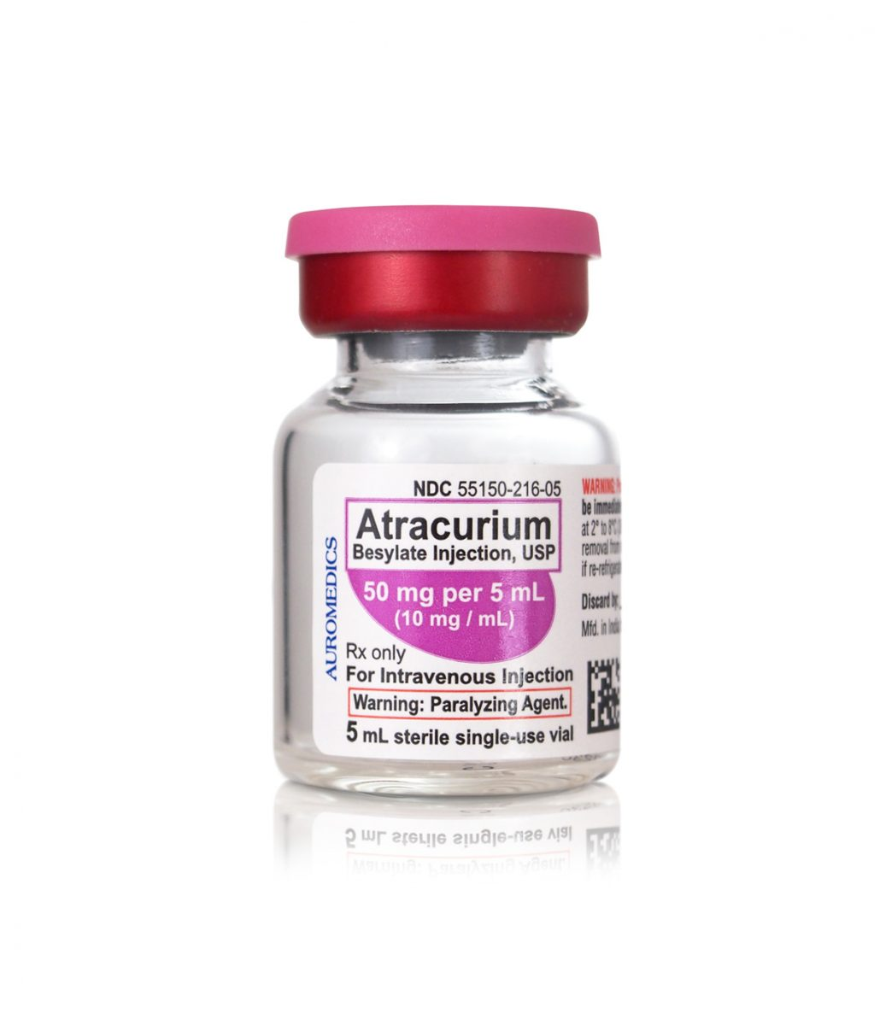
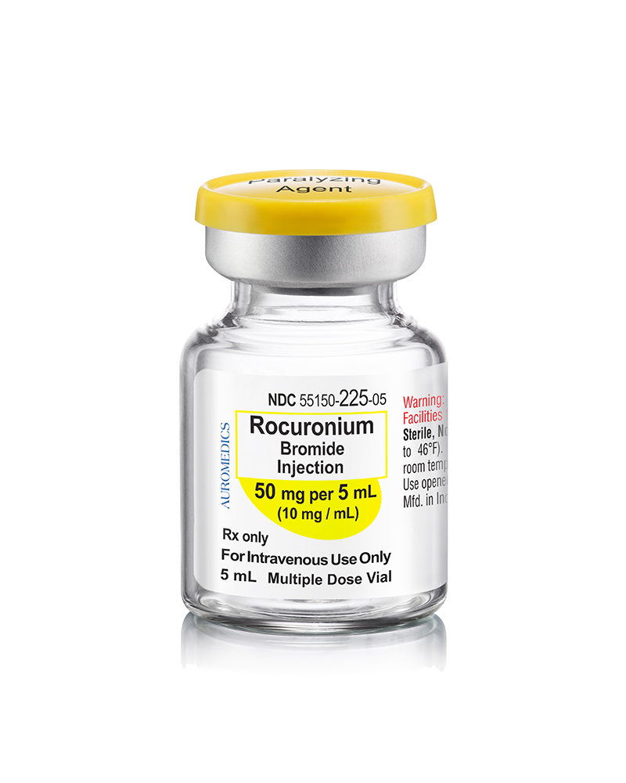
Non-Depolarizing Agents
Benzylisoquinoline derivatives (atracurium, cisatracurium, mivacurium)
Aminosteroids (vecuronium, pancuronium, rocuronium)
Bind to post-synaptic ACh receptors but do NOT induce channel opening/ generation of an action potential and thus there are no initial muscle fasciculations
Results in competitive blockade whereby ACh cannot bind to its receptors
Progressive weakening of muscle contraction and ultimately flaccid paralysis

Slide 10
Depolarizing Agents (Succinylcholine)
Phase 1 block: initial muscle stimulation (seen as widespread transient muscle fasciculations), followed by flaccid paralysis
What is a phase 2 block?
May occur with repeated or high doses
assumes some characteristics of a non-depolarizing block and becomes relatively long-acting
Fade occurs with TOF; mechanism by which this occurs in unclear
Can occur with even a single dose in dogs, so rarely used

Slide 11
Drug | Class | Metabolism | Time of onset | Duration | Side Effects | Reversal | Dose
Succinylcholine | Depolarizing | Plasma cholinesterase | Fast 30-60 s | Short 5 - 25 mins | - CV: brady or tachycardia, arrhythmias, hypertension - muscle fasciculations -> hyperkalemia, post-anesthetic pain - increase in IOP (sustained contraction of extraocular muscles) - may trigger malignant hyperthermia? | No reversal agent | Dogs: 0.3 mg/kg IV Cats: 0.2 mg/kg IV
Atracurium | Non-depolarizing Benzylisoquinoline | Non-specific esterases & Hofmann elimination | Slow ~5 mins | Intermediate 20 – 40 mins | - Laudanosine production (byproduct of Hofman elimination) requiring hepatic metabolism -> can cause seizures - histamine release (high doses given rapidly) | Anti-cholinesterase | Dogs & cats: 0.25 – 0.5 mg/kg IV Or 0.25 mg/kg IV bolus then 0.4-0.5 mg/kg/hr
Cisatricurium | Non-depolarizing Benzylisoquinoline | Hofmann elimination | Slow ~5mins | Intermediate 20 - 40 mins | - lower propensity to release histamine - less laudanosine production | Anti-cholinesterase | Dogs: 0.15 mg/kg IV (+/- 0.2-0.45 mg/kg/hr Cats: no clinical reports of use in cats
Vecuronium | Non-depolarizing Aminosteroid | Hepatic metabolism; biliary & urinary excretion | Slow ~5mins | Intermediate ~30 mins | - Negligible effect on CV system, even at high doses | Anti-cholinesterase | Dogs & cats: 0.1 mg/kg IV +/- 0.1 mg/kg/hr
Roncuronium | Non-depolarizing Aminosteroid | Mostly hepatic, some renal excretion | Fast 60s | Short to intermediate ~30 mins | - Minimal CV effects, mild tachycardia and hypertension | Anti-cholinesterase | Dogs: 0.5-0.6 mg/kg +/- 0.2 mg/kg/hr Cats: 0.6 – 1.5 mg/kg

Slide 12
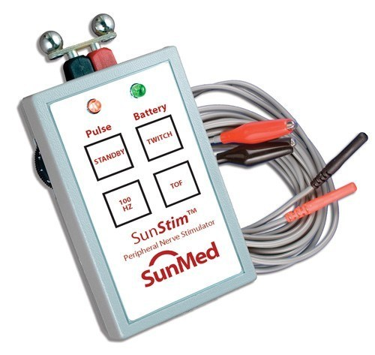
Monitoring of the NMJ
Peripheral nerve stimulator
  Delivers a small current through a pair of electrodes attached to the skin
  Square-wave pulse generation
  Locations: Ulnar nerve on the medial aspect of the elbow, perineal nerve at the lateral head of the fibula, or dorsal buccal branch of the facial nerve
Baseline nerve stimulation should be assess prior to administration of NMBAs
Simulation patterns
  Single twitch
  Train of four
  Tetanic stimulation
  Double burst stimulation

Slide 13
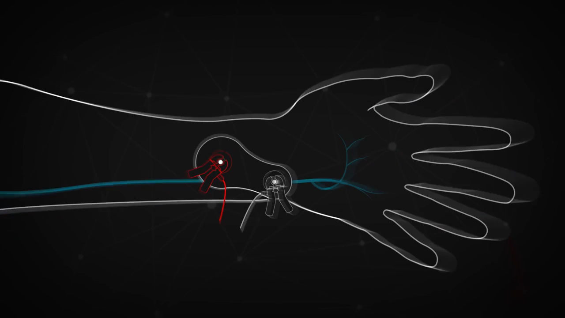
Single Twitch
single electrical pulse delivered at a rate between one second (1 Hz) to one per 10 seconds (0.1 Hz)
usually used to assess the onset of blockade, particularly during intubation in humans
not that clinically applicable in animals

Slide 14
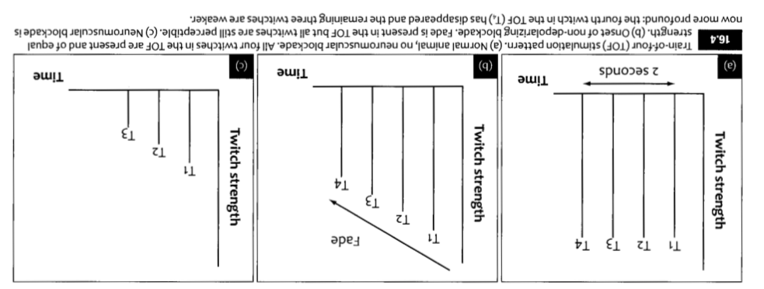
Train of Four
Most common pattern of nerve stimulation, assesses blockade intraoperatively & during recovery
Four electrical pulses applied to the nerve over a 2-second period (2 Hz)
In the absence of blockade:
    four distinct muscle twitches will occur (T1, T2, T3, T4), each identical in strength
  With blockade: fade response
    T4 becomes weaker and then disappears (75% of ACh receptors are blocked)
    T3 disappears (80% blocked)
    T2 disappears (90% blocked),
    T1 disappears (100% blocked)

Slide 15
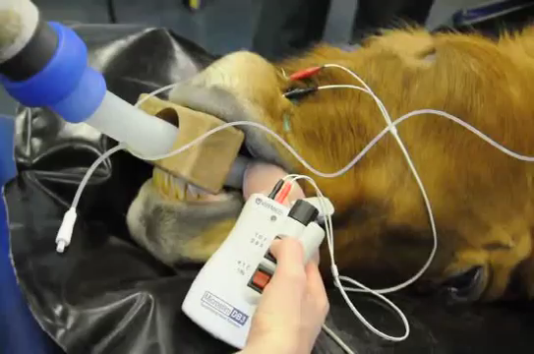
Train of Four
During recovery the twitches will reappear in reverse order
Fade is only observed with non-depolarizing agents
Acceleromyography: transducer detects a voltage change that is proportional to the acceleration of a contracting muscle, allowing the machine to display a quantitative TOF ratio
    In humans, TOF ratio of 0.9 is requires before extubation

Slide 16
Tetanic Stimulation
sustained electrical stimulus of 50 Hz for a 5 second period
muscle stimulation summates to produce one sustained muscle contraction
with blockade, tetanic fade will be observed
painful in awake patients, rarely used

Slide 17
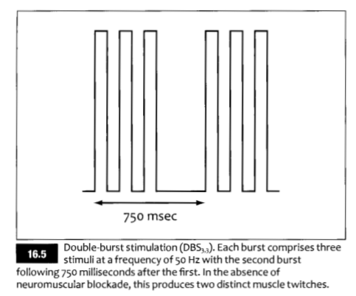
Double Burst Stimulation
three short pulses at 50 Hz, followed by either 2 or 3 additional pulses
resultant muscle response is two individual muscle twitches, which are stronger than those produced by train of 4
can be easier to interpret because only two successive twitches are being observed
Preferable to detect residual neuromuscular blockade

Slide 18
Monitoring Adequacy of Anesthesia
Degree of neuromuscular blockade has gives no indication of adequacy of anesthesia
Depth may be more difficult to assess as many of the typical responses are eliminated
What responses may be eliminated in patients receiving NMBAs?
eyes remain centrally positioned
elimination of palpebral response
elimination of jaw tone
paralysis of respiratory muscles prevents alterations in spontaneous ventilatory patterns
gross movement impossible

Slide 19
Monitoring Adequacy of Anesthesia
Degree of neuromuscular blockade has gives no indication of adequacy of anesthesia
Depth may be more difficult to assess as many of the typical responses are eliminated
What may be seen in response to inadequate anesthesia in patients who have received a NMBA?
tachycardia, hypertension
excessive salivation
increased tear production,
dilation of the pupils
increased in end-tidal CO2
isolated muscle twitching (particularly in extremities, tongue or oral commissures)

Slide 20
NMBA use with Concurrent disease
Renal and hepatic disease:
  atracurium (or cisatricurium) agent of choice due to unique mechanism of degradation
Acid-base/ electrolyte disturbances:
  hyperNa+ and hypoK+ generally potentiate NMBAs
  hypoNa+ and hyperK+ generally antagonize NMBAs
Myasthenia gravis:
  extremely sensitive to non-depolarizing NMBAs
  one-tenth of typical dosing should be used with strict monitoring
Spinal cord injury:
  may increase sensitivity to non-depolarizing agents

Slide 21
Reversal
Recovery from blockade may occur spontaneously
Alternatively, non-depolarizing agents may be reversed with anticholinesterases
How do anticholinesterases work?
Inhibit acetylcholinesterase, preventing degradation of ACh, allowing for accumulation of ACh, which is then able to competitively displace the NMBA from the post-synaptic ACh receptor, restoring neuromuscular transmission
What are the major side effects of anticholinesterases and how can these be avoided?
Anticholinesterases will also allow build-up of ACh at muscarinic receptors in the parasympathetic system, resulting in bradycardia, arrhythmias (eg. AV block, sinus arrest), bronchoconstriction, miosis, salivation, defecation, diarrhea. To prevent these effects, anticholinesterases should be administered with an antimuscarinic agent, such as atropine or glycopyrrolate.

Slide 22
Reversal
Neostigmine
  slow onset, long duration
  generally used with gylcopyrrolate
Edrophonium
  rapid onset, short duration
  generally used with atropine
Pyridostigmine
  slow onset, long duration
What is the risk of reversing a long-acting NMBA with a short-acting anticholinesterase?
There is an increased risk of return of neuromuscular blockade once the anticholinesterase concentration declines

Slide 23
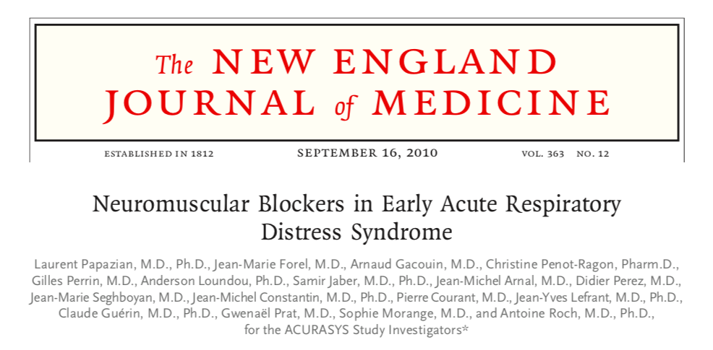
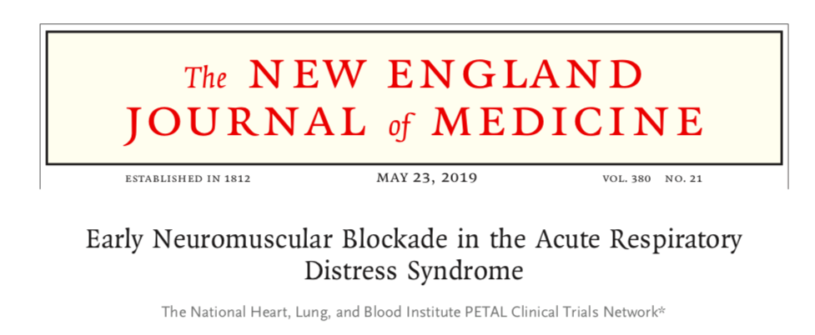
Neuromuscular blockers in Ards
What are the proposed benefits of using NMBAs in mechanically ventilated patients?
improves ventilator-patient synchrony
eliminates work of breathing
may improve gas-exchange
reduction in alveolar fluid accumulation
What are risks of using NMBAs in mechanically ventilated patients?
development of muscle weakness
need for deeper sedation

Slide 24
ACURASYS (NEJM 2010) – study design
Multi-centre, randomized, placebo-controlled, double-blinded trial
Onset of severe ARDS in past 48 hours
  Severe ARDS = PF <150
  PEEP 5 cmH2O and 6-8 mL/kg TV
  Bilateral pulmonary infiltrates
  Absence of left atrial hypertension
Randomized to received either: cisatracurium CRI (n =178) for 48h or placebo (n = 162)
  Allowed for up to two boluses of cisatracurium if persistent high Pplat
Ventilation procedure standardized
Primary outcome: 90 day in-hospital mortality
Secondary outcomes: 28d mortality, days outside the ICU, days without organ failure, rate of barotrauma, rate of ICU-acquired paresis, MRC scores, ventilator free days
ARDS definition?

Slide 25
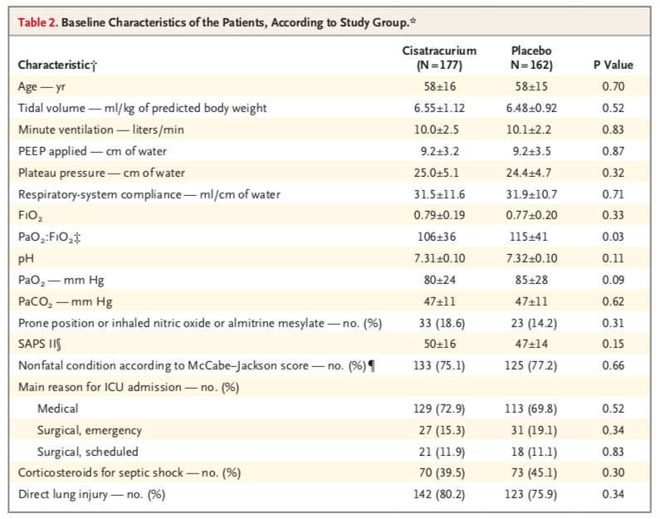
ACURASYS (NEJM 2010) - Results

Slide 26
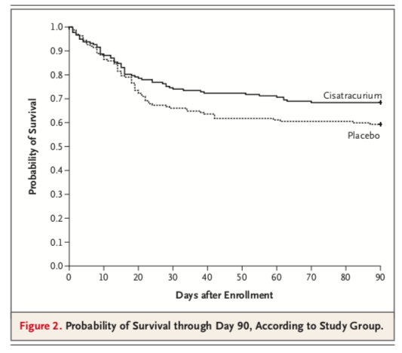
ACURASYS (NEJM 2010) - Results
  Cisatracurium: hazard for death 0.68 (95% CI, 0.48-0.98; P=0.04)
    Adjusted for baseline P:F, plateau pressure, and simplified acute physiology II score
    Crude 90-d mortality 31.6% (95% CI, 25.2 to 38.8) versus 40.7% (95% CI, 33.5 to 48.4, P=0.08)

Slide 27
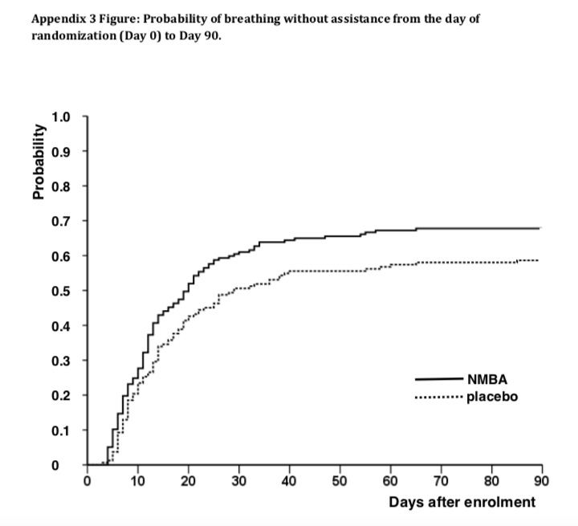
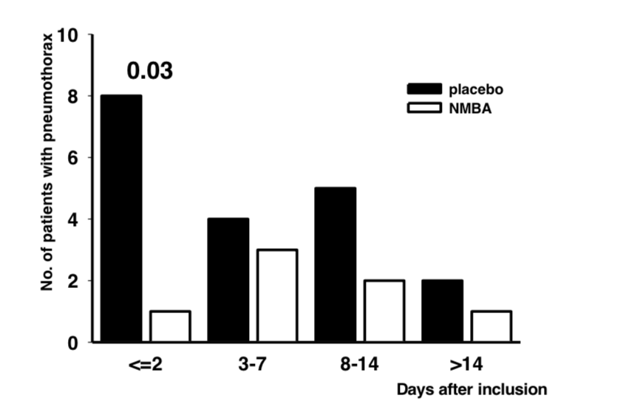
ACURASYS (NEJM 2010) - Results
  Cisatracurium group
    More ventilator free days
    More days free of organ failure (15.8+/- 9.9 days versus 12.2 +/- 11.1 days; P=0.01)
    Less incidence of barotrauma & pneumothorax (4.0% versus 11.7%; P=0.01)
    No difference in ICU-acquired paresis
Conclusion: early administration of a NMBA improved 90d survival and increased time off the ventilator without increasing muscle weakness

Slide 28
ACURASYS (NEJM 2010) - Limitations
Specific to cisatracurium
Specific to severe ARDS
Concurrent conditions may antagonize or potentiate effects of NMBAs
Mortality rate in placebo group lower than expected, making study underpowered
Beneficial effect of NMBA on survival confined to the two-thirds of patients with a P:F <120
  Subgroup analysis based on P:F
  Probability of survival to day 90 (log-rank test)
    PaO2:FiO2 <120, p=0.05
    PaO2:FiO2 ≥120, p=0.74

Slide 29
ROSE PETAL (NEJM 2019) – Study Design
Multi-centre unblinded, randomized trial
Moderate to severe ARDS
  P:F < 150 mmHg
  PEEP > 8 cmH20
  Bilateral pulmonary infiltrates
  Absence LA hypertension
Randomized to receive either cisatracurium CRI with deep sedation (n=501) versus usual care with lighter sedation targets (n = 505)
  86/505 (17%) received a NMBA in the usual care group
Standardized ventilation strategy (including high-PEEP strategy)
Primary outcome: 90d in-hospital mortality
Secondary outcomes: organ dysfunction, 28d mortality, ICU-free days, ventilation-free days, recall of paralysis, ICU-acquired weakness, arrhythmias, barotrauma

Slide 30
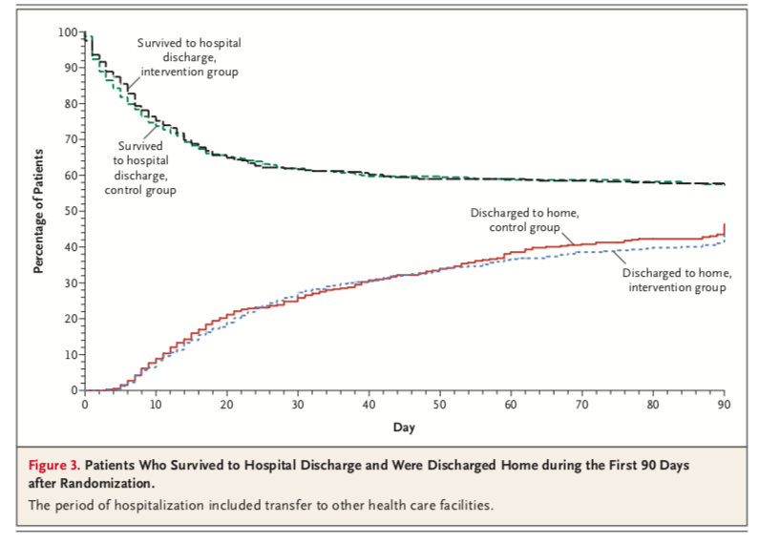
ROSE PETAL (NEJM 2019) – Results
Trial stopped early for futility
Primary outcome: No difference in mortality (42.5% versus 42.8%; p=0.93)
Secondary outcomes: more CV adverse events in cisatracurium group (14 vs 4), control group more physically active
No difference in barotrauma, ICU-acquired muscle weakness
Conclusion: no significant difference in mortality at 90 days between patients who received early standardized cisatracurium infusion versus usual care

Slide 31
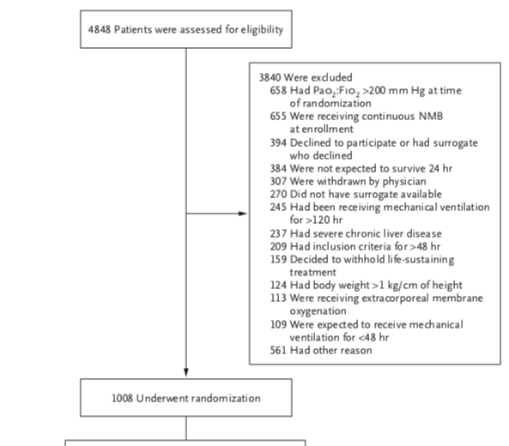
PETAL (NEJM 2019) – Limitations
Higher PEEP than ACURASYS trial (best care) -> may have blunted treatment effect of NMBAs?
Adverse CV events may have been a result of deep sedation rather than NMBA
Lower mortality in control group may have been a result of lighter sedation protocol?
Lack of blinding
Many patients lost following enrollment due to have already received neuromuscular blockade or already improved
  May have biased the results in favour of the control group
Trial stopped early -> technically underpowered
Fewer patients proned

Slide 32
References
The National Heart, Lung, and Blood Institute PETAL Clinical Trials Network. Early Neuromuscular Blockade in the Acute Respiratory Distress Syndrome. N Engl J Med. 2019;380(21):1997-2008. doi:10.1056/NEJMoa1901686.
Papazian L, Forel J-M, Gacouin A, et al. Neuromuscular blockers in early acute respiratory distress syndrome. N Engl J Med. 2010;363(12):1107-1116. doi:10.1056/NEJMoa1005372.
Constanzo Physiology 6th Ed
Ganong’s Review of Medical Physiology 24th Ed
Essentials of Small Animal Anesthesia & Analgesia 2nd Ed Grimm et al.
BSAVA Manual of Canine & Feline Anesthesia & Analgesia

