Slide 1
Acquired Myelopathies
Dr Williams
Cornell University
ECC Boards Review

Slide 2
Acquired myelopathies
IVDH
FCE
Neoplastic myelopathies
Traumatic myelopathies

Slide 3
Intervertebral Disk Disease/Herniation

Slide 4
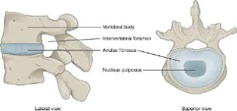
Intervertebral Disk Disease/Herniation
normal IVD:
  incompressible nucleus pulposus
  encompassing annulus fibrosus
together with the ligamentous annulus fibrosus allow limited motion in any plane
resilience to resist the compressive forces

Slide 5
IVDD in humans
initiating factor for IVDD in humans → loss of diffusional capacity of the vertebral endplate blood vessels that provide nutrition for the nucleus pulposus
decreases the production of extracellular matrix, leading to secondary degenerative changes in the annulus fibrosus

Slide 6
In dogs IVDD is most likely associated with multigenetic predispositions:
  Some of these may cause vasculopathy,
  Other genes appear to be associated with selection for chondrodystrophy
  Premature senescence of notochordal cells and replacement by chondrocyte-like cells → critical mechanism in chondrodystrophoid dogs

Slide 7
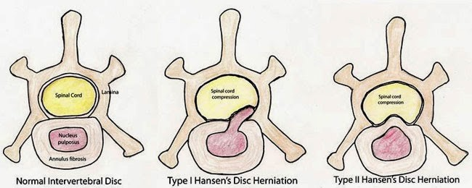
The pathological features of IVDD in dogs were described in Hansen’s classic study published approximately 60 years ago

Slide 8
Hansen Type I - chondroid degeneration
chondrodystrophic dogs
NP dehydrates and becomes dystrophically calcified
Foci of mechanical stress on the annulus
Rupture of individual collagenous strands of the annulus until a final mechanical failure, which can occur catastrophically, releases the degenerate nucleus
This extrusion can occur in any direction, but frequently is dorsally directed

Slide 9
Hansen Type II - fibroid degeneration
nonchondrodystrophic dogs
The annulus is the focus of the degenerative process,
The fibers of the annulus become split from one another allowing accumulation of tissue fluid and plasma
The mechanical pressure exerted by the nucleus causes thickening of the annulus, especially dorsally
This can cause the annulus to protrude into the vertebral canal

Slide 10
Most cases of clinically relevant IVDH can be classified into 1 of these 2 types of syndrome
Some cases of IVDH do not fit neatly into one or the other of these categories

Slide 11
Clinical signs can appear rapidly in association with type II IVDH, and chronic clinical signs can be associated with type I IVDH
Which dogs can be considered chondrodystrophic (Cocker Spaniels, Beagles) often are included in this group despite the lack of characteristic stunted limbs

Slide 12
All types
Most affected dogs exhibit no external evidence of this degenerative process
When clinical signs do occur, they usually result from impingement of the degenerating disk on neural structures
Stretching of fibers of the dorsal annulus or of the dorsal longitudinal ligament also may cause pain
When clinical signs do occur, they can result either from:
(1) stretching the fibers of the dorsal annulus or of the dorsal longitudinal ligament
(2) impingement of the degenerating disk on neural structures

Slide 13
IVDH vs IVDD
IVDH cansummarize mechanisms by which a degenerating disk can cause pain and neurologic deficits
‘Localized displacement of the intervertebral disk beyond the normal 3-dimensional anatomic limits of the disk’

Slide 14
This then can be broadly divided into 2 subtypes:
1) extrusion of the degenerate nucleus (type I)
2) protrusion of the degenerating annulus into the vertebral canal (type II).
These 2 events imply different modes of injury to the spinal cord. Nuclear extrusion results in a mixed compressive and contusive lesion

Slide 15
Type III IVDD or traumatic disk prolapse
Peracute extrusion of apparently normal IVD nucleus
associated with supraphysiological, mechanical stress during athletic activity
A portion of the nucleus is explosively expelled through the annulus
No evidence of preexisting disk degeneration
The injury to the spinal cord varies widely
Can be very severe

Slide 16
Consequences of IVDH
1) Contusion
Localized axonal injury can be detected immediately after spinal cord contusion and there is evidence of vascular injury including breaching of the blood–spinal cord barrier
Little immediate structural disruption.
Followed during the succeeding few (approximately 7) days by an evolving secondary lesions
Key pathological event of contusion injury is Ca entry into neuronal cell bodies, axons, astrocytes, and oligodendrocytes.
  apoptosis or necrosis
Free radicals release

Slide 17
Clinical Signs of contusion
Rapid loss of neurologic function (seconds to minutes)
In association with IVDH the clinically observable events may occur over a period of minutes to days
Depend on location of lesion

Slide 18
2) Myelomalacia
May spread cranially and caudally
Can be fatal.
It is most common after severe acute TL contusion
10% of dogs with negative DPP
MOA: not completely understood, suspect consequence of ischemia
Signs: loss of initially intact spinal reflexes, respiratory distress, and, finally in many cases, death as a result of respiratory paralysis
Warning signs: decreased body temperature and ascending cutaneous trunci (panniculus) reflex cutoff
  Can be detected within about 2 days of the injury
No treatment

Slide 19
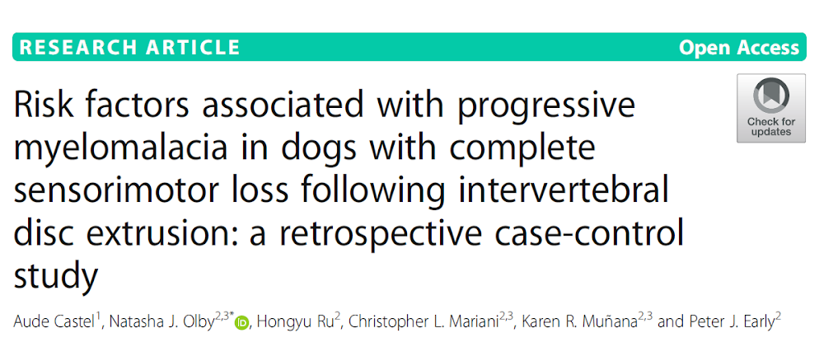
Dogs with lumbar intumescence IVDE are at increased risk of PMM
Timing of surgery and corticosteroid use warrant further investigations
PMM and recovery of walking are influenced by different factors

Slide 20
3) Spinal Cord Compression
Chronic compression will lead to axonal loss, with evidence of Wallerian degeneration in the segments distal to the lesion
White matter damage is most prominent
MOA: not been elucidated but have been assumed to be caused by poor blood flow owing to the increased pressure within the glial boundaries
Mild compression can cause a reversible damage

Slide 21
Clinical Signs of compression
In type II IVDH classically insidious onset
Owners typically report a loss of function occurring over a period of weeks to months
  Often with periods in which a step-like acute worsening occurs
Depend on localization of the lesion
Signs of pain may be reported: reflects stimulation of nociceptors in the annulus or arise because of nerve compression

Slide 22
4) Lesions of the Spinal Nerves
Peripheral nerve injuries because of the proximity of the spinal nerves to the intervertebral disks
Contusive injuries to nerves less common and self-limiting
There are 2 main anatomical sites at which nerve compression can occur
  the vertebral canal in the lumbosacral region
  The foramina at any intervertebral space.

Slide 23
Spinal nerves commonly are compressed in type I TL IVDH: source of pain.
In the cervical or LS regions, lateralized disk extrusions may cause lameness or limb pain because of nerve compression (nerve root)
In the LS → cauda equina
Lateralized IVD lesions in LS can cause lameness rather than typical neurologic deficits
Nerve compression can be exquisitely painful
  Should be suspected in animals that present with “screaming pain,” even without other localizing signs

Slide 24
Distribution of IVDH
Acute cervical IVDH: 75-80% C2 to C4
TL segment: 75–80% of acute IVDH: T11 and L1
Chronic IVDH is most common in the caudal cervical, TL and L7/S1
TL more susceptible because it lies at the junction between the heavily muscled lumbar region and the rigid thoracic cage
Caudal cervical region predisposed to chronic IVDH due to increased rotational forces that can be applied to those IVD owing to the orientation of the articular facets
LS may be susceptible because it is the focus of locomotor forces transferred from the pelvis to vertebral column, and there is also a high incidence of congenital deformities at this intervertebral space

Slide 25
IMAGING MODALITIES
X-rays:
Recommended for dogs presented with pain alone
Useful to rule out major lesions

Slide 26
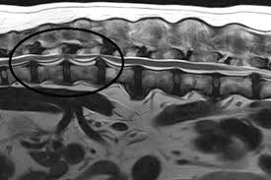
MRI:
Detail of the spinal cord parenchyma
Hyperintensity on T2W scans that can be correlated with the region in which the blood–spinal cord barrier has been compromised
The extent of T2W hyperintensity after an acute disk extrusion can have prognostic value

Slide 27
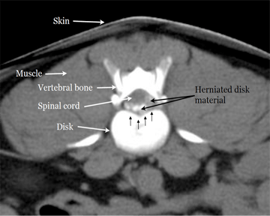
CT
Sensitive to changes in radiographic density
  allowing definition and high spatial resolution of calcified nuclear material within the vertebral canal or intervertebral foramina
Cross-sectional image allows very clear definition of the circumferential location of the extruded or protruded material
less sensitive than MR
  Difficult to detect non-calcified disks
  Hemorrhage associated with disk extrusion is not clearly differentiated from spinal cord

Slide 28
MRI or CT?
Choice between these modalities in diagnosing symptomatic IVDH relies on deciding whether imaging the spinal cord or the compressing material itself is of greatest importance
Goal is to accurately localize extruded material so that a surgical procedure to access and remove it can be planned.
Can be achieved by CT in most cases
MRI provides a critical advantage in detecting nonmineralized compressive material (hemorrhage, or type II IVDH)

Slide 29
Treatment of Symptomatic IVDD:
Tendency for spontaneous recovery of function after injuries to the nervous system, and therefore there is argument over the extent to which surgical intervention is necessary to aid in recovery
Variability in presenting clinical signs and whether they are recurrent or first-time occurrences, all of which may affect the treatment decision

Slide 30
Contusion Injuries
There is no medical or surgical intervention
  apart from maintenance of blood pressure within normal limits.
Methylprednisolone sodium – NACSIS trial
Small study in experimental dogs failed to detect any improvement over placebo after MPSS

Slide 31
Nursing care plus rehabilitation exercises
No data to support their effectiveness
Possible complications of severe contusive injuries
  pneumonia, decubital ulcers, and urinary tract infection,
  The time needed for recovery varies among individual animals and depends on severity and site of the lesion, but the full recovery period is at least 3 months
Some contusive injuries are of sufficient severity to preclude functional recovery
These currently are difficult to identify at the time of injury, although they will have loss of DPP soon after the impact

Slide 32
Spinal Cord Compression
Medically or surgically
The spinal cord is able to function satisfactorily even when it is compressed to some degree
  There appears to be a threshold level of compression at which its function becomes rapidly compromised.
how much compression justifies a decompressive surgical procedure?

Slide 33
Compression Associated with Type II IVDH:
Progressive over months and frequently are associated with moderate-to-severe compression that may be exacerbated by a dynamic component—especially in the cervical region
These cases are clear candidates for surgery
There are no comparable data available for thoracolumbar IVD protrusions.
On the whole, the decision for individual dogs affected by TL type II IVDH is made after consulting with the owner about their goals and potential to recover or suffer injury.
In largebreed dogs: consider the possibility of concurrent DM
Outcome frequently very gratifying, especially when the disk is excised using corpectomy
  there is often a risk of recurrence at another site
  Steroids – benefit/side effects

Slide 34
Spinal Cord Compression Associated with Type I IVDH
Pain → candidates for surgical decompression
Decompression is warranted to accelerate and provide more extensive recovery in dogs that are nonambulatory and, sometimes, to alleviate pain in ambulatory patients
Data in mice suggest that compression of <50% of the spinal cord diameter may not be associated with long-term loss of function
  although it is difficult to interpret directly because the magnitude of contusive injury also will vary in clinical cases
Data suggest that rapid decompression is beneficial, although the effect is minimal if decompression is not carried out within approximately 6–8 hours of injury, which may not always be practical

Slide 35
Recurrent Clinical Signs Associated with IVDD
Most animals that suffer clinical signs associated with IVDD are at risk of future episodes because the degenerative process
Clinical signs can recur
signs associated can vary from mild spinal pain to deep pain-negative paraplegia that may later prove irreversible
Known risk of recurrence after decompressive surgery alone, although the reported proportions vary widely from study to study.

Slide 36
Prognostic indicators
Testing DPP is the only method that is in common use
  50% of deep pain-negative dogs will recover, it is not possible to identify which of them will recover when they present
Biomarkers
myelin basic protein concentration and creatine kinase activity in CSF
Levels of MMP-9 activity in CSF
Concentration of tau protein in the CSF
  delay between sample acquisition and the need for intervention

Slide 37
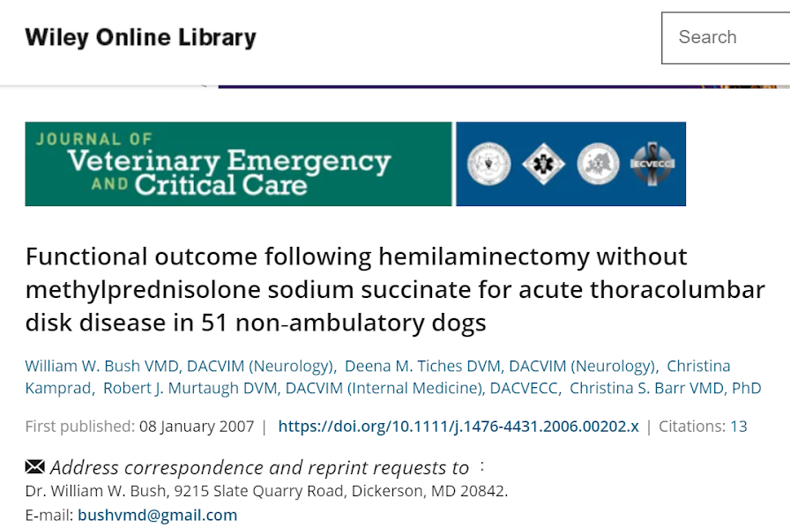
Hemilaminectomy is highly successful in returning non‐ambulatory, small breed dogs to full function
In these dogs MPSS may not be a necessary adjunct to surgery

Slide 38
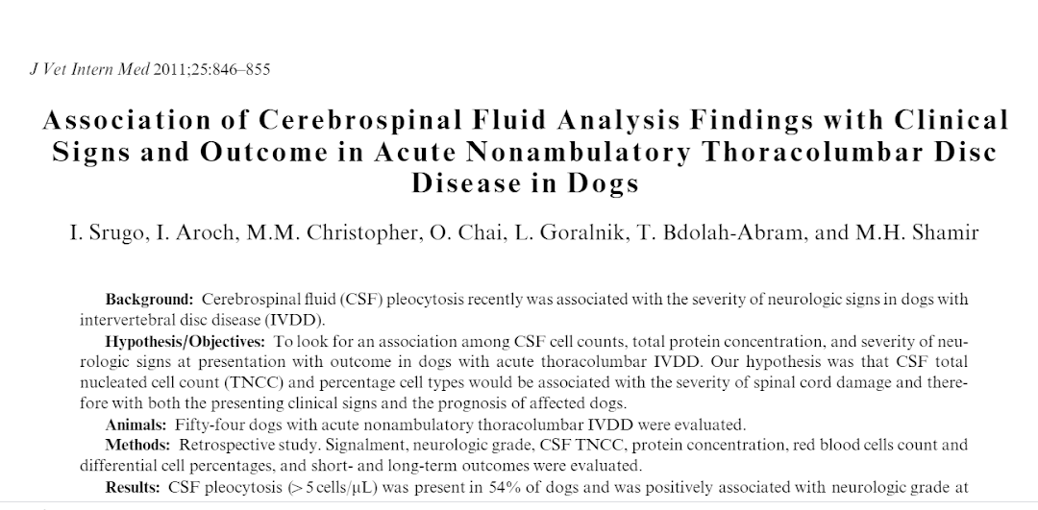
CSF pleocytosis is positively associated with the severity of spinal cord damage in dogs with thoracolumbar IVDD. The percentage of CSF macrophages can be used as a prognostic indicator for regaining ambulation in dogs that have lost DPS

Slide 39
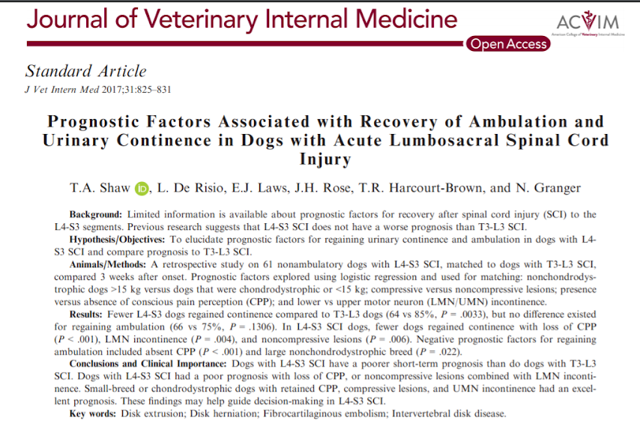

Slide 40
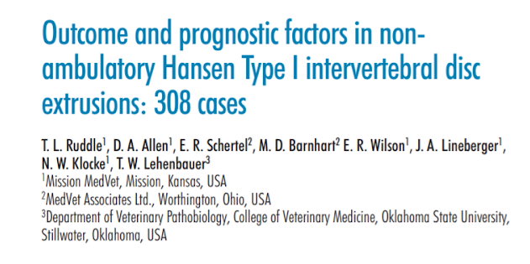
disc space did not have any effect on outcome
Dogs with deep pain present preoperatively had a 1.7 times better chance for becoming ambulatory compared to dogs without deep pain perception
There was no significant difference in the ability to regain ambulation or time to ambulation between dogs that were treated with corticosteroids pre- or postoperatively compared to those patients that did not receive steroids
The patients with disc extrusions at or caudal to L3–4 were twice as likely to achieve strong ambulatory status sooner than those patients with disc extrusion between T10-L3
Increasing age had a negative effect on regaining strong ambulatory status

Slide 41
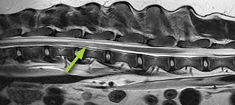
Fibrocartilaginous Thromboembolism

Slide 42
Common syndrome caused by embolization of arterial and/or venous supply to an area of spinal cord
The embolizing material is fibrocartilage that it is believed to originate from the NP of the IVD
The mechanism by which this material reaches the spinal cord vasculature is unknown
Theories:
  Venous entry
  Arterial entry

Slide 43
Affects mainly nonchondrodystrophic dogs - giant and large breeds
Smaller breeds and cats have been reported
20% of FCE dogs are smaller than 20 kg
  Mini Schnauzers
Age of onset varies: juvenile to elderly
Some very young Irish wolfhounds described
Most cats: middle aged to older
Most feline cases: C6 - T2

Slide 44
Hx of peracute to acute onset and progression of clinical signs
Most patients reach peak severity of neuro status within 24 hours, many within 6 hours or less
  Very rarely they develop dysfunction over several days
Usually pet cries in pain during exercise of mild traumatic event, shortly before the onset of neuro dysfunction
  50% of dogs that develop FCE - during intense physical activity
  43-79% of of cats develop FCE during intense physical activity
The usually do not present to us in pain
Spinal hyperestesia can be elicited in 20% of FCE cases, usually in the acute phase of the disease

Slide 45
Signs:
Clinical signs vary upon localization
Deficits are moderate to strongly asymmetric
Signs do not typically progress after the first 24 hrs of infarction
Strong asymmetry of cutaneous trunci reflex in the TL region (different cut-off levels) is a very common feature
Most common location in dogs:
  L4-S3 (44-50%)
  T3-L3 (27-42%)

Slide 46
Most common location in cats:
  C6-T2
  Cats can have very severe presentations

Slide 47
Diagnosis
  History and signalment
  Clinical signs
  DDX: IVDDm trauma and mielitis
  Rads, CSF and myelogram are usually WNL
  MRI: focal, sharp demarcated, hyperintense parenchymal lesions on T2-W and FLAIR images
  Lesions often primarily within gray matter of the spinal cord, and unilateral in location

Slide 48
Treatment
  No study has systematically evaluated treatment for FCE
  Recovery rates are much faster than IVDD
  Vasodilators - no evidence of beneficial support
  Controlled physiotherapy might have benefits

Slide 49
Outcome
  Most pets show improvement in the first 3-7 days post FCE
  Developement of collateral circulation and reperfusion may be responsible for this improvement
  For non-ambulatory (and large/giant) dogs - prognosis is guarded
  Negative prognostic indications: loss of DPP or severe LMN damage
  Overall prognosis is positive (84% with successful outcomes)
  Median recovery times: 3.75 months to maximal neurologic status
  Prognosis in cats similar to dogs(79% recovery)
  Median recovery times: 3.5 to 11 days to recover ambulation

Slide 50
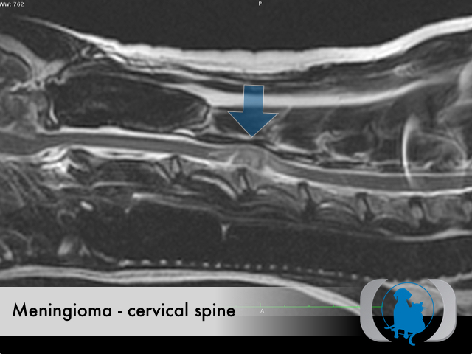
Neoplastic Myelopathy

Slide 51
Usually middle aged - older patients (> 5 years of age)
  Some seen in younger animals (LSA)
Much more common in larger dogs bs smaller breeds
Boxers and Goldens overrepresented for meningiomas
Median age in cats: 2-3 years
Usually cause progressive signs of myeloptahy, but acute or subacute development of spinal cord dysfunction often occurs, especially in feline spinal LSA
Rapid onset can be due to pathologic fractures, acute hemorrhage or necrosis of the tumor

Slide 52
Typically solitary lesions, can occur anywhere along the spine
Meningiomas and malignant nerve sheath tumors - frequently in cervical spine
  Nerve sheath tumors - very commonly in the cervical intumescence area

Slide 53
Types of neoplasms
Primary: arise from spinal cord parenchyma (neurons, glial cells)
  More common than metastatic
secondary tumors (primary or metastatic vertebral neoplasms, malignant nerve sheath tumors, and metastases to the extradural space or the cord parenchyma)
13% intradural/extramedullary
6% intramedullary
33% mixed compartment

Slide 54
Pathophysiology and distribution
They exert pathologic effects by compression and/or invasion of the spinal cord, as well as producing peritumoral edema, inflammation and hemorrhage
Extradural tumors:
  48% extradural
  Can be primary and secondary
  Vertebral and soft-tissue tumors
  Vertebral: OSA (the most common in dogs), chondrosarcoma, myeloma, fibrosarcoma
  Carcinomas are the most common secondary vertebral neoplasms in dogs
Intradural/extramedullary tumors:
  Meningiomas and malignant nerve sheath tumors are the most common
Intramedullary tumors:
  Infrequently encountered
  Most common primary tumors: Ependymoma and astrocytoma
  Most common secondary tumors: HSA and TCC

Slide 55
Clinical signs
Spinal hyperesthesia common feature of most spinal tumors, along with voluntary motor deficits.

Slide 56
Diagnosis
Signalment and history
Clinical signs
Bloodwork: non-specific, hyperglobulinemia in cases of MM
CSF can yield neoplastic cells
CT/MRI

Slide 57
Treatment
Supportive: prednisone 0.5 mg/kg PO BID
Curative: megavoltage radiation
  Chemo in LSA and MM
Prognosis: poor
  Data lacking, patients euthanized due to progression of disease

Slide 58
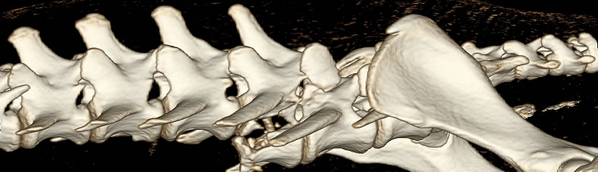
Traumatic myelopathies

Slide 59
Primary injuries:
1) Concussion and compression: Patients with external trauma have primarily a concussive injury. They may also have hematomas but the concussive injury is the most relevant
  Concussion is a more severe form of spinal cord injury. Prognosis of dogs with severe spinal cord injury (plegic with absent DPP) caused by external trauma is significantly worse compared with those dogs with acute IVDH

Slide 60
2) Vertebral fracture and luxation
  Most common sites: LS, TL and AA juctions
  Cats are more likely to suffer from sacro-caudal fractures and typically have a combination of fracture/luxation
  20% of the dogs will have a luxation only
  Sudden luxations can lead transection, contusion and compression
  Movement of unstable segments can lead to repeated small spinal cord injuries that lead to a deterioration in neurological status

Slide 61
3) Traumatic IVDH
occurs mainly in dogs with underlying IVDD
Pathology predisposes the annulus to rupture with trauma, resulting in compression of the spinal cord due to herniation of the nucleus pulposus into the canal
Less than 30% of dogs with traumatic IVD extrusion had spinal cord compression
  Type III IVDD is the most common consequence of the trauma - non-compressive herniation

Slide 62
4) Spinal cord contusion
damage to the blood vessel in the spinal cord parenchyma
Hemorrhage into the cord parenchyma due to trauma is not commonly reported in dogs and cats
Contusions can occur after fractures and luxations or traumatic IDVH.

Slide 63
5) Extra-axial hemorrhage:
Disruption of the blood supply to the supportive structures surrounding the spinal cord → results in accumulation of blood and hematoma formation
Subdural or epidural accumulation cna cause neurologic dysfunction by compressing spincal cord blood flow.
Rare in dogs and cats

Slide 64
Secondary injuries:
1) Excitotoxicity:
Excitatory neurotransmitters such as glutamate and aspartate are present in increased concentration in the spinal cord parenchyma due to leakage from damaged neurons as well as decreased clearance from ischemic astrocytes
The result is cellular edema and spinal cord swelling.
Compression of the swollen spinal cord leads to further cellular ischemia

Slide 65
2) Loss of autoregulation and ischemia:
Spinal cord blood flow remains constant despite changes in systemic blood pressure due to an intrinsic autoregulatory mechanism
This mechanism is compromised after spinal cord trauma
The ischemia effects primarily the gray matter because it has a higher metabolic need than white matter

Slide 66
3) Accumulation of intracellular calcium:
Excitotoxicity leads to activation of voltage-gated Ca channels, resulting in activation of phospholipase A2 that triggers the inflammation cascade
Increased intracellular Ca leads to neuronal death
4) Oxidative injury:
Increased intracell Ca and ischemia lead to production of reactive O2 species that react with neuronal cell membranes (rich in lipids)
5) Inflammation:
Can be severe
Release of NO as a chemotactic agent
Microvascular thrombosis

Slide 67
Stabilization and treatment:
Fluid therapy
  A patient with a SBP < 90 or a MAP < 80 mmHg is at risk of secondary spinal cord inijury
  Aggressive fluid therapy is warranted in all hypovolemic trauma patients
  Blood products if needed
  HTS: inotropic, immunomodulatory effects and reduced endothelial swelling
Pressors:
  Beneficial in patients with inappropriate vasodilation - common in trauma
O2 and ventilation
  Alleviation of pneumo/hemothorax
  Pulmonary contusions
  Cervical spinal trauma → Mechanical ventilation

Slide 68
Initial neurological evaluation:
  Once stabilized, brief neuro exam should be done
  All patients should be put or ‘taped’ to a rigid backboard to provide coaptation
  Neuro exam should evaluate:
    Mentation
    CN
    Ambulation
    Motor function
    Segmental reflexes
    Pain Perception

Slide 69
Diagnostics:
  Rads:
    Sedation can lead to further instability of the spinal column - handle with caution
    Low sensitivity for spinal fractures (72%) and subluxations (77.5%)
    Low NPV for the presence of fractures (51%) compared to CT
  CT:
    100% sensitivity for acute bony lesions
    Iohexol can identify edema and hemorrhage in the spinal cord
  MRI:
    Superior for evaluation of intramedullary changes
    Poor detail for bony structures

Slide 70
Specific therapy for spinal cord injury
Primary injuries:
  Vertebral fractures and luxations: surgical decompression, reduction or fixation
    Indications for surgical repair:
      Minimal voluntary motor or complete paralysis
      Clinical or radiographic evidence of highly unstable fractures
      Progression of neurologic signs despite appropriate non-surgical management
    Stabilization options:
    Internal fixation:
      Plates
      PMMA
      Screws
      Steinmann Pins

Slide 71
External coaptation and cage rest:
  6-8 weeks
  Splints need to immobilize the entire vertebral region
  Fore and hind limbs need to be included in the splint to immobilize the TL region
  Head and forelimbs to immobilize cranial cervical spine
  Splints should be checked and changed daily
  Suportive therapy - pain control and NSAIDs
  Nursing care

Slide 72
Traumatic IVDH:
  Type III IVDD are non-compressive in nature - surgery might not be beneficial
    Hemilaminectomy if indicated
    Cage rest + NSAIDS

Slide 73
Secondary injuries:
  Maintenance of perfusion
  Corticosteroids: controversial - NASCIS study
  Cell based therapies
  Rehab

Slide 74
Prognosis and complications
Recovery after trauma difficult to predict
Affected by type and severity of primary injury and effectiveness and timeline of treatments
Presence of nociception has been consistently correlated with prognosis
Fractures and luxations carry a poorer prognosis that traumatic IVDH
Cervical vertebral farcture stabilization is associated with a high perioperative mortality (36%)
  Dogs that survive this period have good prognosis for recovery
  Risk of post-operative ventilation
Prognosis in cats is similar to dogs

Slide 75
Thank you

