Slide 1
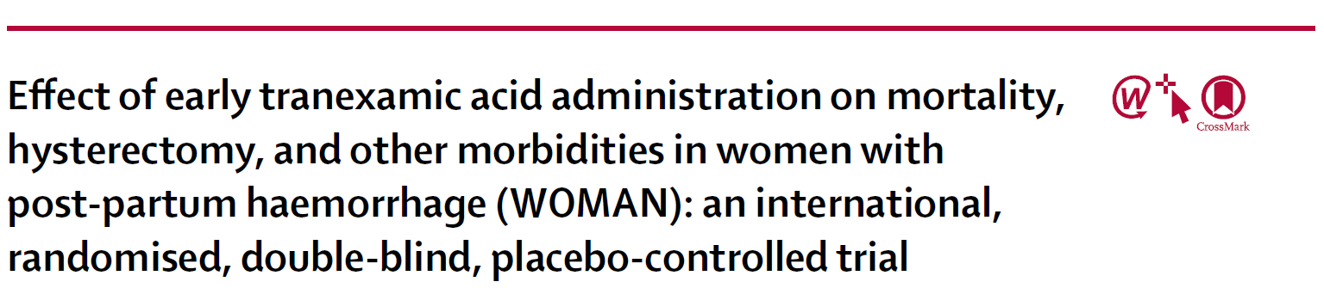
Journal Club
1/21/2020
Cornell University
Tomas Boullhesen-Williams

Slide 2
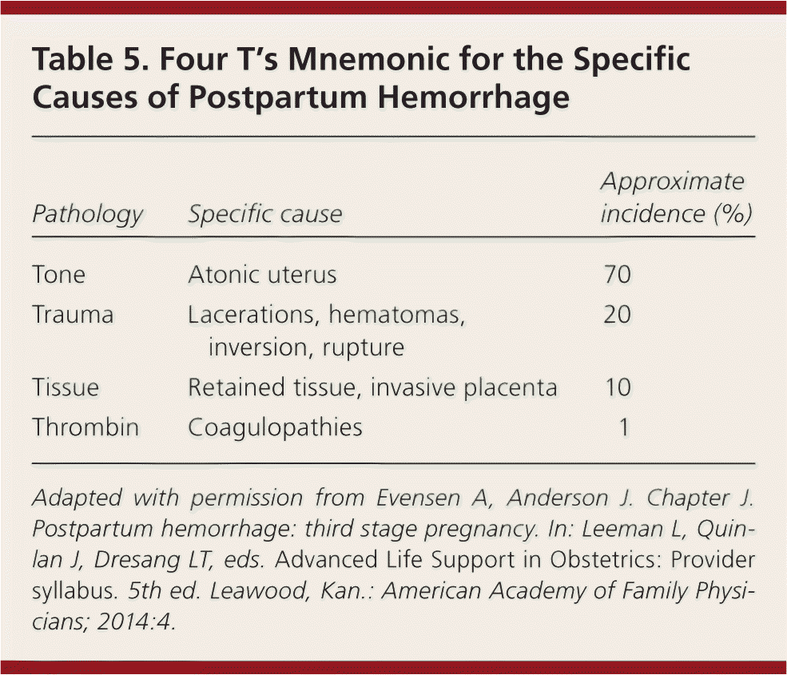
Introduction
Primary post-partum hemorrhage, usually defined as a blood loss of more than 500 mL within 24 h of giving birth
leading cause of maternal death worldwide, about 100 000 deaths every year
Most deaths occur soon after giving birth and almost all (99%) occur in low-income and middle-income countries

Slide 3
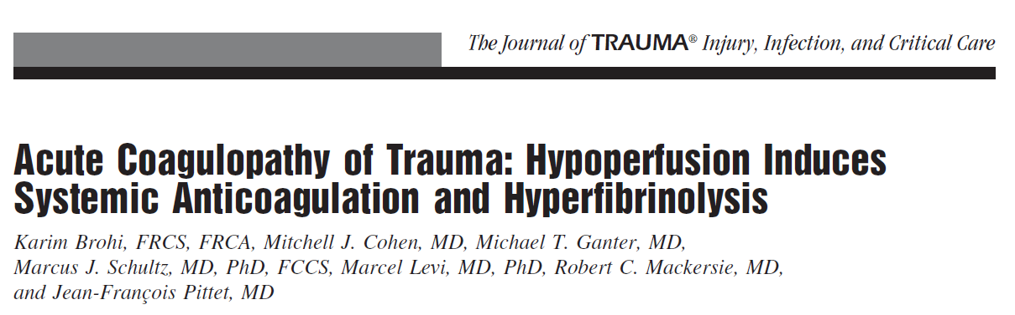
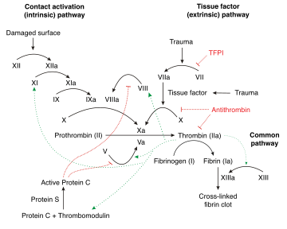
Coagulopathy is present at admission in 25% of trauma patients, is associated with shock and a 5-fold increase in mortality
associated with systemic activation of the protein C pathway
fibrinolysis associated with injury is exacerbated by shock and this is mediated by de-inhibition of tPA through the consumption of Plasminogen Activator inhibitor (PAI-1)
Low levels of PAI-1, in combination with the increased release of plasminogen activators from the vessel wall will result in hyperfibrinolysis

Slide 4
HEMOSTATIC DRUGS
Clinical disorders in small animals that may benefit from non-transfusional hemostatic drugs
  von Willebrand disease (vWD)
  hemophilia A and B and other hereditary coagulation factor deficiencies
  hereditary thrombopathies (Glanzmann’s thromboasthenia)
  acquired thrombopathies
  enhanced hyperfibrinolytic states after surgery or trauma.

Slide 5
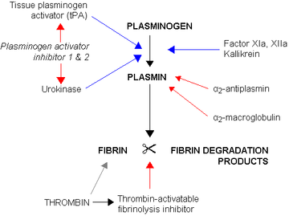
Fibrinolysis is initiated as tissue plasminogen activator and/or urokinase, which cleave plasminogen into plasmin
are released from the endothelium following injury, ischemia, or exposure to thrombin
Plasmin degrades fibrin into soluble fibrin degradation products

Slide 6
ANTIFIBRINOLYTIC DRUGS
The antifibrinolytic agents most commonly used in human and veterinary medicine are the synthetic lysine analogs ε-aminocaproic
acid (EACA) and tranexamic acid (TXA)

Slide 7
MOA
Plasminogen acts as a fibrinolytic substance by binding to fibrin at a lysine-binding site
Plasminogen → converted into plasmin → breaks down fibrin into fibrin degradation products.
Both, EACA and TXA reversibly block the lysine-binding site on plasminogen, which is essential for binding to fibrin
blocks the activation of plasminogen on the surface of fibrinogen and thereby prevents the breakdown of fibrin, although plasmin generation does occur

Slide 8
Indications
intraoperative hemorrhage (cardiac surgery, liver transplantation, spinal surgery, and orthopedic surgery)
gastrointestinal bleeding,
urinary tract and uterine hemorrhage
trauma

Slide 9
Contraindications
(possibly) patients with prothrombotic disease processes because there is a concern of promoting thrombus formation
  DIC, ATE, IMHA, Cushing’s

Slide 10
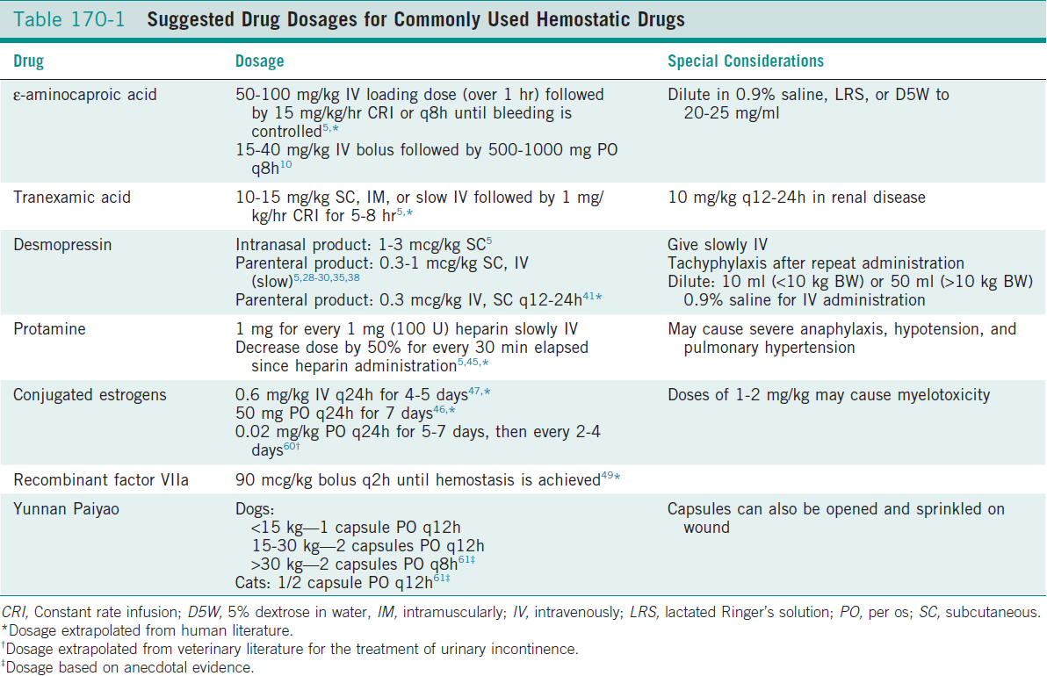

Slide 11
ε-Aminocaproic acid
competitively inhibits plasminogen activation and at higher doses may also directly inhibit plasmin
The elimination half-life of EACA is 1 to 2 hours in adult human patients
eliminated unchanged by renal excretion (65%); about 30% to 35% undergoes hepatic metabolism
Reported adverse effects in humans:
  Hypotension, nausea, vomiting, diarrhea, generalized weakness, myonecrosis with myoglobinuria, and rhabdomyolysis

Slide 12
Tranexamic Acid
competitive inhibitor of plasminogen activation and at high concentrations is a noncompetitive inhibitor of plasmin
6 to 10 times more potent in vitro than EACA, with higher and more sustained antifibrinolytic activity
shown to increase thrombus formation in animal models in a dose-dependent manner
Adverse effects are similar to EACA in humans

Slide 13
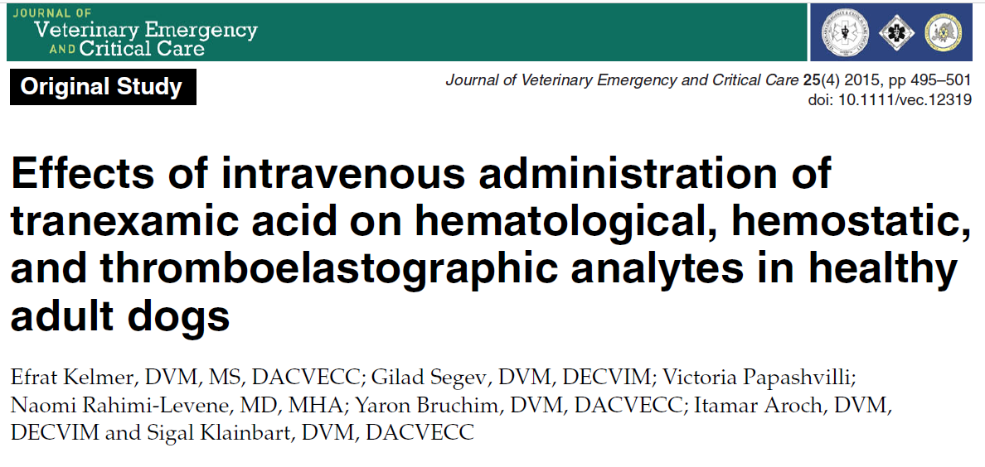
Administration of TXA as a slow IV bolus at 10 mg/kg, followed by a 10 mg/kg/h CRI over 3 hours to healthy dogs is safe
however, its effect on TEG A30, A60, LY30, and LY60 values was inconsistent with its expected anti-fibrinolytic properties

Slide 14
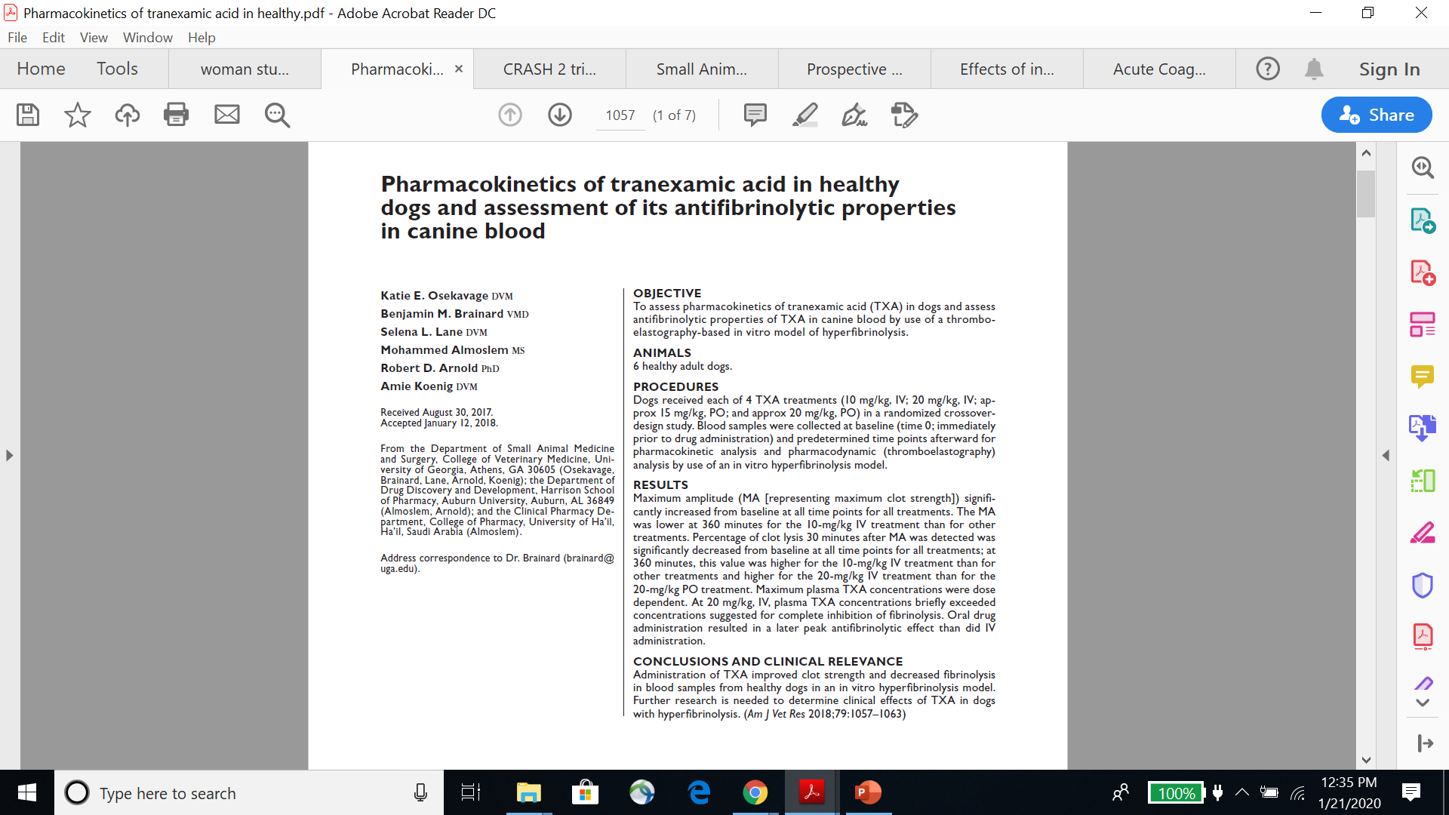
Maximum amplitude significantly increased from baseline at all time points for all treatments
The MA was lower at 360 minutes for the 10-mg/kg IV treatment than for other treatments
Percentage of clot lysis 30 minutes after MA was detected was significantly decreased from baseline at all time points for all treatments
Administration of TXA improved clot strength and decreased fibrinolysis in blood samples from healthy dogs in an in vitro hyperfibrinolysis model
Further research is needed to determine clinical effects of TXA in dogs with hyperfibrinolysis

Slide 15
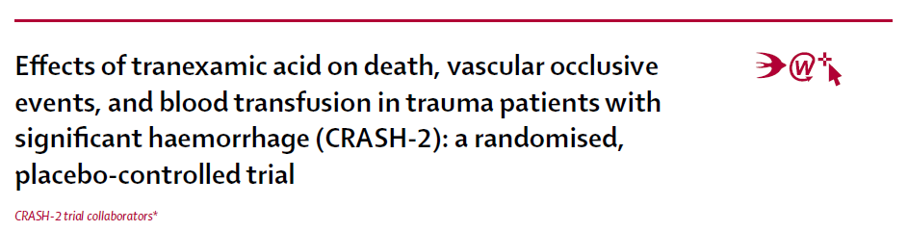
20 211 adults with acute traumatic bleeding
TXA reduced death due to bleeding, with no apparent increase in vascular occlusive events
Early treatment is essential
  In patients given treatment within 3 h of injury, tranexamic acid reduced death due to bleeding by nearly one third. However, when given after 3 h, there was no benefit

Slide 16
Back to WOMAN trial
Early activation of fibrinolysis is also recorded after childbirth
Within 1 h of giving birth, the serum concentration of tPA doubles, possibly because of tissue damage during childbirth; thereafter, the concentration falls
Based on results of clinical trials in surgery and trauma, TXA is recommended for the treatment of primary post-partum hemorrhage if uterotonics fail to control the bleeding or if the bleeding is thought to be due to trauma

Slide 17
Aim of the WOMAN Trail:
Evaluate the effects of early administration of tranexamic acid on death, hysterectomy, and other relevant outcomes in women with post-partum hemorrhage

Slide 18
Methods
international, randomized, double-blind placebo-controlled trial
women aged 16 years and older with a clinical diagnosis of post-partum hemorrhage after a vaginal birth or C section done
193 hospitals in 21 countries

Slide 19
diagnoses were clinical
Specified diagnosis:
  Estimated blood loss of more than 500 mL after vaginal birth or 1000 mL after caesarean section or any blood loss sufficient to compromise hemodynamic stability
  Patients received all usual care but were also randomly allocated to receive tranexamic acid or placebo

Slide 20
After eligibility was confirmed and consent procedures completed, baseline information was collected on the entry form
Patients were then randomly allocated to receive TXA or placebo

Slide 21
Procedures
Patients were randomly allocated to receive 1 g TXA or placebo by slow intravenous injection at an approximate rate of 1 mL per min
If bleeding continued after 30 min or stopped and restarted within 24 h of the first dose, a second dose of 1 g of TXA or placebo could be given
Outcome data were collected at death, discharge or 6 weeks (42 days) after randomization (whichever occurred first)
Adverse events were reported up to day 42

Slide 22
Outcomes
The primary outcome was death from all causes or hysterectomy within 42 days of randomization
Death was also assessed separately
Participating clinicians were requested to record the immediate cause of death
If there was more than one cause, clinicians were asked to record the main cause

Slide 23
Other secondary outcomes:
  Thromboembolic events
  surgical interventions (intrauterine tamponade, embolization, brace sutures, arterial ligation, hysterectomy, and laparotomies done after randomization to control bleeding and achieve hemostasis)
  complications (renal, cardiac, respiratory or hepatic failure, sepsis, and seizures)
  quality of life measured using the EQ5D
  status of any thromboembolic events in breastfed babies
Outcomes were measured at hospital discharge or on day 42 if still in hospital
Data were sent to the trial coordinating center

Slide 24
Statistical analysis
Before the trial started, they anticipated a baseline event rate of 2.5% for death and 2.5% for hysterectomy
Assuming a control group event rate of 2.5% for death and 2.5% for hysterectomy and that 1% of women die after hysterectomy
  they estimated that a trial with 15 000 women would have 90% power to detect a 25% reduction in the composite primary endpoint death or hysterectomy at the 5% significance level

Slide 25
During the trial it became apparent that the decision to conduct a hysterectomy was often made at the same time as randomization
  in response to life-threatening bleeding during caesarean section, a clinician might decide to do a hysterectomy, and while the hysterectomy is underway, the woman is enrolled into the trial.
Although TXA could affect the risk of death in these cases, it could not affect the risk of hysterectomy
To protect against the possibility that the effect of TXA on death and hysterectomy was different, the sample size was increased from 15 000 to 20 000 women.
  20 000 women should have sufficient power to detect a 25% reduction in mortality at the 5% significance level
  They hoped that the increased sample size might compensate for the dilution of the treatment effect from hysterectomies that were done at the same time as randomization

Slide 26
They also refined the study hypothesis in view of new evidence that had become available since the trial was initiated
CRASH-2 trial → TXA acid reduces death due to bleeding in trauma patients and that early treatment was more effective
  In response, they pre-specified an analysis of cause-specific mortality with death due to bleeding as the main outcome
  They also pre-specified subgroup analyses by time to treatment
  These changes were made before un-blinding and without any knowledge of the trial results

Slide 27
They reported the effects of treatment on the primary outcome
subdivided by three baseline characteristics:
  hours from giving birth to randomization (<1, 1–3, >3 h)
  type of birth (vaginal or caesarean section)
  and primary cause of hemorrhage (uterine atony vs all others)

Slide 28
Results
Between March, 2010, and April, 2016,
  20 060 women were enrolled and randomly assigned to receive
  TXA (n=10 051) v placebo (n=10 009)
20 002 (99·7%) received the first dose of the allocated treatment (10 037 received tranexamic acid and 9975 received placebo)
  Seven women withdrew their consent after randomization and we excluded (four in the TXA group and three in the placebo group)
  Unable to obtain primary outcome data for 32 women and 12 patients did not fulfil the trial eligibility criteria
  One patient in the TXA group was randomly assigned twice
Final number for analysis: 20 021 (99·8%) women

Slide 29
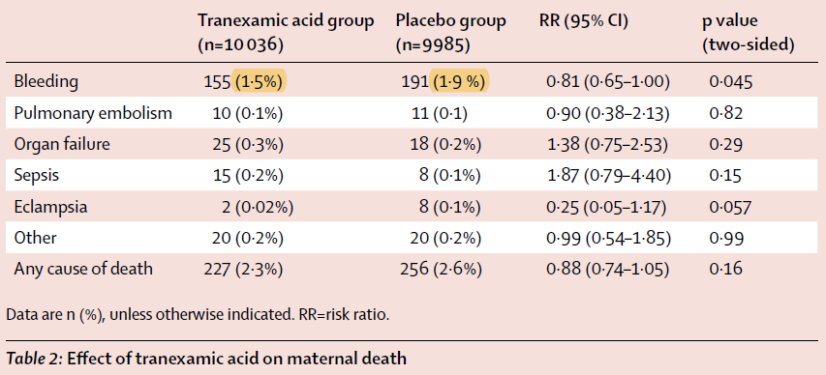
There were 483 maternal deaths of which 374 (77%) were within 24 h of randomization and 43 (9%) were within 1 h of randomization
346 (72%) deaths were due to bleeding
The risk of death due to bleeding was significantly reduced in patients who received TXA (155 [1·5%] of 10 036 vs 191 [1·9%] in the placebo group
After adjusting for baseline risk, the risk ratio for death due to bleeding with TXA was 0·78
Deaths from pulmonary embolism, organ failure, sepsis, eclampsia and other causes did not differ significantly between groups
Fewer deaths recorded from all causes with TXA but the reduction was not significant

Slide 30
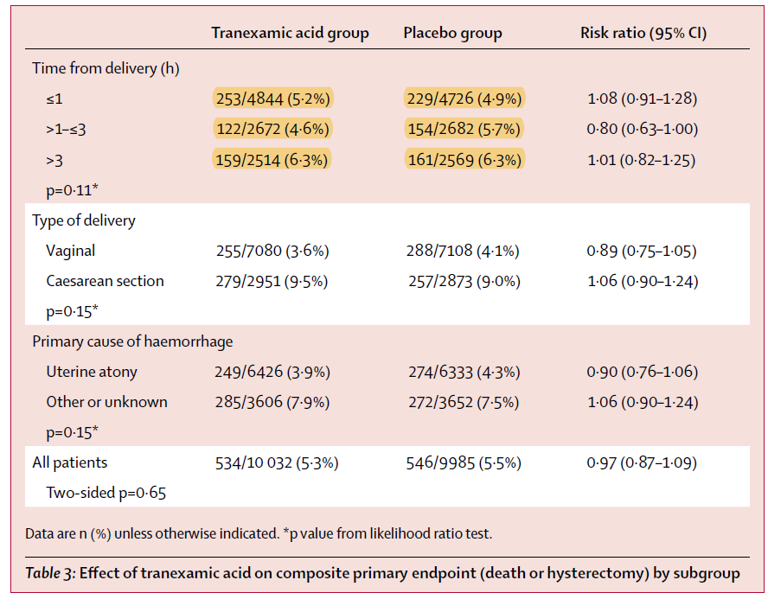
In women given TXA within 3 h of giving birth, TXA substantially reduced the risk of death due to bleeding (89 [1·2%] women died in the TXA vs 127 [1·7%] in the placebo group
There was no apparent reduction when TXA was given after 3 h (66 [2·6%] tranexamic acid group vs 63 [2·5%] placebo group
There was no difference in the effect by type of birth or cause of bleeding

Slide 31
TXA and hysterectomies
709 women had hysterectomies of which 608 (86%) were on the day of randomization and 191 (27%) were within 1 h of randomization
The risk of hysterectomy was not reduced with TXA (358 [3·6%] done in the TXA group vs 351 [3·5%] in the placebo group
The risk of hysterectomy to control bleeding was not significantly reduced with TXA (283 [2·8%] tranexamic acidgroup vs 295 [3·0%] placebo group

Slide 32
TXA and death
The primary endpoint of death from all causes or hysterectomy within 42 days of giving birth occurred in 1080 women
Of these, 371 (34%) women died without undergoing a hysterectomy, 112 (10%) died after hysterectomy, and 597 (55%) survived after hysterectomy
The risk of death from all causes or hysterectomy was not reduced with TXA (534 [5·3%] tranexamic acid vs 546 [5·6%] placebo group
There was no significant difference in the effect of TXA by type of birth or cause of bleeding

Slide 33
TXA and additional procedures
The use of intrauterine tamponade, embolization, manual removal of the placenta, and arterial ligation did not differ significantly between groups
Brace sutures were used more often in the TXA
209 laparotomies were done after randomization to control bleeding and achieve hemostasis of which 114 (55%) followed caesarean section births and 95 (45%) followed vaginal births
There was a significant reduction in laparotomy to control bleeding with TXA (82 [0.8%] TXA vs 127 [1.3%] placebo group

Slide 34
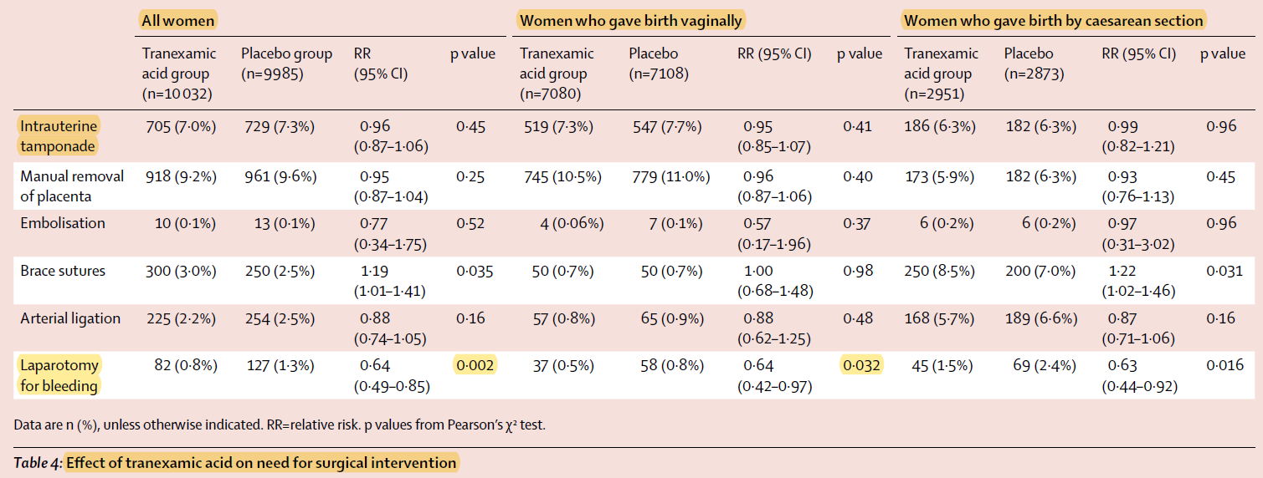

Slide 35
TXA and blood products
Blood product transfusions were given to 5461 (54%) of 10 036 patients allocated to TXA and 5426 (54%) of 9985 women allocated to placebo
The mean number of blood units received did not differ significantly between patients in groups
Of the women who died, 37 (7·7%) did not receive any blood products
  Of these, 18 (48·7%) were in the TXA group and 19 (51·4%) were in the placebo group

Slide 36
TXA and other complications
The incidence of thromboembolic events did not differ significantly between groups
The risk of organ failure (renal, cardiac, respiratory, and hepatic) and sepsis did not differ significantly between groups

Slide 37
TXA and other complications
33 (0.33%) women in the TXA group had a seizure versus 43 (0.43%) in the placebo group
Eight women in the TXA group suffered the death of a breast-fed baby compared with seven women in the placebo group
No thromboembolic events were reported in breast-fed babies in either group
Of women who survived, there were no significant differences in quality of life measures

Slide 38
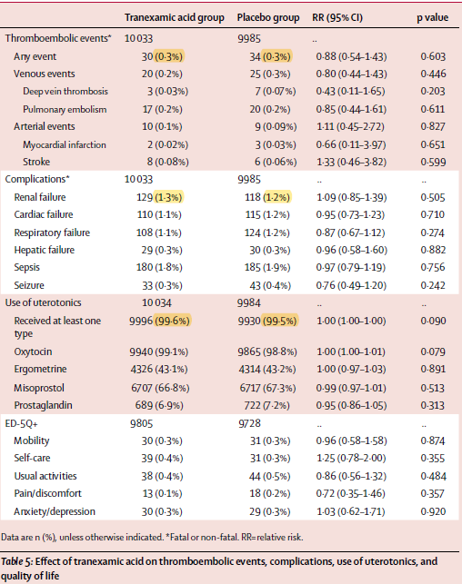

Slide 39
Discussion
The administration of TXA to women with post-partum hemorrhage reduces
  deaths due to bleeding
  laparotomy to control bleeding
  with no evidence of any adverse effects or complications
When given soon after delivery, tranexamic acid reduces death due to bleeding by nearly one third

Slide 40
Strengths of the study
Randomization
Population, multicenter
Almost all randomly assigned patients were followed up

Slide 41
Hysterectomies as a dilution factor
Although TXA did not prevent hysterectomy, it substantially reduced the number of laparotomies to control bleeding
While hysterectomy might be a last resort to control bleeding in high-income settings, in Africa and Asia where many women are anemic and blood supplies are limited, hysterectomy is often an early intervention to prevent death from exsanguination

Slide 42
Hysterectomies as a dilution factor
The dilution of the effect of TXA arising from interventions that were initiated prior to receipt of the trial treatment is likely to apply to other surgical interventions and blood transfusion
Given the urgency, clinicians cannot wait and see if the trial treatment has an effect before giving other treatments, not least because half of the women received placebo

Slide 43
How did this trial change practice?
WHO guidelines: pre-WOMAN
  recommended tranexamic acid in post-partum hemorrhage if uterotonics fail to stop the bleeding or if it is thought that the bleeding may be due to trauma
Results of WOMAN trial suggest that if tranexamic acid is used in the treatment of postpartum hemorrhage it should be given soon after the onset of post-partum hemorrhage alongside uterotonics
a significant proportion of mothers die within hours of post-partum haemorrhage onset.
  waiting to see if uterotonics fail to stop the bleeding could put some mothers’ lives at risk.

Slide 44
CRASH-2 and WOMAN
early administration is most effective:
  Treatment within 3 h of birth significantly reduced death due to bleeding and the need for laparotomy to control bleeding
  They did not see a monotonic decrease in the risk of death due to bleeding with decreasing time to treatment, as seen in trauma,
    likely to reflect the imprecision of the estimates rather than the underlying biological relationship
  There was a clear decrease in the risk of laparotomy to control bleeding as time to treatment decreased

Slide 45
CRASH-2 and WOMAN
The temporal changes in fibrinolytic activation after childbirth are similar to those in trauma with an early (within one hour) increase in levels of tissue plasminogen activator. However, in the light of this trial’s results, further research into the time course of the changes in coagulation and fibrinolysis after childbirth are needed

Slide 46
Weaknesses
In the WOMAN trial, TXA was given by intravenous injection
  in low-income and middle-income countries, many deaths from postpartum bleeding occur at home or settings where intravenous injections might not be feasible
Bioavailability of tranexamic acid after non-intravenous routes of administration needs to be assessed

Slide 47
Thank you!

