Slide 1
Lange CV Physio Questions

Slide 2
Match the following characteristics with the appropriate vessel classification.
Consist of single layer of endothelial cells Very distensible with thin-walls Have relatively thick walls Contain no smooth muscle Contain large component of elastin and collagen fibers Have large amount of smooth muscle Cannot actively change diameter Have one-way valves Contain more than 50% of blood volume Largest collective cross-sectional area “Resistance vessels” “Capacitance vessels” “Conduit vessels” “Exchange vessels”
Arteries
Arterioles
Capillaries
Venules/ Veins

Slide 3
Arteries | Contain large component of elastin and collagen fibers “Conduit vessels”
Arterioles | Have relatively thick walls Have large amount of smooth muscle “Resistance vessels”
Capillaries | Consist of single layer of endothelial cells Contain no smooth muscle Cannot actively change diameter Largest collective cross-sectional area “Exchange vessels”
Venules/ Veins | Very distensible with thin-walls Have one-way valves Contain more than 50% of blood volume “Capacitance vessels”

Slide 4
Define “diffusion potential”

Slide 5
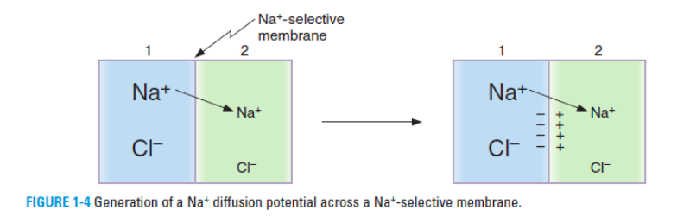
Diffusion potential: potential difference generated across a membrane because of the concentration difference of an ion. A diffusion potential can only be generated if the membrane is permeable to that ion.

Slide 6
Define “equilibrium potential”

Slide 7
Equilibrium potential: the diffusion potential that exactly balanced (opposes) the tendency for diffusion caused by a concentration difference, i.e. when the membrane potential has this value, there is no net movement of the ion across the membrane. The *Nernst equation* is used to calculate equilibrium potentials.
* Potassium equilibrium potential = -90 mV
* Sodium equilibrium potential = + 70 mV
* Calcium equilibrium potential = + 100 mV

Slide 8
Draw an action potential for a cardiac myocyte and describe what occurs during each phase

Slide 9
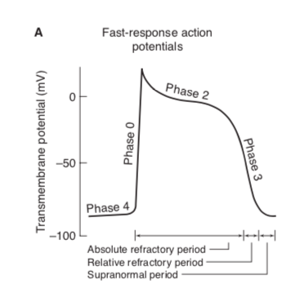
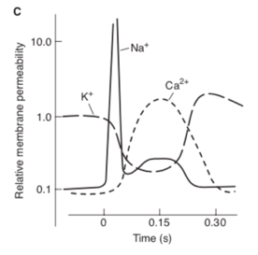
phase 0 = rapid depolarization with substantial overshoot (positive inside voltage)
opening of voltage-gated fast Na+ channels
phase 1 = rapid reversal of the overshoot potential*
initial brief depolarization
less Na+ conductance due to closure of Na+ channels
transient outward K+ current (iTO)
phase 2 = long plateau
slowly developed and prolonged opening of voltage-gated Ca+ channels, allowing inward Ca+ movement
action of Na+/Ca+ exchanger in which 3 Na+ ions move into the cell in exchange for a single Ca+ ion moving out
phase 3 = repolarization
delayed increase in K+ permeability, resulting in high outward K+ current
closure of the Ca++ and Na+ channels
phase 4 = stable, high (large negative) RMP
resting membrane potential
period during which inward and outward current are equal

Slide 10
Draw an action potential for a pacemaker cell and describe what occurs during each phase

Slide 11
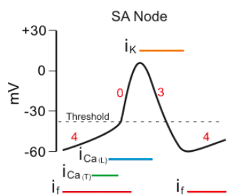
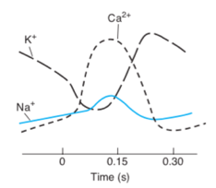
phase 4 = slow depolarization
depolarization to an unstable, slowly depolarizing “resting” potential referred to phase 4 depolarization, diastolic depolarization or pacemaker potential
occurs due to:
  conductance carried by “funny” channels (If)
  funny current is turned on by repolarization of the membrane potential during the proceeding action potential
  slight increase in permeability to Na+ and Ca+
progressive decrease in membrane’s permeability to K+ during the resting phase
phase 0 = depolarization
slower initial depolarization phase with lower amplitude overshoot
primarily a result of inward movement of Ca+ ions
phase 3 = repolarization
shorter and less stable plateau phase
increase in K+ conductance, resulting in outward K+ current
phases 1 and 2 are not present

Slide 12
Fill in the blank: Cardiac myocyte action potentials are of [ LONG/ SHORT ] duration compared to skeletal muscle.
Why is this physiologically relevant?

Slide 13
LONG DURATION
The refractory period does not end until the mechanical response is completed, which ensures that the heart cannot form fused contractions, i.e. prevents tetany and allows for diastole

Slide 14
What is the function of the sinoatrial node?
What is the function of the atrioventricular node?

Slide 15
Sinoatrial node
Spontaneous electrical pacemaker activity (automaticity) of cells in the SA node results in normal rhythmic contractions
Intrinsic rate of ~100 beats/minute (humans) in the absence of any outside influences
Atrioventricular node
slowly conducting cells that function to create a slight delay between atrial contraction and ventricular contraction
referred to as the latent pacemaker

Slide 16
Describe the autonomic nervous system controls heart rate. Include what neurotransmitters are used and what ion permeabilities are affected.

Slide 17
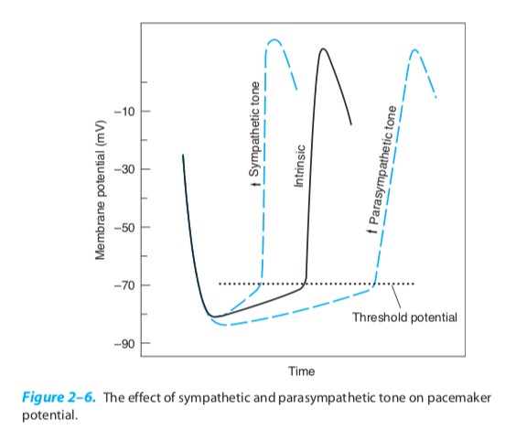
*Sympathetic* - increased heart rate
neurotransmitter = norepinephrine
increases inward currents carried by Na+ (if) and Ca+ during diastolic interval (increases rate of diastolic depolarization)
*Parasympathetic* - slows the heart rate
via vagus nerve, neurotransmitter = acetylcholine
increases permeability of the resting membrane to K+ (hyperpolarizes) and decreases the diastolic permeability to Na+ (slows rate of spontaneous depolarization)
tonic activity of the vagus nerve results in an average resting heart rate of approximately 70 beats/min

Slide 18
What is meant by dromotropy?
How does the autonomic nervous system affect dromotropy?
With a positive dromotropic effect, what change would you expect to see on a EKG?

Slide 19
Dromotropy refers to conduction velocity (mostly through the AV node)
Sympathetic activity has a positive dromotropic effect
Parasympathetic activity has a negative dromotropic effect
Positive dromotropic effect = increased conduction velocity = shortened PR interval
Negative dromotropic effect = slower conduction velocity = lengthened PR interval

Slide 20
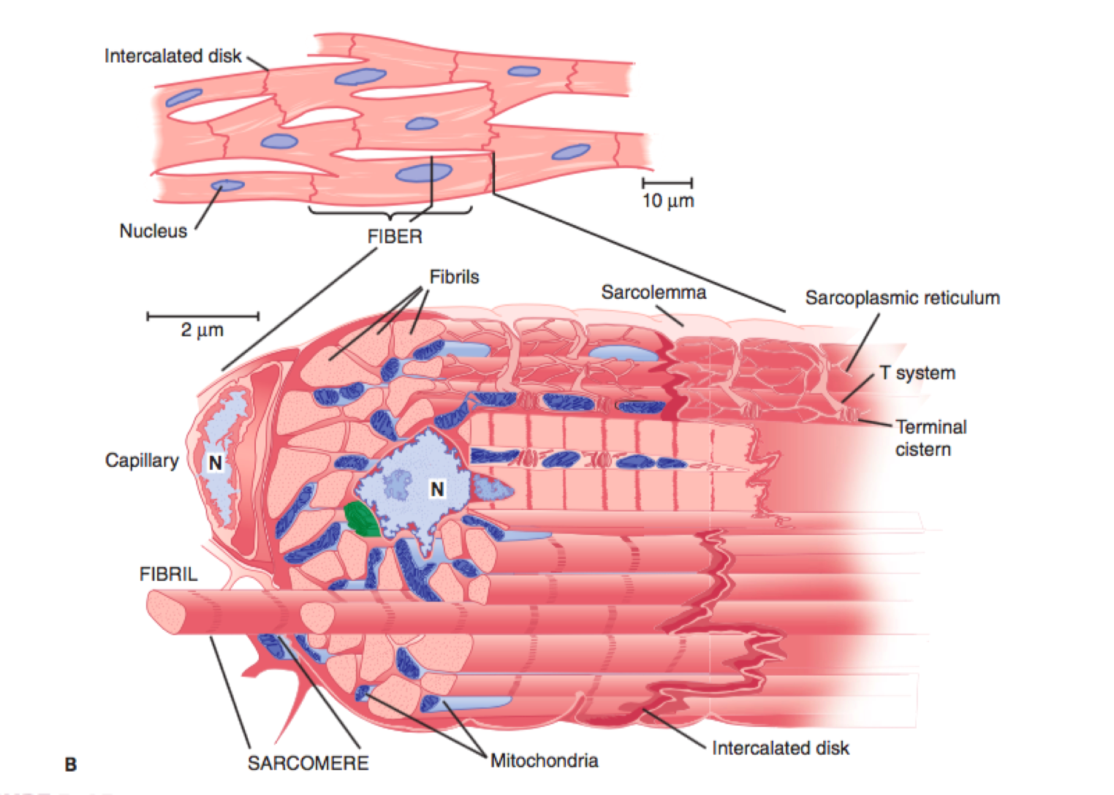
Label the following diagram of cardiac muscle

Slide 21
sarcomeres: parallel interdigitating thick and think filaments arranged in serial units to make an extensive myofibrillar structure, allowing for shortening
sarcoplasmic reticulum: intracellular membrane forming a complex internal compartmentalization of the cytoplasm; sequesters calcium
T-tubules: regularly spaced, extensive invaginations of the sarcolemma (cell membrane) that carry action potential signal to the inner parts of the cells
Large number of *mitrochrondia* to provide oxidative phosphorylation needed to supply ATP and meet the high metabolic demands of cardiac muscle

Slide 22
What are intercalcated discs and why are they physiologically relevant to cardiac muscle?

Slide 23
Cardiac muscle is connected by end-to-end structures called *intercalated disks*.
These disks contain:
Desmosomes: firm mechanical attachments between cell membranes
Gap junctions: Low-resistance electrical connections between adjacent cells formed by proteins called connexin. Allow for the heart to act as a *functional syncytium*

Slide 24
How is excitation-contraction coupling different in cardiac muscle than skeletal muscle?

Slide 25
It may be modulated - i.e. variation in intracellular Ca++ concentration will result in a different intensity of actin-myosin interaction, and resultant variation in CONTRACTILITY
Duration of cardiac muscle contraction is about the same as the action potential so that the refractory period is not over until the mechanical response is complete. As such, cardiac cells cannot form fused contractions!

Slide 26
Define isometric and isotonic contraction.
Do the inotropic effects of norepinephrine result in increased isometric or isotonic contraction?

Slide 27
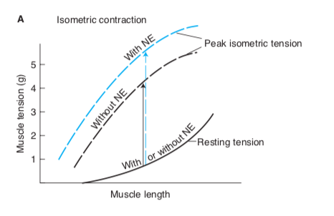
*Isometric contraction:* contraction without an appreciable decrease in the length of the whole muscle, i.e. fixed length
*Isotonic contraction:* contraction against a constant load with a decrease in muscle length, .e. fixed tension
Norepinephrine results in an increase in peak ISOMETRIC tension at a FIXED length.
(Mediated through β1 effects)
Increased calcium current during the plateau phase of the action potential, resulting in more cross-bridges to be formed and a greater tension to be developed

Slide 28
Fill in the blank: norepinephrine has a small [ POSITIVE/ NEGATIVE ] lusitropic effect on cardiac muscle

Slide 29
Norepinephrine has a small POSITIVE lusitropic effect on cardiac muscle.
Enhances the rate of relaxation
Norepi increases the activity of sarcoplasmic reticular Ca++ATPase pump, increase the rate of calcium re-uptake and thus enhancing the rate of relaxation.
Also shortens the duration of the action potential (by increasing K+ permeability) at higher heart rates, thus preventing compromise of diastolic filling time

Slide 30
Lange 2-1
Small changes in extracellular potassium ion concentrations have major effects on cell membrane potentials.
What will happen to the potassium equilibrium potential of cardiac muscle cells when interstitial [K+] is elevated?
What effect will this have on the cell’s resting membrane potential?
What effect will this have on the cell’s excitability?

Slide 31
Lange 2-1
What will happen to the potassium equilibrium potential of cardiac muscle cells when interstitial [K+] is elevated?
The potassium equilibrium potential will become less negative because a lower electrical potential is require to balance the decreased tendency for net K+ diffusion out of the cell
What effect will this have on the cell’s resting membrane potential?
B/c the RMP is most permeable to K+, the RMP will always be closest to K+. Thus, the RMP will also become less negative (depolarize).
What effect will this have on the cell’s excitability?
The RMP will be closer to the htreshold, intially making the cell more excitable
The fast sodium channels will become inactivated, making the cell less exctiable

Slide 32
Lange 2-3 A
What are the effects of sodium channel blockers on the PR interval on the ECG? On the duration of the QRS complex?

Slide 33
Lange 2-3 A
Sodium channel blockers delay the opening of the fast sodium channels. This slows the rate of depolarization (PHASE 0), which will in turn slow conduction velocity. This will result in prolongation of the PR interval, and widening of the QRS complex.

Slide 34
Lange 2-3 B
What are the effect of calcium channel blockers on the rate of firing of the SA nodal cells? On the rate of conduction of the action potential through the AV node? On myocardial contractility?

Slide 35
Lange 2-3 B
Calcium channel blockers slow the firing rate of SA nodal cells by blocking the calcium component of diastolic depolarization.
They will reduce the rate of AV nodal cell depolarization (which is largely due to calcium entry into cells) and slow the rate of AV nodal conduction
They will decrease the amount of calcium made available durin excitation-contraction coupling, and thus decrease tension production/ contractility

Slide 36
Lange 2-3 C
What are the effects of potassium channel blockers on the action potential duration? On refractory periods?

Slide 37
Lange 2-3 C
Potassium channel blockers inhibit the delayed increase in potassium permeability that contributes to the initiation and rate of repolarization of cardiac myocytes. This prolongs the plateau phase of the action potential, prolonging the QT interval of the ECG, and prolonging the refractory period of the cell.

Slide 38
Lange 2-8 (Multiple choice)
The primary route of removal of Ca++ from the sarcoplasm during relaxation of a cardiac muscle cell is by …
Active transport out of the cell
Passive exchange with extracellular sodium
Active transport into the sarcoplasmic reticulum
Trapping of calcium by troponin in the myofilaments
Passive movement out of the cell via L-type calcium channels

Slide 39
Lange 2-8 (Multiple choice)
The primary route of removal of Ca++ from the sarcoplasm during relaxation of a cardiac muscle cell is by …
Active transport out of the cell
Passive exchange with extracellular sodium
Active transport into the sarcoplasmic reticulum
Trapping of calcium by troponin in the myofilaments
Passive movement out of the cell via L-type calcium channels

Slide 40
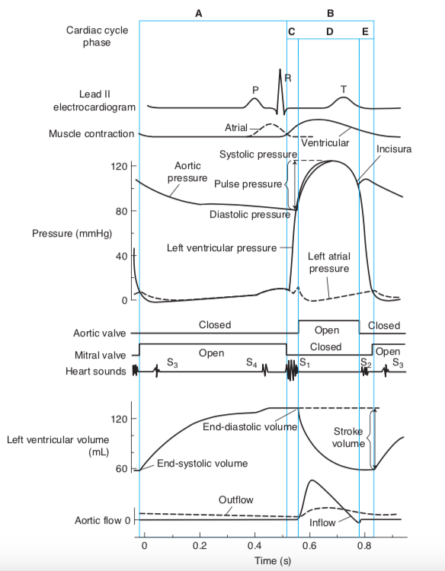
Label the following diagram of the cardiac cycle

Slide 41
Notes:
### Diastole
Diastole begins with opening of the AV valves when ventricular pressure falls below the atrial pressure. Previously accumulated blood in the atrium rapidly empties into the ventricles, causing initial drop in atrial pressure. Then the pressures in both chambers rise slowly together during passive filling.
*Atrial contraction* is initiated near the end of ventricular diastole, resulting in atrial kick. The ventricle has nearly reached it’s end diastolic volume even before atrial contraction at normal heart rates. At high heart rates, the time interval for passive filling becomes progressively shorter and the atrial kick becomes more relevant.
### Systole
Once the action potential breaks through the AV node, the pressure in the left ventricle rises sharply. When pressure exceeds that in the aorta, the aortic valve opens. The period between mitral valve closure and aortic valve opening is *isovolumetric contraction*. When the aortic valve opens, blood rushes into the aorta rapidly and causes the pressure there to rise. Once peak systolic pressure is reach, ventricular muscle contraction slows and eventually the intraventricular pressure falls below the aortic pressure. The aortic valve closes abruptly and creates the *incisura/ dicrotic notch* (small volume of aortic blood flows backwards to fill the aortic valve leaflets as they close). After the aortic valves close, the intraventricular pressure falls rapidly while the mitral valve is still closed, which is *isovolumetric relaxation*. Once the intraventricular pressure falls below atrial pressure, the AV valves open and a new cardiac cycle begins.

Slide 42
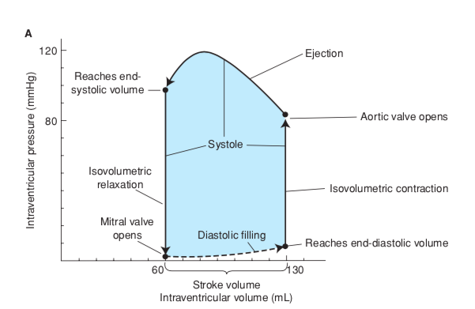
Label the following diagram

Slide 44
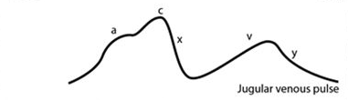
Describe the events occuring at each stage of a jugular venous pulse waveform

Slide 45
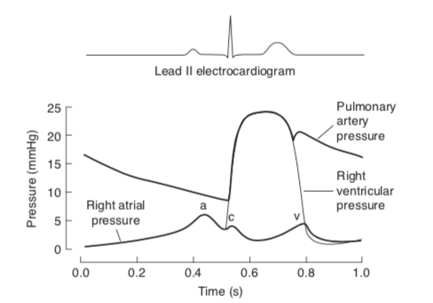
Jugular Venous Pulse = pressure pulsations that occur in the right atrium are transmitted in retrograde fashion to the large veins near the heart
a wave: atrial contraction
c wave: ventricular contraction (causes an initial bulging of the tricuspid valve into the right atrium)
x: atrial relaxation and downward displacement of the tricuspid valve during ventricular emptying
v wave: late systole, right atrium begins to fill behind a closed tricuspid valve
y: diastole, opening of the tricuspid valve and right ventricle fills

Slide 46
What is Starling’s Law of the heart?

Slide 47
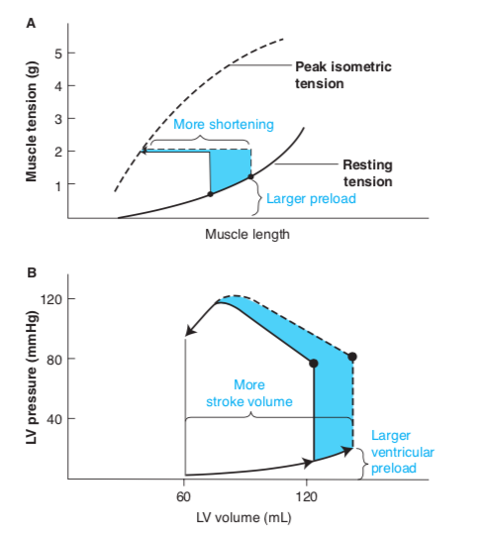
Stroke volume increases as cardiac filling increases.
i.e. increases in preload (cardiac filling pressure) will result in increased end-diastolic volume and stroke volume.

Slide 48
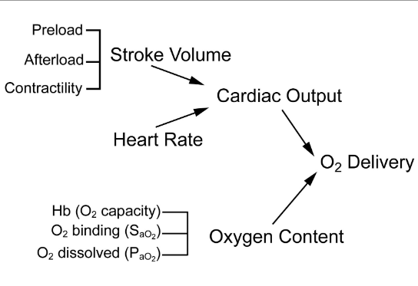
Fill in the blanks

Slide 49
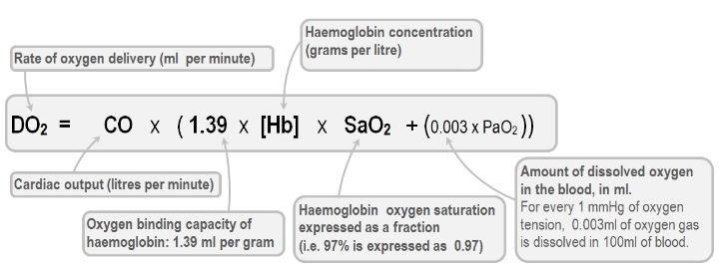

Slide 50
What is the law of Laplasse and how is it relevant to cardiac workload?

Slide 51
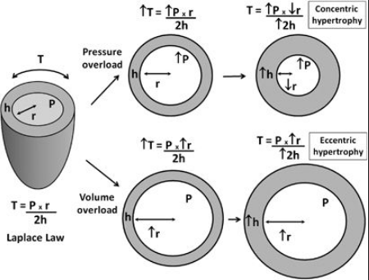
Law of Laplasse
Wall stress = pressure x radius/ 2(thickness of the walls)
The energy needed for isovolumetric contraction depends heavily on the intraventricular pressure (more specifically theiisometric wall tension/ stress). Thus, cardiac afterload is a major determinant of myocardial oxygen consumption, and reductions in after load are especially helpful in reducing myocardial oxygen requirements.

Slide 52
True or False:
In general, it is more efficient to achieve a given cardiac output with a low heart rate and high stroke volume than with a high heart rate and low stroke volume.

Slide 53
TRUE
In general, it is more efficient to achieve a given cardiac output with a low heart rate and high stroke volume than with a high heart rate and low stroke volume.
There is a relatively high energy cost for pressure development (wall tension) during the cardiac cycle. So, the less often wall tension must be developed, the better.

Slide 54
Lange 3-3
Which of the following interventions will increase cardiac stroke volume?
Decreased ventricular filling pressure
Decreased arterial pressure
Decreased activity of cardiac sympathetic nerves
Decreased circulating catecholamine levels

Slide 55
Lange 3-3
Which of the following interventions will increase cardiac stroke volume?
Decreased ventricular filling pressure
Decreased arterial pressure
Decreased activity of cardiac sympathetic nerves
Decreased circulating catecholamine levels

Slide 56
Lange 3-6
Four of these conditions exist during the same phase of the cardiac cycle and one does not. Which on is the odd one?
The mitral valve is open
The QRS wave of the ECG is occuring
The “v” wave of the jugular venous pulse is rapidly increasing
Ventricular volume is rapidly increasing
Aortic pressure is falling

Slide 57
Lange 3-6
Four of these conditions exist during the same phase of the cardiac cycle and one does not. Which on is the odd one?
The mitral valve is open
The QRS wave of the ECG is occuring
The “v” wave of the jugular venous pulse is rapidly increasing
Ventricular volume is rapidly increasing
Aortic pressure is falling

Slide 58
What is Fick’s principle of cardiac output measurement?

Slide 59
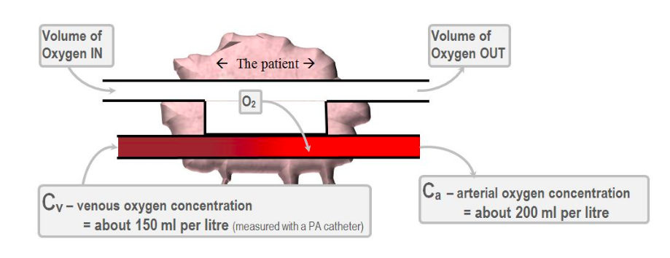
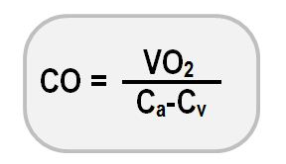
Fick’s principle is one of the most accurate methods of measuring cardiac output. This principle using the whole body oxygen consumption rate, the oxygen concentration in arterial blood, and the oxygen concentration in mixed venous blood.

Slide 60
How do you calculate ejection fraction?
How do you calculate fractional shortening?
What is normal fractional shortening?

Slide 61
Ejection fraction = stroke volume / end diastolic volume
In general, normal FS% is 28%–45% in the dog and 30%–50% in the cat. A FS% below 20% suggests severe myocardial systolic failure, and a FS% above 55% is considered hyperdynamic LV function

Slide 62
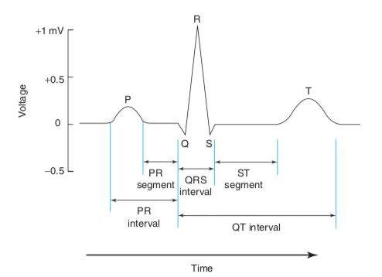
Match each label with the appropriate event
ventricular repolarization
atrial cells are depolarized (in plateau phase) and ventricular cells are resting
atrial depolarization
atrial cells are resting phase and ventricular cells are depolarized (in plateau phase)
ventricular depolarization
roughly approximates ventricular myocyte depolarization, i.e. ventricular systole
time it takes for an action potential to spread through the atria to the AV node

Slide 63
P = atrial depolarization
QRS = ventricular depolarization
T = ventricular repolarization (less evident than depolarization because it is less synchronoized)
PR interval= time it takes for an action potential to spread through the atria to the AV node
PR segment = atrial cells are depolarized (in plateau phase) and ventricular cells are resting, so no voltage is detected on the body surface
ST segment = atrial cells have returned to resting phase and ventricular cells are all depolarized (in plateau phase)
QT interval = roughly approximates ventricular myocyte depolarization, i.e. ventricular systole

Slide 64
Lange 4-1
Given the following information, calculate cardiac output:
Systemic arterial blood oxygen concentration = 200 mL/L
Pulmonary arterial blood oxygen concentration = 140 mL/L
Total body oxygen consumption = 600 mL/min

Slide 65
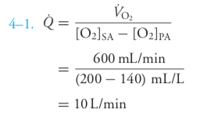

Slide 66
Lange 4-3 Multiple choice
An increase in atriventricular nodal conduction velocity will ..
Decrease the heart rate
Increase P-wave amplitude
Increase the PR interval
Widen the QRS complex
Increase ST-segment duration

Slide 67
Lange 4-3 Multiple choice
An increase in atriventricular nodal conduction velocity will ..
Decrease the heart rate
Increase P-wave amplitude
Increase the PR interval
Widen the QRS complex
Increase ST-segment duration

Slide 68
Lange 4-8
If something slows the conduction pathway of the action potential through the ventricular muscle, which of the following alterations would you most likely see on the ECG?
Absence of P waves
Prolongation of the PR interval
Prolongation of the QRS interval
Shortening of the QT segment
Elevation of the ST segment

Slide 69
Lange 4-8
If something slows the conduction pathway of the action potential through the ventricular muscle, which of the following alterations would you most likely see on the ECG?
Absence of P waves
Prolongation of the PR interval
Prolongation of the QRS interval
Shortening of the QT segment
Elevation of the ST segment

Slide 70
Match the following descriptions with the appropriate arrhythmia
Supraventricular tachycardia
Atrial flutter
First-degree heart block
Second-degree heart block
Third-degree heart block
Atrial fibrillation
Bundle branch blocks
Premature ventricular contractions
Ventricular tachycardia
Ventricular fibrillation
-May occur due to an ectopic focus within atrial tissue outside the SA node
-p waves are absent and instead there may be rapid-irregular waves apparent throughout diastole, and the ventricular rate is very irregular
-p waves appear normally and QRS complexes are longer than normal
-no pumping action occurs
-Caused by action potentials initiated by an ectopic focus in the ventricle
-Often followed by a missed beat/ pause, and the subsequent beat has a higher than normal stroke volume
-fatal unless corrected quickly by cardiac conversion
-Occurs due to large reentrant pathway within the atrium causing very fast atrial rates (250-300 bpm)
-results in an abnormally long PR interval
-some but not all p waves will be accompanied by a QRS
-ECG shows a sawtooth pattern of mergred p waves with intermittent normal QRS complexes
-often precedes ventricular fibrillation
-ventricles are driven at high rates from impulses originating from ventricular ectopic focus
-occurs when no impulses are transmitted through the AV node
-can occur in either of the branches of the Pukinje system
-Also called paroxysmal atrial tachycardia
-atrial and ventricular rates are completely independent

Slide 71
Supraventricular tachycardia | -Also called paroxysmal atrial tachycardia -May occur due to an ectopic focus within atrial tissue outside the SA node
Atrial flutter | -Occurs due to large reentrant pathway within the atrium causing very fast atrial rates (250-300 bpm) -ECG shows a sawtooth pattern of mergred p waves with intermittent normal QRS complexes
First-degree heart block | -results in an abnormally long PR interval
Second-degree heart block | -some but not all p waves will be accompanied by a QRS
Third-degree heart block | -occurs when no impulses are transmitted through the AV node -atrial and ventricular rates are completely independent
Atrial fibrillation | -p waves are absent and instead there may be rapid-irregular waves apparent throughout diastole, and the ventricular rate is very irregular
Bundle branch blocks | -can occur in either of the branches of the Pukinje system -p waves appear normally and QRS complexes are longer than normal
Premature ventricular contractions | -Caused by action potentials initiated by an ectopic focus in teh ventricle - Often followed by a missed beat/ pause, and the subsequent beat has a higher than normal stroke volume
Ventricular tachycardia | -ventricles are driven at high rates from impulses originating from ventricular ectopic focus -often proceeds ventricular fibrillation
Ventricular fibrillation | -no pumping action occurs -fatal unless corrected quickly by cardiac conversion

Slide 72
Lange 5-1
Which of the following arrhythmias might result in a reduced stroke volume? (multiple answers may be correct)
Paroxysmal atrial tachycardia
Ventricular tachycardia
Atrial fibrillation
Ventricular fibrillation
Third-degree heart block

Slide 73
Lange 5-1
Which of the following arrhythmias might result in a reduced stroke volume? (multiple answers may be correct)
Paroxysmal atrial tachycardia - filling time is reduced
Ventricular tachycardia - filling time is reduced
Atrial fibrillation - if ventricular rate is rapid filling time is reduced
Ventricular fibrillation - heart isn’t pumping
Third-degree heart block - ventricular pacemakers produce lower heart rate, which is usually associated with a larger SV

Slide 74
What is Starling’s equation? Revised equation?

Slide 75
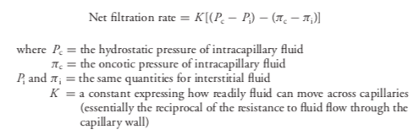
Revised Starling’ equation:
Net filtration rate = (capillary hydrostatic pressure - interstitial hydrostatic pressure) - (capillary oncotic pressure - subglycocalyx oncotic pressure)

Slide 76
Lange 6-5
Given the following data, calculate an individual’s total peripheral resistance:
Mean arterial pressure = 100 mmHg
Central venous pressure = 0 mmHg
Cardiac output = 6L/min

Slide 77
Lange 6-5
MAP = cardiac output x total peripheral resistance
100 mmHg = 6 L/min x TPR
TPR = 16.7 mmHg x L/min

Slide 78
Lange 6-6
TRUE/FALSE: The TPR to blood flow is greater than the resistance to flow through any of the systemic organs.

Slide 79

Lange 6-6
FALSE
TPR is less than the resistance to flow through any of the organs. When vessels with individual resistances are connected in parallel, the overall resistance of the network is given by:

Slide 80
Lange 6-11
TRUE/ FALSE: Acute increases in arterial pulse pressure usually result from increases in stroke volume

Slide 81
Lange 6-11
TRUE
Acute increases in arterial pulse pressure usually result from increases in stroke volume.
Arterial pulse pressure is defined as systolic pressure minus diastolic pressure.
C = △V/△P
△P = △V/ C
Arterial pulse pressure = △V/C
Arterial pulse pressure = stroke volume/ arterial compliance
Arterial compliance is relatively static, so changes in arterial pulse pressure is mostly a result of changes in stroke volume.

