Slide 1
Linked Data in LTS :
What’s all the fuss about?
Sarah Ross, LTS
LTS Continuing Education
September 28, 2016

Slide 2


Slide 3
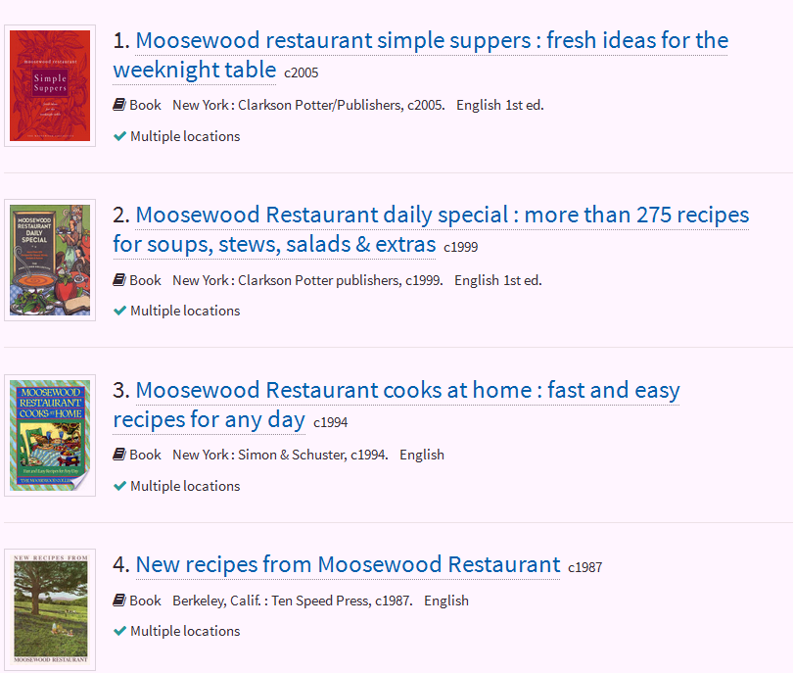

An evil use.
But we are librarians, so we do boring
instead.

Slide 4
Naun’s Prediction
In a few years, authority control without identifiers is going to seem like inventory without barcodes.

Slide 5
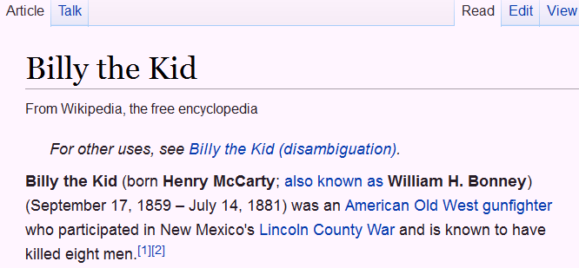
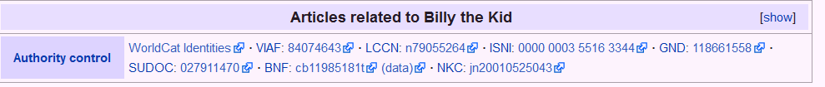

Slide 6
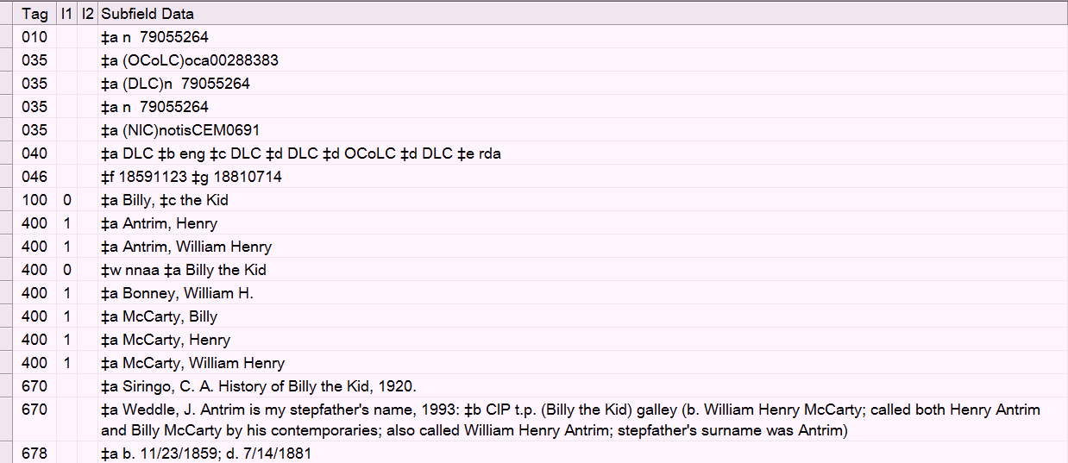
The NAF record. Note 010!

Slide 7
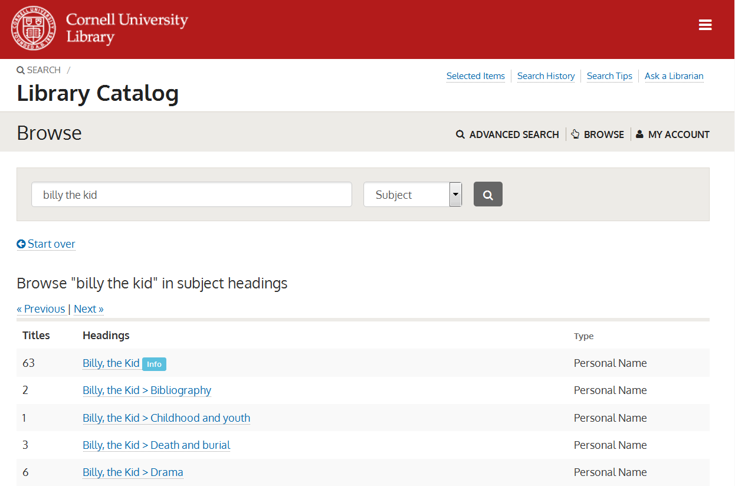
Currently in our OPAC

Slide 8
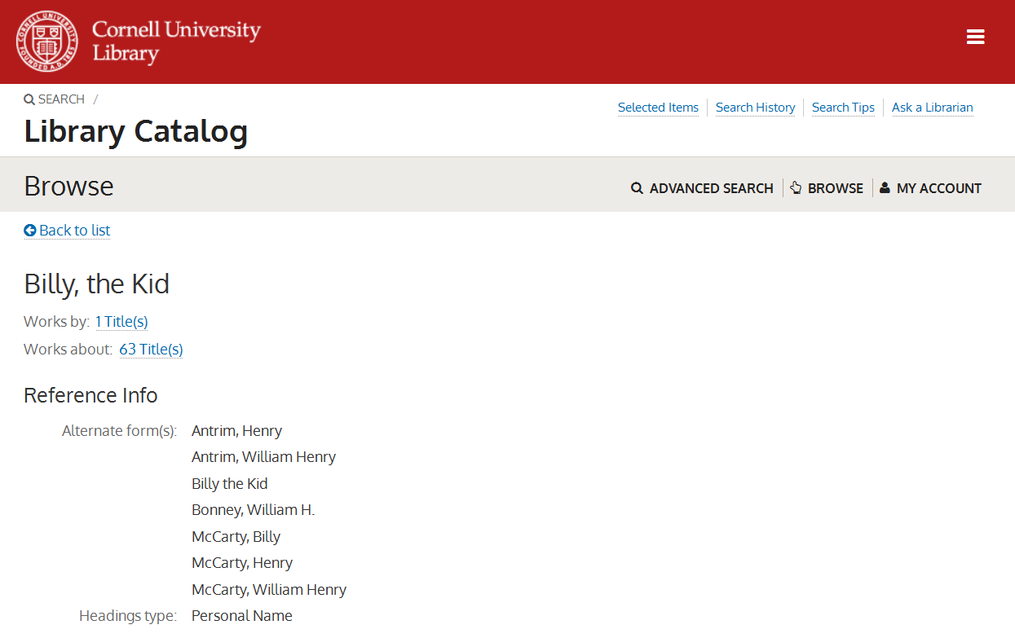
And the info button takes you here

Slide 9
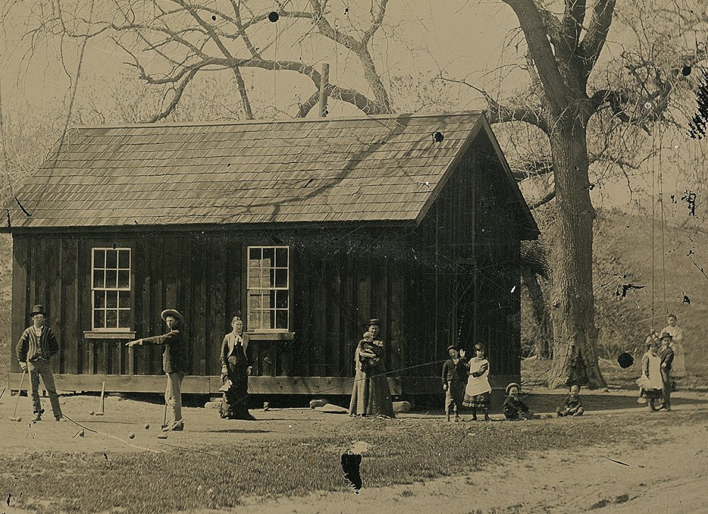
But let’s expand our universe: every 100, 600, 700 in the entire OCLC database, approx. 17 million person entities

Slide 10
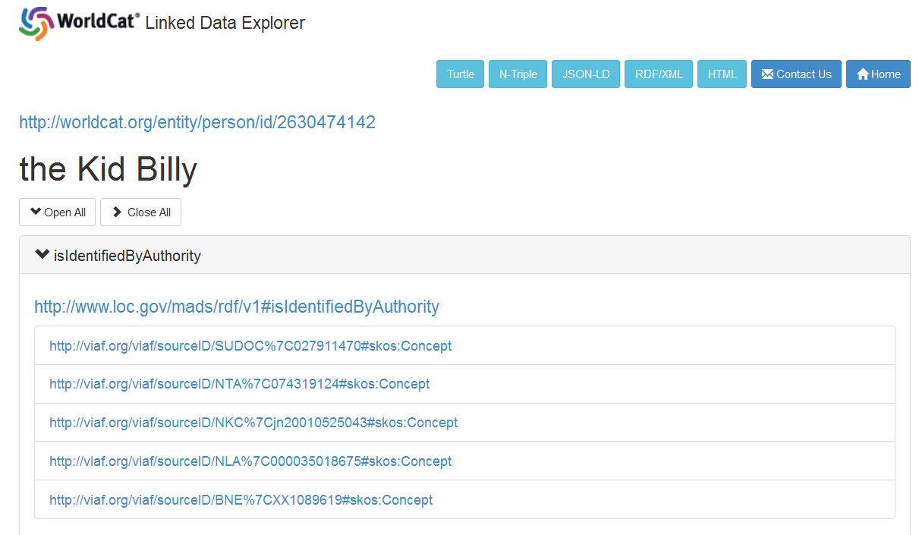
http://experiment.worldcat.org/entity/person/data/2630474142

Slide 11
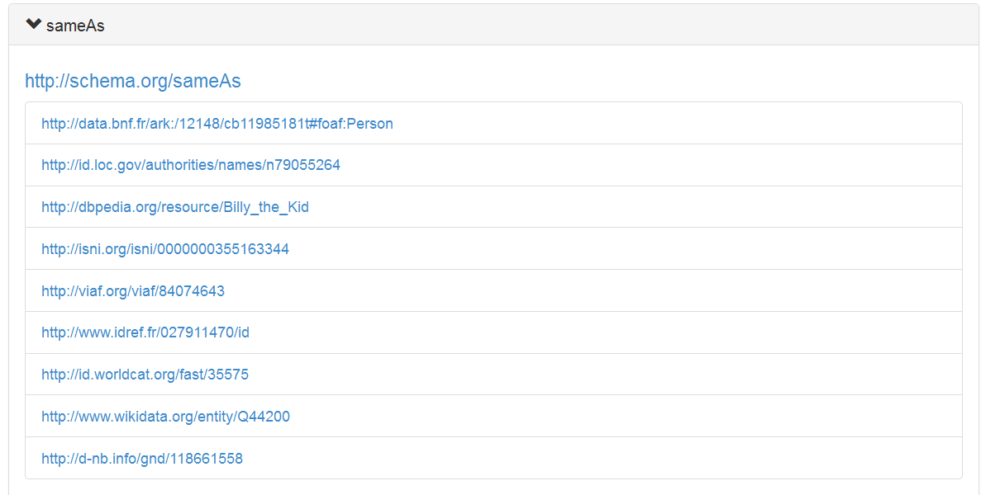
Reconciliation:
All these sameAs

Slide 12
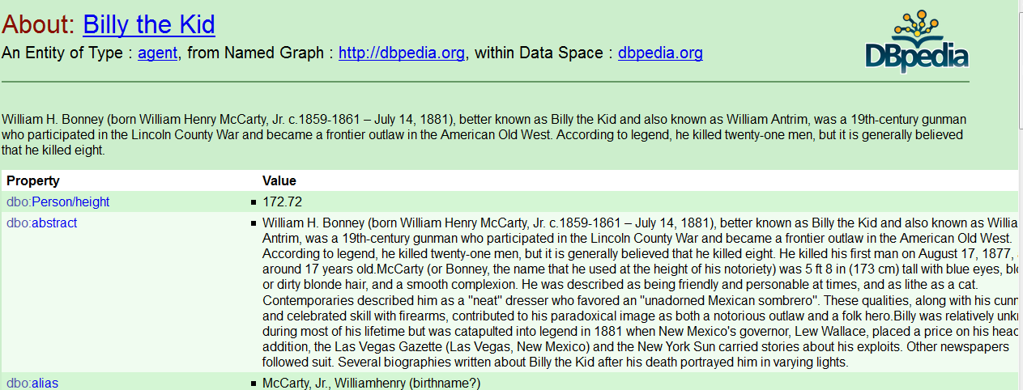
But what if

Slide 13
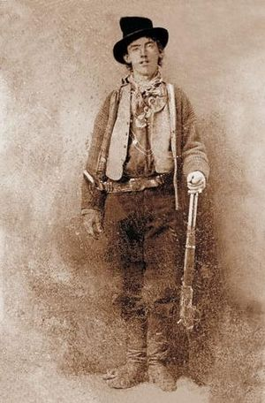

Slide 14


Slide 15
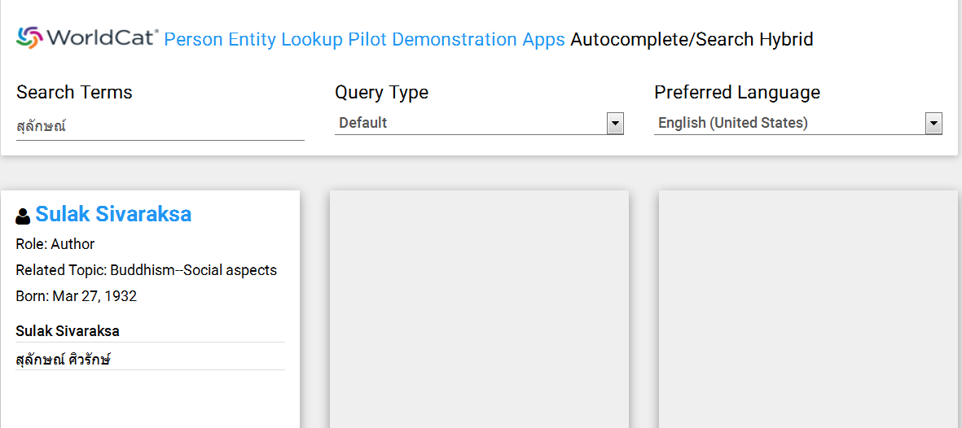
Enabling previously unsupported scripts, without NACO!

Slide 16
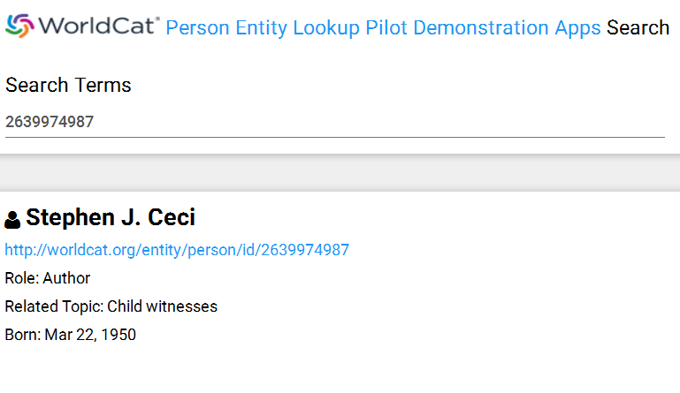

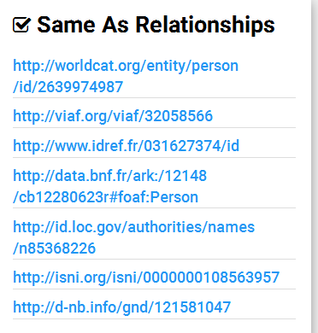

Maybe feed in VIVO, with all its journal articles?

Slide 17
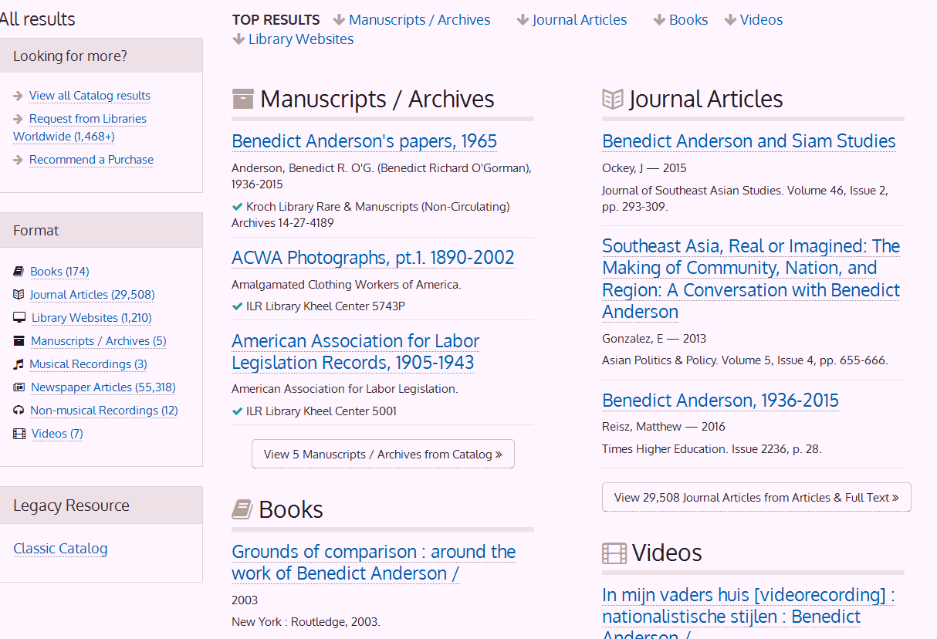
Across bento boxes

Slide 18
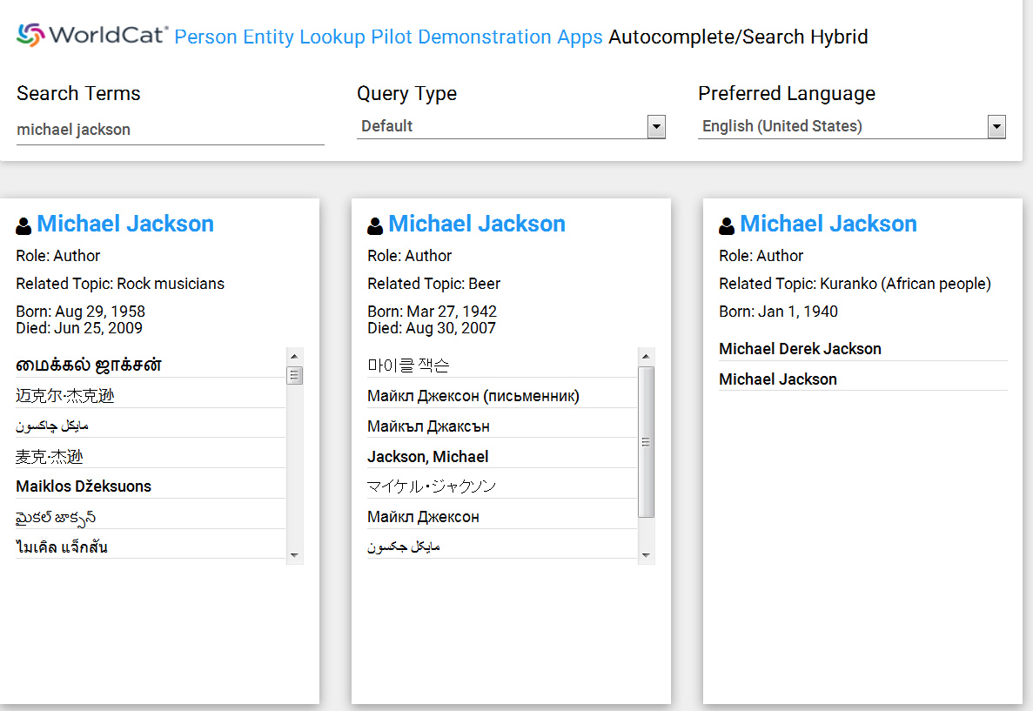
Intuitive search interface
Unique strings, but not necessarily unique headings
For staff and public use

Slide 19
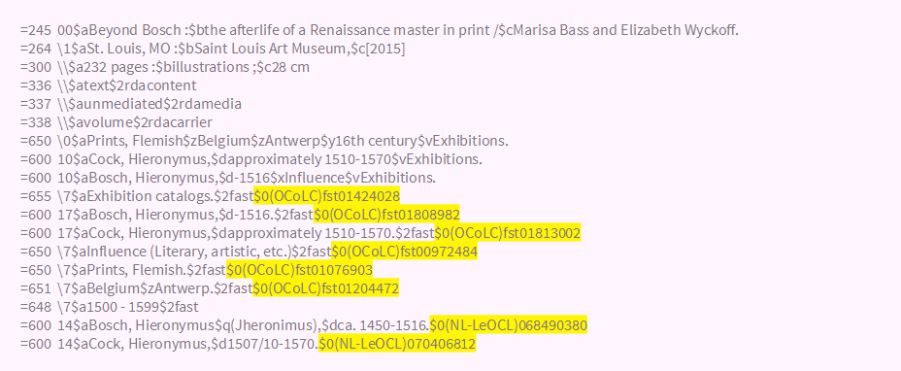
Sample record with authority identifiers

Slide 20
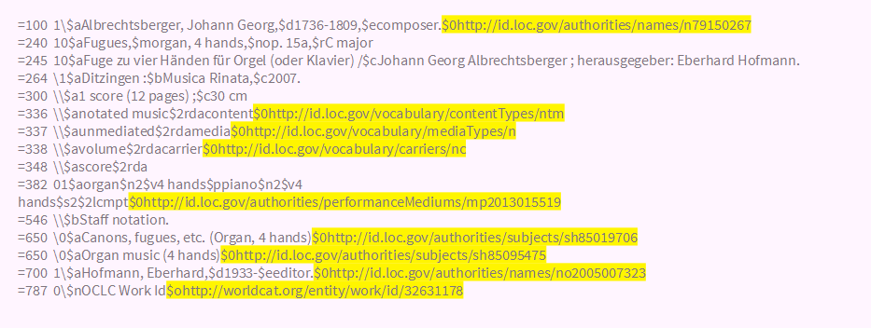
Sample record with URIs

Slide 21
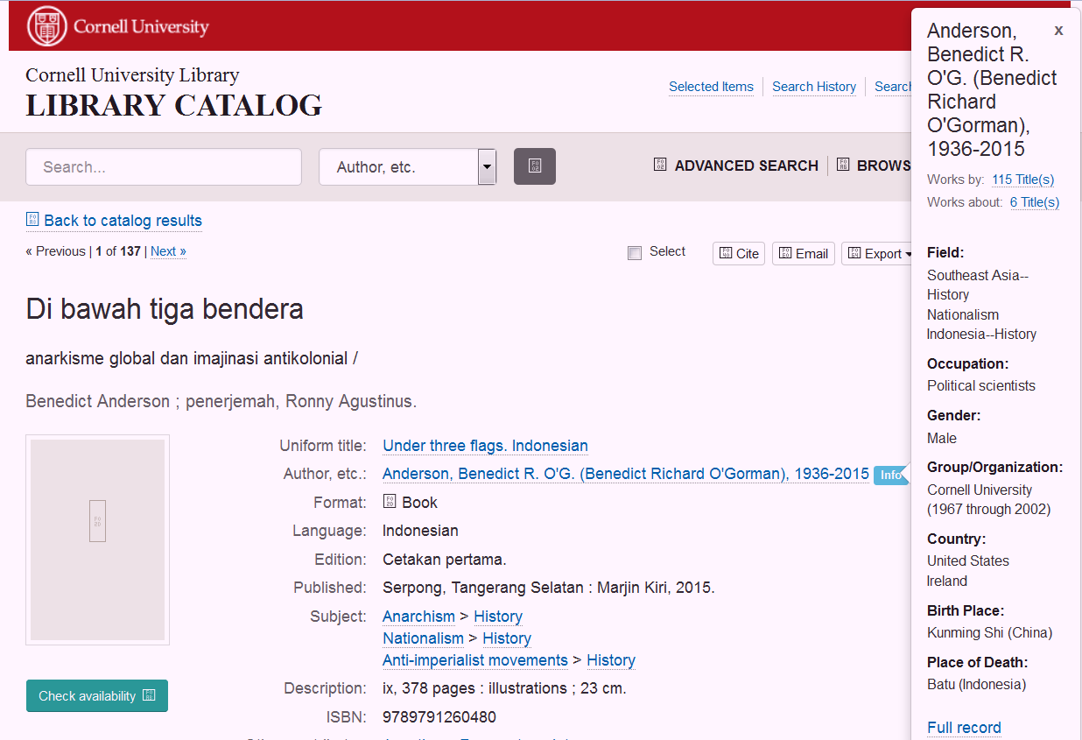
A better maintenance model

Slide 22
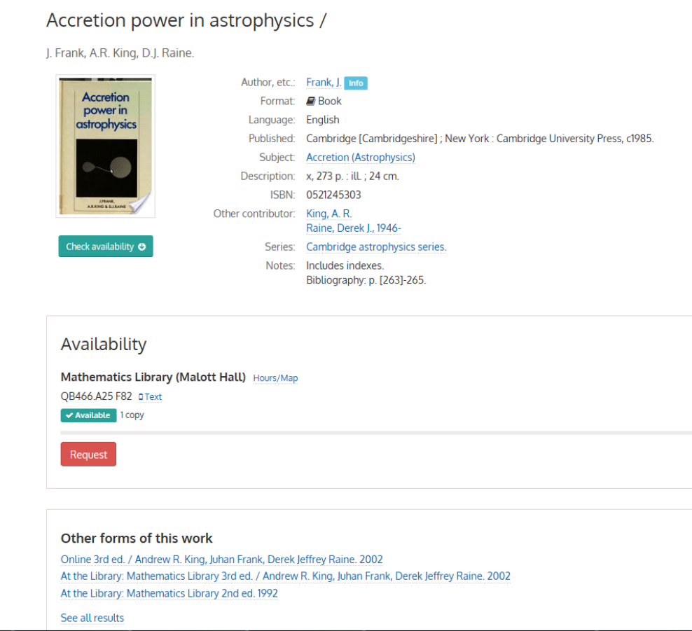
A FRBR work can be “barcoded” too.

Slide 23
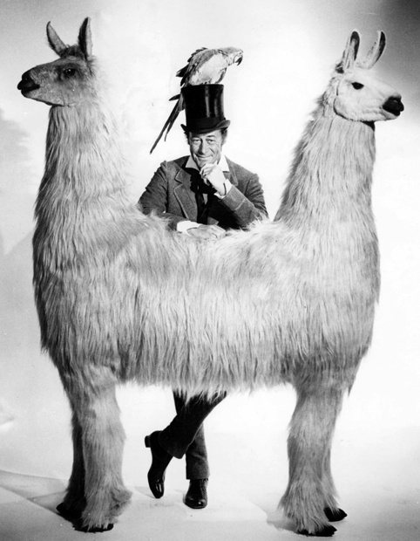
Notes:
We pull, but we also push. Adam is interested in measuring.

Slide 24
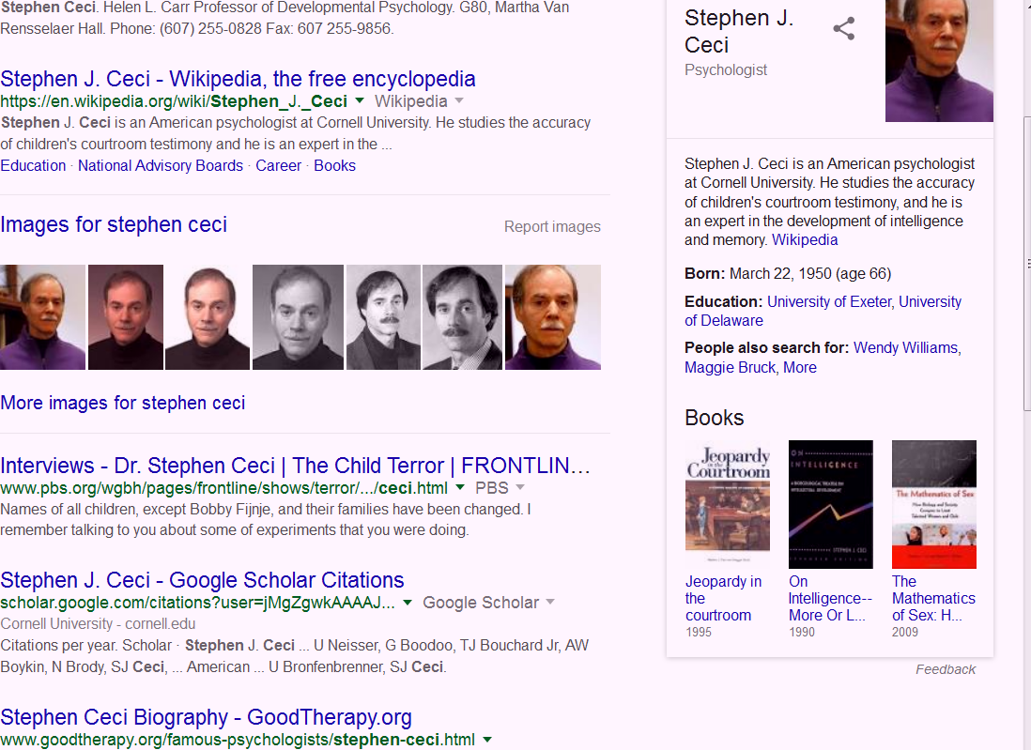
What if we could push to here?

Slide 25
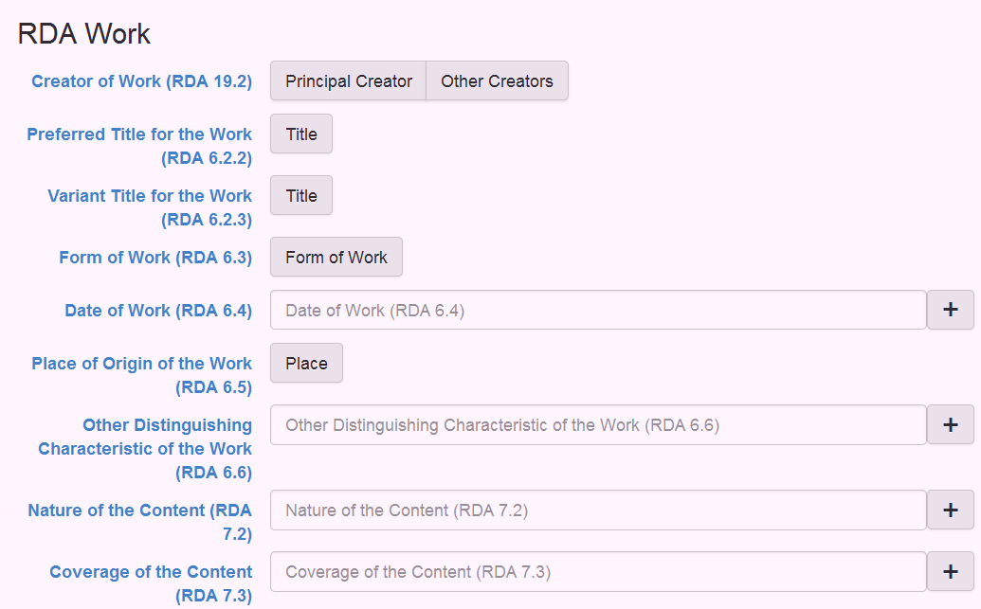
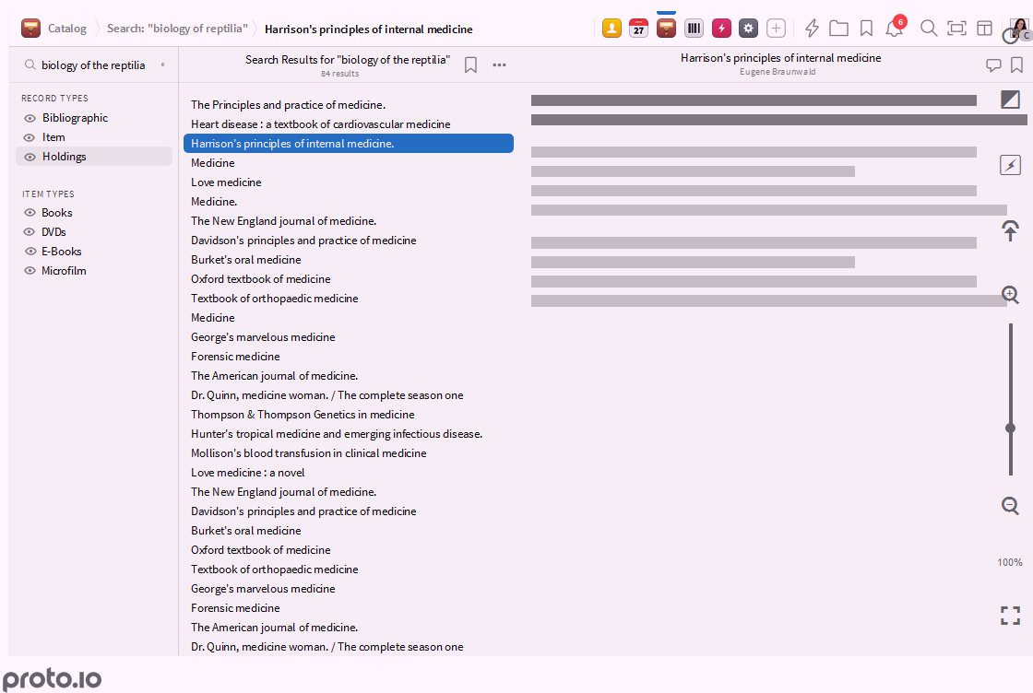
BIBFRAME/Folio/LD4All Experiments
No backlog?

Slide 26
We need to talk.
My thanks to:
Frances Webb
Christina Harlow
Chew Chiat Naun
Jason Kovari
Adam Chandler
Doris Hendrickson

