Slide 1

Research Report Writing
Research Report Writing | Fall 2016
Notes:
[[Insert your abstract here.]]
[[Add a link to your full report here. ]]

Slide 2
Returning members,
Are you thinking….
“Why am I sitting here if I’ve already been trained in report writing?”
Research Report Writing | Fall 2016
Notes:
Cite your sources here.
Caption your figure and explain its relevance to your presentation/thesis here. You can take the caption from your Final Report and modify it.
Write a summary of this slide here. A future team member or client should be able to read this note and understand this slide without having your team explain it to them.
If there are any appendix slides that are relevant to this slide, mention it in your notes.

Slide 3


We updated the
Research Report Template!!!
Research Report Writing | Fall 2016
Notes:
Images from https://giphy.com/gifs/reaction-news-excited-PvdjYHPDgh6W4 and https://giphy.com/gifs/cheer-cheering-11sBLVxNs7v6WA

Slide 4
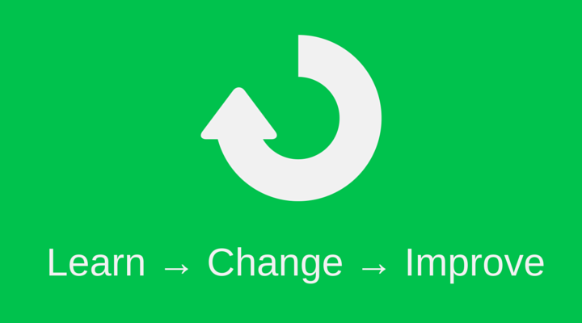
Feedback from Spring 2016 Team
Iterations are not fantastic
We’re spending too much time writing really long reports
Including all the details about iterations isn’t professional
Research Report Writing | Fall 2016
Notes:
Image from http://blog.clientheartbeat.com/wp-content/uploads/2015/01/customer-feedback-loops.png

Slide 5
What’s the purpose of a Research Report?
Document your subteam’s work in a professional way for researchers worldwide and future team members to reference
Research Report Writing | Fall 2016
Notes:
Cite your sources here.
Caption your figure and explain its relevance to your presentation/thesis here. You can take the caption from your Final Report and modify it.
Write a summary of this slide here. A future team member or client should be able to read this note and understand this slide without having your team explain it to them.
If there are any appendix slides that are relevant to this slide, mention it in your notes.

Slide 6
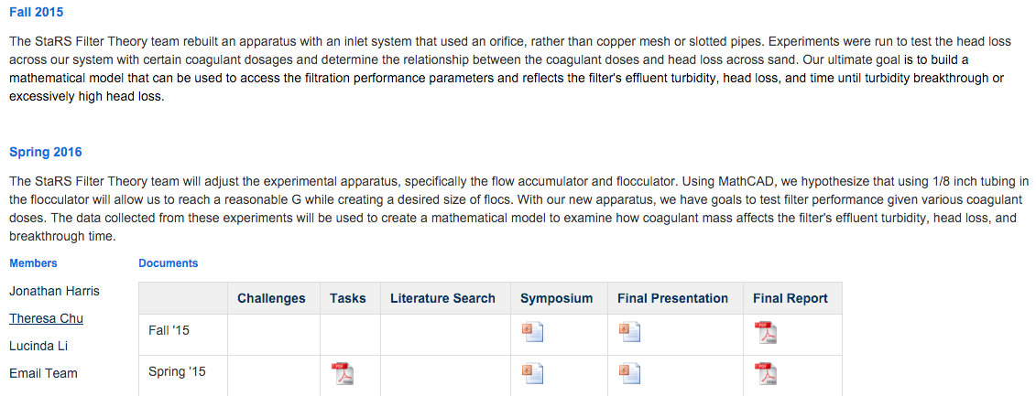
Abstract
Keep it short! - maximum of 100 words
For now, briefly summarize subteam’s goals for the semester
Post your abstract on your team wiki page by Friday
Research Report Writing | Fall 2016
Notes:
Image from http://blog.clientheartbeat.com/wp-content/uploads/2015/01/customer-feedback-loops.png

Slide 7
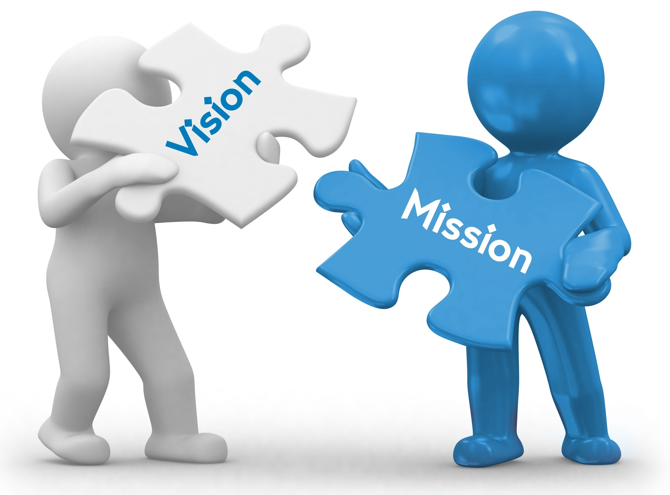
Introduction
Explain the context of your team’s work in AguaClara and the world
  Why does your team exist?
What are you trying to prove/test?
How are you doing this?
What kind of results do you expect and why?
Research Report Writing | Fall 2016
Notes:
Image from http://blog.clientheartbeat.com/wp-content/uploads/2015/01/customer-feedback-loops.png

Slide 8

Literature Review
Review outside literature
Explain its relevance to your team’s challenge
**Please do not write an essay or an entire history book about AguaClara/water treatment technology
Research Report Writing | Fall 2016

Slide 9
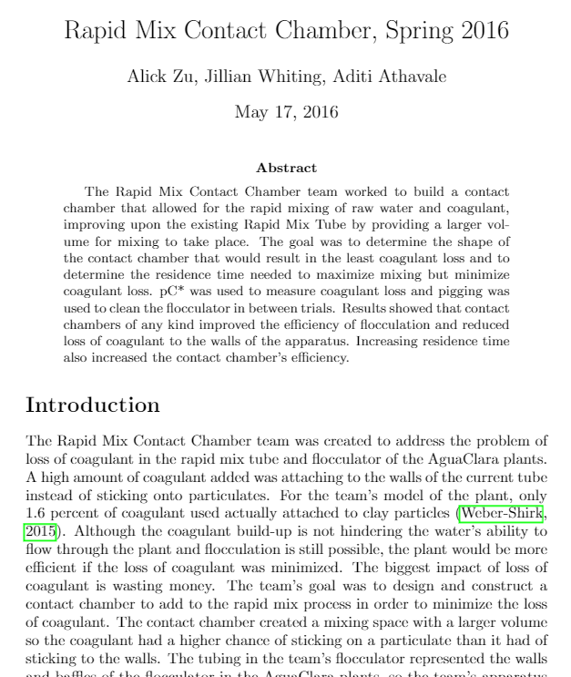
Previous Work
Review relevant past teams’ reports
Explain the importance of their findings and processes to your research.
Research Report Writing | Fall 2016
Notes:
https://www.overleaf.com/4304815tggvbh#/12773696/

Slide 10
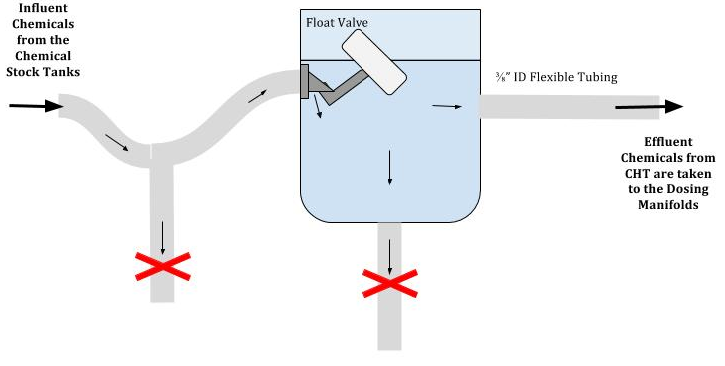
Methods**
Clearly explain your apparatus and experiments
  A manual for your experiments should be submitted by the end of the semester as a supplement to the research reports.
  Long ≠ good!
Research Report Writing | Fall 2016

Slide 11
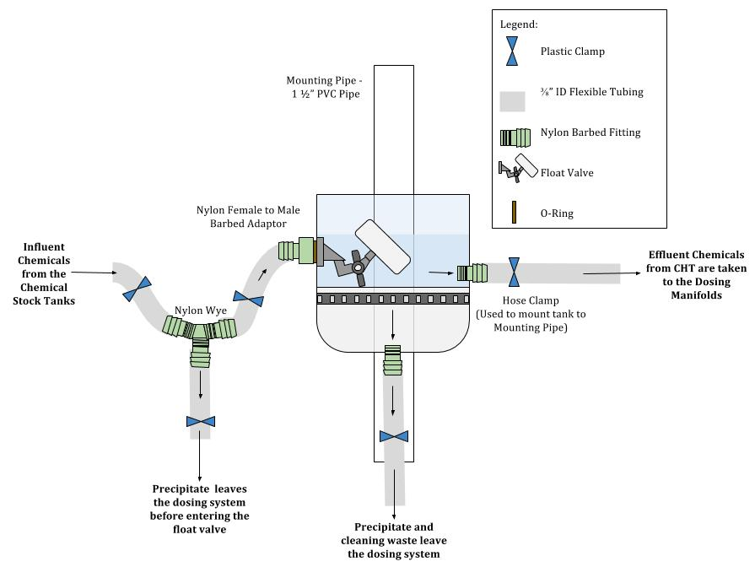
Methods v. Manual Schematic
Methods
Manual
Research Report Writing | Fall 2016

Slide 12
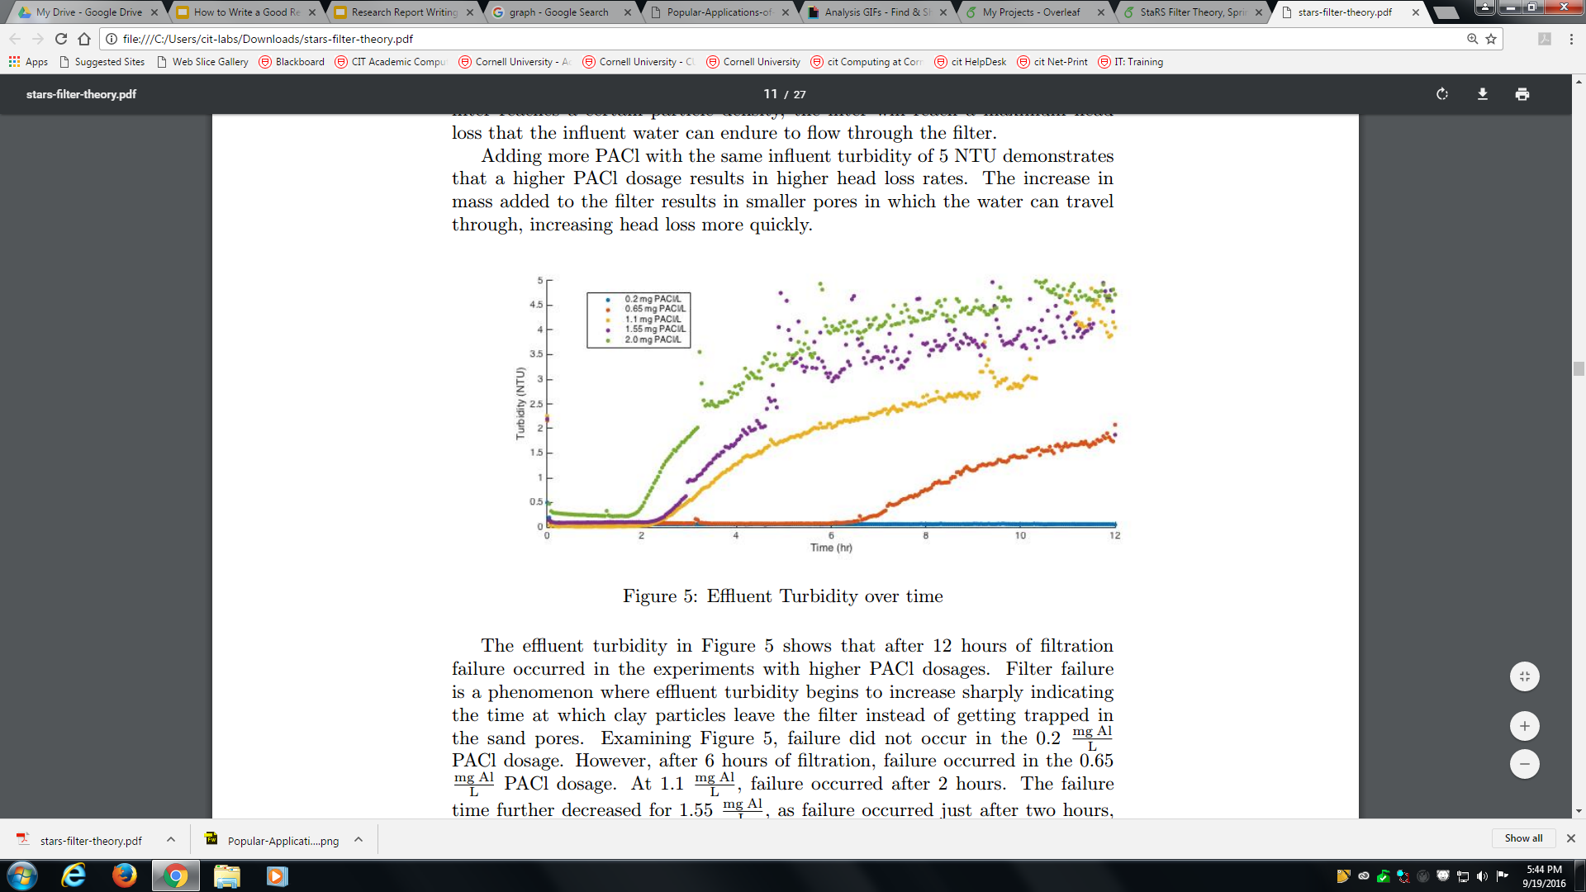
Results**
Present your data
  Graphs
  Tables
  Charts
Research Report Writing | Fall 2016
Notes:
Taken from https://www.overleaf.com/4432769jhnpqm#/13254539/ Spring 2016 StaRS Filter Theory Report

Slide 13
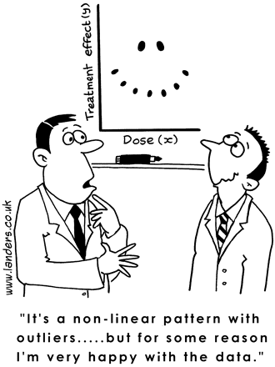
Analysis**
Analyze your results and compare with theoretical expectations
  If you have not done experiments, describe expectations based on established knowledge
Include implications of results
How will your results influence the design/performance of AguaClara plants?
Research Report Writing | Fall 2016
Notes:
Image from http://analyticstraining.com/wp-content/uploads/2014/05/Popular-Applications-of-Linear-Regression-for-Businesses.png

Slide 14
Conclusions
Summarize all of the analysis you have completed
Explain the relevance of your findings to AguaClara
Research Report Writing | Fall 2016

Slide 15
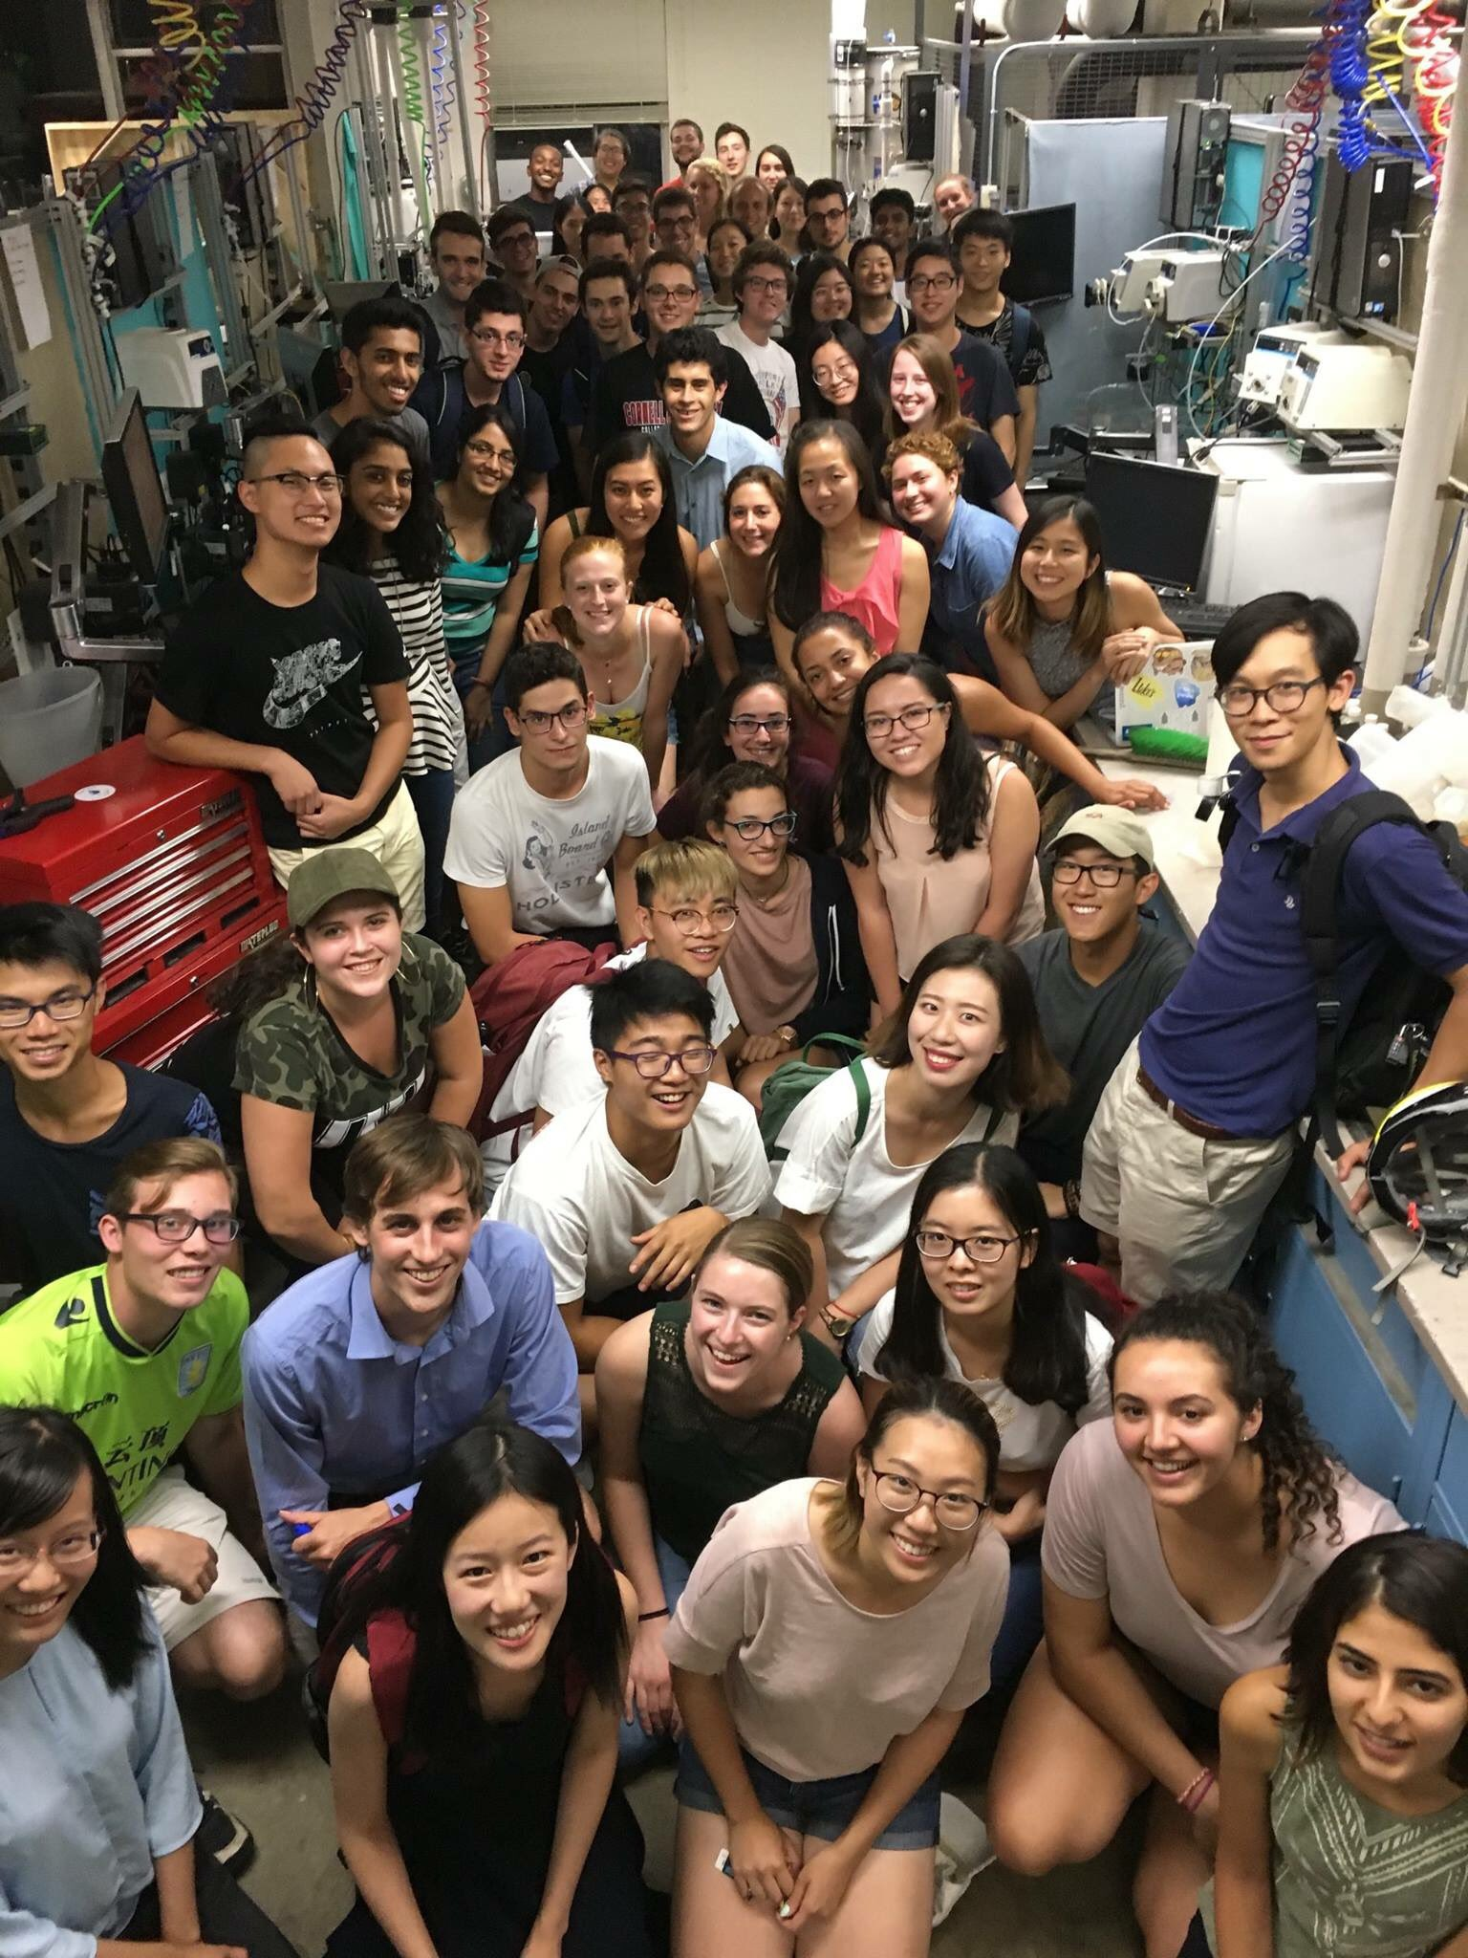
Future Work
For Now: Describe your plans for the remainder of the semester
Final Report: Describe what future teams can work on
Research Report Writing | Fall 2016

Slide 16
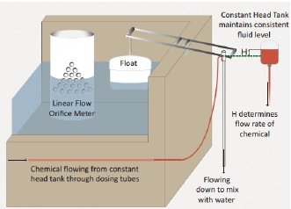
Captions
Poor Caption: Schematic of a CDC in an AguaClara plant.
Better Caption: A schematic of the Chemical Dose Control (CDC) system. The chemical flow rate into the treatment train is automatically controlled based on the elevation difference between the free surface in the CHT and the dosing tube level determined by the water level in the Entrance Tank.
Research Report Writing | Fall 2016

Slide 17
Technical Writing Guidelines
Past tense
No personal pronouns
Active voice
Spell check
Include enough technical information so that a non-AguaClara engineer can replicate your experiment
Modify for each team
Great Resources:
https://confluence.cornell.edu/display/AGUACLARA/Grammar+Guidelines+for+Reports
https://confluence.cornell.edu/display/AGUACLARA/Style+Guide+for+Figures%2C+Tables%2C+and+Equations
Research Report Writing | Fall 2016

Slide 18
Announcements
Due Friday @ 11:59PM
  Research Report 1
  Abstract on Wiki
Research Report Office Hours 3-6pm
Monroe Meeting invitations
WTP tour makeup Thursday 5:00PM
Research Report Writing | Fall 2016

Slide 19
Appendix
Slides
Research Report Writing | Fall 2016
Notes:
From this point on, add any slides with figures that will help support your thesis. You might pull these figures from your Final Report.

Slide 20
Difference between Literature Review and Previous Work
Literature Review
Explain the importance of outside literature to your work
Previous Work
Explain the importance of AguaClara literature to your work
*Make sure that all literature is relevant.
Long ≠ Better!
Research Report Writing | Fall 2016

Slide 21
Difference between Results and Analysis
Results
Simply present the data in the form of numbers, tables, and/or graphs
Analysis
Establish patterns from the data
What did you learn?
Research Report Writing | Fall 2016

Slide 22
Difference between Analysis and Conclusions
Analysis
Establish patterns from the data
Conclusions
Overarching summary of all analysis conducted
Why do your findings matter to AguaClara?
Research Report Writing | Fall 2016

Slide 23
Difference between Conclusions and Future Work
Conclusions
Overarching summary of all analysis conducted
Why do your findings matter to AguaClara?
Future Work
Describe the trajectory of your subteam this semester
Include plans for future semesters
Research Report Writing | Fall 2016

