Slide 1
IT Updates
2014 Roadmap
Statistics, Infrastructure

Slide 2
Secure communications
SSL now enforced for all areas of site requiring login or user credentials
Enable site-wide?
Notes:
Completed late 2013
Submission, moderation and admin interfaces
The question of whether to enable SSL site-wide is still open, as this changes every URL, potentially impacts performance

Slide 3
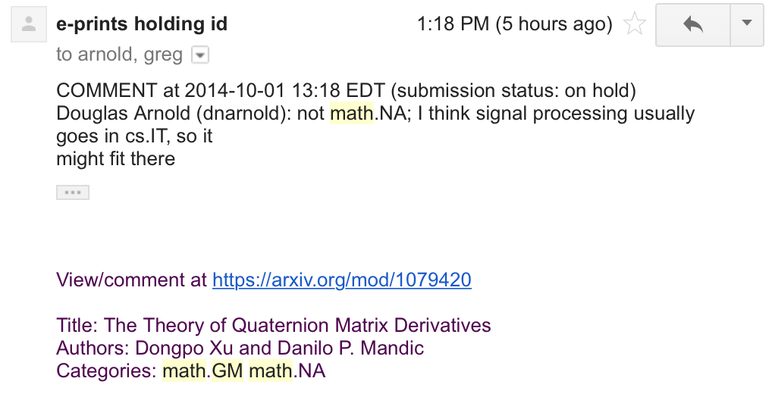
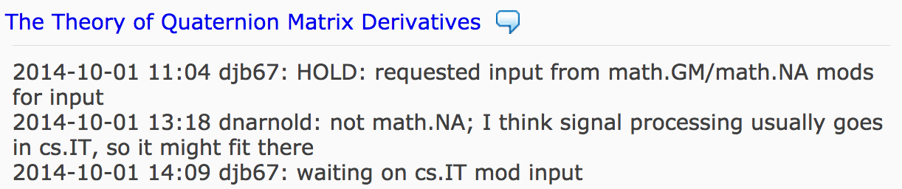
Moderation tools and Interfaces
Opt-in daily email digest
Submission notifications
Monthly digest
Enhancements to web interface
Notes:
We’ve made many changes over the year: some subtle, some rather significant. Perhaps the most noticeable are changes to the content and volume of emails going out.
Though it may seem somewhat counterintuitive, we’re trying to bridge the gap between the traditional email communications (between moderators and admins) and the web interface, particularly with regards to the submission lifecycle
The overall goal is to create tools and processes that make moderation more efficient.
18 moderators are currently subscribed to the daily digest
Monthly digest is complete but currently mothballed as we refine our other communications

Slide 4
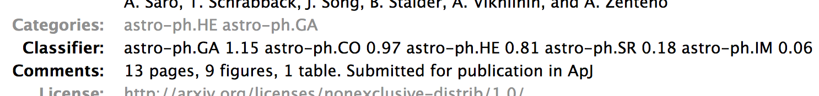
Classification checks
Integrated into submission workflow
Future improvements:
  Presentation
  Automation
Notes:
Automated classification checks have been part of the submission workflow since early August
Whenever a user clicks submit, the submission’s full-text is sent via remote call to Paul Ginsparg’s classifier software.
The output from that call presented in submission emails and web interfaces
Appears to be informative and speeding up the decision making process

Slide 5
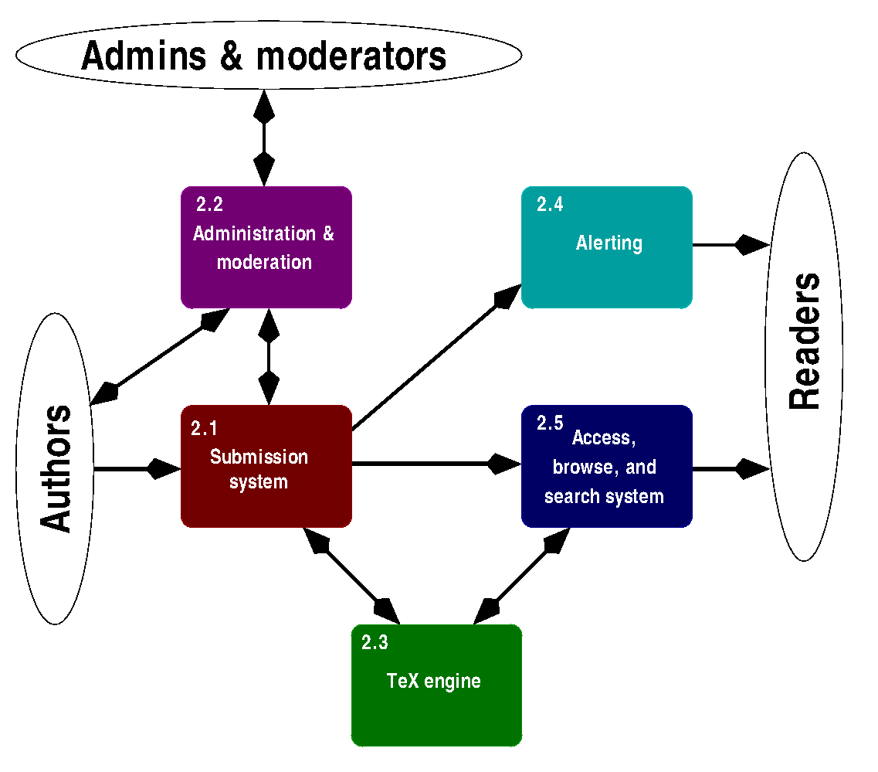
Documentation
Codebase
Technologies
Personnel expertise
http://goo.gl/CeFmei
Notes:
Documentation on the arXiv codebase, core technologies and personnel expertise is now up-to-date
Chris, Simeon will discuss in more detail

Slide 6
Categories & Aliases
q-fin.EC & q-fin.MF added in April
  76 papers as of October 1
cs/math/stat aliasing not yet started
Notes:
- We haven’t started the merging process yet, but the issues are well-understood and just a matter of scheduling

Slide 7
OVERLAP checks
Title similarity check against staged submissions
Full-text overlap detection against published corpus and staged submissions
Notes:
We’re in the beginning stages of adding overlap detection features into the submission pipeline
We’re close to completing the simpler of the two: title similarity checks against staged submissions, which should reduce the amount of time spent dealing with duplicate submissions
We haven’t started on full-text overlap yet, but hope to get started this year.
As with the classifier data, we plan on including the output from the overlap checks in the moderation and admin web interfaces, and in submission emails

Slide 8
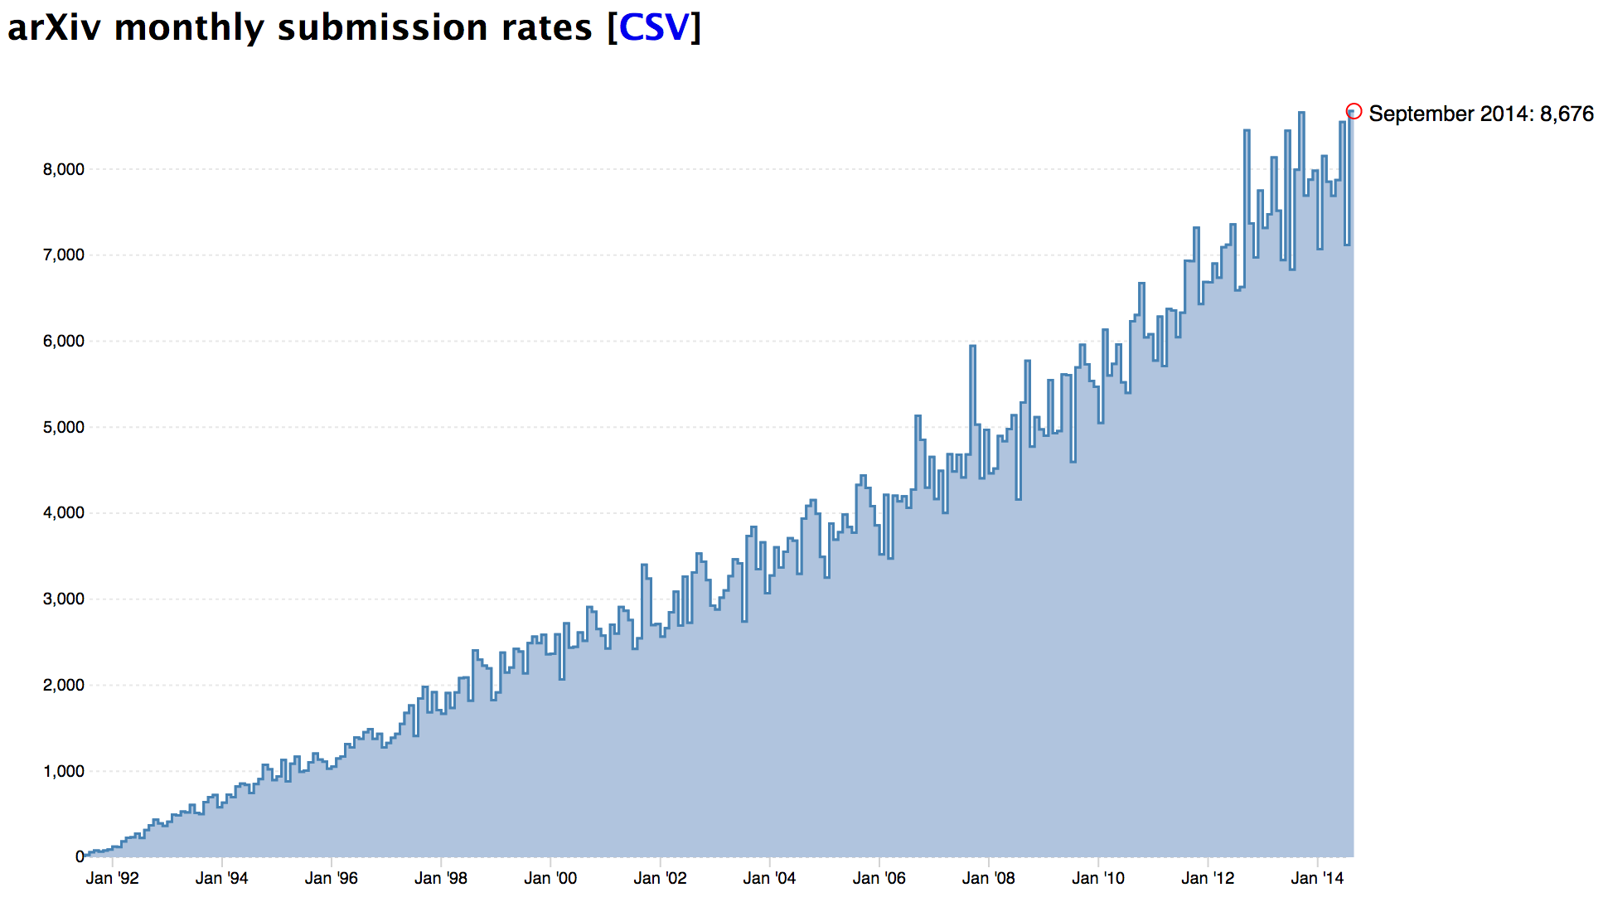
“The P10K ISSUE”
arXiv:YYMM.nnnn
Notes:
Our current identifier scheme supports 10000-1 papers per month, and we’re quickly approaching 9K a month. 10K is also just a matter of time.
September saw the highest number of submissions (barely)
We’ve assessed the impact and implemented preliminary changes. We’re preparing for a code review and deployment plan in an upcoming sprint; we may decide to canonicalize the 5-digit suffix at the start of 2015.

Slide 9
“The P10K ISSUE”
Notes:
Graph provided by Joe Skovira. Trendline is order 3 polynomial.
We’ll most likely hit 10K by the end of 2015.

Slide 10

Author disambiguation
Support ORCID iDs
Route to providing institutionally-based submission data for our supporters
Improved data interchange with ADS, INSPIRE, etc.
Notes:
We’d like to support ORCID for better interoperability with other repositories implementing authority control
Institutional affiliation will be stored with ORCID author data, which will give us the means to provide better institutional statistics
Work is in progress; Simeon will provide additional comments

Slide 11
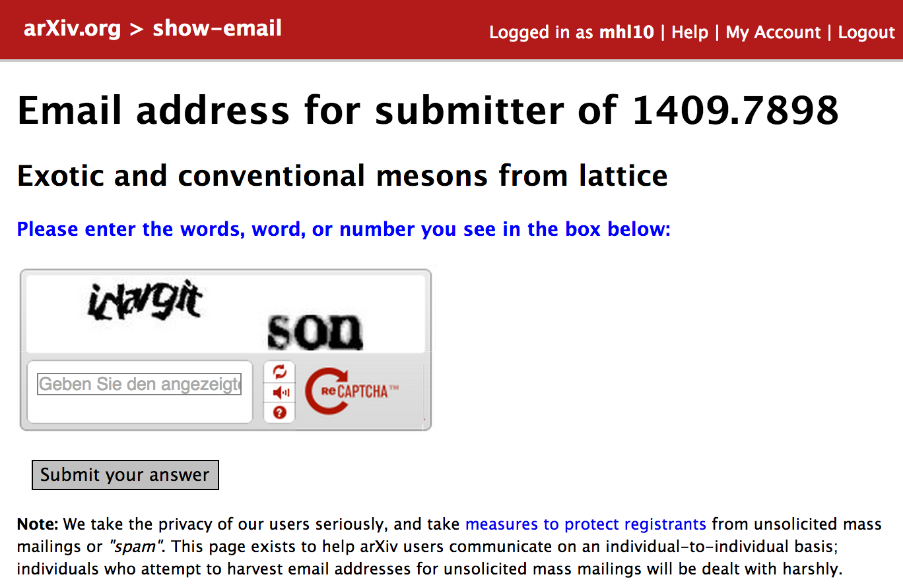
Submitter privacy
“View-email” pages
Metadata files
Indirect: account creation
Notes:
Submitter email addresses should not be harvestable. We’ve received some complaints about this.
“View-email” pages are now protected with login and reCAPTCHA
We have not yet removed email addresses from metadata (.abs) files, which ar.
Protecting account creation with reCAPTCHA will also deter harvesting

Slide 12
Others
Dataset support
  Data Conservancy pilot concluded
  Data not yet pulled into arXiv
  Metadata + DOIs for ancillary files
Email alert system
  Web & user account integration
  Maintainability
  Scalability
Notes:
We intend to ingest the data from the pilot, but we currently offer very little support for ancillary files. We plan on pulling in the DC metadata and assigning DOIs from EZID to make these files citable.
The email alert system hasn’t changed much since arXiv’s inception and needs to be overhauled to support things like web-based subscription management.
Maintainability – hard to test, old code

Slide 13
Rest of Year
More moderation tool improvements
  Auto-hold submissions based on classifier flags
  Enable moderators to take additional actions through web interface
  Refinements to emails
Implementation of P10K changes
Infrastructure
  Nexus VM for routine tasks and incoming email
  PDF download performance investigation
Notes:
- Additional actions may include things like category suggestions, which could have the effect of including other moderators into the conversation
- Web nodes are somewhat asymmetrical when it comes to the routine tasks

Slide 14
Statistics
517M papers served since 1994
8M papers served in June 2014
2.4M page requests to main site / day
Stats available for public consumption

Slide 15
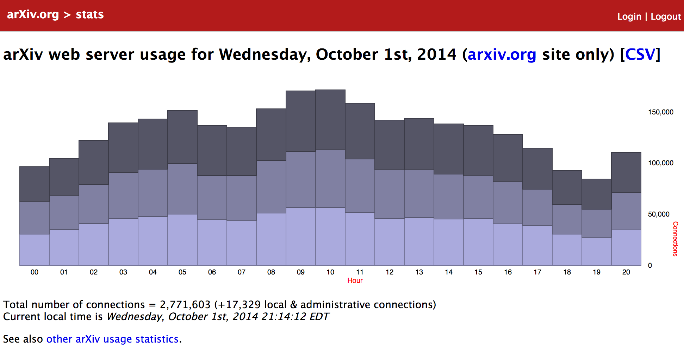
Statistics
Notes:
http://arxiv.org/stats/today

Slide 16
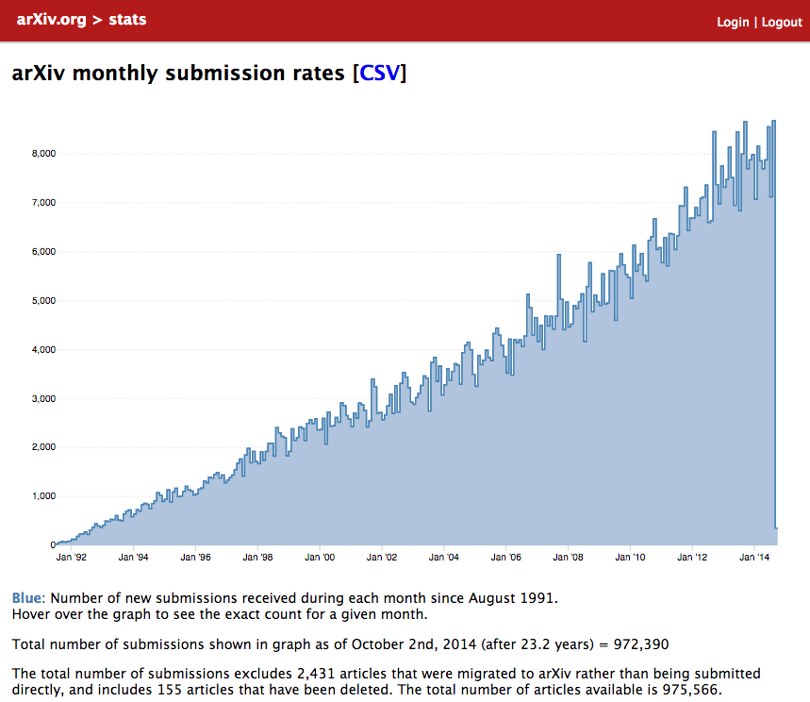
Statistics
Notes:
http://arxiv.org/stats/monthly_submissions

Slide 17
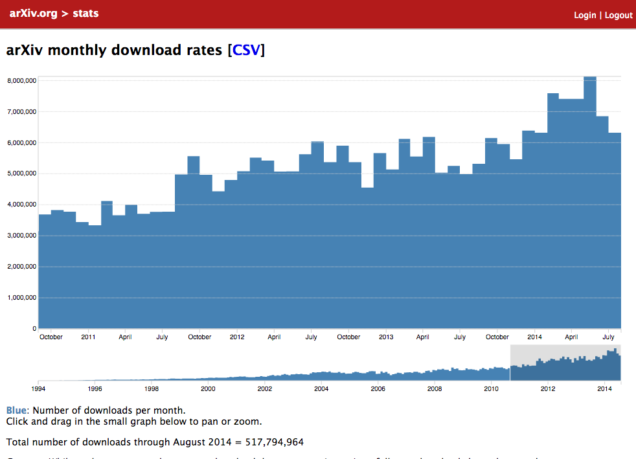
Statistics
Notes:
http://arxiv.org/stats/monthly_downloads

Slide 18
Infrastructure
13 local VMs (production and development)
9 mirrors
Main service load-balanced since July 2013, Export service since April 2014
  → Highly available services
  Shared filesystems via NFS
Notes:
3 main web nodes + 2 export web nodes + 3 DB nodes + Mail + Nexus + Res + Dev + Beta
Over the last year we’ve brought all of our mirrors up-to-date with our current deployment workflow (git)
Individual nodes have occasionally gone down, mostly out of our control, but the services haven’t
More nodes slow down the deployment process, but this expense is balanced by much more formalized workflow that is less error-prone
PDF download performance has declined since the migration to the load-balanced environment and shared filesystems

