Slide 1
Security Features of AWS VPC
June 8, 2016
Paul Allen
CIT Cloudification Services
Notes:
Today I describe AWS virtual private clouds and describe how those features can be used to protect AWS resources running there.

Slide 2
Cloudification Services Team
⌄
Mission:
  Facilitate Campus’ transition to the cloud while encouraging modern DevOps practices
Safe
v
Team
  Shawn Bower
  Ned La Celle
  Marty Sullivan
  Paul Allen
  Nicole Rawleigh
  Sarah Christen (mgr)
Notes:
The mission of the cloudification services team is to help units move to the cloud while ensuring security that is equal to or better than what they had on campus.

Slide 3
Shared Responsibility Model
Security Policies
Cornell Standard VPC
Audit Logging
Notes:
The Cloudification Services Team and ITSO have worked together to translate Cornell policies as they apply to cloud infrastructures.
Our plan is to have regular presentations at the Security SIG to talk about those.
AWS promotes what they call a shared security model where they lay out who is responsible for what.
Customer responsibility == unit responsibility.
When a campus unit begins work in AWS, the ITSO and Cloudification Team provide some basic audit logging and security protocols for accessing AWS administrator functionality.
However, you can shoot yourself in the foot more easily than using most on-campus services.

Slide 4
Virtual Private Cloud
logically isolated network in AWS cloud
on-premise connectivity options
  none
  VPN
  DirectConnect

Slide 5
VPC Components
required:
subnets
route tables
network ACL
security groups
optional:
internet gateway
NAT gateway
hardware VPN
virtual private gateway
customer gateway
peering connection
flow logs

Slide 6
Benefits of VPC
connectivity options
custom subnets, routing
layered security
  security groups
  network ACL
continuity with on-premise networks
single-tenancy, if desired

Slide 7
Notes:
We have defined a standard VPC configuration that is provisioned for most Cornell AWS accounts.
Note some of the main components
AWS region (us-east-1)
Availability Zones (i.e., us-east-1b, us-east-1c)
connectivity to campus
private and public subnets

Slide 8
Notes:
Campus connectivity
seamless connectivity between campus and VPC
old: VPN; new: DC
10-space traffic (only) routed over VPN/DC

Slide 9
Notes:
Subnet+AZ configuration
subnets: 2 private, 2 public
one of each in two different availability zones
10-space of subnets is integrated into campus 10-space

Slide 10
Notes:
Internet Connectivity
public subnets are connected to the internet with Internet Gateway
these still are also on the 10-space network
only have public IPs, if assigned
internet gateway provides NAT if no public IP assigned

Slide 11
Notes:
Private Subnets
- gain access to internet for purposes of software updates, etc via NAT Gatway

Slide 12
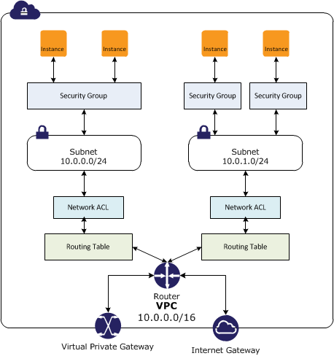
Security Groups and Network ACLs
Notes:
Network ACL
stateless; require inbound and outbound traffic specifications
apply to one or more subnets
Security Groups
stateful; inbound traffic specs only
resources with same security group have unhindered access to each other

Slide 13
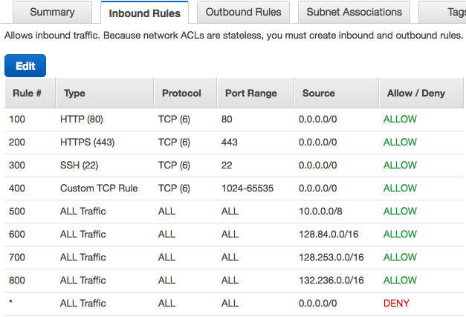
Baseline
Cornell Network
ACL
Notes:
This is baseline.
Certainly recommended to tighten up, depending on specific needs.
E.g. Could designate Test and Prod subnets, then use NACL to block access between them.

Slide 14
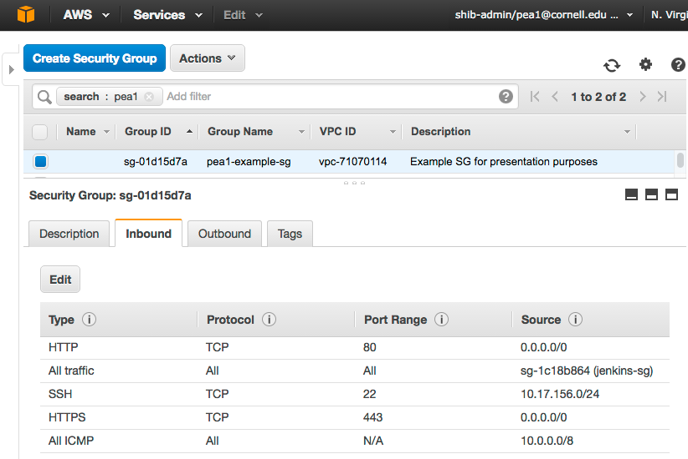
Example Security Group
Notes:
Allow all traffic from internet on HTTP/HTTPS
SSH traffic from departmental VPN
ICMP (ping) from any Cornell 10-space address
all traffic from another SG

Slide 15
Notes:
One of the nicest things about working in an AWS VPC is the visibility I have over all the networking. I can troubleshoot connectivity problems, or assure myself that I’m not letting any unnecessary traffic in.

Slide 16
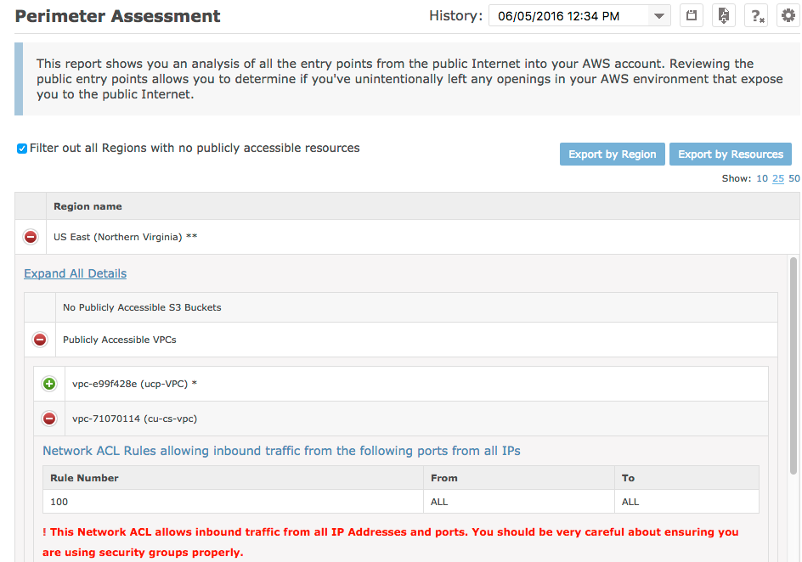
Notes:
Since VPCs are declaratively defined and configuration is easily available to tools, it is easy to programmatically analyze your security perimeter.
Here is the CloudCheckr report on the security perimeter of a VPC.
All AWS accounts linked with the Cornell master account have access to CloudCheckr, free of charge.

Slide 17
VPC Peering
Notes:
peering is not transitive
one Cornell VPC cannot access another Cornell VPC by means of the campus network. They must be peered directly instead.

Slide 18
VPC-related Pricing
 | base charges | data charges
VPC | free | n/a
VPN connections | $0.05/connection-hour | n/a
NAT gateway | $0.045/hr | $0.045/GB (ingress) $0.045/GB (egress)
Direct Connect – 1G | $0.30/hr | $0.00/GB (ingress) $0.03/GB (egress**)
Direct Connect – 100M | $0.06/hr | $0.00/GB (ingress) $0.03/GB (egress**)
Standard Data Transfer | n/a | $0.00/GB (ingress) $0.09/GB (egress to internet**)
** Research Data Egress waiver (15% of total bill)
Notes:
DC charges are picked up by the Cornell master account.
VPN and NAT gateway costs are charged to individual Cornell account.
“Research Data Egress” credit (up to 15% of total bill)

Slide 19
Questions?
https://blogs.cornell.edu/cloudification/tech-blog/
https://confluence.cornell.edu/display/CLOUD/
cloudification-l@cornell.edu
pea1@cornell.edu

