Slide 1
Floc Hopper Probe
Fall 2015
Miguel Castellanos
John Lopez

Slide 2
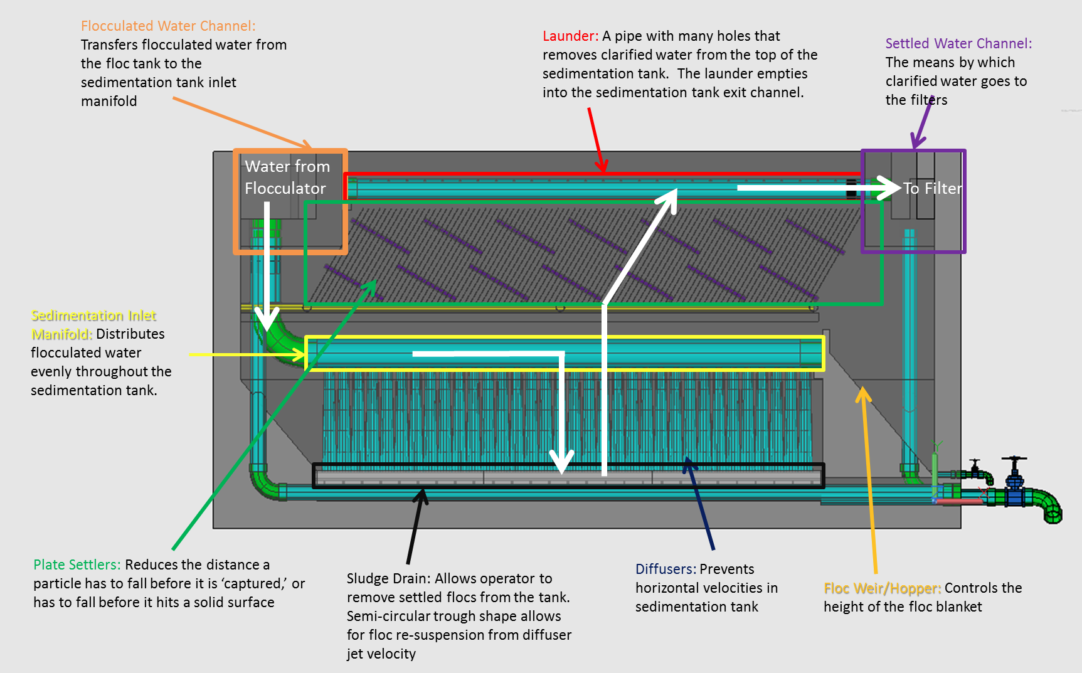
Sedimentation
What we know:
Flocs created in the flocculator settle out here forming a fluidized blanket.
Due to the slight density difference the floc settle out over a weir into the floc hopper.
This hopper has a valve to let sludge flow out of.
and

Slide 3
The Issues
What’s going on in here!?
and

Slide 4
Goals
We want to create a device that is easy to use and can help the operator know where the top of the sludge blanket is in the floc hopper, so the operator can adjust the flow out of the floc hopper to remove sludge.

Slide 5
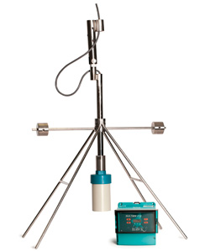
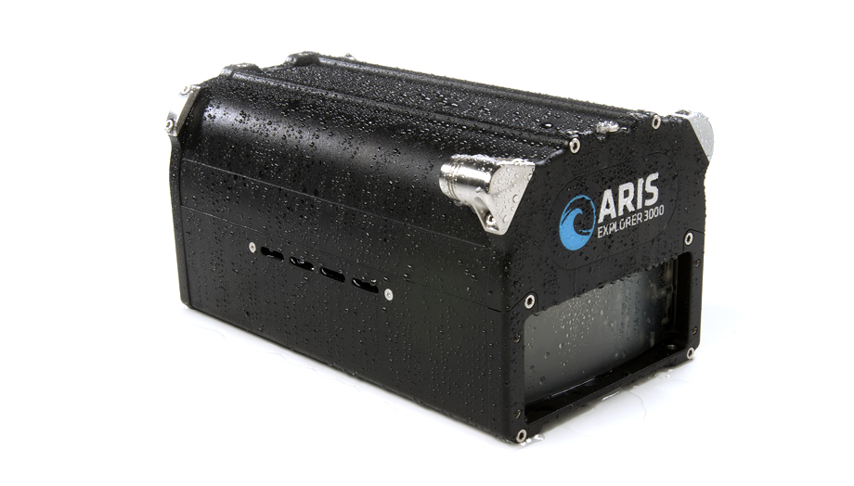
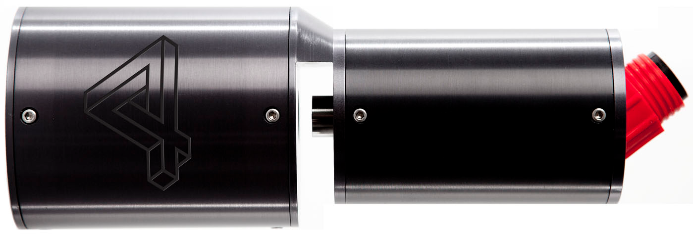
Past Work
Underwater Sonar Video Camera
Sultan Sonar System
Submersible Microscope

Slide 6
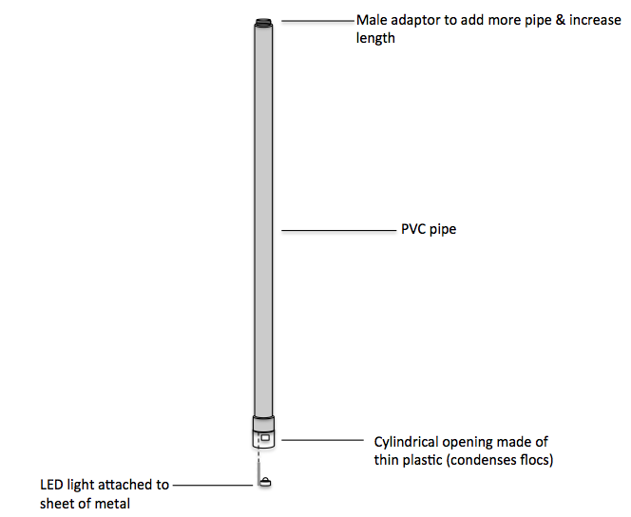
Probes

Slide 7
Results
Videos removed to decrease size for upload they exist on the drive.

Slide 8

Results
This is our visual que.

Slide 9
Results
All in all we have made the final touches and I have personally had near 100% success rate with the current design we just need to figure out why Miguel hasn’t and work on that. We build a new prototype from scratch and have increase the surface area of the exit orifices. :D

Slide 10
Moving Forward
Inscribe a measurement system into the pvc pipe
Continue testing designs and develop standard
Test prototype at local water treatment plant
Assembling guide

Slide 11

Questions?
Suggestions?

