Slide 1
Spectrophotometer: October 2015 Symposium

Slide 2
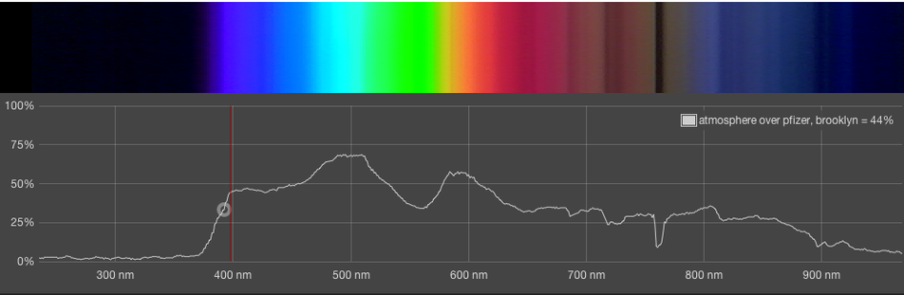
What is Spectrophotometry?

Slide 3
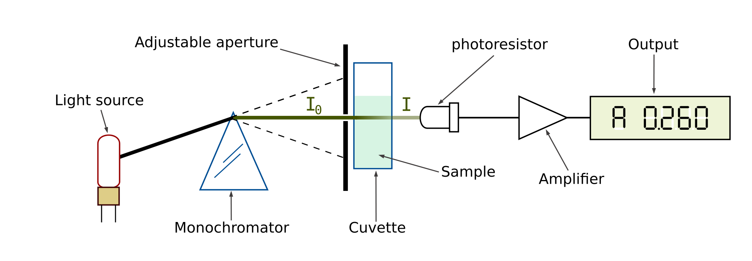
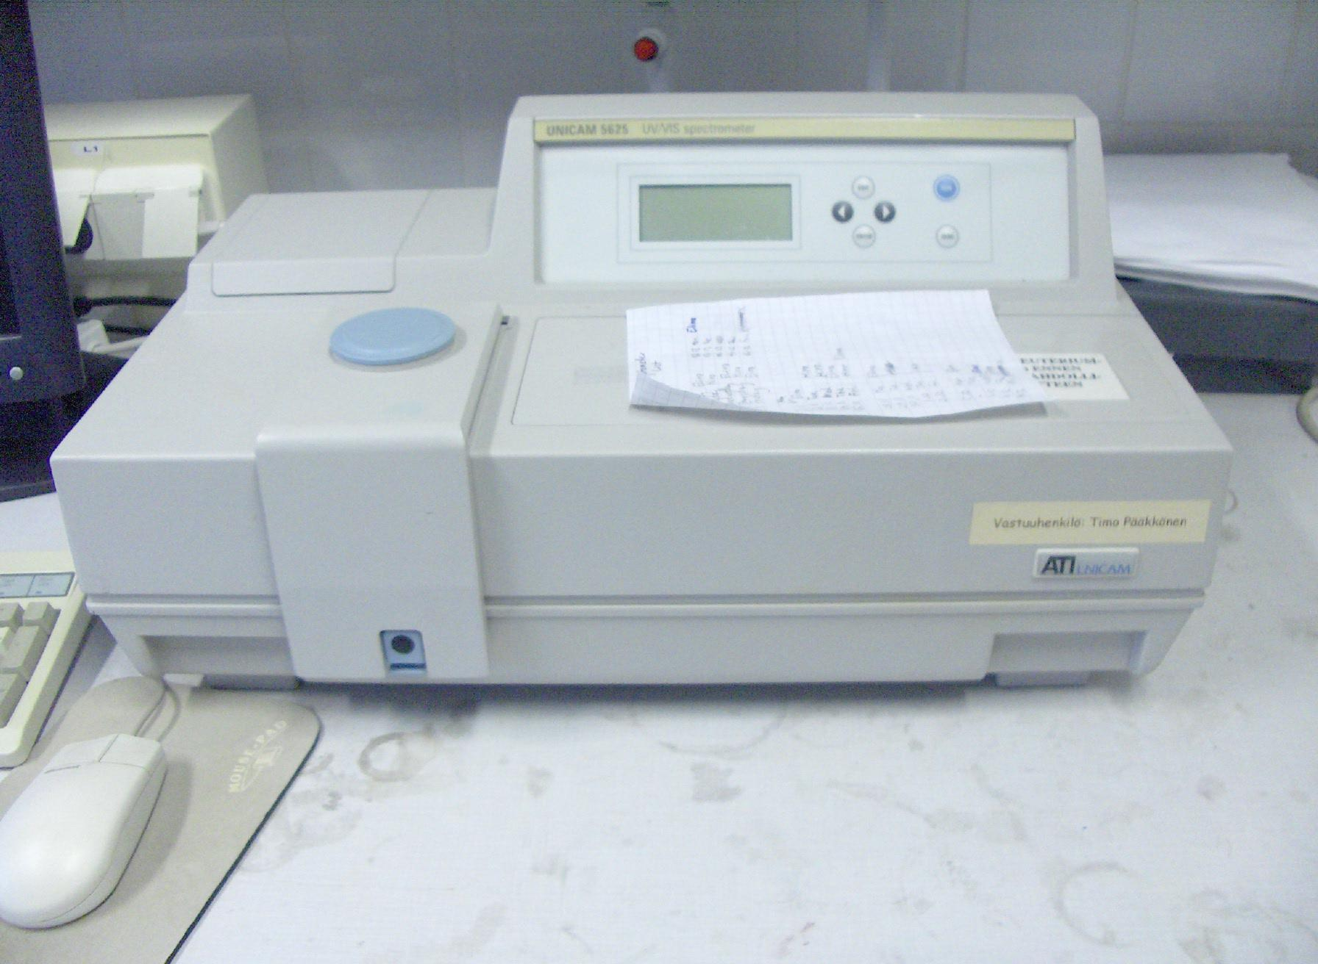
Traditional Spectrophotmetry
Expensive

Slide 4
Goals
Build an inexpensive spectrophotometer device to measure concentration.
Start with Red Dye 40, as this is a substance that can be used in the lab to test our AguaClara water treatment apparatuses.

Slide 5
Previous Work
Arduino-based device
“Color Sensor” integrated circuit used as main detector
Inaccurate, imprecise.
  For the same sample, widely varying values obtained.
  For vastly different samples, the same values were sometimes obtained.

Slide 6
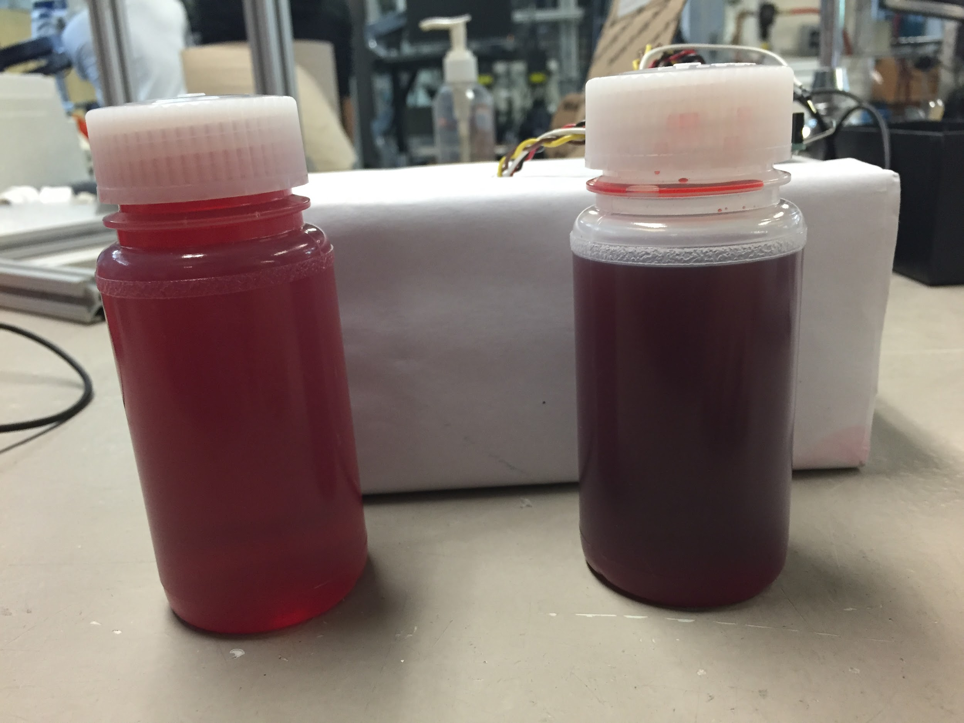
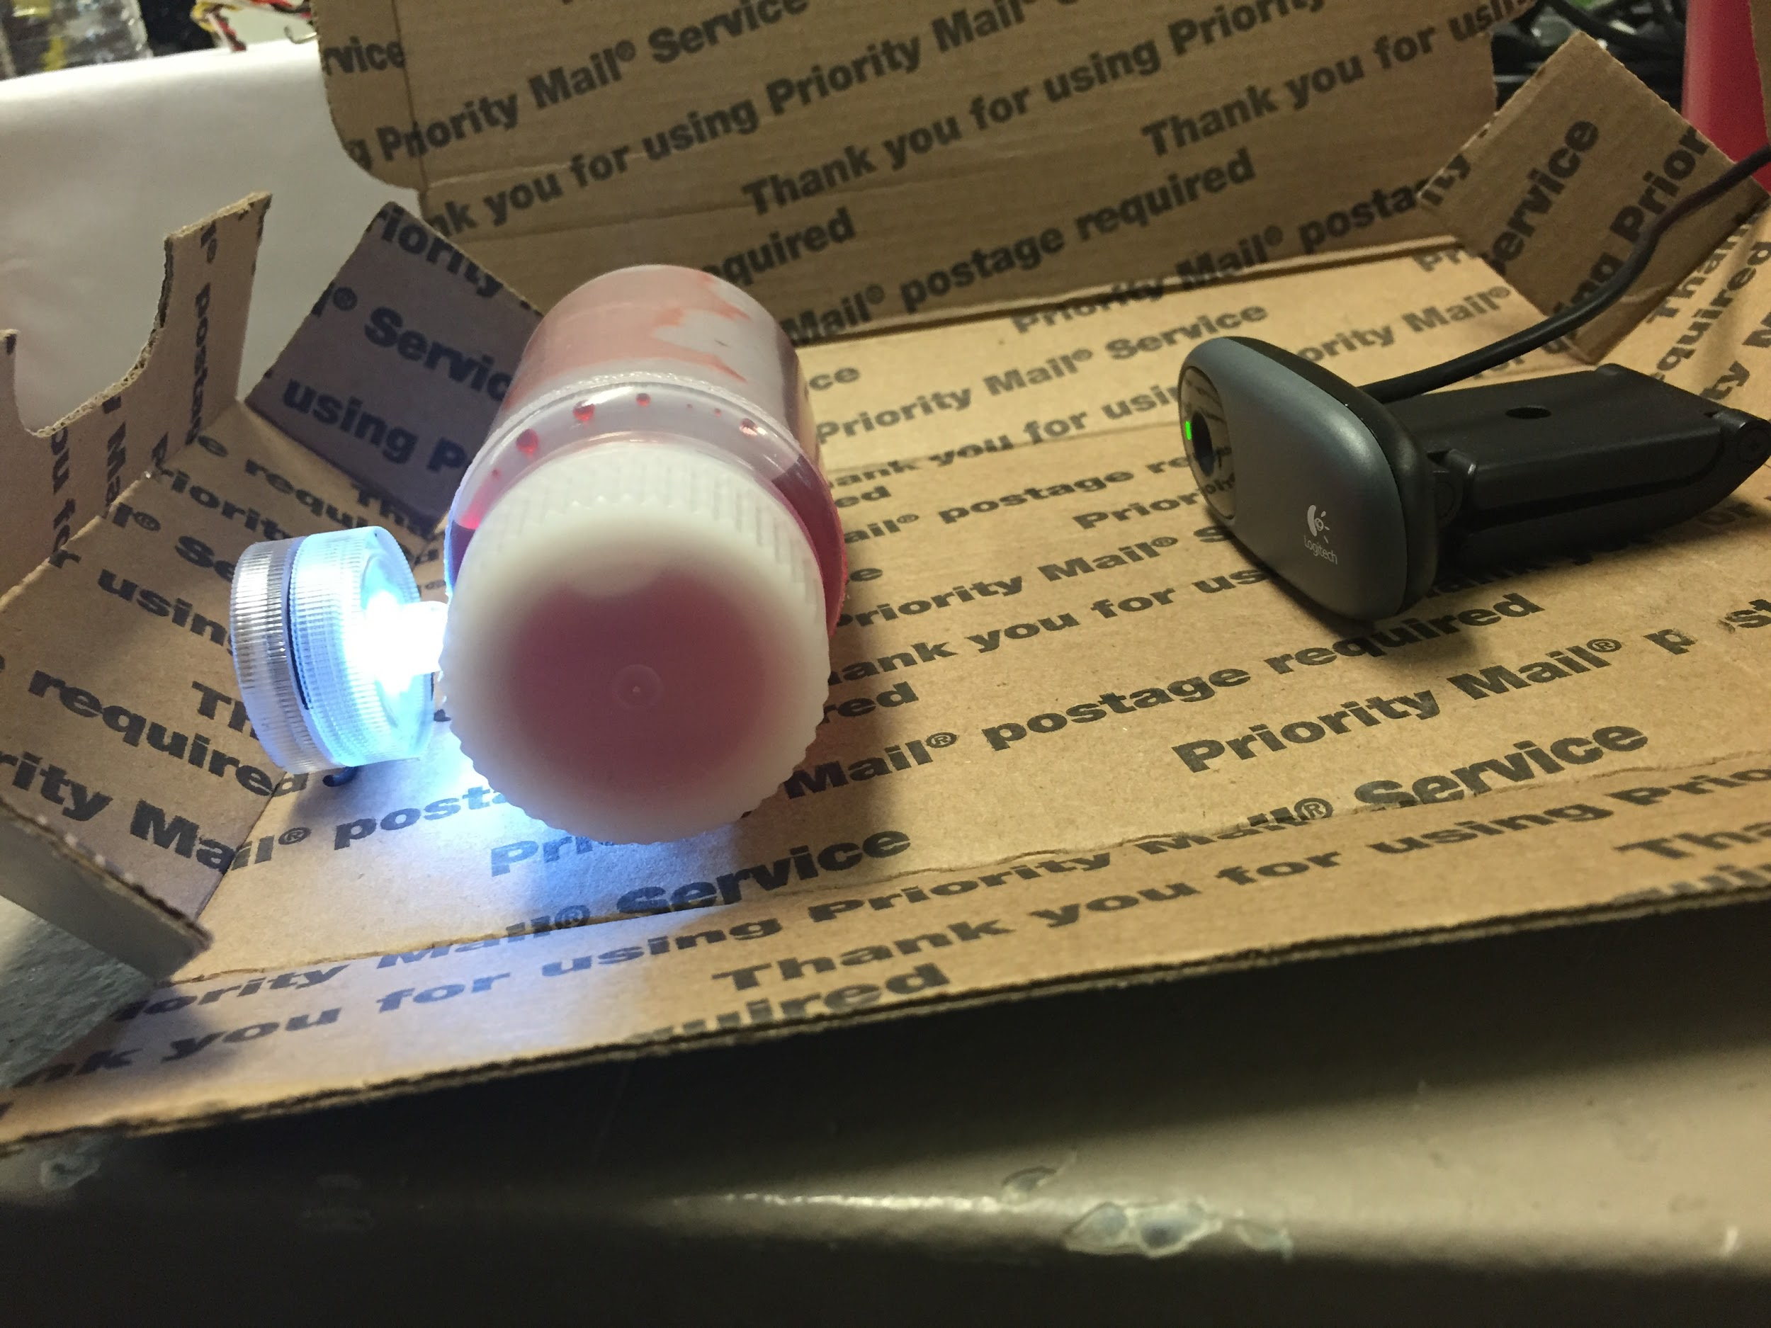
Initial Tests

Slide 7
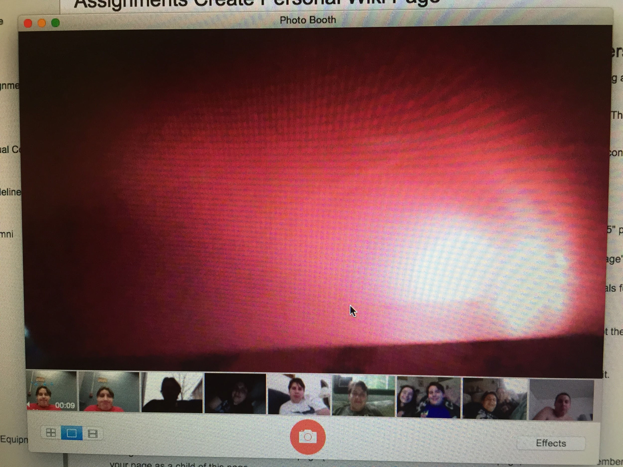
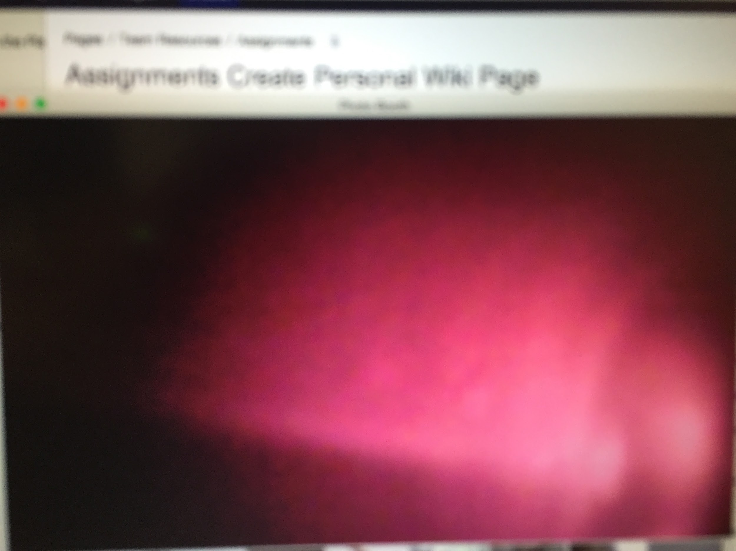
Initial Tests

Slide 8
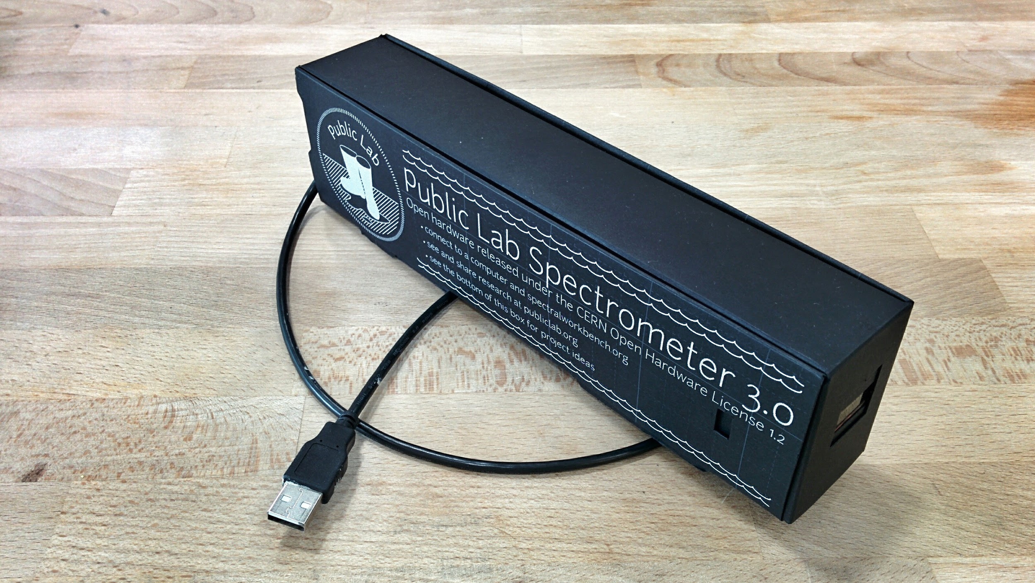
New Approach

Slide 9

Kit Experiments

Slide 10
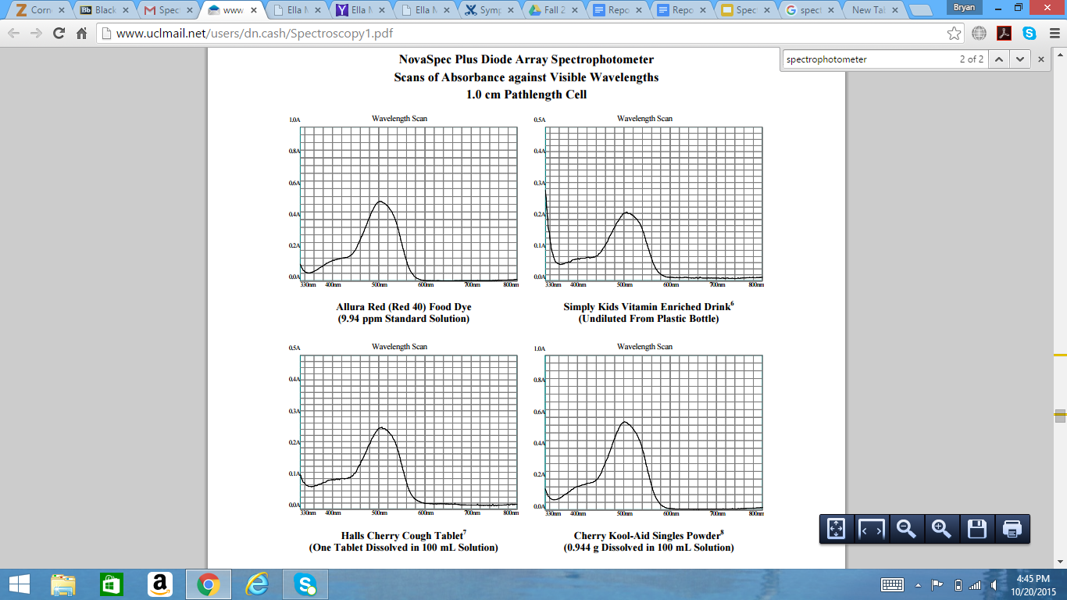
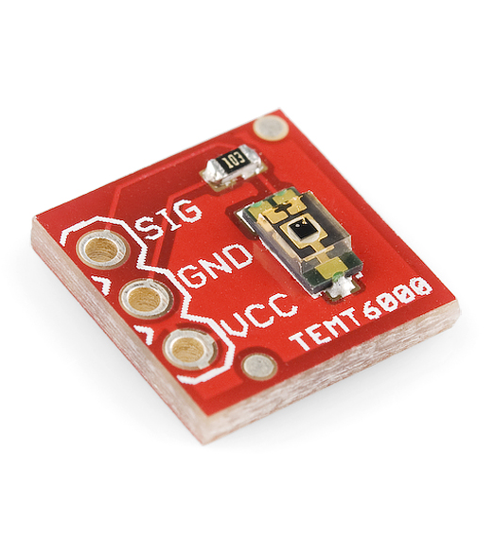
New Approach 2

Slide 11
Questions?

