Slide 1


Cardiac Output (CO) Monitoring
IVECCS 2015
Francesca Di Mauro

Slide 2
Why is Measuring CO Important?
Measurement of CO benefits the care of critically ill patients
Maintenance of appropriate CO and oxygen delivery
  Prevents multiple organ ischemic injury
  Decreases morbidity and mortality

Slide 3
Why is Measuring CO Important?
Preload indicator
  Accurately assess volume status
  Replace the deficit
Early indicator of deteriorating cardiovascular status
  Anesthetic/ sedatives cause vasoconstriction /vasodilatation → blood pressure an unreliable indicator of worsening cardiac performance
Notes:
1. Accurately assess the volume status of the patient and replace the eventual deficit

Slide 4
Why is Measuring CO Important?
Important indicator of the global macro circulation
  Adequacy of blood delivered to the body as a whole
  Does NOT have a relationship with micro-circulation adequacy
  CO does not indicate good tissue perfusion

Slide 5
CO as a Preload Indicator
To guide fluid resuscitation
Traditionally indicators of preload include
  Central venous pressure (CVP)
  Mean arterial blood pressure (MAP)
  Pulmonary capillary wedge pressure (PCWP)
  Blood lactate concentration
  Urine output
Unreliable indicators of fluid status

Slide 6
Techniques to Measure CO
Indicator methods
  Pulmonary thermodilution
  Lithium dilution
Derivation of Fick’s principle
Arterial pulse wave analysis
Imaging diagnostic technique
  Trans-thoracic echocardiogram
  Thoracic bio-impedance

Slide 7
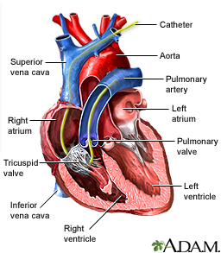
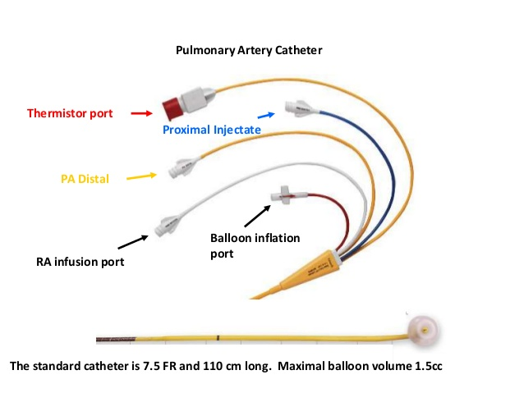
Indicator Methods:
Pulmonary Thermodilution
Gold standard
Use of a pulmonary arterial (PA) catheter
Swan Ganz technique
Notes:
Swan-Ganz catheterization is the passing of a thin tube (catheter) into the right side of the heart and the arteries leading to the lungs. It is done to monitor the heart's function and blood flow.
NORMAL human results
Cardiac index is 2.8 to 4.2 liters per minute per square meter (of body surface area)
Pulmonary artery systolic pressure is 17 to 32 millimeters of mercury (mmHg)
Pulmonary artery mean pressure is 9 to 19 mmHg
Pulmonary diastolic pressure is 4 to 13 mmHg
Pulmonary capillary wedge pressure is 4 to 12 mmHg
Right atrial pressure is 0 to 7 mmHg

Slide 8
Indicator Methods:
Pulmonary Thermodilution
Involves using thermal energy as the indicator
A bolus of cold, isotonic solution is injected proximal to the right ventricle
  Dilution of the indicator is followed continuously somewhere distal to the ventricle (pulmonary artery)
CO is determined by the Stewart-Hamilton principle
  Inversely proportional to the AUC of the concentration vs time curve

Slide 9
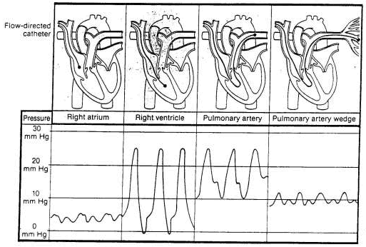

Slide 10
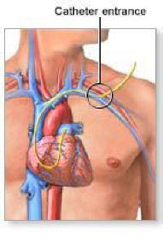
Complications Associated with Pulmonary Thermodilution
Arrhythmias
Damage to cardiac endothelium
Infection
Pulmonary thromboembolism
Not routinely used in veterinary
medicine

Slide 11

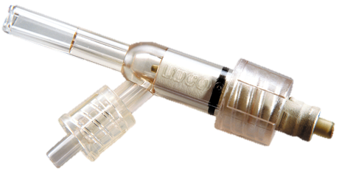
Indicator Methods:
Lithium Dilution
Hemoglobin and serum sodium concentration required
Determined using a blood gas analyzer
Lithium chloride (0.003 mmol/kg) injected via a central vein, arterial blood withdrawn through a lithium sensor placed between the side port of 3-way port and the metatarsal arterial catheter
Notes:
Hemoglobin concentration and serum sodium concentration required for CO measurement

Slide 12
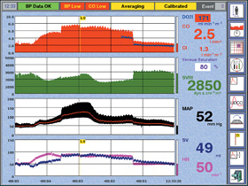
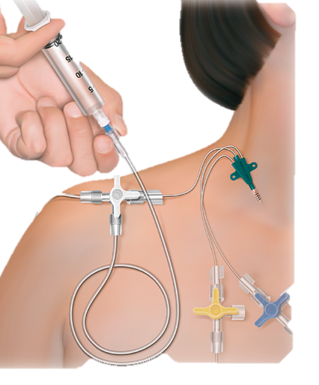
Indicator Methods:
Lithium Dilution
Blood was collected through a peristaltic pump at a flow rate of 4 ml/min across the sensor
Cardiac output automatically derived from the concentration versus time curve using system software

Slide 13
Arterial Pulse Wave Analysis
2 pulse contour CO monitors evaluated in vet med
Transpulmonary pulse contour analysis monitor (PiCCO)
  Uses cold saline transpulmonary thermodilution for calibration
  LESS EXPENSIVE
Lithium dilution arterial waveform analysis monitor (PulseCO)
  Uses lithium chloride dilution technique as the calibration factor
Notes:
Intensive care: Cecconi et al., (2009) assessed the LiDCO/PulseCO preload responsiveness parameters in post-operative intensive care patients on IPPV with 8ml/kg tidal volumes and PEEP of 5cm H20. Only PPV% and SVV% were able to give cutoff values with sensitivity and specificity >50%. ROC curve analysis gave predicted cut-off limits of 11% for SVV% (Sens: 72%, Spec: 79%) and for PPV% >12% (Sens: 86%, Spec: 70%). Their conclusion was: “SVV, PPV and SPV of PulseCO are good predictors of Fluid Responsiveness in fully sedated and mechanically ventilated patients in the intensive care.
Effects of vasoactive drugs on PPV%/ SVV%. A key question for pressure waveform analysis methods has been their robustness in the presence of vasoactive administration - Hadian et al (2010) investigated the effects of vasoactive therapy on LIDCO’s PPV% and SVV%. Seventy-one paired events were studied - 38 vasodilators, 10 vasoconstrictor & 14 inotrope administrations. As expected, vasodilator therapy increased PPV% and SVV% from 13% to 17% and 9 to 15% respectively (p < 0.001). Whereas, increasing inotropes or vasoconstriction did not alter PPV% and SVV%. The authors’ conclusion was “ Thus, SVV% and PPV% can be used to drive fluid resuscitation algorithms in the setting of changing vasoactive drug therapy”.
High-risk general surgery: Richard et al (2010) compared measurements of arterial pulse pressure variation (PPV) from the LiDCOrapid to the same parameter displayed by the Philips Intellivue MP50 monitors on patients during high-risk abdominal surgery. Their conclusions were that the: “LiDCOrapid PPV measurement demonstrated a high degree of correlation with the Philips Intellivue MP50 PPV values. Use of either monitor should generate accurate measurements of continuous PPV to guide fluid resuscitation.”

Slide 14
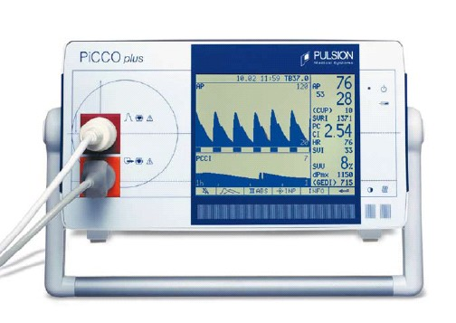
Transpulmonary pulse contour analysis monitor (PiCCO)

Slide 15
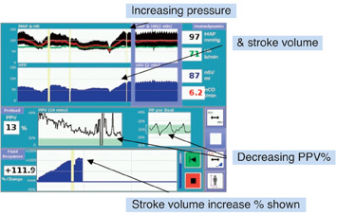
The LiDCOrapid monitor
Shows both trended changes in SVV% or PPV% and ∆SV in response to fluid challenges to increase stroke volume
Notes:
ROC curve analysis gave predicted cut-off limits of 11% for SVV% (Sens: 72%, Spec: 79%) and for PPV% >12% (Sens: 86%, Spec: 70%).
SHIH SAID >20% MEANS NEEDS MORE FLUIDS

Slide 16
Arterial Pulse Wave Analysis: Considerations
Minimally invasive
Continuous CO determination
Both techniques limited by severe arrhythmias, severe vasoconstriction, aortic valve regurgitation
PiCCO requires femoral catheterization
  Cannot use on cats
  Less clinically applicable
Notes:
The manufacturer recommends that the PICCO arterial catheter be placed in the femoral artery with the catheter tip located in the aorta (central catheterization) to detect central aortic blood pressure. Arterial central catheterization is not commonly performed in veterinary medicine, and the fact that the PICCO method requires femoral catheterization makes it less clinically applicable

Slide 17
Ultra sound velocity dilution (UDCO)
An arterio-venous loop made by attaching tubing between the metatarsal arterial and central venous catheters
  Connects central venous and peripheral arterial catheters and created an extracorporeal circuit
Two ultrasound velocity sensors are attached to this circuit
  Venous flow sensor is placed upstream from the venous catheter
  Arterial flow sensor is placed downstream from the arterial catheter

Slide 18
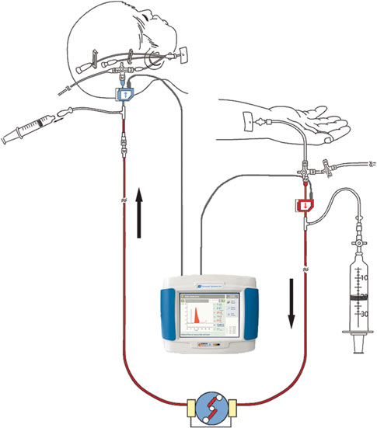

Slide 19
Ultra sound velocity dilution (UDCO)
A small bolus of isotonic saline (0.5 to 1 ml/kg) is injected into the venous circulation, creating a transient hemodilution and change in the ultrasound velocity
CO is the product of volume of isotonic saline and the decrease in blood velocity as saline passes through an ultrasonic sensor
Notes:
Ultrasound velocity in the blood is 1,560-1,590 m/sec
Mainly dependant on rbc and protein
The ultrasound velocity in isotonic saline is lower than in blood (1,533m/sec)
The injection of a saline bolus into the venous system will generate an ultrasound velocity dilution curve due to a transient dilution of blood proteins and consequently decease the ultrasound velocity in the arterial sample

Slide 20
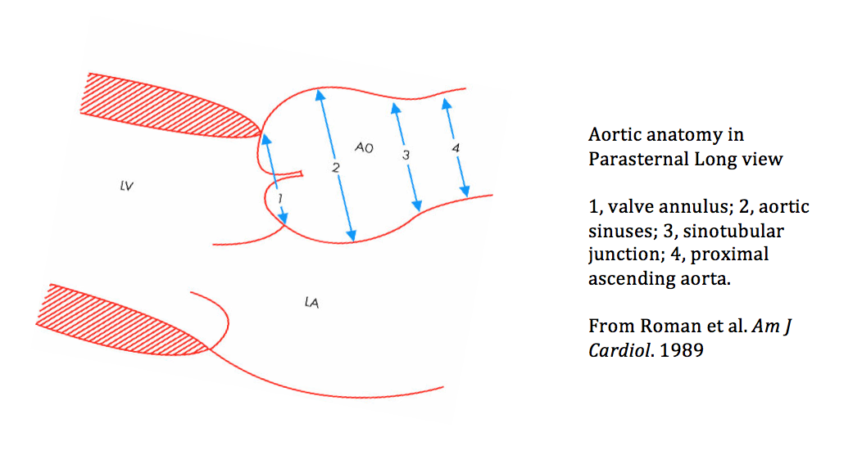
Imaging Techniques: Echocardiogram
True non invasive techniques
Measurement of blood velocity (using Doppler) and aortic diameter allow estimates of stroke volume
Notes:
Indicator method and pulse contour CO are all less invasive then PAD but still require placement of both venous and arterial catheter.

Slide 21
Imaging Techniques: Bioimpedance
Noninvasive
Evaluates changes in the conductivity of the thorax resulting from the pulsatile flow of blood within the thoracic cavity
Sets of electrodes are placed around the patient chest.
  Apply a small known voltage to the patient and measure what portion of initial voltage reaches distal electrodes the conductivity (and impedance) can be calculated
  Changes in thoracic blood volume over time would lead to change in bio-impedance
Notes:
Thoracic electral bio-impedance is a noninvasive method of evaluating changes in the conductivity of the thorax resulting from the pulsatile flow of blood within the thoracic cavity

Slide 22
Fick’s Method
Fick’s Principle: As long as there is no pulmonary and cardiac shunting the oxygen uptake by the blood (VO2) is the product of rate of blood flow through the lungs (CO) and the difference in oxygen content between pulmonary venous and pulmonary arterial blood
VO2=CO x (CaO2-CvO2)
Rearranged as: CO= VO2/(CaO2-CvO2)
Notes:
https://upload.wikimedia.org/math/4/9/4/494c7eb1e060432276df0dc1d0fb524c.png
There are some drawbacks for the Fick’s method: Mixed blood sampling requires placement
of a pulmonary arterial catheter (with all the complication stated above). Blood sample from
right atrium and jugular vein are poor substitute to mixed venous sampling. Furthermore,
oxygen uptake is calculated as VO2 = VE (FIO2-FEO2) where VO2 = oxygen uptake, VE =
expired minute ventilation volume, FIO2 = fractional concentration of oxygen in inspired gas
and FEO2 = fractional concentration of oxygen in expired gas. Accurate determination of
expired minute ventilation volume is difficult to measure in conscious animals. Furthermore,
the Ficks method relies on the patient maintaining a table metabolic state throughout the
period of gas collection; tjus the less stable the patient the les reliable this method becomes. 5
In order to avoid some of these drawbacks, carbon dioxide (CO2) production, instead of
oxygen consumption can be used in a modified Fick’s Equation. The rate of CO2 elimination
by lungs (VCO2) is the product of CO and the difference in CO2 content between pulmonary
venous and pulmonary arterial blood. Mixed blood gas is substituted by having the animal
rebreath exhaled air until CO2 tension in the breathing circuit plateaus (NICCO). This CO2
tension is theoretically that of the mixed venous blood (eliminating the need for pulmonary
arterial catheter). 20The rebreating technique (NICCO) has been validated in anesthetized
foals and demonstrated good correlation when compared to Lithium dilution technique 1 20
Unfortunately the commercially available rebreathing circuits can’t be adapted for adult
horses, making it less then ideal technique.

Slide 23
Fick’s Method
Although oxygen content analyzers are available, it is more typical for the clinician to measure the oxygen partial pressure (PO2), hemoglobin saturation (Sat) and hemoglobin concentration (Hb) with a gas analyzer
Manually calculate oxygen content using the formula: CO2= (1.34 Hb x Sat) + (0.003 PO2)

Slide 24
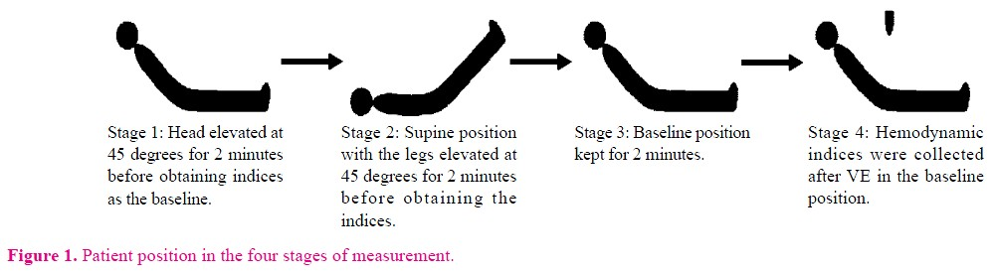
New CO Methods
Passive Leg Raising (human)
  Evaluate responsiveness to fluids
Raising dogs at 5 degree angle (Andre Shih)
  Echo Left atrium after dog is raised
    Does LA appear larger?

