Slide 1
Effect of Duration of Packed Red Blood Cell Storage on Morbidity and Mortality in Dogs After Transfusion: 3,095 cases (2001–2010)
Jo-Annie Letendre, DVM
Journal Club December 2014

Slide 2
JVIM
November 2014
UPenn
Authors
  Dr. King (DACVECC) and Dr. Callan (DACVIM)
  Dr. Brown and Dr. Hann
Presented in part as a research abstract at the 2013 ACVIM Forum
Not supported by a grant or other funding.
Notes:
Callan: clinical and research interests in hematology and transfusion medicine, several publications in that regard

Slide 3
Research question
Does the duration of storage of pRBCs have an effect on morbidity & mortality in dogs receiving pRBCs transfusion?
Potential adverse effects associated with transfusion of older stored RBCs to critically ill dogs have not yet been reported.
Notes:
However, large observational studies of human patients, especially those with trauma,3 after cardiac surgery,4 or in a pediatric intensive care unit,5human patients, especially those with trauma,3 after cardiac surgery,4 or in a pediatric intensive care unit,5found associations between transfusions of olderPRBCs (generally defined as >14 days of storage) andincreased sepsis, multiple organ dysfunction syndrome(MODS), mortality or some combination of these.

Slide 4
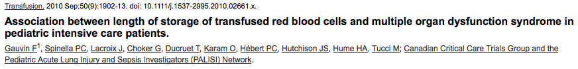

Background & literature review
Associations between transfusions of older pRBCS (> 14 days) and sepsis, MODS, mortality – trauma, cardiac surgery, PICU
A storage time of more than 14 days was independently associated with increased MODS (adjusted OR, 2.23; 95% CI, 1.20-4.15) and more than 21 days was associated with increased Pediatric Logistic Organ Dysfunction (PELOD) scores (adjusted mean difference, 4.26; 95% CI, 1.99-6.53) and higher mortality (9.2% vs. 3.8%).
Patients who died (n = 117) received more units of older blood than those who lived (5 units versus 3 units, p < 0.001). Patients with complicated sepsis (n = 244) received a greater volume of older blood than those without complicated sepsis (6 units versus 3 units, p < 0.001).

Slide 5


Background & literature review
The animals receiving older stored blood had a higher mortality rate (42 d: 100% vs 7 d: 33%)
No significant differences were observed between LR and non-LR transfusions. A pro-inflammatory cytokine response (MCP-1) was observed 6 hours after only old RBC transfusions, irrespective of infusion rate (P<0.001). This response was accompanied by increased neutrophil counts (P<0.001) and decreased platelet counts (P<0.001).
Notes:
monocyte chemoattractant protein (MCP)-1
measures of the severity of multiple organ dysfunction syndrome in paediatric intensive care units;

Slide 6
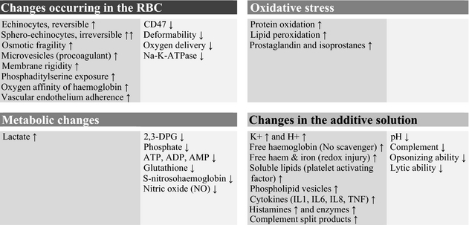
Does prolonged storage of red blood cells cause harm?
British Journal of Haematology
Volume 165, Issue 1, pages 3-16, 25 JAN 2014 DOI: 10.1111/bjh.12747
http://onlinelibrary.wiley.com/doi/10.1111/bjh.12747/full#bjh12747-fig-0003
Notes:
The original concern regarding RBC storage time and maximal acceptable shelf life for patient care evolved from observations of the RBC storage lesion(s) During the duration of their shelf life, RBCs are exposed to oxidative stress and undergo metabolic changes. The accumulating metabolites, altered proteins and particles, such as microvesicles, may be released and The damage affecting the membrane and cytoskeleton results in altered deformability and shape and compromises RBC integrity
The RBC storage lesion. The changes affect the RBC cytoplasm and more so the membrane, parts of which are shed into the supernatant as microvesicles. RBC, red blood cell; 2,3‐DPG, 2,3‐diphosphoglycerate; ATP, adenosine triphosphate; ADP, adenosine diphosphate; AMP, adenosine monophosphate; IL, interleukin; TNF, tumour necrosis factor.
© IF THIS IMAGE HAS BEEN PROVIDED BY OR IS OWNED BY A THIRD PARTY, AS INDICATED IN THE CAPTION LINE, THEN FURTHER PERMISSION MAY BE NEEDED BEFORE ANY FURTHER USE. PLEASE CONTACT WILEY'S PERMISSIONS DEPARTMENT ON PERMISSIONS@WILEY.COM OR USE THE RIGHTSLINK SERVICE BY CLICKING ON THE 'REQUEST PERMISSION' LINK ACCOMPANYING THIS ARTICLE. WILEY OR AUTHOR OWNED IMAGES MAY BE USED FOR NON-COMMERCIAL PURPOSES, SUBJECT TO PROPER CITATION OF THE ARTICLE, AUTHOR, AND PUBLISHER.

Slide 7
Background & literature review

Slide 8
Study Design
Retrospective
  Blood bank logbooks
  January 2001-2010
Case review
Notes:
The blood bank logbooks of the hospital were reviewed to identify dogs that received pRBCS transfusions between january 2001 and december 2010

Slide 9
Study subjects
Dogs that received pRBCs transfusions
  Excluded
    if incomplete medical record or not available
    If received < 5 ml/kg of pRBCs
n = 3095 dogs (5412 pRBC units)
Categories:
  Hemorrhage
  Hemolysis
  Ineffective erythropoiesis
Notes:
PCV and TP (measured within 4 hoursafter the first PRBC transfusion), body temperature, evidence ofa febrile nonhemolytic transfusion reaction (FNHTR; increase inbody temperature by ≥2°F during or within 4 hours after transfu-sion without evidence of hemolysis) or acute hemolytic transfu-sion reaction (AHTR; presence of fever, hemoglobinemia,hemoglobinuria, and lack of increase in PCV), and developmentof new or progressive organ failure, SIRS, TED, DIC, or nosoco-mial infection.

Slide 10
Predictor variable
Duration of pRBCs storage
  Review of the blood bank logbooks and medical records
    Date of collection of blood from the donor
    Date of administration of pRBCs
    Number and volume of pRBC transfusions
    Volume of concurrent blood products
Notes:
A predictor variable is a variable used in regression to predict another variable. It is sometimes referred to as an independent variable if it is manipulated rather than just measured.

Slide 11
Outcome variables
Morbidity and mortality in dogs after pRBCs transfusion
  Febrile non hemolytic transfusion reaction
    Increase in body temperature by ≥2°F during or within 4 hours after transfusion without evidence of hemolysis
  Acute hemolytic transfusion reaction
    Presence of fever, hemoglobinemia, hemoglobinuria, and lack of increase in PCV
  New or progressive:
    Organ failure
      Hemodynamic, respiratory, renal, neurologic, hepatic, pancreatic, or coagulation failure
    Sepsis
      SIRS + histological or microbiological confirmation of infection
    SIRS
      ≥3 of the following: hypo- or hyperthermia [<100 or >103°F]; tachycardia [>140]; tachypnea [>40]; and leukopenia [<6,000/ lL], leukocytosis [>16,000/lL], or >3% band neutrophils
    Thromboembolic disease: clot visualized with CT angiography, US, necropsy
    DIC
      ≥2 of the following: PT or aPTT >25% above the upper reference interval, platelet count <100,000/uL, and increased D-dimer concentration
    Nosocomial infection: pneumonia, UTI, surgical site infection
  Outcome
    Discharged, euthanized, died
    Survival at 30 days after the first and +/- oldest transfusion
Notes:
hemodynamic failure [systolic blood pressure <90 mmHg, mean blood pressure <60 mmHg, or vasopressors required], respiratory failure [oxygen supplementation or mechan- ical ventilation required], renal failure [serum creatinine concen- tration >3.4 mg/dL or urine output <0.25 mL/kg/h after fluid resuscitation], neurologic failure [abnormal mentation not attrib- utable to drug treatment, seizures, or other objective evidence of central nervous system dysfunction], hepatic failure [serum total bilirubin >5.0 mg/dL without anemia, posthepatic obstruction, or pancreatitis; increased blood ammonia concentration], pancreaticfailure

Slide 12
Statistics
Fisher’s exact test
  Association between categorical data
Mann-Whitney test
  Association between continuous variables (2 categories)
Kruskal-Wallis test
  Association between continuous variables (3 categories or more)
Logistic regression analysis
  Association of duration of pRBCs storage with 30-day survival
  Control for any potential confounding factors
Notes:
Fisher's exact test^{[1][2][3]} is a statistical significance test used in the analysis of contingency tables. Although in practice it is employed when sample sizes are small, it is valid for all sample sizes. It is named after its inventor, Sir R. A. Fisher, and is one of a class of exact tests, so called because the significance of the deviation from a null hypothesis (e.g., P-value) can be calculated exactly, rather than relying on an approximation that becomes exact in the limit as the sample size grows to infinity, as with many statistical tests.
The Mann-Whitney test is a nonparametric test that allows two groups or conditions or treatments to be compared without making the assumption that values are normally distributed. So, for example, one might compare the speed at which two different groups of people can run 100 metres, where one group has trained for six weeks and the other has not.
Requirements
Two random, independent samples
The data is continuous - in other words, it must, in principle, be possible to distinguish between values at the nth decimal place
Scale of measurement should be ordinal, interval or ratio
For maximum accuracy, there should be no ties, though this test - like others - has a way to handle ties
Null Hypothesis
The null hypothesis asserts that the medians of the two samples are identical.
LOGISTIC REGRESSION: Logistic regression analyzes the relationship between multiple independent variables and a
categorical dependent variable ( 30 day survival: yes or no)
Independent variables: duration of storage of pRBCS ; and controlling for potential CONFOUNDING variables: signalment, body weight, history of previous RBC transfusion, major cause of anemia (eg, hemorrhage, hemolysis, or ineffective erythropoiesis [IE]), major underlying disease process, and concurrent medical conditions. Also evaluate the effects of packed cell volume (PCV); total plasma protein concentration (TP); absolute reticulocyte count; platelet count; total white blood cell count; neutrophil count; serum creatinine, bilirubin, albumin, and glucose concentrations; blood lactate concentration; venous pH; body temperature; and, presence or absence of a blood crossmatch.

Slide 13
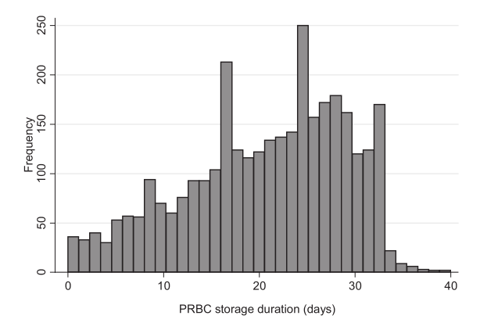
Results
20%received only units ≤14 days
Notes:
80% of the dogs received pRBCS older than 14 days and 20% received prBCS younger than 14 days
There was a wide distribution of pRBCS unit storage duration – from 0 to 40 days.
Median storage duration was 23 days.

Slide 14
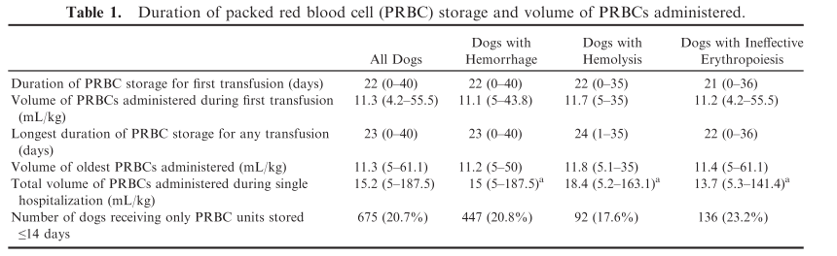
Results
Notes:
Only 675/3095 dogs received pRBCS younger than 14 days

Slide 15
Results
Adverse event | Incidence | Duration of RBC storage | pRBC volume
FNHTR | 3% | 22 days: no FNHTR 23.5 days: FNHTR p= 0.003
AHTR | 0.21% | Not associated with development of AHTR | 34 ml/kg (10.7 -128.7): AHTR 15.1 ml/kg: no AHTR
Notes:
there was a statistically significant associa-tion between longer PRBC storage and development of a FNHTR, the clinical relevance of this observation is questionable given that the median durations of PRBC storage were 23.5 and 22 days
34 mL/kg (range,10.7–128.7), more than twice the median volume for all dogs with hemorrhage
All the dogs who experienced AHTR were dogs treated for transfusions because of hemorrhage.

Slide 16
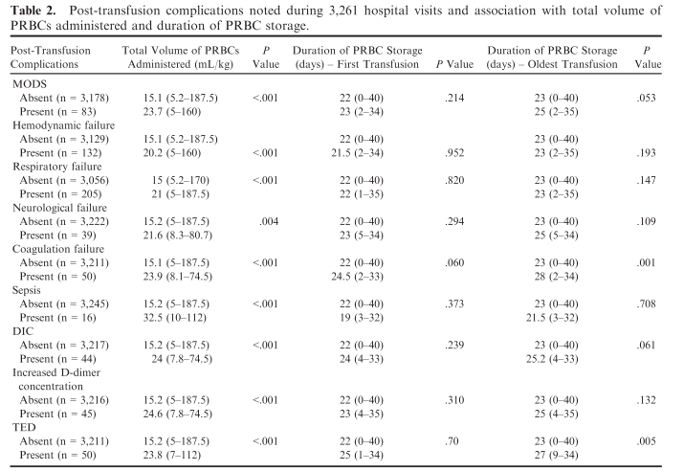
Results
Notes:
a larger total volume of PRBCs administered was strongly associated with development of new or progressive MODS, individual organ failures, sepsis, DIC, and TED
But there was no association with 30-day survival
There was an association between duration of pRBC storage and development of coagulation failure or TED.

Slide 17
Results
Larger volume of pRBCs: associated with post-transfusion complications
Larger volume of pRBCs: not associated with 30-day survival overall or for each group (hemorrhage, hemolysis, or IE)
  30-day survival vs volume first transfusion (all dogs)
    Yes: 15.1 ml/kg (5.2 – 170)
    No: 15.3 ml/kg (5 – 187.5)
Transfusion of older pRBC units was associated with development of coagulation failure and TED.
Notes:
Although a larger total volume of PRBCs administered was associated with post-transfusion complications as noted above (Table 2), there was no association with 30-day survival overall or for each subset (hemorrhage, hemolysis, or IE).
There was a statistically but not clinically relevant difference in the total volume of PRBCs administered to all dogs being discharged (median,

Slide 18
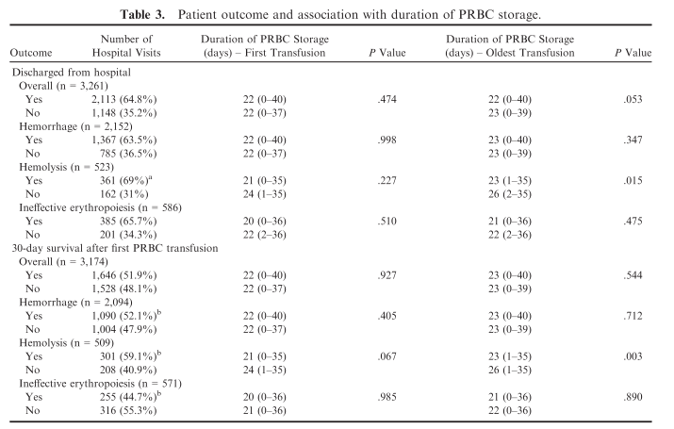
Results
Notes:
The percentage of dogs discharged from the hospital was significantly higher when the major cause of anemia was hemolysis rather than hemorrhage
Survival at 30 days after the first PRBC trans-fusion was longest for dogs with hemolysis
longer duration of PRBC storage was a negative risk factor for survival in dogs with hemolysis, but not for dogs with hemorrhage or IE.

Slide 19
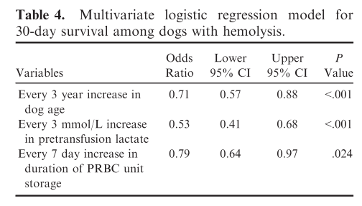
Results
Notes:
For every 7 day increase in storage, there was a 0.79 lesser odds of 30-day survival in dogs with hemolysis
Increasing patient age and pretransfusion plasma lactate concentration also were found to be negative risk factors for survival of dogs with hemolysis.

Slide 20
Conclusions
RBC storage may have a negative effect on the outcome in dogs with IMHA.
RBC storage may contribute to increased morbidity (coagulation failure, TED).
Storage of pRBCs for 5-6 weeks may not be optimal
Prospective studies are necessary.
Notes:
However, when considering all dogs, regardless of cause of anemia, there was no association between the PRBC storage time and survival.
A synergistic effect of older PRBC transfusion-associated inflammation with the inflammatory response in dogs with IMHA may contribute to mortality
.

Slide 21
Validity of the study
Large number of dogs
Progression of the disease or post-transfusion complications?
  Other factors that may have influence morbidity/mortality
Retrospective nature
  Underestimation of the incidence of adverse effects
  Severity of the disease
Strict definition
  Underestimation of the incidence of adverse effects
Duration of storage
  20% received pRBCS younger than 14 days
  80% received pRBCS older than 14 days
    Underestimation of possible differences in morbidity/mortality when patients receive fresh vs old blood
Notes:
Effect of their strict definition for coagulation failure, TED
Statistical association – but cause and effect?
Retrospective nature
Only 20% received pRBCS younger than 14 days.
Other factors that may have influence morbidity/mortality in this population of sick patients other than pRBCs itself.
Large number of dogs + but very heterogenous group

Slide 22
Conclusion
Fresh vs old pRBCs
  Only 20% received fresh blood
Prospective study
Will you consider using the most fresh unit available for your next IMHA patient?
Notes:
But When comparing dogs that received only PRBCunits stored ≤14 days (n = 675) to those that receivedPRBC units stored for >14 days (n = 2,586), there was no difference in outcome (discharged, died, or eutha-nized) or 30-day survival for all dogs overall or fo rany subset (hemorrhage, hemolysis, or IE).

