Slide 1
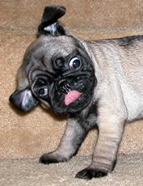

neurolocalization
Valerie Madden
Small Animal ECC Resident
Cornell University

Slide 2
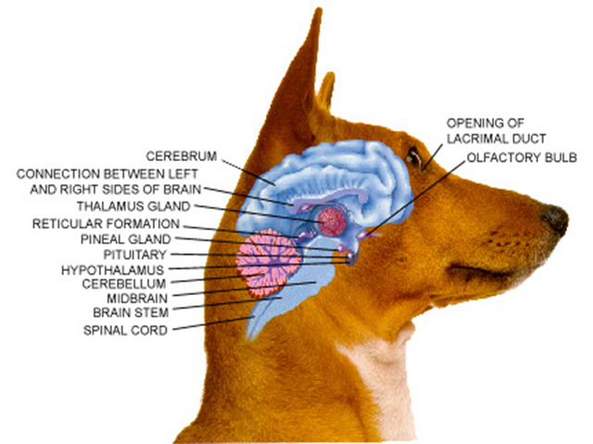
Overview
Divisions of the nervous system
Anatomy
Forebrain
Midbrain
Brain stem
Cerebellum
Spinal cord

Slide 3
PNS
CNS
Brain
SC
Forebrain
Brainstem
Cerebellum
C1-C5
C6-T2
T3-L3
L4-S3
Myopathy
Neuropathy
NMJ

Slide 4
PNS
CNS
Brain
SC
Forebrain
Brainstem
Cerebellum
C1-C5
C6-T2
T3-L3
L4-S3
Myopathy
Neuropathy
NMJ
Notes:
Peripheral nervous system (PNS)
which includes sensory receptors, sensory nerves, and ganglia outside the CNS

Slide 5
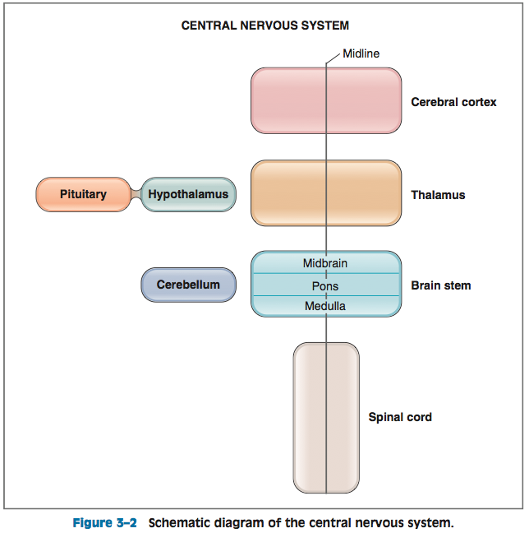
Central Nervous System

Slide 6
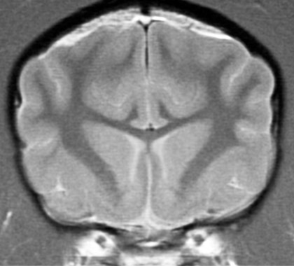
Major division of the Central nervous system
  Cerebral hemispheres
      cerebral cortex
      white matter
      basal ganglia
      hippocampal formation
      amygdala
  Diencephalon
      thalamus and hypothalamus
  Brain stem
      medulla
      pons
      midbrain
  Cerebellum
  Spinal cord

Slide 9
Forebrain- Telencephalon + Diencephalon
Cerebral hemispheres:
Consist of the cerebral cortex, an underlying white matter, and three deep nuclei (basal ganglia, hippocampus, and amygdala)
The functions of the cerebral hemispheres are perception, higher motor functions, cognition, memory, and emotion
  Cerebral cortex
    Is the convoluted surface of the cerebral hemispheres and consists of four lobes: frontal, parietal, temporal, and occipital.
    Cerebral cortex receives and processes sensory information and integrates motor functions

Slide 10
Forebrain- Telencephalon + Diencephalon
Thalamus and hypothalamus:
Together, the thalamus and hypothalamus form the diencephalon
  Thalamus processes almost all sensory information going to the cerebral cortex and almost all motor information coming from the cerebral cortex to the brain stem and spinal cord
  Hypothalamus contains centers that regulate body temperature, food intake, and water balance. The hypothalamus is also an endocrine gland that controls the hormone secretions of the pituitary gland
    The hypothalamus secretes releasing hormones and release-inhibiting hormones into hypophysial portal blood that cause release (or inhibition of release) of the anterior pituitary hormones
    The hypothalamus also contains the cell bodies of neurons of the posterior pituitary gland that secrete antidiuretic hormone (ADH) and oxytocin

Slide 11
Forebrain- Telencephalon + Diencephalon
Seizures
Abnormal mentation (Dull →Coma )
Behavior changes
Hemi-neglect
GP deficits (contralateral)
Circling (Ipsilateral)
Vision (menace) deficits (contralateral)
Facial sensation deficits (contralateral)
Head/neck pain
Micturation abnormalities
Mild facial droop (contralateral)
Diencephalon: PU/PD, Temp, Endocrine

Slide 12
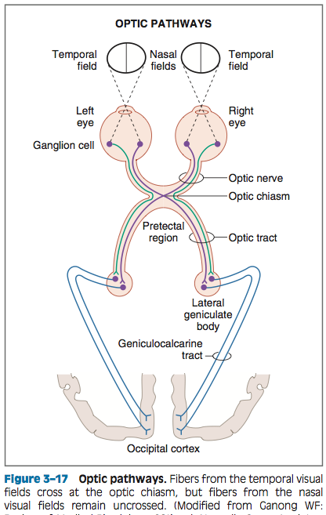
Vision
Notes:
Axons from retinal ganglion cells form the optic nerves and optic tracts, synapse in the lateral geniculate body of the thalamus, and ascend to the visual cortex in the geniculocalcarine tract
The temporal visual fields project onto the nasal retina, and the nasal fields project onto the temporal retina
Nerve fibers from each nasal hemiretina cross at the optic chiasm and ascend contralaterally

Slide 13
vision
Axons from retinal ganglion cells form the optic nerves and optic tracts, synapse in the lateral geniculate body of the thalamus, and ascend to the visual cortex in the geniculocalcarine tract
The temporal visual fields project onto the nasal retina, and the nasal fields project onto the temporal retina
Nerve fibers from each nasal hemiretina cross at the optic chiasm and ascend contralaterally

Slide 14
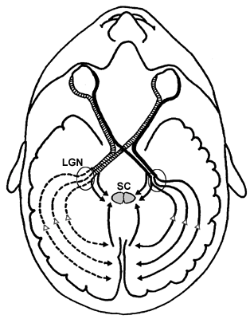
VISION
Fiber crossing at chiasm:
Cat-65%, Dog-75%

Slide 15
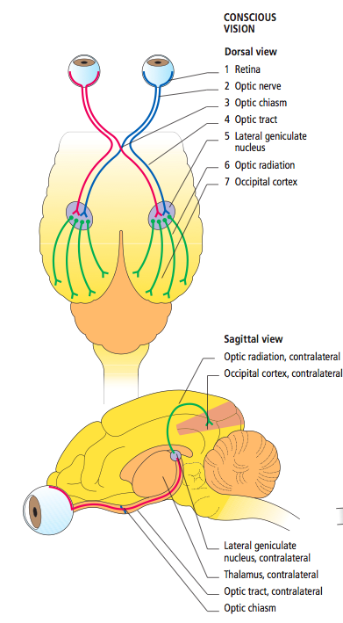

Slide 16
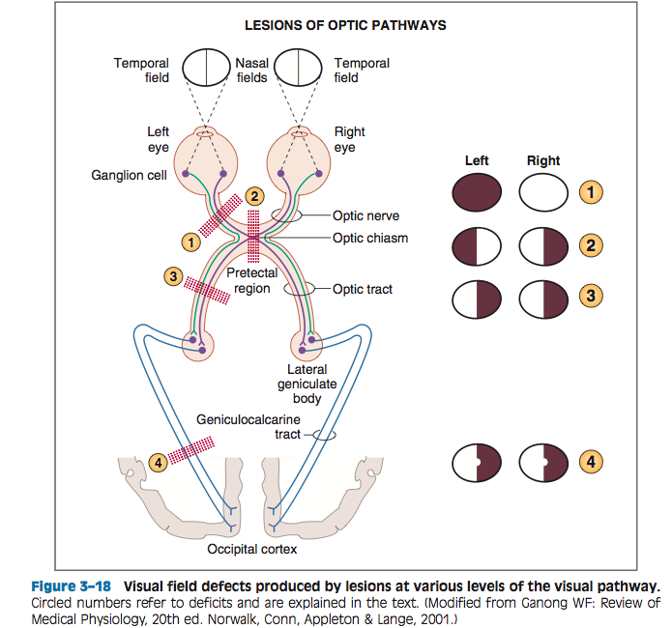
Notes:
NOTE: Hemianopia is the loss of vision in half the visual field of one or both eyes.
1. Optic nerve. Cutting the optic nerve causes blindness in the ipsilateral (same side) eye. Thus, cutting the left optic nerve causes blindness in the left eye. All sensory information coming from that eye is lost because the cut occurs before any fibers cross at the optic chiasm.
2. Optic chiasm. Cutting the optic chiasm causes het- eronymous (both eyes) bitemporal (both temporal visual fields) hemianopia. In other words, all information is lost from fibers that cross. Thus, information from the temporal visual fields from both eyes is lost because these fibers cross at the optic chiasm.
3. Optic tract. Cutting the optic tract causes homonymous contralateral hemianopia. As shown in the figure, cutting the left optic tract results in loss of the temporal visual field from the right eye (crossed) and loss of the nasal visual field from the left eye (uncrossed).
4. Geniculocalcarine tract. Cutting the geniculocalcarine tract causes homonymous contralateral hemianopia with macular sparing (the visual field from the macula is intact). Macular sparing occurs because lesions of the visual cortex do not destroy all neurons that represent the macula.

Slide 17
Brainstem
Brainstem:
  Midbrain
  Pons
  Medulla
  Collectively called the brain stem
Ten of the 12 cranial nerves (CN III–XII) arise in the brain stem

Slide 18
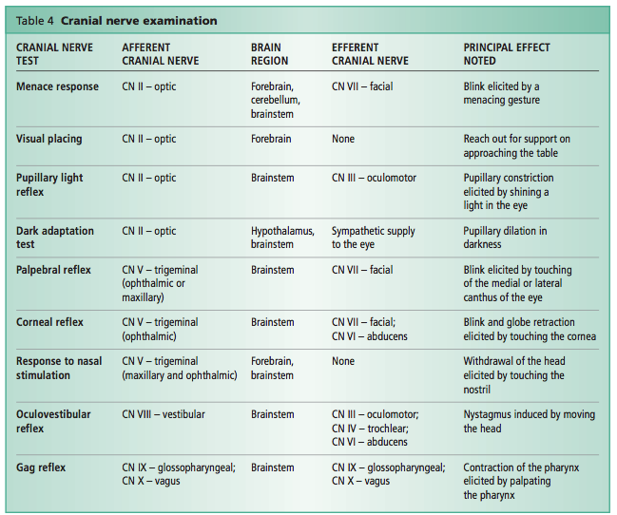
Cranial NERVE EXAM
Notes:
This reaction is a learned response that may not be developed until 10–12 weeks of age in puppies and kittens.

Slide 19
midbrain
Rostral to the pons
Participates in the control of eye movements
Contains relay nuclei of the auditory and visual systems

Slide 20
Midbrain
Stupor, Coma
Paresis → Plegia (ipsilateral)
Spinal ataxia
GP deficits (ipsilateral)
CN III (strabismus, anisocoria, PLR)
CN IV (dorsomedial strabismus)
Head / Neck pain
Horner’s Syndrome

Slide 21
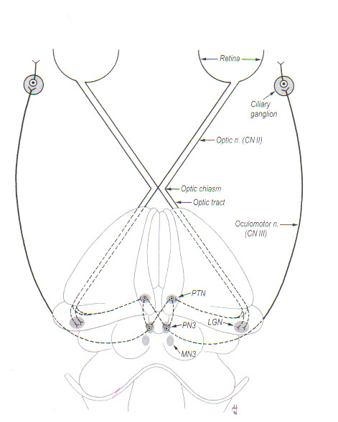
PLR
Notes:
The PLR involves an afferent arm and an efferent arm. The afferent arm of this reflex shares some common pathways (ipsilateral retina, optic nerve, optic chiasm and contralateral optic tract) with part of the afferent arm of the menace response and visual placing. These tests use different integration centres within the brain and different efferent pathways. The PLR does not test the animal’s vision and the cerebrum is not involved in the PLR pathway. The efferent arm of the PLR reflex is mediated by the parasympathetic portion of CN III. While axons involved in vision reach the conscious level after synapse with the lateral geniculate nucleus, the axons involved in the PLR synapse with a third neuron in the pretectal nucleus. Most of the axons arising from this nucleus decussate again and synapse on the parasympa- thetic component of the oculomotor nucleus (ipsilateral to the stimulated eye) in the mesencephalon. There are also neurons that do not decussate and which project to the oculomotor nucleus on the contralateral side of the stimulated eye. The proportion of axons that decussate is higher than that of the ones that do not decussate, explaining why the direct response (constriction in the eye receiving the light stimulus) is greater than the consensual response (constriction in the eye not receiving the light stimulus).

Slide 22
PLR

Slide 23
PLR

Slide 24
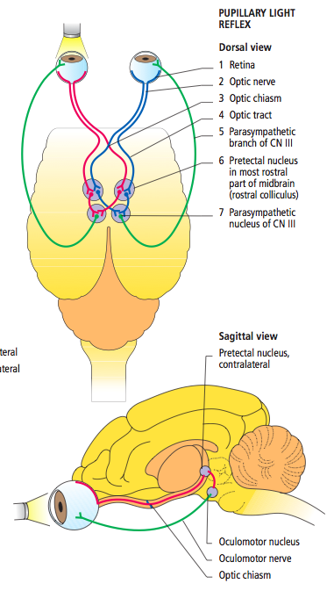
Notes:
Neuroanatomical pathway for the pupillary light reflex (PLR). A bright light stimulus enters the retina (1) and travels through the optic nerve (2), optic chiasm (3) and optic tract (4). The stimulus is relayed to the pretectal nucleus within the rostral colliculus (6). The parasympathetic nucleus of cranial nerve III (7) is stimulated and the signal is transmitted through its parasympathetic branch (5), resulting in contraction of the iris sphincter muscle and constriction of the pupil. A lesion in any part of the pathway can disrupt the PLR.

Slide 25
PUPIL SIZE
Size of the pupils represents a balance of:
  parasympathetic system (responsive to the amount of light entering the eye)
  sympathetic system (responsive to the emotional state of the animal)
The parasympathetic component of the oculomotor nerve (CN III) is involved in the control of pupillary constriction
Tone of the iris dilator muscle is maintained by the sympathetic system

Slide 26
Brainstem reflexes and PLR
Mydriasis usually denotes a lesion (ipsilateral or bilateral) of the midbrain or the CN III
Miosis may occur ipsilateral to severe brainstem injury or aspart of Horner’s syndrome (ptosis, enophthalmos, third eyelid protrusion), indicating a lesion affecting the sympathetic pathway to the eye
Severe bilateral miosis is a sign of acute, extensive brain disturbance and probably occurs as a result of functional disturbance of higher centers, with release of CN III efferents from cerebral inhibition
Severe, unresponsive bilateral mydriasis generally indicates a grave prognosis, and it often accompanies brain herniation
The return of pupils to normal size and responsiveness to light is a favorable prognostic sign

Slide 27
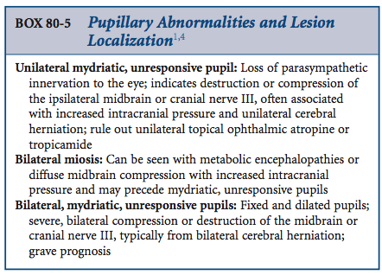
Pupil size

Slide 28
Pons
Rostral to the medulla
Together with centers in the medulla, participates in:
  balance and maintenance of posture
  regulation of breathing
Relays information from the cerebral hemispheres to the cerebellum

Slide 29
Pons
Stupor, Coma
Paresis → Plegia (ipsilateral)
Spinal ataxia
GP deficits (ipsilateral)
CN V (motor) deficits
Head / neck pain
Horner’s Syndrome

Slide 30
Medulla
Rostral extension of the spinal cord
Contains autonomic centers that regulate breathing and blood pressure
Contains centers that coordinate coughing, swallowing and vomiting reflexes

Slide 31
Medulla
Stupor, Coma
Paresis → Plegia (ipsilateral)
Spinal / vestibular ataxia
GP deficits (ipsilateral)
CN VI-XII deficits
Head / neck pain
Respiratory dysfunction
Autonomic dysfunction (HR, BP)
Vestibular signs often most notable
Horner’s Syndrome

Slide 32
Cerebellum
Lies dorsal to the pons and medulla
Functions of the cerebellum:
  Coordination of movement
  Planning and execution of movement
  Maintenance of posture
  Coordination of head and eye movements
Integrates sensory information about position from the spinal cord, motor information from the cerebral cortex, and information about balance from the vestibular organs of the inner ear

Slide 33
Cerebellum
Cerebellar ataxia
Hypermetric gait
Intention tremors
Vestibular signs
Absent menace with normal vision
Anisocoria
+/- GP deficits

Slide 34
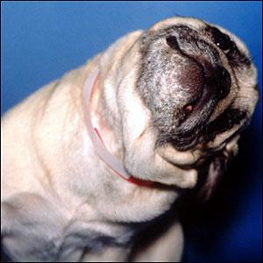
Vestibular system

Slide 35
Vestibular system
Consists of:
  A receptor organ within the petrous temporal bone (inner ear)
  The vestibular nerve (CN VIII)
  A balance control Centre at the back of the brain
    4 brainstem nuclei located in the rostral medulla on each side of the fourth ventricle

Slide 36
Vestibular system
Maintain equilibrium or balance by detecting angular and linear accelerations of the head
Sensory information from the vestibular system is used to:
  Provide a stable visual image for the retina (while the head moves)
  Make the adjustments in posture that are necessary to maintain balance

Slide 37
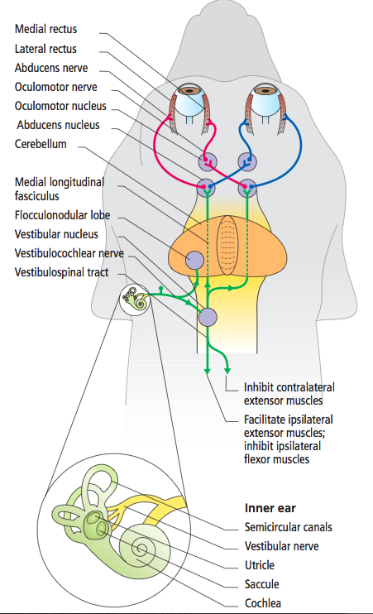

Slide 38
Vestibular system
Afferent nerves from vestibular hair cells terminate in vestibular nuclei of the medulla
The balance control centre in the brainstem processes this information and sends messages to the rest of the body to keep the animal upright via:
  facilitatory effect on the ipsilateral extensor muscles of the limb via the vestibulospinal tract
Messages are also sent to the muscles controlling movement of the eyes (via medial longitudinal fasciculus and CNs III, IV and VI) to change the position of the eyes according to the position of the head
Brainstem vestibular nuclei receive some influence from higher vestibular centres in the thalamus and from vestibular centres in the cerebellum (flocculonodular lobe and fastigial nuclei)

Slide 39
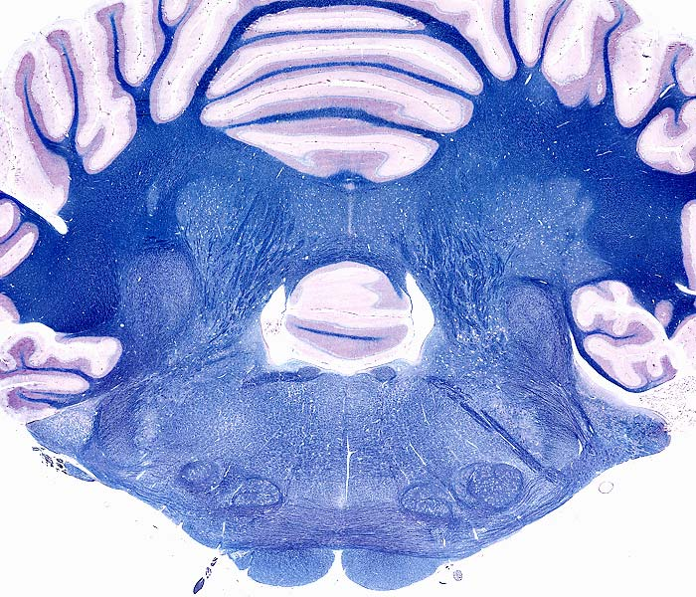
Everything is balanced
Extensor limb muscles
Extensor limb muscles

Slide 40
Central Vestibular Lesion

Slide 41
Roll, turn, head tilt to the side of the lesion
Extensor limb muscles
Extensor limb muscles

Slide 42
Paradoxical Vestibular Lesion

Slide 43
Roll, turn, head tilt away from of the lesion
Extensor limb muscles
Extensor limb muscles
Notes:
When the head tilt is opposite to the side of the lesion, it is termed paradoxical. This can be seen with lesions of the flocculonodular lobe of the cerebellum or the supramedullary part of the caudal cerebellar peduncle, with sparing of the vestibular nuclei in the rostral medulla; the head tilt often is accompanied by ipsilateral cerebellar signs, paresis, and proprioceptive deficits

Slide 44
Peripheral vs. Central Vestibular
Peripheral Central
No Yes
No Yes
Yes Yes
No Possible
Yes Yes
Yes Yes
Yes Yes
No Yes
Yes Yes
Yes Yes
No Yes
Yes Yes
Neurologic Signs
CP deficits
Altered mentation
Head tilt
CN deficits (other than VII)
Nystagmus
-Horizontal
-Rotary
-Vertical
-Positional
-Conjugate
-Disconjugate
Strabismus

Slide 45
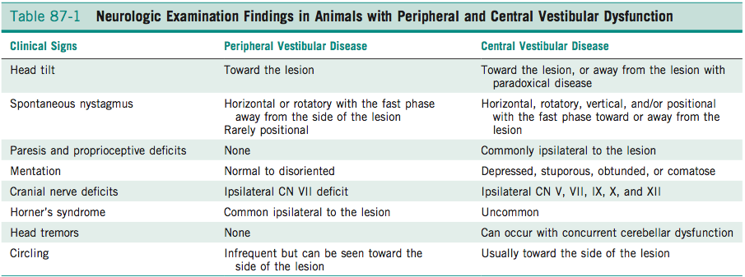

Slide 46
Peripheral vs. Central Vestibular
Centralizing Signs
  1. Mentation Changes
  2. Proprioceptive Deficits
  3. Cranial Nerve Involvement (other than CNVII & VIII)
  4. Vertical Nystagmus

Slide 47
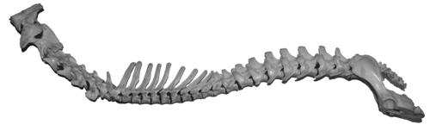
Spinal Cord

Slide 48
Spinal cord
Spinal cord:
Paired spinal nerves that contain both sensory (afferent) nerves and motor (efferent) nerves
Sensory nerves carry information to the spinal cord from the skin, joints, muscles, and visceral organs in the periphery via dorsal root and cranial nerve ganglia
Motor nerves carry information from the spinal cord to the periphery and include both somatic motor nerves, which innervate skeletal muscle, and motor nerves of the autonomic nervous system, which innervate cardiac muscle, smooth muscle, glands, and secretory cells

Slide 49
Spinal Cord
C1-C5
L4-S3
C6-T2
T3-L3

Slide 50
Spinal Cord
C1-C5
L4-S3
C6-T2
T3-L3

Slide 51
C1-C5
L4-S3
C6-T2
T3-L3
GAIT
GP
REFLEXES
BLADDER
OTHER
C1-C5 | C6-T2 | T3-L3 | L4-S3
Tetraparesis/ plegia Ataxia | Tetraparesis/ plegia Ataxia “2 engine gait”: short strided in TL, long in PL | Paraparesis/plegiaAtaxia | Paraparesis/ plegia Ataxia Stiff, short strided
↓ all 4 | ↓ all 4 | ↓ in PL | ↓ in PL
Normal | ↓ in TL | Normal | ↓ in PL
UMN | UMN | UMN | UMN/LMN
Respiratory, Horner’s | Respiratory, Horner’s, CT def. | Schiff-Sherrington Cutaneous Trunci | Urinary/Fecal Incontinence

Slide 52
Peripheral nervous system
Peripheral nervous system (PNS)
Includes:
    sensory receptors
    sensory nerves
    ganglia outside the CNS
Myopathy
Neuropathy
NMJ

Slide 53
Peripheral nervous system
Mental status
Muscle mass/tone
Gait
GP
CN
Reflexes
Myopathy | Neuropathy | NMJ
Normal | Normal | Normal
↓ | ↓ | Normal
Paresis | Paresis/ataxia | Episodic Paresis
Normal | ↓ | Normal
Atrophy of MMM Dysphagia, ME | Dysphagia, Facial paralysis, ME | Dysphagia, ME
Normal | ↓ | Normal

Slide 54
Case Example 1
2 yr FS Chihuahua
CC: acute onset balance problems
Neurologic examination:
  Mental status: normal
  Gait: severe ataxia, falling, rolling to the right, cannot walk but appears hypermetric when supported
  GP: normal
  CN: head tilt to the right, horizontal nystagmus (FP left), absent menace OU
Neurolocalization: Left cerebellum

Slide 55
Case Example 2
10 Yr Golden Retriever
CC: 2 month history of “seeming spaced out”, appears blind at times
Neurologic examination:
  Mentation: dull
  Gait: compulsively circles to the right
  GP: absent on left fore and hind limb
  CN: absent menace OS, left facial droop
Neurolocalization: Right forebrain

Slide 56
Case Example 3
3 yr Lab
CC: Head tilt and falling
Neurological examination:
  Mental status: normal
  Gait: falling to the left
  GP: normal
  CN: left head tilt, horizontal nystagmus (FP right)
Neurolocalization: Left peripheral vestibular

Slide 57
Case Example 4
2 Yr Doberman
CC: Tripping in all 4 limbs
Neurologic examination:
  Mental status: normal
  Gait: Short and choppy gait in the forelimbs, crossing over in the pelvic limbs
  GP: slow placing in all 4
  Reflexes: normal in PL, slow withdraw in both TL
  CN: normal
Neurolocalization: C6-T2

Slide 58
Case Example 5
4 Yr Newfoundland
CC: Collapsing and vomiting
Neurologic examination:
  Mental status: normal
  Gait: can barely walk for a few steps then collapses (repeatable)
  GP: normal when supported well
  CN: appear normal, but megaesophagus on rads
  Reflexes: normal
Neurolocalization: neuromuscular (NMJ)

Slide 59
Case Example 6
8 Yr lab
CC: can’t walk
Neurologic examination:
  Mental status: normal
  Muscle tone: generalized muscle atrophy
  Gait: Severe tetraparesis
  CN: decreased gag, voice change, megaesophagus
  GP: decreased all 4
  Reflexes: decreased patellar reflexes and withdraw reflexes in all 4
  Neurolocalization: Neuromusucular (neuropathy)

