Slide 1
COMPARISON OF 3% AND 7.5% HYPERTONIC SALINE IN RESUSCITATION
AFTER TRAUMATIC HYPOVOLEMIC SHOCK
JOURNAL CLUB
May 2015
Jo-Annie Letendre, DVM

Slide 2
SHOCK
March 2015
China
No conflicts of interest
Supported by the National Natural Science Foundation of Chongqing and a grant from the Sanitary Bureau Foundation in Chongqing.

Slide 3
RESEARCH QUESTION
Is 3% hypertonic saline an effective and safe fluid for the resuscitation of patients with hypovolemic shock?

Slide 4
BACKGROUND &
LITERATURE REVIEW
Complications associated with large volume of isotonic crystalloid fluids
Small volume of HS can increase plasma volume, improve MAP, CO, and microcirculation, and decrease post-traumatic inflammatory reactions.
Optimal concentration and volume of HS = ?
Rat model of hemorrhagic shock: 3% HS had immunomodulatory and metabolic effects and attenuates tissue injuries
Swine model with hemorrhagic shock: 3% HS produced an adequate and sustained increase in MAP and tissue oxygen saturation, and attenuated hypercoagulability
Large-scale, controlled clinical trials evaluating 3% HS are currently lacking.
Notes:
adult respiratory dis-tress syndrome (ARDS), acidosis, coagulopathy, hypothermia, intracranial hypertension, and pulmonary edema

Slide 5
STUDY DESIGN
Single-center
Randomized
Double-blind
Notes:
clinical trial

Slide 6
STUDY SUBJECTS
Trauma victims (≥ 15 yo)
Presented in hypovolemic shock
  Defined by SBP ≤ 70 mmHg; or SBP = 70-90 mmHg and HR ≥ 108 bpm
Notes:
prehospital systolic bloodpressure (SBP) of less than or equal to 70 mmHg or 70 to 90 mmHg and a heartrate (HR) of greater than or equal to 108 beats/min who were aged 15 yearsor older.
They excluded:
younger than 15 years, injury during the previous 4 h, hypothermia (G28-C), administration of dopamine or other vasoactive agents, administration of more than 2,000 mL of crystalloid before the study fluid, ongoing cardiopulmonary resuscitation, severe cardio- respiratory dysfunction, known or suspected pregnancy, traumatic brain injury (TBI), or death within 1 h after intervention

Slide 7
PREDICTOR VARIABLE
250 ml fluid:
  3% HS
  7.5% HS
  LRS

Slide 8
OUTCOME VARIABLES
Blood pressure
Mean arterial pressure
Heart rate
Total resuscitation fluid volume
Electrolytes
Urine volume
Complications of fluid therapy
Notes:
presumed complications of HSS or standard fluid resuscitation, includingcardiac dysrhythmia, coagulopathy, electrolyte disturbances, acute renal fail-ure, allergic reaction, and abdominal compartment syndrome, were recorded

Slide 9
STATISTICAL ANALYSIS
Differences among groups: ANOVA
Hemodynamic parameters : Unpaired t-test
Incidence of adverse reactions: Chi-square
24h-survival: Kaplan-Meier curve and log rank test
Notes:
They evaluate differences among groups by ANOVA
Unpaired t –test for hemodynamic parameters across time and between groups
Chi-square for incidence of adverse reactions between groups
24h: kaplan-meier curve and log rank test
In the results section they mentioned that there was no difference between groups and they assess differences between groups with ANOVA but in the statistical analysis section they do not tel if the data were normally distributed (and how they evaluate for normality), which prevent the use of a parametric test like ANOVA or t-test.
SEM = standard error of the mean; probably because normal distribution; (with nongaussian distribution, usually report data as median)
*They do not talk about HOW they evaluate if the data were normally distributed.Because they have “large” samples (n= 246; 82, 84 and 80 per group). The decision to choose a parametric or nonparametric test matters less with huge samples (say greater than 100 or so).
T-test, ANOVA = parametric tests
Chi-square = non-parametric test
Normality tests: D’agostino- Pearson, Shapiro-Wilk, Kolmogorov-Smirnov.
All data are expressed as the mean T SEM. The statistical significance o fdifferences among groups was determined by analysis of variance. Unpaired t tests were used to assess differences in hemodynamic parameters across time and between groups. Chi-square analysis was used to compare the incidence of adverse reactions between groups. The statistical significance of 24-h survival among the three groups was analyzed using a Kaplan-Meier curve and the log- rank test. A value of P G 0.05 was considered significant.
Hemodynamics: one-way ANOVA and then multiple comparisons (since there are 3 groups)
Log-rank test: are the KM curves statistically equivalent?
Independent variables: type of fluids
Dependent variables: hemodynamic parameters

Slide 10
STATISTICAL ANALYSIS
Normally distributed?
Expressed results as mean +/- SEM
Comparison among groups: 3 groups
  Hemodynamic parameters across time and between groups – unpaired t tests
  But there are 3 groups…
Chi-square: incidence of adverse reactions between groups
24-h survival: Kaplan-Meier curve and log-rank test
Notes:
They evaluate differences among groups by ANOVA
Unpaired t –test for hemodynamic parameters across time and between groups
Chi-square for incidence of adverse reactions between groups
24h: kaplan-meier curve and log rank test
In the results section they mentioned that there was no difference between groups and they assess differences between groups with ANOVA but in the statistical analysis section they do not tel if the data were normally distributed (and how they evaluate for normality), which prevent the use of a parametric test like ANOVA or t-test.
SEM = standard error of the mean; probably because normal distribution; (with nongaussian distribution, usually report data as median)
*They do not talk about HOW they evaluate if the data were normally distributed.Because they have “large” samples (n= 246; 82, 84 and 80 per group). The decision to choose a parametric or nonparametric test matters less with huge samples (say greater than 100 or so).
T-test, ANOVA = parametric tests
Chi-square = non-parametric test
Normality tests: D’agostino- Pearson, Shapiro-Wilk, Kolmogorov-Smirnov.
All data are expressed as the mean T SEM. The statistical significance o fdifferences among groups was determined by analysis of variance. Unpaired t tests were used to assess differences in hemodynamic parameters across time and between groups. Chi-square analysis was used to compare the incidence of adverse reactions between groups. The statistical significance of 24-h survival among the three groups was analyzed using a Kaplan-Meier curve and the log- rank test. A value of P G 0.05 was considered significant.
Hemodynamics: one-way ANOVA and then multiple comparisons (since there are 3 groups)
Log-rank test: are the KM curves statistically equivalent? But should also correct for MULTIPLE comparisons.
Independent variables: type of fluids
Dependent variables: hemodynamic parameters
Large sample. What happens when you use a parametric test with data from a nongaussian population? The central limit theorem (discussed in Chapter 5) ensures that parametric tests work well with large samples even if the population is non-Gaussian. In other words, parametric tests are robust to deviations from Gaussian distributions, so long as the samples are large. The snag is that it is impossible to say how large is large enough, as it depends on the nature of the particular non-Gaussian distribution. Unless the population distribution is really weird, you are probably safe choosing a parametric test when there are at least two dozen data points in each group
The SD quantifies scatter — how much the values vary from one another.
• The SEM quantifies how precisely you know the true mean of the population. It takes into account both the value of the SD and the sample size.
•Both SD and SEM are in the same units -- the units of the data.
• The SEM, by definition, is always smaller than the SD.
•The SEM gets smaller as your samples get larger. This makes sense, because the mean of a large sample is likely to be closer to the true population mean than is the mean of a small sample. With a huge sample, you'll know the value of the mean with a lot of precision even if the data are very scattered.
•The SD does not change predictably as you acquire more data. The SD you compute from a sample is the best possible estimate of the SD of the overall population. As you collect more data, you'll assess the SD of the population with more precision. But you can't predict whether the SD from a larger sample will be bigger or smaller than the SD from a small sample. (This is not strictly true. It is the variance -- the SD squared -- that doesn't change predictably, but the change in SD is trivial and much much smaller than the change in the SEM.)

Slide 11
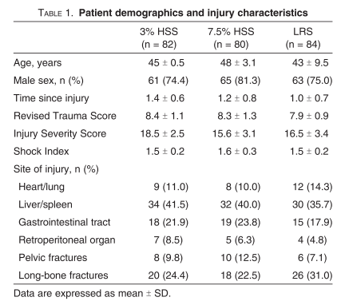
RESULTS
Notes:
246 patients included in the study; randomly received either 250 ml of LRS, 250 ml of 3% saline or 250 ml of 7.5% saline
69 patients received fluid PRIOR to inclusion in the study: 300 – 1000 ml

Slide 12
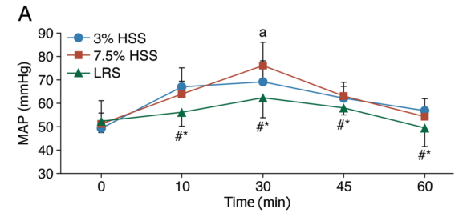
RESULTS
Notes:
Preinfusion MAP similar in all groups: 49 mmHg (3%), 51 (7.5%), 52 (LRS) – Blue and red line (HS) – sustained, rapid increased (and normalization) of MAP. Monitoring during 60 minutes, and at the end, MAP still higher in HS groups vs LRS.
HSS presented with a rapid and sustained restoration of MAP compared with the LRS group. Even at the end of the obser- vation period, the MAPs of both HSS groups remained at higher levels.
*Significant difference between the 3% HSS and LRS groups. #Significant difference between the 7.5% HSS and LRS groups. aSignificant difference between different time points in the same group. (WHICH GROUP???)

Slide 13
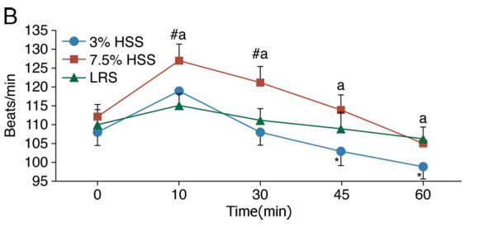
RESULTS
Notes:
7.5% (red): significant increase in HR – peaked at 10 minutes and then gradually decreased, close to baseline but still higher than 3% HS
3%: kind of follow the same curve shape – increase in HR and peak at 10 minutes, than gradually decreased- and decreased lower than baseline preinfusion value. No significant difference among times in this group.
LRS: HR stable, close to baseline throughout the monitoring period.
A single bolus of 7.5% HSS infusion resulted in an obviously increasedHR, as shown in Figure 1B. On average, the HR of the 7.5% HSS group increased to 127 beats/min at 10 min after the beginning of fluid resuscitation, followed by a decrease until the end of the study; however, it remained at a higher level compared with those of the other groups. Although HR varia- tions among the patients in the 3% HSS group were similar to those in the 7.5% HSS group, the curve indicating HR changes appeared stable. The HR then decreased and was close to the baseline level at 30min after the study intervention, declining to values that were lower than the preinfusion values at the end of the observation period. In the LRS group, the curve remained stable and close to the baseline level.

Slide 14
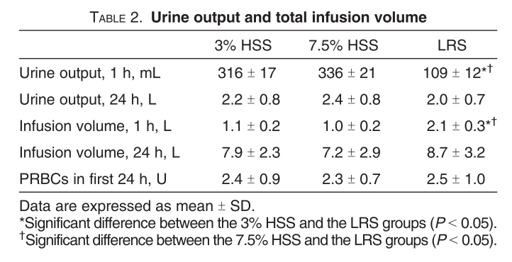
RESULTS
Notes:
Total infusion volume after 1 h was significantly higher in the LRS group when compared to both HS groups – but no difference at 24h (in the section results; they said TOTAL volume and do not specify 1h vs 24h).
UOP was significantly less after 1 h in the LRS group (vs both HS groups) – no difference at 24h.

Slide 15
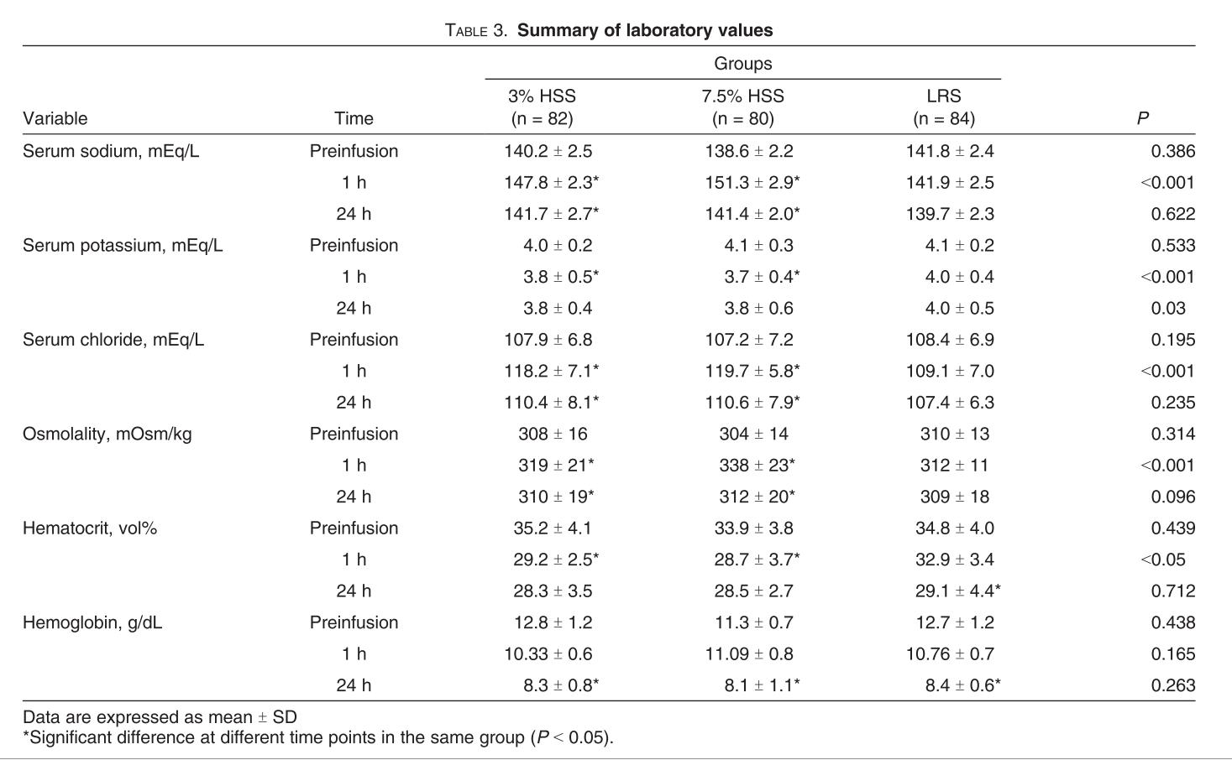
RESULTS
Notes:
Na, chloride, osmolalities: significanlty higher at 1h in both HS groups compared to LRS – NSF at 24h.
Na, Cl, osmolalities were HIGHER in the 7.5% group compared to the 3% - did no reach significance
At 1h: potassium significantly lower in both HS groups compared to LRS, and potassium concentration also decreased in LRS group compared to baseline, but all within RR.
Hematrocrit: significantly lower in both HS compared to LRS at 1h only.
Compared with those in the LRS group, the serum sodium concentrations, chloride concentrations, and osmolalities were significantly elevated in response to study fluid infusion in both HSS groups at 1 h after the resuscitation (P G 0.05). These abnormalities resolved within 24 h (Table 3). The previously mentioned electrolyte concentrations in the 3% HSS group were lower than those in the 7.5% HSS group, but no signifi- cant difference was observed between these groups (P 9 0.05). Serum sodium levels were higher than 155 mEq/L in five pa- tients in the 7.5% HSS group. There were no cases of hypernatremia in the other groups. Serumpotassium levels decreased slightly in all groups but were still within the normal range (Table 3). The mean hematocrit values at 1 h after the start of resuscitation were lower in the 3% and 7.5% HSS groups than in the LRS group (P G 0.05), but no difference was observed between the groups at subsequent time points (P 9 0.05)

Slide 16
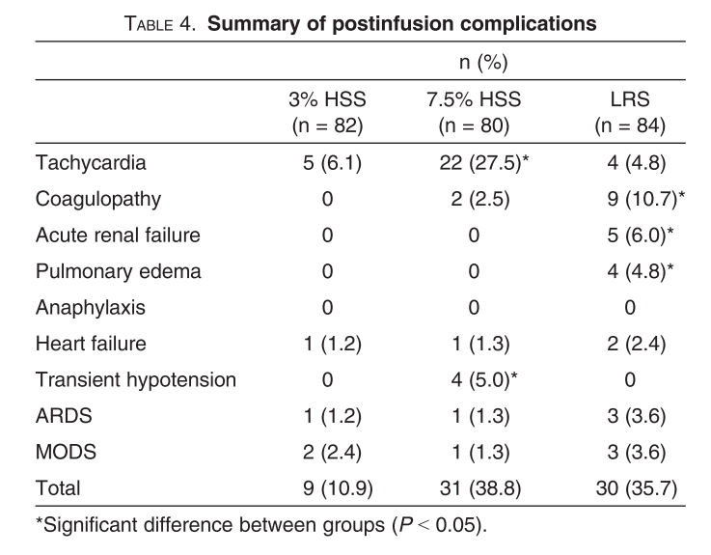
RESULTS
Notes:
More patients developed tachycardia in the 7.5% HS group than in the 2 other groups – tachycardia = 108 bpm
More coagulopathy, pulmonary edema and acute renal failure in LRS (do not define coagulopathy-acute renal failure….)
As shown in Table 4, 31 patients developed severe tachy-cardia, including five patients in the 3%HSS group, 22 patients in the 7.5% HSS group, and four patients in the LRS group. The average HR of these patients exceeded 120 beats/min, and their electrocardiography indicated sinus tachycardia.
Hypotension observed only in the HS7 group – during initial 3-5 minutes
no statistically significant differences were observed between the groups for the development of ARDS and MODS.
No ven- tricular dysrhythmia or myocardial infarction developed. Three of the 31 patients died because of other complications; two of these patients were in the 7.5% HSS group and suffered from heart failure andmultiple organ dysfunction syndrome (MODS), and the remaining patient was in the LRS group and suffered from ARDS. Hypotension was observed in four patients in the 7.5% HSS group during the initial 3 to 5 min of the study in- tervention; however, the hypotension was transient and was resolved by decreasing the infusion rate. One of these four pa- tients died of MODS. The incidence rates of certain compli- cations, such as coagulopathy (P G 0.001), acute renal failure (P G 0.001), and pulmonary edema (P G 0.001), were higher in the LRS group compared with the HSS groups. Moreover, our results indicated that five patients suffered from ARDS, in- cluding four (one in the 7.5% HSS group and three in the LRS group). Six patients suffered from MODS, including four patients within 7 days, one patient after 10 days, and one patient after 23 days, secondary to serious infections. However,

Slide 17
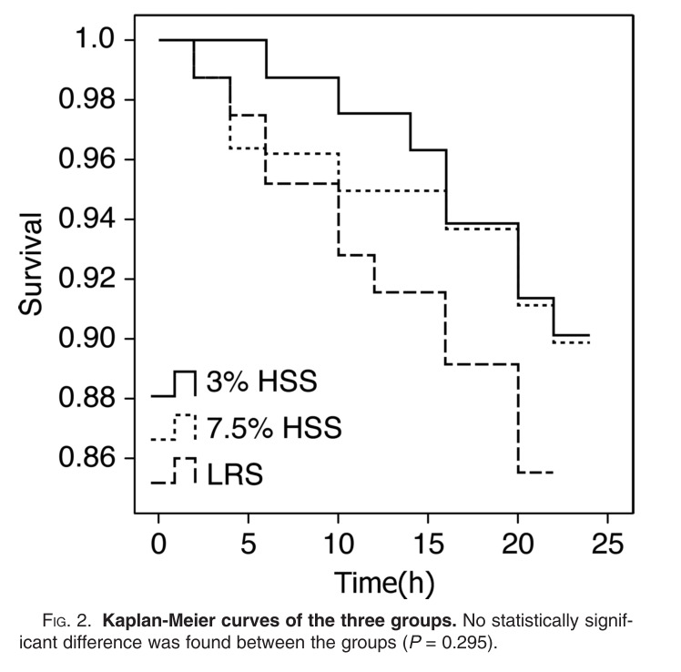
RESULTS
Notes:
THEY DO NOT MENTION THAT THEY ADJUST THE DEFINITION OF SIGNIFICANCE TO ACCOUNT FOR MULTIPLE COMPARAISONS (SINCE THEY ARE ANALYSING 3 GROUPS)
37 patients died; 30 w/in 24h.
Only 7 patients died after 24h (severe infections. MODS, DIC)
24h survival in the HS groups better than in the LRS = NSD
To compare the 24-h survival rates, a Kaplan-Meier curveand a log-rank test were used to analyze significant differences between the groups. In total, 37 patients (15.4%) died, with 30 deaths (81.1%) occurring within the first 24 h. Only seven patients died after 24 h; four of these patients died from severe infections, two patients died from MODS, and one patient in the LRS group developed disseminated intravascular coagu- lation and died at 28 h after the start of fluid infusion. The 24-h survival in theHSS groups was better than that in the LRS group, but no statistically significant difference was found (Fig. 2)

Slide 18
Summary of the results
Blood pressure/MAP: *
  Faster restoration of BP and higher BP with both HS.
Heart rate: *
  Increase in HR with 7.5% at 10 minutes
Total resuscitation fluid volume
  1h: approximately 2x more fluid in LRS group *
  24h: NSD
Electrolytes
  1h: Na+, Cl-, osmolality higher in HS groups * ; 155 mEq/L (Na) in 5 patients (7.5%)
  1h: Na+, Cl-, osmolality higher in 7.5%
  24h: NSD
Urine volume
  1h: lower in LRS group *
  24h: NSD
Complications of fluid therapy
  Tachycardia – 7.5% *
  Coagulopathy, AKI, pulmonary edema – LRS *
  Transient hypotension – 7.5%*
Notes:
*: significant
But only 4 patients in 7.5% had transient hypotension…. 0 in other 2 groups.
22 patients in 7.5% had sinus tachycardia during initial 3-5 minutes- resolved by decreasing infusion rate
Higher incidence of AKI, pulmonary edema and coagulopathy – how many???

Slide 19
CONCLUSION OF THE STUDY
“In summary, administration of 3% HSS offered hemodynamic benefits equivalent to those of 7.5% HSS infusion with lower degrees of hypernatremia and hyperchloremia and lower risks of cardiac dysrhythmia and transient hypotension. In addition, higher incidences of pulmonary edema, renal failure, and coagulopathy occurred in the LRS group.”

Slide 20
VALIDITY OF THE STUDY
Number of patients
Randomized; double-blind study
End of observation period: 28 days
Stats
  Unpaired t-test, multiple comparisons (3 groups)
Bag of 250 ml (70 kg)
  3.5 ml/kg
Definition of the complications
Transfusions
Conclusion
  Dysrythmia
Notes:
246 patients, approximately 80 per groups
Randomized, double-blind study (randomization by a random-generated numeric code); identical bags.
End of observation period of this study was 28 d…..???? But they never talked about what they did/evaluate at this 28 d time point…
Stats:
Do not mention if the data were normally distributed and report the results as mean +/- standard error of the mean; use parametric tests; probably okay because they had a larger sample than what we usually have in veterinary medicine…. But they compare 3 groups and do not mention that they correct for multiple comparisons. More chance of type I error
ONE WAY ANOVA or KRUSKAL-WALLIS
Their doses were 250 ml *presumptively to a normal 70 kg * which represent 3.5 ml/kg – adequate for a bolus of HS but we never use that kind of dose for isotonic crystalloid bolus administration. 250 ml = for a 70 kg human patient = 3 ml/kg ok for HS both for isotonic…. Choose 250 – reported to be safe in previous report but we never use that small amount of isotonic fluid in our patients…. Do not compare how we usually use that kind of fluid….
In the present study, no significant difference was observed in transfusion volume be-tween the groups within the first 24 h, which indicates that all patients enrolled in the study had massive blood loss. All 3 groups received 2.4ish units of pRBCS as transfusion as seen in table 2; however they do not mention anything about blood transfusion anywhere else in the paper…
3% HSS infusion with lower degrees of hypernatremia and hyperchloremia and lower risks of cardiac dysrhythmia and transient hypotension – but do not mention incidence of dysrhytmia, what type of dysryhtmia, unless they consider sinus tachycardia as a dysrythmia….

Slide 21
CONCLUSION
3 or 7.5% hypertonic saline?
Or isotonic balanced isotonic solution?
Notes:
in animal models, hypertonic saline decreased neutrophil activation, inflammation, neutrophil-endothelium binding, and lung and bowel injury and augmented the function of T cells. (3,12-20) Hypertonic saline has been shown to modulate tumor necrosis factor (TNF)-a-induced inflammation in the pulmonary epithelium, thereby decreasing posttraumatic acute lung injury.21 However, the effect of hypertonic saline on neutrophil activation is also more pronounced in the lungs rather than other areas in the body where a neutrophil response may be desired. (22) The immunemodulating and antiinflammatory effects of hypertonic saline have been confirmed in human studies. (23,24) In these studies, patients given a single 250-mL bolus dose of hypertonic saline with dextran had decreased expression of CD11b, a neutrophil adhesion molecule that is typically upregulated after injury and is one measure of cellular activation after shock. Hypertonic saline with dextran also decreased proinflammatory TNF-[alpha] production and increased antiinflammatory cytokines.
The substantially increased osmolarity of hypertonic saline compared with isotonic crystalloids allows the use of a much lower volume to achieve the same degree of plasma expansion. The degree of plasma or intravascular expansion is dependent on several factors in addition to osmolarity, such as volume and rate of fluid administration, vascular permeability to water and electrolytes, time when plasma expansion is measured, and the technique used to measure plasma expansion. (7,8) Hypertonic saline also distributes into the extracellular space similarly to 0.9% sodium chloride injection; however, hypertonic saline solutions may initially facilitate movement of fluid from the interstitial and intracellular compartments to the intravascular compartment, thereby restoring mean arterial pressure (MAP) with smaller fluid volumes. The marked extracellular expansion associated with using small-volume i.v. fluids is particularly appealing in combat casualty care in the military .
A number of animal studies have demonstrated the profoundmodulatory effects of HSS on the inflammatory response, in-cluding the attenuation of inflammatory factor release (7, 21Y23)and the enhancement of the adaptive immune response (24, 25).

