Slide 1
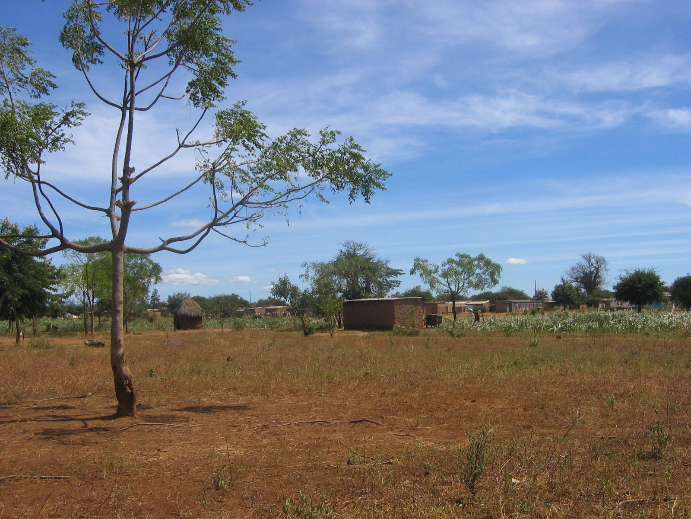
we deliver
Multimedia Exchange Systems for Small Holder Farmers

Slide 2
--Cell Phones
--Radio
--Internet
--TV
--Print
--Other Media
World AgInfo
DESIGN & INTERVENTION
Cell Phone
Radio
Internet
TV
Print
Other
Face-Face
M & E
National Assessment
Community
Assessment
Feedback

Slide 3
Print &
Face-to-Face
Electricity &
Cell Coverage
Radio
Video &
Internet
Rudimentary
Low-Intermediate
High-Intermediate
Advanced

Slide 4
Concept
Deliver guidelines, survey templates, and analysis tools to recommend and deploy appropriate, sustainable and gender-equitable multimedia interventions to smallholder farmers.
Compelling
Relevant content matched with appropriate delivery mechanisms based on community type (taxonomy)
Impact
Two-part assessment to balance the community's existing infrastructure with regional telecom/broadcast/info policies
→ Multimedia interventions that add value and will actually be used
Scalability & Sustainability
Multimedia roadmap to help communities move from one community type to the next, moving them economic self-sustainability
Feedback
Champion the incremental improvements of a set of existing multimedia solutions

Slide 5
Current
*
Potential
Projects | Media | Market Info | Farm Mgt | Gov Services | Ag Ed Cur | Feedback | Women | Evaluation
Digital Green (5c) | Human/ Video
AIR (9e) | Radio
IRI (3d) | Audio/ Radio
aaQua | Cell Phones
*
*
*
*
*
*
*
*
*
*

