Slide 1
Plant Cost Calculator
Andrew Bales, Chris Mills, Derrick Yee

Slide 2
Purpose
Create tool to output accurate plant cost estimate
Will allow for better comparison of water treatment technologies
Intended Results:
  Transparency (lessen “data turbidity”)
  Better information for communities
  Big picture: clean water for more people

Slide 3

Goals
Obtain reliable cost information
Create an easy-to-manipulate cost formula
Design friendly user interface
Ensure calculator is modular and robust

Slide 4
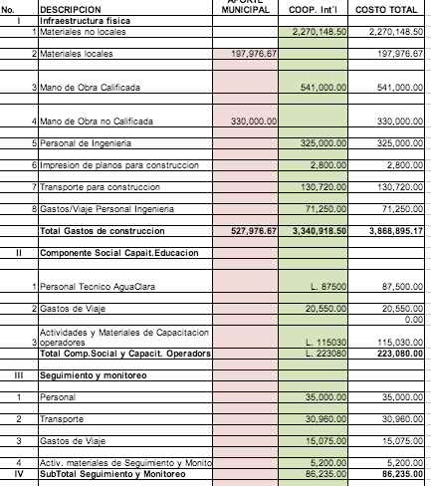
Research
Established initial cost formula
Found, tabulated, and verified relevant cost data
Ran regression on relevant data for initial evaluation
Evaluation of program back-end and interface options

Slide 5
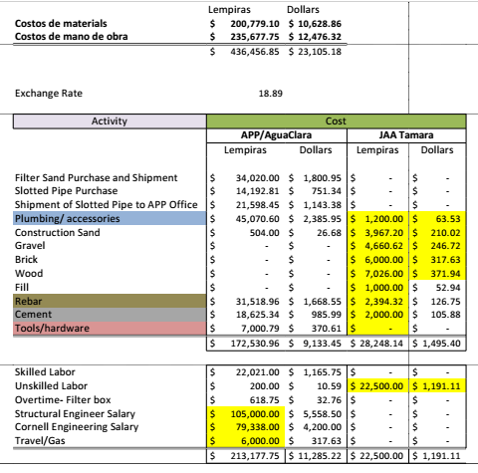
Acquisition
Plant budgets via Tori and AguaClara affiliates
Handled conversion (exchange rates, etc.), compensation for filter addition in new models

Slide 6
Cost Formula
User inputs
  Initial population
  Population growth rate
  Per capita demand
  Desired plant adequacy
  Hourly Wage

Slide 7

Population & Timeline
P(t)= Po * (1+n/100)^t
  n: rate of growth
  t: plant adequacy time
  Po: initial population
Localization of growth rate
calculations?
Helps determine appropriate flow rate

Slide 8
Demand & Construction
q = 150 [L/day*person ]
  Default: 150, but allow user to change
Auto-calculation of local materials, labor?
Fixed construction cost, variable costs predictable (e.g. plant operator)
Key Challenge: estimate cost via flow rate
  Design, build, train, operate, transfer
  Rough estimate: 10,000 USD/L/S of flow [L/S]

Slide 9
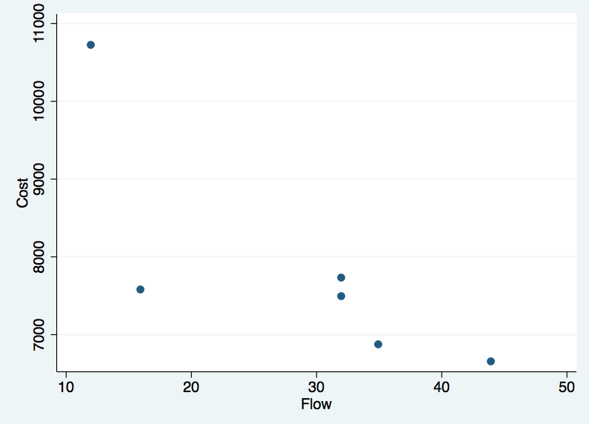
Cost vs. Flow Rate
Cost (USD)
Flow Rate (L/s)

Slide 10

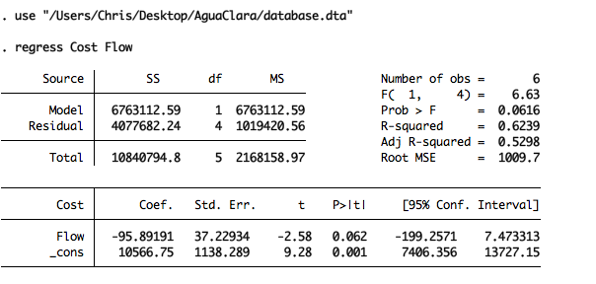
Cost vs. Flow Rate

Slide 11
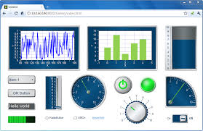
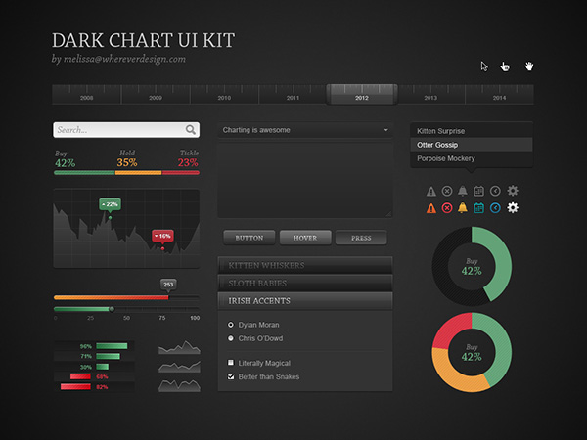
Design
Imperative to have friendly user interface
Must be easily updated and altered
Considering NI labVIEW, HTML visual editors

Slide 12
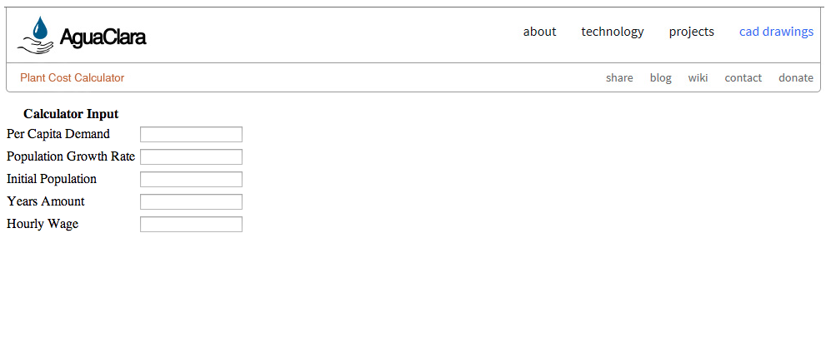
Beginning Stages
Interfacing with AguaClara Webpage

Slide 13




Beginning Stages
Exploring Database Options

Slide 14

Looking Forward
Cost Calculator Prototype
  Integrated database and cost regression equations
Front-end Development
Growing and Updating
  Interpret incoming data
  Cost by location

Slide 15
Plant Cost Calculator
Andrew Bales, Chris Mills, Derrick Yee

