Slide 1
Introduction to subteams
Monroe Weber-Shirk

Slide 2
The Potential Teams
Village Supply System
Village Waste Management
Plant Cost Calculator
Water Treatment Tech Selection Guide
Pilot Scale AguaClara Facility
Sed Tank Controls
Anaerobic Wastewater Treatment
Chemical Dose Controller
SRSF Theory
Low Flow SRSF
Laminar Tube Floc
Turbulent Tube Floc
Fluidized Bed Flocculator
Digital camera floc sizing
Ram Pump
Small Scale Plant Model
Sed Tank Hydraulics
Floc Probe
Chemical Stock Tank Mixing
Arsenic
Foam Filtration
Demo Plant
Design
Public Relations

Slide 3
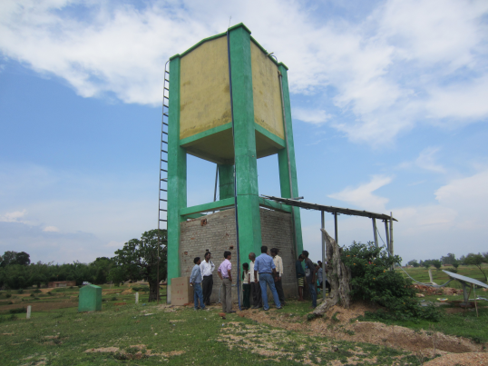
Village Supply System
Objectives: design distributed storage for a village water supply
Evaluate designs to eliminate the elevated storage tank and elevated AguaClara plant
Design the photovoltaic and pump system for equitable distribution
Build on work done by 4540
teams last semester
Skills: water treatment,
photovoltaics, pumps, Mathcad

Slide 4
Village Waste Management
Objective: Evaluate options for handling human waste, greywater, and/or plastic at the household/village level
Literature review
Evaluate options like composting toilets and urine-diverting dry toilets for human waste

Slide 5
Plant Cost Calculator
Objective: create a live plant cost calculator based on plant flow rate or population served
Possibly use LabVIEW Web UI Builder
Computer science!
Work with Water Treatment Tech Selection Guide team (see following slide)
Preferable skills: programming, ability to generalize and learn to use new tools

Slide 6
Water Treatment Tech Selection Guide
Objective: develop a guide to indicate the constraints that determine which technology is best suited for different levels and types of contamination
Must be designed as a front end for the AguaClara design engine
Work with Plant Cost Calculator team to ensure cohesive web-based expert guidance
Preferable skills: drinking water treatment, website creation, online forms

Slide 7
Pilot Scale AguaClara Facility at Cornell
Objective: design an AguaClara full scale 1 L/s plant to act as a testing facility for our lab
Include flow recycle to reduce water use
Modular design to allow for easy modification of various parameters – this is where we will test our proposed design changes!
Preferable skills: AguaClara processes, fluids, Mathcad, AutoCAD, structural engineering, fabrication

Slide 8
Sedimentation Tank Controls
Objective: develop tools to make it easier to remove caps from sed tank launder pipes and pipe stubs in sed tank inlets and drain channels
Preferable skills: fabrication

Slide 9
Anaerobic Wastewater Treatment
Objective: develop robust, sustainable, low energy, low cost, operator-friendly, wastewater treatment system
Apply the key findings from the AguaClara: Drinking Water program to the AguaClara: Wastewater program
Preferable skills: microbiology, wastewater, lab experience, Process Controller

Slide 10
Chemical Dose Controller
Objectives:
  Solve air lock problem
  Design horizontal axis constant head tank
Impact: improve accuracy of dosing and facilitate the implementation of dosing systems
Preferable skills:
fabrication, physics,
fluids

Slide 11
Stacked Rapid Sand Filtration Theory
Objective: develop a fundamental understanding and parameterization of SRSF performance
Big goal is to develop a performance model for an AguaClara plant so we can begin to optimize the overall design
Conduct experiments to characterize performance
Develop models for mass of clay that can fill a pore before no more particles can attach
Preferable skills: lab experience, fluids, Process Controller

Slide 12
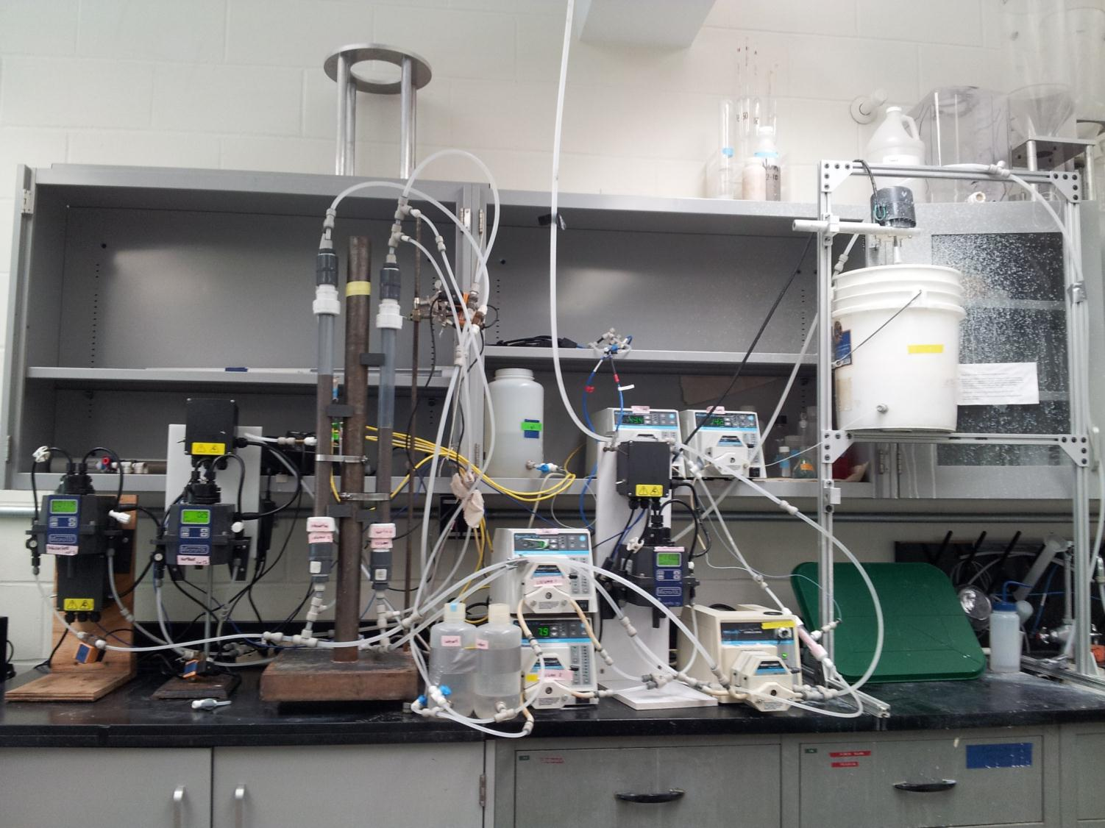
SRSF Theory
EPA Phase II Grant

Slide 13
Low Flow Stacked Rapid Sand Filter
Objectives:
  Complete fabrication of 0.8 L/s LFSRSF that uses hydraulic controls
  Run tests to determine important parameters
  Refine design for several parts of the filter
EPA P3 Phase II grant
6 LFSRSF being fabricated in India, interest in scaling up to 50 or 100 villages
Preferable skills: fluids, fabrication

Slide 14
Laminar Tube, Turbulent Tube, and Fluidized Bed Flocculator
Objective: design and fabricate a settled water turbidity (SWaT) measurement system to evaluate floc break up at low turbidities
Complete design and fabrication of the entire apparatus
Preferable skills: lab experience, fluids, Process Controller, Mathcad

Slide 15
Digital camera floc sizing flow through cell
Objective: create a tool to quickly measure floc size and floc size distribution in a nondestructive manner in a flow through cell
Use a digital camera, image analysis software and appropriate lighting to capture images and count and size flocs.
Determine if a strobe light is necessary to stop the motion of the flocs
Preferable skills: programming, willingness to learn LabVIEW, optics

Slide 16
Ram Pump
Objectives:
  Improve reliability
  Measure pump efficiency and assess possible design improvements to improve efficiency
  Determine how to scale the pump for various flow rates and test at a larger scale
  Create documentation
  Evaluate whether it should be included in the plant design or as a standalone item
Preferable skills: fabrication, fluids, physics

Slide 17
Small Scale Plant Model
Objective: finish the scale model created last semester and put it on display
Explore the option of making an even smaller model with all the concrete printed as a single object
Preferable skills: fabrication, problem solving

Slide 18
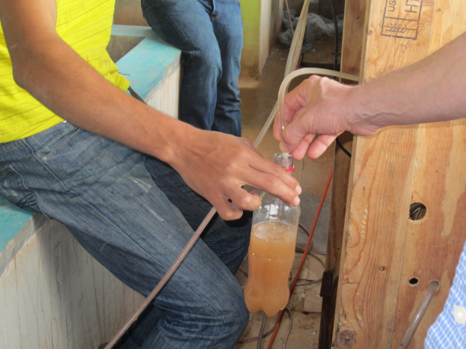
Floc Blanket Probe
Objective: develop an easy method for operators to monitor floc blanket depth and the depth of sludge in the floc hopper
Potential options:
  Eye as detector
    Sludge judge (transparent tube with valve at bottom that can grab a column of water from within the sed tank)
    Submersible LED light
  Sensors (ultrasound, optical)
Preferable skills: fabrication of
detectors, experimentation to
measure ease of use

Slide 19
Chemical Stock Tank Mixing
Objective: explore options to improve pumping efficiency of Fall 2013 team’s design
Preferable skills: fluids, fabrication of test apparatus, Mathcad

Slide 20
Arsenic
Objective: evaluate options for improving arsenic removal
EPA P3 Phase I grant
Design and fabricate a reactor system and data collection system to evaluate arsenic removal
Learn to use a graphite furnace atomic absorption spectrophotometer (GFAA)
Preferable skills: flocculation, sedimentation, filtration, fluids, process controller, design of apparatus

Slide 21
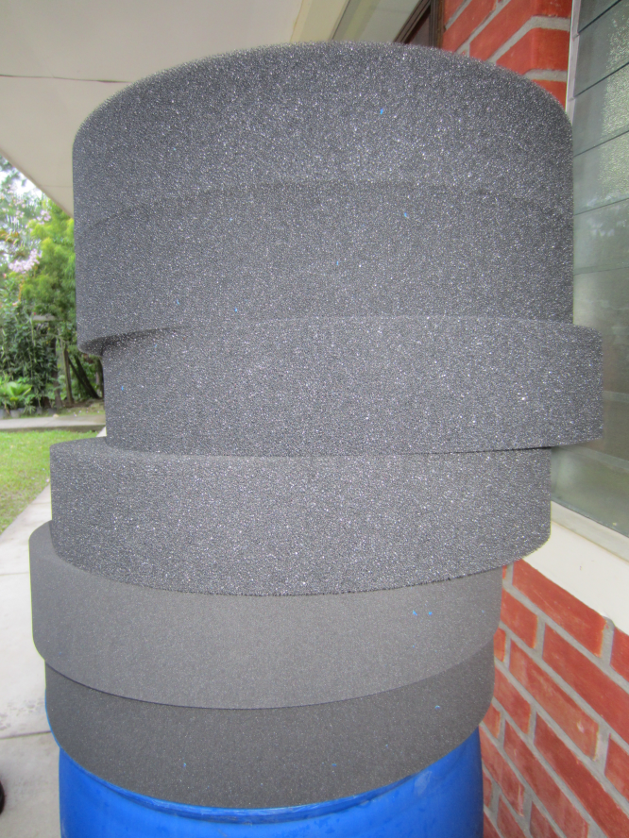
Foam Filtration
Objective: design and test a neatly packaged and portable filter
Preferable skills: fabrication, design, fluids

Slide 22
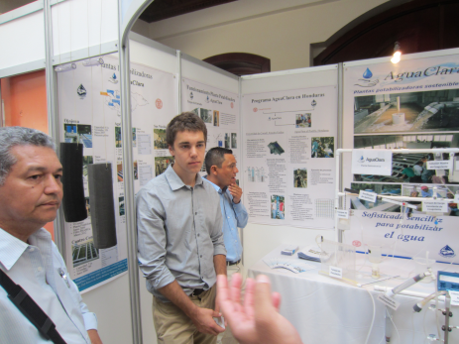
Demo Plant
Objective: improve ease of use and assembly, elegance, and presentation of demonstration plant
Design to be easily transported and deployed
Find material for tanks that isn’t brittle
Create startup procedures that are easy to implement
Make it fun to operate!
Preferable skills: fabrication
and design

Slide 23
Public Relations
Think Big
Publicize AguaClara – TED talk, National Press, Cornell Press
Blog posts about every subteam
Newsletter twice per semester
Update website with new international projects

Slide 24

Design
User Inputs
Plant
Design
LabVIEW
Design Engine
AutoCAD
Mathcad
Design
MS Word
Mathcad
Drawing Code

Slide 25
Design Goals
  Incorporating new research progress and feedback from Honduras into the design
  Designing plants for a greater range of flow rates
  Making our designs more easily understood
  Creating more flexible inputs for the design tool
  Communicating with the teams in Honduras and India, and with new implementation partners, to address concerns

Slide 26
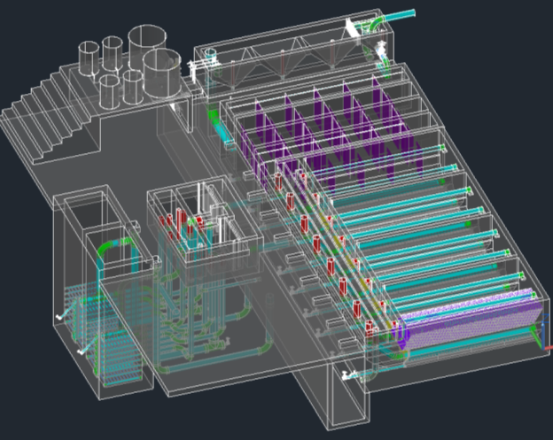
The Plant Drawing

Slide 27
Expectations
All team members are expected to:
  Spend at least 10 hours per week working on their project (including time in class)
  Consistently meet with subteam
    Be respectful of teammates
    Show up to meetings on time
    Communicate clearly
  Always attend full class meetings
  Submit reports on time
  Clean up after themselves in the lab

Slide 28
Interviews
Sign up online
  aguaclara.cornell.edu/wiki -> syllabus -> Sign up for an interview
Held in Hollister B60 (basement of Hollister)
  We can show you where this is after class today if you ask
Thursday (tomorrow!!) through Saturday from 8:00 AM to 5:00 PM
Will last approximately 15 minutes
Will determine admission onto the overall team as well as subteam placement

Slide 29
Pre-Interview Tasks
Review How Water Flows Through the Plant
  Download PowerPoint from the syllabus
  This will help you understand the challenges
Read the Team Challenges page
Fill out the team organization survey
Check out the syllabus at:
  https://confluence.cornell.edu/display/AGUACLARA/Syllabi

