Slide 1
An Introduction
Spring 2014 AguaClara
Monroe Weber-Shirk

Slide 2
AguaClara…
Creates solutions to real world problems and works with partner organizations to deploy the new technologies
Invents technologies with potential to improve the quality of life for millions
Creates an international collaborative network of organizations
Creates a problem based learning environment for Cornell students
b

Slide 3
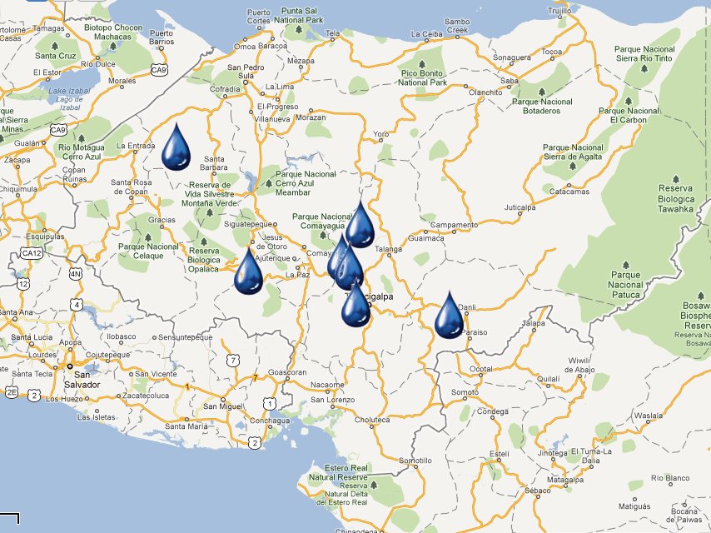



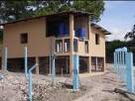



Since 2005:
AguaClara in Honduras
“Cuatro Comunidades” 2009
Atima 2012
Agalteca 2010
Tamara 2008
Marcala 2008/2011
Alauca 2011
Ojojona 2007

Slide 4
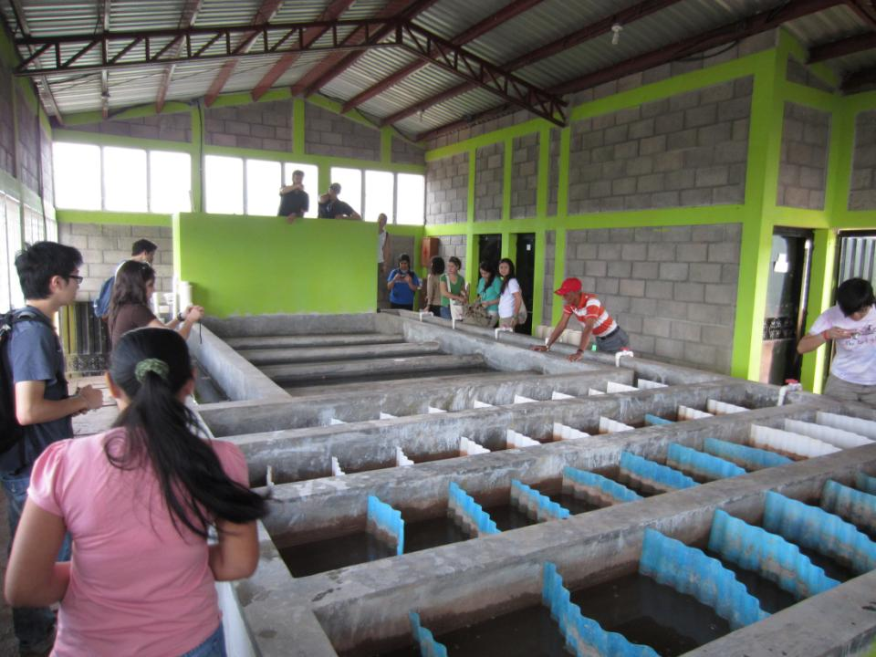

Slide 5
AguaClara Network
Investigation, innovation, education, and design
Cornell U
AguaClara R&D
AguaClara LLC
Technology Transfer, quality assurance, consulting services, and technical assistance for the implementation partners
Implementation Partners
Design/Build/Operate/Train/Transfer
Provide ongoing technical assistance for Water Boards
Water boards
Own, operate, maintain their water system. Monitor and upload performance data.
Community Members
Conserve water, drink safe water, and pay the tariff
Notes:
AguaClara Program at Cornell – R&D, new design and technology development. Note that Agua Clara plans to make their designs open source so cost for their proprietary designs is not an impediment to their adoption.
AguaClara Inc. – Proposed commercial entity which recruits and vets engineering and construction firms local to target communities (Implementation Partners, below), provides oversight and QA services, acts as a “face” to regional/local communities and as a go between with the AguaClara program as needed, and provides feedback to Cornell related to lessons learned and downstream technical requirements. In short, the “glue” between all entities.
Implementation Partners – Engineering and Construction firms in the target regions who will develop bids, sell services and build and deploy the plant and transfer support to local water boards.
Local Water Boards – Municipal entities who will “purchase” the build/deploy services from the Implementation Partner, and get funding from municipal/region/national sources for deployment of the plants.

Slide 6
Sharing understanding, feedback, and innovation
Cornell U
AguaClara R&D
AguaClara LLC
Implementation Partners
Water Boards
Community Members

Slide 7

AguaClara at Cornell
Research, Invent, & Design
Graduate Research
Fundamental physical chemical processes for enhanced drinking water & wastewater treatment
Capstone Design Course
CEE 4540: Sustainable Municipal Drinking Water Treatment
Project Based Courses
AguaClara: Sustainable Water Supply Project*
CEE 2550
CEE 4550
CEE 5051/5052
Summer Internships at Cornell
CEE 4560: Engineering in Context
2 week trip to Honduras during January intersession
Service & Learning
Learning & Service
Notes:
This is the “skeleton” of the AC program at Cornell, but not the human story – how this program provides a unique gateway for students into a world of high-stakes tech development an implementation appropriate to the challenges facing the Global South. High stakes because children are dying by the tens millions due to polluted drinking water– and because careful water management is rapidly ascending to the top of the list of critical global development necessities.
As you note, all the way through this Ppt, I am thinking about both the actual details (and organization) of the tasks you represent on the charts (how you would explain them to someone who has no prior knowledge of AC), and the human story that animates them all. We have to be very well prepared to talk about both to serious prospective donors.
---Gail

Slide 8
AguaClara is…
A philosophy of win/win/win for sustainability
Human AND environment friendly
Smart systems engineering
Sustainable systems
  Highly valued product – willing payment of tariff
  Technical support system
  Feedback loop for continual improvements
A third way (not lousy low tech, not hopeless high tech)

Slide 9
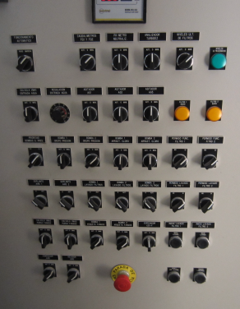
Design for Mega-Impact
The complex infrastructure systems that rely on electronics, software, automation are
  unreliable, expensive to maintain, high labor costs, short-lived, disempowering
The elegantly simple AguaClara designs rely on sophisticated fluid mechanics and particle dynamics to be
  resilient, low cost, long life, empowering

Slide 10

Notes:
What questions do you have about AguaClara?
http://www.polleverywhere.com/free_text_polls/p6dX5lOCI4GgNvc

Slide 11
Where are we going?
The best technology for converting surface water into safe drinking water on all metrics (water quality, capital cost, operating cost, reliability, empowerment, ease of operation and maintenance, human centered design)
Expand into related global challenges
  Wastewater
  Arsenic
Create the AguaClara Cornell Center for Global Water Solutions

Slide 12
Expectations for 2014
3 plants inaugurated in Honduras (San Nicolas, Jesus de Otoro, Moroceli)
Multiple villages with chemical dosers and SRSF in India
Improved funding levels for the Cornell program
More inventions!

