Slide 1
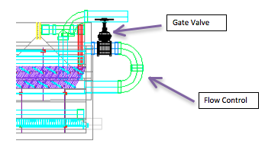
Entrance Tank Flow Control-
High Flow Modifications
Paul Larios
Notes:
FUNCTION/PURPOSE

Slide 2
Entrance Tank Flow Control
Problem:
Price of bronze gate valve becomes overly expensive as the plant flow rate increases.
Challenge:
Design a flow control solution with adequate capacity while minimizing cost and using materials available in Honduras.
Notes:
Trying to size for Entire plant flow, for now.

Slide 3
Entrance Tank Flow Control
Typical Pricing on Bronze Gate Valve:
Pipe Diameter (in) | Price ($)
1’’ | 24.50
2’’ | 39.20
3’’ | 161.70
4’’ | 171.50
6’’ | 588.00
Notes:
Converted from Lempiras to USD, from Drew Hart.
Discuss limitations on cost info.

Slide 4
Entrance Tank Flow Control
Range of Flow Rates for each valve size:
Pipe Diameter (in) | Range of Flow Rates (L/s)
2’’ | 0-1
3’’ | 1-2
4’’ | 2-5
6’’ | 5-13
8’’ | 13-25
10’’ | 25-44
12’’ | 44-68
Notes:
From code

Slide 5
Entrance Tank Flow Control
Alternatives Considered:
The use of valves other than bronze gate valve
The use of multiple, smaller-size valves in parallel leading to common manifold
Sliding gate
Notes:
Types of valves

Slide 6
Entrance Tank Flow Control
Progress:
Designed solutions that are more cost-effective while still maintaining capacity of entire plant flow for flow rates from 2-13 L/s.
Future:
Must gather more cost data for higher flow ranges. Eventually implement in design code.

