Slide 1
Sedimentation Tank Design Details
Team Members: Kristie Guo and Paroma Chakravarty

Slide 2
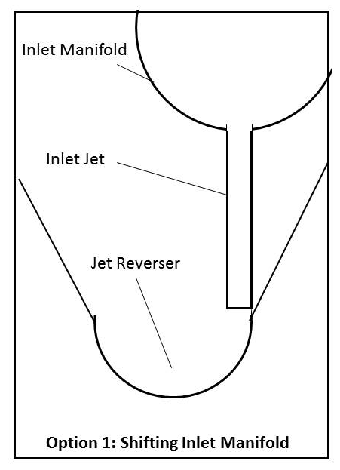
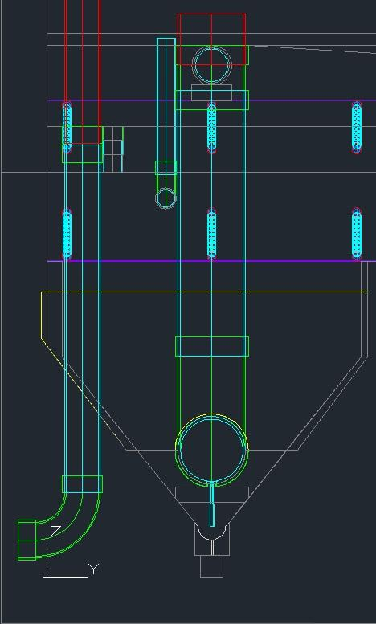
Task 1: Implement New Inlet Jet Design

Slide 3
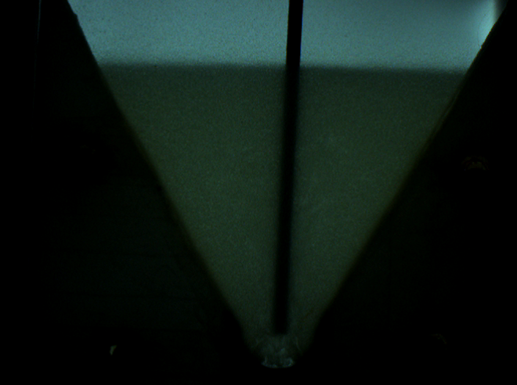
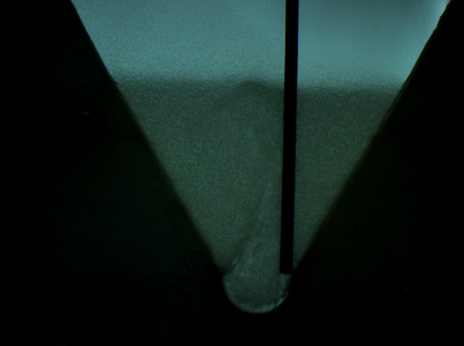
Why should we shift inlet jet over?
A vertically placed asymmetric jet is ideal for floc resuspension
  Eliminates the possibility of sludge buildup in the reverser

Slide 4
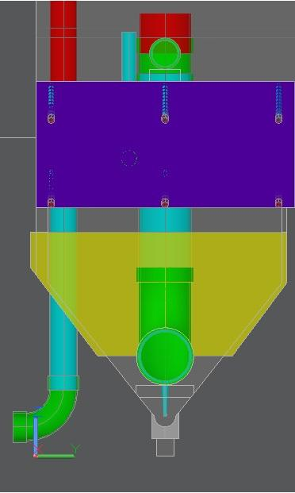
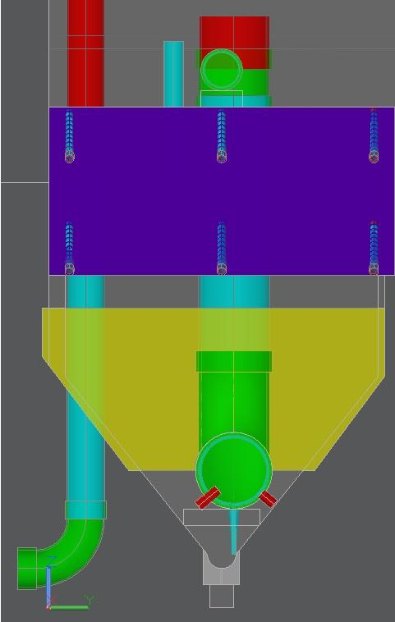
Comparison Between Past Code And Our New Code

Slide 5
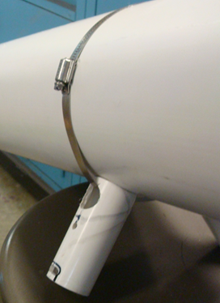
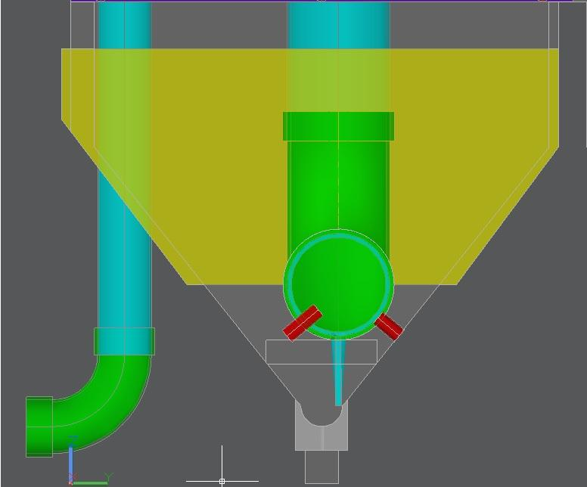
Task 2: Add Feet to Support Manifold
Notes:
feet will stabilize manifold

Slide 6
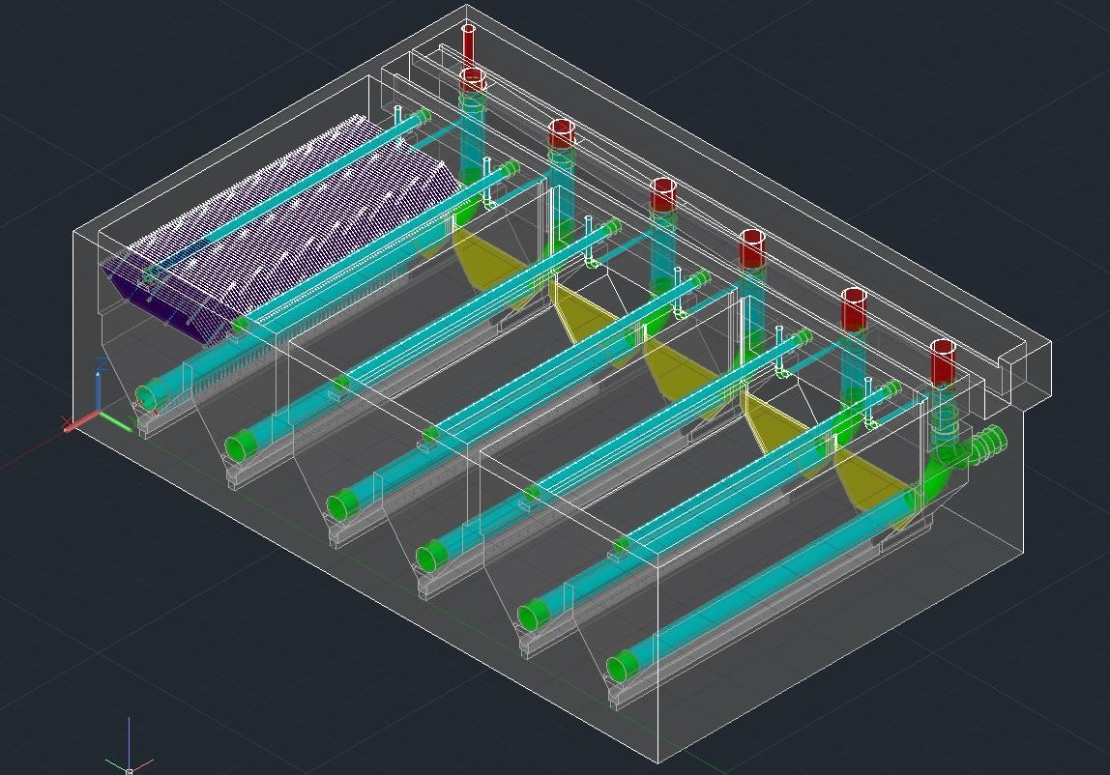
Feet Placement
The feet should go on either end of each pipe

Slide 7
Problems And Future Work
Calculation of the different pipe lengths
Origin points of the feet
The exact position of the feet
Hose clamps to hold the feet against the manifold

Slide 8

Questions

