Slide 2
Design Case Study
Created design document to improve the clarity of all of the files on the AguaClara server, and increase collaboration between people working with the same files and code.
Noticed “poor” coding habits and focused on mainstreaming a process for visible coding

Slide 3
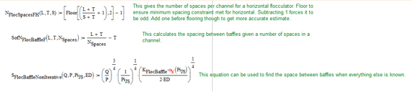
Design Case Study
Section Guidelines:
  File Name.
  References.
  Input Values.
  Variables/Functions.
Photo example on the design document documenting variables/functions.

Slide 4
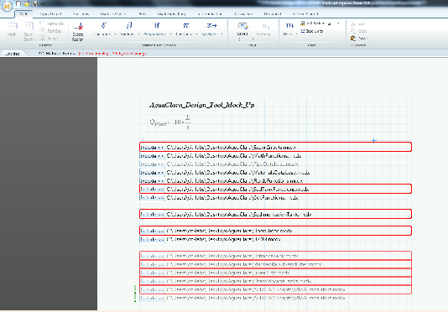
Design Case Study
Investigated options of upgrading from MathCAD 15.0 to MathCAD Prime 3.0 for more functionalities
  -Solve EtFlocSedFi disorganization issue
Figure: Error page of converting MathCAD 15.0 files to MathCAD 3.0. The files have synatax errors that disable the program from operating similar to that of MathCAD 15.0.

Slide 5
Plant Cost Calculator
The purpose of the plant cost calculator is to share the cost information from the website and to make this information more visible.
The user will be providing the input (community size and location) to get a cost estimate to make an informed decision.

Slide 6
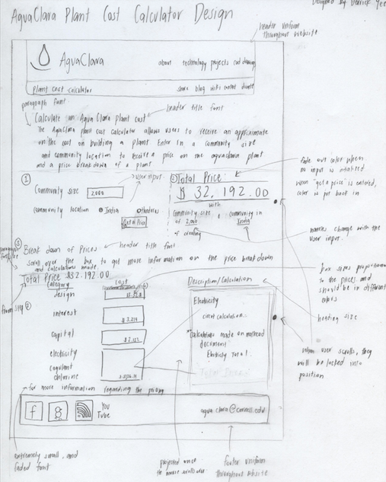
Cost Calculator Initial Design
Process:
  1. Analyze the user needs.
  2. Determining how the data will be stored.
  3. Creating the design and implementation
  4. Verifying calculations are correct

Slide 7
Future Work
Create a running prototype of the calculator and implement the calculator into the website
Researching MathCAD Prime 3.0 and continue to test whether the files on the AguaClara server work
  Simplifying code on EtFlocSedFi Files

Slide 8
Future Challenges
Plant Cost Calculator: calculating the most accurate calculations and documenting the process.
MathCAD Prime 3.0: having all design drawings run “normally”

