Slide 1

New Hire Onboarding
The Supervisor’s Role
March 2018

Slide 2

Cornell Acclimation Study: New Hires
October 2014 Cornell HR surveyed new staff who joined the university in the preceding 3-18 months to understand their overall acclimation experience.
New hires who reported people in their workgroup “helped bring them up to speed in their job” and “helped them navigate how to get things done at Cornell” were also more likely to report feelings of “belonging at Cornell,” and have a greater willingness to “recommend Cornell to a friend” and “see themselves still at Cornell two years from now.”
Notes:
Millennials – less satisfied with set-up
Alumni – happier with job – lonelier

Slide 3

New Hires: 18 Months Later
Following the survey new hires 18 months later, those who had left the university were statistically significantly (p<.001, t-test) less likely to have agreed with the statement “I can see myself still working at Cornell two years from now.”
Those who had been promoted were statistically significantly (P<.001, t-test) more likely to have agreed, “My department provided me with an effective orientation experience.” This finding supports the importance of an effective local acclimation experience.
Fall, 2017 - Cornell piloted a “Supervisor’s Guide to Welcoming Employees,” and an associated checklist.
Notes:
Millennials – less satisfied with set-up
Alumni – happier with job – lonelier

Slide 4
Pilot Program Responses: Onboarding Experience
Survey Item | Pilot Participants |  | Other New Hires
 | Mean | Agree/ Strongly Agree | Mean | Agree/ Strongly Agree
My workplace was ready for my arrival (i.e., computer, tools, phone, desk, locker). | 4.8 | 100% | 4.2 | 82.4%
My department provided me with an effective orientation experience. | 4.6 | 88.9% | 4.0 | 73.3%
I feel like I belong at Cornell. | 4.8 | 100% | 4.2 | 78.1%
See myself still working at Cornell 2 years from now. | 4.7 | 88.9% | 4.4 | 85.9%
All means based on a 5-point Likert-type scale with “1” indicating “strongly disagree” and “5” indicating “strongly agree”. There were 178 responses for the “Other New Hires” group and 9 responses from the pilot program – with about a 60% response rate for each group. Participants were surveyed between 90-120 days after their start date.

Slide 5

Why is Onboarding Important?
It helps with building a strong sense of belonging and engagement from the beginning;
Helps new staff members fully contribute more quickly;
Improves overall job satisfaction;
Builds a more cohesive team and raises team productivity;
Helps increase new employee retention; and
Reduces high turnover costs.

Slide 6

What is the Supervisor’s Role?
Prepare for and plan the first 90 days of your new employee’s experience at Cornell
Bring your newly hired employee up to speed with the policies, processes, culture, key relationships, expectations, and day-to-day responsibilities of your department/unit.
Ensure new employees feel welcomed and engaged; confirm why they joined your department/unit and Cornell University.

Slide 7
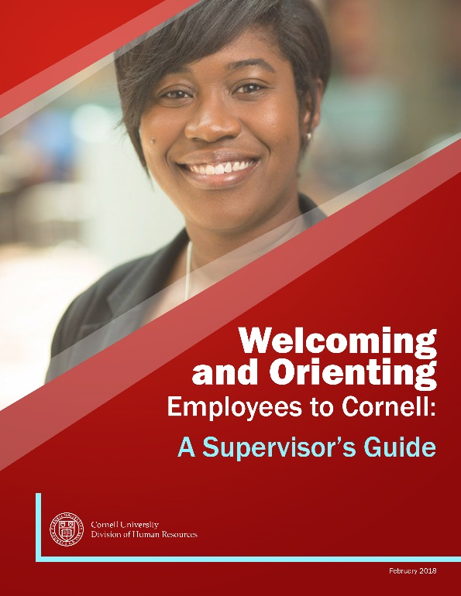
Next Steps
Roll out Supervisor Guide and checklist across (enter college/unit).
  Welcoming and Orienting New Employees: A Supervisor’s Guide
  Easy-to-use checklists for acclimation process
Enter college/unit specific process with HR

Slide 8
Questions?

