Slide 1

Notes:
Thank you for the invitation to come to your meeting.
We’re interested in developing an online learning component to our instruction program.
So we’re here to solicit your input about online tutorials /videos/ modules that you have used to either learn a concept or a craft or update your skills or understand something more in-depth.

Slide 2

Notes:
How many of you have used an online tutorial (or learning video or module) in the last year or so?
It can be for anything – a personal interest or an academic pursuit…. Doesn’t matter which…

Slide 3

Notes:
What have you wanted to learn via an online tutorial /video /module?

Slide 4

Notes:
Several of you indicated you’ve used an online tutorial.
Think back to an online tutorial or video in the last few months that you really liked.
Could be from your class or not…..
Picture it in your brain.

Slide 5

Notes:
Do you remember how long that favorite or most helpful online learning video was?
Prompts:
30 seconds
1-2 minutes
3 – 5 minutes
Longer?
Did you /most of you watch it in its entirety?
If not, how long do you think you watched it for?

Slide 6
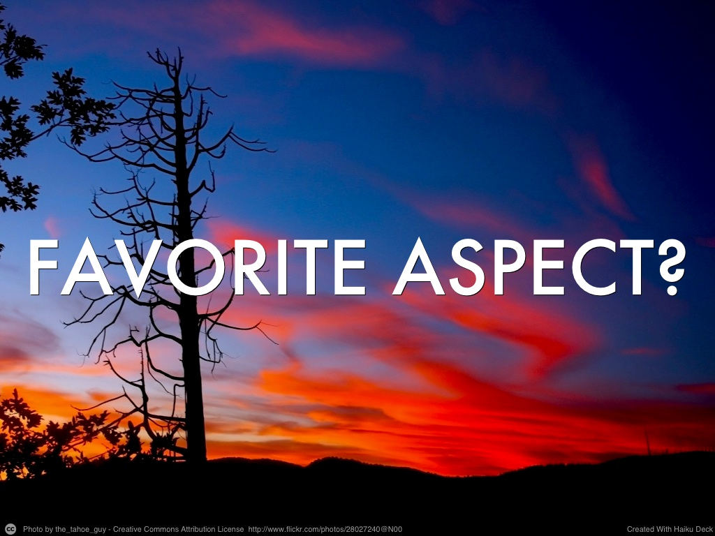
Notes:
What was your favorite aspect of that learning video or online tutorial?
Or, if you want to think about it differently, what did you find most helpful about it?
Prompts:
Was it the:
Music
The color
Got to the point quickly
Clarity, etc….

