Slide 1

Acute Liver Failure
Clare Hyatt, DVM, MS
Resident, Emergency/Critical Care
Cornell University

Slide 2
Acute liver failure
Definition
Pathophysiology
Clinical signs
Diagnosis
Complications of ALF
Treatment
Prognosis

Slide 3
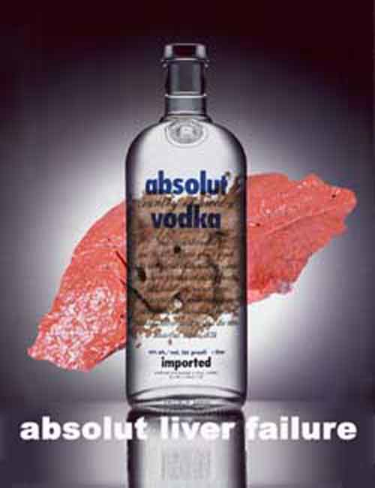
Definitions/Classification
Mostly human stuff

Slide 4
Definitions
Hepatic dysfunction
  Altered alanine animotransferase (ALT) levels and progressively increasing bilirubin

Slide 5
Definitions
Acute liver failure/dysfunction
  Sudden loss of >75% of functional hepatic mass
  Occurs in the absence of preexisting liver disease
  Umbrella term

Slide 6
Definitions
Fulminant hepatic failure
1970
  Potentially reversible disorder, the result of severe liver injury, with onset of encephalopathy within 8 weeks of symptom appearance in the absence of pre-existing liver disease.
1993-today
  Encephalopathy
  Icterus
  Coagulopathy

Slide 7
Definitions
Hepatic Encephalopathy
  Biochemical disorder of the metabolism of the brain due to hepatic dysfunction

Slide 8
Hepatic encephalopathy
Acute form – secondary to fulminant hepatic failure
  Sudden onset
  Rapidly progressive
  Initial excitatory manifestations
Chronic form
  PSS
  Lipidosis
  Congenital errors of metabolism

Slide 9
Classification - ALF
Time from onset of icterus to onset of encephalopathy
  Hyperacute - <7 days (fulminant)
  Acute – 8-28d
  Subacute – 29d-8w (subfulminant)

Slide 10
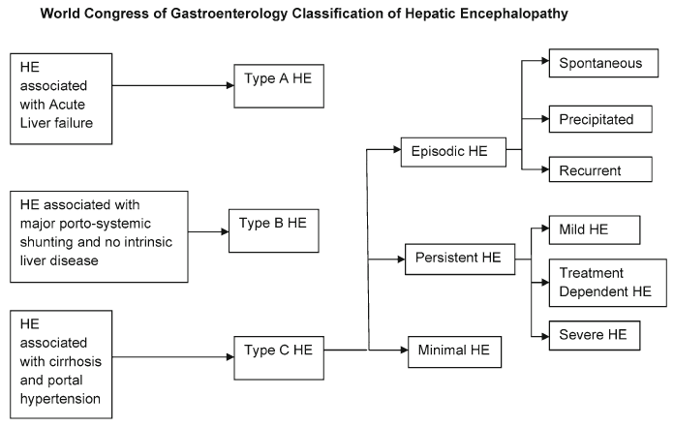
Classification - HE

Slide 11
West-Haven HE criteria
Stage | Consciousness | Behavior | Neuro findings
0 | Normal | Normal | normal
1 | Mild lack of awareness | Shortened attention span | Mild asterixis or tremor
2 | Lethargic | Disoriented, inappropriate behavior | Obvious asterixis, slurred speech
3 | Solmnolent but arousable | Gross disorientation, bizarre behavior | Muscle rigidity and clonus Hyper-reflexxia
4 | Coma | Coma | Decerebrate posturing
http://www.youtube.com/watch?v=Rbv-zaVszlk
Notes:
Asterixis – flapping tremor caused by disturbance in the oscillatory networks in the brain. Deomonstrated in the tongue, upper and lower extremities. If gripping hands the grip oscillates between tight and loose

Slide 12

Pathophysiology
Hepatic encephalopathy mostly

Slide 13
HE
Mechanism incompletely understood
Accumulation of endogenous gut derived toxins
  Ammonia
Alteration of energy balance and neurotransmission
  GABA, Glutamine, Endogenously derived benzodiazepine receptor agonists
Cerebral blood flow
Cerebral glucose and oxygen metabolism

Slide 14
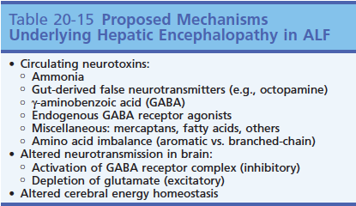
HE

Slide 15
Ammonia
Predominately gut derived
Bacterial metabolism of urea and amino acids
Accumulation in brain → encephalopathy
  Altered brain metabolism
  Altered neurotransmission

Slide 16
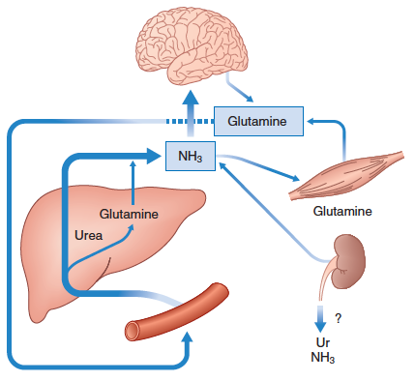
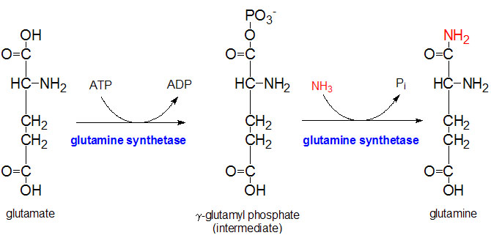
Notes:
Primary source of ammonia is the gut – normally cleared by urea cycle and glutamine (minor) in the liver
ALF → accumulation of ammonia in peripheral tissues, particularly brain and muscle which detoxify ammonia by synthesizing glutamine from glutamate

Slide 17
Ammonia
Produced from protein, amino acid, pyramidine metabolism
Produced in small intestines
  Synthesized by bacteria
  Breakdown of dietary protein and glutamine
  Deamination of glutamine by glutaminase in small intestine, colon
  Hydrolysis of urea
    Catalyzed by urease-producing bacteria

Slide 18
Ammonia
Transported across intestinal mucosa into portal circulation 80-90%
Metabolized by peripheral tissues (brain, skeletal muscle)
  Glutamine synthetase – glutamate → glutamine (removes ammonia)
Removed as urea via urea cycle
  Renal excretion ~75%
  Intestinal excretion ~25%

Slide 19
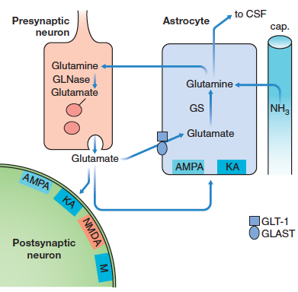
Ammonia

Slide 20
Ammonia in HE
Excess of gut-derived ammonia
Increased detoxification of ammonia by brain and muscles
Osmotic disturbances resulting from astrocytic metabolism of ammonia to glutamine
Changes in neurotransmitter synthesis and release
Neuronal oxidative stress
Impaired mitochondrial function

Slide 21
Ammonia effects on astrocytes
Astrocytes are glial cells in the CNS
Involved in providing nutrition to neuron
Important part of blood-brain barrier
Hyperammonemia:
  Glutamine accumulation in astrocytes
  Increased osmotic pressure and astrocyte edema
  Cerebral edema and increased ICP

Slide 22
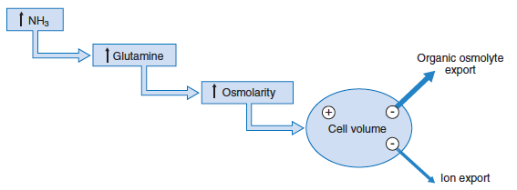
Ammonia effects on astrocytes

Slide 23
Ammonia
Interference with glutamatergic excitatory neurotransmission
Impairment of brain energy metabolism and autoregulatory of blood flow

Slide 24
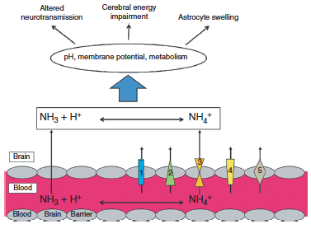
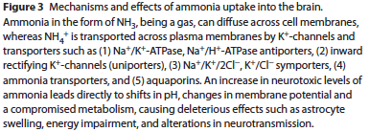

Slide 25
Altered neurotransmission
GABA
  Inhibits neurotransmission
  Site of action of benzodiazepines
  Increased circulating endogenous ligands for GABA receptors have been detected
    Ammonia increases the affinity of such ligands for this receptor
  Decreased GABA turnover may contribute to increase in GABA-ergic tone

Slide 26
Altered neurotransmission
Glutamate
  Decreased concentrations
    Increased consumption
    Used to detoxify ammonia within astrocytes

Slide 27
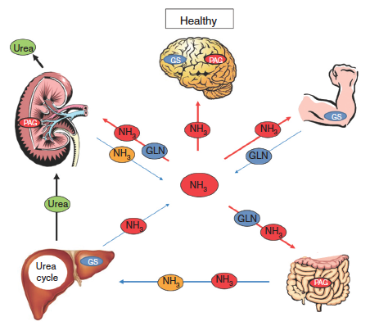
Ammonia

Slide 28
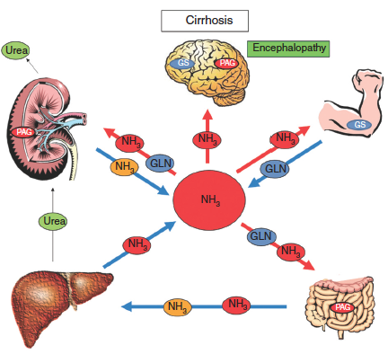
Ammonia

Slide 29

Clinical signs
And associated problems

Slide 30
Clinical signs
Anorexia, vomiting, weight loss dehydration
Icterus
  Prehepatic
  Hepatic
  Post-hepatic
PU/PD
  Decreased urea production → defective renal medullary concentrating ability
  Decreased responsiveness to ADH in collecting duct
  Central effects of hepatotoxins → primary polydipsia
Coagulopathy
Ascites
Hepatic encephalopathy

Slide 31
Hepatic encephalopathy
Clinical signs
Behavioral changes
Ataxia
Blindness
Circling
Head pressing
Panting
Pacing
Seizures
Coma
Ptylaism
Altered mentation
Bleeding diatheses
Melena
Ascites

Slide 32
Ascites
Neurohormonal events → changes in vascular compliance → redistribution of blood flow via vasodilatory mechanisms and altered hormone signalling
Sinusoidal hypertension
  Structural changes in liver
  Distortion of blood thru sinusoids

Slide 33
Ascites
Portal hypertension
  Vasodilation
RAAS activtion
  Na + H2O retention
Splanchnic vasodilation
  Increased lymphatic flow → hepatic capsule leakage of lymph fluid and drainage into abdomen

Slide 34

Etiology
So many choices…

Slide 35
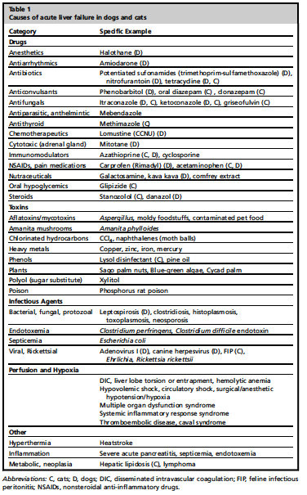
Etiology

Slide 36
Etiology

Slide 37
Etiology
Phase I
Hydroxylation
Active compound
Intermediary
Active Toxic
Phase II
Acetylation Methylation
Conjugation
Less active/
Inactive
Goal:
Increase water solubility and thus excretion

Slide 38
Phase I
CYP450 catalyzed
  Oxidation
  Reduction
  Hydrolysis
Inactive compound → active
Nontoxic →toxic
Endogenous: steroids/eicosanoids/retinoids
Exogenous: drugs/pesticides/pollutants

Slide 39
Phase II
Conjugation
  Glutathione (GSH)
  Glucuronidation
    Cats deficient
  Sulfate
Methylation
Acetylation
  Deficient in dogs

Slide 40
Hepatotoxic drugs
Acetaminophen | NAPQI mediated
Potentiated sufonamides | T-cell mediated response to proteins haptented by oxidative sulfonamide metabolites Massive hepatic necrosis Poor prognosis – 45% survival w/ hepatopathy
Oral diazepam | Cats Panlobular hepatocellular necrosis spares biliary epithelium Mortality rate as high as 90%
Methimazole | Cholestatic hepatotoxicity Hyperthyriodism in other species reduces hepatic [GSH] Cats with pre-existing gut or liver disease with GSH depletion predisposed
NSAID’s | Hepatocellular injury most common Aspirin and phenylbutaxzone – directly hepatotoxic Carprofen – idiosyncratic cytotoxic hepatotoxicity in dogs (Lab)

Slide 41
Plants/Fungus
Aflatoxins | Aspergillus flavus and penicillium spp mycotoxins Corn, peanuts, cottonseed Metabolites bind with cellular components (zone 3 parenchymal collapse) Dx: analysis of food/urine/vomitus/liver
Amanita | Inhibit nuclear RNA synthesis, inhibits ribosomal protein synthesis High metabolic rate cells most sensitive – gut/liver Three phases: latent (6-24 h), GI phase (2-3 d), hepatic (36-48 h)
Cyanobacteria | Following warm and sunny weather Acute / peracute / GI Microcystins – disorganization of actin filaments of hepatic cytoskeleton leading to cellular collapse Clinical signs within 12 hours after exposure Death from intrahepatic hemorrhage and/or acute hepatic failure
Sago palm | Cycasin and 2 neurotoxins Seeds contain highest levels cycasin, entire plant toxic Centrolobular and midzonal coagulatie hepatic necrosis Lab values abnormal in 1-2 days Mortality rate 30%

Slide 42
Infectious agents
Dogs | Cats
Canine adenovirus-1 Acidophil cell hepatitis virus Canine herpes virus | FIP Liver flukes Liver abscesses
Clostridia Leptospirosis Bartonellosis Tularemia | Clostridia Histoplasmosis Cryptococcus Toxoplasmosis
Histoplasmosis Coccidiomycosis Blastomycosis
Dirofilaria immitis Ehrlichia canis Rickettsia rickettsii
Hepatozoonosis Liver abscess Toxoplasmosis

Slide 43
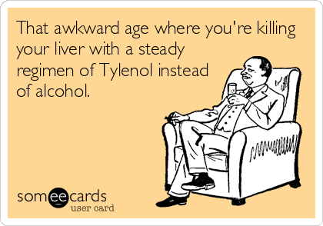
Drug-related
Expected liver values
ALT > 3x normal
ALP > 2x normal
tBili > 2x normal if associated with any elevation in ALT or ALP

Slide 44
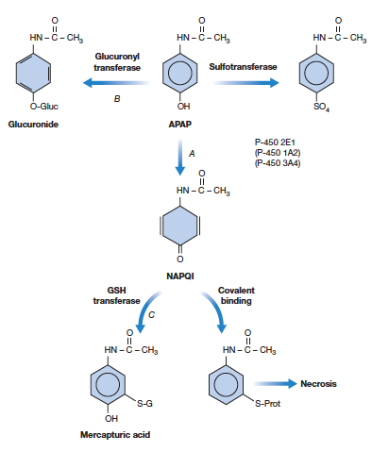
Acetaminophen
Acetaminophen (APAP)
Phase I – CYP 450
→ NAPQI
CYP2E1, CYP1A2, CYP2D6
→nontoxic substances via GSH
Phase II – Glucoridation/Sulfation

Slide 45
Xylitol
5 carbon sugar alcohol
Artificial sweetener
  Sugar-free candy, gum, toothpaste, bulk sweetener for baking, beverages
Rapidly absorbed
Causes 6x increase in insulin release in dogs
Hepatic necrosis
  Pentose-phosphate pathway – ATP depletion due to production of phosphorylated intermediates
  NADH production → ROS production

Slide 46
Feline hepatic lipidosis
Catabolic state leading to enhanced mobilization of peripheral fat stores ot the liver
Impaired dissemination of lipid from hepatocytes
Incompletely understood mechanism
During prolonged anorexia
  Impaired glucose tolerance
  Decreased insulin responsiveness
  Decreased glucagon/insulin ratio compared to healthy cats

Slide 47
Feline hepatic lipidosis
Intense peripheral lipolysis
  Hormone-sensitive lipase
  Stimulated by glucagon, thyroid hormones, norepi, glucocorticoids, growth hormone
  Inhibited by insulin
  Increase in free fatty acids in blood

Slide 48
Feline hepatic lipidosis
FFA’s taken up by peripheral blood → liver, enter the itochondria (L-carnitine) → beta oxidation
  Produces acetyl-Co-A → TCA cycle
    + glucose → energy
    Ketone bodies
  Esterified into triglycerides
    Accumulate in vacuoles within hepatocytes

Slide 49
Feline hepatic lipidosis
Fatty Acids in liver
Mitochondria
B-oxidation
TCA cycle (w/ glucose)
Ketones
Esterified into triglyerides
Accumulate in hepatocytes
Acetyl-Co-A
L-carnitine

Slide 50

The end of this talk

Slide 51


Slide 52

Diagnosis
Clinical signs of HE

Slide 53
Hematologic changes
Target cells, acanthocytes, anisocytosis
Anemia
  Nonregenerative
  Regenerative
Leukocytosis or leukopenia
Thrombocytopenia
Notes:
Nonregenerative anemia – chronic GI blood loss, chronic disease, PSS, microvascular shunting
Regenerative – GI bleeding acute

Slide 54
Biochemical abnormalities
Elevations in ALT, AST
  Cytosolic leak enzymes
Elevations in ALP, GGT
  Cholestatic enzymes
Hyperbilirubinemia
  Breakdown of hemoglobin, myoglobin, cytochromes, significant cholestasis
  Visible icterus
Notes:
ALT – more liver specific – 24-60hr half life
AST – liver/muscle – shorted half life
ALP – bone/steroid/liver – located on the membranes of the hepatocyte canalicular cells and biliary epithelial cells. Short half life in cats
GGT – membranes of the hepatocyte canalicular cells and biliary epithelial cells – more specific and less sensitive than ALP (esp in cats)

Slide 55
Liver function tests
Hypoalbuminemia
Hypocholesterolemia
Hypoglycemia
Decreased BUN levels
Hyperbilirubinemia

Slide 56
Hypoalbuminemia
Produced only in liver
Present when 66-80% of liver function compromised
Long half life

Slide 57
Hypocholesterolemia
Approx 50% synthesized in liver
Hypercholesterolemia can be seen with concurrent biliary obstruction or pancreatitis

Slide 58
Hypoglycemia
More later…

Slide 59
Electrolytes
Hyponatremia
  Nonosmotic hypersecretion of ADH
  May effect brain function and predispose to HE
  Degree of hyponatremia is proportional to severity of liver failure

Slide 60
Electrolytes
Hypokalemia
  Decreased intake
  Vomiting
  Potassium wasting diuretics
  Centrally induced hyperventilation and respiratory alkalosis → potassium excretion
  May exacerbate HE
Hypophosphatemia
  Hypocapnia → shift in intracellular CO2 into extracellular space, raising intracellular pH and accelerating the utilization of phosphate to phosphorylate glucose

Slide 61
Other testing
Prolongation of PT, PTT, BMBT
Elevation of bile acids
Elevated ammonia levels

Slide 62
Imaging
Abdominal radiographs
Ultrasound
CT

Slide 63
Cytology/histopathology
FNA
Biopsies
  Tru-cut
  Laparoscopically
  Surgically
Samples for:
  Cytology/histopathology
  Culture
  Copper analysis
  PCR

Slide 64
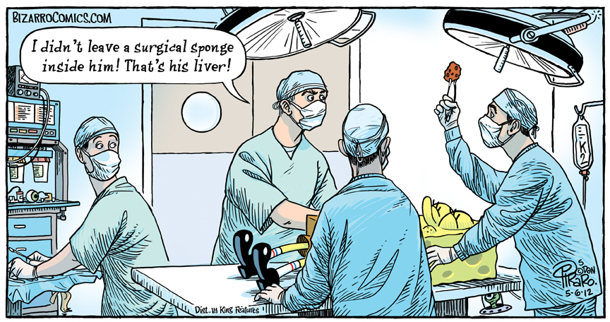
Complications of ALF
As if it wasn’t bad enough already

Slide 65
Complications of ALF
Hypoglycemia
Encephalopathy
Coagulopathy
Infection / sepsis
Acute renal failure
Acute respiratory distress
Microcirculatory dysfunction

Slide 66
Complications of ALF
Hypoglycemia
Encephalopathy
Coagulopathy
Infection / sepsis
Acute kidney injury
Acute respiratory distress
Microcirculatory dysfunction

Slide 67
Hypoglycemia
Decreased glycogenolysis and gluconeogenesis
Hyperinsulinemia
  Decreased hepatic metabolism
Concurrent sepsis

Slide 68
Complications of ALF
Hypoglycemia
Encephalopathy
Coagulopathy
Infection / sepsis
Acute kidney injury
Acute respiratory distress
Microcirculatory dysfunction

Slide 69
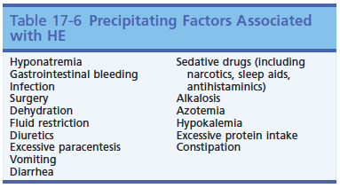
Encephalopathy

Slide 70
Complications of ALF
Hypoglycemia
Encephalopathy
Coagulopathy
Infection / sepsis
Acute kidney injury
Acute respiratory distress
Microcirculatory dysfunction

Slide 71
Coagulopathy
Part of the definition of ALF
Multifactorial
Severe liver disease not intrinsically pro- or anti-coagulant condition
Hemorrhagic complications uncommon
  GI ulceration
  Invasive procedures
  Concurrent problems
Impaired ability to recover form insult

Slide 72
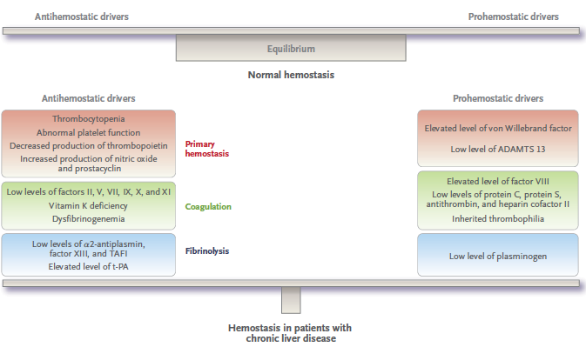
Hemostasis in liver dz

Slide 73
Coagulation disorders
Altered factor levels
Increased fibrinolysis and tissue thromboplastin release
Decreased platelet function/numbers
Vitamin K deficiency

Slide 74
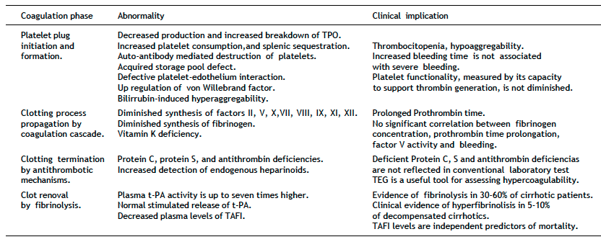
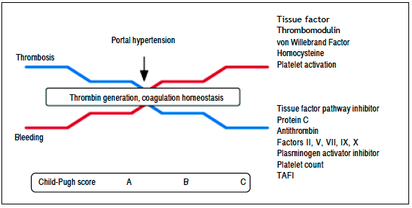
Coagulation abnormalities

Slide 75
Factor levels
II, V, VII, IX, X, XI, XII synthesis decreased
Protein C, S, antithrombin synthesis decreased
  Decreased liver function
  Increased consumption (DIC)
  hyperfibrinolysis
  Vitamin K deficiency
vWB and VIII synthesis increased
PT prolongation not uncommon
Increased factor utilization
Notes:
V and VII have shortest half lives – are most affected

Slide 76
Hyperfibrinolysis
Reported in patients with chronic liver disease
Uncertain mechanism
Normal to elevated fibrinogen levels
Plasminogen, plasmin inhibitor, TAFI and XIII levels decreased
tPA increased (not produced in liver)
PAI-1 increased in ALF
  Shifts balance to hyperfibrinolysis
Notes:
TAFI – thrombin activatable fibrinolysis activator
PAI – plasminogen activator inhibitor
tPA – tissue plasminogen activator

Slide 77
Platelets
Thrombocytopenia – common in liver diseases
  Sequestration in spleen d/t portal hypertension
  Impaired platelet production – dec TPO
  Thrombin mediated platelet consumption
  May be offset by increased vWB

Slide 78
Platelets
Thrombocytopathia
  Acquired storage pool deficits
    Decreased ATP and serotonin in dense granules
    Decreased TXA2 synthesis
    Altered transmembrane signal transduction
      Decreased αIIβb3 receptors
      Decreased response to collagen, thrombin, arachadonic acid, ADP, epi
    Extrinsic factors
      Abnormal lipoprotein levels, reduced HCT, inc levels of platelet inhibitors

Slide 79
Platelets
Promoters of platelet activation
  Increased vWF
  Unconjugated bilirubin is strong inducer of platelet aggregation similar to ADP

Slide 80
Vitamin K deficiency
Poor nutrition
Malabsorption due to decreased bile production or biliary obstruction

Slide 81
Complications of ALF
Hypoglycemia
Encephalopathy
Coagulopathy
Infection / sepsis
Acute kidney injury
Acute respiratory distress
Microcirculatory dysfunction

Slide 82
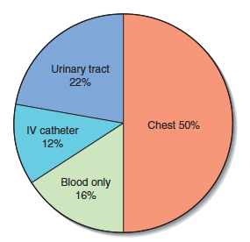
Infection / sepsis
Liver plays central role in sepsis
  Kupffer cells – largest collection of macrophages in the body
  Abnormal neutrophil function secondary to complement deficiency
  Gram negative bacteria from GI
  Gram positive bacteria from respiratory/urinary tracts
ALF can be result of or complication of sepsis

Slide 83
Infection / sepsis
Reduced gluconeogenesis and glycolysis
Altered protein production and amino acid metabolism
Reduction of removal of serum triglycerides
Reduced synthesis of coagulation factors
Derangements in host defenses
Reduced glutamine levels
  Increased translocation of gram-negative bacteria

Slide 84
Infection / Sepsis
MODS –
  “Physiologic homeostasis cannot be regulated without intervention”
  2-hit theory
    Activation of mononuclear cells with massive cytotoxin release → over-exaggerated immune response, septic shock
    Reduction in hepatic oxygenation
      Generation of ROS

Slide 85
Infection / sepsis
Decreased hepatic blood flow
  Splanchnic venous drainage increases in proportion with cardiac output
  Hemoglobin saturation decreased in the portal blood
  Increased oxygen demand
  Decreased hepatic artery blood flow secondary to increased portal flow

Slide 86
Complications of ALF
Hypoglycemia
Encephalopathy
Coagulopathy
Infection / sepsis
Acute kidney injury
Acute respiratory distress
Microcirculatory dysfunction

Slide 87
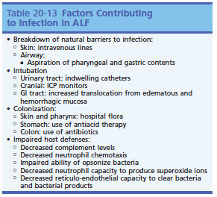
Infection / sepsis

Slide 88
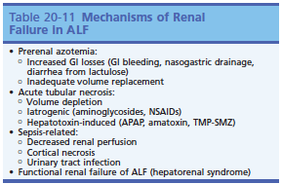
Acute kidney injury

Slide 89
Acute kidney injury
Hepatorenal syndrome
  Compensatory renal vasoconstriction
  Reduced GFR → renal hypoperfusion and permanent renal damage
Effective blood volume depletion
Acute tubular necrosis
Sepsis

Slide 90
Complications of ALF
Hypoglycemia
Encephalopathy
Coagulopathy
Infection / sepsis
Acute kidney injury
Acute respiratory distress
Microcirculatory dysfunction

Slide 91
Respiratory distress
Secondary to ALF
  Hypoxemia d/t V/Q mismatch, volume overload, LV failure, intrapulmonary shunting, pneumonia, increased pulmonary capillary permeability, thromboembolism
  Pulmonary edema with normal pulmonary capillary wedge pressure suggests ARDS

Slide 92
Complications of ALF
Hypoglycemia
Encephalopathy
Coagulopathy
Infection / sepsis
Acute kidney injury
Acute respiratory distress
Microcirculatory dysfunction

Slide 93
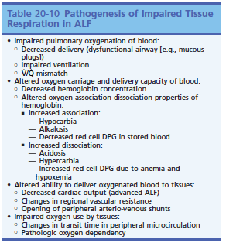
Microcirculatory dysfxn

Slide 94

Treatment
Medications
Diet modification

Slide 95
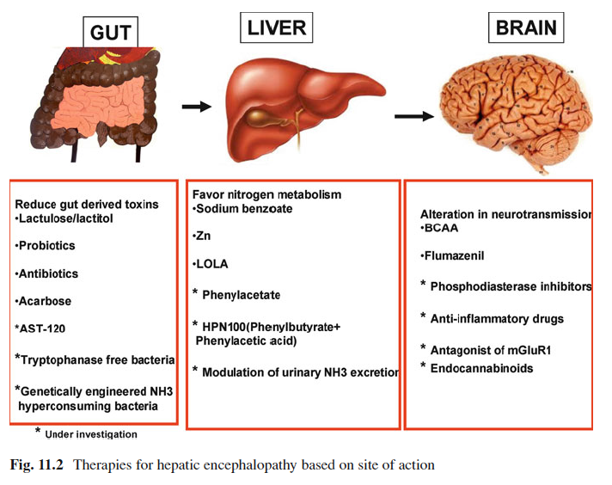
Treatment

Slide 96
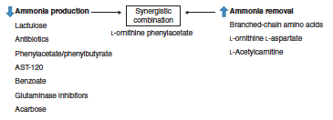
Ammonia lowering strategies

Slide 97
Treatment - Lactulose
Disaccharide - Lactose and galactose
Metabolized by colonic bacteria to acetic acid and lactic acid
Creates hostile environment for urease producing bacteria
Facilitates conversion of NH3 to NH4+
Reduces levels of NH3 in colon and portal blood
Increases fecal nitrogen excretion

Slide 98
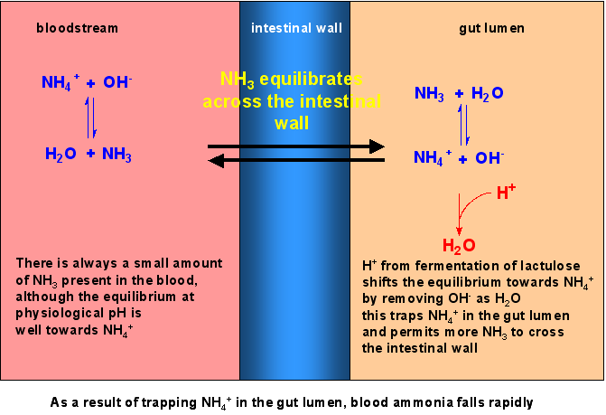
Lactulose

Slide 99
Treatment - Antimicrobials
Inhibit ammonia generation in gut from enteric bacteria
Anaerobic antibiotics more efficacious than aerobic antibiotics
Neomycin
Metronidazole
Rifaximin

Slide 100
Neomycin
Inhibits intestinal glutaminase
Majority of portal vein ammonia comes from glutaminase, not from intestinal bacteria
High doses used in human medicine led to signs of toxicity (1-3g q6)

Slide 101
Metronidazole
Nitroimidazole antibiotic
MOA –
  Reduce anaerobic bacteria to reduce urea production
  Decrease risk of bacterial translocation and systemic infections
Less extensively studied than neomycin or rifaximin

Slide 102
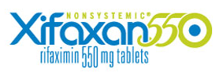
Rifaximin
Only FDA approved (human) medicine for HE
Aerobic and anaerobic gram positive and gram negative spectrum
Poorly absorbed
Studies have indicated NSD between rifaximin and lactulose/lactitol for treatment of HE (meta-analysis)
  NSD diarrhea
  Improvement in abdominal pain

Slide 103
L-ornithine L-aspartate (LOLA)
Substrates of urea cycle
Stimulates muscle glutamine synthesis
Detoxifying ammonia

Slide 104
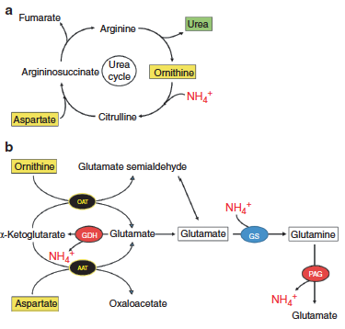
L-Ornithine L-aspartate (LOLA)

Slide 105
L-ornithine phenylacetate
Ornithine + phenylacetate
Increased conversion of glutamate to glutamine by stimulate of glutamine synthase in muscle
  Increased excretion of ammonia
Reduced ammonia → reduced ICP
Improvement in inflammation and NO pathways
Modulates iNOS and NFκB mechanisms
Prevents LPS-induced brain edema in cirrhotic rats

Slide 106
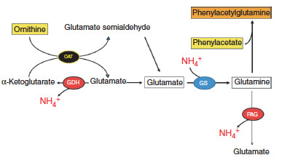
L-ornithine phenylacetate

Slide 107
Branched chain AA’s
Valine, Leucine, Isoleucine
Branched-chain aminotransferase
  Amino group from the BCAA → glutamate from alpha-ketoglutarate
  Branched chain ketoacids
    CoA → TCA cycle

Slide 108
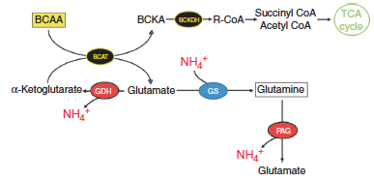
Branched-chain AA’s

Slide 109
Branched chain AA’s
Lower blood ammonia
Improve mental status
Cochrane review 2004 – no effect on morbidity/mortality with end stage dz
Large multicenter trial –
  Reduces risk of death
  Attenuates progression in cirrhotic pts

Slide 110
Carbon microspheres
AST-120
Oral absorbant
  CKD, IBS, active pouchitis
Activated carbon microspheres high nonspecific absorptive surface area
Provide sustained binding surface for <10 kD compounds
Shown to absorb ammonia in vitro and reduce hyperammonemia, attenuate brain edema, and attenuate HE is cirrhotic rats

Slide 111
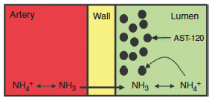
Carbon microspheres
Acts as an ammonia sink by drawing ammonia from systemic circulation

Slide 112
Carbon microspheres
ASTUTE trial
  150 patients, randomized, 8 weeks
  Failed to attenuate mild HE after 4 or 8 weeks
  Reduced blood ammonia levels at 4 and 8 weeks

Slide 113
Other HE treatments
Sodium benzoate
  Conjugates glycine to form hippuric acid
  Excreted by kidneys
  Glycine → ammonia via glycine cleavage sys
  Can inhibit production of urea
Glutaminase inhibitors
  Main glutamine-catabolizing enzyme in the SI – 85% of ammonia generated
  BPTES, THDP17, DON - Only tested in vitro
Notes:
Glycine produces ammonia as an end product
Glutaminase activity higher in cirrhotic patients

Slide 114
Other HE treatments
Acarbose
  Alpha-glycosidase inhibitor
  Prevents conversion of carbs into monosaccharides
  Decrease colonic proteolytic bacteria
  Improvement noted in overt HE / DM patients in ammonia levels and attenuation of HE
Flumazenil
  Short acting benzodiazepine antagonist

Slide 115
Symptomatic therapy
GI ulceration/bleeding
  H2 blockers, PPI’s, sucralfate
Vitamin K1
  Cholestasis/altered fat metabolism
Transfusions
  As indicated

Slide 116
Fluid therapy
Maintain hydration
Correct hyponatremia
Avoid LRS (hepatic metabolism of lactate)
  Avoid all buffered fluids?
Supplement potassium and glucose as needed

Slide 117
Hepatoprotectants
N-acetyl-cysteine
S-adenosylmethionine
Silymarin
Ursodeoxycholic acid
L-carnitine
Vitamin B complex
Vitamin E / Vitamin C

Slide 118
Anti-convulsants
Midazolam (vs diazepam)
Keppra
Propofol
Mannitol – also to decreased ICP

Slide 119
Probiotics
Administration of live cultures of microorganisms
Improving intestinal microflora
Well tolerated
Studies have shown imorivement in tx of HE
  Lowering ammonia levels
  Modulating intestinal bacteria by the introduction of non-urease producing bacteria
Cochrane review 2011- inconclusive findings warranting further study

Slide 120
Nutrition
Readily digestible
Protein source of high biologic value
  Avoid negative nitrogen balance
Supply essential fatty acids
Maintain palatability
Adequate mineral/vitamin quantity
Protein restriction in humans not recommended
  →Lean body mass loss
  →Increased nitrogen load into circulation

Slide 121
Nutrition
Humans with severe hepatic insufficiency
  Normal requirements for essential AA’s
  Increased requirements for nonessential AA’s
    Endogenous protein catabolism
Healthy adult cats require 3-5x more dietary protein than adult dogs
Cats- protein restriction should not exceed that of CKD
Dogs – can tolerate more protein restriction

Slide 122
Nutrition
Tyrosine, phenylalanine, tryptophan –
  Amine synthesis substrates in brain
  Can lead to formation of encephalogenic “false neurotransmitters”
  Increase in HE as result of dependency on hepatic extraction and metabolism

Slide 123
Nutrition
Milk/vegetable proteins
  Lower in aromatic AA’s
  Higher in branched chain AA’s
Soy protein –
Deficient in methionine
Reduces enteric taurine availability
Low digestibility
Avoid protein restricted diets unless HE present

Slide 124
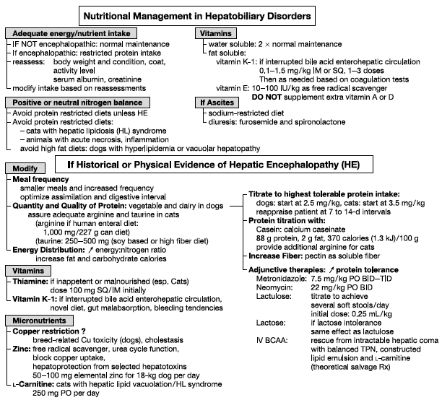
Notes:
----- Meeting Notes (10/15/13 14:58) -----
Algorithm presented by Center in 1998 J nutrition article

Slide 125

Prognosis

Slide 126
Prognosis
Depends on the degree on insult
Generally poor
Associated with poorer prognosis
  PT > 100 sec
  Very young or very old animals
  Viral or idiosyncratic reactions
  Markedly elevated bilirubin levels
  Lack of antidote

Slide 127

Questions?

Slide 128
References
No, I didn’t pull all this information outta thin air

Slide 129
Amodio, P., Bemeur, C., Butterworth, R., Cordoba, J., Kato, A., Montagnese, S., … Morgan, M. Y. (2013). The nutritional management of hepatic encephalopathy in patients with cirrhosis: International Society for Hepatic Encephalopathy and Nitrogen Metabolism Consensus. Hepatology (Baltimore, Md.), 58(1), 325–36. doi:10.1002/hep.26370
Atluri, D. K., Prakash, R., & Mullen, K. D. (2011). Pathogenesis, Diagnosis, and Treatment of Hepatic Encephalopathy. Journal of Clinical and Experimental Hepatology, 1(2), 77–86. doi:10.1016/S0973-6883(11)60126-6
Bak, L. K., Waagepetersen, H. S., Sørensen, M., Ott, P., Vilstrup, H., Keiding, S., & Schousboe, A. (2013). Role of branched chain amino acids in cerebral ammonia homeostasis related to hepatic encephalopathy. Metabolic brain disease, 28(2), 209–15. doi:10.1007/s11011-013-9381-7
Bernal, W., Auzinger, G., Dhawan, A., & Wendon, J. (2010). Acute liver failure. Lancet, 376(9736), 190–201. doi:10.1016/S0140-6736(10)60274-7
Butterworth, R. F. (2011). Hepatic encephalopathy: a central neuroinflammatory disorder? Hepatology (Baltimore, Md.), 53(4), 1372–6. doi:10.1002/hep.24228
Center, S. a. (2007). Interpretation of liver enzymes. The Veterinary clinics of North America. Small animal practice, 37(2), 297–333, vii. doi:10.1016/j.cvsm.2006.11.009
Center, S. a. (2009). Diseases of the gallbladder and biliary tree. The Veterinary clinics of North America. Small animal practice, 39(3), 543–98. doi:10.1016/j.cvsm.2009.01.004
Cerquetella, M., Giuliano, V., Rossi, G., Corsi, S., Laus, F., Spaterna, A., … Bassotti, G. (2012). Chronic hepatitis in man and in dog: a comparative update. Revista española de enfermedades digestivas : organo oficial de la Sociedad Española de Patología Digestiva, 104(4), 203–9. Retrieved from http://www.ncbi.nlm.nih.gov/pubmed/22537369
Córdoba, J. (2011). New assessment of hepatic encephalopathy. Journal of hepatology, 54(5), 1030–40. doi:10.1016/j.jhep.2010.11.015
Desjardins, P., Du, T., Jiang, W., Peng, L., & Butterworth, R. F. (2012). Pathogenesis of hepatic encephalopathy and brain edema in acute liver failure: role of glutamine redefined. Neurochemistry international, 60(7), 690–6. doi:10.1016/j.neuint.2012.02.001
Favier, R. P. (2009). Idiopathic hepatitis and cirrhosis in dogs. The Veterinary clinics of North America. Small animal practice, 39(3), 481–8. doi:10.1016/j.cvsm.2009.01.002
Gonzalez, S. A., & Keeffe, E. B. (n.d.). Acute liver failure, 20–33. doi:10.1016/B978-1-4377-1725-9.10002-4

Slide 130
Guevara, M., Baccaro, M. E., Ríos, J., Martín-Llahí, M., Uriz, J., Ruiz del Arbol, L., … Ginès, P. (2010). Risk factors for hepatic encephalopathy in patients with cirrhosis and refractory ascites: relevance of serum sodium concentration. Liver international : official journal of the International Association for the Study of the Liver, 30(8), 1137–42. doi:10.1111/j.1478-3231.2010.02293.x
Hoffmann, G. (2009). Copper-associated liver diseases. The Veterinary clinics of North America. Small animal practice, 39(3), 489–511. doi:10.1016/j.cvsm.2009.02.001
Kawaguchi, T., Taniguchi, E., & Sata, M. (2013). Effects of oral branched-chain amino acids on hepatic encephalopathy and outcome in patients with liver cirrhosis. Nutrition in clinical practice : official publication of the American Society for Parenteral and Enteral Nutrition, 28(5), 580–8. doi:10.1177/0884533613496432
Keiding, S., & Pavese, N. (2013). Brain metabolism in patients with hepatic encephalopathy studied by PET and MR. Archives of biochemistry and biophysics, 536(2), 131–42. doi:10.1016/j.abb.2013.05.006
Kirk’s CVT XIV Chap 132.pdf. (n.d.).
Lachmann, V., Görg, B., Bidmon, H. J., Keitel, V., & Häussinger, D. (2013). Precipitants of hepatic encephalopathy induce rapid astrocyte swelling in an oxidative stress dependent manner. Archives of biochemistry and biophysics, 536(2), 143–51. doi:10.1016/j.abb.2013.05.004
Lee, W. M. (2012). Acute liver failure. Seminars in respiratory and critical care medicine, 33(1), 36–45. doi:10.1055/s-0032-1301733
McCord, K. W., & Webb, C. B. (2011). Hepatic dysfunction. The Veterinary clinics of North America. Small animal practice, 41(4), 745–58, vi. doi:10.1016/j.cvsm.2011.04.002
Moon, S.-J., Kim, J.-W., Kang, B.-T., Lim, C.-Y., & Park, H.-M. (2012). Magnetic Resonance Imaging Findings of Hepatic Encephalopathy in a Dog with a Portosystemic Shunt. Journal of Veterinary Medical Science, 74(3), 361–366. doi:10.1292/jvms.11-0198
Mpabanzi, L., & Jalan, R. (2012). Neurological complications of acute liver failure: pathophysiological basis of current management and emerging therapies. Neurochemistry international, 60(7), 736–42. doi:10.1016/j.neuint.2011.10.014
Muciño-Bermejo, J., Carrillo-Esper, R., Uribe, M., & Méndez-Sánchez, N. (2013). Coagulation abnormalities in the cirrhotic patient. Annals of hepatology, 12(5), 713–24. Retrieved from http://www.ncbi.nlm.nih.gov/pubmed/24018489
Murphy, L. a, & Coleman, A. E. (2012). Xylitol toxicosis in dogs. The Veterinary clinics of North America. Small animal practice, 42(2), 307–12, vii. doi:10.1016/j.cvsm.2011.12.003

Slide 131
Ortega, L. (2010a). Series Editor (Vol. 60, pp. vii–ix). doi:10.1111/j.1467-9922.2010.00578.x
Ortega, L. (2010b). Series Editor (Vol. 60, pp. vii–ix). doi:10.1111/j.1467-9922.2010.00578.x
Park, F. M. (2012). Successful treatment of hepatic failure secondary to diazepam administration in a cat. Journal of feline medicine and surgery, 14(2), 158–60. doi:10.1177/1098612X11432238
Points, K. E. Y. (n.d.). Hepatic encephalopathy, 183–192. doi:10.1016/B978-1-4377-1725-9.10013-9
Poldervaart, J. H., Favier, R. P., Penning, L. C., & Rothuizen, J. (2009). Pr imar y H epatitis in Dogs : A R etr os pec tiv e R eview (2002 –2006), 72–80.
Puschner, B., & Wegenast, C. (2012). Mushroom poisoning cases in dogs and cats: diagnosis and treatment of hepatotoxic, neurotoxic, gastroenterotoxic, nephrotoxic, and muscarinic mushrooms. The Veterinary clinics of North America. Small animal practice, 42(2), 375–87, viii. doi:10.1016/j.cvsm.2011.12.002
Rama Rao, K. V, Jayakumar, A. R., & Norenberg, M. D. (2012). Glutamine in the pathogenesis of acute hepatic encephalopathy. Neurochemistry international, 61(4), 575–80. doi:10.1016/j.neuint.2012.01.012
Rl, K., Avenell, A., & To, L. (2012). Nutritional support for liver disease ( Review ), (5).
Rose, C. F. (2010). Increase brain lactate in hepatic encephalopathy: cause or consequence? Neurochemistry international, 57(4), 389–94. doi:10.1016/j.neuint.2010.06.012
Rothuizen, J., & Twedt, D. C. (2009). Liver biopsy techniques. The Veterinary clinics of North America. Small animal practice, 39(3), 469–80. doi:10.1016/j.cvsm.2009.02.006
Saja, M. F., Abdo, A. a, Sanai, F. M., Shaikh, S. a, & Gader, A. G. M. A. (2013). The coagulopathy of liver disease: does vitamin K help? Blood coagulation & fibrinolysis : an international journal in haemostasis and thrombosis, 24(1), 10–7. doi:10.1097/MBC.0b013e32835975ed
Sebbag, L., Smee, N., van der Merwe, D., & Schmid, D. (2013). Liver Failure in a Dog Following Suspected Ingestion of Blue-Green Algae (Microcystis spp.): A Case Report and Review of the Toxin. Journal of the American Animal Hospital Association, 49(5), 342–6. doi:10.5326/JAAHA-MS-5913
Shawcross, D. L., Shabbir, S. S., Taylor, N. J., & Hughes, R. D. (2010). Ammonia and the neutrophil in the pathogenesis of hepatic encephalopathy in cirrhosis. Hepatology (Baltimore, Md.), 51(3), 1062–9. doi:10.1002/hep.23367

Slide 132
Stravitz, R. T., & Kramer, D. J. (n.d.). Acute Liver Failure. Zakim and Boyer’s Hepatology (Sixth Edition., pp. 327–351.e4). Elsevier Inc. doi:10.1016/B978-1-4377-0881-3.00020-6
The New England Journal of Medicine Downloaded from nejm.org at WEILL CORNELL MEDICAL LIBRARY on October 2, 2013. For personal use only. No other uses without permission. Copyright © 1993 Massachusetts Medical Society. All rights reserved. (1993).
Thumburu, K. K., Taneja, S., Vasishta, R. K., & Dhiman, R. K. (2012). Neuropathology of acute liver failure. Neurochemistry international, 60(7), 672–5. doi:10.1016/j.neuint.2011.10.013
Tripodi, A., & Mannucci, P. M. (2011). The coagulopathy of chronic liver disease. The New England journal of medicine, 365(2), 147–56. doi:10.1056/NEJMra1011170
Tuñón, M. J. (2009). An overview of animal models for investigating the pathogenesis and therapeutic strategies in acute hepatic failure. World Journal of Gastroenterology, 15(25), 3086. doi:10.3748/wjg.15.3086
Vandeweerd, J.-M., Cambier, C., & Gustin, P. (2013). Nutraceuticals for canine liver disease: assessing the evidence. The Veterinary clinics of North America. Small animal practice, 43(5), 1171–9. doi:10.1016/j.cvsm.2013.05.003
Webb, C., & Twedt, D. (2008). Oxidative stress and liver disease. The Veterinary clinics of North America. Small animal practice, 38(1), 125–35, v. doi:10.1016/j.cvsm.2007.10.001
Wilkinson, D. J., Smeeton, N. J., & Watt, P. W. (2010). Ammonia metabolism, the brain and fatigue; revisiting the link. Progress in neurobiology, 91(3), 200–19. doi:10.1016/j.pneurobio.2010.01.012

