Slide 1
An Introduction
Fall 2013 AguaClara
Monroe Weber-Shirk

Slide 2
AguaClara…
Creates solutions to real world problems and works with partner organizations to deploy the new technologies
Has developed technologies with potential to improve the quality of life for millions
Creates an international collaborative network of organizations
Creates a problem based learning environment for Cornell students
b

Slide 3
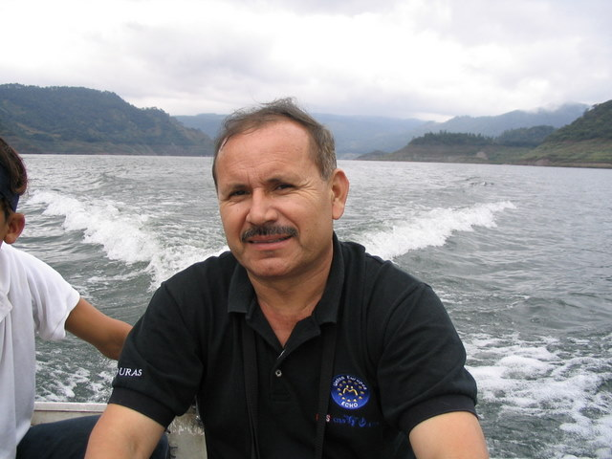
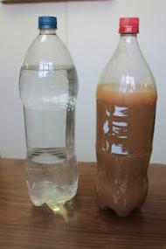
What can we do to treat the dirty water that we are providing to rural communities?
Notes:
What can we do to treat the dirty water that we are providing to rural communities?

Slide 4
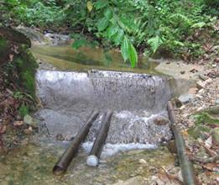
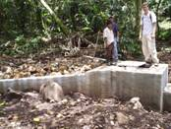
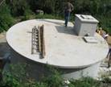
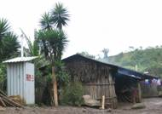
Gravity Water Supply
Drip Chlorinator
Distribution Tank
Spring box or dam

Slide 5
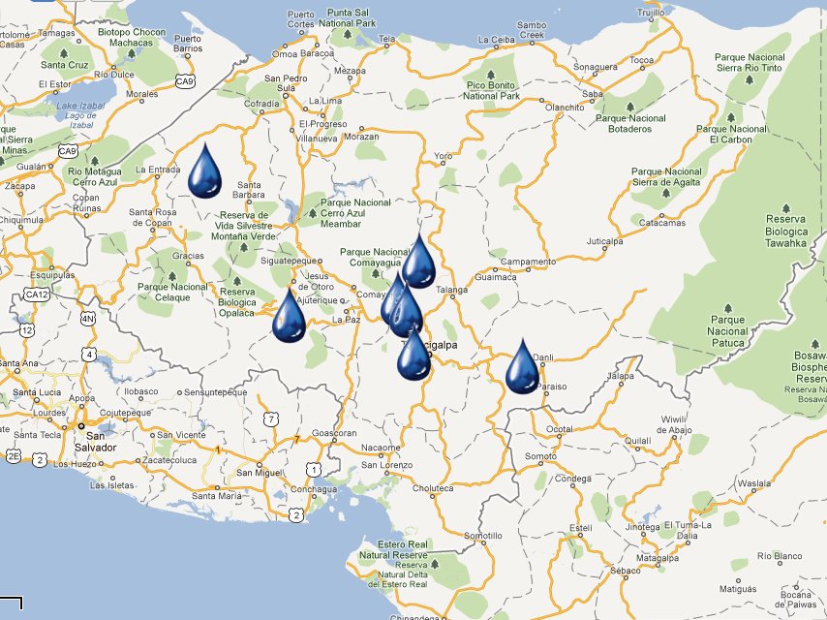



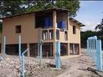



Since 2005:
AguaClara in Honduras
“Cuatro Comunidades” 2009
Atima 2012
Agalteca 2010
Tamara 2008
Marcala 2008/2011
Alauca 2011
Ojojona 2007

Slide 6
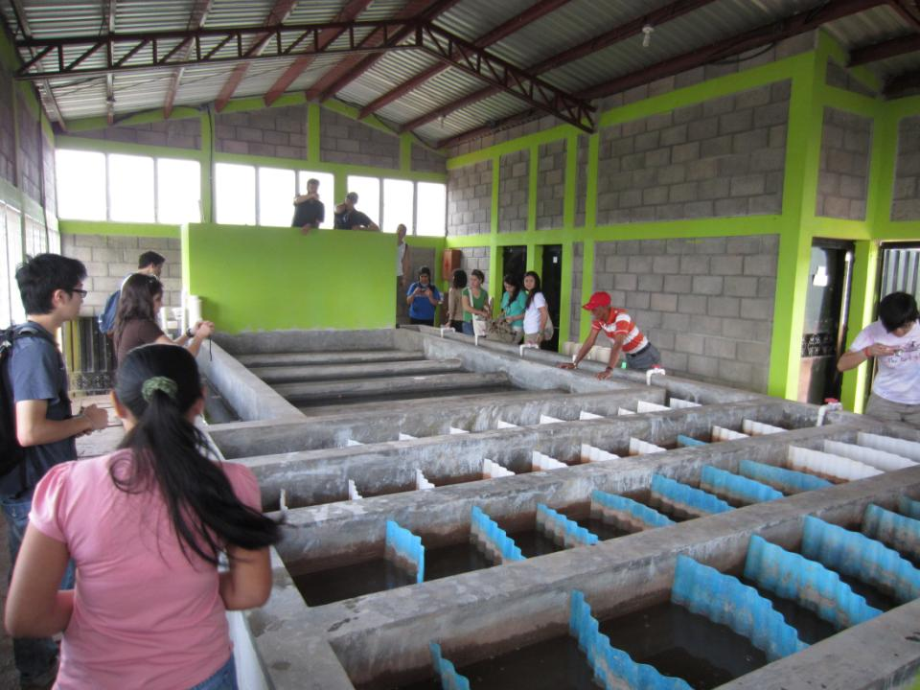

Slide 7
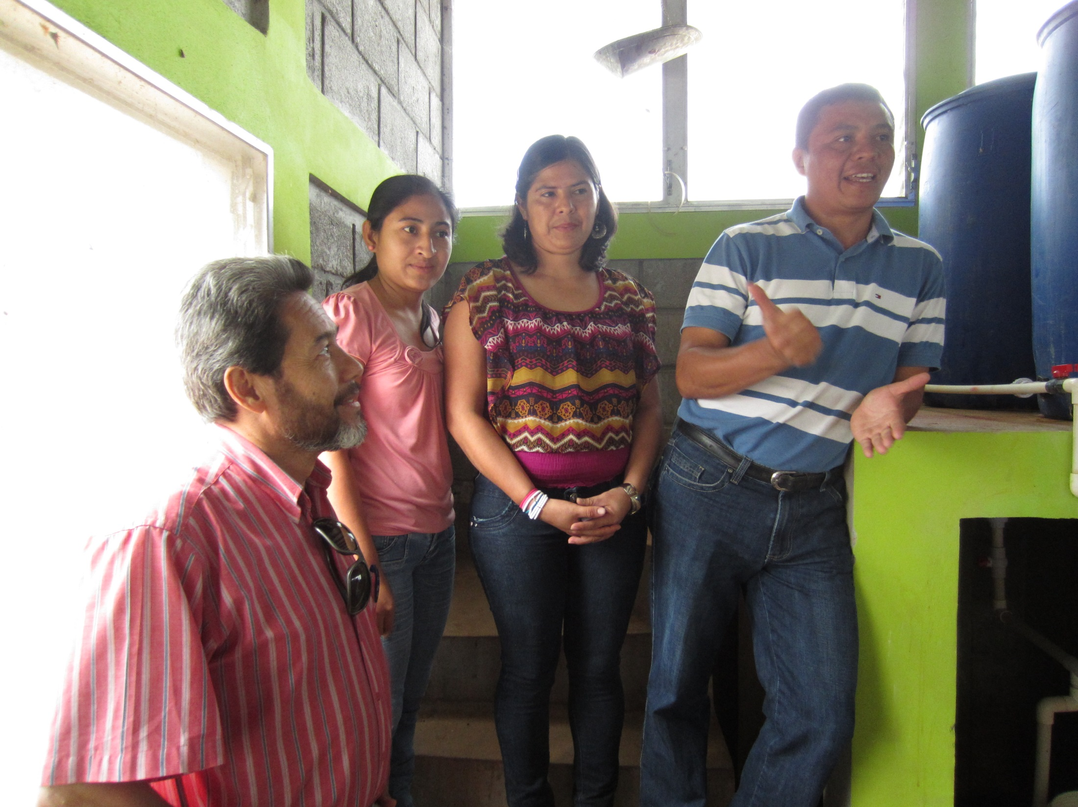
First Female AguaClara Plant Operators!

Slide 8
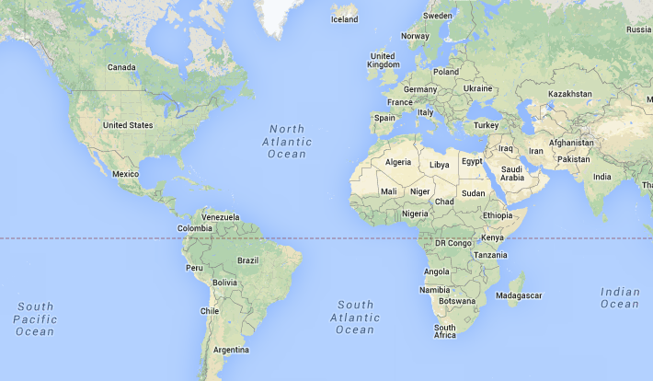
Since Fall of 2012
AguaClara: Wastewater
AguaClara LLC: Washington DC
Honduras: San Nicolas
India: Jharkhand

Slide 9



AguaClara LLC/PRADAN Solar Pumped System in Jharkhand, India
Water treatment facility
Minimum height for adequate pressure at highest tap
Maximum elevation change
Solar panels
Transmission Line Length
Pump control room
Minimum well water level

Slide 10
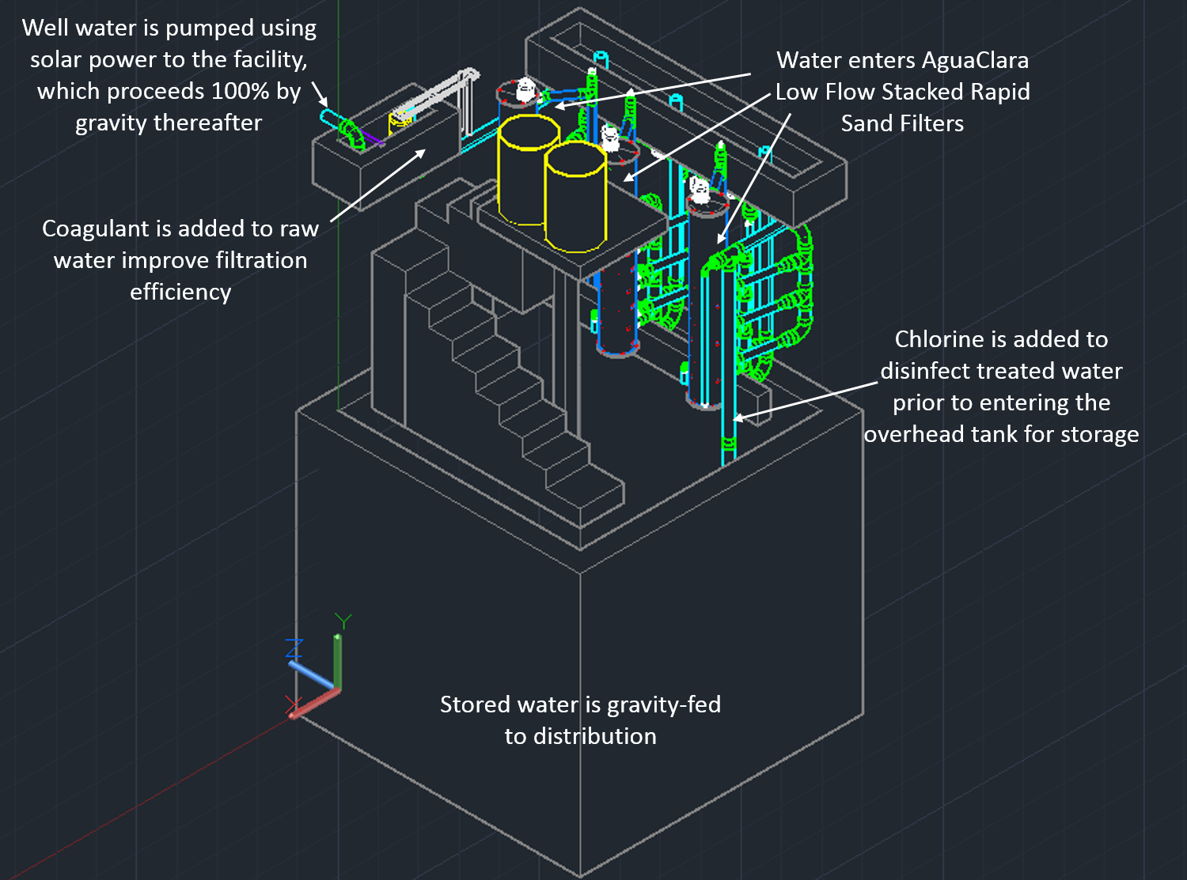

Slide 11
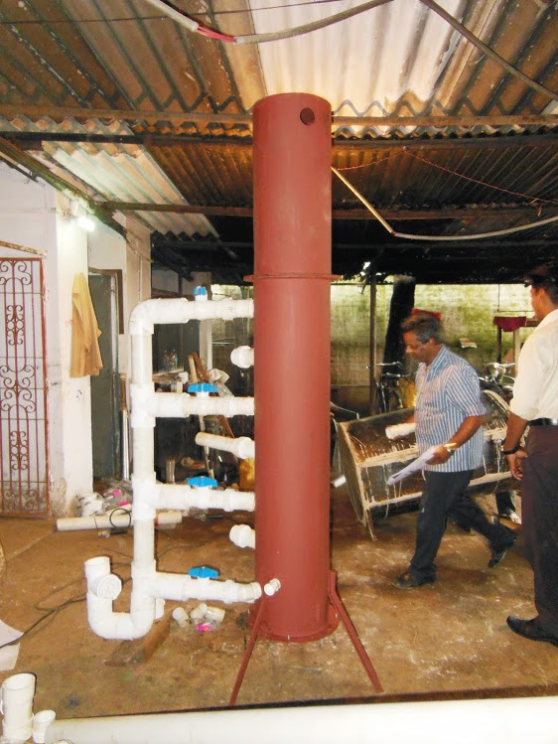

Slide 12
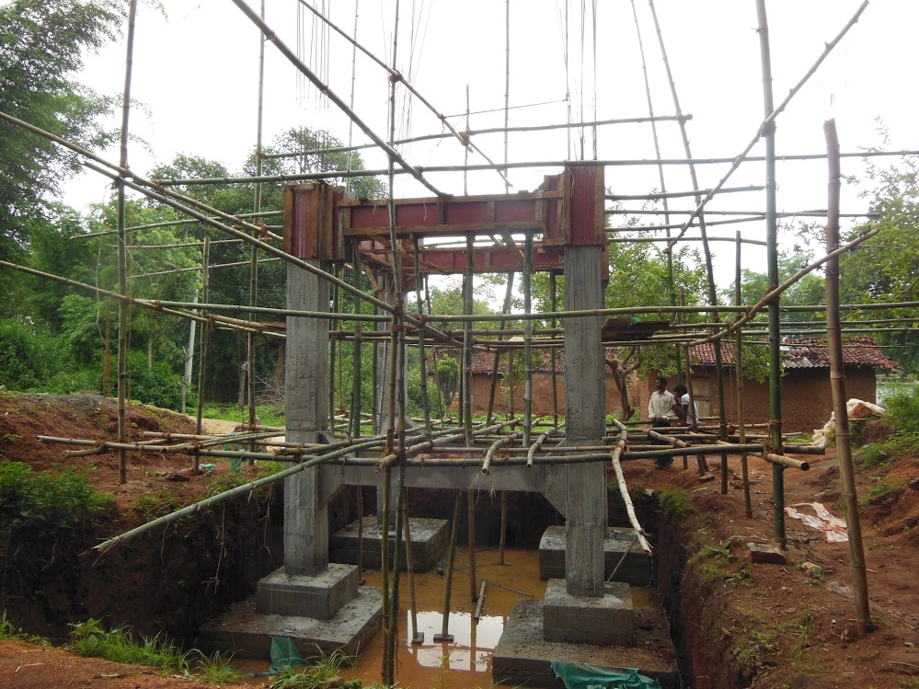

Slide 13
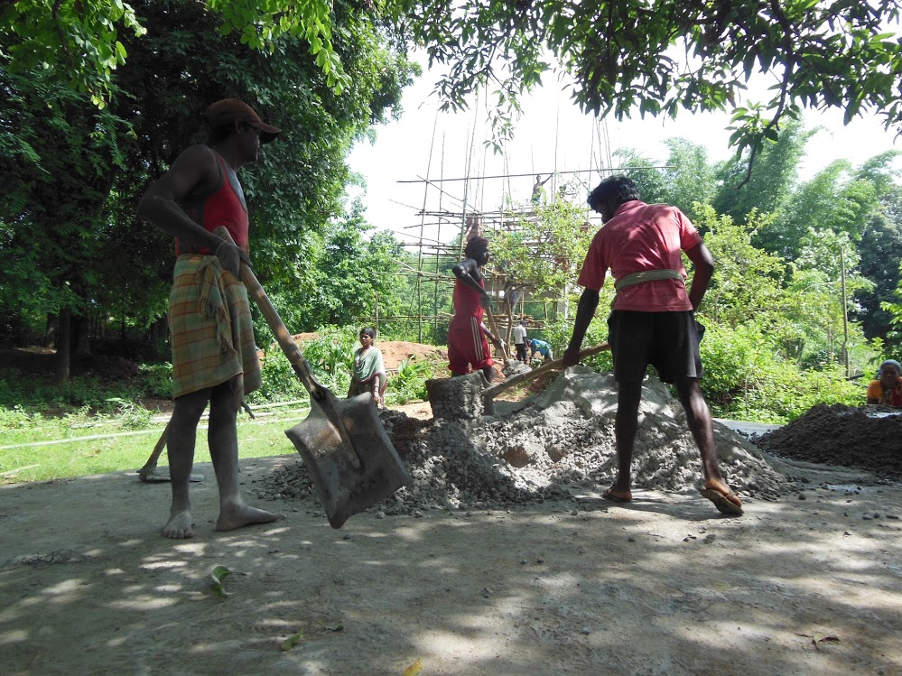

Slide 14
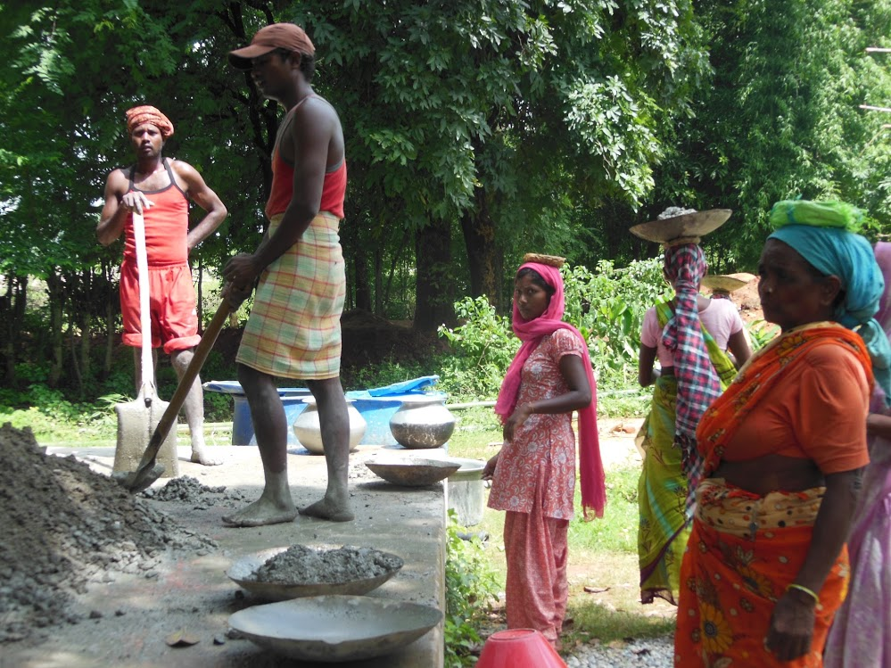

Slide 15
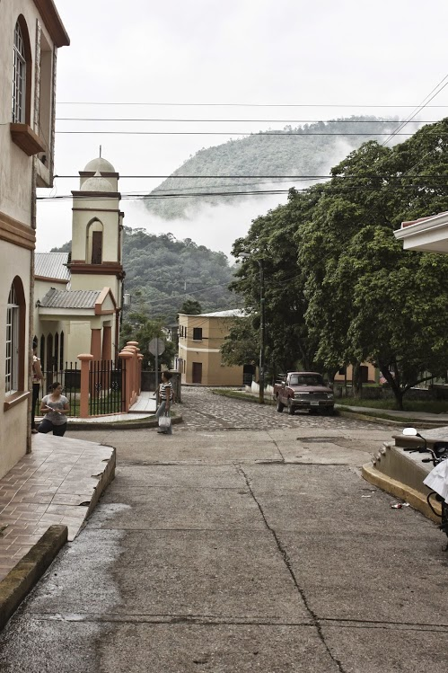

Slide 16
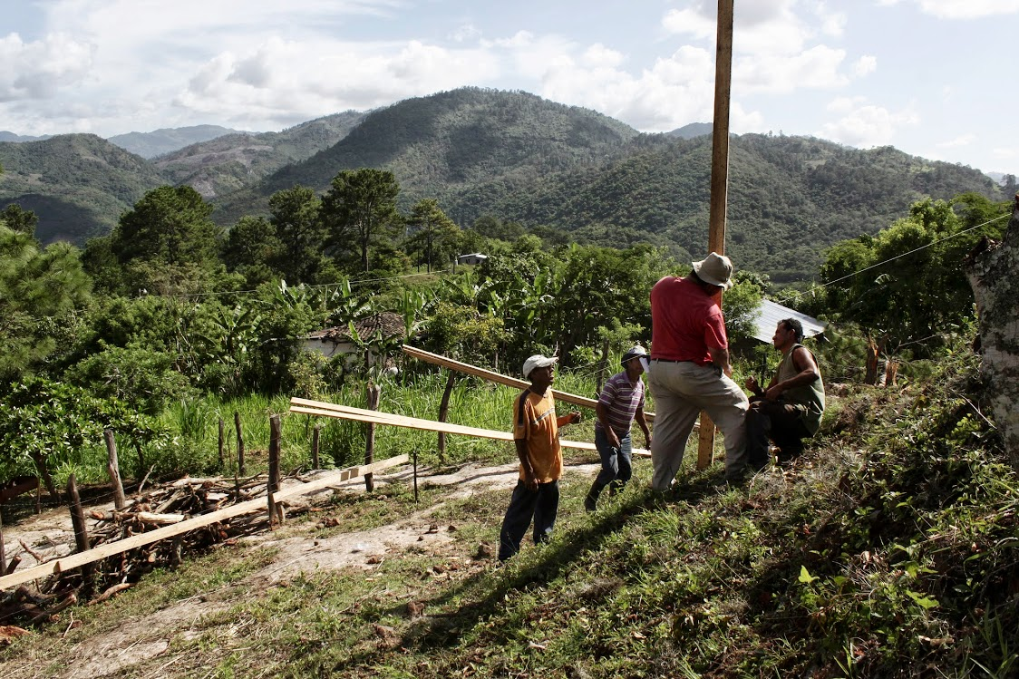
June 25, 2013

Slide 17
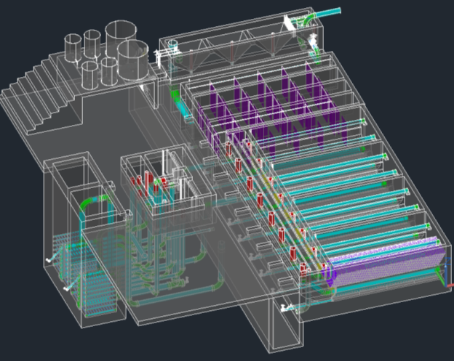

Slide 18
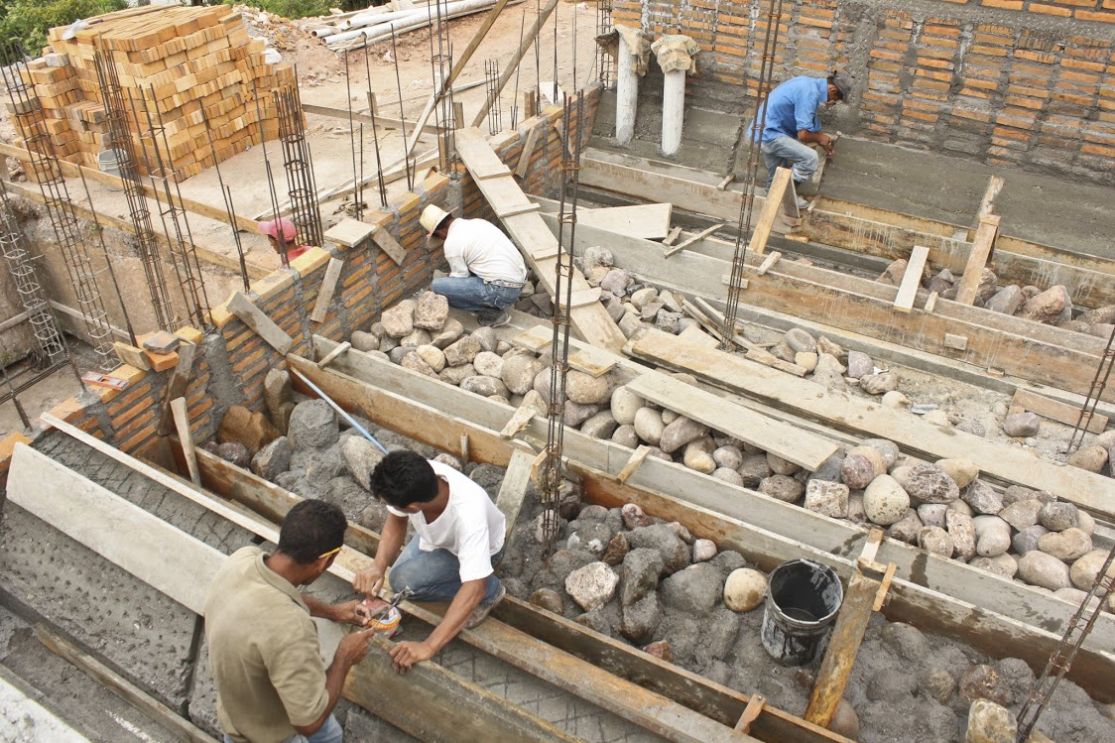
August 16, 2013

Slide 20
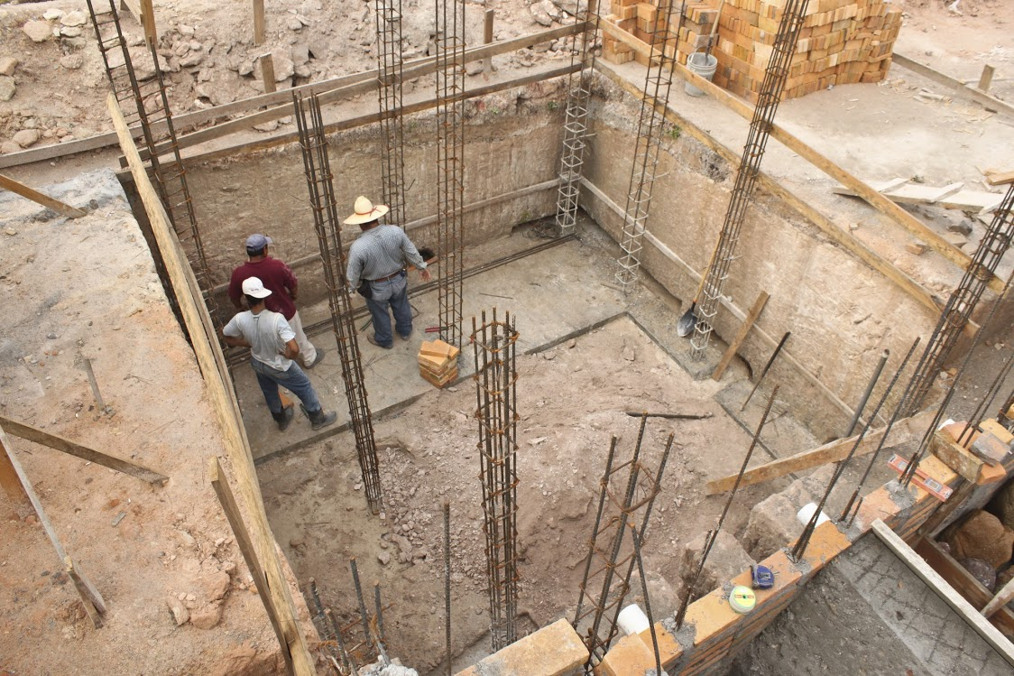

Slide 21
AguaClara Network
Investigation, innovation, education, and design
Cornell U
AguaClara R&D
AguaClara LLC
Technology Transfer, quality assurance, consulting services, and technical assistance for the implementation partners
Implementation Partners
Design/Build/Operate/Train/Transfer
Provide ongoing technical assistance for Water Boards
Water boards
Own, operate, maintain their water system. Monitor and upload performance data.
Community Members
Conserve water, drink safe water, and pay the tariff
Notes:
AguaClara Program at Cornell – R&D, new design and technology development. Note that Agua Clara plans to make their designs open source so cost for their proprietary designs is not an impediment to their adoption.
AguaClara Inc. – Proposed commercial entity which recruits and vets engineering and construction firms local to target communities (Implementation Partners, below), provides oversight and QA services, acts as a “face” to regional/local communities and as a go between with the AguaClara program as needed, and provides feedback to Cornell related to lessons learned and downstream technical requirements. In short, the “glue” between all entities.
Implementation Partners – Engineering and Construction firms in the target regions who will develop bids, sell services and build and deploy the plant and transfer support to local water boards.
Local Water Boards – Municipal entities who will “purchase” the build/deploy services from the Implementation Partner, and get funding from municipal/region/national sources for deployment of the plants.

Slide 22
Sharing understanding, feedback, and innovation
Cornell U
AguaClara R&D
AguaClara LLC
Implementation Partners
Water Boards
Community Members

Slide 23

AguaClara at Cornell
Research, Invent, & Design
Graduate Research
Fundamental physical chemical processes for enhanced drinking water & wastewater treatment
Capstone Design Course
CEE 4540: Sustainable Municipal Drinking Water Treatment
Project Based Courses
AguaClara: Sustainable Water Supply Project*
CEE 2550
CEE 4550
CEE 5051/5052
Summer Internships at Cornell
CEE 4560: Engineering in Context
2 week trip to Honduras during January intersession
Service & Learning
Learning & Service
Notes:
This is the “skeleton” of the AC program at Cornell, but not the human story – how this program provides a unique gateway for students into a world of high-stakes tech development an implementation appropriate to the challenges facing the Global South. High stakes because children are dying by the tens millions due to polluted drinking water– and because careful water management is rapidly ascending to the top of the list of critical global development necessities.
As you note, all the way through this Ppt, I am thinking about both the actual details (and organization) of the tasks you represent on the charts (how you would explain them to someone who has no prior knowledge of AC), and the human story that animates them all. We have to be very well prepared to talk about both to serious prospective donors.
---Gail

Slide 24
What question do you have about AguaClara?
Individuals come up with at least 2 questions
Teams of 3 answer each other’s questions
Left over questions?
We will take a few questions right now!

Slide 25
AguaClara is…
A philosophy of win/win/win for sustainability
Human AND environment friendly
Smart systems engineering
Sustainable systems
  Highly valued product – willing payment of tariff
  Technical support system
  Feedback loop for continual improvements
A third way (not lousy low tech, not hopeless high tech)

Slide 26
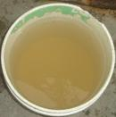
What is it like?
To wash dishes, clothing, children?
To try to keep your children healthy when the water is full of pathogens?

Slide 27
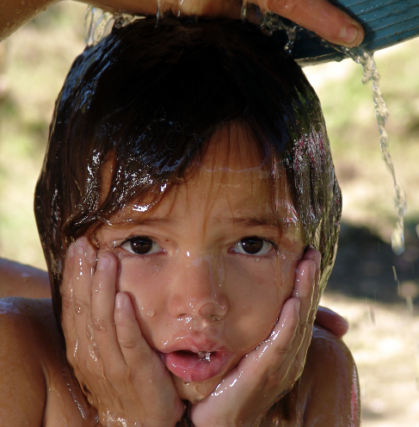
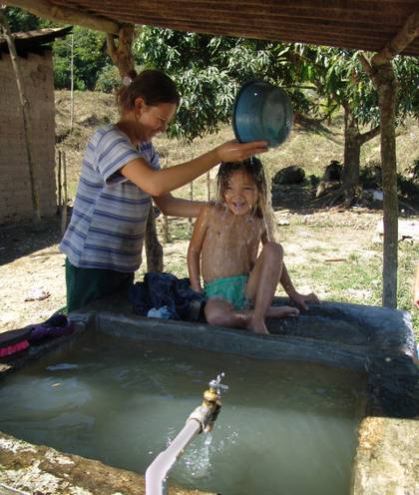
Why we do what we do...
AguaClara: Whenever possible provide local water treatment infrastructure rather than requiring every household to treat their own water

