Slide 1
Inspire
Monroe Weber-Shirk

Slide 2
What gives you a deep sense of satisfaction?
Knowledge, power, money, social status?
Do you feel pride from a job well done?
Do you have a sense of satisfaction from the beauty of a group of people working together to do something that none of them could have done by themselves?

Slide 3
What is Love?
Love is "the movement of the self toward the Other for the Good of the Other"
the Other is persons, non-human animals, the environment.
Good is "thriving."
--Dr. Andy Fitz-Gibbon, in Love as a Guide to Morals.
Andy Fitz-Gibbon suggests "loving relationships" rather than happiness is the goal of human life.

Slide 4
What is Engineering?
Creating an environment that enable humans to
  Thrive
  Meet our basic needs
  Live lives full of dignity
  Be healthy
  Be creative
  Live in community
And protecting the environment from the negative impact of humans

Slide 5
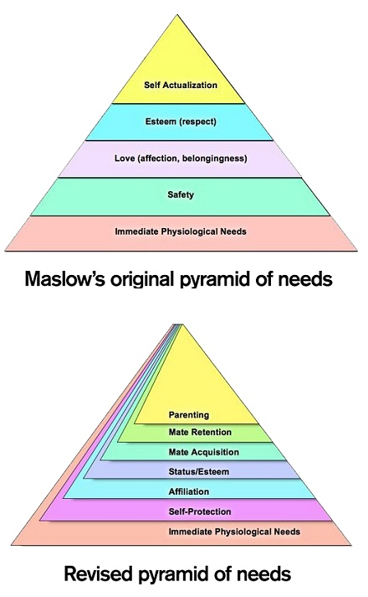
Abraham Maslow’s pyramid of needs
Where does our motivation for engineering come in?

Slide 6
Revised (Revised pyramid of needs (2010))
Where does our motivation for engineering come in?
Why do we want to make the world a better place?
I am motivated to create systems that improve the lives of others and that keep on working
Community
Notes:
http://psychcentral.com/news/2010/08/23/updated-maslows-pyramid-of-needs/17144.html

Slide 7
What is AguaClara Cornell doing?
Solving a problem identified by a community
Creating a network of organizations to scale the solution globally
Patenting the technologies
Designing an appropriate technology
Preparing to have students share new technologies in January
Solving a problem identified by a development organization
Working with a community to implement a solution
Sharing the technologies
Designing the best technology
Preparing to have students build a water treatment plant in January

Slide 8
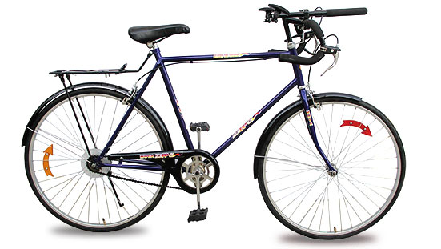
RIDE
We seek to understand the physics (Research)
We Invent new technologies to take advantage of the physics
We codify that understanding in our Designs
We Empower partners to use those Designs to make the world a better place (no patents!)
And we do this all in teams…

Slide 9
Hope, optimism, meaning, and make the world a better place
Working to improve the lives of others leads to hope
Hope motivates working to improve the lives of others
Working in teams, building community (and networks of organizations), respect for the other, and servant leadership are important elements of this cycle of hope

Slide 10
We are optimists
We can steer the universe by leaning in the direction we want to go
We take the long view: changing the way engineers think about water treatment will take time
  We arrived at 2005 with 100 years of empirical water treatment plant designs
  We are less than a decade into creating a new research and design paradigm

Slide 11
We don’t give up easily!
“Do not lose hope. We work in India through obstacles all the time. These are not tough ones.
We shall certainly pilot AguaClara in India -- be it in [this state] or another state...”
-A senior environmental engineer in India

Slide 12
Plant Performance: without filters
5
0.3
A profound change in the well-being of a community that is self perpetuating!

Slide 13
Tamara with the First Stacked Rapid Sand Filter
5 NTU
What will happen when we combine well designed sed tank with a SRSF in San Nicolas?

Slide 14
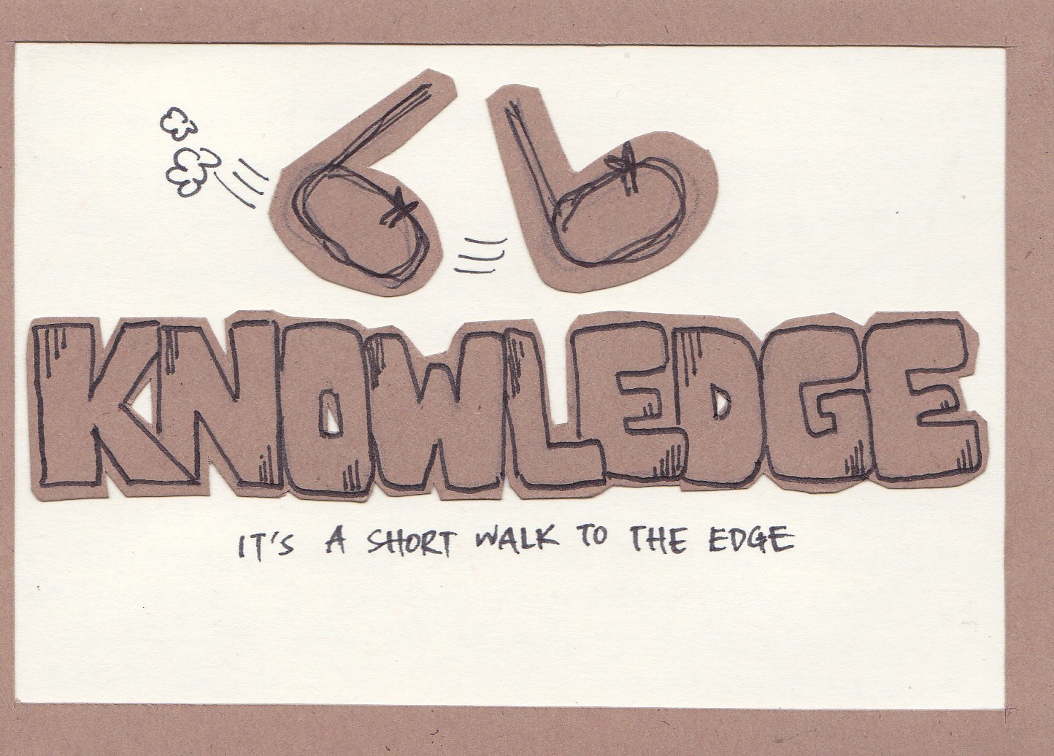

Slide 15
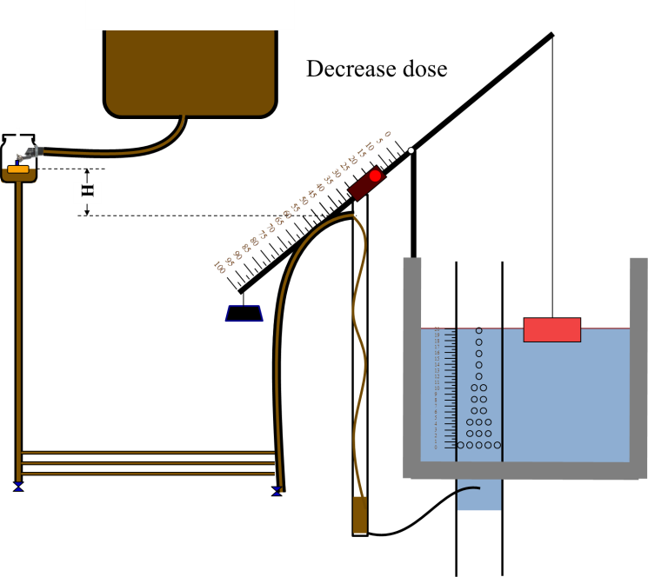
AguaClara expanded knowledge - Chemical Dose Controller
First gravity powered chemical dose controller
Easier to operate and maintain than the “high tech” computer controlled chemical pump

Slide 16
AguaClara expanded knowledge - Flocculation
New theory for why coagulants are sticky
First hydraulic flocculator design that accounts for turbulence
First predictive performance model for hydraulic flocculators
High rate flocculators with a residence time of about 10 minutes

Slide 17
AguaClara expanded knowledge - Sedimentation
First shallow sedimentation tank
First sedimentation tank designed to resuspend all particles to create a floc blanket
Reduced plate settler spacing to reduce plate settler depth by a factor of 2
Residence time in the sedimentation tank of only 30 minutes

Slide 18
AguaClara expanded knowledge - Filtration
Highest rate sand filtration system
First use of slotted pipes to inject water to be filtered into the sand bed
First use of airlock to control backwash siphon on a full scale filter

Slide 19
AguaClara expanded knowledge - Design
First automated parametric design of a water treatment plant
First web based design tool that produces customized designs based on user inputs

Slide 20
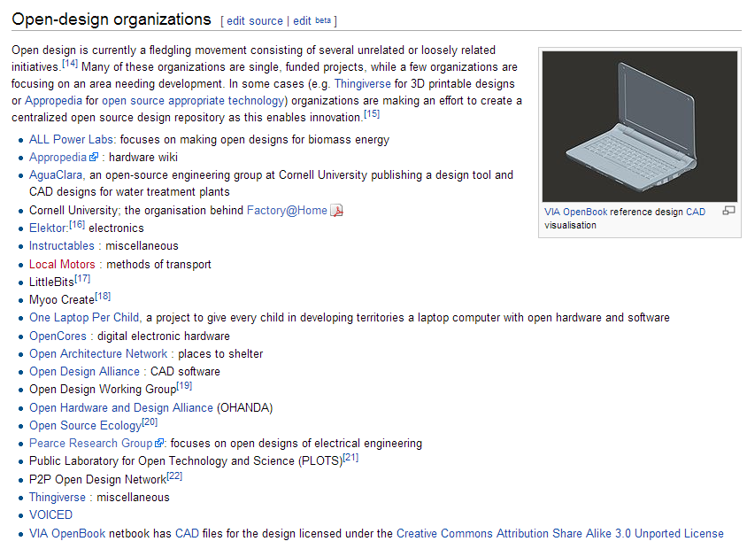
AguaClara expanded knowledge – Open Source
First engineering program that is open source

Slide 21
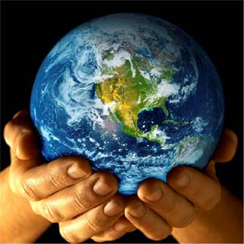
So, we want to change the world
Are we a drop in the bucket?
  One drop is 20 μL – one bucket is 20 L (factor of 1 million)
  Our goal is to improve the lives of about 3 billion
  We’ve changed the lives of 30,000
  Factor of 100,000
AguaClara is already 10 drops in a bucket!!!!!
Almost 10 years to get to 10 drops (1 drip per year)
999,990 drops to go… What’s our strategy?

Slide 22
So where are we taking the universe?
Which direction are we going to lean?
We arrive at 2013 based on choices we made in 2006
Where do we want AguaClara to be in 2020?
  Dream
  Work in groups of 2 or 3

Slide 23
Mission Statement – needs to be revised!
AguaClara is a program in Civil and Environmental Engineering at Cornell University that is improving drinking water quality through innovative research, knowledge transfer, Open Source Engineering and design of sustainable, replicable water treatment systems.
^
and wastewater

Slide 24
Vision
AguaClara Cornell will become a global center of excellence for creating and disseminating sustainable drinking water & waste water treatment technologies and for pioneering engineering education that empowers students to engage with and solve global challenges.
Notes:
AguaClara is a program in Civil and Environmental Engineering at Cornell University that is improving drinking water quality through innovative research, knowledge transfer, Open Source Engineering and design of sustainable, replicable water treatment systems.

Slide 25
Monroe’s Philosophy – a work in progress
Labor that improves the life of a community leads to happiness and satisfaction. (sharing is more fun)
Wisdom is in the group, power is in the community, ideas come from a network
I make mistakes. My goal is to learn from them.
Positive Energy – optimism - gratitude
  Surround yourself with people who can dream
  Dreaming makes it possible to create a new reality
Don’t burn bridges
You always have a choice – use it!
Exceed Expectations
Identify a need and then invent

Slide 26
Types of Teams
High-Performing
Cooperative
members
team
Cooperative
Performance Level
Traditional
Pseudo
Types of Teams

Slide 27
High-performance Team
Outperforms all reasonable expectations, given its membership
High level of commitment
Mutual concern for each other’s personal growth
Achieve high-performance and also have lots of fun
When you meet with your team later this week REFLECT together on how your team is performing

Slide 28
AguaClara as a team?
I’ve always thought of teams as the subteams working on a well defined task
But we can vary the scale. Let’s zoom out…
AguaClara Cornell
AguaClara (APP-Honduras, Pradan-India, AguaClara Cornell, AguaClara LLC, Water boards, and communities)
Where is the AguaClara team?

Slide 29
Two Challenges
To become a VERY HIGH PERFORMING TEAM
AND MAKE the WORLD a BETTER PLACE

Slide 30
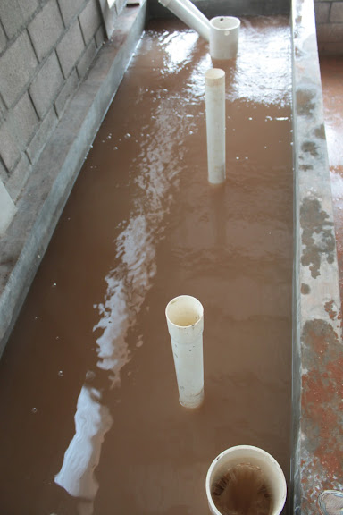
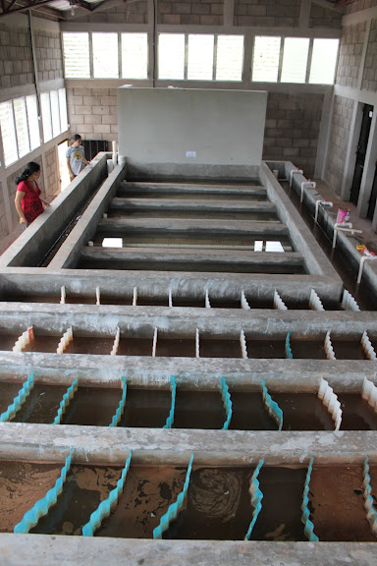
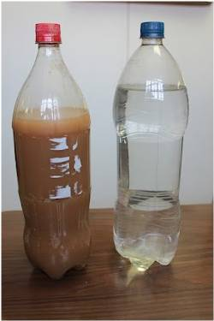
Clean that water!

Slide 31
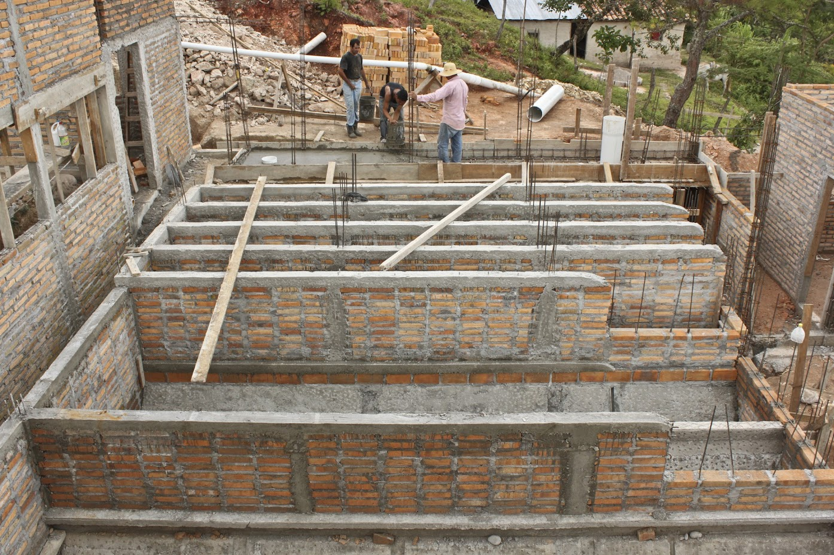
San Nicolas

Slide 32
