Slide 1

Materials List
Annie Ding
03/11/13

Slide 2
Purpose
Calculate the amount and cost of materials needed to build a design requested from the server.
Useful for cities looking into getting a plant and construction teams.

Slide 3
Materials
Hydraulic design materials:
Pipes
Pipe ﬁttings
Sheets for ﬂocculator baﬄes
Sedimentation plate settlers
Chemical dose controller pieces
Structural design materials include but are not limited to:
Brick
Rebar
Cement for plant walls
River rock for entrance tank hoppers

Slide 4
Optimizing Pipes
Overall outputs:
  Matrix with the number of lances (6.1m lengths of pipes sold in Honduras) of each pipe specification and nominal diameter needed to build plant.
  Matrix with the lengths we can cut out of individual lances

Slide 5
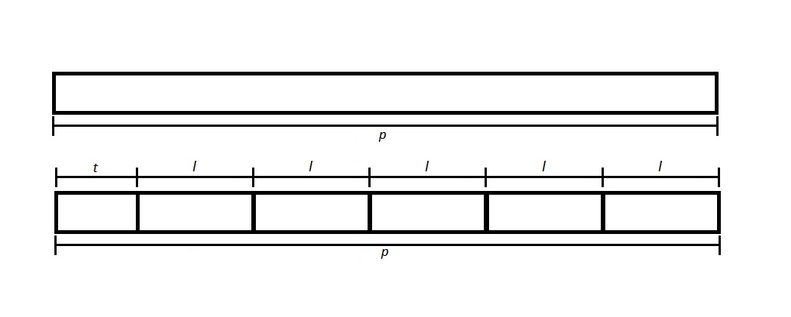
For Pipes Longer than a Lance

Slide 6
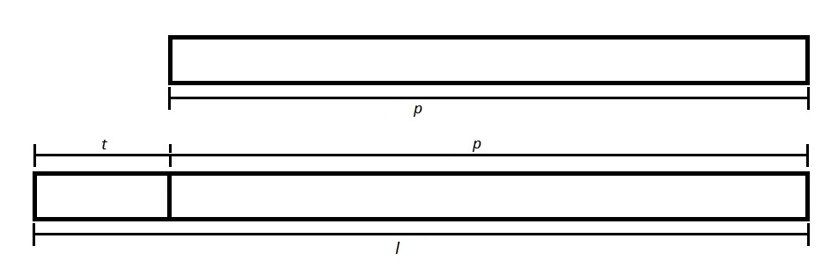
For Pipes Shorter than a Lance

Slide 7
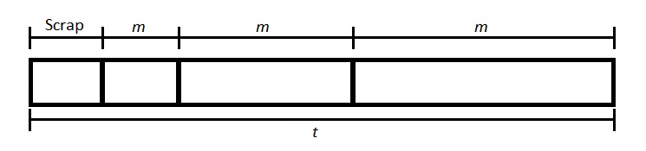
Getting as much out of a lance as possible (cutting stock problem)

