Slide 1

Entrance Tank High Flow Modifications
Bonnie Schiffman and Brooke Pian

Slide 2

Major Adjustments Needed
Flow measurement: LFOM pipe to sheet
Dosing location
Rapid mix: Pipe to channel

Slide 3
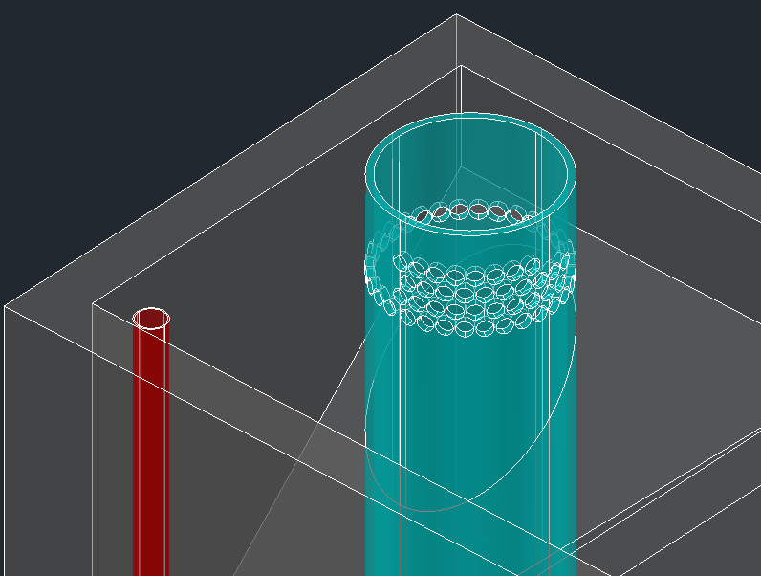
Previous LFOM Changes
Problem: at higher flow rates the LFOM pipe required is too large to be easily found, affordable, and easily used during the construction process in Honduras
Current 90 L/s LFOM design
Research by Tori Klug, 2012
Notes:
to allow for a linear relationship between height of water in the entrance tank and plant flow rate is
39 L/s LFOM – 15 in

Slide 4
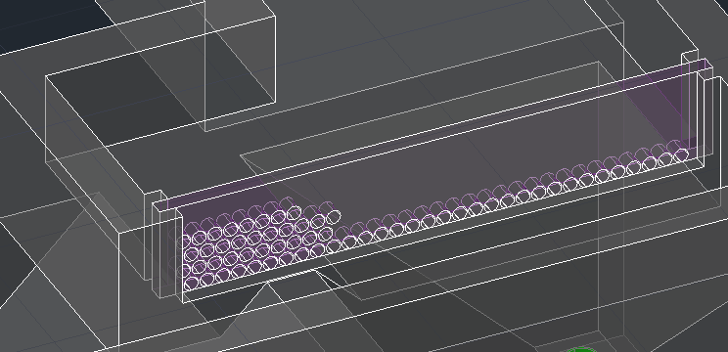
Previous LFOM Changes
Solution: transition to an “LFOM Channel,” or a concrete channel with orifices
  Length of channel determined by number and size of orifices needed in the bottom row of the LFOM
Proposed 90 L/s LFOM Channel design
Research by Tori Klug, 2012
Notes:
LFOM channel design code in the making

Slide 5
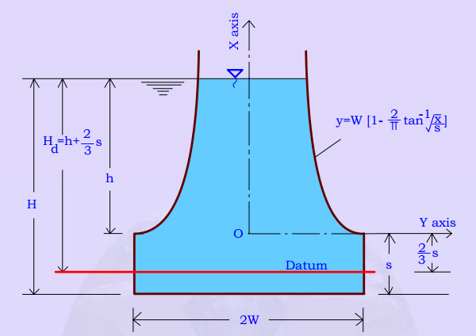
Previous LFOM Changes
Problem: length required for an LFOM channel exceeds length of an entrance tank hopper at approximately 125 L/s
Solution: transition to a double-sided LFOM channel or a Sutro Weir channel (i.e. a channel with a Sutro Weir cut into a plastic sheet on the side)
Sutro Weir with governing equations
Research by Tori Klug, 2012
Notes:
LFOM channel design code in the making

Slide 6
Goals
Design for macro-mixing
Design for micro-mixing and rapid mix channel geometry
Determine transition from LFOM to LFOM channel, and Sutro Weir channel
Assess the option of a double hopper entrance tank
Evaluate the entrance tank constraints with respect to changes in sedimentation tank geometry for high flow rates

Slide 7
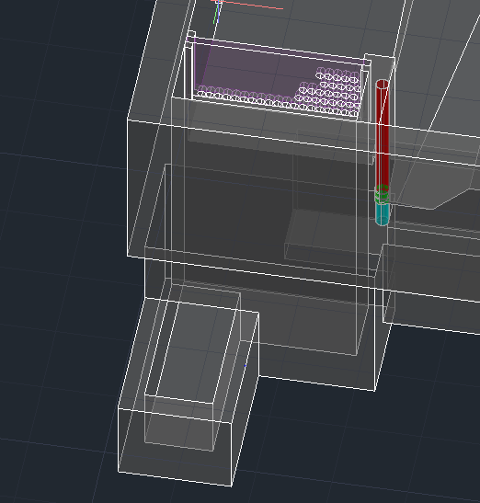
Tori’s Design

Slide 8
Our Schematic
LFOM sheet
Macro-mixing
Micro-mixing

Slide 9
LFOM Channel
Length of channel and macro-mixing location, allowing for a 10 cm safety factor
Depth of channel
Macro-mixing constraints to determine diameter of macro-mixing orifice

Slide 10
Schematic
LFOM sheet
Macro-mixing
Micro-mixing

Slide 11
Rapid Mix Channel
Geometry of channel, with human hip width constraint
Micro-mixing orifice sheet location, number and diameter of orifices
Minimize head loss

