Slide 1
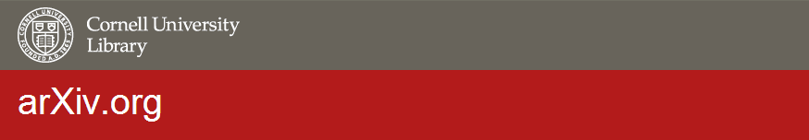
arXiv Member Advisory Board
Introductory Meeting
March 2013
Oya Y. Rieger
rieger@cornell.edu
Notes:
Good afternoon.
It is a great pleasure to be participating at the 7th SPARC Japan Seminar.
I want to sincerely thank the National Institute of Informatics for inviting me to speak at this forum.

Slide 2
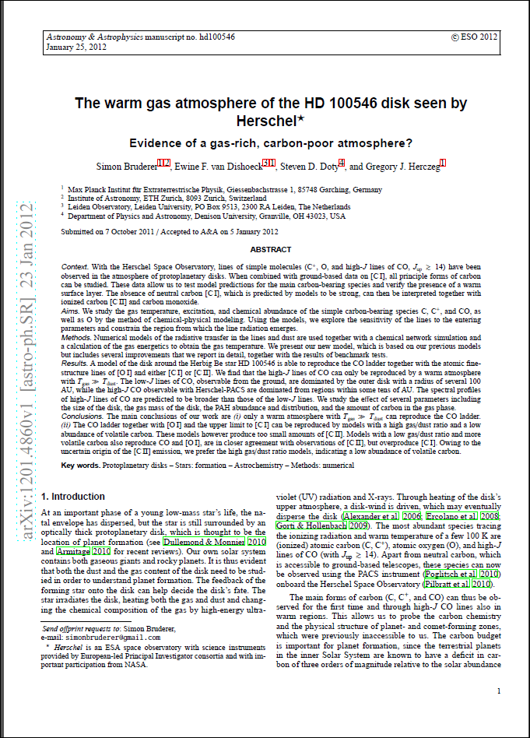
established in 1991 by
Paul Ginsparg
has been hosted at Cornell
since 2001
includes 824,000 e-prints
2012
  84,603 new submissions
  ~50 million downloads
Notes:
arXiv was established in 1991 by Paul Ginsparg and has been managed by the Cornell University Library since 2001.
As of January 2013, arXiv included 814,000 e-prints.
In 2012 there were 84,603 new submissions and close to 50 million downloads from all over the world.
The total submission in 2011 was 76,587. This represents more than a 10% percent increase in submissions in one year.

Slide 3
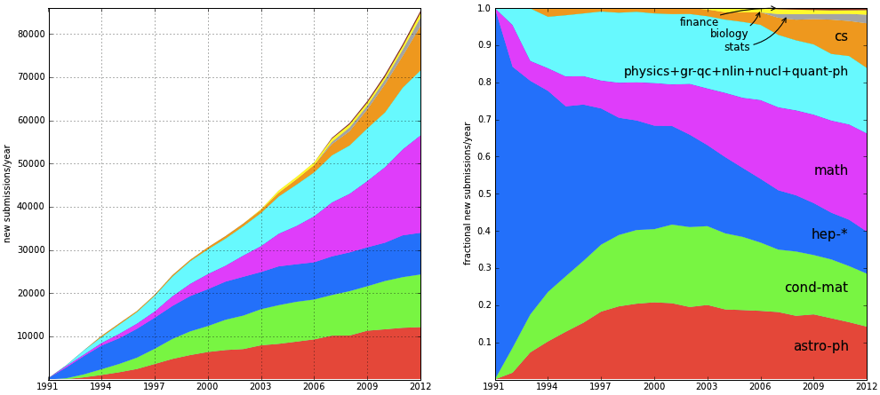
arXiv Growth (1991-2012)
arXiv Annual Submissions
arXiv New Submission Rate
Notes:
Here are two graphs to illustrate how arXiv has been growing since 1991.
The colors indicate different subject areas.
The first one is growth by submission and you can see that it is still climbing.
The second one shows the submission rates by fraction.
It illustrates how the arXiv community is growing and adding different fields, not limited to physics.
You will notice that high energy physics submissions have reached a steady growth rate whereas math and computer science domains are growing.

Slide 4
2012 Submission Rates by Fields
Math (22565): 26.7%
Condensed Matter (12184): 14.4%
Astrophysics (12121): 14.3%
Computer Science (10236): 12.1%
High Energy Physics (9636): 11.3%
Physics (6545): 7.7%
Quantum Physics (3767): 4.5%
General Relativity & Quantum Cosmology (2057): 2.4%
Nuclear Experiment & Theory (1829): 2.2%
Statistics (1284): 1.5%
Qualitative Biology (1057): 1.2%
Nonlinear Sciences (839): 1.0%
Quantitative Finance (483): 0.6%
Notes:
Here are the 2012 submission rates for different subject domains.
Top three fields are:
Math (22565): 26.7%
Condensed Matter (12184): 14.4%
Astrophysics (12121): 14.3%

Slide 5
Projected Expenses (2013-2017)
2.25 FTE + 0.36 student
0.50 FTE
1.58 FTE
Notes:
arXiv’s operating costs for 2013 are projected to be approximately $600,000, including six FTE staff, server maintenance, and networking.
First category, is staff expenses including management, programming, and user support. For instance, for 2013, we are estimating to spend $537,000 for staff salaries.
Second category, is other direct costs: The budget also include server and networking costs and other staff expenses such as training. For example, for 2013, we have budgeted $74,000 for this group of expenses.
Third category, indirect costs. We factor in that represent expenses such as facilities maintenance, administration, legal services, etc. The indirect expenses for 2013 is $226,000.

Slide 6

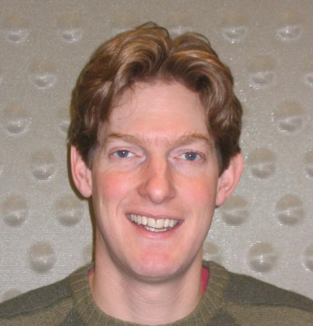
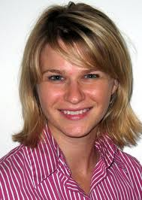
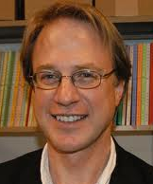
arXiv Organizational Chart
Kenney, University Librarian *
Resolve disputes between CUL, MAB, SAB as they relate to CUL’s responsibilities
Determine termination and need for transition strategy
Rieger, Program Director (15-20%) *
Oversee the arXiv program (user support, IT, and membership)
Foster a transparent and open communication strategy
Identify and develop policies relevant to arXiv operation, preservation, and sustainability
Take the lead in business planning
Warner, IT Lead (30%)
Porciello, Membership Program Lead *
(10%)
Ruddy, User Support Lead (20%)
Operate arXiv’s technical infrastructure Provide interfaces and data access to support open reuse of arXiv data;
  Implement archiving strategies
  Establish and maintain partnership with related initiatives
  STAFF – Shawn Bower, Peter Halliday, Martin Lessmeister (25%)
Oversee arXiv’s user-support, moderation, and administration processes
Working with SAB in developing new policies and procedures
Oversee the moderation process, including resolving problem cases
STAFF –Don Beyer, Laura Jones, Jake Weiskoff
Manage the arXiv membership program
Maintain and communicate information about sustainability program
Participate in other fund raising efforts to diversify arXiv’s revenues
Last updated: April 29, 2012
* Included in CUL’s indirect contributions
Notes:
Here is an organizational chart for the arXiv team at Cornell:
As the program director, I report to the University Librarian and spend almost 20% of my time managing arXiv.
As the program director, my role is to oversee our team and facilitate collaboration.
Simeon Warner leads the IT team at 30% capacity.
Jaron Porciello manages the membership program at 10% capacity.
David Ruddy oversees the arXiv’s user support staff at 20% capacity.
You will notice that all the leads are working part-time on this project as they are involved in other library programs too. arXiv team is embedded in the general library program. For instance, David also oversees the user support and policy aspects of the library’s institutional repository, archival repository, and Euclid (math publishing project).

Slide 7
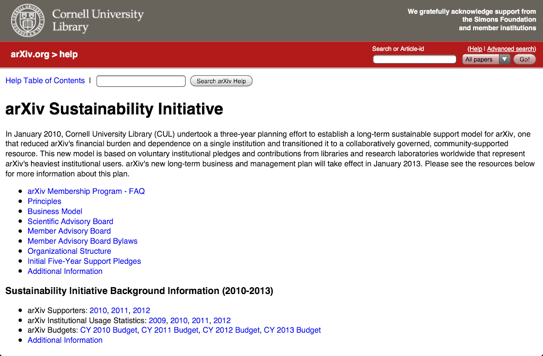
http://arxiv.org/help/support
Notes:
After this brief description of arXiv, now I would like to talk about the arXiv sustainability initiative.
Scholars worldwide depend on the stable operation and continued development of arXiv.
So arXiv’s sustainability strategy aims to reduce arXiv's dependence on Cornell, on a single institution.
The goal is to create a broad-based, community-supported resource.
Since January 2010, Cornell University Library (CUL) has undertaken an effort to establish a sustainability model for arXiv. We are grateful for Jun Adachi’s active participation in the planning process.
I would like to share with you the new sustainability model, which is the outcome of the 3-year planning efforts.

Slide 8
Membership Program
Engage libraries and research laboratories worldwide that represent arXiv's heaviest institutional users in arXiv's support and governance
Each member institution pledges a five-year initial funding commitment to support arXiv
Notes:
We developed a membership model to engage libraries and research laboratories worldwide that represent arXiv's heaviest institutional users in arXiv's support and governance.
We ask each member institution pledges a five-year initial funding commitment to support arXiv. This is not a legally binding obligation. It is only a good faith statement to support arXiv.

Slide 9
Business Model, 2013-2017
Cornell University Library
  $75,000 per year in support of operational costs
  in-kind contribution of all indirect costs (37%)
Simons Foundation
  $50,000 per year
  $300,000 per year matching grant
Member Institution
  annual fees within $1,500-3,000 range (based on usage ranking)
Notes:
The business model for 2013-2017 is composed of four sources of revenue:
Cornell’s annual funding of $75,000 per year and indirect expenses (represents 37% of direct expenses)
$50,000 per year gift from the Simons Foundation, which is a non-for-profit scientific organization
annual fee income from the member institutions - Based on institutional usage ranking, the annual fees are set in four tiers within the $1,500-3,000 range.
In addition, $300,000 per year challenge grant from the Simons Foundation based on the revenues generated through membership payments
The substantial gift from the Simons Foundation aims to encourage long-term community support by lowering arXiv membership fees. We want to make participation affordable to a broad range of institutions.

Slide 10
Notes:
arXiv’s governance model focuses on the top 200 academic and research institutions that are heavy users of arXiv.
In our membership model, we decided to partner with universities and research laboratories because we are stewards of information and support learning, teaching, and research activities.
As you can see from this chart, arXiv has users from all over the world and Cornell is ranked as #25 among US edu domain users.
A quarter of the institutional users are coming from the US and then the next top users are Germany, UK, Japan, and France. 7% of usage is coming from Japanese institutions. This chart represents only the top 200 heavy using institutions.

Slide 11
2013
Distribution of
arXiv Members
5-Year Pledges
134 members
21 countries
$307,500 in membership fees
Notes:
This pie chart shows the distribution of membership for 2013-2017.
So far, from our list of top 200 institutional arXiv users, 134 of them became members and pledged their support.
This represents 21 countries and $310,000 in membership fees.
Simons Foundation will be matching up to $300,000 so this means $610,000 in revenues.

Slide 12
Cornell University Library
Manages the moderation of submissions and user support
Operates arXiv’s technical infrastructure
Ensures long-term access
Establishes and maintains partnerships
Assumes financial responsibility
Maintains transparent and open communication
Provides legal protection
Scientific Advisory
Board
Member Advisory
Board
Provides advice and guidance pertaining to the intellectual oversight of arXiv
Oversees arXiv's moderation system
Reviews the criteria and standards for deposit in arXiv
Proposes new subject or discipline domains
Advises CUL on issues related to:
repository management and development
standards implementation & interoperability
development priorities
business planning
outreach and advocacy
Notes:
At the center of the sustainability initiative was to clearly define arXiv’s goals and management structure.
Here is a diagram of arXiv’s governance structure:
CUL holds the overall administrative and financial responsibility for arXiv’s operation and development
Strategic and operational guidance comes from its Member Advisory Board and its Scientific Advisory Board.
SAB is composed of scientists and researchers in areas covered by arXiv. It provides advice and guidance pertaining to the intellectual oversight of arXiv.
MAB is elected from arXiv’s membership. The group advises CUL on issues related to repository management and development, standards implementation, interoperability, development priorities, business planning and financial planning.
We just formed a new Member Advisory Board through an election process and the information is available on the arXiv sustainability website.

Slide 13
Principles for Sustainability
Deep integration into academic community and scholarly processes
Clearly defined mandate & governance structure
Technology platform stability and innovation
Systematic development of content policies
Reliance on business planning strategies
Notes:
Based on Cornell’s experience in planning the future of arXiv, I would like to propose five sustainability principles.
I hope that these principles can be generalized and be useful for other open access initiatives.

Slide 14
Repository Architecture
Discovery and Access
Submission, Moderation, Quality Control
Interoperability with Related Systems
Scientific Cultures
&
Other Stakeholders
Financial Stability
SUSTAINABILITY
Notes:
In conclusion, I would like to stress the importance of understanding and addressing the business aspects of open access scholarly communication systems.
The arXiv case study illustrates the need to manage repositories broadly by taking into consideration a range of lifecycle and usability issues. We also need to factor in changing patterns and values of scholarly communication ecology.
With the increasing emphasis on open science and open data, we must consider the sustainability requirements upstream and remember that the services we are experimenting and creating now have long-term implications.
Viewing scientific repositories as business enterprises will ensure that the emerging scholarly communication structures and practices will be effective, efficient and enduring.

Slide 15
arXiv Roadmap https://confluence.cornell.edu/display/culpublic/2013+arXiv+Roadmap
Technical
User Support & Moderation
Governance
New Partnerships & Communication

