Slide 1
Stacked Rapid Sand Filter Theory (SRSF)
Spring 2014
Tanya Peifer
Valerie Shao

Slide 2

What is SRSF?
Stacked Rapid Sand Filter/Filtration
Invented by AguaClara and is currently used in the newer plants
Subsurface Water Injection
Notes:
Tanya

Slide 3
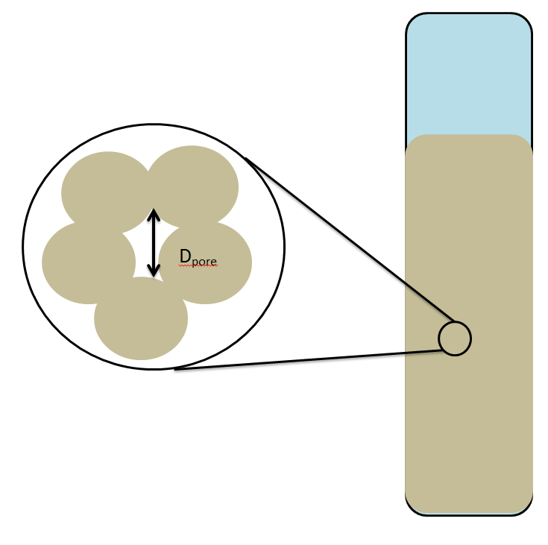
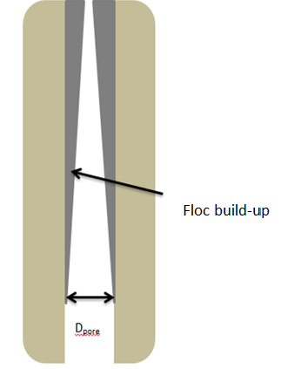
Why Are We Here?
Flocs build-up in sand pores, causing:
  An increase in
    Head loss
    Shear force
    Water velocity
  A decrease in
    Pore diameter
Notes:
Tanya

Slide 4
Semester Challenge
Determining the relationship between mass added into system and its effects on head loss and effluent turbidity within the filter column
Creating a mathematical model defining this relationship
Determining the minimum Dpore at each concentration of PACl
Notes:
Tanya

Slide 5
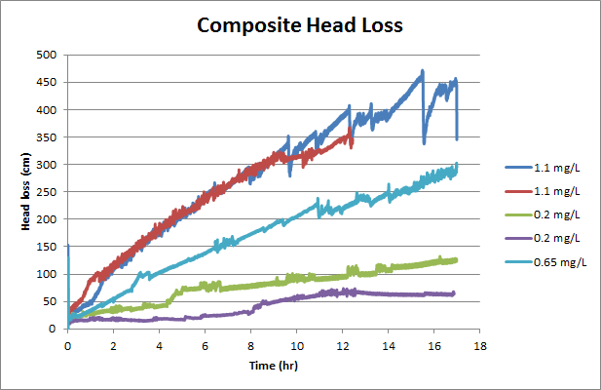
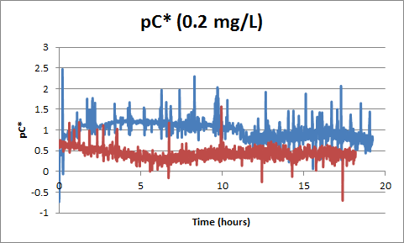
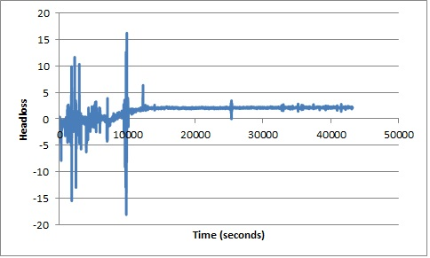
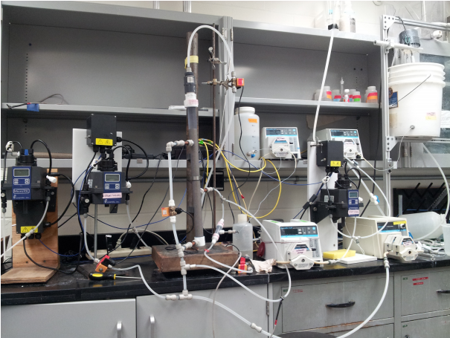
Pre-Symposium Recap
Running experiments for 17-24 hours and recording head loss, influent turbidity, and effluent turbidity
From this collected data, we graphed specific relationships to analyze and observe any potential trends.
Notes:
Val

Slide 6
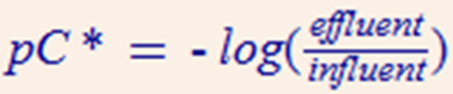
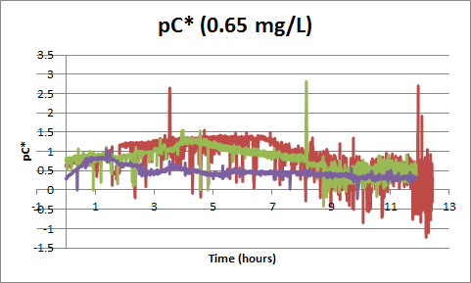
Performance Curves
Higher values denote higher efficiency
Notes:
Val
analyzing the data we graphed performance curves for each of the PACl dosages. We run three trials of each PACl dosage.

Slide 7
Performance Curves
Plots at different PACl dosages all show distinct drop in efficiency followed by slight increase
Correspond to flocs being knocked out of filter due to high shear stress
Notes:
Val

Slide 8
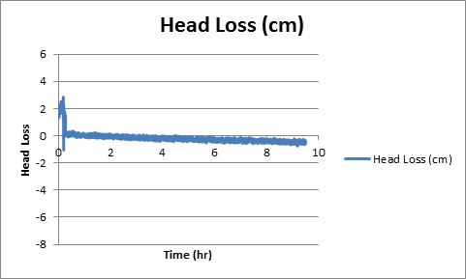
Problems with Head Loss
Earlier this semester we were having a lot of trouble with our head loss data.
No consistent trend(s) between tests
Negative head loss values
Notes:
Tanya

Slide 9
BUT, with a little bit of Monroe Magic…
Notes:
Val
the linear trend that was expected during filter runtime. No more negative values!

Slide 10
Head Loss
Originally, we hypothesized that head loss would level off after filter failure. But this trend was not happening.
Notes:
Tanya. Values were increasing well beyond 400 cm for a number of our experimental tests – 1.1 mg/L. In a 40 cm column, how is this possible without some sort of uplift of the sand (which wasn’t observed)?

Slide 11
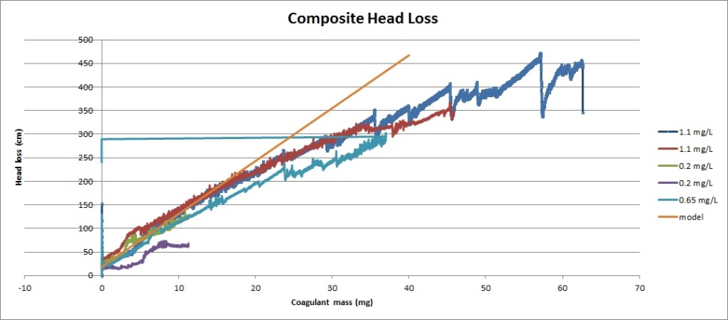
Head Loss Normalized
Notes:
Tanya

Slide 12
Possible Explanations?
Three Theories:
1. Higher concentrations of PACl would result in stronger bonds between floc particles and also the sides of the filter column.
2. Flocs exhibit fractal behavior. Increased concentration of PACl would produce flocs of lower densities because of its increase in water content.
3. With increased PACl dosages, more masses are being added into the filter column. An increase of mass accumulated within the pore would result in a smaller pore size and an overall greater head loss.
Notes:
Val 1/2
Tanya 3

Slide 13
Mathematical Proof
Using the Hagen-Poiseuille Equation to relate head loss with the volume of accumulated mass and pore size. Defined as:
Defining filter failure as the point when effluent turbidity become 50% of influent. Using this cap of 2.5 NTU to find diameter pore size
Notes:
Tanya
Originally wanted to use this to directly relate maximum head loss (when we thought it would level off) directly to the d_pore – hence the minimum pore diameter for each PACl dosage. BUT, this didn’t work because head loss didn’t level off.

Slide 14
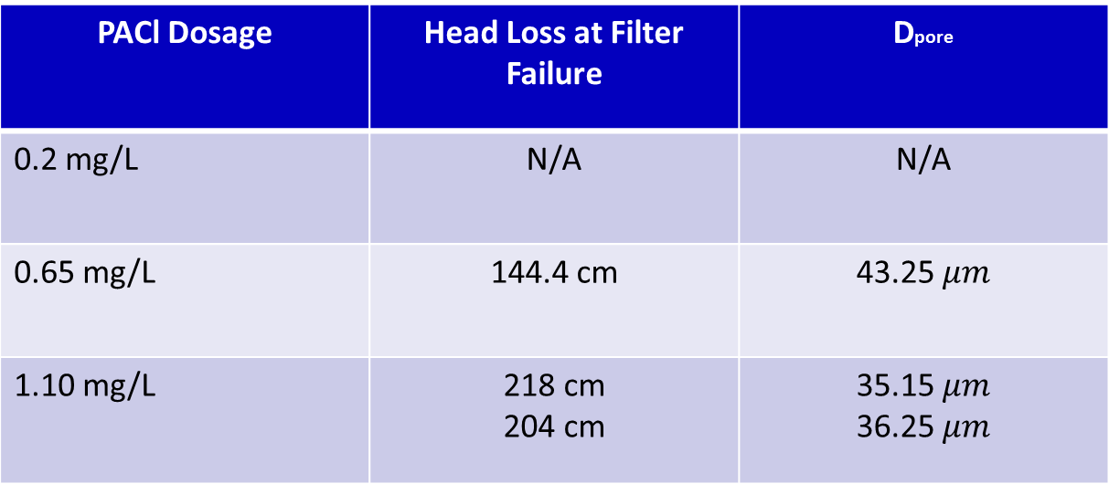
Mathematical Proof
PACl Dosage | Head Loss at Filter Failure | Dpore
0.2 mg/L | N/A | N/A
0.65 mg/L | 144.4 cm | 43.25 $μm$
1.10 mg/L | 218 cm 204 cm | 35.15 $μm$ 36.25 $μm$
Notes:
Tanya
Talk about calculating mass and using this to solve for the density of the flocs

Slide 15
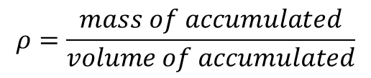
Mathematical Proof
Volumeaccumulated = ΔV
$$ρ=\frac{mass of accumulated}{volume of accumulated}$$
Dpore
PACl Dosage | Mass Accumulated (mg) | Volume Accumulated (m^3) | Density of Flocs (mg/m^3)
0.65 mg/L | 1126.7 mg | 8.55E-13 | 1.317
1.10 mg/L | 220.9 mg 249.15 | 2.13E-11 2.23E-11 | 1.035 1.062
Notes:
Val
Talk about calculating mass and using this to solve for the density of the flocs

Slide 16
Conclusions
Head loss increases linearly even after filter failure
Density of flocs decreases as PACl dosages increases – theory number #2?
Head loss is more dependent on PACl dosages rather than the amount clay added to the system
Notes:
Tanya

Slide 17
Future Work
Continue exploring the three proposed theories and running more experiments to prove/disprove them
Formulating a concrete relationship between head loss and PACl dosage.
Notes:
Val

Slide 18
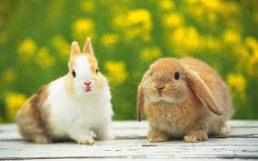
Questions/Comments?

