Slide 1

Materials List
Kira Gidron

Slide 2
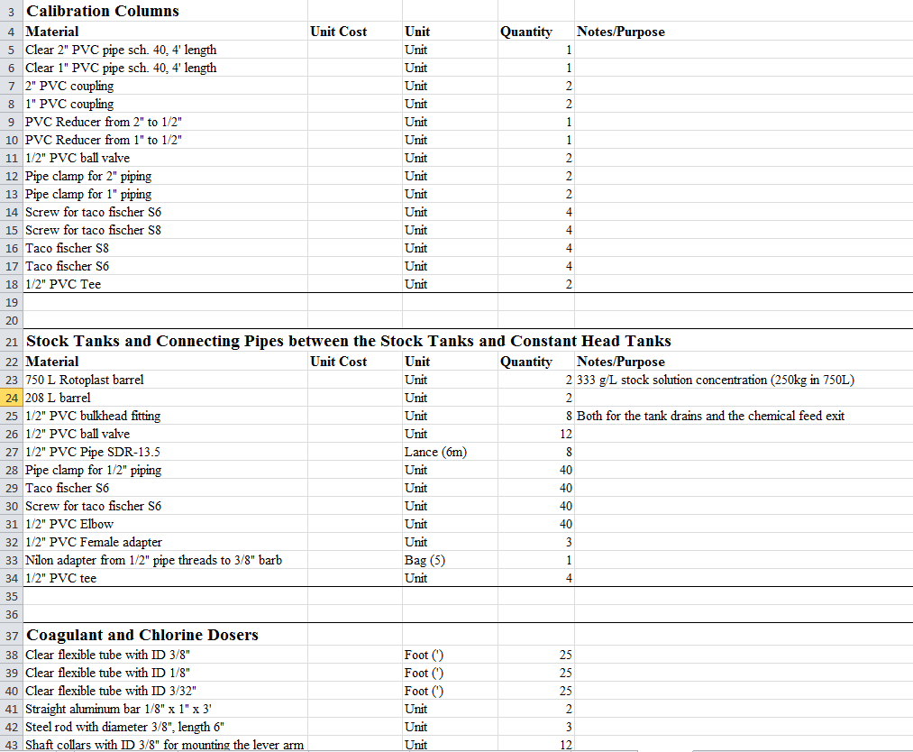
Motivation

Slide 3

Components
Hydraulic materials
  Cut list
Structural materials
Pricing
Spanish
Reducing Costs

Slide 4
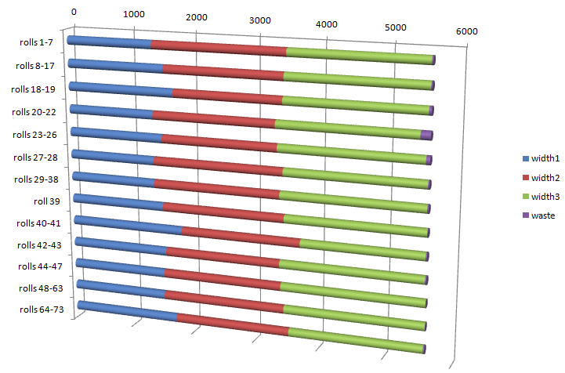
Cut List

