Slide 1
Enclosed Stacked Rapid Sand Filters (EStaRS) Team
Sarah Bolander
Skyler Erickson
Subhani Katugampala
Mary Millard
Savannah Wing
Notes:
Subhani

Slide 2
EStaRS Background
Invented by AguaClara in 2010
The First full scale LFSRSF was designed and fabricated last year, and redesigned to work at the 0.8L/s design flow rate this Summer
Started projects in India
Notes:
Conventional Filtration methods are much larger and labor intensive

Slide 3
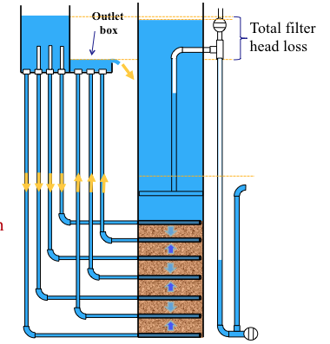
EStaRS: How It Works
Water flows into and out of EStaRS
Better alternative to traditional sand filter - labor and size
Notes:
explain why srsf is better than traditional sand filter - reduce space; explain how water flows up and down

Slide 4
Goals For The Semester
Create backwash storage system
Test the filter’s backwash efficiency
Find a way to test sand bed fluidization
Analyze the problem of cap blow-off
Design a parallel filter system
Optimize current system for mass production

Slide 5
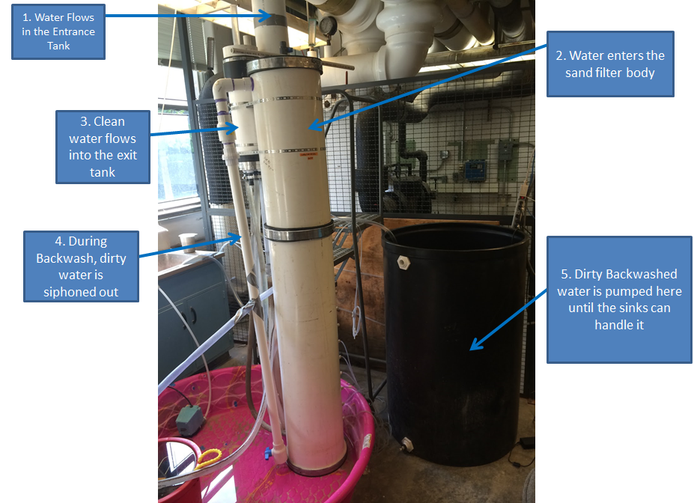
Experimental Setup
Notes:
Skyler

Slide 6
Filter Trial Results
Trial (at 0.8L/s) | Influent Turbidity Average NTU | Effluent Turbidity Average NTU | Previous Backwash Volume at (0.8L/s) | Filter Run Time (before NTU>10) | Filter Percent Cleaned During Backwash | pC* at start of trial | pC*at end of trial
1 | 633.19 | 5.30 | (first trial) | 8 minutes | - | 2.1 | 1.8
2 | 565.73 | 4.10 | 480L | 9 minutes | - | 3.1 | 1.8
3 | 481 | 4.15 | 480L | 8 minutes | 0.74 | 2.1 | 1.7

Slide 7
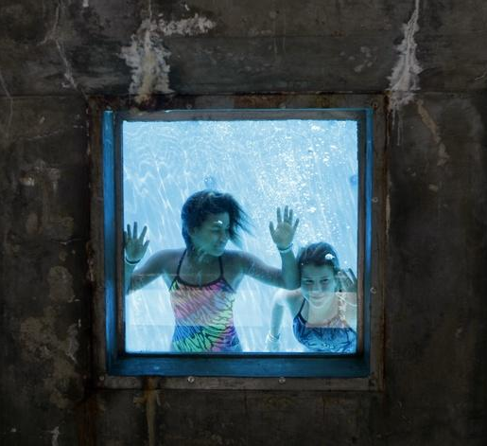
Bed Fluidization: Windows?
What’s going on in there??
discussed a possible fabrication method with shop staff
positives: could allow us to see fluidization rate
negatives: time-consuming and difficult, might not be able to see sand level, need to make water-tight

Slide 8
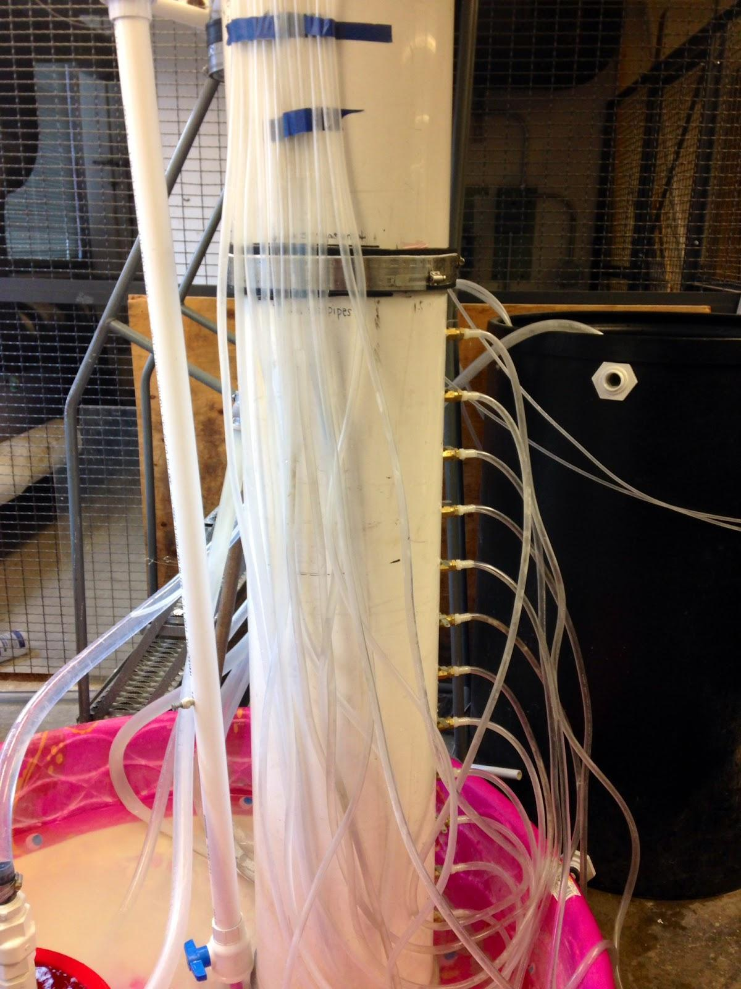
Bed Fluidization: Manometers
Used to determine scale of bed fluidization
positives: gave expected results during forward filtration
negatives: air bubbles during backwash mode

Slide 9
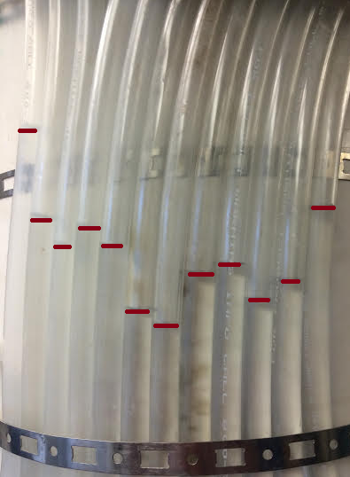
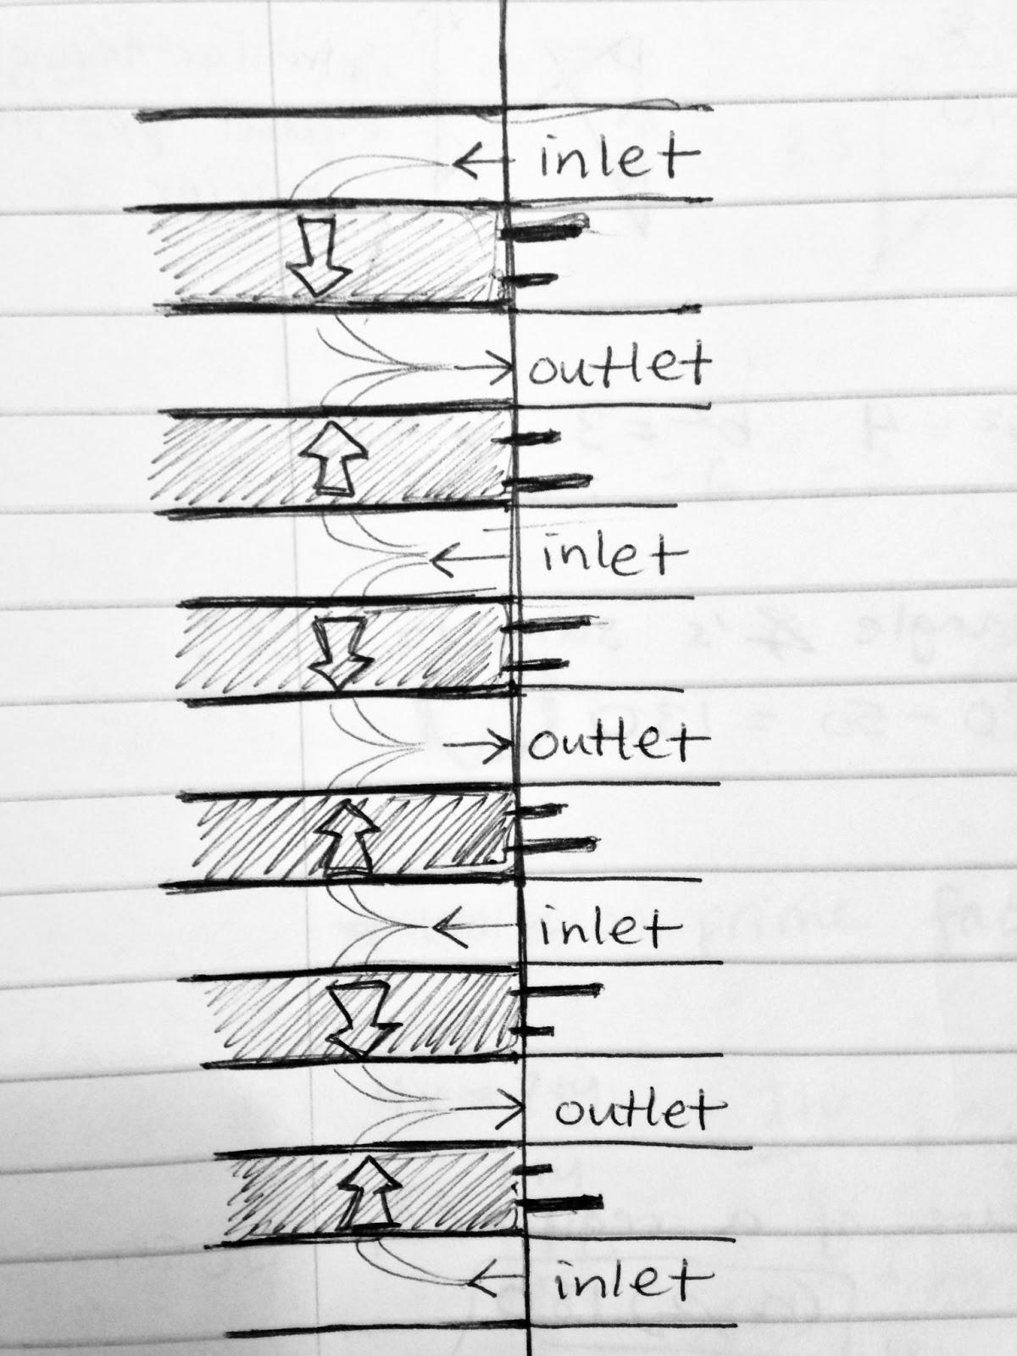
Bed Fluidization: Manometers
Notes:
Mary
The manometers reflected that water was moving from the inlet manifolds at high pressure towards the exit manifolds at a lower pressure, and there was an evident change of pressure from positive to negative somewhere in the middle of the filter
-over an extended filtration period, the manometer level corresponding to the higher-pressure side of each sand layer rose more quickly than the level corresponding to the lower-pressure side of each sand layer
-flocs build up in the sand during filtration, especially near the high pressure inlets. this demonstrates the effectiveness of the manometer system during filtration.
-Once the issue of air bubbles is no longer a hindrance to obtaining manometer readings for backwash mode, this could be a means of confirming fluidization of the bed by measuring the difference of water heights between two manometers and comparing it to the actual distance between those two manometer taps. For instance, two manometers placed 20 cm apart should have a water height difference of less than 20 cm if the bed is fluidized, since a fluidized sand would decrease the the pressure and would not be simply a 20 cm water column.

Slide 10
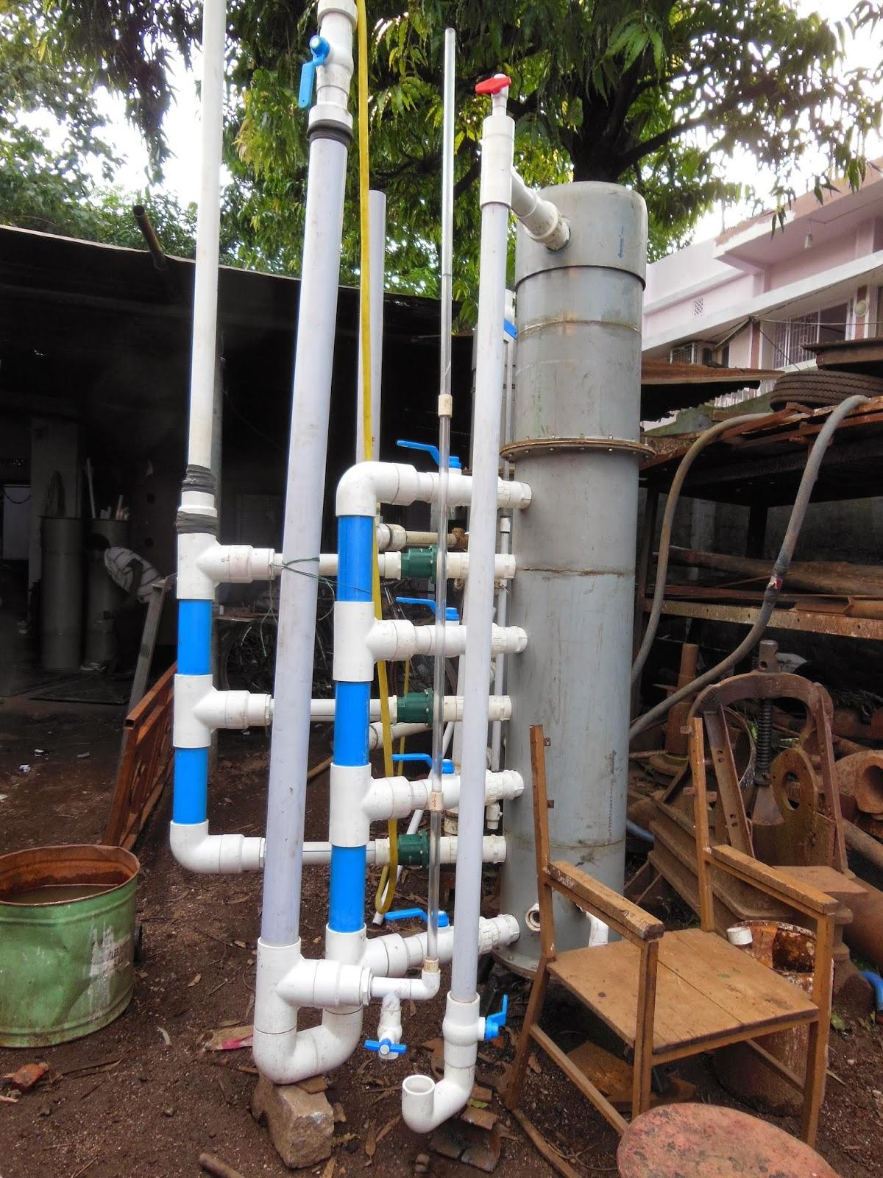
Multiple Filters in Parallel
Pumping rates from wells in India can exceed 0.8 L/s, so multiple filters are implemented in each plant
Irregular pumping rates - filters in parallel need to maintain equal flows through each filter during forward filtration and of divert sufficient flow to backwashing filters
Notes:
Our contact in India, Maysoon, has an idea for such a process

Slide 11
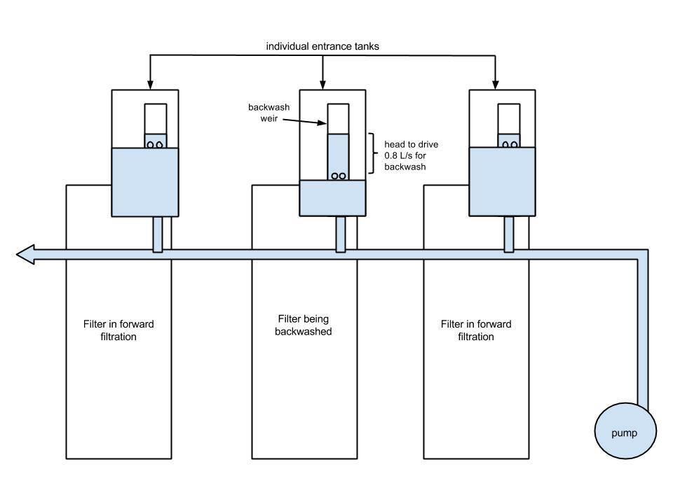
Multiple Filters in Parallel
Notes:
Savannah

Slide 12
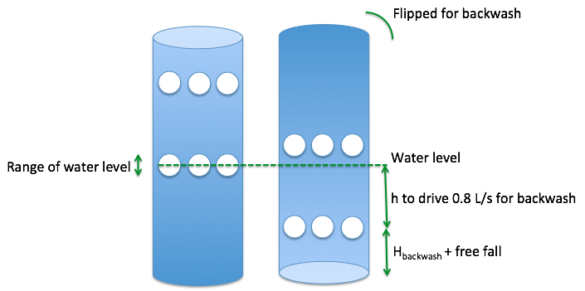
Weir Design
One pipe with two sets of orifices
Maintains 0.8 L/s flow into backwash filter
Left models forward filtration, right models backwash

Slide 13
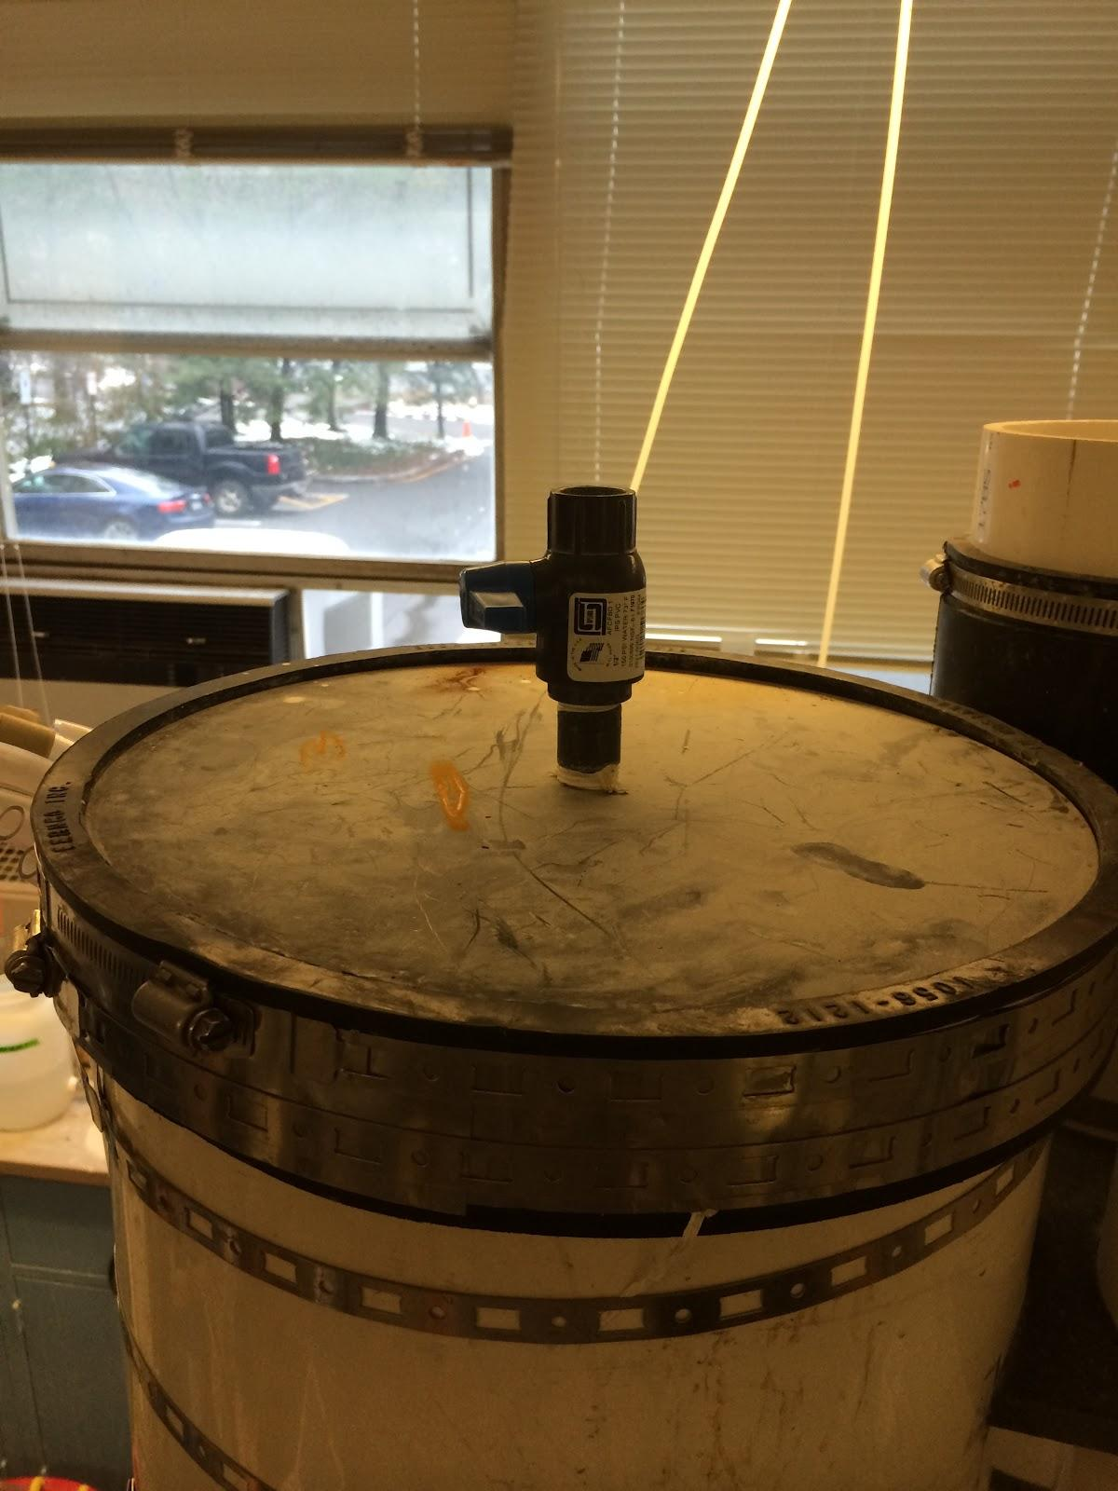
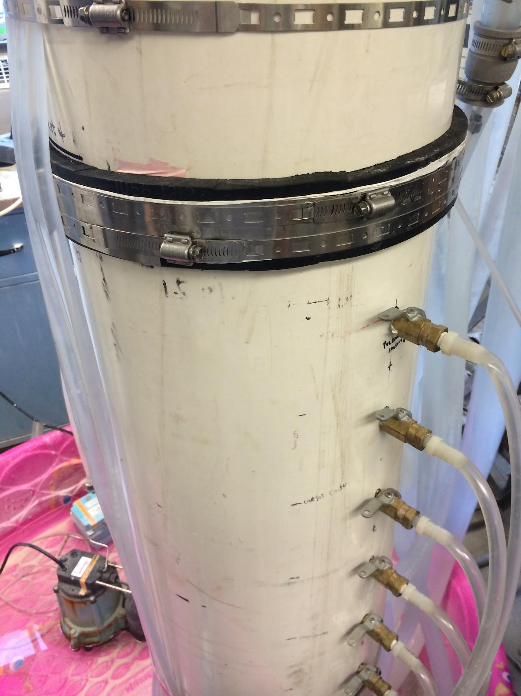
Cap Design
circular PVC plate attached with rubber Fernco gasket, steel shim stock, and hose clamps
the cap has blown off three times to date
cap design is different in India
Notes:
Sarah

Slide 14
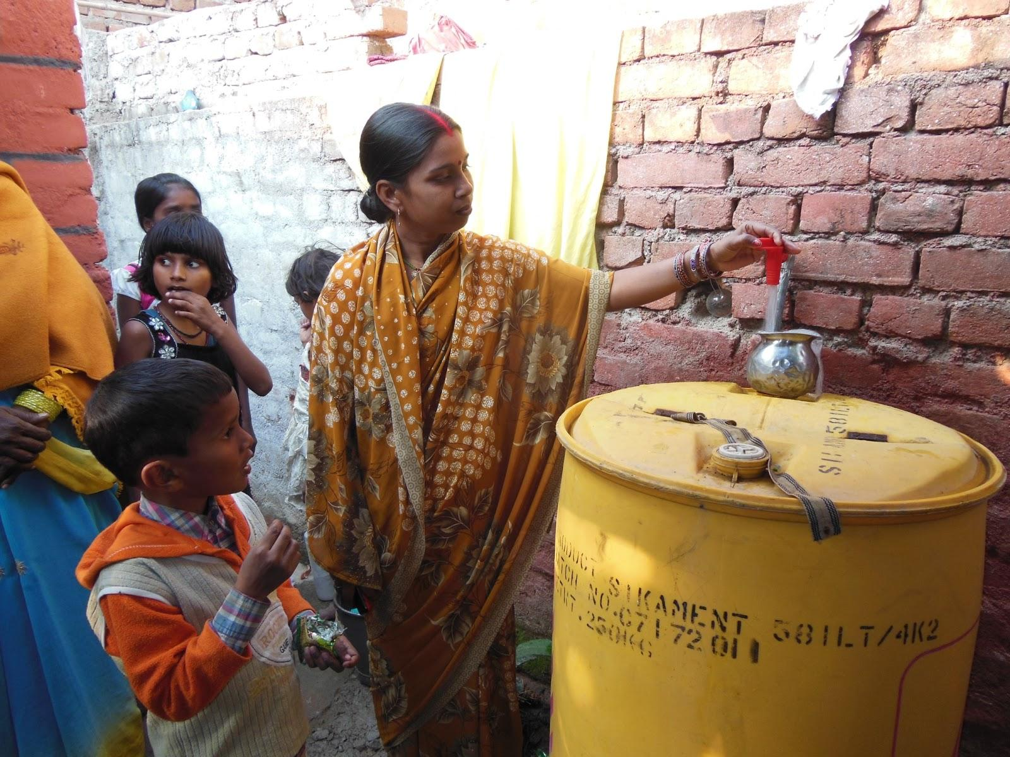
Next Steps
Tata-Cornell Agriculture and Nutrition Initiative in India
  Cornell opportunity
  Scale up for mass production
Notes:
tata links cornell to Indian universitites to focus on agriculture, nutrition, and rural development
Aguaclara fits in the water, santitation, and nutrition part of this program
In India: Building a well cover because of Algae growth, filters need to be continuously de-clogged because of high headloss caused be algae
Explaining to operators that just because water looks clean, doesn’t mean it is.
A lot of cultural/communal issues with getting operators on board to take an interest in filter operation. Sourcing PACl, replacing broken parts, etc.

Slide 15
Next Steps...
Filter Efficiency:
  continue monitoring bed fluidization (obtain conclusive data from manometers)
  continue monitoring backwash efficiency
Design an improved filter column cap
Design Improvements in conjunction with India:
  Calculate weir dimensions and orifice sizing
  Determine multiple filter setup
Notes:
Calculate the pressure required for our gaskets to fail- and whether our filter ever runs near these constraints
measure the headloss required for fluidization
target fluidization of 30%
Design algorithms for entrance and exit tank elevations
headloss fluidization required for clean and clogged conditions

Slide 16

Questions?
Notes:
Calculate the pressure required for our gaskets to fail- and whether our filter ever runs near these constraints
measure the headloss required for fluidization
target fluidization of 30%
Design algorithms for entrance and exit tank elevations

