Slide 1

Turbulent Flocculator
Ana Oliveira, Felice Chan, Jonathan Christensen, and Stephen Jacobs
Fall 2013

Slide 2
Goals
Designing, building and testing a lab scale turbulent tube flocculator.
  Raw water turbidity, coagulant, and flow control
  Measure effluent turbidity
Notes:
Turbulent regions on the flow through the flocculator
The importance of understanding the prior design from the Summer team

Slide 3
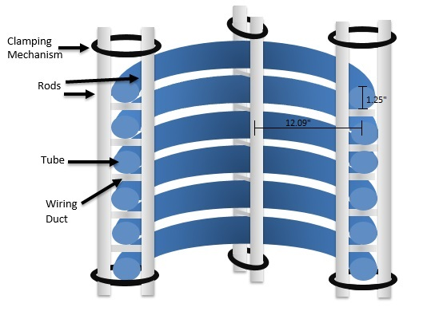
Design from Summer 2013
Stacked coiled tube
Rods to create constrictions for turbulence
Diameter = .614 m (about 2 feet)
30 coils high
Constricted height = 1.464m (about 4.8 ft)
General Design from Summer 2013

Slide 4
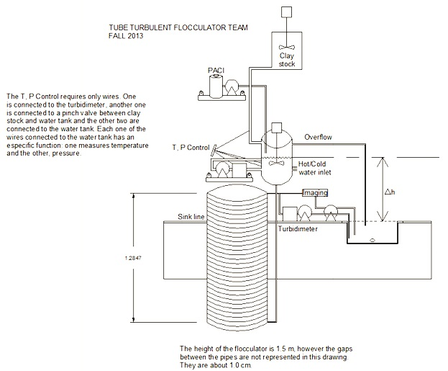
AutoCAD drawings
Notes:
Calculation of the length, the diameter, and the number of coils of the flocculator
Adding important equipment: clay stock, turbidimeters, pumps, stirrers, temperature and pressure

Slide 5
Materials To Purchase
Thin Walled Metal Tubing
Solenoid Valve
Clamping Materials (Steel Bar and PVC)
Head Tank
Fittings for flocculator
Bulk Head Fitting

Slide 6
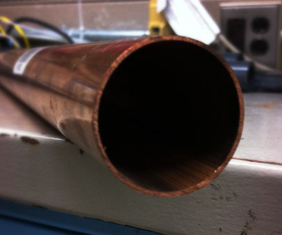
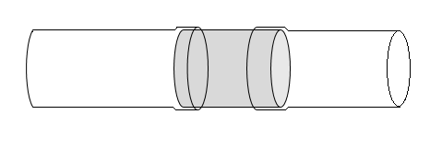
Thin Walled Metal Tubing
Because the flexible tubing came in four separate pieces we need a way to connect them.
Flexible Tubing
ID:1.25”
Rigid Tubing
Notes:
1. Drawing from Summer 2013 Powerpoint

Slide 7
Solenoid Valve Testing
The team measured from the flow from the sink and from the solenoid valves in the lab.
The flow from the existing solenoid valves were insufficient.
The existing valves in the lab have an orifice diameter of 3mm
  Q_{cold.tap} = 315 mL/s
  Q_{hot.tap} = 295.1 mL/s
  Q_{valve} = 59.2 mL/s

Slide 8
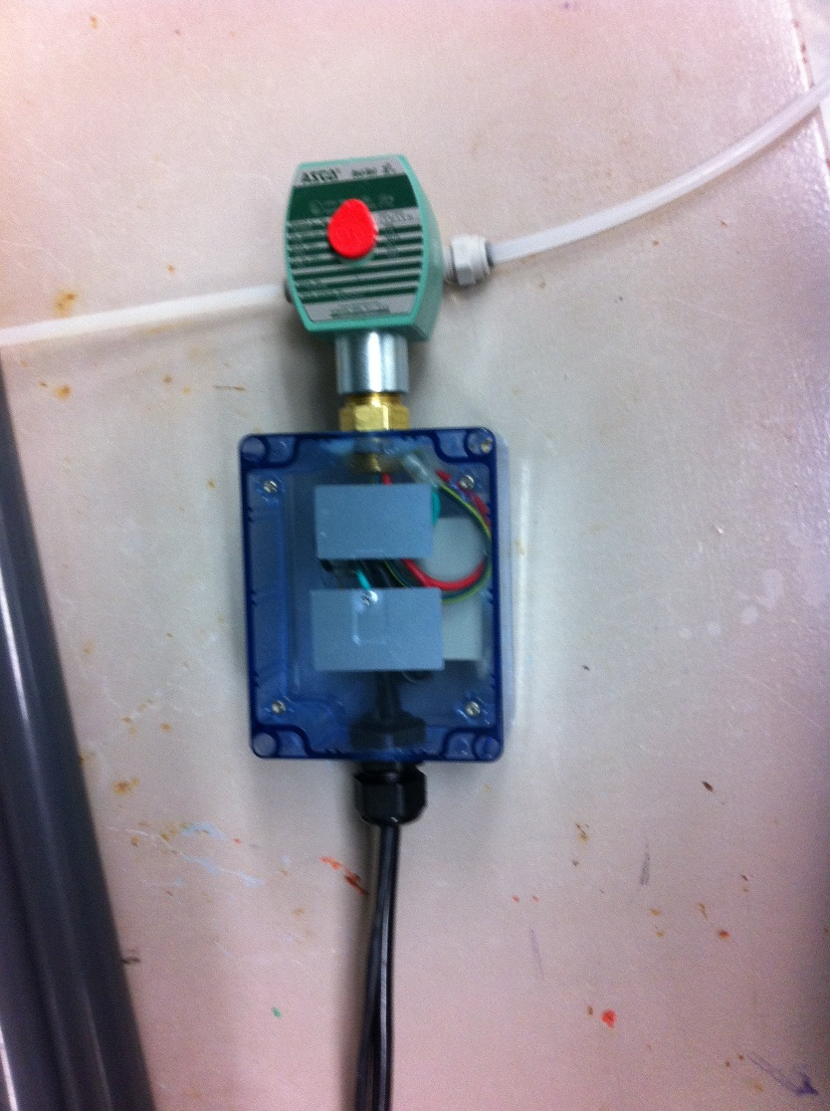
New Solenoid Valve
Minimum Orifice Diameter
= 3.456mm (0.136 in)
Actual Orifice Diameter = 0.156 in
Q_{valve = 130 mL/s}
Orifice Diameter= 0.156 in
Pipe Diameter= 0.25 in
Notes:
Orifice Diameter is 5/32”
Pipe Diameter is .25”
Voltage: 120 AC
Purchased from Grainger
Talk about the thing that Paul made for us

Slide 9
Clamping Materials
Need long round tubes to create constrictions
  Approximate ID of tube should be between 1” – 1.5”
  The deformation of the tube must be minimal.
Need a way to create a frame or base so the flocculator can stand on its own.

Slide 10
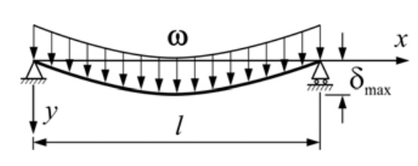
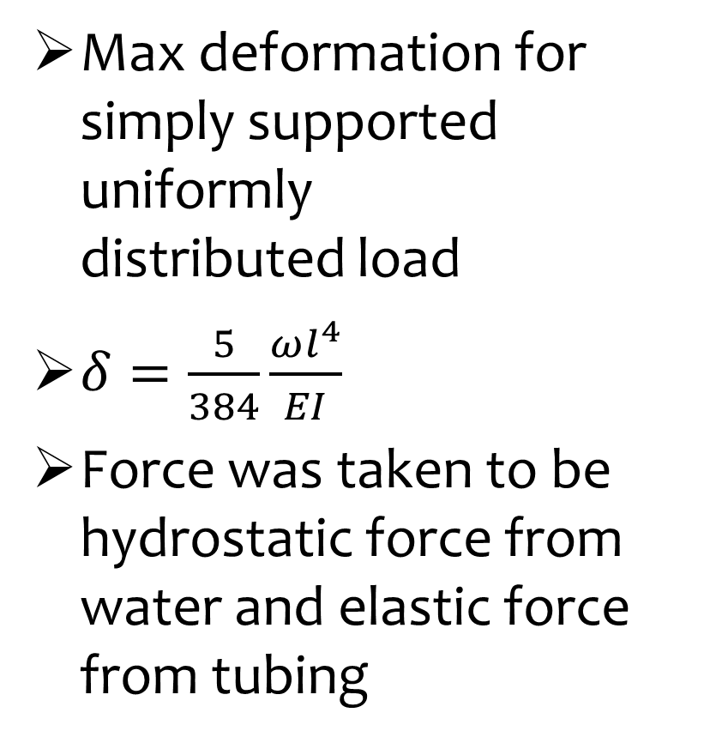
Beam Deformation Calculations
Max deformation for simply supported uniformly
distributed load
$δ=\frac{5}{384}\frac{ωl^{4}}{EI}$
Force was taken to be hydrostatic force from water and elastic force from tubing

Slide 11
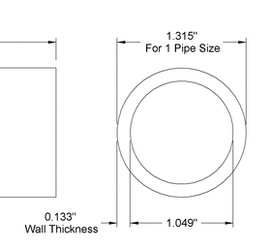
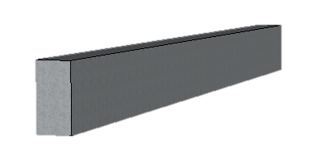
Clamping Materials
Purchased Schedule 40 1-inch PVC and a steel bar.
The steel bar will fit inside the PVC to create the rigidity that we need.
1/4" Thick, 1" Width
6’ Length

Slide 12
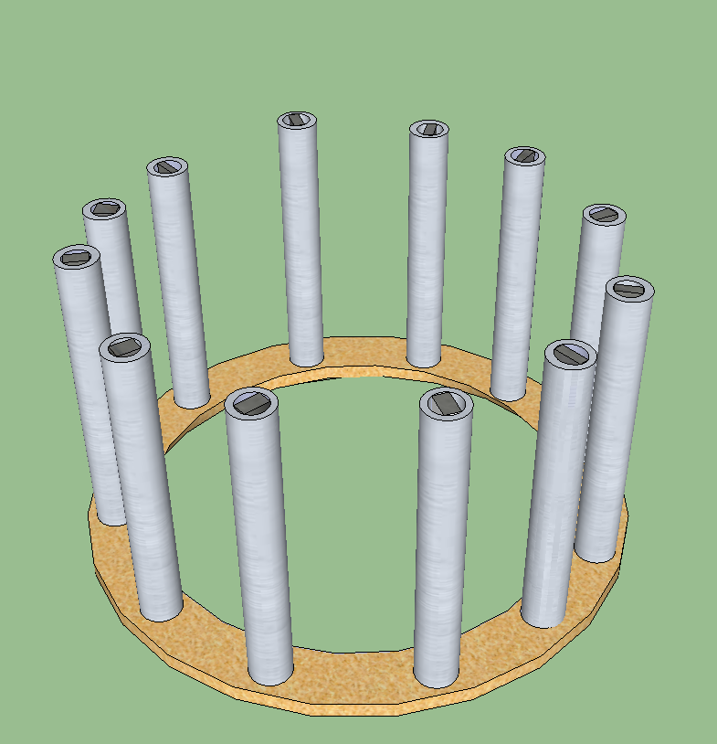
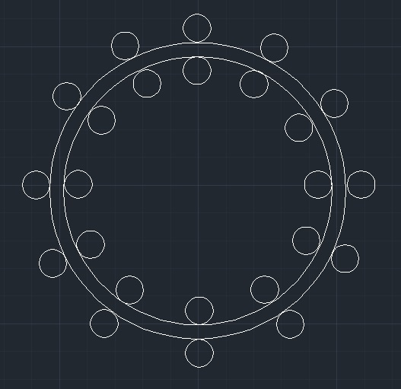
Proposed Design
Drill holes in Plywood Base and place PVC tubes in the holes.

Slide 13
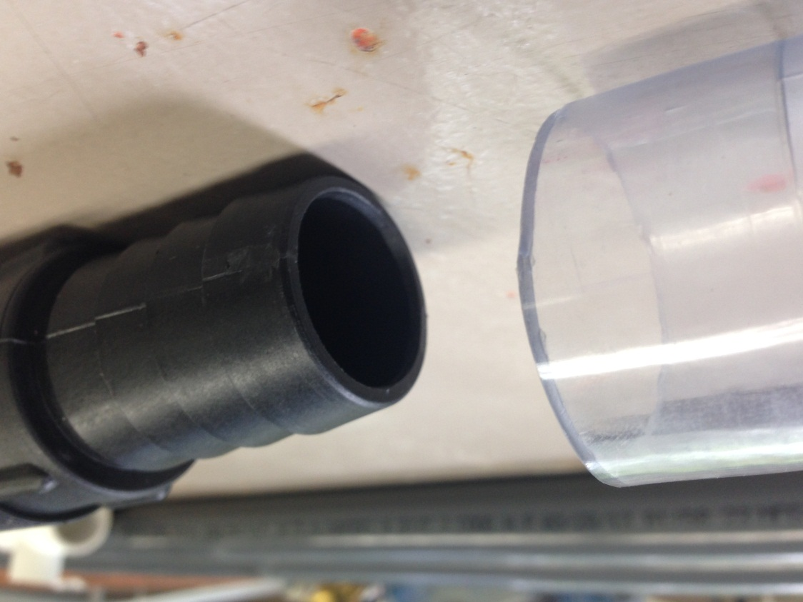
Rapid Mix
2.4 cm

Slide 14
Head Loss

Slide 15
Future Work
Finalize design and purchase the rest of the materials.
Construct the flocculator.
Set up process controller.
Run experiments!

Slide 16

Questions?

