Slide 1
Turbulent Tube Flocculator
Felice Chan, Mingze Niu, William Pennock

Slide 2
Turbulent Tube Flocculator
Project Goals
Current Flocculator
Developments
Testing
Future Work
Notes:
Felice

Slide 3
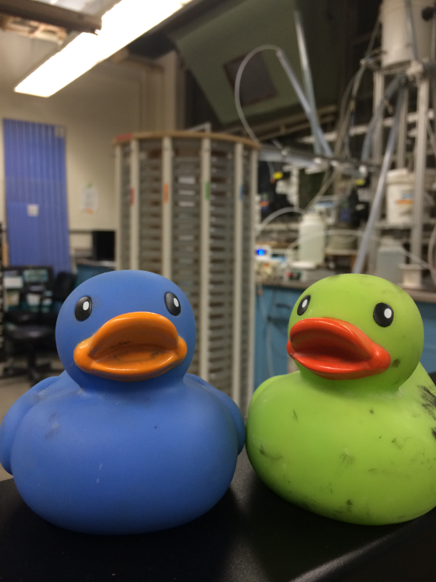
Project Goals
Determine how turbulent flow affects flocculation
Semester goals: Prepare flocculator for experimentation
Notes:
Felice
Improve structure of apparatus
Add flow control
Add air drains
Update process controller method file

Slide 4
Turbulent Tube Flocculator
Project Goals
Current Flocculator
Developments
Testing
Future Work

Slide 5
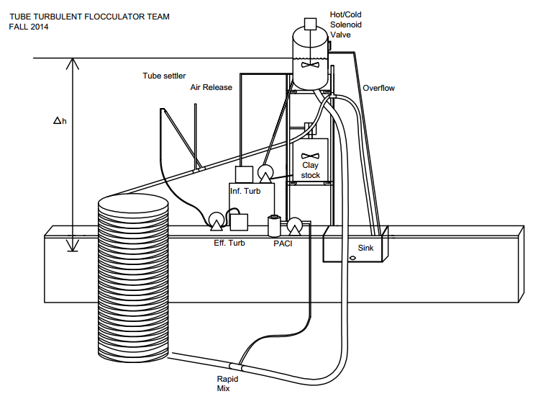
Notes:
Felice

Slide 6
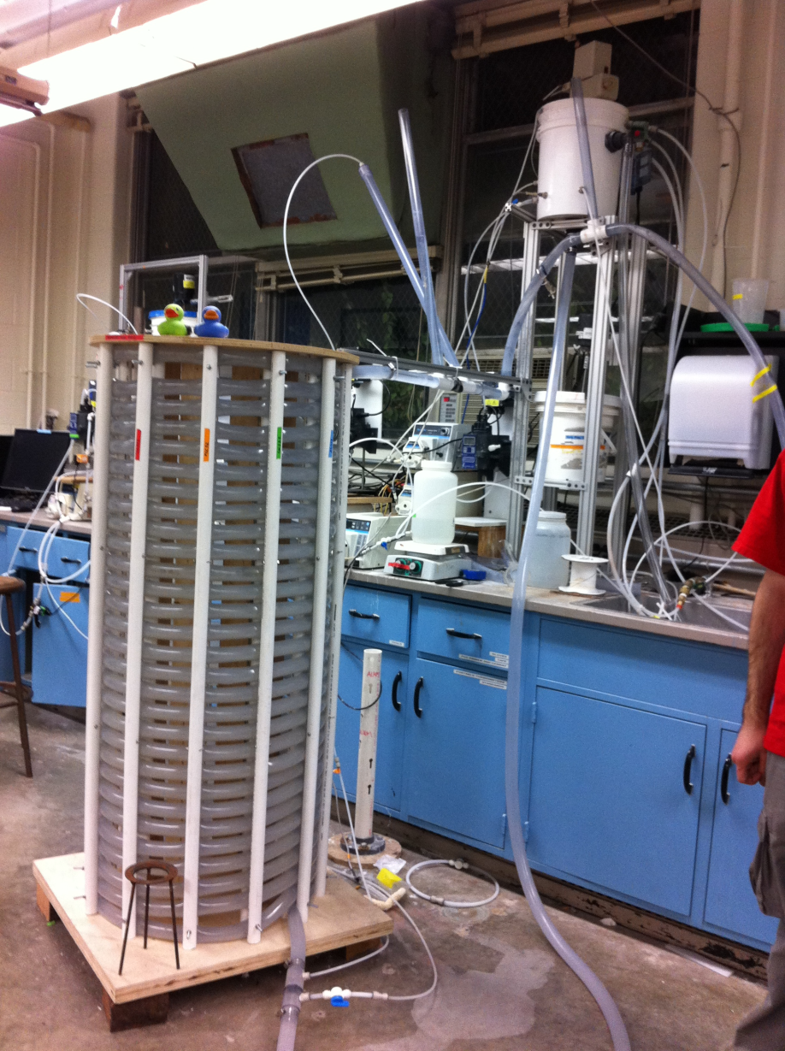
How it Works
Notes:
Felice

Slide 7
Turbulent Tube Flocculator
Project Goals
Current Flocculator
Developments
Experiments
Future Work

Slide 8
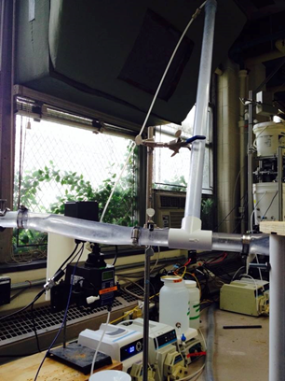
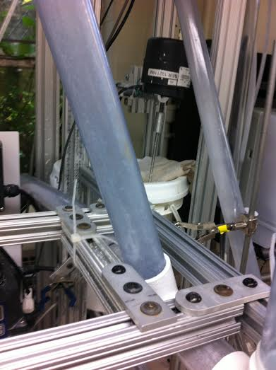
SWaT Improvements
Need to keep SWaT at constant 60 degrees
Before:
After:
Before:
After:
Notes:
Mingze

Slide 9
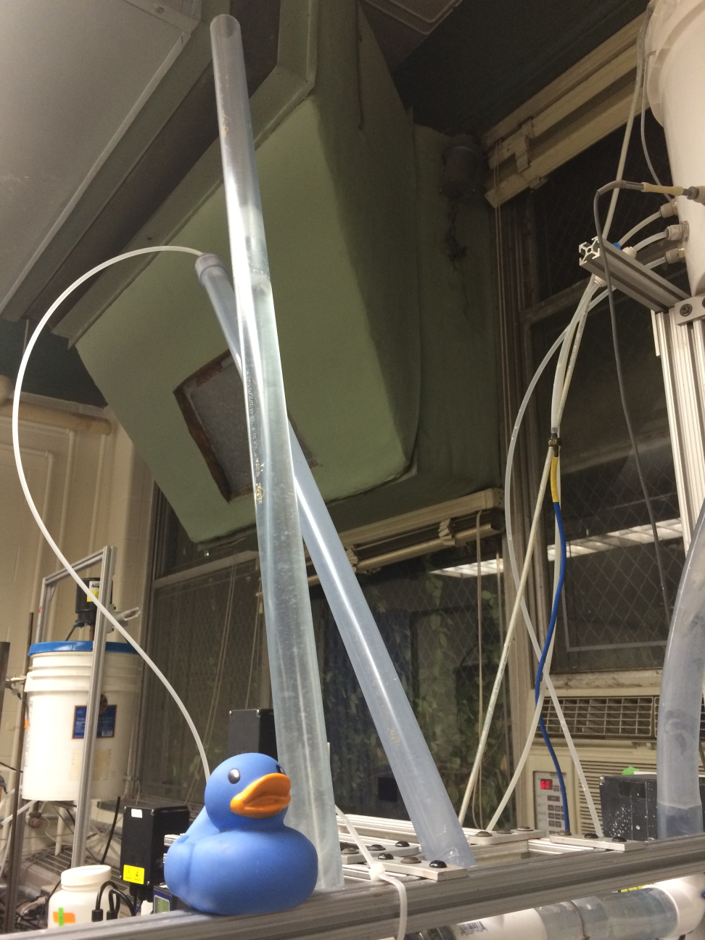
Air Drain
Notes:
Mingze

Slide 10
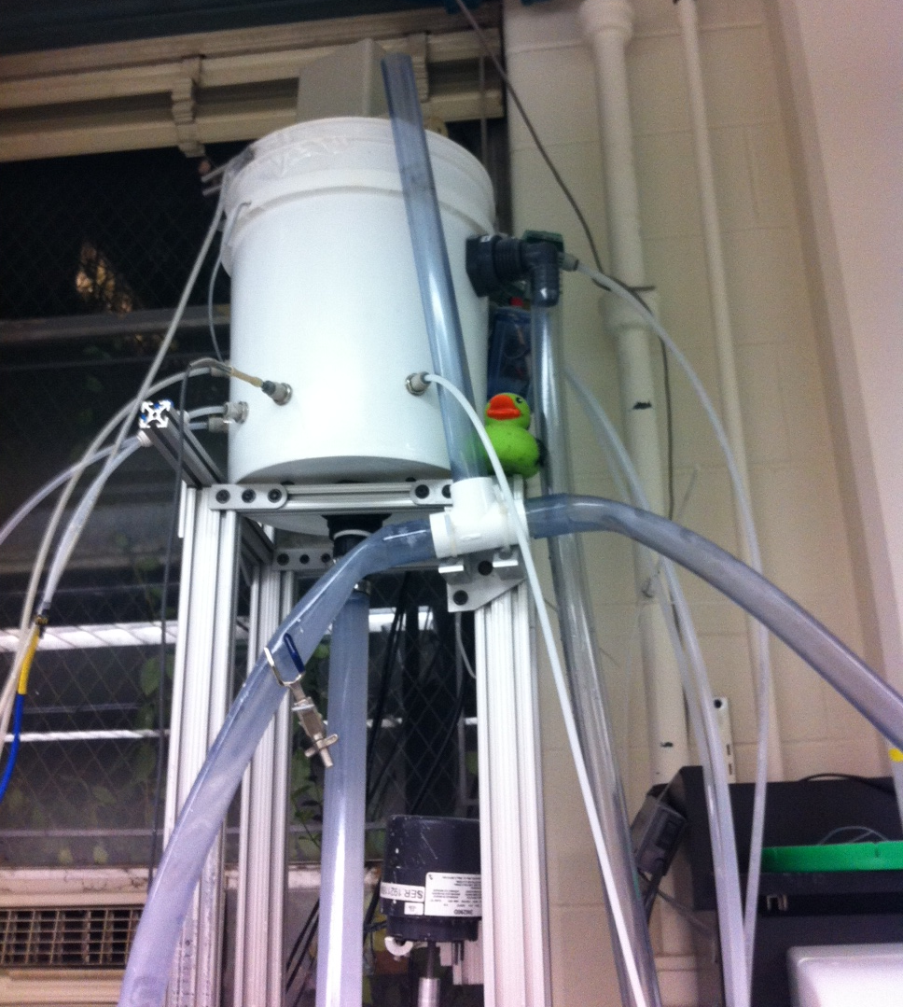
Flow Control System
Δh
Notes:
William

Slide 11
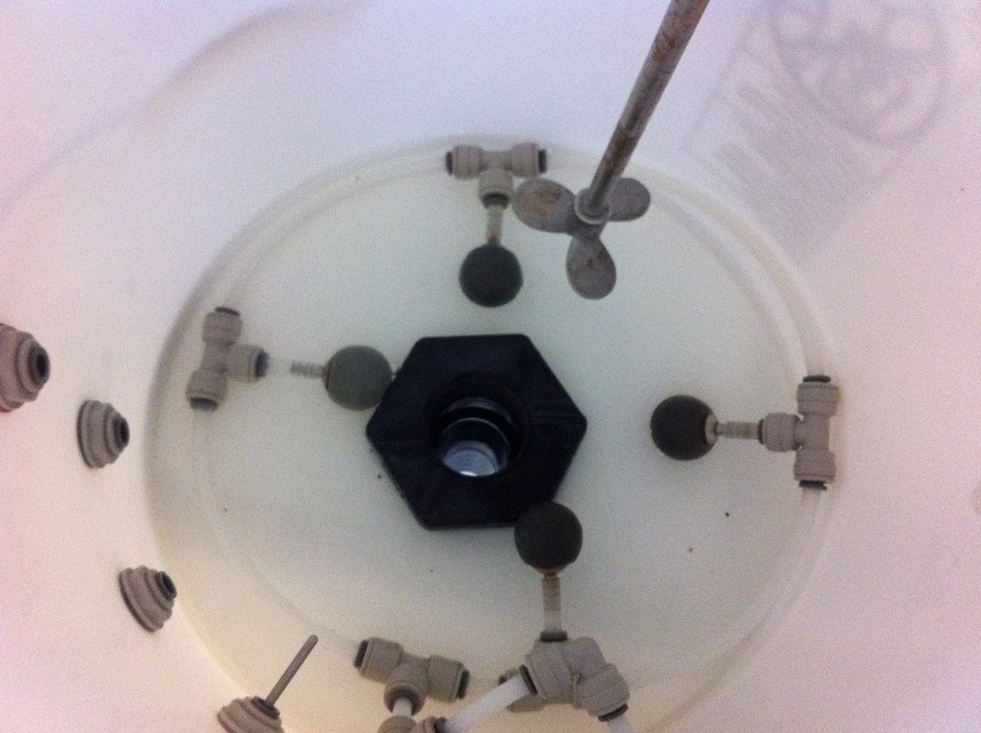
Diffuser System
Notes:
William

Slide 12
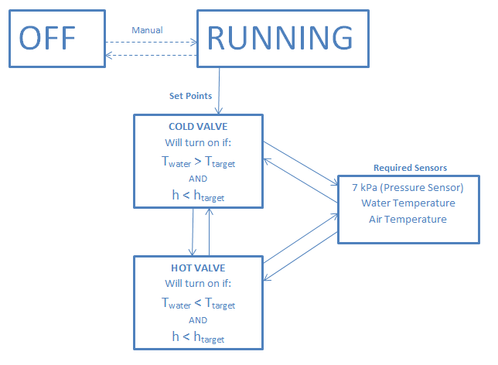
Process Controller
Notes:
William

Slide 13
Turbulent Tube Flocculator
Project Goals
Current Flocculator
Developments
Testing
Future Work
Notes:
Mingze

Slide 14
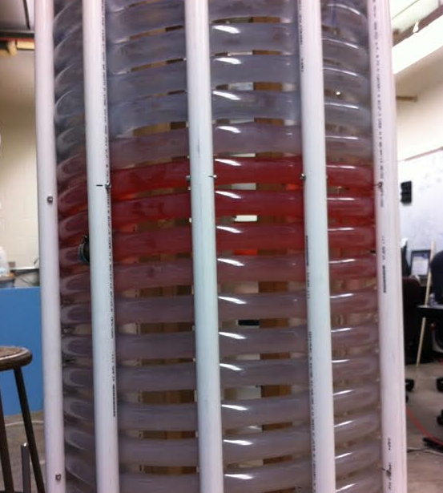
Pulse Input Tracer Test
Red Dye Test: 10 mL of 10 g/L red dye solution into entrance orifice.
Clay Test: 30 mL of 10 g/L clay suspension
  Experimentally:
  θ = 8 minutes, 30 seconds
Notes:
Mingze

Slide 15
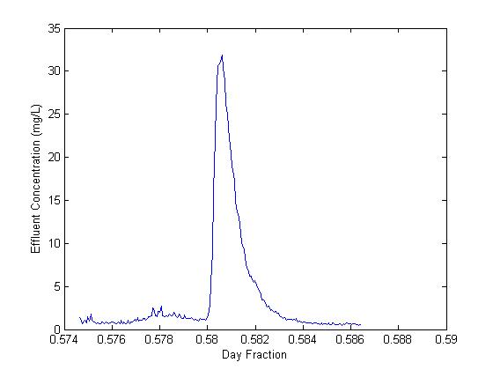
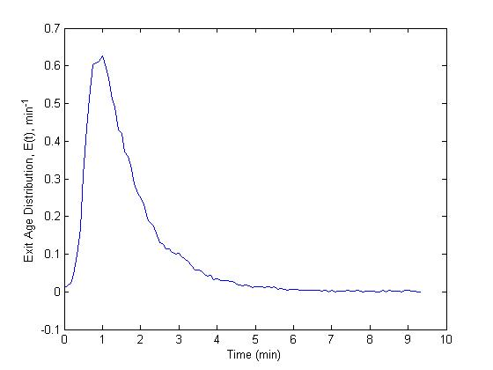

Exit Age Distribution
$$E\left(t\right)=\frac{Q}{M_{p, in}}c_{p}\left(t\right)$$
Notes:
Felice

Slide 16
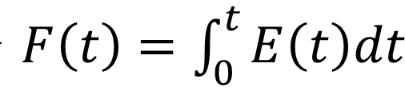
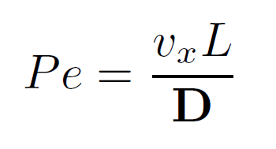
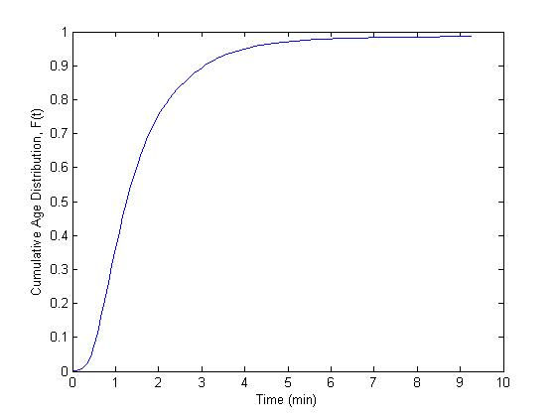
Residence Time Distribution
Pulse input tracer test
  Pe ≈ 4.13
Notes:
Felice

Slide 17
Turbulent Tube Flocculator
Project Goals
Current Flocculator
Developments
Testing
Future Work
Notes:
Mingze

Slide 18
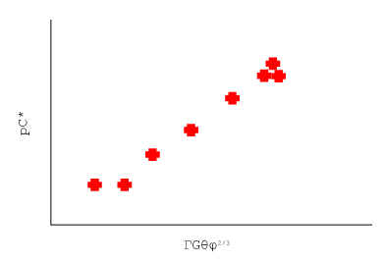
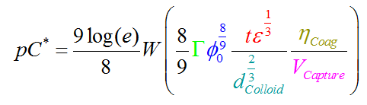
Future Work
Vary:
  Influent turbidity: 5, 15, 50, 150, 500 NTU
  Coagulant dose: Varies by turbidity
  Capture velocity: 0.06, 0.12, 0.25, 0.5, 1.0 mm/s
Develop turbulent flocculation model
Notes:
William

Slide 19

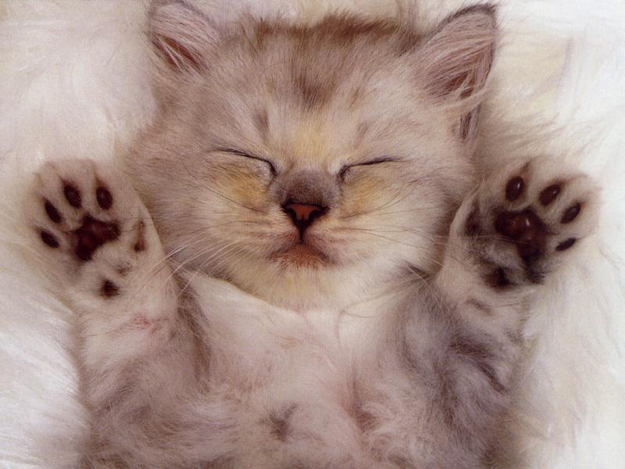
Questions?
Notes:
<3

