Slide 1
MALT Committee
Year End Review
2012
MALT = Mann Learning Technologies Committee

Slide 2
Our Objective
To identify new technology-based services for the library, especially those technologies that focus on meeting patron needs outside the classroom
Coordinate the implementation of such technologies in specific spaces throughout the library
This year’s focus…
the Bissett Space!

Slide 3
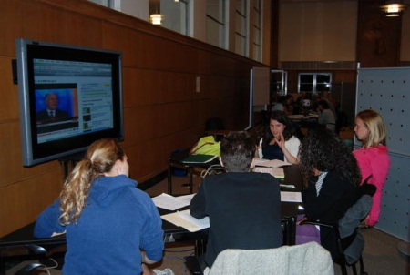
What did we need to know?
Bissett Collaborative Space
Current use
Space preferences
Collaboration
Technologies
Notes:
Do students use the Bissett Space? How?
What type of space or environment for collaboration do they prefer? What spaces on or off campus do they currently use and why?
How do they collaborate with one another on group projects and how would they like to collaborate in an ideal world?
What do they find difficult about collaborating?
Are they using any mobile devices for their research or group work?
What other technology do they currently use and what technology would they like to see in the Bissett Space?

Slide 4
How did we get the information?
Questions
IRB & Training
Recruitment
Interviews
Usability Testing
Observations
Report & “Shopping”
Recommendations & Implementation
Next Steps/Future Studies
  IRB for multiyear study
Human subjects and interview training
Review of other institutions & “shopping”
Future ethnographic user studies
Notes:
IRB – certification process for all involved members as well as interview training and then study process outlined above
As part of recommendations, also did review of other institutions – examined collaborative spaces at universities across the US: Stanford, NCState, Georgia Tech, Duke. What these universities had to offer informed our approach to student questions and gave us a guideline for searching equipment.
Future Studies – In the fall we’ll continue with our studies, including more interviews (also including questions on students’ use of AV to inform our AV production room redesign) as well as ethnographic techniques taken from the University of Rochester’s Studying Students project such as photo diaries 9in which students are asked to take pictures of collaborative spaces they use and like around campus, library-based or not, and interviewed about the features they do and don’t like) and an space design exercise (in which students are asked to draw their ideal collaborative study space and interviewed about their features)

Slide 5
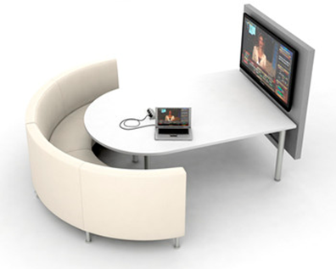
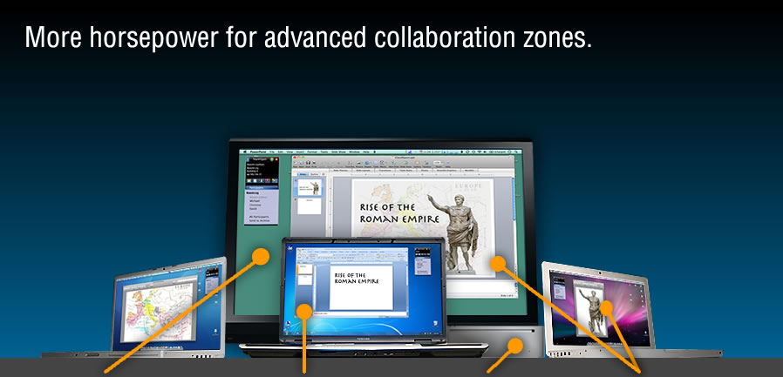
How did we get the information?
  Student interviews on collaborative work
  Agati furniture demo & survey
  Collaborative software research - TeamSpot demo, survey & usability testing
  Bissett Space observations
Agati
TeamSpot
Notes:
Student Interviews – 10 individual student interviews, 30-60 minutes in length
Furniture available for 3 weeks with surveys
TeamSpot available for almost 2 months – students, staff both demo’d product
DEA students observed Bissett on various days and times for nearly 6 weeks to see how students were using the space

Slide 6
What did we find out?
Staff TeamSpot Usability Testing
Student TeamSpot Usability Testing
TeamSpot & Bissett Furniture Survey
Interview & Observation Highlights
Notes:
Staff TeamSpot Usability Testing
Steep learning curve
Technical issues – confusing system messages and feedback, lack of mobile device compatibility, PC/Mac compatibility
Better instructions/signage
Student TeamSpot Usability Testing
Lots of little glitches, especially network congestion & PC/Mac compatibility
Steep learning curve
More instruction needed
Confusion with pop-ups and other TeamSpot initiated instructions
Group dynamic issues
TeamSpot Survey
39 of 61 respondents said yes (some with caveats)
Better instructions/signage needed
Technical issues including Mac/PC compatibility, non-functionality
Bissett Furniture Survey
26 of 29 respondents said yes to the Agati furniture.
24 of 29 wanted more whiteboards
Concern over noise and privacy
Whiteboard markers
Footrests
Bissett Space Signage
Interview & Observation
Comfortable furniture
Whiteboards, whiteboards, & more whiteboards 24 of 29 wanted more whiteboards
2-4 person group size
They love GoogleDocs (and dropbox)
LCD screens are crucial for group work and presentation practice
Noise level too high
Reservation system
Presentation practice space
Like the newness of Mann
Frequency & type of group project depends of major and college and there are different needs for different types of group work

Slide 7


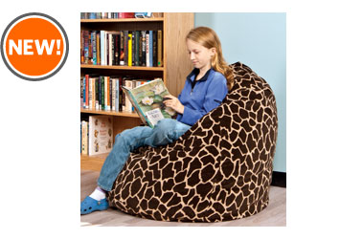
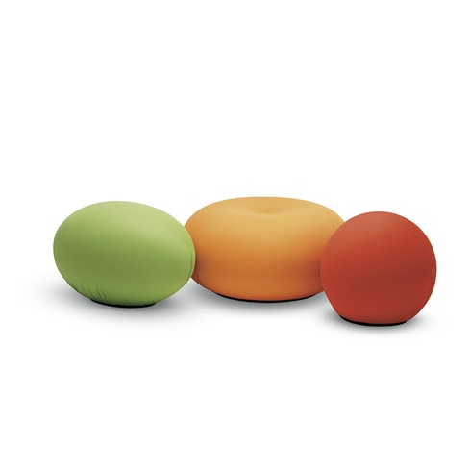
Interesting observations
Low tech vs. high tech
Variety of comfortable furniture
Workspace needs dependent on program
Notes:
64% of students were interested in using TeamSpot for their group projects but still highly favored GoogleDocs even though they report issues with GoogleDocs
2-4 group size
Different needs depending on program and type of work (lower need for group work than we expected; maybe need to target particular programs and explore futher; some programs have their own spaces)
Most had no idea that the space they were in was the Bissett Space

Slide 8

Next steps
Privacy & noise
Reservation system
Presentation space
Lighting
Notes:
Agati furniture and extra whiteboards do help address the privacy and noise issues but we are looking into sound masking systems
Students want reservable spaces – group rooms, individual rooms, group spaces – we are looking at reservation systems and hope to make 2 of the 4 agati units reservable
Students asked for a presentation space. Shane has upgraded group room 261 so that it can function as a presentation space and we hope that that can meet student needs.
Task and better overhead lighting were concerns for students and we hope to find some way to address this issue.

Slide 9
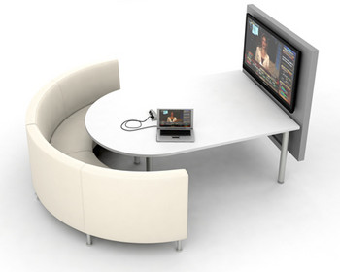
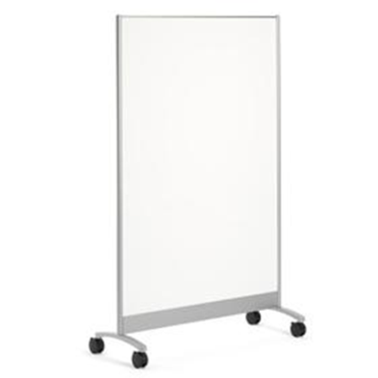
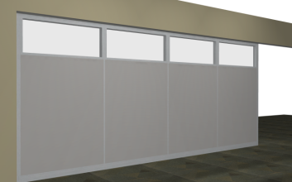
On Our Wishlist
Notes:
Brief explanation of each
Whiteboard wall – still popular idea for students but didn’t quite work for the space. This is something we hope that we can revisit and find a way for it to work.

Slide 10
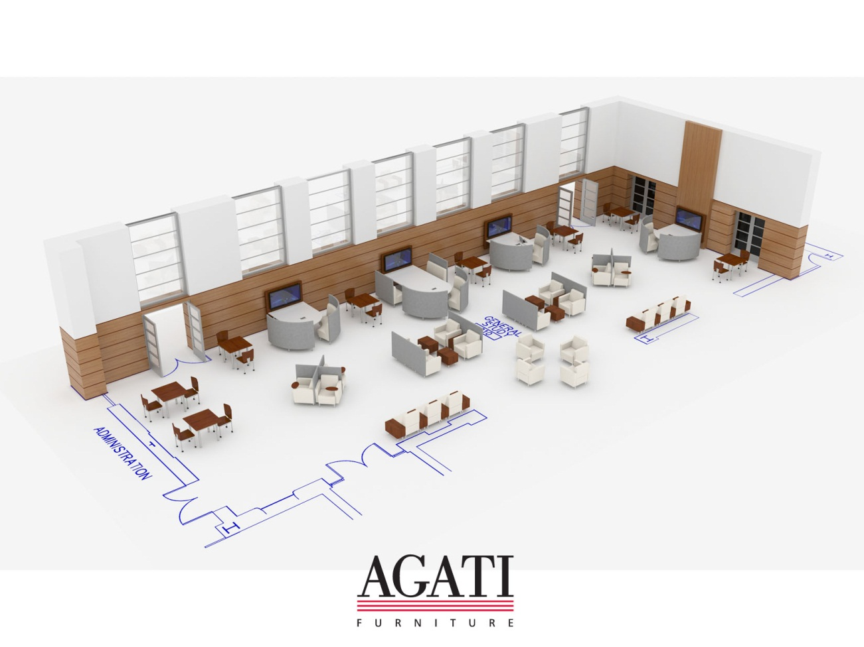
The future
?
Notes:
This is what the arrangement of furniture will look like for the most part. The rendering was done by agati so this is using all agati furniture. Our new layout will add ottomans, beanbags, and lots of color!

