Slide 1
Congestive Heart Failure
Jillian DiFazio, DVM
Emergency and Critical Care Resident
Cornell University Hospital for Animals

Slide 2

Outline
Definitions
Etiologies
Pathophysiology
Classification
Clinical signs
Diagnostics
Treatment
Prognosis
Pertinent recent literature

Slide 3
Definitions
Heart Failure
  Diagnosis characterized by moderate-severe cardiac disease accompanied by increased capillary/venous pressures, low cardiac output and/or low blood pressure
  Defined as a clinical syndrome caused by heart disease that results in systolic and/or diastolic cardiac dysfunction that overwhelms the cardiovascular system’s compensatory mechanisms and/or results in decreased peripheral perfusion
Notes:
Heart failure is the end result of severe heart disease and is a clinical syndrome seen as congestion and edema, poor peripheral perfusion and or systemic hypotension
Heart disease is always present when heart failure is present; however heart disease can be present and never lead to heart failure
Normal cardiovascular system is responsible for maintaining normal systemic arterial blood pressure, normal perfusion and normal venous and capillary pressures
Heart failure occurs when heart disease becomes so severe that the cardiovascular system can no longer maintain one or more of these normal functions
Commonly defined as an abnormality of cardiac function that results in the failure of the heart to pump blood at a rate commensurate with the requirements of metabolizing tissues (NEJM 1997- The effect of digoxin on mortality and morbidity in patients with heart failure. The Digitalis Investigation Group, NEJM 336: 525, 1997)
It has also been defined as the inabiliyt of the heart to pump sufficient blood to meet the metabolic needs of the body at normal filling pressures, provided the venous return to the heart is normal (JAMA 1994; Baker DW, Konstam MA, Bottorff M, et al: Management of heart failur. I Pharmacologic treatment. JAMA 1994; 272: 1361)
These definitions only describe situations in which systolic dysfunction contributes to heart failure and only describe the inability of the heart to pump blood in a forward direction (i.e. decrease in cardiac output or forward heart failure)

Slide 4
Definitions
Cardiogenic shock: Inadequate cellular metabolism secondary to cardiac dysfunction in the face of adequate intravascular volume
Forward heart failure
Backward heart failure (i.e. CHF)
Notes:
Decreased tissue perfusion and subsequent inadequate metabolism and energy production at the cellular level will occur when cardiac output is reduced
In the face of adequate intravascular volume, but reduced cardiac output from cardiac dysfunction, a patient has forward failure
When forward failure is sufficient to cause inadequate perfusion despite an adequate intravascular volume, patient is said to have cardiogenic shock
Backward failure is said to occur secondary to elevated venous pressure and left ventricular failure (forward flow failure) is said to occur secondary to reduced forward flow into the aort and systemic circulation
CO=SV x HR

Slide 5
Pathophysiology
CO= SV x HR
Options that the body has to deal with a decrease in CO
  Increase HR
  Increase SV
    Increase preload
    Increase contractility
    Decrease afterload
Notes:
CO is a product of stroke volume and heart rate
A decrease in either stroke volume or heart rate can therefore lead to a reduction in cardiac output
Normal physiologic response to a decrease in stroke volume is a compensatory increase in HR (and systemic vascular resistance) to maintain cardiac output
Due to a baroreceptor-mediated sympathetic stimulation to preserve blood pressure and tissue perfusion
A decrease in stroke volume that cannot be reciprocally compensated for by a further increase in heart rate will lead to reduced cardiac output and forward flow failure
Similarly forward failure may result froma severe decrease in HR without a primary decrease in stroke volume
Cardiogenic shock will ensue if forward flow failure leads to decreased perfusion that does not adequately meet cellular energy demands
Stroke volume is determined by preload, afterload and contractility
Cardiogenic shock can ensue from alterations in any of these
Compensatory mechanisms are typically focused on maximizing CO and ultimately lead to the development of CHF prior to the development of signs of forward failure and congestion

Slide 6
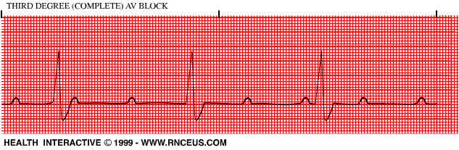
Etiologies
Primary myocardial failure
Volume (flow) overload
Systolic pressure overload
Reduced ventricular compliance
Bradyarrhythmias
Notes:
Dysfunction d/t systolic or diastolic dysfunction or arrhythmias
Systolic dysfunction can result from a decrease in cardiac contractility or decreased flow through the left ventricular outflow tract (i.e. mechanical failure). Decreased outflow can occur secondaryt o a functional obstruction or severe retrograde blood flow
Diastolic dysfunction is implied by reduced ventricular compliance
Diastolic dysfunction can result from a physical restriction to ventricular filling (i.e. tamponade), inability of the myocardium to relax (i.e. HCM) with resultant decreases in end diastolic ventricular volume, or inadequate time for ventricular filling (i.e. tachycardia)
Diastolic failure results in reduced preload and, therefore, stroke volume
Seen with HCM, cardiac tamponade, tachyarrhythmias
Bradyarrhythmias

Slide 7
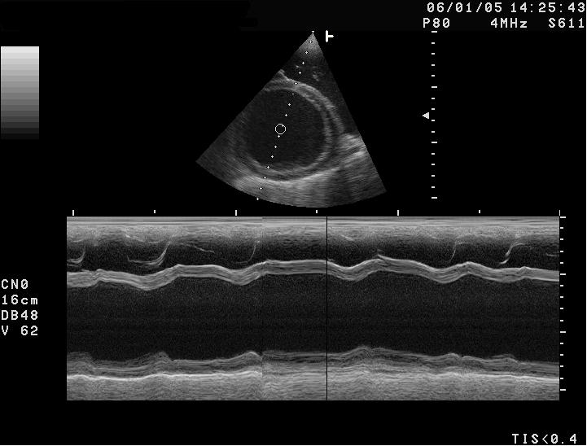
Primary myocardial failure
Characterized by systolic dysfunction
Progressive dilation of the affected ventricle occurs
  AV valve insufficiency develops
Dilated cardiomyopathy
  Also tachyarrhythmias, nutritional deficiencies, metabolic deficiencies, myocarditis/endomyocarditis, sepsis, infarction
Notes:
A progressive decrease in myocardial contractility that can occur over months to years will result in a gradual decrease in stroke volume and forward failure
Decrease in systolic function and myocardial hypocontractility primary disturbance; dilation occurs secondary to compensatory mechanisms
Sepsis- Systolic dysfunction of myocardium well-documented in sepsis
Even during hyperdynamic phase, with increased cardiac output, a decrease in ejection fraction has been noted

Slide 8

Volume (flow) overload
Usually involves a primary
“plumbing” problem
Chronic high output state can also underlie
Myocardial contractility eventually deteriorates
Chronic degenerative AV valve disease
  Mitral or aortic valve endocarditis
  Some congenital malformations
Notes:
Chronic high output states= hyperT4 or anemia
Typically these animals have normal to increased myocardial contractility

Slide 9
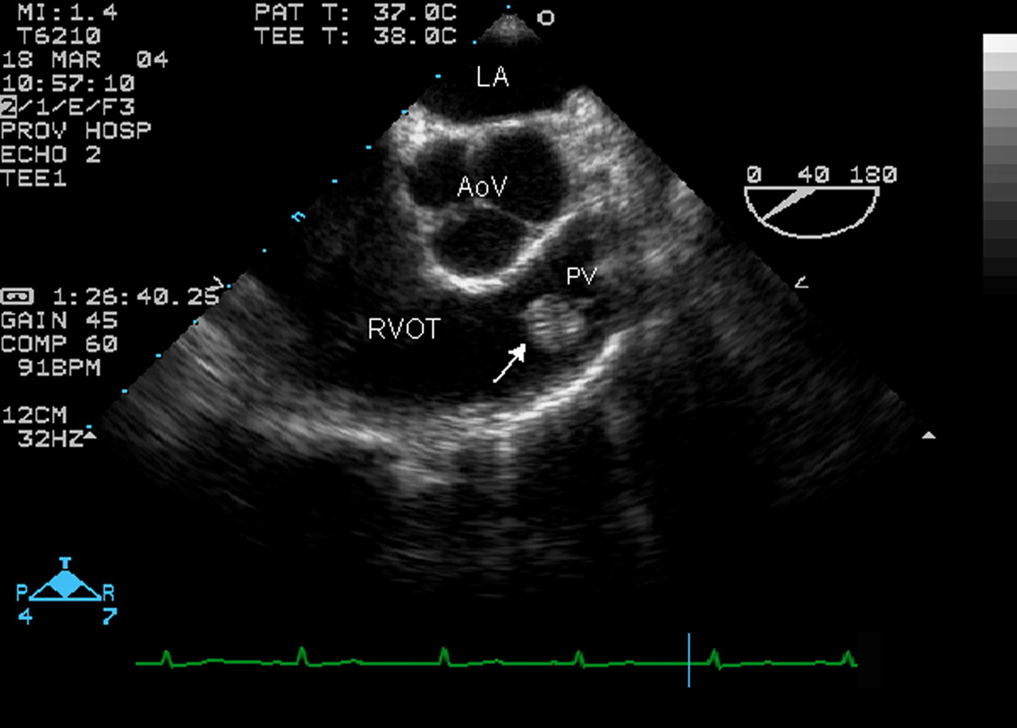
Systolic pressure overload
Occurs when the ventricle must generate
greater than normal systolic pressure
to eject blood
Stimulates concentric hypertrophy
Myocardial contractility eventually declines
Pulmonic or (sub)aortic stenosis, pulmonary hypertension, systemic hypertension
Notes:
Increases ventricular stiffness and can lead to ischemia
Outflow tract obstruction in HCM

Slide 10
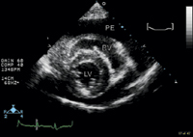
Reduced ventricular filling
Results from hypertrophic and
restrictive cardiomyopathies
and pericardial diseases
Also can be seen with tachyarrhythmias
Contractility usually normal
  Elevated ventricular pressure leads to congestion and may diminish cardiac output
Notes:
Decreased end-diastolic ventricular volume occurs due to the inability of the myocardium to relax, leading to a decrease in preload and subsequently to a decrease in SV and CO
Systolic function typically remains adequate and patients typically have backward flow failure
Tachyarrhythmias- End-diastolic volume is largely dependent on venous return
When patients become tachycardic, there is inadequate time for diastolic filling to occur prior to systole and as a result end diastolic volume and therefore stroke volume is reduced.

Slide 11
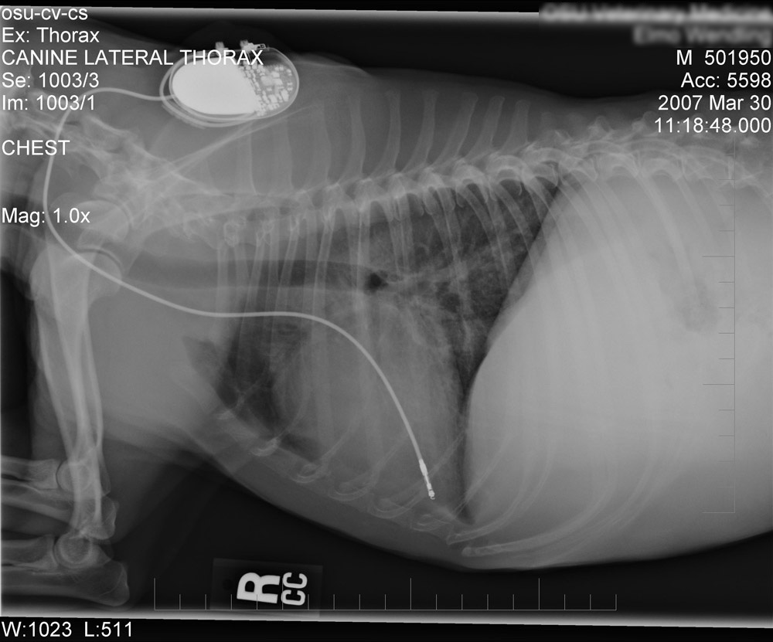
Bradyarrhythmias
Severe bradycardia can lead to
a decrease in CO
  Severe high grade second
  degree AVB, third degree
  AVB, SSS
Notes:
Such that cardiogenic shock ensues
Blood pressure may be normal, but important to remember that BP does NOT equal flow

Slide 12
Order of presentation
As a general rule, patients with chronic heart failure exhibit signs of congestive failure before signs of forward failure
Priority of functions:
  First priority: Maintenance of systemic arterial BP
  Second priority: Maintenance of blood flow
  Third priority: Maintenance of capillary pressure
  Why?
Blood pressure>Blood flow>Maintenance of capillary pressure
Notes:
Systemic arterial BP is usually maintained within normal range or only mildly decreased even in severe chronic heart failure
In a study of dogs with chronic heart failure as a result of mitral regurg, mean aortic blood pressure was normal (104mmHg), cardiac index was moderately reduced (292Lmin/m²) and mean pulmonary capillary pressure was severely increased (40mmHg).
Three basic functions of the CV system: 1) Maintain normal systemic arterial blood pressure; 2) Maintain normal tissue blood flow; 3) maintain normal systemic and pulmonary cap pressure
High pressure baroreceptors responsible for maintaining normal systemic arterial blood pressure predominate over the low-pressure atrial receptors responsible for maintaining normal venous pressures in mammals
Maintenance of systemic arterial BP is the CV system’s first priority and it will maintain BP even at the expense of other functions
Ex: If myocardial contractility is decreased suddenly, CO (SV x HR) will decrease. Because of this decrease in CO, systemic arterial pressure also decreases, as long as arteriolar tone and peripheral vascular resistance stay the same (blood flow x peripheral vascular restance= arterial pressure)
CV system must make a hoic whether to increase blood pressure by increasing arteriolar tone and resistance to flow or to decrease tone reducing resistance to blood flow and consequently increasing CO. It chooses to increase BP, though this results in a further decrease in CO
Pressure>Flow predominates in chronic CHF
Second priority is to maintain a normal cardiac output
Third priority is to maintain normal capillary pressure
Ex: A dog with chronic mitral regurg and mild CHF suffers a ruptured chordae tendineae. This results in an increase in blood flow into the left atrium and consequently an increase in left atrial pressure and a decrease in forward blood flow into the aorta (i.e. cardiac output)
CV system must choose between retaining sodium and water to increase end-diastolic volume to increase CO back toward normal or to decrease retention to decrease the left atrial pressure and decrease pulmonary edema
Body always chooses to chronically increase renal sodium and water retention to increase CO at the expense of increasing left atrial pressure
Why this priority of functions?
Likely related to need to maintain normal/adequate blood pressure to maintain perfusion of the three critical vascular beds in the body: brain, heart, kidneys
All three beds have high innate resistances to blood flow. Consequently they need high pressures to force blood flow through them
Vascular beds that demand that MAPs be greater than 50-60mmHg
Without adequate blood flow to these essential vascular beds, death comes about rapidly, hence the high priority assigned to blood pressure
With decreased cardiac output, the vascular system can compensate for poor blood flow to the critical vascular beds by peripheral vasoconstriction, shifting blood flow tot eh critical beds
If blood flow becomes inadeqaute tot eh other regions of the body, however, oxygen deliveryt o the body becomes inadeqaute, resulting in aaerobic metabolism, cell death and finally death of the patient. Therefore, maintaining blood flow is the second priority.
Elevated capillary pressures cause edema, resulting in poor organ function. Rapidity with which this abnormality kills the patient depends on the organ involved
Peripheral edema not as a big of a deal as fulminant pulmonary edema
Pressure receptors within the left atrium become desensitized with chronic CHF, allowing pressure to increase unchecked; receptors in the body regulating blood pressure and flow remain functional in heart failure, again proving the relative priorities in heart failure

Slide 13
Cardiac responses
Ventricular remodeling
  Myocardial hypertrophy, cardiac cell loss or self-destruction, excessive interstitial matrix formation and loss of normal collagen binding between individual myocytes
  Increased chamber size increases wall stress and myocardial oxygen demand
  Stimuli for remodeling include mechanical forces, neurohormones, proinflammatory cytokines
Notes:
The development of heart failure involves structural and functional changes in myocardial cells, vascular cells and the ECM, as well as multiple systemic compensatory mechanisms
Progressive alterations in cardiac size and shape (remodelling) occur in response to mechanical, biochemical, and molecular signals that are induced by injury or stress
Valvular disease, genetic mutations, acute inflammation, ischemia, increased systolic pressure load and other events can initiate this process
Triggering stimulus as well as the resulting cardiac hypertrophy and remodeling begin long before heart failure manifests
Loss of normal collagen binding between individual myocytes occurs d/t the effects of myocardial collagenases or matrix metalloprotenase; promotes ventricular dilation and distortion from slippage of adjacent myocytes
Mechanical forces= increased wall stress from volume/pressure overload
Neurohormones=AT II, NE, aldosterone, endothelin
Proinflammatory cytokines= TNF, interleukins, other factors
Biochemical abnormalities of oxidative phosphorylation, high energy phosphate metabolism, calcium fluxes, contractile proteins, protein synthesis and catecholamine metabolism have also been identified in different heart failure models and in clinical patients

Slide 14
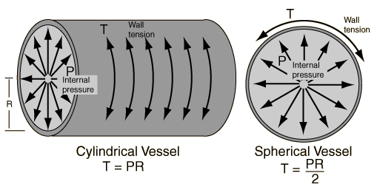
Cardiac responses
Increased ventricular filling (preload)
results in increased stroke volume
Normalizes cardiac output when pressure/volume load rise, but ventricular wall stress and oxygen consumption also increase
Compensatory myocardial hypertrophy reduces wall stress
Notes:
Wall stress is related directly to ventricular pressure and internal dimensions (radius); inversely related to wall thickness (Laplace’s law)
Compensatory myocardial hypertrophy reduces wall stress and lessens the importance of the Frank-Starling mechanism in stable chronic heart failure
Concentric hypertrophy occurs with pressure overload; eccentric hypertrophy occurs with volume overload
Abnormal pressure and volume loads both impair cardiac function over time
Volume loads are better tolerated because myocardial oxygen demand is not as severe; however decompensation and myocardial failure eventually develop
In primary myocardial disease, loading conditions are initially normal
Intrinsic myocardial defects lead to the hypertrophy and dilation observed, although secondary alterations in preload and afterload can contribute

Slide 15
Cardiac responses
Myocyte hypertrophy and reactive fibrosis increase total cardiac mass and ventricular stiffness
Promotes elevated filling pressures
Hypertrophy predisposes to ischemia
Hypertrophy results in impaired relaxation and further fibrosis, ventricular stiffness, and diastolic dysfunction
Diastolic dysfunction can contribute to systolic dysfunction
Notes:
Predisposes to ischemia as the relative density of capillaries and mitochondria becomes reduced
Impaired relaxation and further fibrosis, ventricular stiffness, and diastolic dysfunction are consequences of hypertrophy
Diastolic abnormlaities result from delayed or incomplete relaxation in early diastole, reduced passive compliance and external constraint caused by pericardial disease
Clinical heart failure can be viewed as a state of decompensated hypertrophy, in which ventricular function progressively deteriorates as contractility and relaxation become more abnormal
Ventricular remodeling also promotes the development of arrhythmias

Slide 16
Neurohormonal mechanisms
Increased SVR
Left ventricular remodeling
Increased LV filling pressure
Vasoconstriction
(Increased afterload)
Increased preload
Left ventricular dysfunction
Decreased CO
Increased blood volume
Increased sympathetic tone
With ⬆ aldosterone
Decreased renal blood flow
Sodium and water retention
Baroreceptor inactivation
With ⬇ CO
Hypotension
Increased ADH

Slide 17
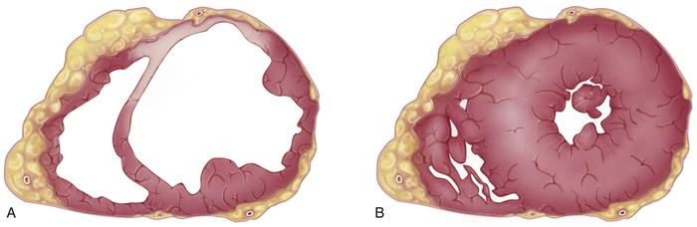
Neurohormonal mechanisms
Increased sympathetic tone
Attenuated vagal tone
Renin-angiotensin-aldosterone system (RAAS) activation
Release of antidiuretic hormone (ADH)
Notes:
ADH or arginine vasopressin (AVP)

Slide 18

Neurohormonal mechanisms
Activation results in:
  Increased vascular volume
  Increased vascular tone
Intensity of activation varies with the severity and etiology of heart failure
  In general, as failure worsens, intensity of activation increases
  Initially activation is selective and regional
Notes:
Increase vascular volume via sodium and water retention and increased thirst
These mechanisms support circulation in the face of acute hypotension and hypovolemia, their chronic activation is maladaptive
Excessive volume retention causes edema and effusions
Systemic vasoconstriction increased cardiac workload and can reduce forward cardiac output and exacerbate valvular regurgitation
Accelerate cardiac function deterioration and pathologic remodeling
Increased production of endothelins and proinflammatory cytokines, as well as altered expression of vasodilatory and natriuretic factors contribute to the complex interplay amongt hese NH mechanisms and their consequences

Slide 19
Neurohormonal mechaniss
Initial stimulus for activation is unclear
Stimulation of low pressure cardiac receptors, ventricular dilation and early cardiac remodeling increase sympathetic afferent activity, which then initiates the NH activation process
Reduced cardiac output and arterial baroreceptor unloading eventually lead to systemic NH activation and are late consequences of CHF
Notes:
Thought to be process described above, not low cardiac output or effective circulating blood volume being the initial activator

Slide 20
Sympathetic stimulation
Increased sympathetic and decreased parasympathetic tone increase HR and contractility raising cardiac output
Detrimental effects include greater myocardial afterload stress and oxygen demand, cellular damage, myocardial remodeling and fibrosis and increased potential for arrhythmias
Notes:
Sympathetic stimulation occurs relatively early in cardiac disease in dogs with experimental mitral valve disease, first locally at the level of the heart and kidney; later spreads more systemically
Concentrations are significantly and consistently elevated in dogs with CHF and degenerative valve disease
Diminished heart rate variability also occurs with sympathetic stimulation
NE can also stimulate growth and increase oxidative stress which can promote apoptosis
Input arm of the SNS consists of pressure and chemical receptors within the CNS, carotid sinus, aortic arch renal afferent arteries and heart
Reduced CO and arterial hypotension offloads pressure receptors resulting in a centrally mediated decrease in vagal tone and increase in sympathetic tone
Central and peripheral chemoreceptors respond to changes in lactic acid concentrations and oxygen and carbon dioxide tension; hypercapnia, hypoxia and acidosis result in heightened sympathetic tone
Efferent activity is mediated via norepinephrine (increased release, decreased reuptake, increased central turnover and increased adrenal medullary production of epi)

Slide 21
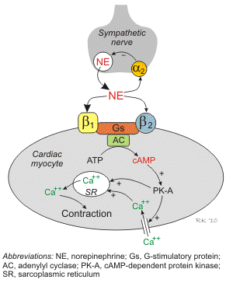
Sympathetic stimulation
Norepinephrine
  Via beta-1 receptor activation increases cAMP
  production and intracellular Ca²⁺ concentrations
    Prolonged exposure can cause calcium overload
    and cell necrosis
  Promotes arrhythmias by increasing
  automaticity
  Stimulates growth and increase oxidative stress
  Peripheral vasoconstrictive effect as well as its renal effects promote volume retention leading to increased ventricular size and pressure
Notes:
High circulating NE levels have been correlated with CHF severity and a worse prognosis (NE and epi in humans)
With increased ventricular size and pressure increases myocardial oxygen demand
In the normal heart, the primary adrenergic receptor is the B1 receptor; binding of NE triggers a cascade of secondary messengers including cAMP and protein kinases
Protein kinase phosphorylates a wide assortment of regulatory proteins within the myocardium resulting in increases in intracellular calcium, resulting in increased force of contraction and increased HR
In peripheral smooth muscle, the primary adrenergic receptor is the alpha-1 receptor, binding elicitng vasoconstriction

Slide 22
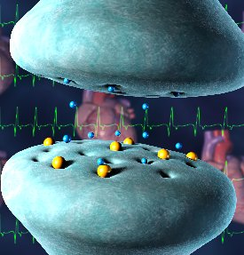
Sympathetic stimulation
Chronic catecholamine exposure leads to decreased myocardial sensitivity to changes
in adrenergic tone
  Myocardial beta1-receptor
  down-regulation
  Myocardial beta2- and
  alpha1-receptors are not
  down-regulated
Notes:
Chronically elevated SNS activity results in myocyte hypertrophy, persistent tachycardia, increased myocardial oxygen demand, increased afterload, receptor downregulation, inefficient energy production and loss of myocytes through apoptosis and necrosis
Therefore, longterm effects are harmful and outweigh beneficial acute effects
Eventual suppression of this excessive activity is a cornerstone of management in human medicine
Reduced myocardial beta1-receptor density (down-regulation), uncoupling of beta2-receptors from G-regulatory protein complex
Beta1-receptor down-regulation may be a protective mechanism against the cardiotoxic and arrhythmogenic effects of catecholamines
But cardiac beta-2 and alpha-1 receptors are not down-regulated; these can also contribute to myocardial remodeling and arrhythmmogenesis
Cardiac beta-3 receptors may contribute to declining myocardial function by their negative inotropic effect

Slide 23
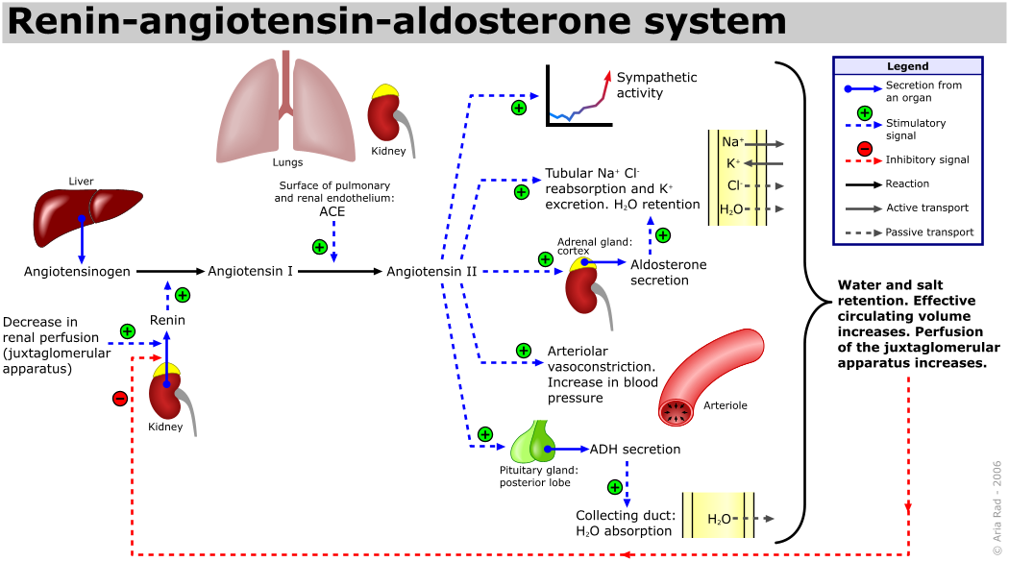
RAAS
Notes:
Input arm of the RAAS consists of the JG cells of the afferent renal arteriole and the macula densa cells of the distal convoluted tubule
Either decreased RBF or renal tubular sodium chloride concentration elicits production of preprorenin from the JG cells
Preproprenin is quickly cleaved to prorenin and then to renin by a trypsin-like enzyme
Renin converts angiotensinogen that is produced by the liver into angiotensin I
Angiotensin I then converted by ACE
Angiotenin II has many functions including increased sympathetic activity, increased arteriolar vasoconsriction, increase tubular NaCl reabsorption, H20 retention and K excretion; also positively affected by aldosterone which it increases the release of, also increases ADH secretion with subsequent increased water reabsorption at the level of the collecting duct

Slide 24
RAAS- renin
Renin released in response to several stimuli including renal beta1-adrenergic stimulation, low perfusion pressure and reduced sodium/chloride delivery to the macula densa
Renin facilitates conversion of angiotensinogen to angiotensin I
Angiotensin-converting enzyme converts angiotensin I to angiotensin II; also degrades vasodilatory kinins
Notes:
Released from the renal juxtaglomerular apparatus
Stringent dietary salt restriction and diuretic or vasodilator therapy also promote renin release

Slide 25
RAAS- angiotensin II
Angiotensin II
  Acts as a potent vasoconstrictor
  Causes sodium and water retention by a direct effect on the proximal tubule and by stimulating aldosterone release
  Increases thirst and salt appetite
  Enhances neuronal norepinephrine synthesis and release
  Decreases neuronal norepinephrine reuptake
  Enhances ADH/AVP release
  Increases adrenal epinephrine secretion
Notes:
Effects of ATII are mediated by AT-R1 and AT-R2 receptors; heart and peripheral vascular smooth muscle rich in AT-R1 and binding increases contractility, vasoconstriction, hypertrophy, remodelling nad myocardial fibrosis
AT-R1 are also present in the kidneys and activation promotes active sodium exchange within the tubules, vasoconstriction of renal blood vessels and passive retenion of sodium within the loop of Henle
Centrally located AT-R1 mediate increased thirst while AT-R1 within the adrenal gland cortex stimulates aldosterone secretion
Therefore, major effects= fluid retention, vasoconstriction, vascular and myocardial remodelling
Functiuons of AT-R2 are generally contrary to those of AT-R1--- elicits vasodilation, fluid diuresis
Therefore, inhibition of ACE can reduce NH activation as well as promote vasodilation and diuresis
Local angiotensin II production also occurs in the heart, blood vessels, adrenal glands and other tissues
This local activity affects cardiovascular structure and function by enhancing sympathetic effects and promoting tissue remodeling including hypertrophy, inflammation and fibrosis
Biological effects are contributory to the progression of heart disease and elevated ATII levels are predictive of cardiovascular death

Slide 26
RAAS- aldosterone
Aldosterone
  Secretion is stimulated by:
    ATII
    Hyperkalemia
    Chronically high plasma corticotropin
  Promotes Na⁺ and Cl⁺ reabsorption and K⁺ and H⁺ secretion in the collecting tubules
    Concurrent water reabsorption augments volume
  Interferes with baroreceptor function
  Detrimental effects on ventricular function chronically
Notes:
Less important in increasing aldosterone release are circulating catecholamines, endotehlins, and ADH/AVP
Increased aldosterone concentrations can promote hypokalemia and hypomagnesemia
Aldosterone is also produced locally in the cardiovascular systema dn mediates inflammation and fibrosis
Chronic ALD exposure has detrimental effects on ventricular function- contributes to pathologic remodeling, inhibits myocardial NE uptake and promotes myocardial fibrosis
Also- vascular remodeling and fibrosis, and endothelial cell dysfunction
Reduced hepatic perfusion slows the clearance of ALD

Slide 27
RAAS
Controversy as to whether RAAS is activated systemically before overt CHF occurs
  Plasma renin and aldosterone concentrations are not increased in all patients with CHF; increases can occur with disease alone
  ACE inhibition does not prevent volume overload myocardial hypertrophy in dogs
Notes:
Studies in dogs with mild asymptomatic degenerative valve disease, angiotensin I, ATII and aldosterone are either not elevated or variably elevated in comparison with normal dogs.
(Häggström and oth- ers 1997, Fujii and others 2007) or vari- ably elevated (Pedersen and others 1995, 1999, Pedersen 1996, Rush and others 2000)
ACE inhibition improves surival in dogs with symptomatic DMVD (COVE Study Group 1995, Ettinger and others 1998)
But does not appear to substantially reduce the risk for CHF when used in dogs with asymptomatic disease. Therefore, suggestive that RAAS activation actually occurs relatively late in disease.
However, circulating vs local - Fujii et al in 2007 reported that myocardial ACE activity was increased in dogs with mild experimental mitral regurg while circulating renin, angioten I, ATII and aldosterone were all normal. Thus similar to the SNS, local RAAS activity may be important in the early stages of DMVD prompting consideration of ACE inhibitors with local and high-tissue ACE specificity.
In dogs with experimental mitral regurg, aggressive ACE inhibition suppresses myocardial collagen formation and leads to progressive cardiac chamber enlargement
Alternate pathways of ATII production also exist which may be able to circumvent ACE. In dogs, this alternate system involves chymase and kallikrein. Tissue chymase converts angiotensin I to ATII, while kallikrein converts angiotensinogen directly to ATII. Thus, both ATII and aldosterone can be elevated in humans despite the use of ACE inhibitors. Tang et al reported in 2002 that 35 and 85% of humans receiving ACEi demonstrated elevated serum aldosterone and ATII concentrations, respectively. Due to this phenomenon of aldosterone escape, adjunctive therapy potentially applicable.

Slide 28

ADH/AVP
Endogenous vasoconstrictor
Increase free water reabsorption in
the distal nephron
Normal stimulus for release is
increased plasma osmolality or
low blood volume
  Reduced effective circulating volume
  and other non-osmotic stimuli cause
  its continued production in CHF
Notes:
Provasopressin synthesized by neurons in the hypothalamus is converted to ADH/AVP within transport vesicles
Become secretory granules in nerve endings within the posterior pituitary
V1A receptors in the vasculature and heart mediate the vasoconstrictive and inotropic effects of ADH/AVP
V2 receptors in the kidney mediate water reabsorption
Osmoreceptors in the portal veins and hypothalamus monitor plasma osmolaltiy and increase central AVP release from the posterior pituitary
Non-osmotic regulation via baroreceptors in the heart, great vessels and carotid sinus also mediates AVP release
Nonosmotic stim= ATII and sympathetic stim
Excessive ADH/AVP contributes to dilutional hyponatremia in some animals with severe CHF; poor prognostic indicator in dogs and humans (Brady et al 2004; Gheorghiade and others 12007).
Increased plasma osmolality or low blood volume are the normal stimuli for ADH/AVP release; reduced effective circulating volume and other nonosmotic stimuli (AT II and symathetic stimulation) cause is continued production in CHF

Slide 29
Baroreceptor function
Normal feedback regulation of the sympathetic nervous and hormonal systems depends on arterial and atrial baroreceptor function
Baroreceptor responsiveness becomes attenuated in chronic heart failure
Contributes to sustained sympathetic and hormonal activation and reduced inhibitory vagal effects
Notes:
Baroreceptor dysfunction can improve, with reversal of heart failure, increased myocardial contractility, decreased cardiac loading conditions or inhibition of AT II which directly attenuates baroreceptor sensitivity
Dig has a positive effect on baroreceptor sensitivity

Slide 30
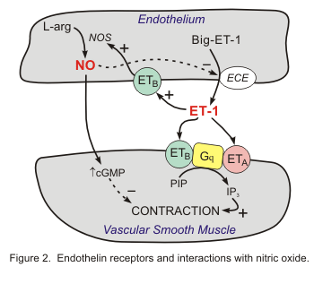
Endothelin
Endothelin 1 is one of several
endothelins produced by the
vascular endothelium
Normal function is to maintain
vascular tone in opposition to
endothelial-derived vasodilators
Production is stimulated by
hypoxia and vascular mechanical
factors
  Also by AT II, ADH/AVP, NE, bradykinin
  and cytokines (TNF-alpha, IL-1)
Acts on ET_{A} and ET_{B}
Notes:
Vasodilators- nitric oxide and prostacyclin
ET-1 is produced in a series of steps leading to conversion from an inactive precursor (proendothelin or big endothelin to active ET-1 via endothelin-converting enzyme
Acts primarily at ET-A receptors on vascular smooth muscle, especially within the aorta, kidneys, and heart, where it increases IC calcium and elicits profound and sustained vasoconstriction
ETA-A receptors are also found in the myocardium where activation increases contractilituy
ETA mediates smooth muscle vasoconstriction, increases myocardial contractility, ALD secretion and renin suppression
Binding of ETB results in formation of NO and associated vascular relaxation
Circulating ET (and pro-ET) are increased in dogs and cats with CHF as well as pulmonary hypertension
Chronically increased ET-1 promotes vascular smooth muscle and myocardial hypertrophy and contributes to remodelling
In humans with heart disease, ET-1 levels are elevated and predictive of mortality
ET-1 is elevated in dogs with experimental heart failure (Ray et al 2004)
ET-1 is elevated in dogs with DMVD or DVM (Procek and others 2004, Tessier-Vetzel and others 20060
Dogs with mild disease have ET-1 levels similar to controls suggesting a relatively late time course
Therapy that targets ET-1 disappointing with improvement in hemodynamics but not morrtality improvement in humans (tang and Francis 2005)

Slide 31
Cytokines
Involved in modulating cardiovascular structure and function
Increased circulating levels are seen in CHF and their overexpression contributes to progression
Chronic increases in sympathetic activity, ATII and aldosterone stimulate further cytokine production
TNF has negative inotropic effects and contributes to remodeling, hypertrophy and apoptosis
Production of NO is stimulated by increased inducible-NO synthetase (iNOS) expression
  Negative inotropic and cytotoxic effects on the myocardium
Notes:
TNF produced by heart, macs and other tissues in responset o stress
Initially is an adaptive and protective response after ischemia and hemodynamic overload; response becomes maladaptive over time
Exuberant production iwthin the heart spills over and can cause secondary circulatory immune stimulating effects

Slide 32
Endogenous oppositional mechanisms
Act to oppose the predominant vasoconstrictive effects induced in heart failure
Include natriuretic peptides, NO, prostaglandins
Endogenous mechanisms become overwhelmed
Notes:
Also invoked with cardiac dysfunction
NO important in the physiologic regulation of vascular tone
Vasodilator prostaglandins
However the influence of the vasoconstrictor mechanisms becomes predominant as heart failure progresses, despite activation of vasodilator mechanisms

Slide 33
Natriuretic peptides
  Natriuretic peptides (ANP, BNP)
    Promote diuresis, natriuresis and peripheral vasodilation
    Antagonize the effects of RAAS
    Also alter vascular permeability and inhibit smooth muscle cell growth
    Circulating concentrations are increased in CHF
Notes:
ANP and BNP, and C-type natriuretic peptide
ANP= atrial natriuretic peptide
BNP= brain natriuretic peptide
ANP and to a minor degree BNP are produced by atrial myocytes as preprohormones
Mechanical stretch of the atrial wall stimulates their release; also can be released in response to SNS/RAAS activity, ET-1, ischemia and inflammation
With myocardial disease, cardiac ventricles become the main source of BNP
Released as pro-hormones which are rapidly cleaved to an inactive N-terminal product (NT-proANP, NT-proBNP) and a biologically active C-terminal end. C-ANP and C-BNP primarily bind to natriuretic peptide receptor-A (NPR-A) located in the heart, kidney, vascular smooth muscle, brain and adrenal glands
Binding induces cGMP production, which causes vasodilation, increased glomerular blood flow and GFR, reduced sodium uptake, natriuresis and diuresis
Natriuretic peptides are degraded by neural endopeptidases and also bind to NPR-C which internalizes and hydrolyzes
Elevations in natriuretic peptides has been correlated with pulmonary capillary wedge pressure and heart failure severity in dogs ((Häggström and others 1994, 1997, 2000, Asano and others 1999, Lainchbury and others 2000, Boswood and others 2003, 2008, Greco and others 2003, Mac- Donald and others 2003, DeFrancesco and others 2007, Oyama and others 2008, Tarnow and others 2009).)
The greater stability and longer half-life of these N-terminal frag- ments is better suited to ELISA-based im- munoassay techniques.
In dogs with mild disease, ANP (Asano and others 1999) and BNP (MacDonald and others 2003, Oyama and others 2008) are only variably elevated. The sensitivity of NT- proANP may be greater than NT-proBNP for detection of mild disease.(Asano and others 1999, Häggström and others 2000) As disease progresses, ANP and BNP tend to increase, and are significantly elevated before the onset of congestive heart failure (Fig 4) (Tarnow and others 2009).

Slide 34
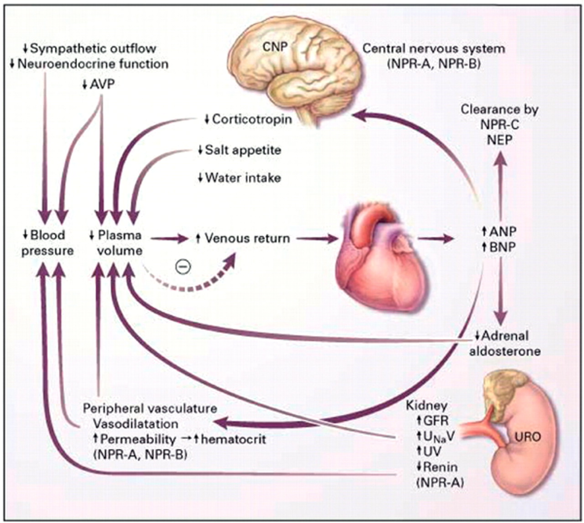
Natriuretic peptides

Slide 35
Nitric oxide
Important functional antagonist of endothelin and angiotensin II
Expressed in vascular endothelium and in the myocardium
Reduced vasodilatory capacity, negative inotropic and chronotropic effects and myocyte damage occur as a consequence of changes in NO synthesis
  Endothelial release of NO is impaired in CHF
  Concurrently myocardial NO release is enhanced because of increased inducible-NOS expression
Notes:
Endothelium-derived relaxing factor
Via endothelial-NOS production impaired in CHF
Occurs secondary to ischemia and release of proinflammatory cytokines (i.e. IL-1, TNF-alpha, IL-6, IFN-gamma)

Slide 36
Vasodilatory substances
Prostaglandins
  Attenuate angiotensin II’s vasoconstrictive effects on afferent arterioles
Adrenomedullin
  Induces natriuresis and vasodilation
  Increased release occurs with inflammation
  Elevated levels have been documented in people with CHF and in dogs with experimental CHF
Apelin
  Endogenous positive inotrope and vasodilator produced by the endothelium and thought to oppose ATII
  Down-regulated in CHF (humans)
Notes:
Produced to a much greater degree in the renal glomerular afferent arterioles As compared to the renal efferent arterioles
Use of PG synthesis inhibitors in severe heart failure could increase afferent arteriolar resistance and thereby reduce GFR and renal blood flow, as well has enhance Na retention, however the clinical significance of this is unknown

Slide 37
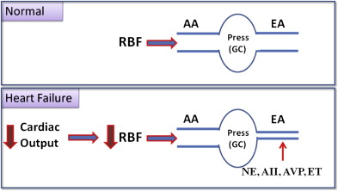
Kidney responses
Efferent glomerular arteriolar
constriction, mediated by sympathetic stimulation and ATII
helps maintain GFR when CO and RBF are reduced
  Higher oncotic and lower hydrostatic pressures that develop in the peritubular capillaries enhance fluid and sodium reabsorption
  ATII promotes renal cortical blood flow redistribution toward the juxtomedullary regions
  ATII induces aldosterone release
  Afferent arteriolar vasodilation mediated by intra-renal vasodilation can partially offset the effects of strong efferent vasoconstriction
Notes:
Balance (or imbalance) between vasoconstrictive/volume retentive stimuli and vasodilatory/natriuretic factors is reflected by the kidney
Juxtomedullary regions are regions where longer loops of Henle penetrate more deeply into the hypertonic medullary region
Promotes greater Na and water reabsorption
Aldosterone release stimulates further sodium and water retention
Intrarenal vasodilation d/t prostaglandins and natriuretic peptides
Progressive reduction in renal blood flow leads to renal insufficiency
Diuretic use can magnify azotemia and lyte loss, further reducing circulating volume and cardiac output and exacerbating NH activation

Slide 38

Exercise capacity
Reduced capacity due to
  Poor diastolic filling
  Inadequate forward cardiac output
  Impaired pulmonary function
  Abnormal peripheral vasodilatory responses can contribute to inadequate skeletal muscle perfusion
    High sympathetic tone, AT II, ADH/AVP
    Increased vascular wall sodium content and interstitial fluid pressure cause vascular stiffening and compression
    Impaired endothelium-dependent relaxation, increased endothelin levels and vascular remodeling
    Normal endothelial-dependent NO production is down-regulated
Notes:
Impaired function from edema/pleural effusion
Vascular wall remodeling induced by the growth factor effects of various NH vasoconstrictors are also implicated

Slide 39
Magnitude of changes
Magnitude of changes
  Humans with DCM and heart failure
    Plasma aldosterone 6.4x normal
    Plasma renin 9.5x normal
    ANP 14.3x normal
    Renal plasma flow 29% control, GFR 65% control
    Mild increases in BUN (43mg/dL) and creatinine (1.6mg/dL)
    Filtration fraction markedly increased
    32% increase in extracellular volume, 34% increase in plasma volume, 22% increase in blood volume, 16% increase in body water, 37% increase in sodium
  Dogs with heart failure
    Plasma aldosterone 7x baseline
    Plasma renin 10x baseline
    Norepinephrine 3x baseline
    Blood and plasma volume increased 18%, ANP increased to 5x control in dogs with Class III heart failure
    Blood and plasma volume increased 32%, ANP increased to 9x control in dogs with Class IV heart failure
Notes:
Heart failure in dogs produced via rapid ventricular pacing- measured concentrations at baseline then again 7 days post

Slide 40

Three Phases
Initial insult/injury phase
Compensation phase
Clinical congestive heart failure phase
Notes:
Initiating phase is often undetected
For most veterinary patients heart disease is identified only late in the clinical congestive heart failure phase

Slide 41
Classification of heart disease/failure
New York Heart Association (NYHA) scheme
International Small Animal Cardiac Health Council (ISACHC) scheme
New classification scheme adopted by the American College of Cardiology/American Heart Association in 2001
Notes:
Classification systems vary but essentially are designed to provide a framework for discussing and comparing the clinical signs of patients in heart failure
Vary in their details, but serve as a semiquantitative scheme for judging the severity of a patient’s clinical signs.
Useful for designing therapeutic protocols and a basis for stratification of subjects in clinical trials
Functional classification systems share a common problem in that they are based on relatively subjective assessments of clinical signs that can change frequently and dramatically over short periods of time. Furthermore, treatments may not differ substantially across the functional classes.

Slide 42
NYHA scheme
Class I: Patients with asymptomatic heart disease
Class II: Patients with heart disease that causes clinical signs only during strenuous exercise
Class III: Patients with heart disease that cause clinical signs with routine daily activities/mild exercise
Class IV: Patients with heart disease the cause severe clinical signs even at rest

Slide 43
ISACHC scheme
IA: Heart disease present, no clinical signs, no signs of compensation
IB: Heart disease present, no clinical signs, signs of compensation on diagnostic imaging
II: Heart disease present, mild to moderate signs of heart failure, at rest no clinical signs of poor systolic function, treatment indicated
IIIA: Heart disease present, clinical signs of advanced heart failure, clinical signs of failure at rest, cardiomegaly apparent, death or severe debilitation likely without treatment, home treatment possible
IIIB: Heart disease present, clinical signs of advanced heart failure, clinical signs of failure at rest, cardiomegaly apparent, death or severe debilitation likely without treatment, hospitalization required

Slide 44
Newer classification scheme adapted by ACC/AHA 2001
Stage A: Patients at high risk for developing heart disease, but that currently have no identifiable structural disorder of the heart
Stage B: Patients with structural heart disease, but that have never developed signs of heart failure
  B1: No evidence of cardiac remodeling
  B2: Evidence of remodeling and cardiac enlargement
Stage C: Patients with past or current clinical signs of heart failure associated with structural disease
Stage D: Patients with end-stage disease with clinical signs of heart failure that are refractory to “standard therapy”
Notes:
ACC: American College of Cardiology
AHA: American Heart Association
Stage A: ex every Cavalier King Charles Spaniel without a heart murmur

Slide 45

Signs of CHF
Congestion and edema
Inadequate blood flow (low output or forward heart failure)
Markedly decreased blood flow and low blood pressure (cardiogenic shock)
Notes:
Cardiogenic shock is rare in patients in chronic heart ailure although it can occur in patients treated vigorously with diuretics that stop eating/drinking and become markedly dehydrated
Cardiogenic shock is more common in patients with acute heart failure

Slide 46
Left-sided CHF
Congestion and edema occur secondary to:
  Increase in capillary hydrostatic pressure
    Increased diastolic pressure in the left ventricle and/or high systolic and diastolic pressures in the left atrium and pulmonary veins
    Transudation of fluid from the capillaries into the pulmonary interstitium and alveoli
  Clinical signs include tachypnea, orthopnea, dyspnea, coughing
  PE findings can also include crackles, tachycardia, heart murmur, gallop rhythm, hypothermia, evidence of poor peripheral perfusion
Notes:
Elevated diastolic pressure in the left ventricle translates to elevated diastolic pressure in the left atrium
Increased left ventricular diastolic pressure is caused by a marked increase in blood volume and venous return or by a stiff left ventricle
When capillary hydrostatic pressure is increased, fluid leaks from the capillaries according to Starling’s law of edema formation or ultrasfiltration- FM=K (Pc + πi – Pi- πc), FM=fluid motion, K= filtration coefficient, Pc=capillary hydrostatic pressure, πi= colloid osmotic pressure of the interstitial fluid, Pi=interstitial hydrostatic pressure, πc=colloid osmotic pressure in the capillary
Capillary hydrostatic pressure is approximately the same as the venous pressure
Net result is that hydrostatic pressure forces fluid out of the vascular space into the interstitium while colloid osmotic pressure draws fluid into the vascular space. Net motion of fluid out of the vascular space intot he interstitum
Lymphatics function to clear this fluid and route it back intot he vascular space
Lymphatics have a flow reserve such that at mild elevations of capillary hydrostatic pressure, edema fluid does not accumulate
Upper end limit for normal pulmonary capillary pressure is 12mmHg; yet patients with cpulmonary cap pressure in the range of 15-20 may not accumulate pulmonary edema b/c lymphatics can increase flow and drain the excess fluid back into the vascular space
In humans- increased pulmonary vein pressure can also cause pleural effusion, probably because the visceral pleural veins drain into the pulmonary veins
Visceral pleural veins also drain into the pulmonary veins in cats and dogs. Consequently it is logical that increased pulmonary vein pressure as a result of pulmonary venous pressure increases as a result of left sided CHF could lead to the formation of pleural effusion
Cats appear to develop pleural effusion much more readily than dogs in lCHF
Parietal pleural veins drain into the systemic venous circulation; therefore, right CHF may also cause pleural effusion
A combo of both is the most efficient means of producing pleural effusion

Slide 47
Pulmonary edema
Accumulation of extravascular fluid within the pulmonary parenchyma or alveoli
  Increased hydrostatic pressure
  Increased permeability
Hypoxemia secondary to V/Q mismatch predominantly
Jv=Kf([Pc-Pi] – σ [π_{c} – π_{i}])
Notes:
Increased hydrostatic pressure also known as high pressure edema
Increased permeability secondary to damage of the microvascular barrier and alveolar epithelium
Jv=net movement between compartments
Kf=filtration coefficient (measure of fluid efflux from the vasculature of specific tisseus and is dependent on the cap surface area and hydraulic conductivity)
Pc= cap hydrostatic pressure
Pi= intestitial hydrostatic pressure
Π_{c}= cap oncotic pressure
Π_{i}= interstitial oncotic pressure
Omega= reflection coefficient- Reflection coefficient indicates relative permeability of the membrane to protein
Pulmonary cap endothelium is relatively permeable to protein compared with other tissues, so the effective COP gradient that can be generated betweent he intravascular space and pulmonary interstitium is lower than in other tissues
Consequently increased lymphatic flow is largely responsible for protecting against edema in the lung and hypoproteinemia rarely causes a decrease in COP resulting in pulmonary edema in the lung
Pulmonary edema occurs when the rate of interstitial fluid formation overwhelms the protective fluid clearance mechanisms
Due to the lower COP gradient, hydrostatic pressure is the main determinant of fluid extravasation and edema formation in the lungs
High pressure edema forms as a result of increasing pulmonary capillary pressures, leading to fluid extravasation that eventually overwhelms the lymphatic removal capacity
Fluid flows initially towards the peibronchovascular interstitium, then distends all parts of the pulmonary interstitium, and eventually spills into the airspaces at he junction of the alveolar and airway epithelia.

Slide 48
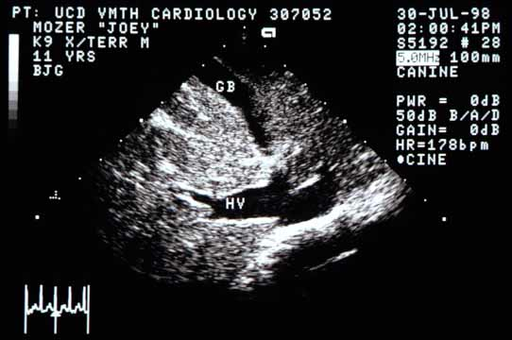
Right-sided CHF
Increased right ventricular diastolic
pressure and/or increased right atrial, systemic
venous and systemic capillary pressure
Ascites, pleural effusion, peripheral edema
  Ascites occurs when hepatic sinusoidal pressure is increased, resulting in weeping from the capsular surface of the liver into the peritoneal space
  Jugular venous distension may or may not be present
Notes:
Identification of distended hepatic veins using ultrasound is a more sensitive means of identifying elevated right heart diastolic pressures.
Measuring right atrial pressure from a jugular catheter is a definitive means of identifying RCHF

Slide 49
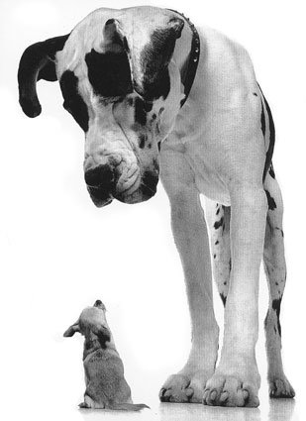
Low-output (forward) heart failure
Clinical Signs:
Fatigue
Weakness
Poor exercise tolerance
Cold extremities
Hypothermia
Poor mucous membrane color
Slow capillary refill time
Laboratory Evidence:
Decreased cardiac index
Decreased tissue oxygen
delivery
Widened arteriovenous
oxygen difference
Lactic acidosis
Decreased venous oxygen
tension
Azotemia
Notes:
Poor cardiac output results in poor tissue perfusion
Cardiac index= CO/BSA (CO=HR x SV)
Tissue oxygen delivery- arterial oxygen content x CO
AV oxygen difference= arterial- venous oxygen difference- widened difference d/t resting tissue oxygen oxygen consumption remaining stable in the face of decreased CO and decreased tissue oxygen delivery. Therefore, for consumption to remain stable, the body must extract more oxygen from the bloodstream to meet their needs for oxygen when cardiac output is reduced
Results in a decreased amount of oxygen and partial pressure of oxygen at the end of a cap bed and on the venous side
Oxygen tension at the end of the cap bed is the critical factor that determines oxygen delivery to the mitochondria (normal>30mmHg; critical level of 20-24 mmHg; if falls below then oxygen delivery to the mitochondria becomes inadequate)
At this stage, cells must rely on anaerobic metabolism with associated lactic acid production

Slide 50
Summary so far…
  Heart failure definition
  Etiologies for heart failure are numerous
  Prioritization of cardiac function occurs
  Many cardiac responses to decreased CO occur
  With time these responses become maladaptive and contribute to the onset of congestive heart failure
  Clinical signs of failure can be predominantly left or right sided or related to systolic dysfunction
Notes:
Heart failure defined as a clinical syndrome caused by heart disease that results in systolic/diastolic dysfunction that overwhelms the cardiovascular system’s compensatory mechanisms and/or results in decreased peripheral perfusion
disease include systolic dysfunction, volume overload, diastolic dysfunction, systolic pressure overload, or bradyarrhythmias
Compensatory mechanisms include increasing HR and SV (either through increased preload or contractility predominantly)

Slide 51
Next time…
We will focus predominantly on therapeutics (relating to recent literature particularly) and outcome measures
Other stuff that will be thrown in…
  Diagnostics predominantly
    Though you’re all pretty good with this

Slide 52

Questions?

