Slide 1

Tube Flocculator
Huifei Wu
Danhong Luo

Slide 2

Outline
Overview
  Apparatus
Research Topic
  Hypothesis
  Method
  Result & Discussion
Future Work

Slide 3
Overview
Why Flocculation?
  transforms tiny particles in raw water into big particles
  Make particles easy to separate from water
What coagulant? PACl
  High efficiency & Lower cost
Our Goal?
  Develop a fundamental understanding of flocculation
  Optimize flocculator design in AguaClara facilities

Slide 4
Overview
Why Flocculation?
  transforms tiny particles in raw water into big particles.
  Make particles easy to separate from water.
What coagulant? PACl
  High efficiency & Lower cost
Our Goal?
  Develop a fundamental understanding of flocculation.
  Optimize flocculator design in AguaClara facilities.

Slide 5
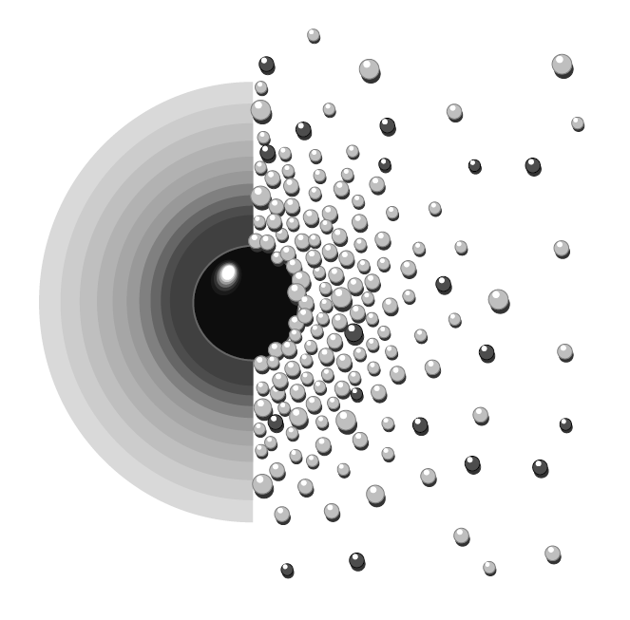
Research Topic
Study the effect of ionic strength on the coagulation performance
  Ionic strength: measurement of ion concentration in a solution

Slide 6
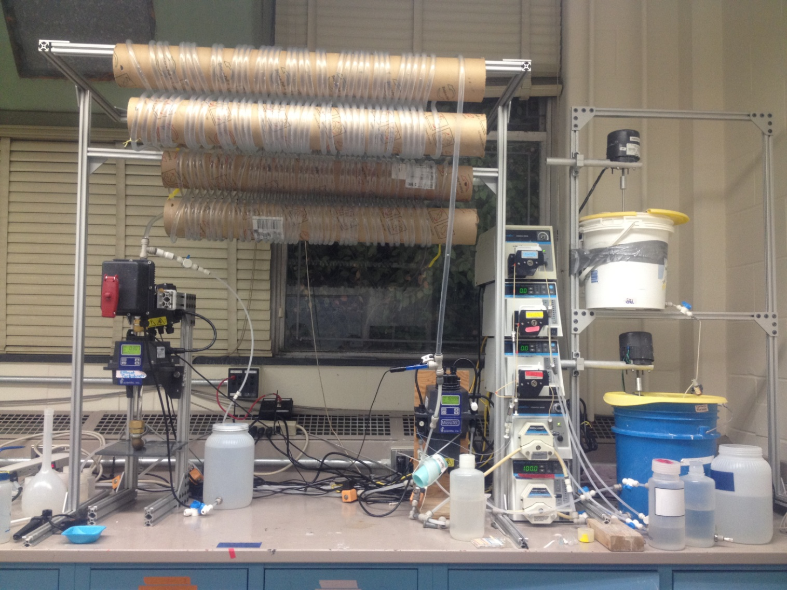
  Apparatus
Tube Flocculation
Clay
pH Measurement
Turbidity
Measurement
Raw Water
Rapid Mix
NaNO3
PACl
Na2CO3
All chemicals mixed here

Slide 7
Hypothesis
PACl Working Mechanism
  Electro-static Patch
  Charge Neutralization
  Bridge Aggregation
Ionic Strength
  Debye Length Theory

Slide 8
  Electro-static Patch
Clay
PACl
-
-
-
-
-
-
-
+
+
-
-
-
-
-
-
-
-
+
+
-
-
-
-
-
-
-
-
+
+
-
-
-
-
-
-
-
-
-
-
-
+
+
-
-
-
-
-
-
-
-
+
+
+
+
-
-
-
-
-
-
-
-
-
-
-
-
-
+
-
-
-
-
-
-
-
-
+
+
-
-
-
-
-
-
+
+
-
-
-
-
-
-
-
-
+
+
+
-
-
-
-
+
+
+
+
-
-
-
-
-
-
-
+
-
-
+
-
-
-
-
-
-
+
-
-
-
-
-
-
-
-
+
-
-
-
-
+
+
+
+
+
+
+
+

Slide 9
  Electro-static Patch
-
-
-
-
-
-
-
-
-
-
-
-
-
-
-
+
-
-
+
-
-
-
-
-
-
+
-
-
-
-
+
+
+
+
-
-
-
-
-
-
-
-
-
+
-
-
-
-
+
+
-
+
-
+
+
+
+
-
-
+
+
+
-
-
-
-
-
-
+
-
-
-
-
+
+
Electro-static Patch
-
-
-
-
-
-
-
+
+
-
-
+
+
-
-
-
-
-
-
+
+
+
-
-
-
-
-
-
-
-
+
+
-
-
-
-
-
-
-
-
-
-
-
-
-
-
-
-
-
-
-
-
-
+
-
-
-
-
-
-
+
-
-
-
-
+
+
+
+
When particle is big enough, gravity makes sedimentation

Slide 10
  Charge Neutralization
Clay
PACl
-
-
-
-
-
-
-
-
-
-
-
-
-
-
-
+
-
-
+
-
-
-
-
-
-
-
-
-
+
-
+
+
+
+
+
+
+
+
+
+
+
-
-
-
-
-
-
-
-
-
-
Lower Charge Clay
+
-
-
-
-
-
-
+
+
-
-
-
-
-
-
-
-
+
+
+
+
+
+
+
-
-
+
-
+
+
+
+
-
-
-
+
-
-
-
-
-
+
+
+
+
+
+
+
+
+
+
+
+
+
+
+
Lower Charge Clay
+
+
+
+
-
-
-
-
-
-
-
-
-
-
-
-
-
-
-
+
+
+
+
+
+
+
+
+
+
+
+
+
+
+
+
+
+
+
+
+
+
+
+
+
+
+
-
-
-
-
-
-
-
-
-
-
+
Lower Charge Clay
+
-
-
-
-
-
-
-
-
-
-
-
-
-
-
-
+
+
+
+
+
+
+
+
+
+
+
+
+
+
+
+

Slide 11
  Bridge Aggregation
Similar to electro-static patch
  Electro-static Patch: Charge matters
  Bridge Aggregation: Particle size matters
-
-
-
-
-
-
-
-
-
-
-
-
-
-
-
-
-
-
-
-
-
-
-
-
-
-
-
-
-
-
-
-
-
-
-
-
-
-
-
-
-
-
-
-
-
-
-
-
-
-
-
-
-
-
-
-
-
-
-
-
-
-
-
-
-
-
-
-
-
-
-
-
-
-
-
-
-
-
-
-
-
-
-
-
-
-
-
-
-
-
-
-
-
-
-
-
-
-
-
-
-
-
-
-
-
-

Slide 12
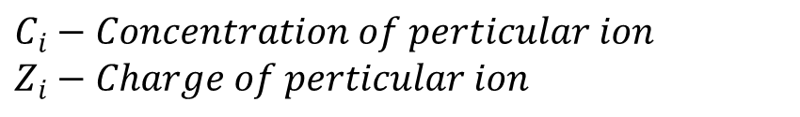
Ionic Strength
Measurement of ion concentration in a solution
Calculation:
$$C_{i}−Concentration of perticular ion$$
$$Z_{i}−Charge of perticular ion$$

Slide 13
Debye Length Theory
Debye length: the distance over which significant charge separation can occur.
  Calculation:
  :charge separation occurs
  : charges are screened

Slide 14
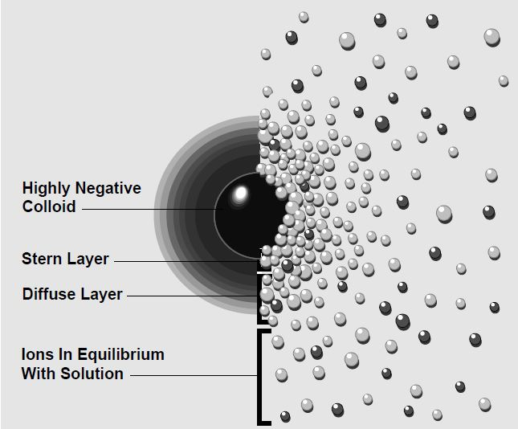
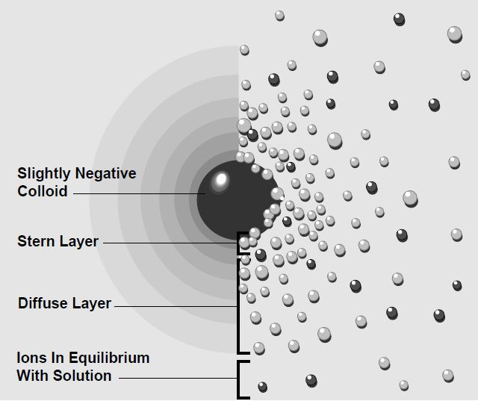
Debye Length Theory

Slide 15
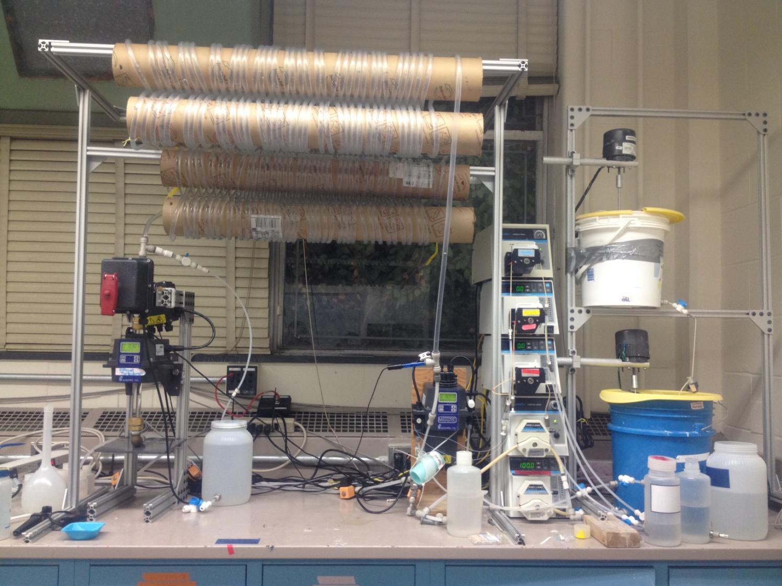
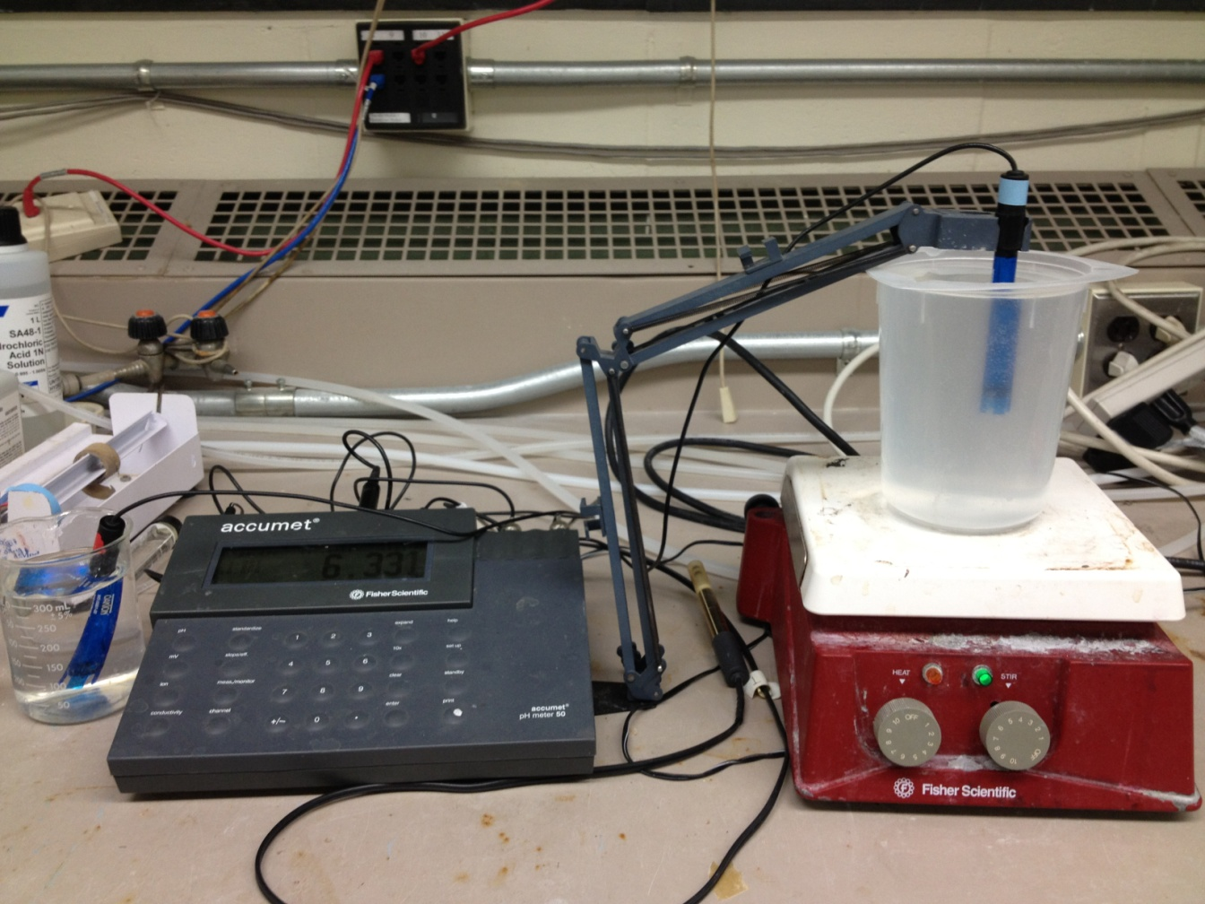
What we are doing now?

Slide 16
Jar test
To find the dosage proportion of Na2CO3 and PACl to maintain the pH at 7.5.
To find the relationship between the experimental ionic strength and theoretical ionic strength.

Slide 17
Method
Running Condition
Ionic Strength | 0.5 | 1 | 5 | 10
Influent Turbidity | 15 | 50 | 100 | 150
Coagulant Dose | 1 | 2 | 3 | 4
Chemical & Function
Na2CO3 | Keep pH=7.5
Clay | Get target turbidity
NaNO3 | Get target ionic strength
Record
Na2CO3
Final Conductivity

Slide 18
Result & Discussion
Theoretically, it should have a linear relationship.
R square shows that the linear equations do not fit very well.
More work need to be done.

Slide 19
Result & Discussion
The Clay dosage has little influence to the conductivity.
Relationship:

Slide 20
Result & Discussion
The PACl dosage has little influence to the conductivity.
Relationship:

Slide 21

  Future Work
Run in the Tube Floc model

Slide 22


Questions

