Slide 1

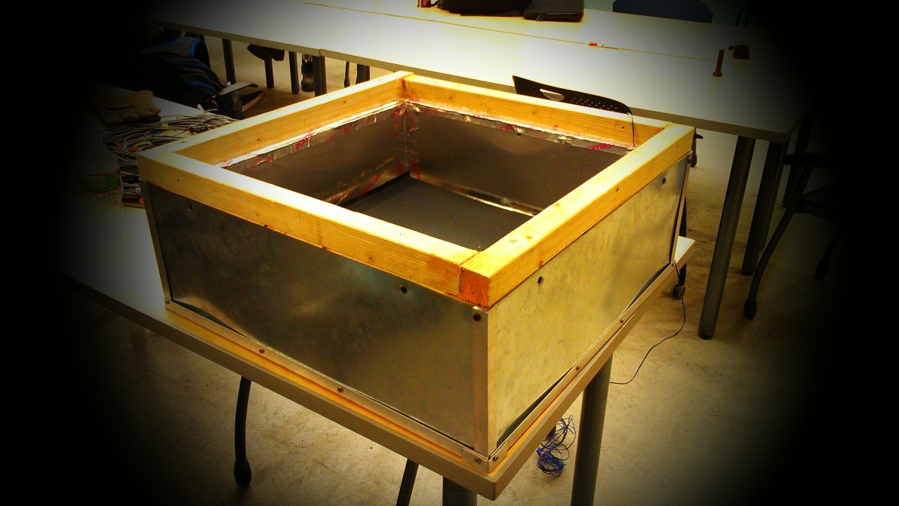
Double Box Team
Alex Huang, Chris Perrotti, Joonyoung Hwang, Mike Horsfield, Mark Henry

Slide 2
Introduction
Formed in the 2011/2012 academic year in order to provide the women’s group with a light and easily constructed solar oven option
After spring 2012 prototype was designed, an improved version was worked on in the fall, but not completed
Efforts this semester focused on completing and testing the oven

Slide 3
Problem Definition and Goals
Complete construction of fall 2012 oven by building a door
Establish testing procedure t0 evaluate effectiveness of oven
Test oven to measure oven performance

Slide 4
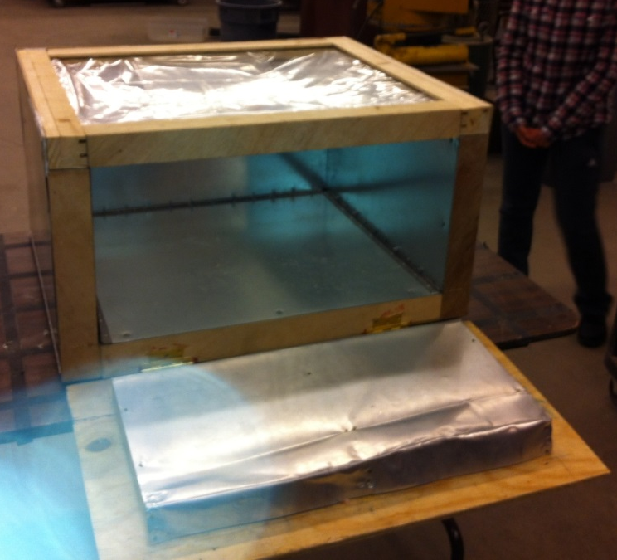
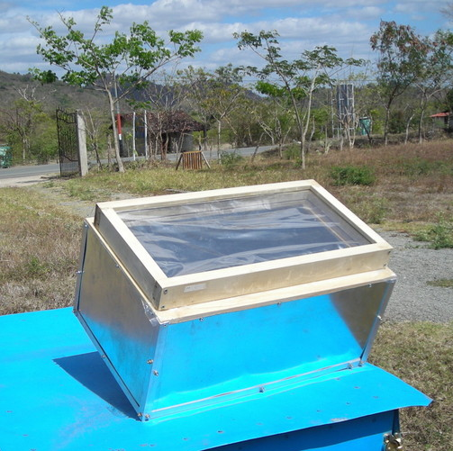
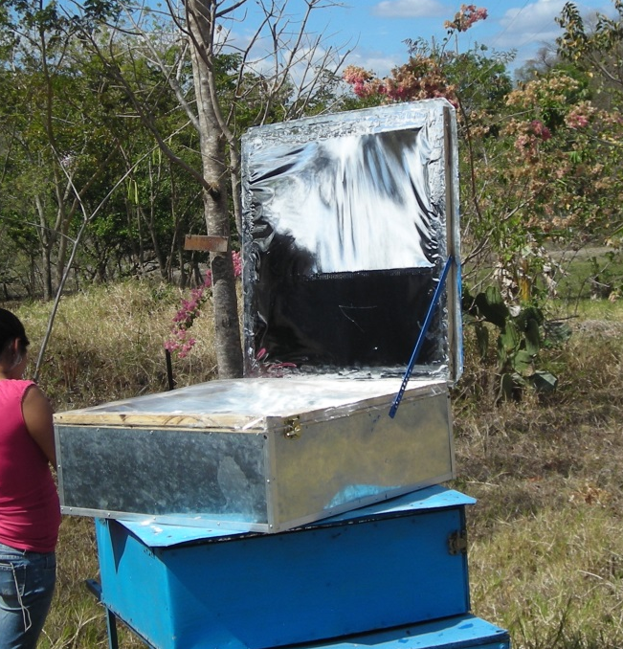

Evolution of Double Box Designs
Design 1 - Spring 2012
Initial design - Fall 2011
Design 2 - Spring 2012
Current design- Spring 2013

Slide 5
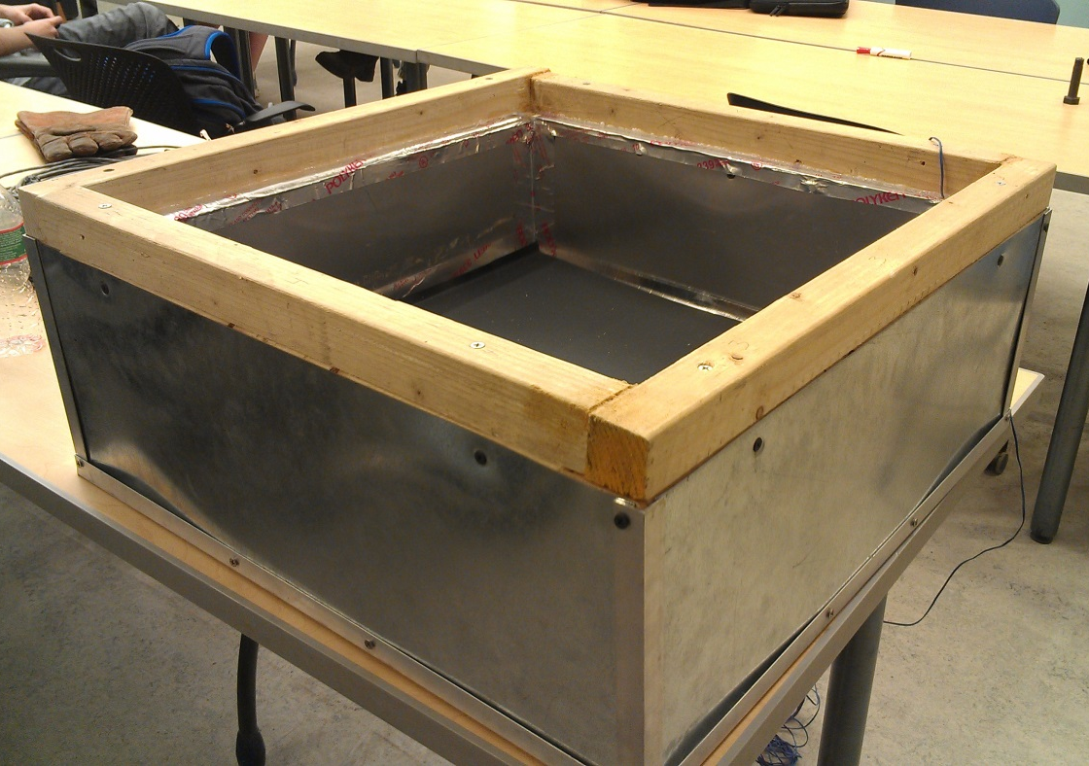
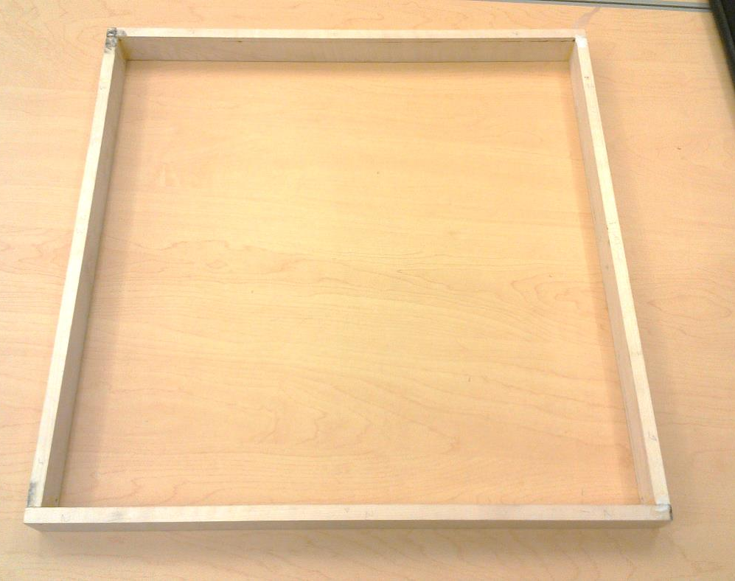
New Door Design

Slide 6
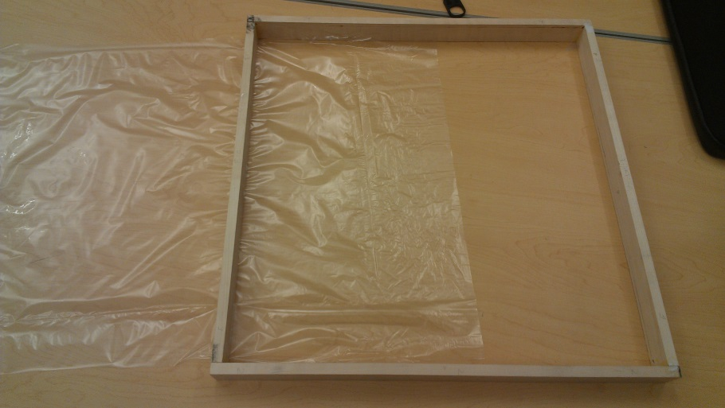
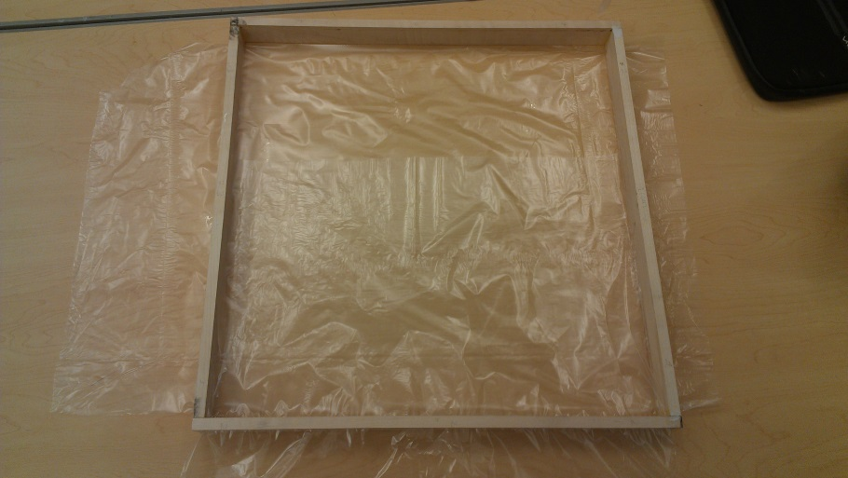
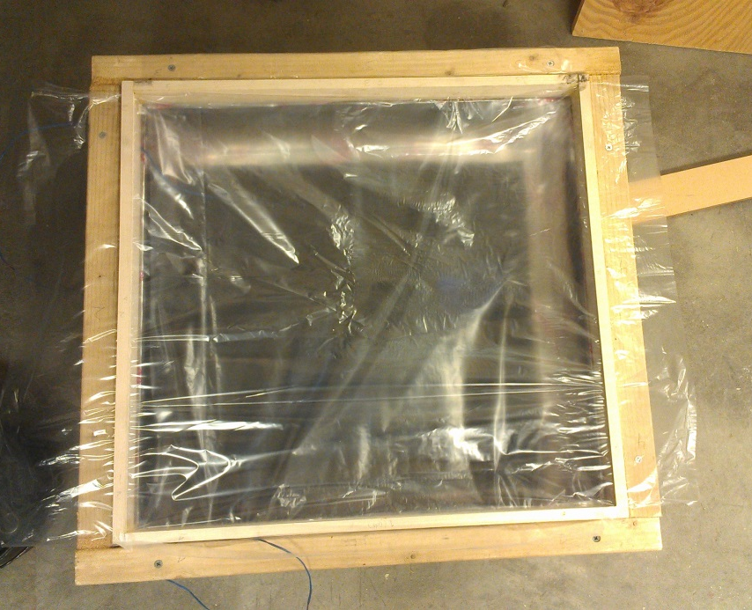
1st Installation Method – “Double Slit”
1
2
3

Slide 7

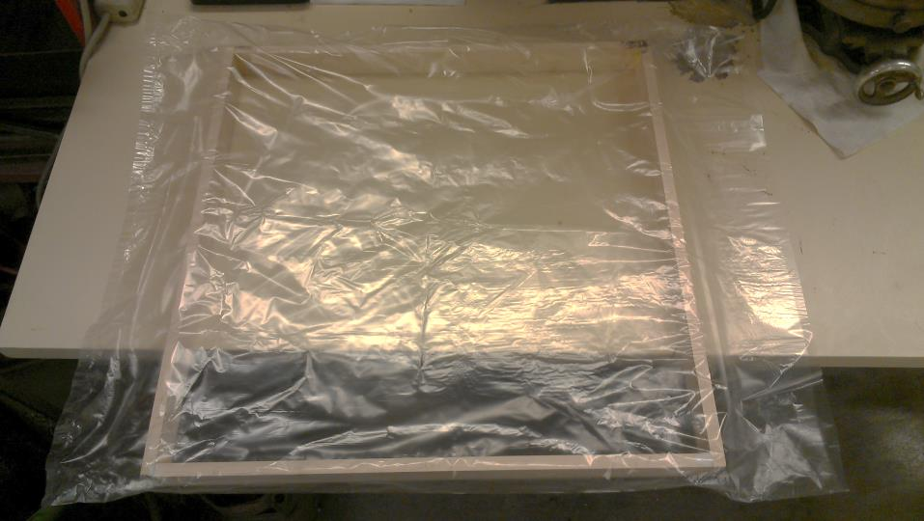
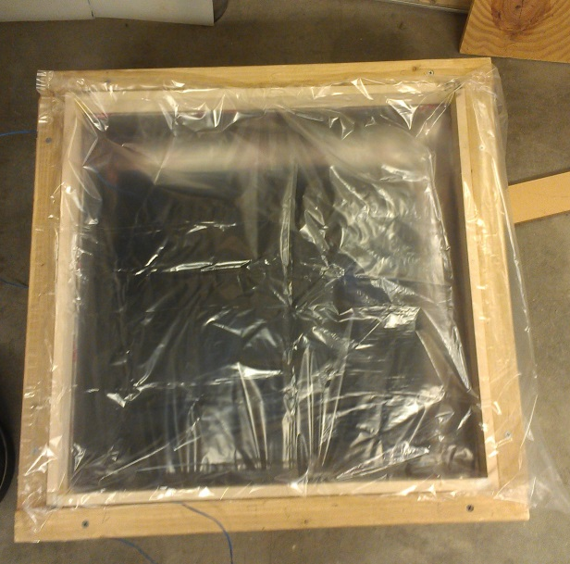
2nd Installation Method – “Full Bag”
1
2
3

Slide 8
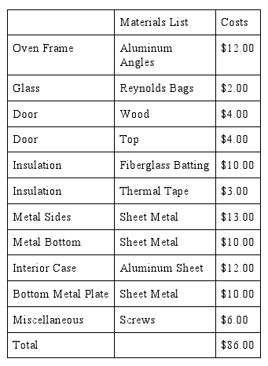
Materials and Costs
Price of implementing door was $7.oo, bringing the total to $86.00
Far less than Spring 2012 projected cost of $213.00

Slide 9
Timeline for Spring 2013
1/21 | 1/28 | 2/4 | 2/11 | 2/18 | 2/25 | 3/4 | 3/11 | 3/18 | 3/25
Plan Semester | Write Project Proposal | Write Project Proposal | Design Door | Design Door | Design Door | Design Door | Fabricate Door | Fabricate Door | Fabricate Door
4/1 | 4/8 | 4/15 | 4/22 | 4/29 | 5/6
Fabricate Door | Test Oven | Test Oven | Write Report | Write Report | Presentation

Slide 10
Testing Procedure
Equipment: 2 Thermocouples and 1 Pyranometer
Thermocouples measure temperature of water inside oven and ambient air temperature.
Power of oven calculated using
  P_{i} = (T₂ – T₁)MC_{v}/60
    Where: P_{i} = cooking power (W)
    T₂ = final water temperature
    T₁ = initial water temperature
    M = water mass (kg)
    C_{v} = heat capacity (4186 Jkg⁻¹K⁻¹)
    Standardized Power is then plotted against temperature difference between water and air

Slide 11
Results: Double Slit Installation
Single measure of performance:
Standardized cooking power at temperature difference of 50°C
86.595 Watts

Slide 12
Results: Full Bag Installation
79.18 Watts

Slide 13

Comparison of Double Slit and Full Bag Installation
Double Slit:
  Requires more extensive construction process
  Less excess polypropylene
  Current design has inherent leaks at sides
  Less ugly
  Standardized power value:
Full Bag:
  Very basic construction process
  Not an effective seal between two layers of glazing
  Ugly
  Standardized power value:
86.595 Watts
79.18 Watts

Slide 14

And the winner is…
DOUBLE SLIT INSTALLATION!

Slide 15
Pros and Cons
Pros
Easy Installation
Quick replacement
Simple construction
Extremely light
Cons
Bags will tear as the inner and outer frames rub together
Difficult to minimize leaks through the door

Slide 16
Future Considerations
Testing
Repeat tests to see if results are consistent
Add additional thermocouple to measure air temperature within oven
Test existing ovens to compare performance
Oven Design
Seal all gaps to prevent leaks
Redesign door to reduce the escape of heat
Employ better carpentry techniques
Handles to easily lift oven

Slide 17

Acknowledgements
Thanks to:
Tim Bond
Small oven team
ESW
Classmates for making food

